Slide 1
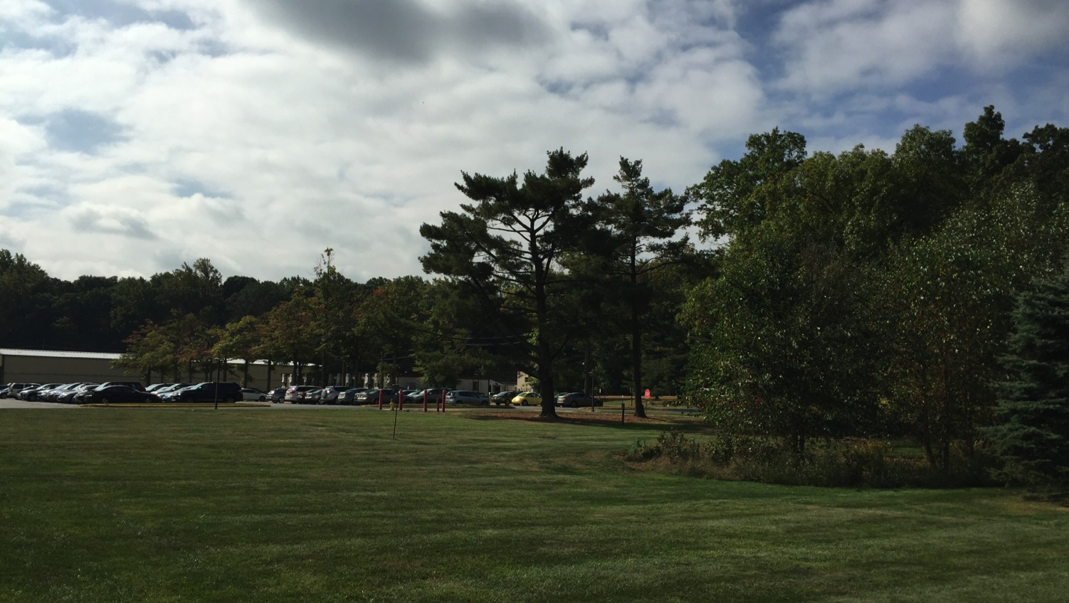
This Week @ PPPL
October 13 - 17, 2014
Brought to you by the PPPL Office of Communications

Slide 2
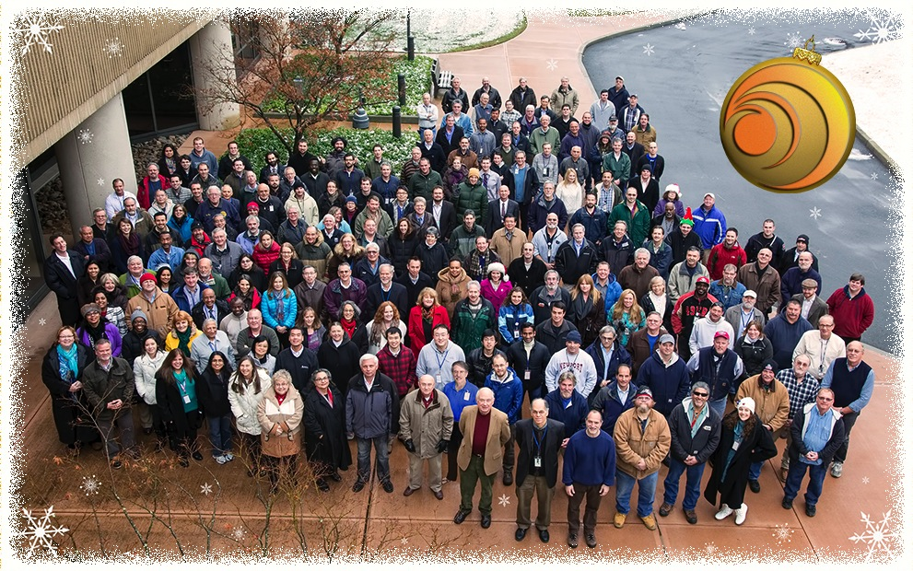
PPPL Photo/Video Shoot
Wednesday, Oct. 15
Meet in Lobby at 10:50 a.m.

Slide 3
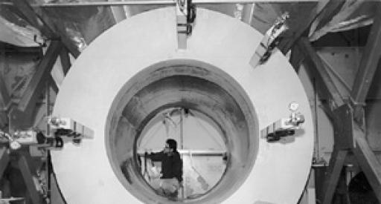

Large Scale Superconducting Magnets
for a Variety of Applications
Joseph Minervini – Massachusetts Institute of Technology
WEDNESDAY, OCTOBER 15
4:15 p.m. • M.B.G. Auditorium

Slide 4
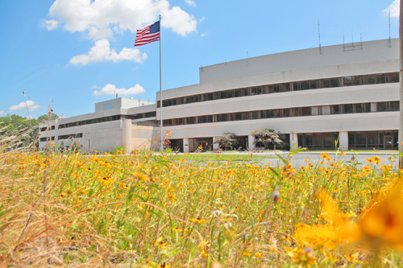


UPCOMING EVENTS
  Wednesday, October 15
  PPPL GROUP PHOTO SHOOT – 11 a.m. – Meet in Lobby at 10:50 a.m.
  Wednesday, October 15
  PPPL COLLOQUIUM - Large Scale Superconducting Magnets
  Monday, October 20
  OPEN ENROLLMENT FOR PRINCETON HEALTH CARE PLANS BEGINS
  Monday, October 20
  BENEFITS CHANGES PRESENTATION – 1 p.m. – MBG Auditorium
  Thursday, October 23
  BENEFITS FAIR AT PPPL – 10 a.m. to 2 p.m. – LSB Lobby

Slide 5
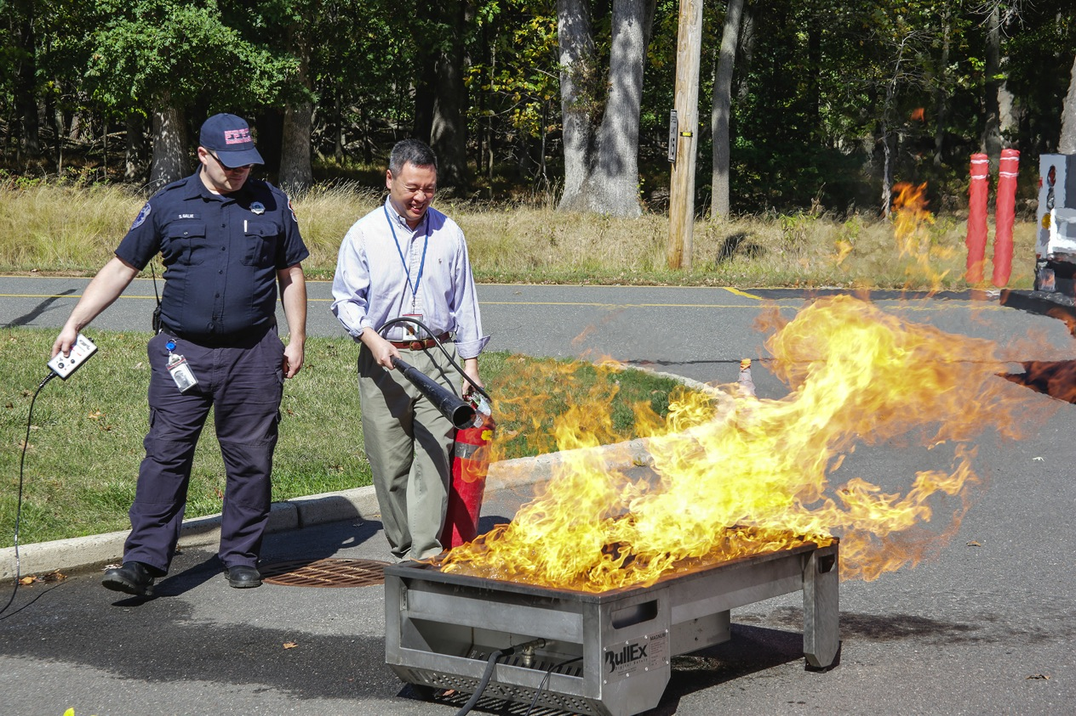
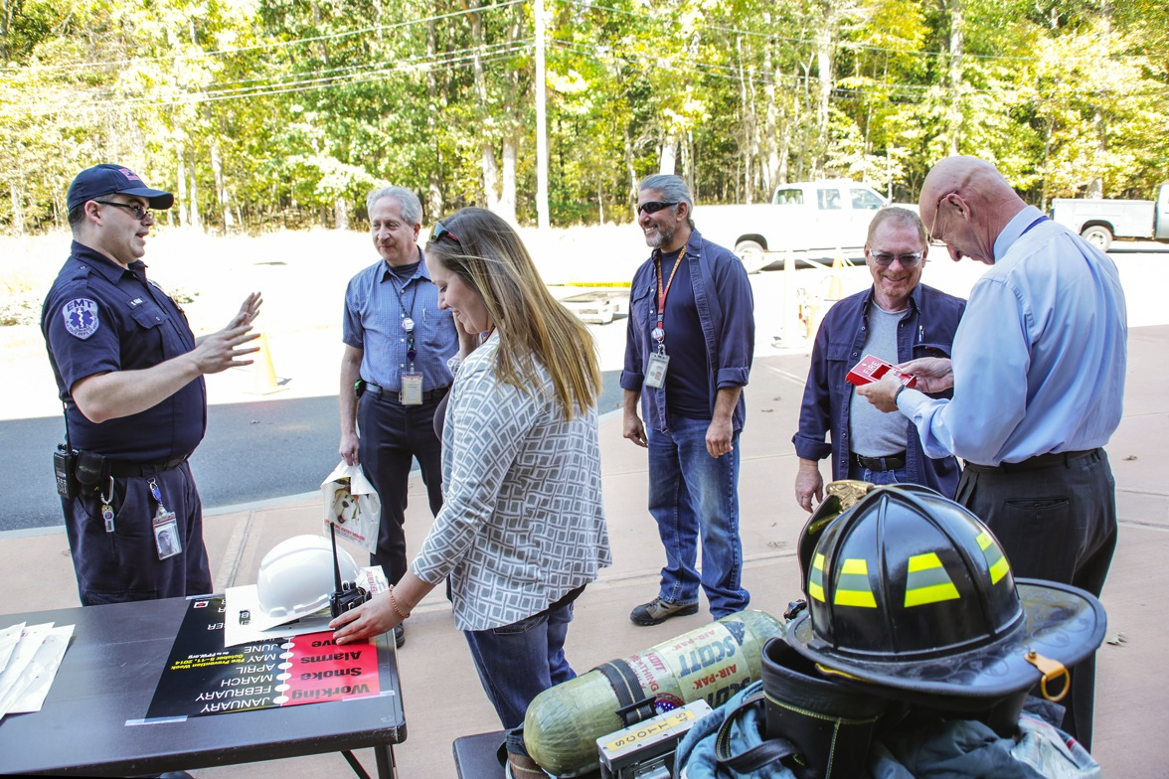
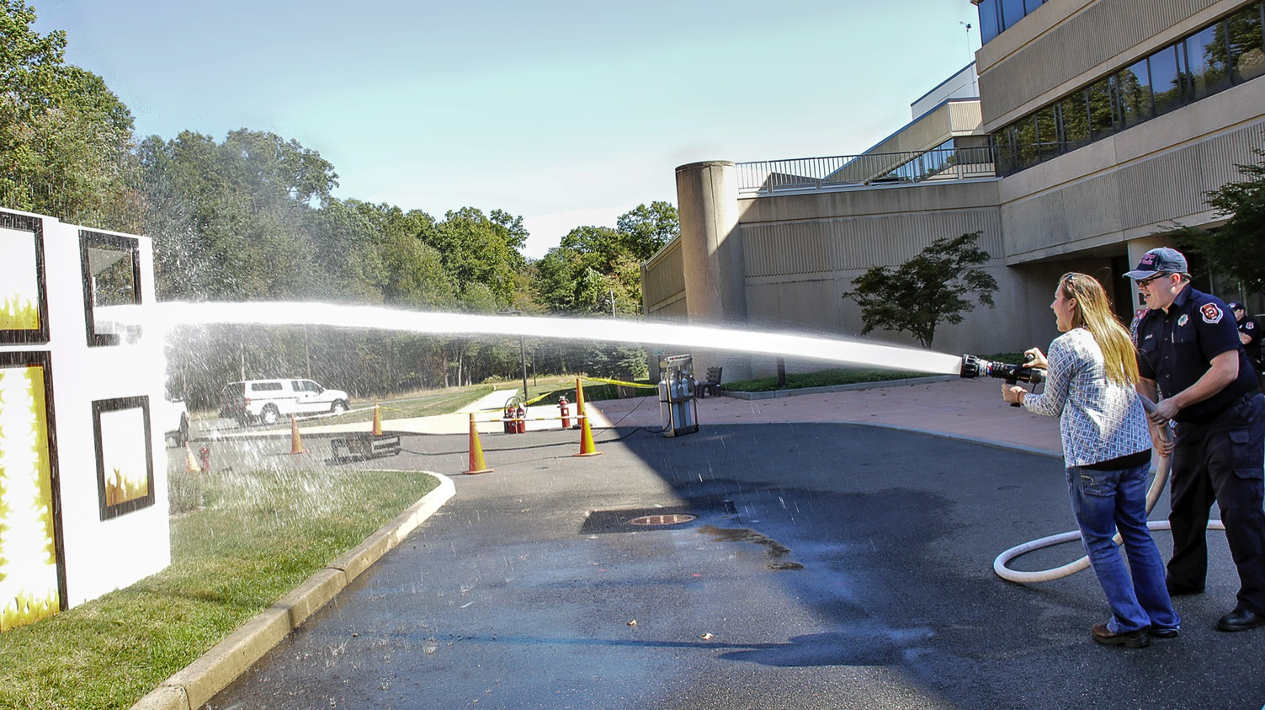
Fire Prevention Week at PPPL

Slide 6
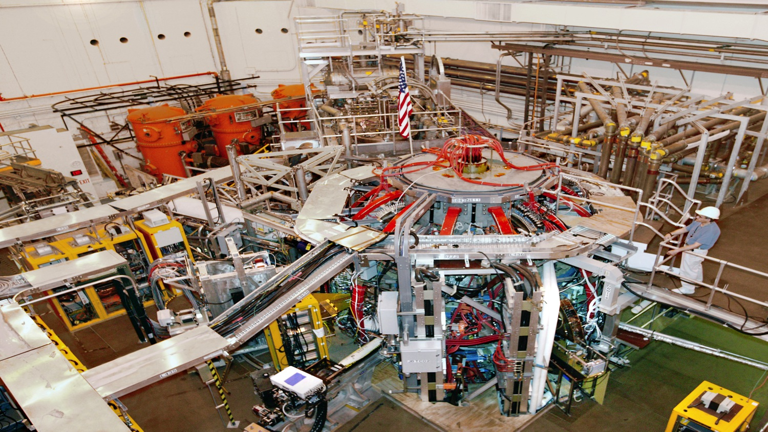


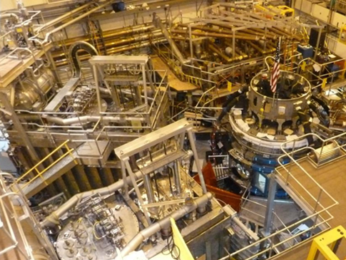
trivia
Similar to ITER,
the NSTX-U is a:
a) supercomputer
b) stellarator
c) tokamak
d) vacuum cleaner

Slide 7
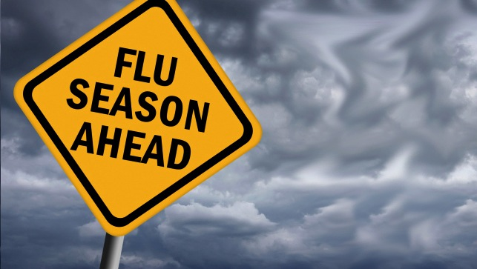


Please call the OMO at extension 3200 to make an appointment.

Slide 8
