Slide 1
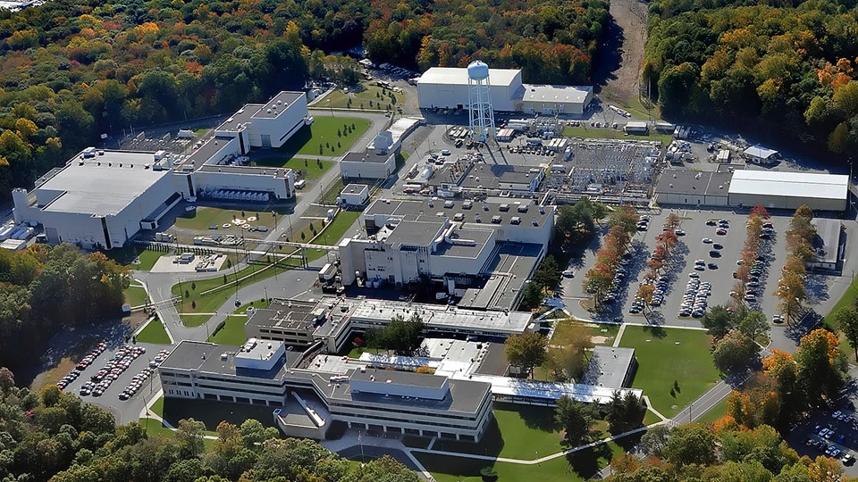
This Week @ PPPL
October 20 - 24, 2014
Brought to you by the PPPL Office of Communications

Slide 2
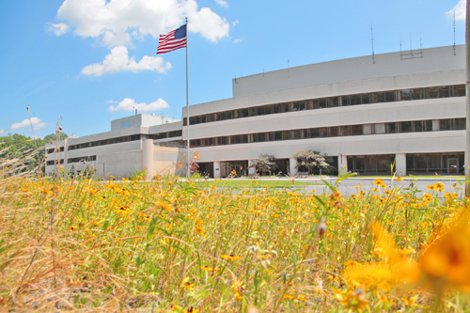


UPCOMING EVENTS
  Monday, October 20
  OPEN ENROLLMENT FOR PRINCETON HEALTH CARE PLANS BEGINS
  Monday, October 20
  BENEFITS CHANGES PRESENTATION – 1 p.m. – MBG Auditorium
  Thursday, October 23
  BENEFITS FAIR AT PPPL – 10 a.m. to 2 p.m. – LSB Lobby
  October 27 - 31
  56th Annual Meeting of the APS Division of Plasma Physics – New Orleans
  Tuesday, November 4
  PPPL COLLOQUIUM – HTS and ARC for Fusion – 4 p.m. – MBG Auditorium
  Tuesday, November 11
  AMERICA RECYCLES DAY CELEBRATION AT PPPL – 10:30 a.m. – LSB Lobby

Slide 3
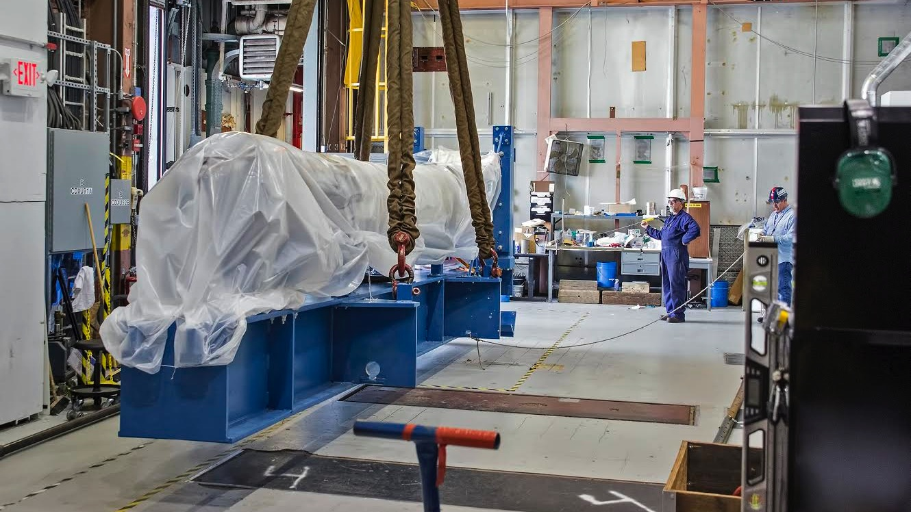
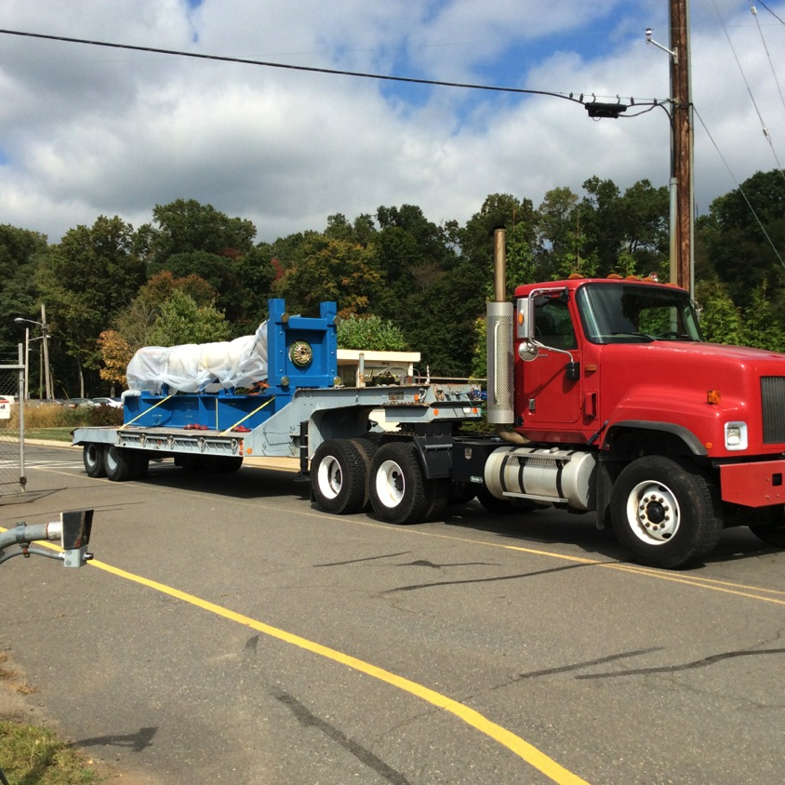
NSTX-U Center Stack moves to D-Site

Slide 4


Slide 5


Slide 6
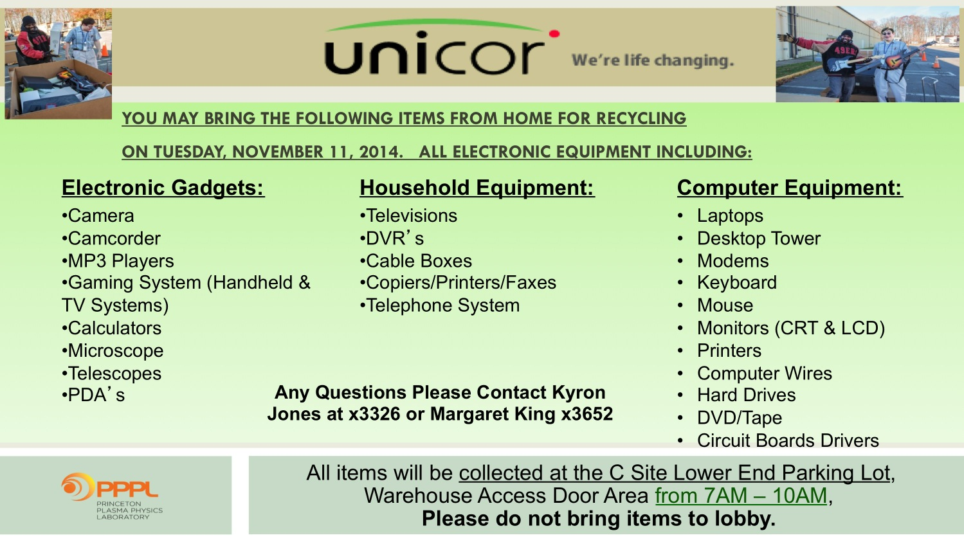

Slide 7

Welcome New PPPL Employees…

Slide 8
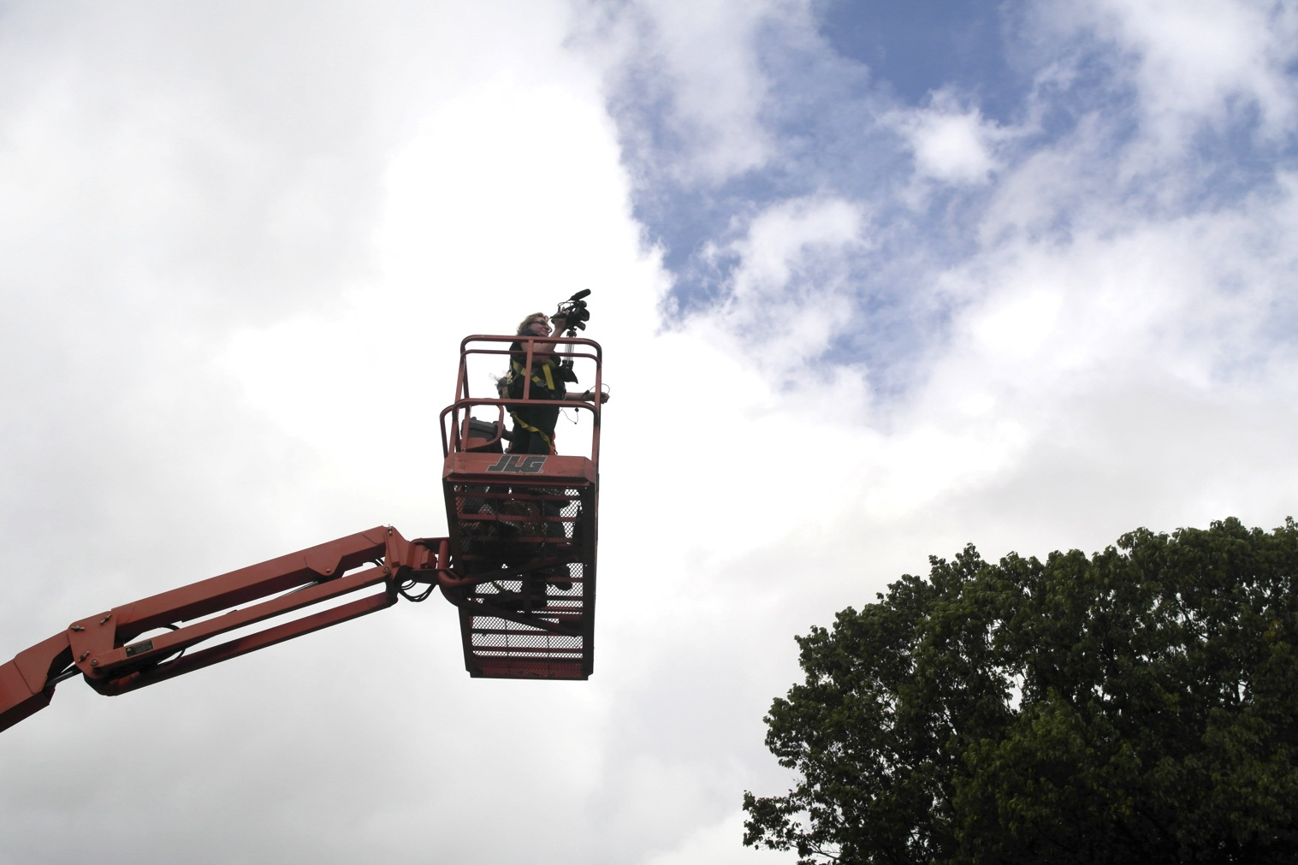
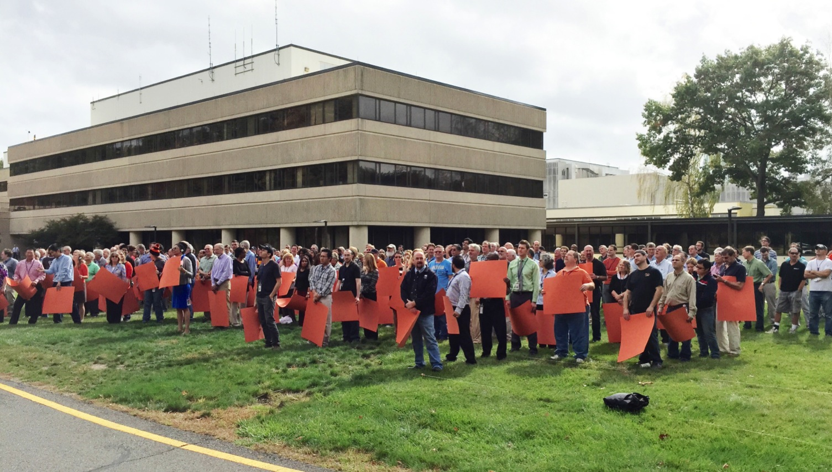
Holiday Video Shoot at PPPL

Slide 9
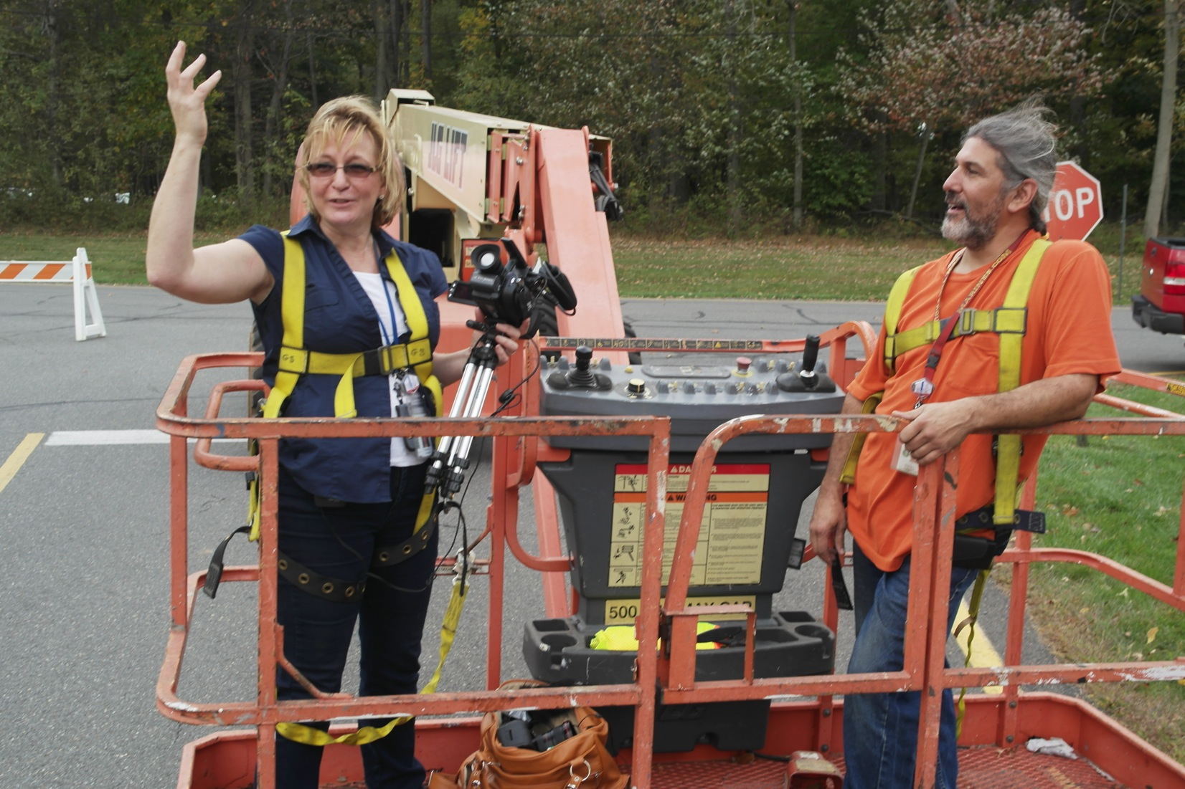
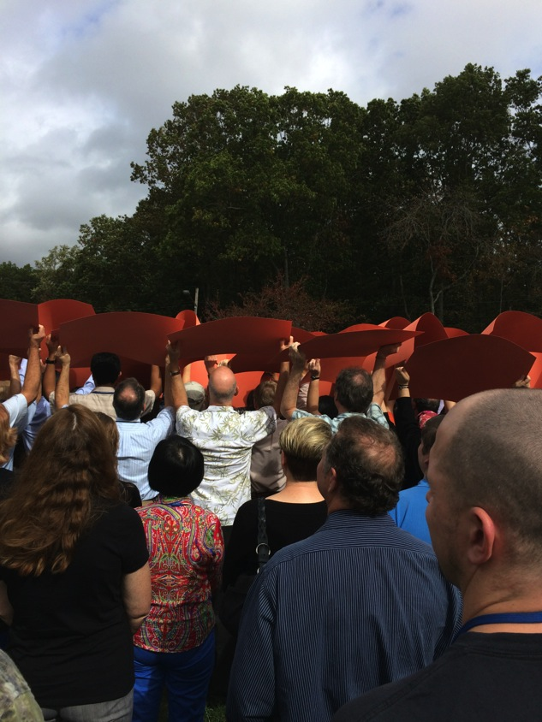
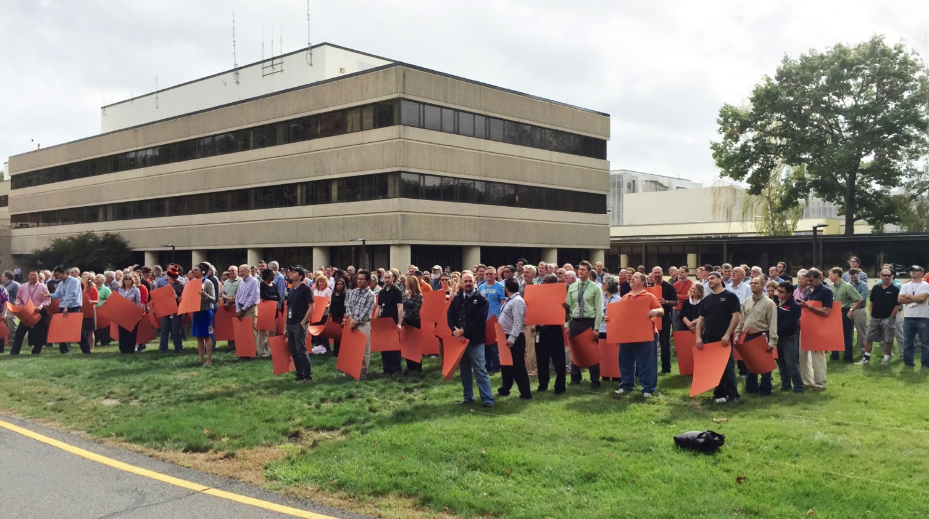
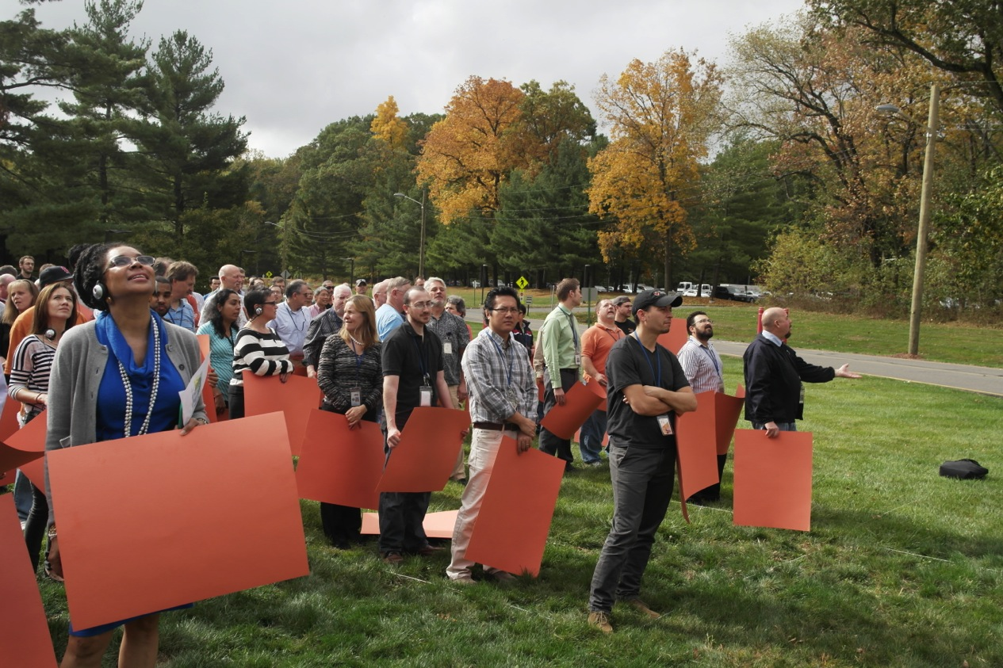
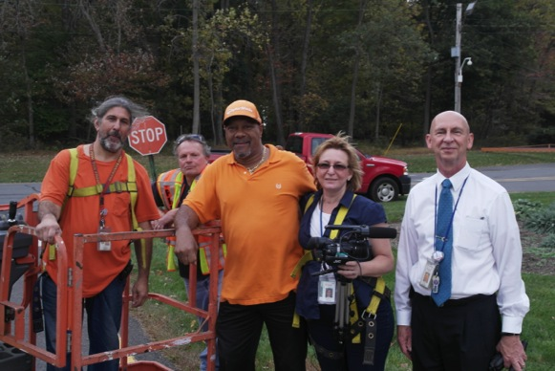
Holiday Video Shoot at PPPL

Slide 10
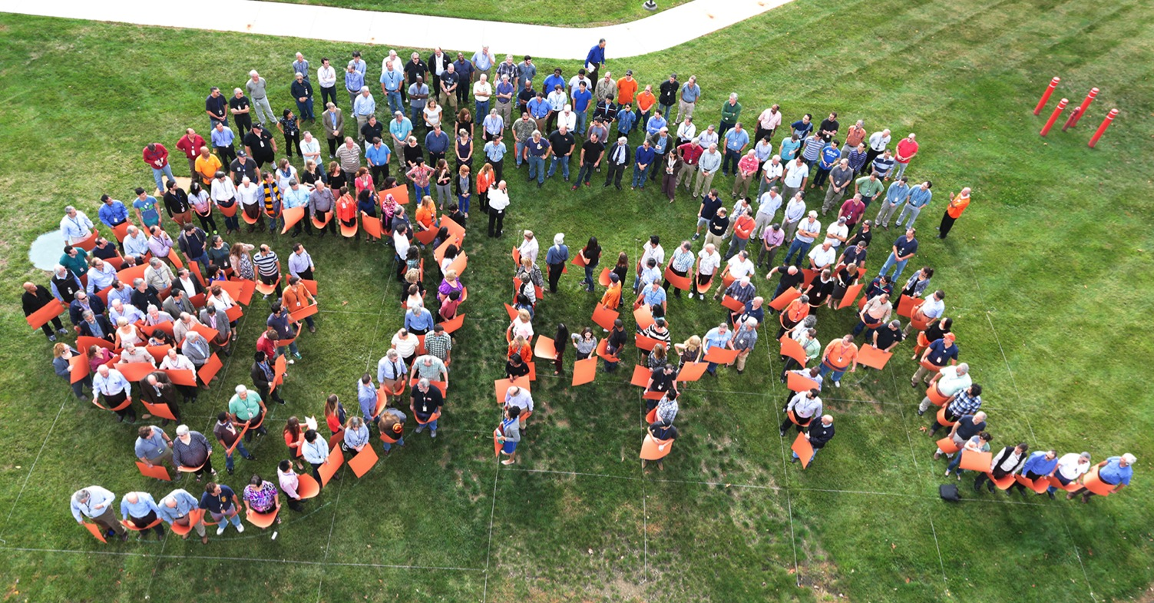
COMING SOON! The 2014 PPPL HOLIDAY VIDEO CARD. Thank you to all who participated in the 2014 PPPL Holiday Video Shoot. COMING SOON! The 2014 PPPL HOLIDAY VIDEO CARD.

Slide 11



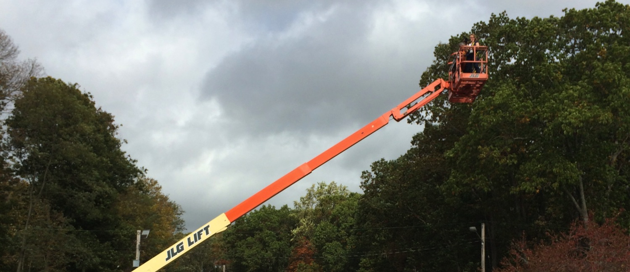
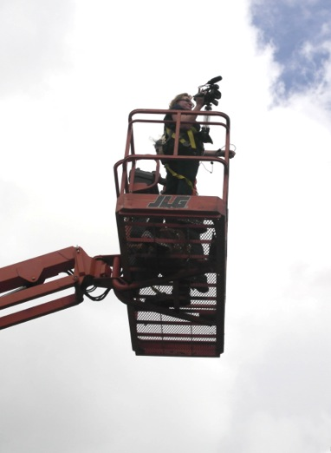
trivia
How high up was Elle during the shooting of the
PPPL holiday video?
a) 100 ft.
b) 80 ft.
c) 60 ft.
~60 ft.
d) 40 ft.

Slide 12
