Slide 1
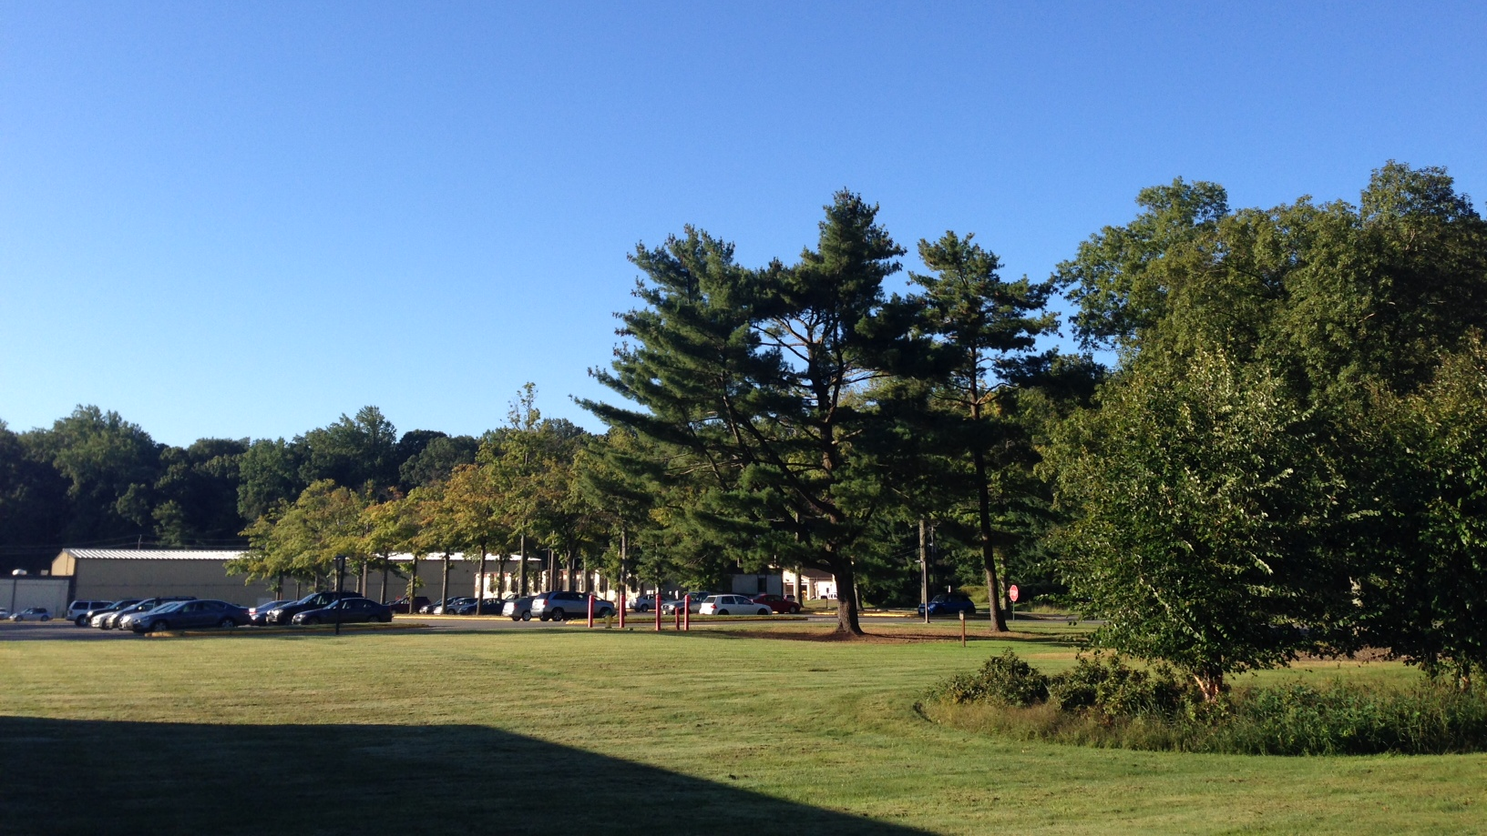
This Week @ PPPL
October 21 - 26, 2013
From the PPPL Office of Communications

Slide 2
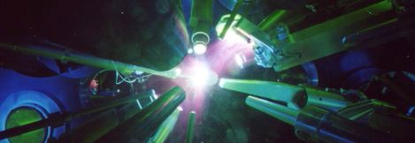

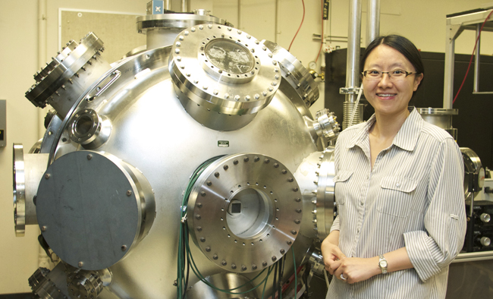
SPECIAL
Creating, Diagnosing and Controlling High-energy-density Matter with Lasers
Yuan Ping
Lawrence Livermore National Laboratory
TUESDAY, OCTOBER 22
NOTE SPECIAL TIME>>> 3 p.m. (Coffee/Tea at 2:45 p.m.) • M.B.G. Auditorium

Slide 3

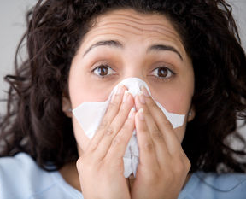
Influenza is a contagious disease caused by a virus that can be spread by coughing, sneezing
or nasal secretions.
The best single way to prevent seasonal flu
is to get an annual influenza vaccination.
By getting vaccinated you can protect yourself from influenza and may also avoid spreading
the illness to others.
Flu vaccine appointments still available.
Contact the OMO at 3200 for an appointment.

Slide 4

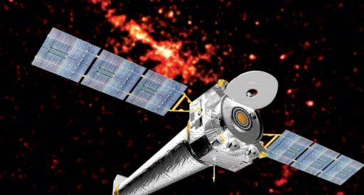
Space Weather
Jacob Bortnik
University of California - Los Angeles
WEDNESDAY, OCTOBER 23
4:15 p.m. (Coffee/Tea at 4 p.m.) • M.B.G. Auditorium

Slide 5


UPCOMING EVENTS
Monday, October 21
  Benefits Open Enrollment Begins
Tuesday, October 22
  PPPL Colloquium • 3 p.m. - MBG Aud. – “Creating, Diagnosing and Controlling High-energy-density Matter with Lasers”
Wednesday, October 23
  PPPL Colloquium • 4:15 p.m. - MBG Auditorium – “Space Weather”
Saturday, October 26
  Boy Scout Merit Badge Fair at PPPL
Monday - Friday, October 28 - November 1
  Max Planck Princeton Research Center for Plasma Physics Meeting – PPPL & Princeton University
Wednesday, October 30
  PPPL Colloquium • 4:15 p.m. - MBG Auditorium – “Why the Big Bang was not the Beginning”
Sunday, November 3
  Daylight Savings Time ends
Monday, November 4
  PPPL’s United Way Campaign begins
Wednesday, November 6
  Open Enrollment Health Fair at PPPL – 10 a.m. to 2 p.m. – LSB Lobby
Monday - Friday, November 11 - 15
  55th Annual Meeting of the APS Division of Plasma Physics, Denver, Colo.
Thursday, November 21
  United Way Presentation – 10 a.m. – MBG Auditorium

Slide 6
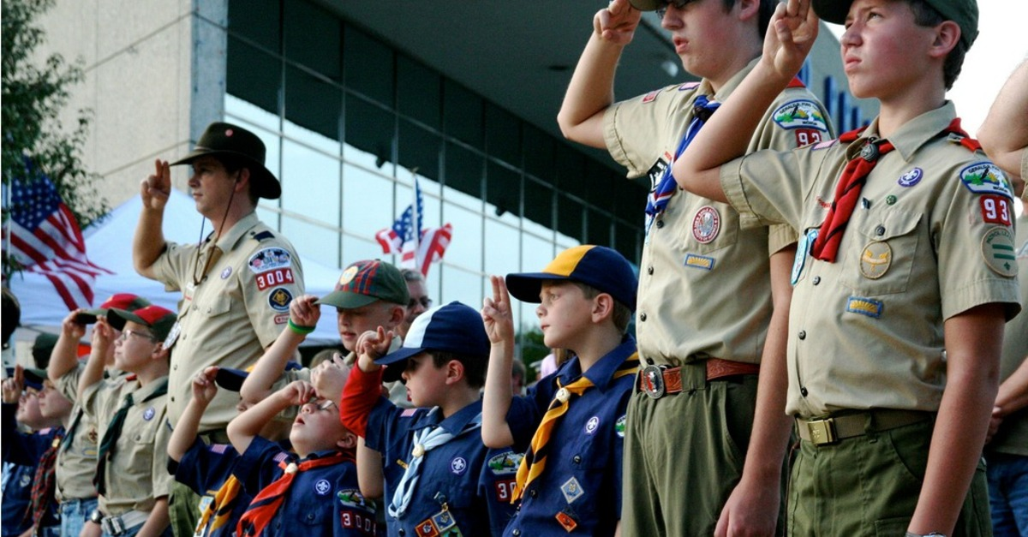

Saturday, Oct. 26
Boy Scout Merit Badge Fair at PPPL

Slide 7
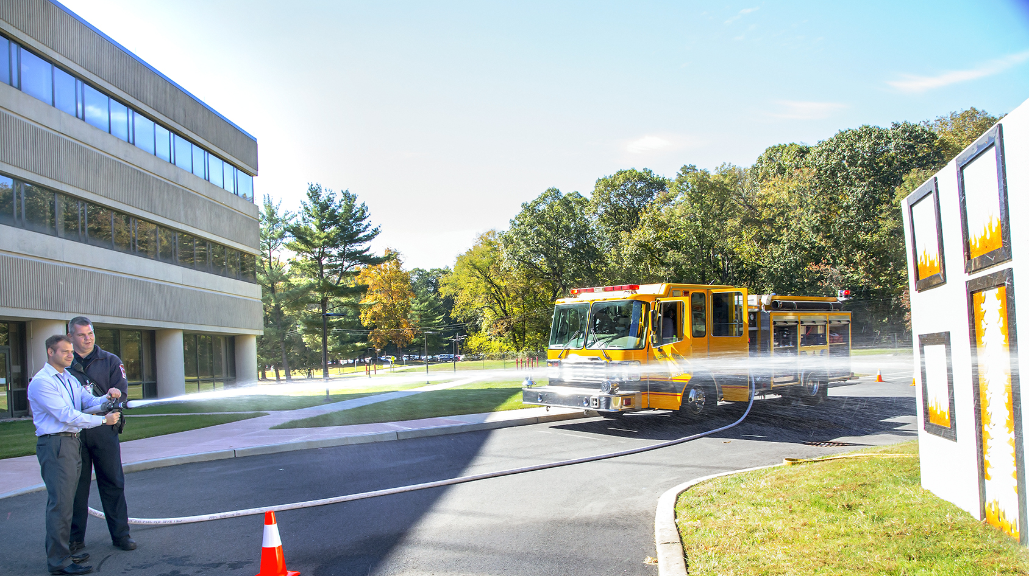
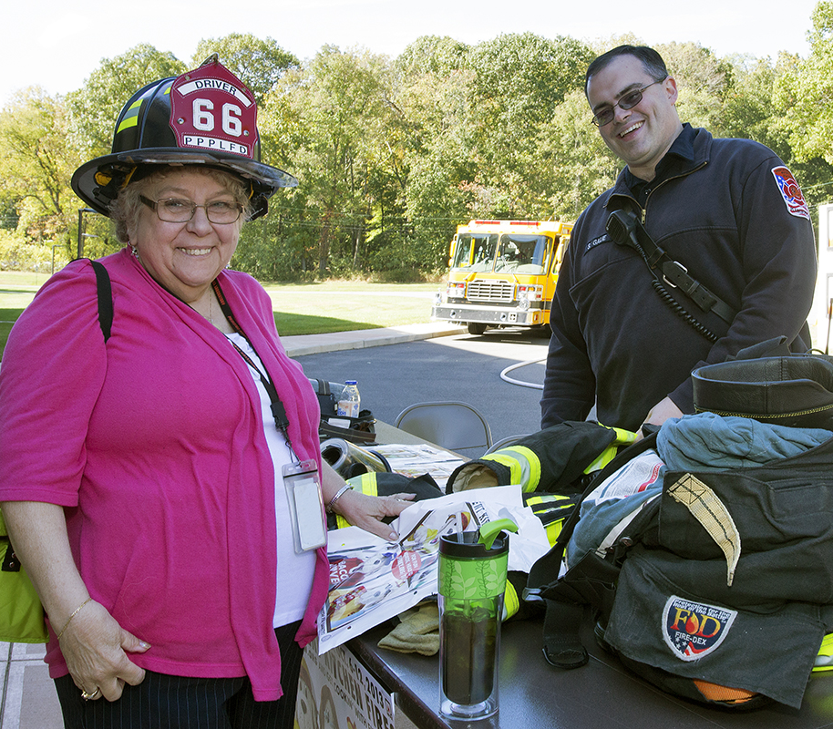
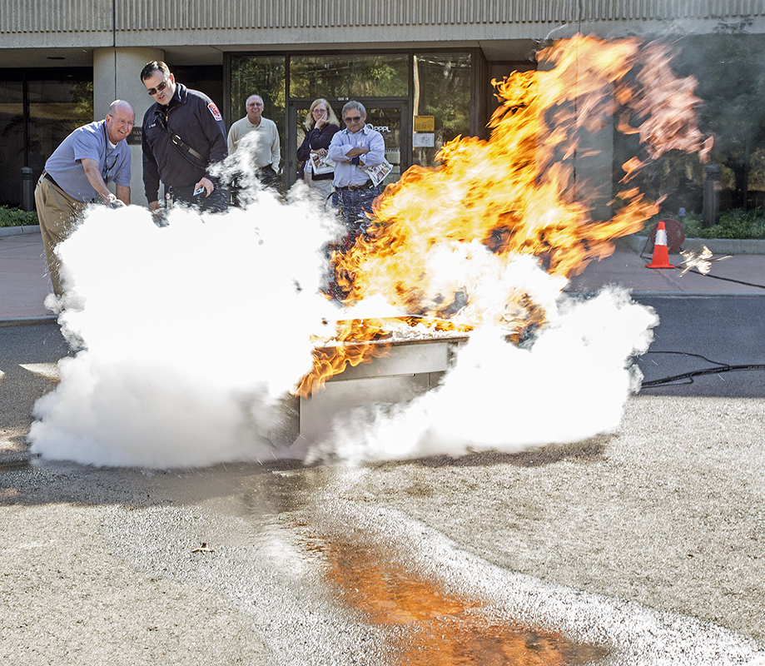

Fire Safety Demonstrations
at PPPL

Slide 8
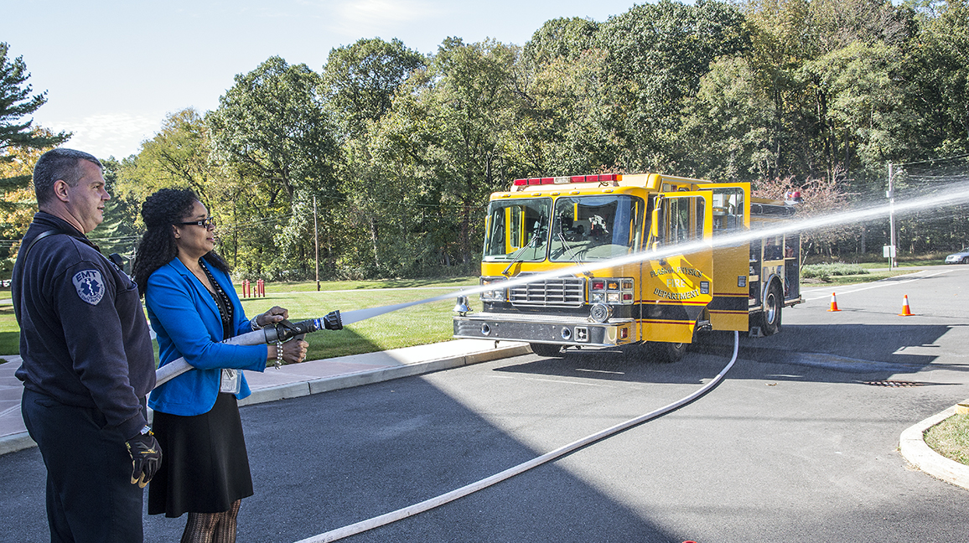
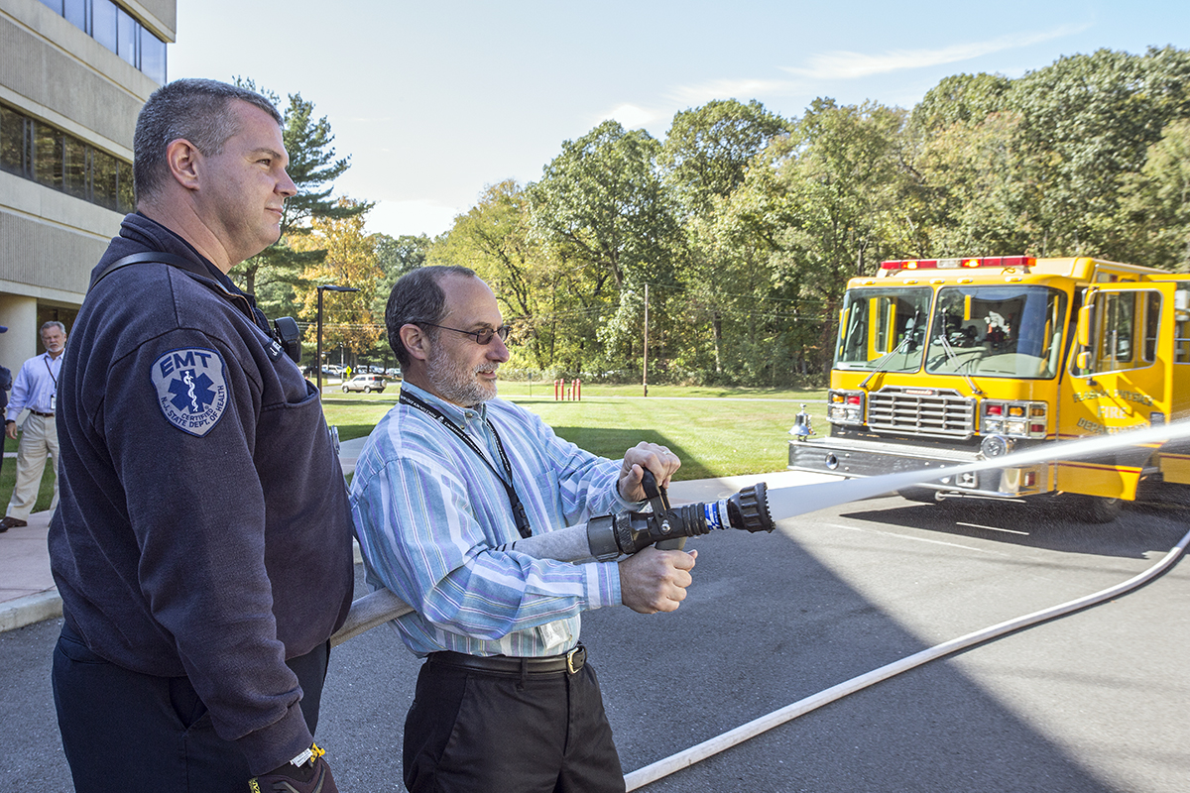
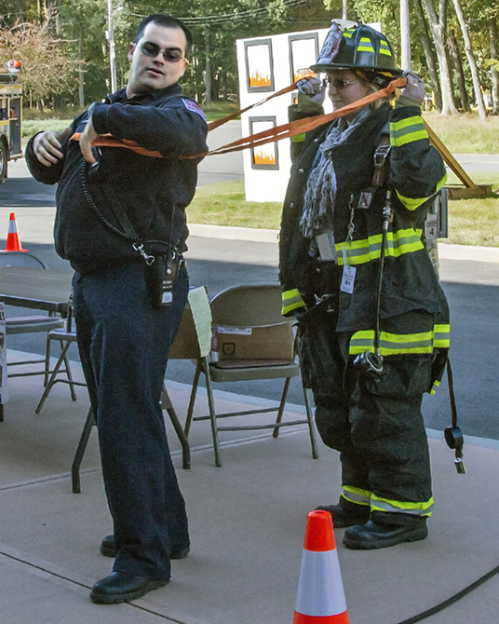
Fire Safety Demonstrations
at PPPL

Slide 9
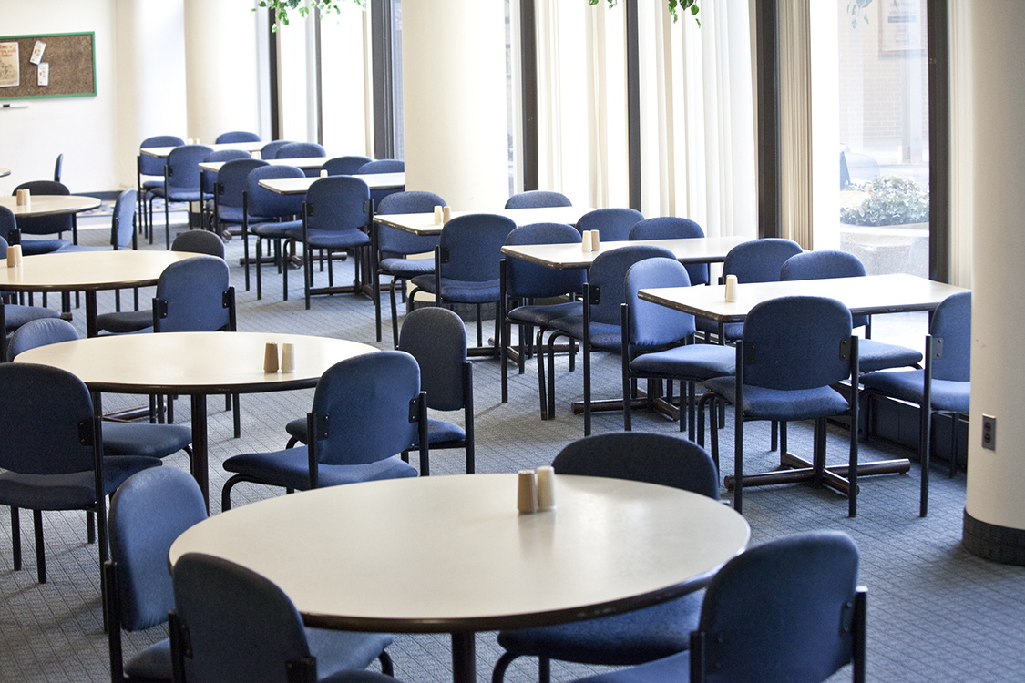


to the
in November

Slide 10

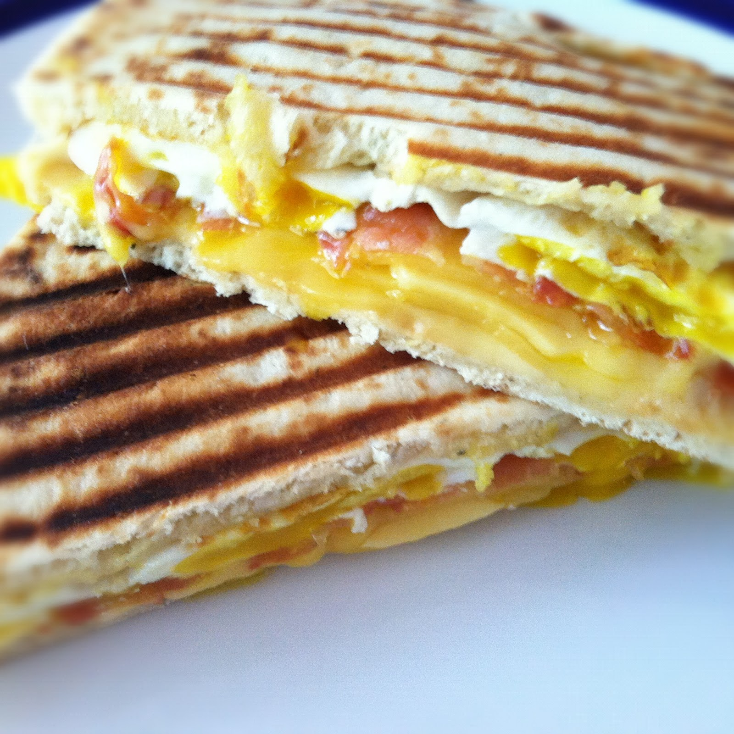

Introducing…
$2 BELOW PPPL Value Menu
Flatbread Breakfast Sandwiches
Breakfast Combos
… and more!

Slide 11
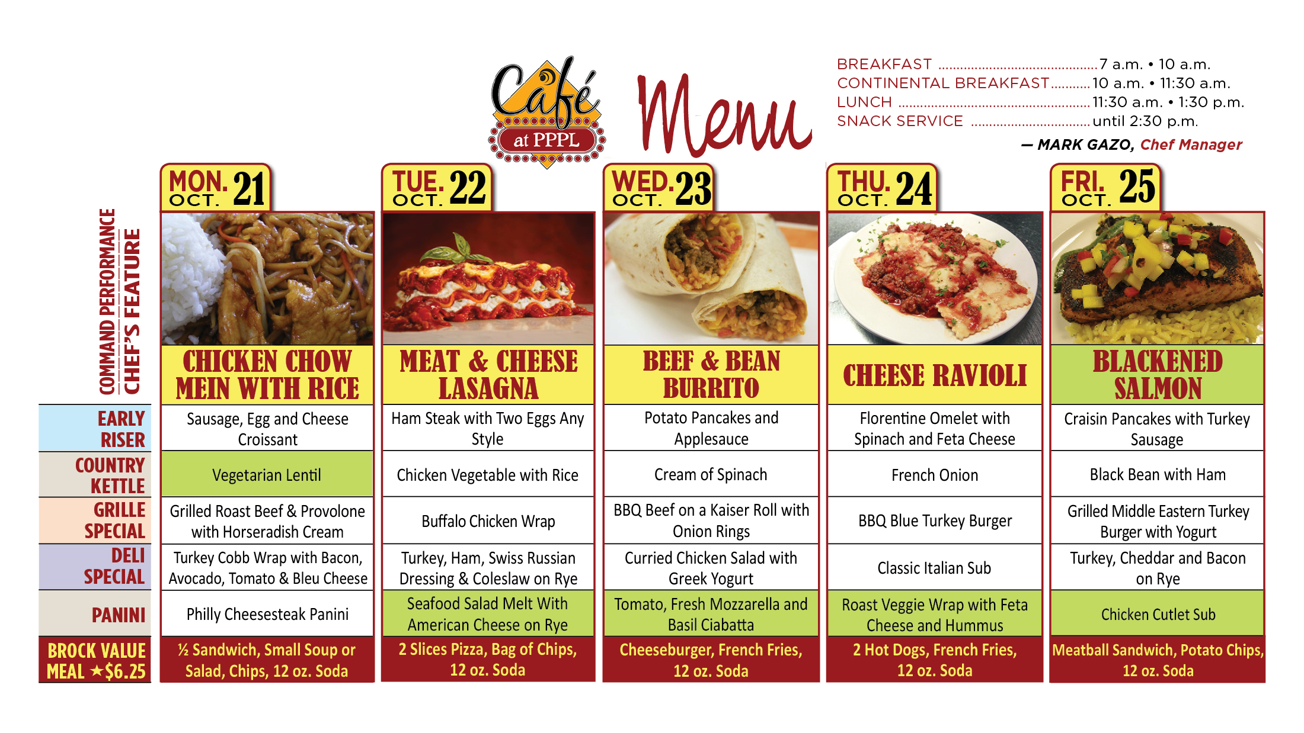
Menu subject to change without notice.

