Slide 1
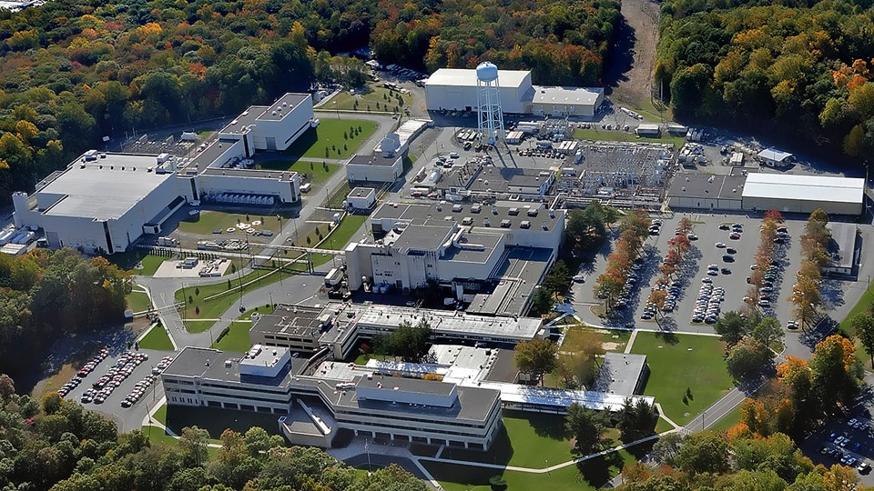
This Week @ PPPL
October 27 - 31, 2014
Brought to you by the PPPL Office of Communications

Slide 2
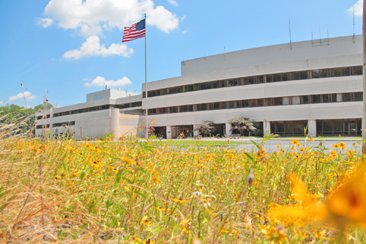


UPCOMING EVENTS
  Tuesday, November 4
  PPPL COLLOQUIUM – HTS and ARC for Fusion – 4 p.m. – MBG Auditorium
  Tuesday, November 11
  Electronics recycling collection 7 to 10 a.m. Lower Parking Lot
  Tuesday, November 11
  America Recycles Day Celebration 10:30 a.m. to 1 p.m. – LSB Lobby
  Friday, November 14
  TFTR 20-year Megawatt Anniversary Celebration with cake and ice cream
  1 p.m. - LSB Lobby
  Talk by PPPL physicist Michael Bell
  Wednesday, November 19
  PPPL COLLOQUIUM – Antibiotic Resistance-A Global Challenge
  4 p.m. – MBG Auditorium

Slide 3
Bob Ellis designs a PPPL first:
^{A 3D} ^{printed mirror for microwave}
^{launchers}

Slide 4
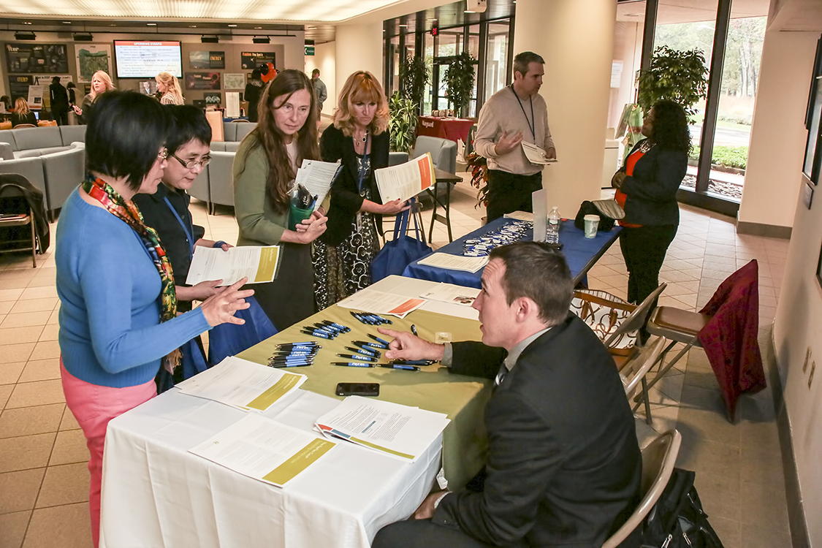

Slide 5


Slide 6
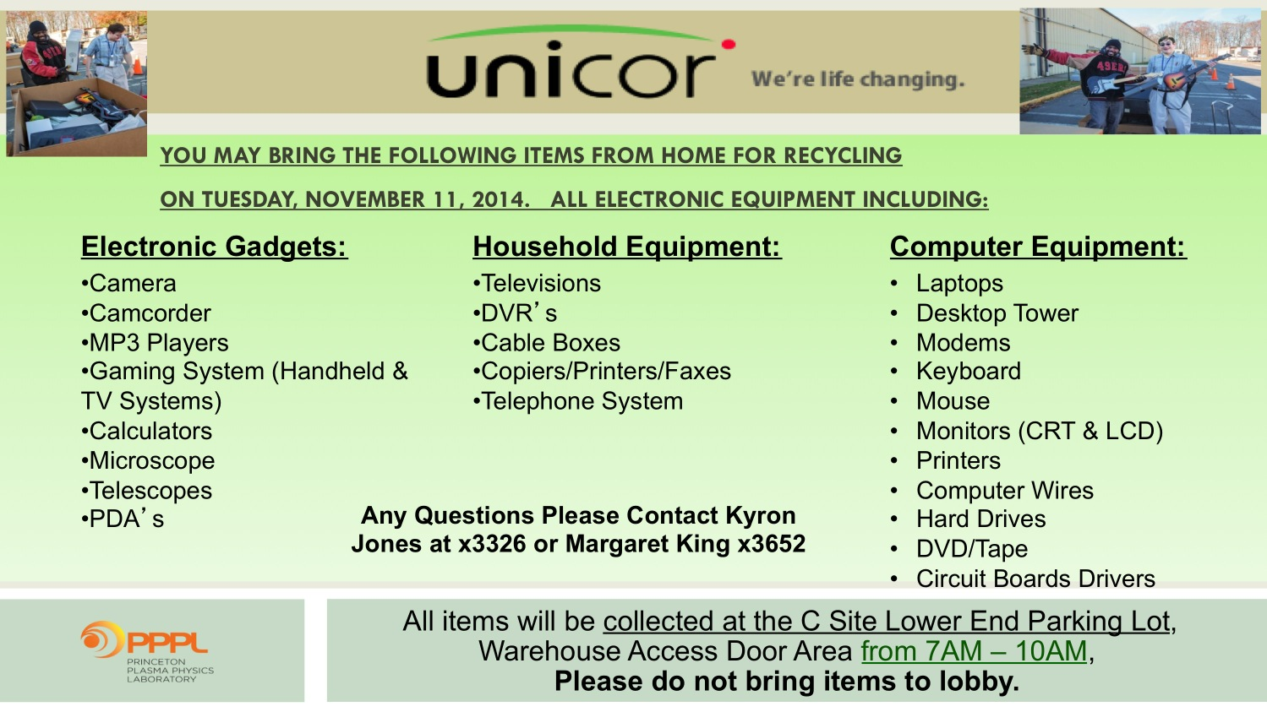

Slide 7
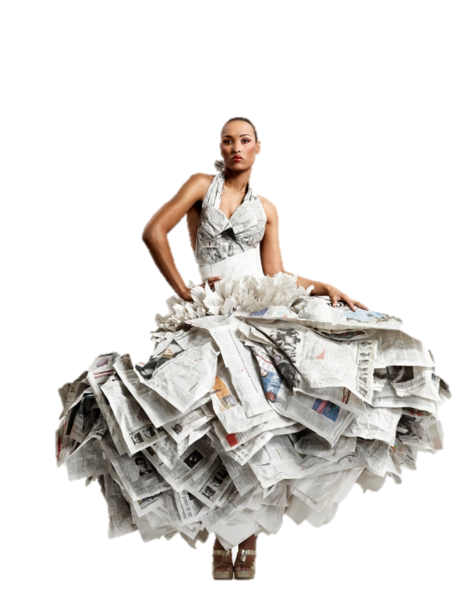
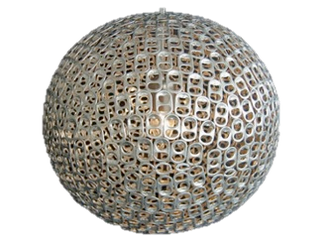
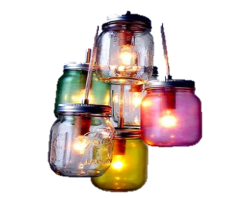
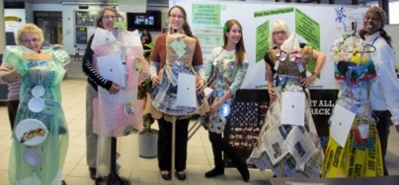
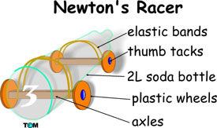
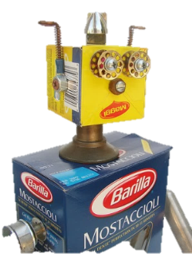
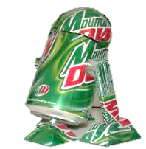
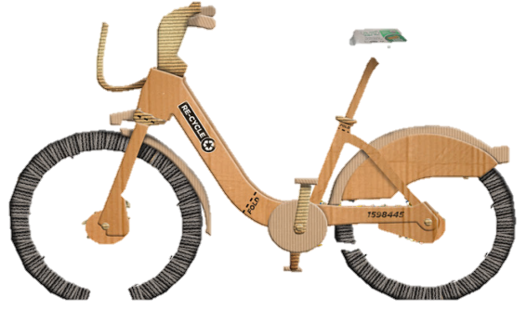



RECYCLING DESIGN CONTEST
Show your recycling spirit by making a recycling creation with items discarded here at the lab!
The categories are
Single stream
Compostable
Trash
Electronic media
Your creation can be an
outfit
artwork
invention
Anyone who makes an outfit is invited to wear it for the Recycling Fashion Shows at 11:45am and 12:30pm
Staff will vote on creations for a prize!
Bring your creations to the LSB lobby
CELEBRATE
AMERICA
RECYCLES
DAY
WITH PPPL
Please contact Dana Eckstein, danae@pppl.gov (ext. 2588) or Nicole Allen, nallen@pppl.gov (ext. 2503) by Nov. 7 to register for the contest. They can also help you with ideas and can help you get materials. CDs and other stock items that are recycled at PPPL are available in the bins outside the stock room.
TUESDAY NOVEMBER 11TH 10:30-1pm

Slide 8


Slide 10


^{Wednesday, November 4}

Slide 12



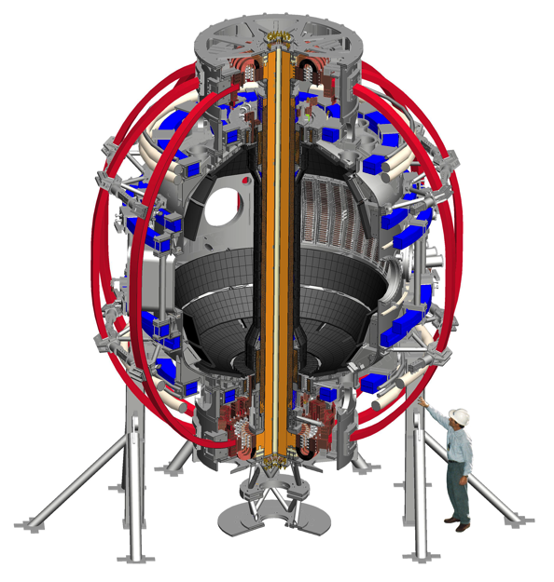
trivia
The NSTX-U upgrade, among other things,
^{is getting a new:}
a) 20 Tesla ceramic magnet coil
b) Second neutral beam injector
c) Titanium niobium shell
d) Dual center stack

Slide 13
