Slide 1
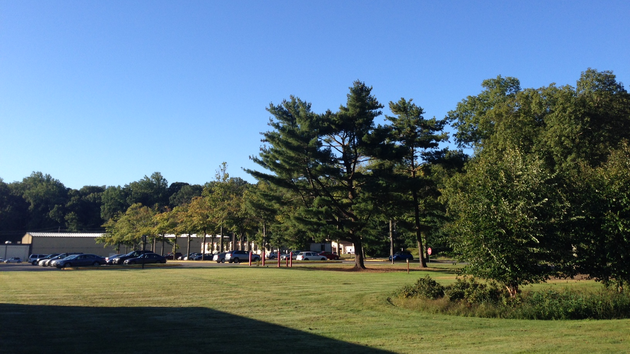


This Week @ PPPL
Oct. 28 – Nov. 2, 2013
From the PPPL Office of Communications

Slide 2

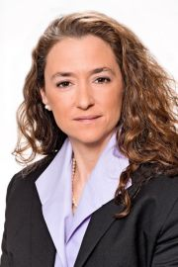
PPPL welcomes
Paulette Gangemi
New PPPL Director of Human Resources

Slide 3

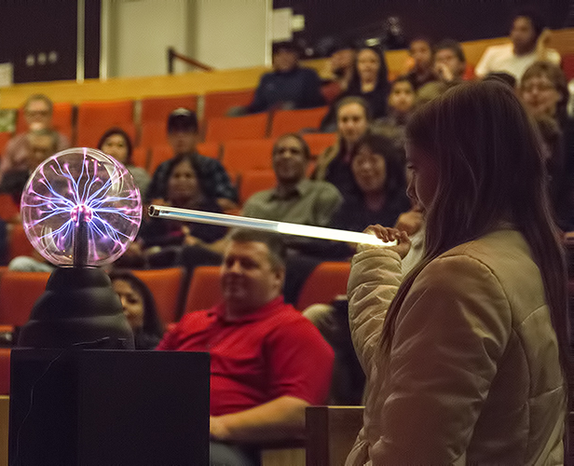
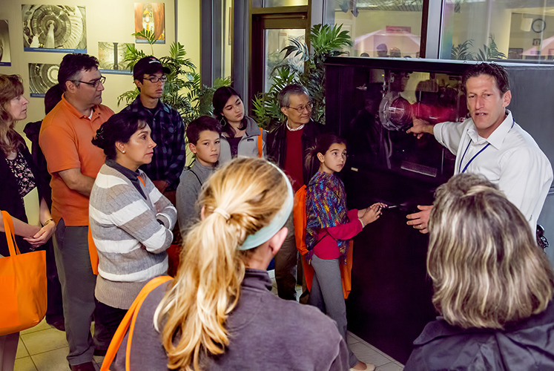
P.U. freshman families tour PPPL

Slide 4
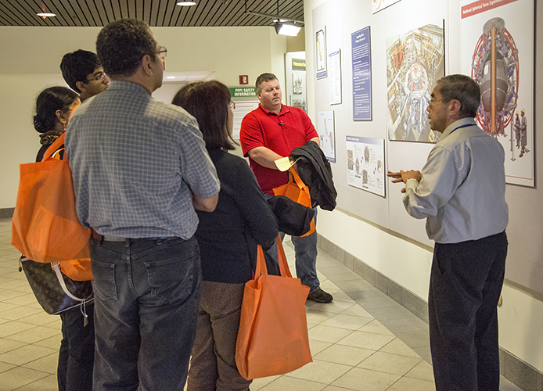
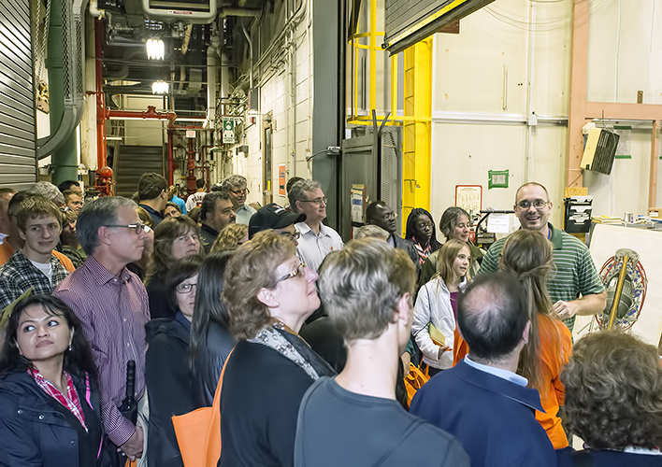
P.U. freshman families tour PPPL

Slide 5


Influenza is a contagious disease caused by a virus that can be spread by coughing, sneezing
or nasal secretions.
The best single way to prevent seasonal flu
is to get an annual influenza vaccination.
By getting vaccinated you can protect yourself from influenza and may also avoid spreading
the illness to others.
Flu vaccine appointments still available.
Contact the OMO at 3200 for an appointment.

Slide 6



Big Bang or Big Bounce?
Paul Steinhardt
Princeton University
WEDNESDAY, OCTOBER 30
4:15 p.m. (Coffee/Tea at 4 p.m.) • M.B.G. Auditorium

Slide 7

UPCOMING EVENTS
Monday - Friday, October 28 - November 1
  Max Planck Princeton Research Center for Plasma Physics Meeting – PPPL & Princeton University
Wednesday, October 30
  PPPL Colloquium • 4:15 p.m. - MBG Auditorium – “Big Bang or Big Bounce”
Sunday, November 3
  Daylight Savings Time ends – Set your clocks back one hour!
Monday, November 4
  PPPL’s United Way Campaign begins
Wednesday, November 6
  Open Enrollment Health Fair at PPPL – 10 a.m. to 2 p.m. – LSB Lobby
Monday - Friday, November 11 - 15
  55th Annual Meeting of the APS Division of Plasma Physics, Denver, Colo.
Thursday, November 21
  United Way Bake Sale – 8 a.m. – Lobby; United Way Presentation – 10 a.m. – MBG Auditorium
Thursday - Friday, November 28 - 29
  Lab Closed – Happy Thanksgiving!

Slide 8


Slide 9

Try our NEW
Flatbread Breakfast Sandwiches
AVAILABLE NOW!

Slide 10
Try our NEW
“$2 BELOW” PPPL VALUE MENU
AVAILABLE NOW!

Slide 11
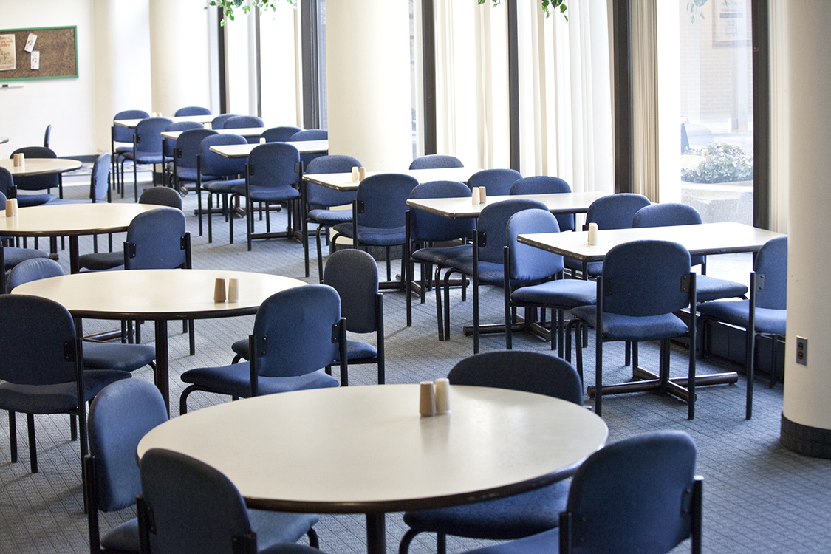

Menu subject to change without notice.

