Slide 1
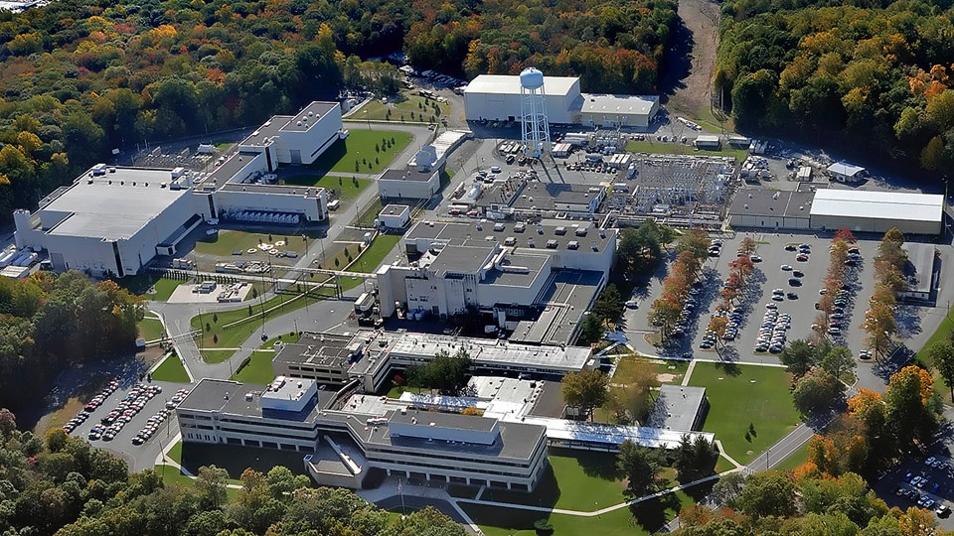
This Week @ PPPL
November 3 - 7, 2014
Brought to you by the PPPL Office of Communications

Slide 2
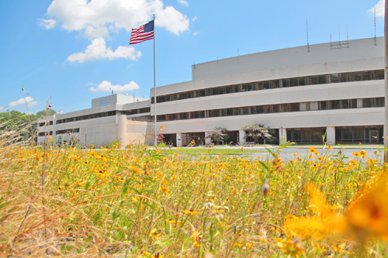


UPCOMING EVENTS
  Tuesday, November 4
  PPPL COLLOQUIUM – HTS and ARC for Fusion – 4 p.m. – MBG Auditorium
  Tuesday, November 5 - 7
  PPPL Advisory Committee
  Tuesday, November 11
  Electronics recycling collection 7 to 10 a.m. Lower Parking Lot America Recycles Day Celebration 10:30 a.m. to 1 p.m. LSB Lobby
  Mon. – Wed., November 17 - 19
  Environmental Management Systems Audit
  Tuesday, November 18
  TFTR 20-year Megawatt Anniversary Celebration with cake and ice cream
  1 p.m. - LSB Lobby • Talk by PPPL physicist Michael Bell
  Wednesday, November 19
  PPPL COLLOQUIUM – Antibiotic Resistance - A Global Challenge 4 p.m. – MBG Aud.
  Wednesday, January 14
  Records/Paper Shredding Event – 9 a.m. to 4 p.m. – Warehouse Receiving Area #3

Slide 3
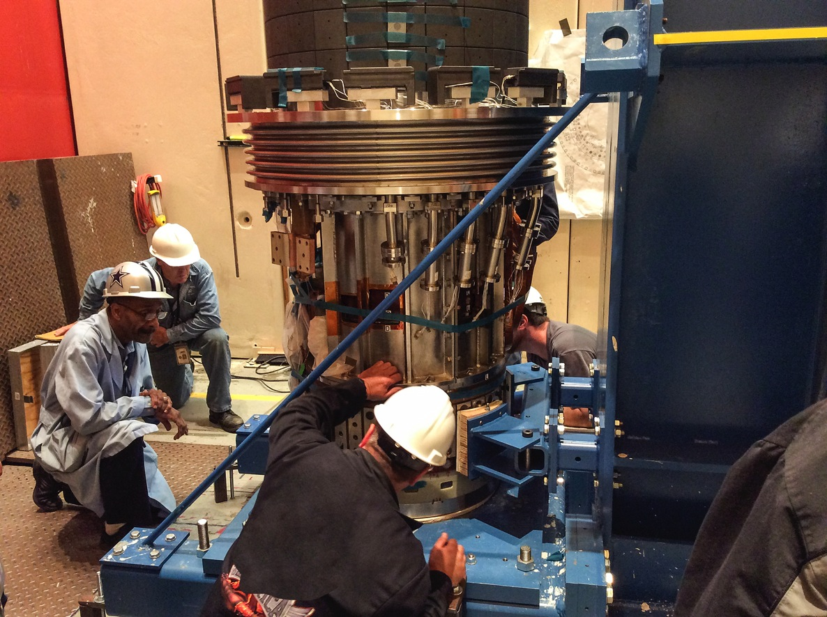

Technicians install the center stack in the
NSTX-U vacuum vessel

Slide 4
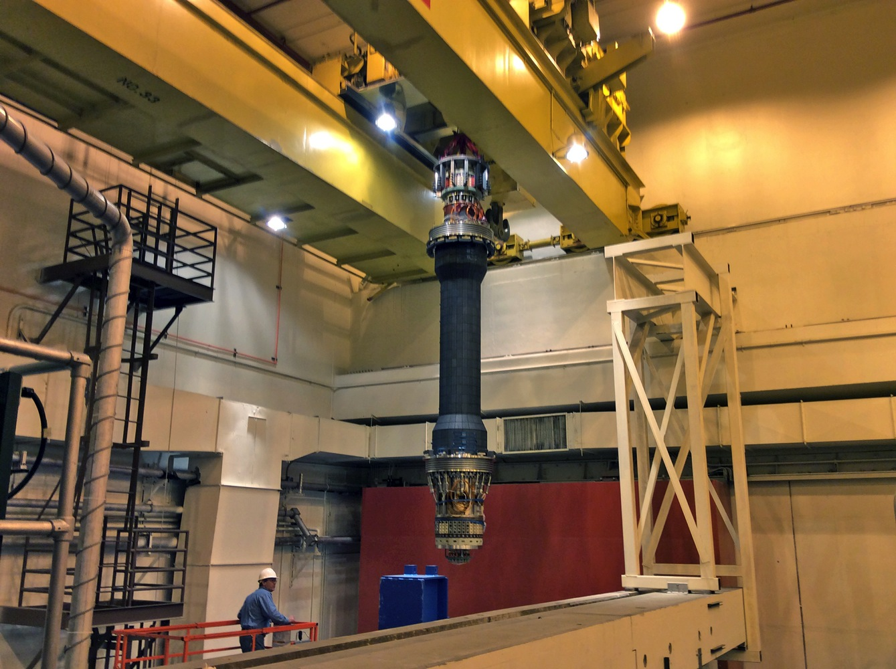
Technicians install the center stack in the
NSTX-U vacuum vessel

Slide 5
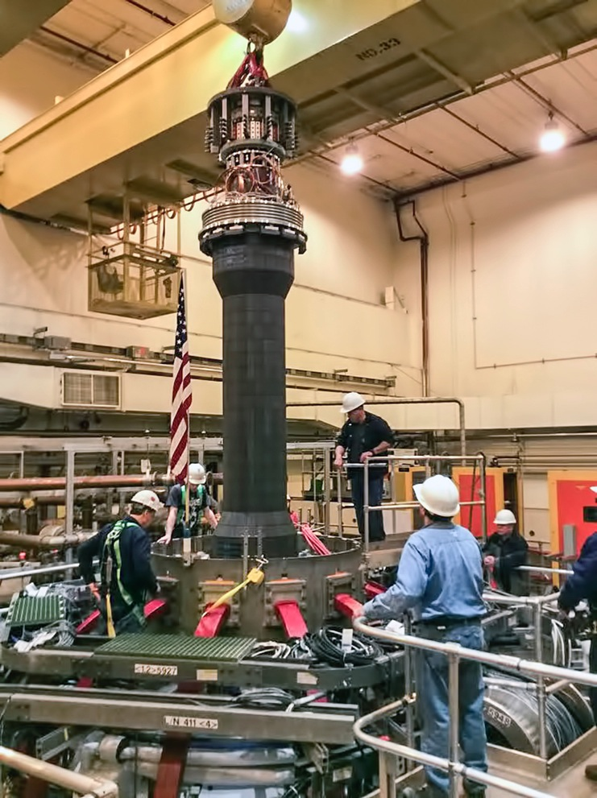
Technicians install the center stack in the
NSTX-U vacuum vessel

Slide 6
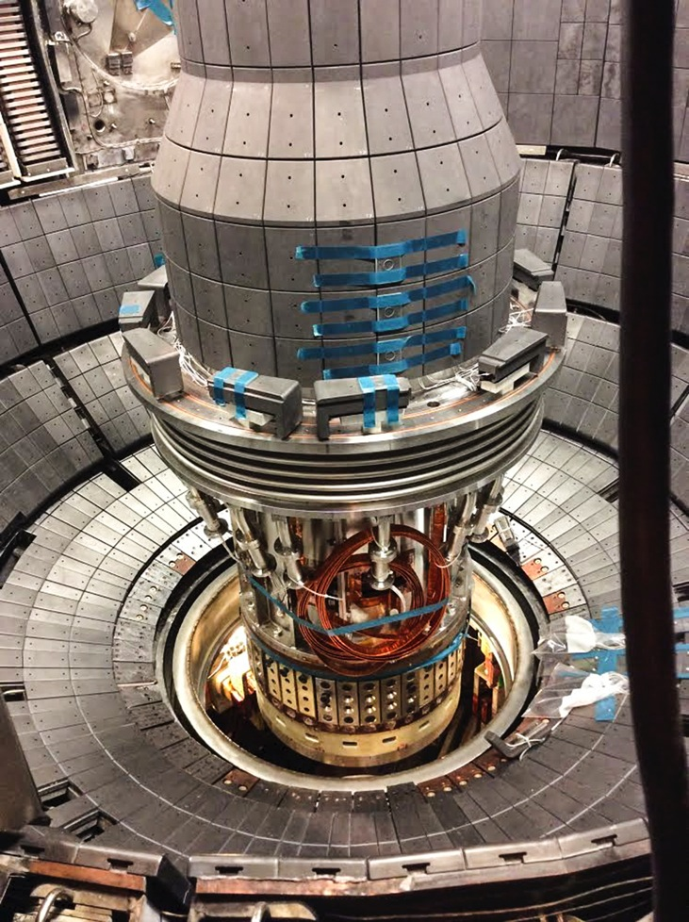
Technicians install the center stack in the
NSTX-U vacuum vessel

Slide 7


^{Wednesday, November 4}

Slide 8


Slide 9
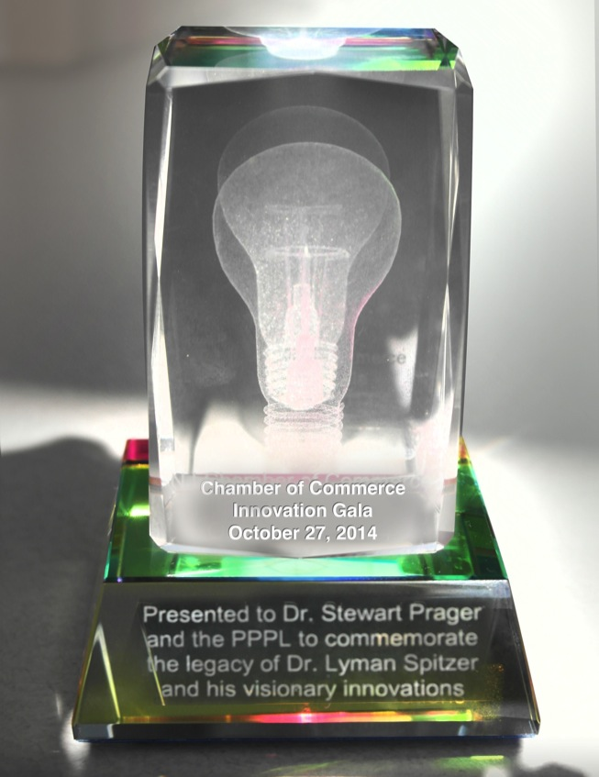
Lyman Spitzer named one of top New Jersey innovators in history

Slide 10


Slide 11
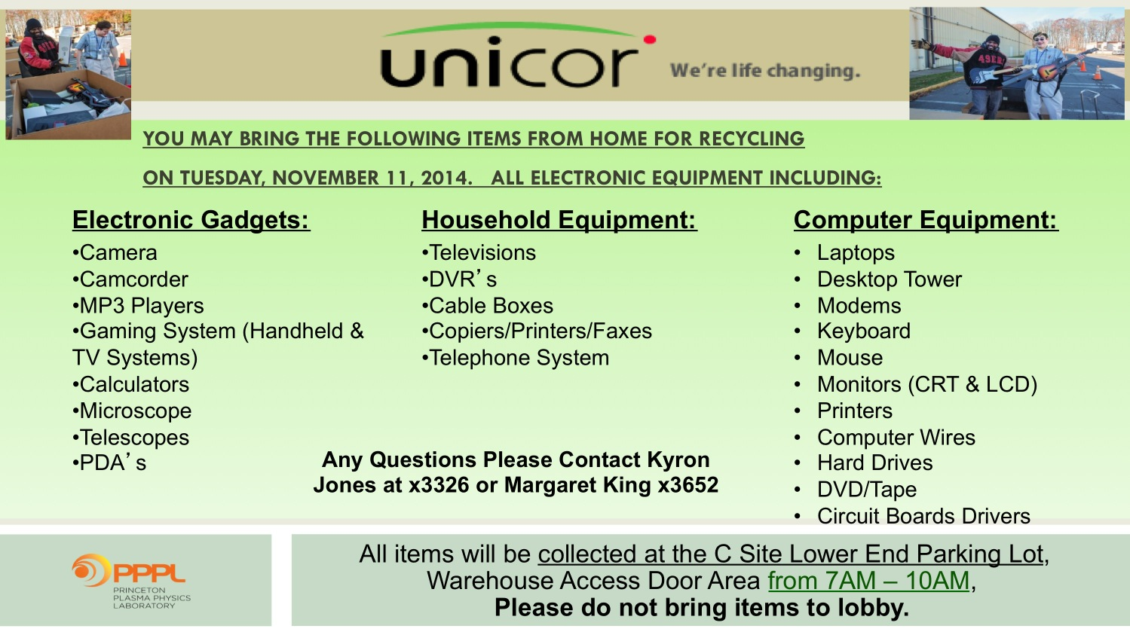

Slide 12

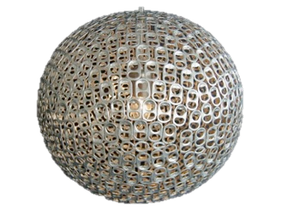

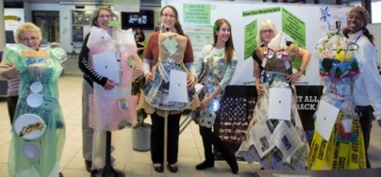
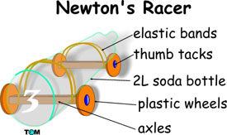
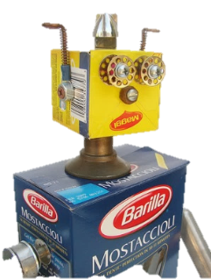
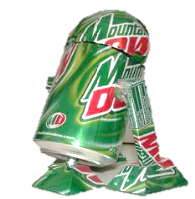
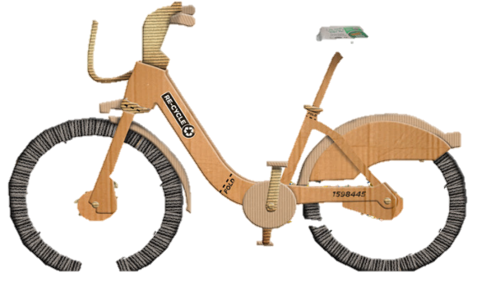



RECYCLING DESIGN CONTEST
Show your recycling spirit by making a recycling creation with items discarded here at the lab!
The categories are
Single stream
Compostable
Trash
Electronic media
Your creation can be an
outfit
artwork
invention
Anyone who makes an outfit is invited to wear it for the Recycling Fashion Shows at 11:45am and 12:30pm
Staff will vote on creations for a prize!
Bring your creations to the LSB lobby
CELEBRATE
AMERICA
RECYCLES
DAY
WITH PPPL
Please contact Dana Eckstein, danae@pppl.gov (ext. 2588) or Nicole Allen, nallen@pppl.gov (ext. 2503) by Nov. 7 to register for the contest. They can also help you with ideas and can help you get materials. CDs and other stock items that are recycled at PPPL are available in the bins outside the stock room.
TUESDAY NOVEMBER 11TH 10:30-1pm

Slide 13
SAVE THE DATE:

Slide 14

RECORDS/PAPER SHREDDING EVENT:
Date:
January 14, 2015 (9:00 am – 4:00 pm)
Centralized location:
Warehouse, Receiving Area #3, Princeton, NJ 08543
Restrictions:
Only PPPL departmental business-related records and documents will be shredded!

Slide 15


^{Wednesday, November 19}

Slide 16
What is PPPL’s Environmental Stewardship Policy?
The policy allows us to conduct scientific research and operate Laboratory facilities in a manner that protects and preserves human health and the environment and fully complies with applicable environmental laws,
regulations, and other requirements.

Slide 17
Process
Environmental
Guidelines
PLAN
Legal & other requirements
Aspects & impacts
Performance goals
ACT
Management Review
Action plans
Continual Improvement
CHECK
Monitor & track performance
Audit
Corrective actions
Records
DO
Roles & Responsibilities
Operational controls
Awareness

Slide 18


What do I need to know about the Environmental Policy?
PPPL’s commitments:
Additional information:
Protect the environment through compliance
Prevent pollution & conserve resources
Communicate sustainable practices
Monitor & improve performance
Email: ems@pppl.gov
Phone: ext. 3380
All employees should:
KNOW:
How the policy affects your job
How your job affects sustainability at PPPL
How to report a spill or other emergency
By calling x3333
DO:
Consider environment in work & planning
Follow ES&H procedures
Provide feedback & ideas for improvement

Slide 19
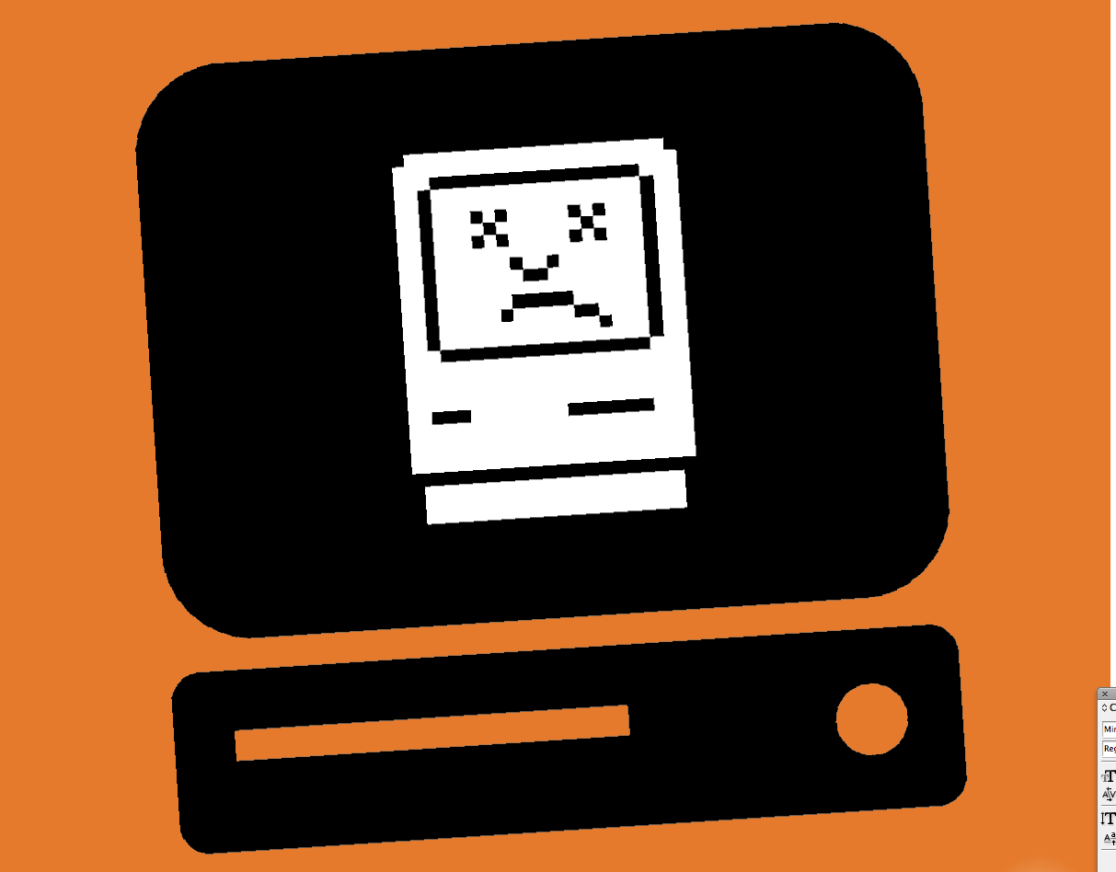


Slide 20


Slide 21
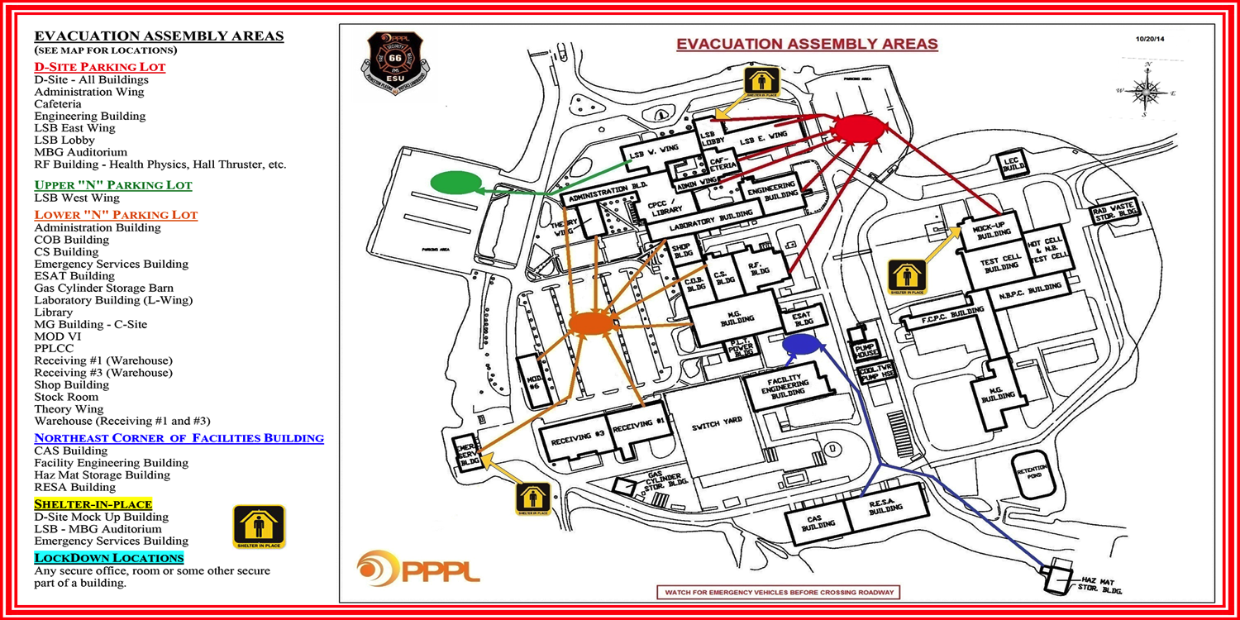
Important Evacuation Information

Slide 23
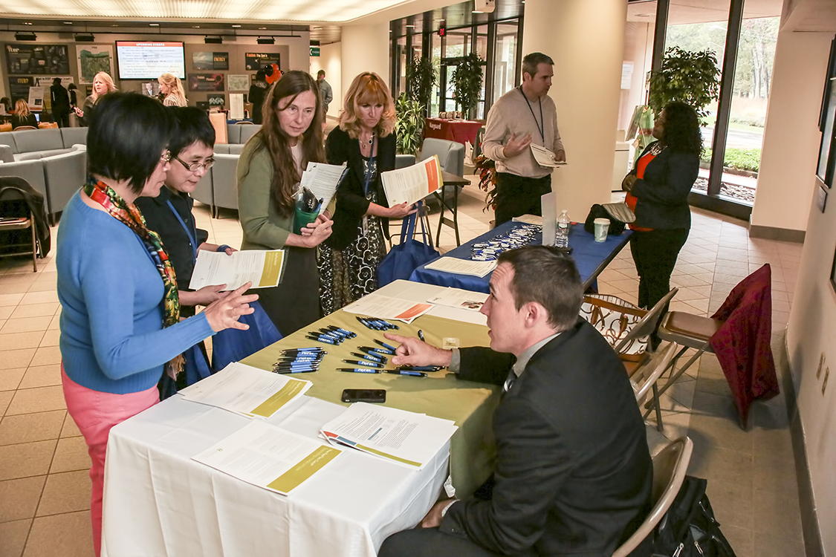

Slide 24



