Slide 1
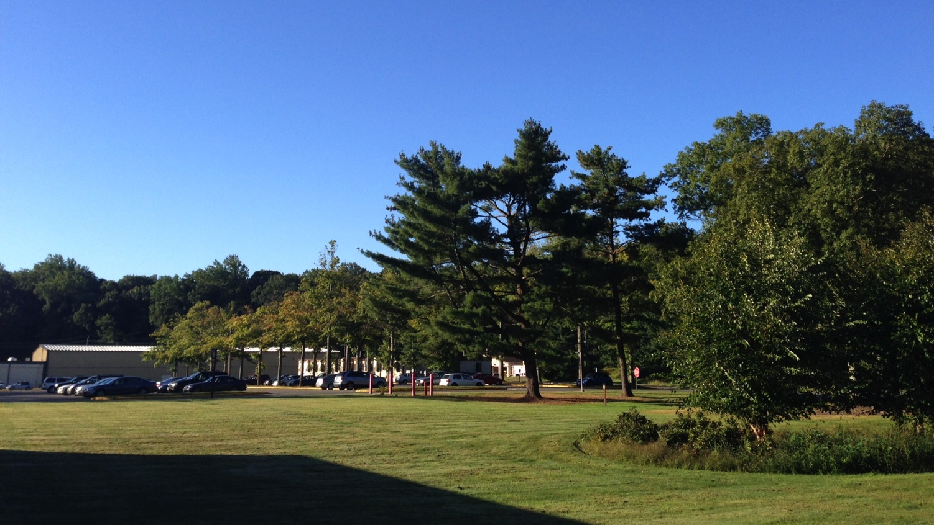
This Week @ PPPL
November 4 - 8, 2013
From the PPPL Office of Communications

Slide 2
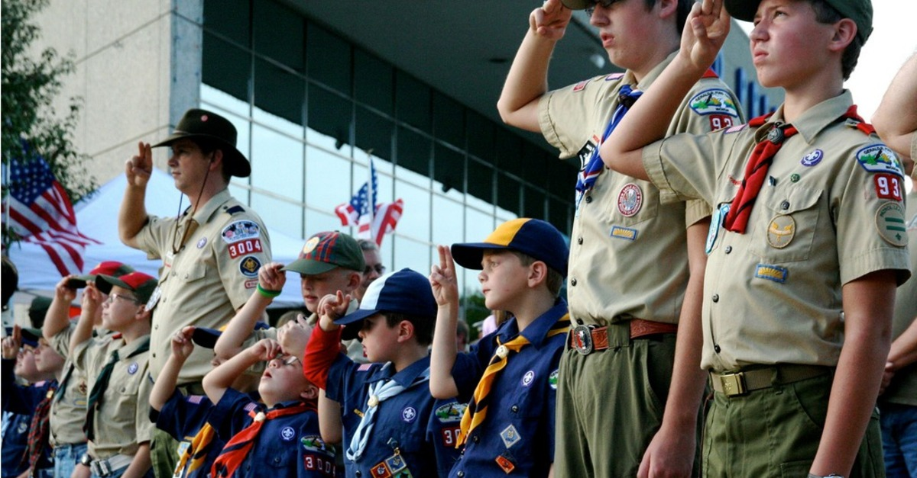
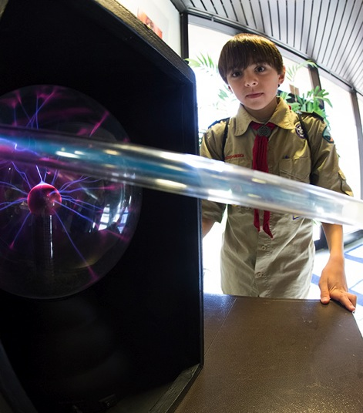
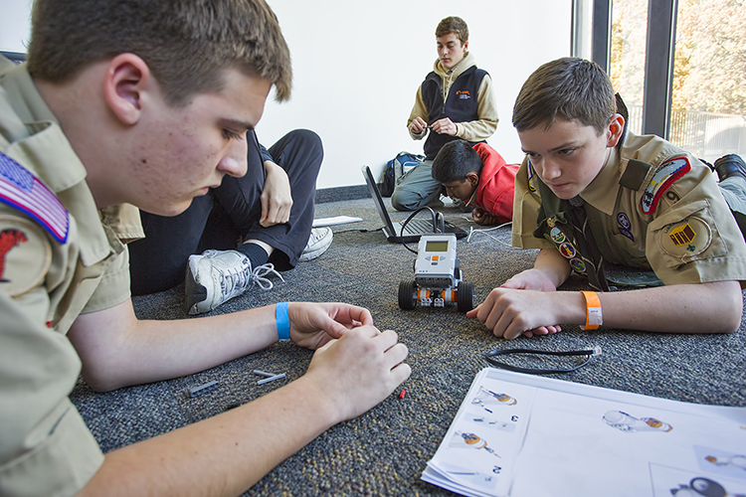
BOY SCOUTS OF AMERICA MERIT BADGE FAIR AT PPPL

Slide 3
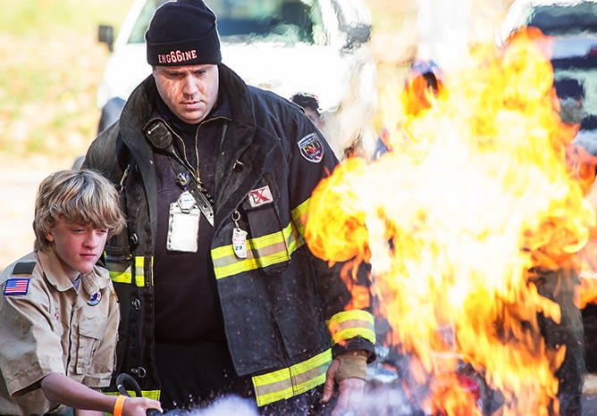
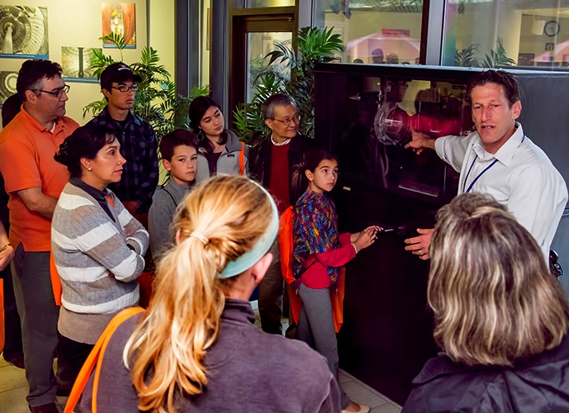
BOY SCOUTS OF AMERICA MERIT BADGE FAIR AT PPPL

Slide 4
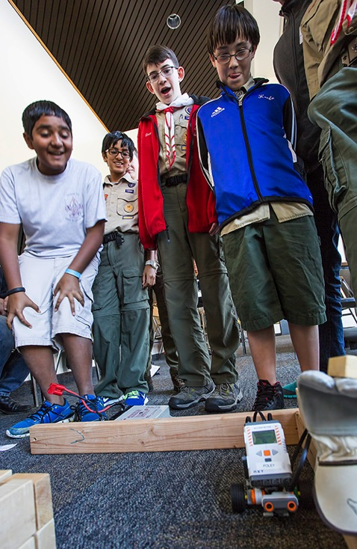
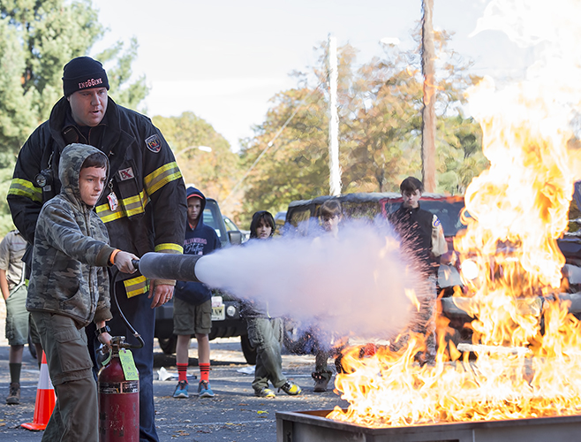
BOY SCOUTS OF AMERICA MERIT BADGE FAIR AT PPPL

Slide 5
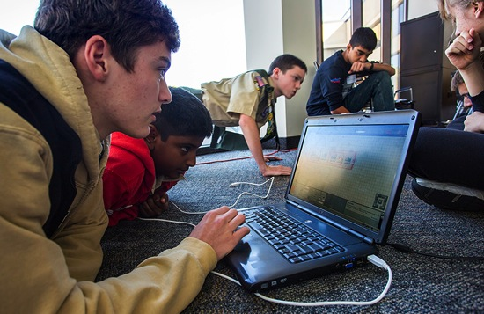
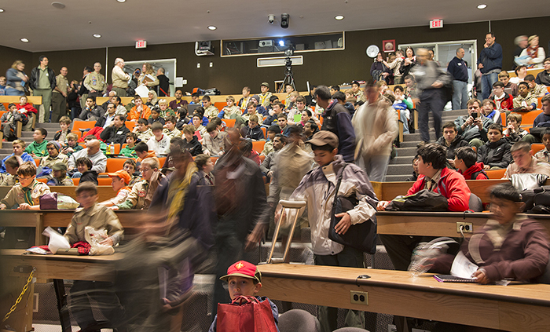
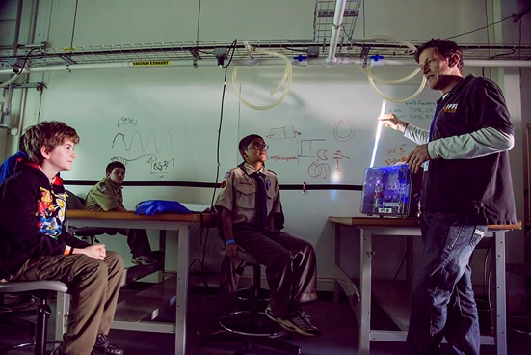
BOY SCOUTS OF AMERICA MERIT BADGE FAIR AT PPPL

Slide 6
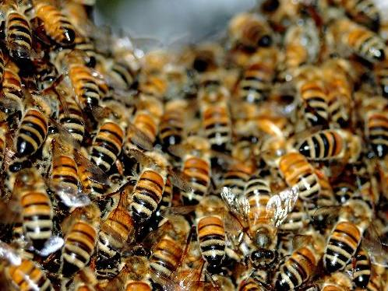

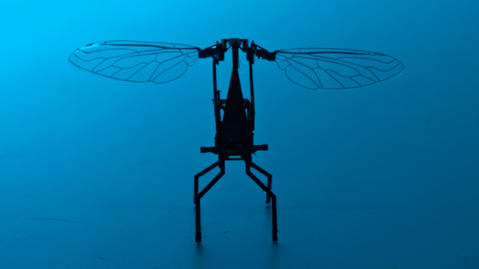
Robot Bees
Noah Jafferis
Harvard University
WEDNESDAY, NOVEMBER 6
4:15 p.m. (Coffee/Tea at 4 p.m.) • M.B.G. Auditorium

Slide 7


UPCOMING EVENTS
Monday, November 4
  PPPL’s United Way Campaign begins
Wednesday, November 6
  Open Enrollment Health Fair at PPPL – 10 a.m. to 2 p.m. – LSB Lobby
Monday - Friday, November 11 - 15
  55th Annual Meeting of the APS Division of Plasma Physics, Denver, Colo.
Thursday, November 14
  America Recycles Day – LSB Lobby
Wednesday, November 20
  Adam Cohen Lecture on PPPL at Princeton University – Princeton Deconstructed Fall Series
Thursday, November 21
  United Way Bake Sale – 8 a.m. – LSB Lobby; United Way Presentation – 10 a.m. – MBG Auditorium
Thursday - Friday, November 28 - 29
  Lab Closed – Happy Thanksgiving!

Slide 8
10 a.m. to 1:30 p.m.

Slide 10


Slide 11
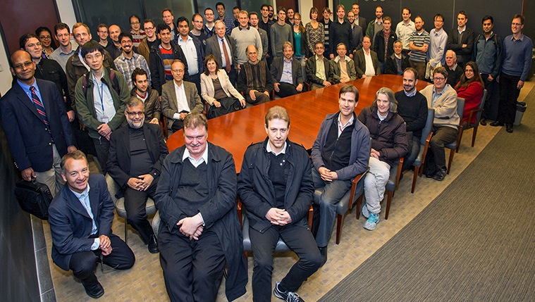
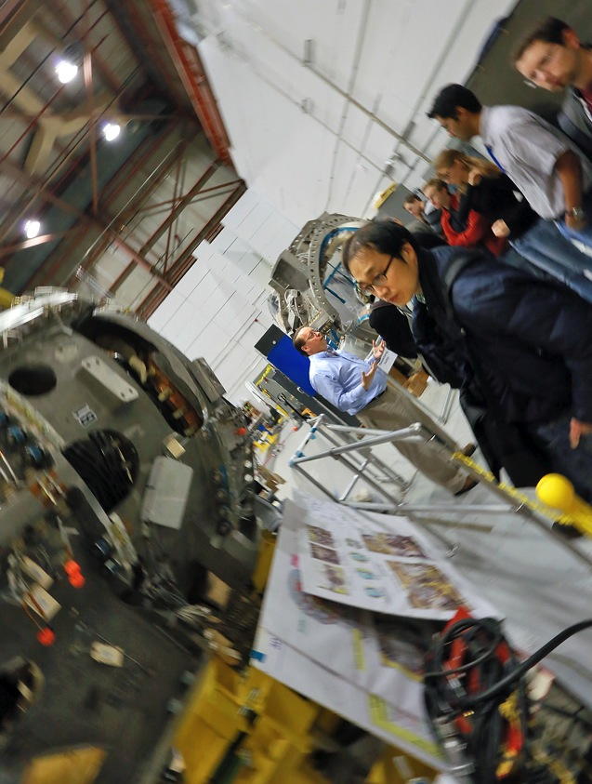
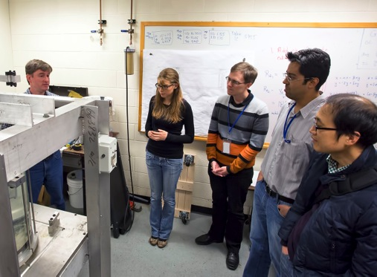
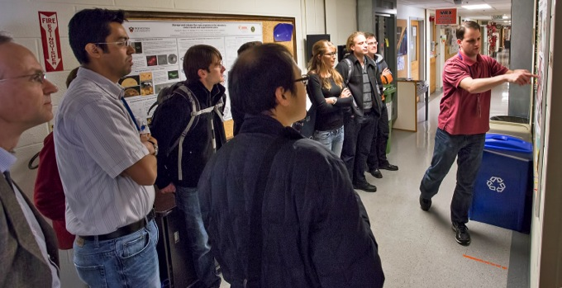
Max Planck Conference attendees tour PPPL

Slide 12


OUR NEW
Flatbread Breakfast Sandwiches
AVAILABLE NOW!

Slide 13
OUR NEW
“$2 BELOW” PPPL VALUE MENU
AVAILABLE NOW!

Slide 14
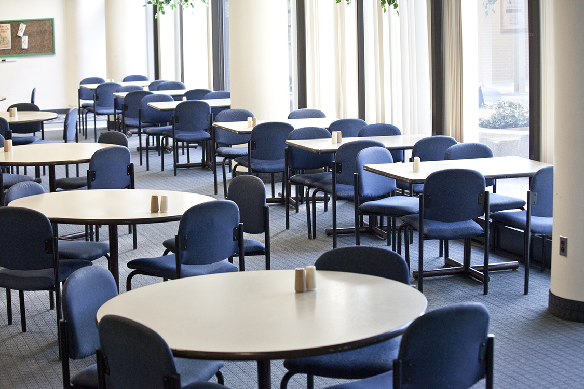
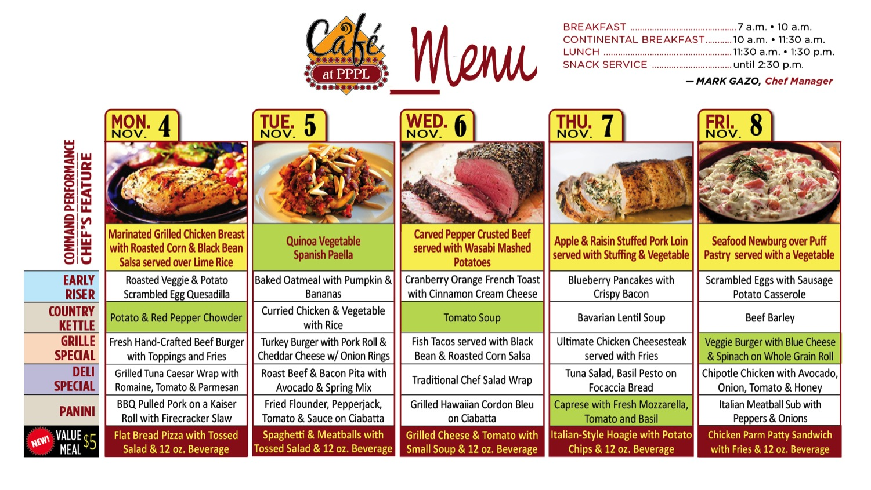
Menu subject to change without notice.

