Slide 1
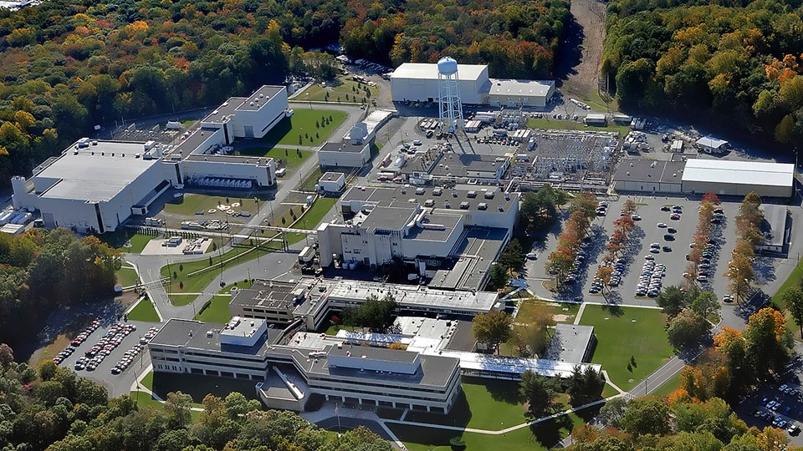
This Week @ PPPL
November 10 - 14, 2014
Brought to you by the PPPL Office of Communications

Slide 2
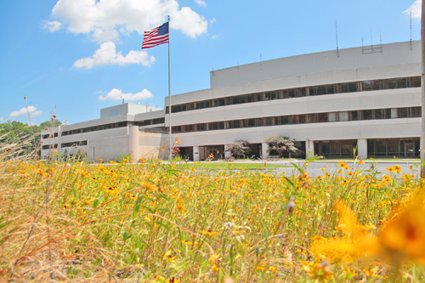


UPCOMING EVENTS
  Tuesday, Nov. 11
  ELECTRONICS RECYCLING COLLECTION 10:30 a.m. to 1 p.m. Lower Parking Lot
  AMERICA RECYCLES DAY CELEBRATION AT PPPL – 10:30 a.m. – LSB Lobby
  Tuesday, Nov. 18
  20th ANNIVERSARY CELEBRATION 10MW of Fusion Power in TFTR
  1 p.m. – LABWIDE CELEBRATION – Ice cream and cake served
  2 p.m. – COLLOQUIUM – Presented by Michael Bell
  Wednesday, Nov. 19
  PPPL COLLOQUIUM – Antibiotic Resistance-A Global Challenge - 4 p.m. – MBG Aud.
  Thu. – Fri., Nov. 27-28
  LAB CLOSED – Thanksgiving Holiday

Slide 3


Slide 4
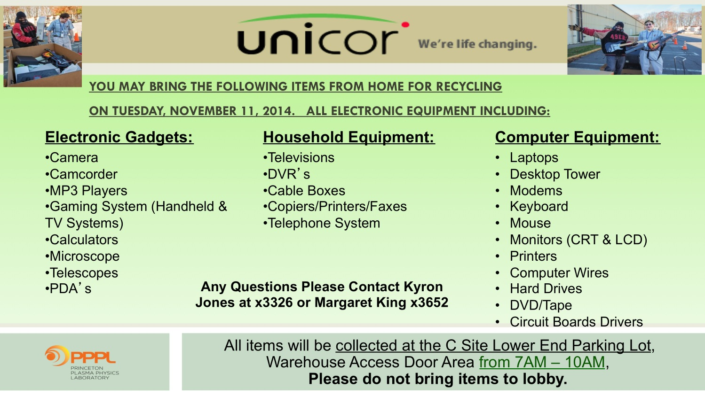

Slide 5

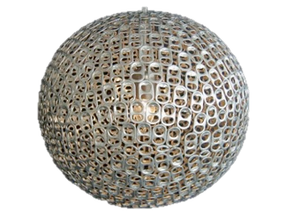

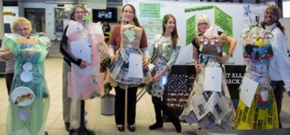
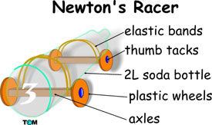
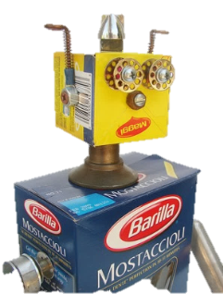
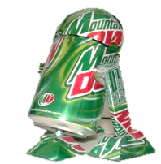
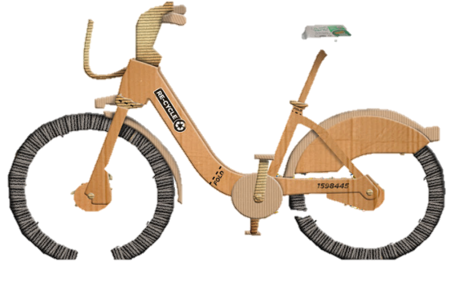



RECYCLING DESIGN CONTEST
Show your recycling spirit by making a recycling creation with items discarded here at the lab!
The categories are
Single stream
Compostable
Trash
Electronic media
Your creation can be an
outfit
artwork
invention
Anyone who makes an outfit is invited to wear it for the Recycling Fashion Shows at 11:45am and 12:30pm
Staff will vote on creations for a prize!
Bring your creations to the LSB lobby
CELEBRATE
AMERICA
RECYCLES
DAY
WITH PPPL
Please contact Dana Eckstein, danae@pppl.gov (ext. 2588) or Nicole Allen, nallen@pppl.gov (ext. 2503) by Nov. 7 to register for the contest. They can also help you with ideas and can help you get materials. CDs and other stock items that are recycled at PPPL are available in the bins outside the stock room.
TUESDAY NOVEMBER 11TH 10:30-1pm

Slide 6
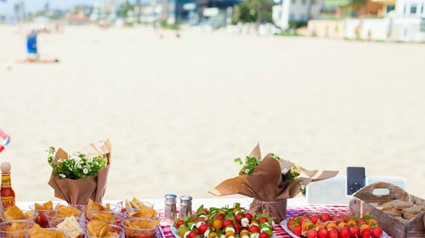
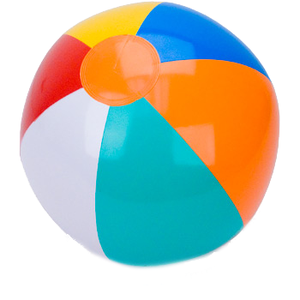
Tuesday, November 11
The Café at PPPL celebrates
Veterans Day and America Recycles Day!
Join us for a BEACH PARTY BBQ
with hot dogs, hamburgers and all the fixins!
Wear a Green (America Recycles Day) or Hawaiian Shirt to enter a drawing for a Cookbook or an Eco Mug!

Slide 7

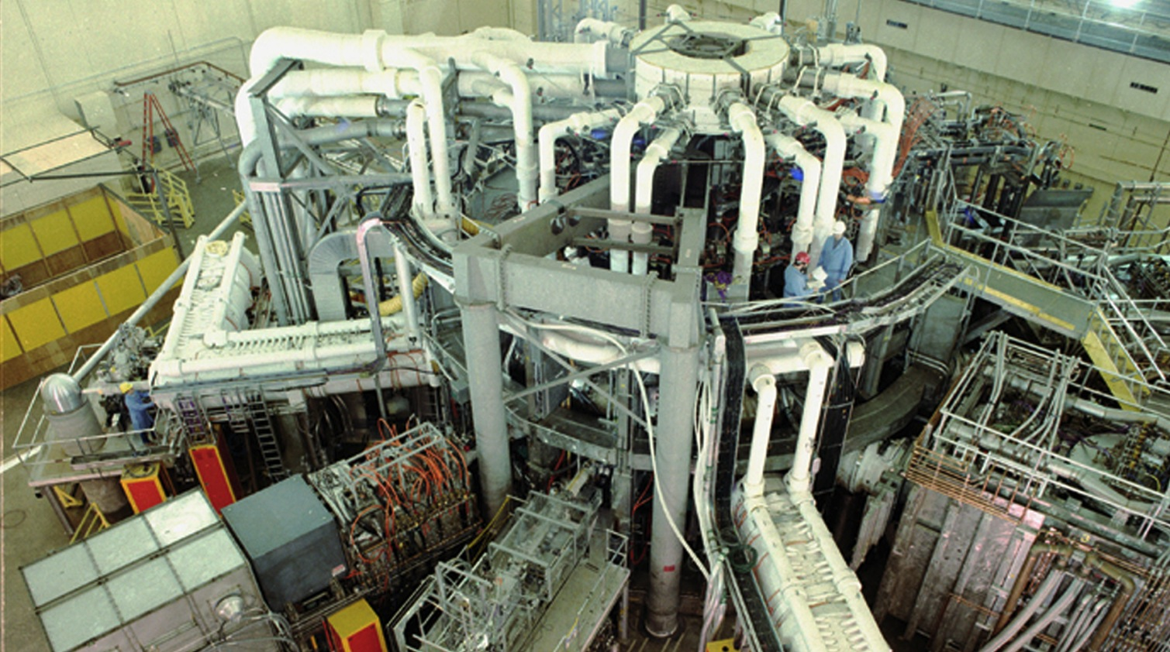

Slide 8

SAVE THE DATE
RECORDS/PAPER SHREDDING EVENT:
Date:
January 14, 2015 (9:00 am – 4:00 pm)
Centralized location:
Warehouse, Receiving Area #3, Princeton, NJ 08543
Restrictions:
Only PPPL departmental business-related records and documents will be shredded!

Slide 9



Slide 10

This event is not sponsored by PPPL

Slide 11
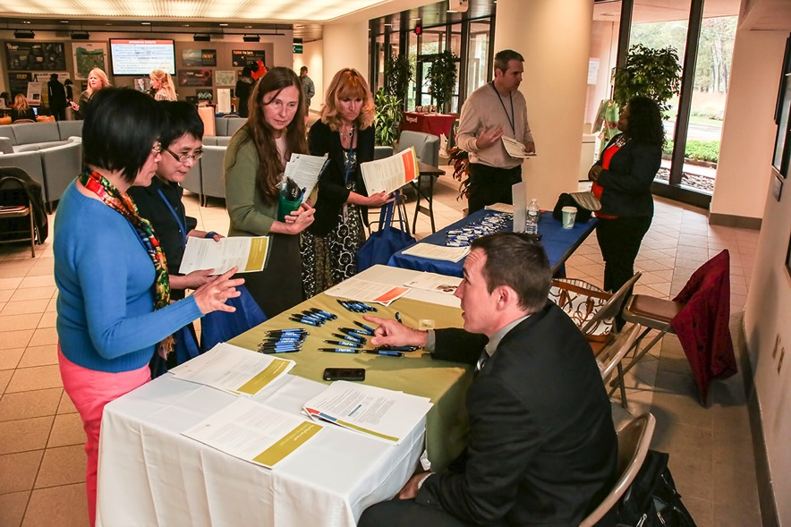
Princeton University OPEN ENROLLMENT ends this Friday, November 14

Slide 12
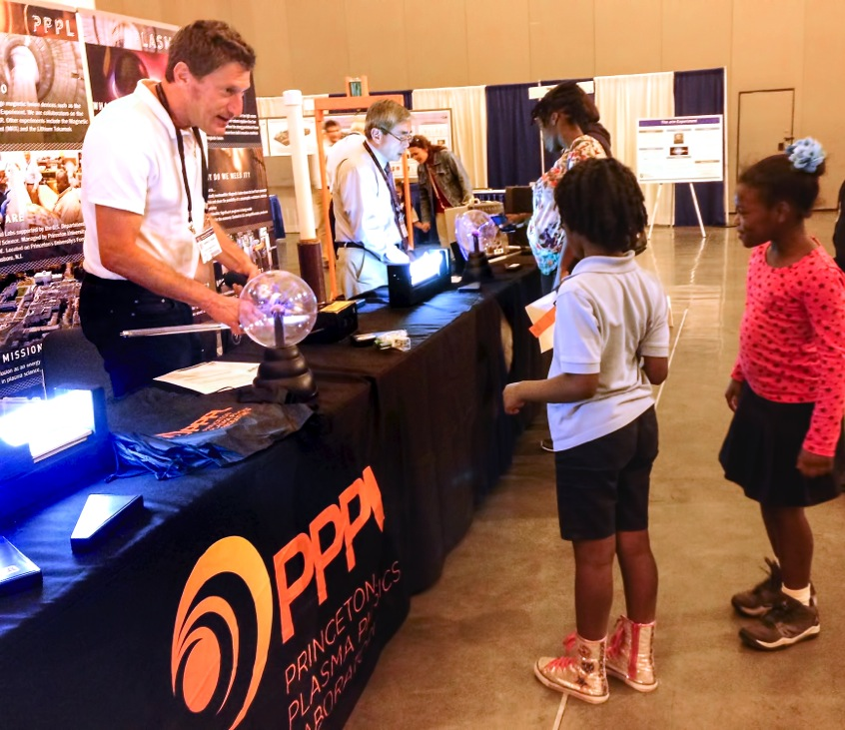
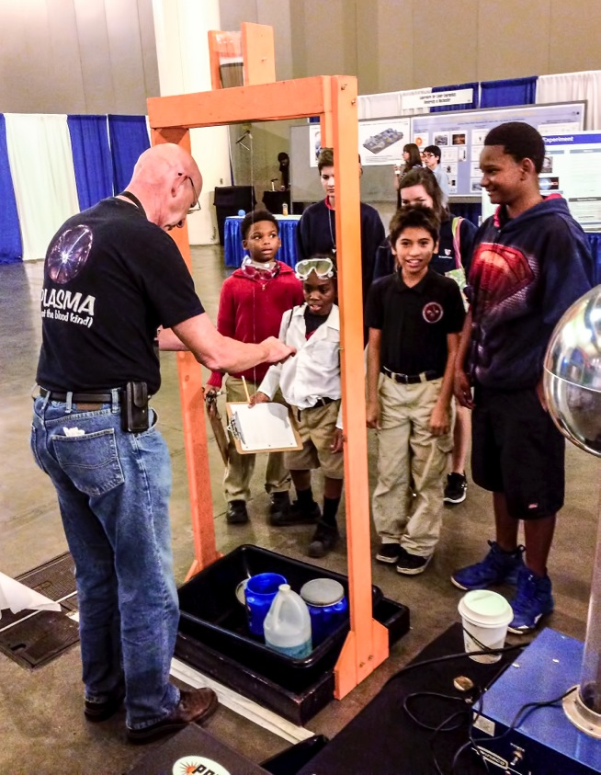
PPPL’s Science Education team is a hit at
APS Plasma Sciences Expo

Slide 13


trivia
Who should PPPLers contact with their benefits questions?
a) Kate Harkness @ PPPL
b) Paulette Gangemi @ PPPL
c) Andrea Moten @ PPPL
HR on Main Campus
benefits @ princeton.edu
609-258-8888
d) Benefits @ princeton.edu

Slide 14

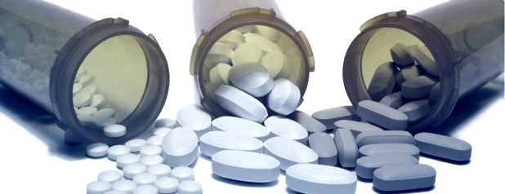
Antibiotic Resistance: A Global Challenge
Ramanan Laxminarayan – Princeton University – Princeton Environmental Institute
WEDNESDAY, NOVEMBER 19
4:15 p.m. • M.B.G. Auditorium

Slide 15
