Slide 1
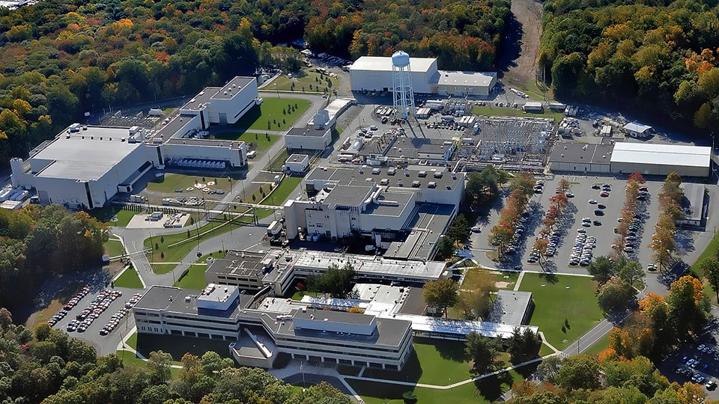
This Week @ PPPL
November 17 - 21, 2014
Brought to you by the PPPL Office of Communications

Slide 2
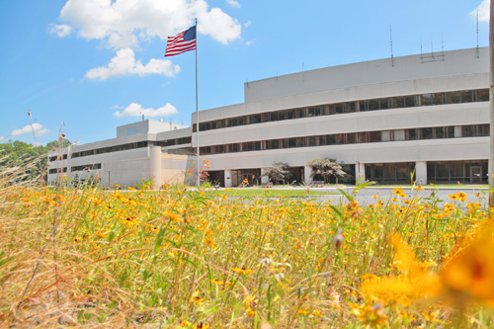


UPCOMING EVENTS
  Tuesday, Nov. 18
  20th ANNIVERSARY CELEBRATION 10MW of Fusion Power in TFTR
  1 p.m. – LABWIDE CELEBRATION – Ice cream and cake served
  2 p.m. – COLLOQUIUM – Presented by Michael Bell
  Wednesday, Nov. 19
  UNITED WAY CAMPAIGN KICKOFF – 10:30 a.m. – MBG Auditorium
  Wednesday, Nov. 19
  PPPL COLLOQUIUM – Antibiotic Resistance-A Global Challenge - 4 p.m. – MBG Aud.
  Thu. – Fri., Nov. 27-28
  LAB CLOSED – Thanksgiving Holiday
  Wednesday, Jan. 15, 2015
  PPPL’S RECORDS PAPER SHREDDING EVENT

Slide 3

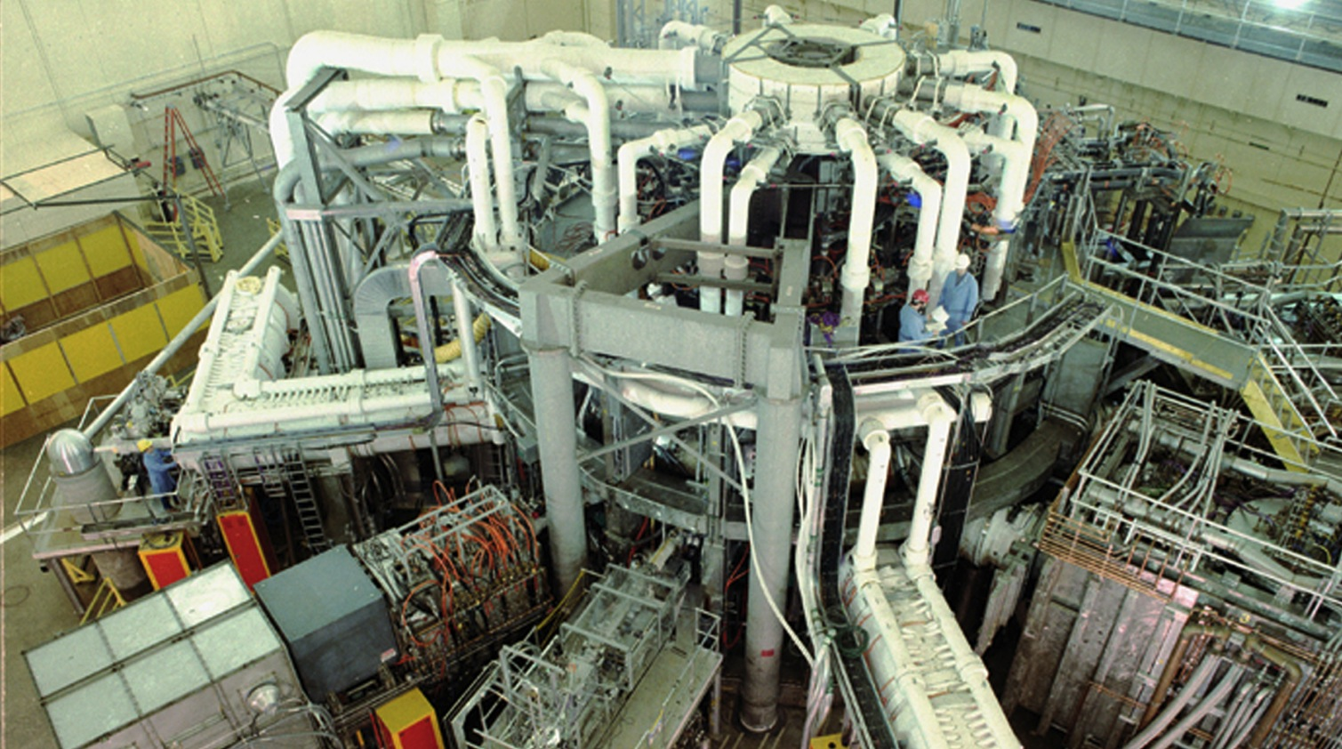

Slide 4

SAVE THE DATE
RECORDS/PAPER SHREDDING EVENT:
Date:
January 14, 2015 (9:00 am – 4:00 pm)
Centralized location:
Warehouse, Receiving Area #3, Princeton, NJ 08543
Restrictions:
Only PPPL departmental business-related records and documents will be shredded!

Slide 5



Slide 6

This event is not sponsored by PPPL

Slide 7
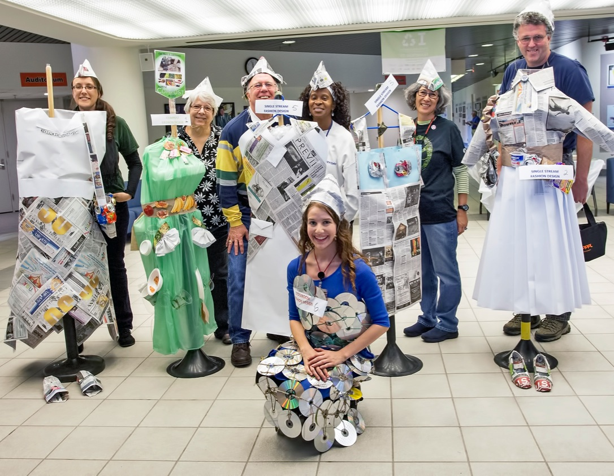
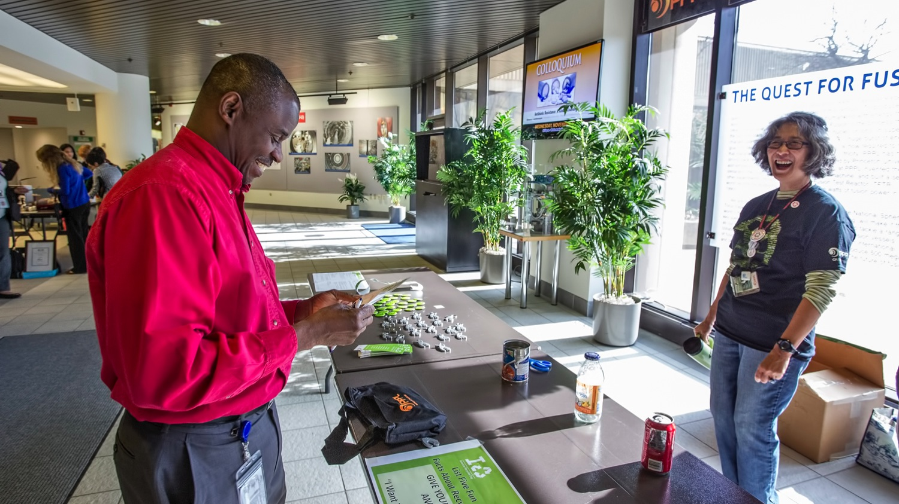
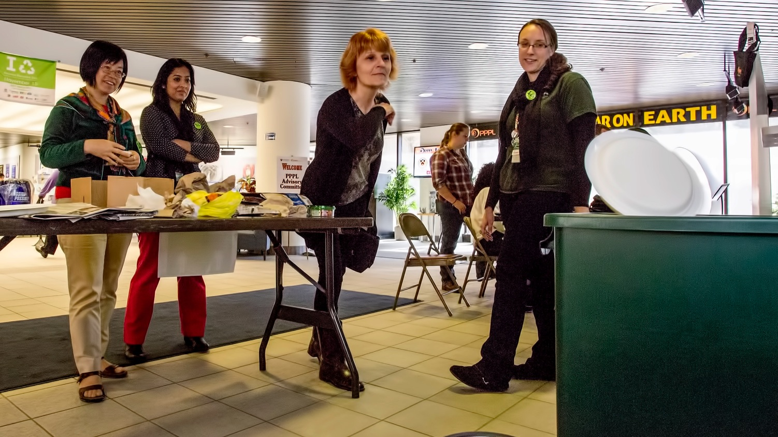
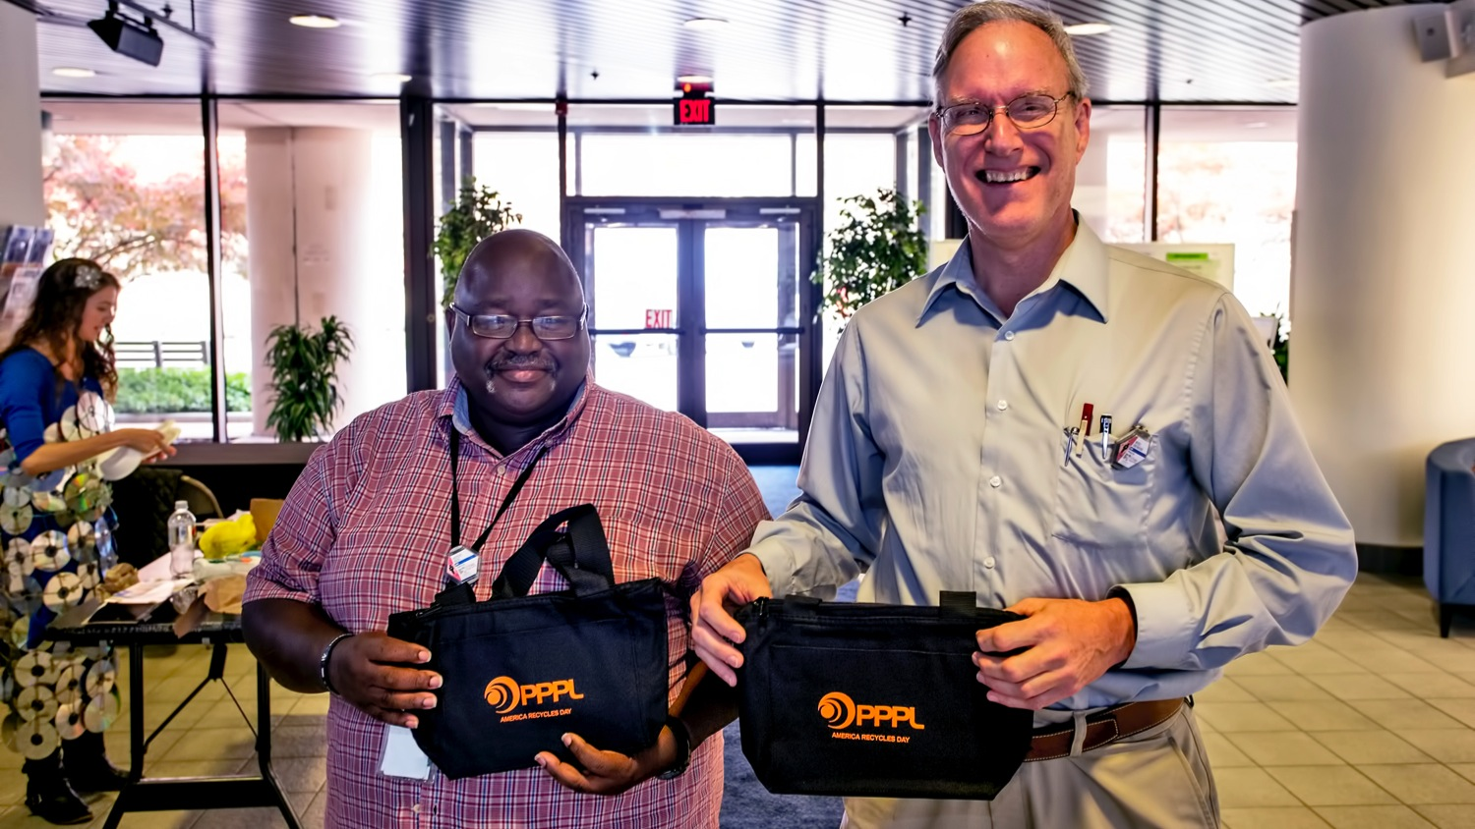
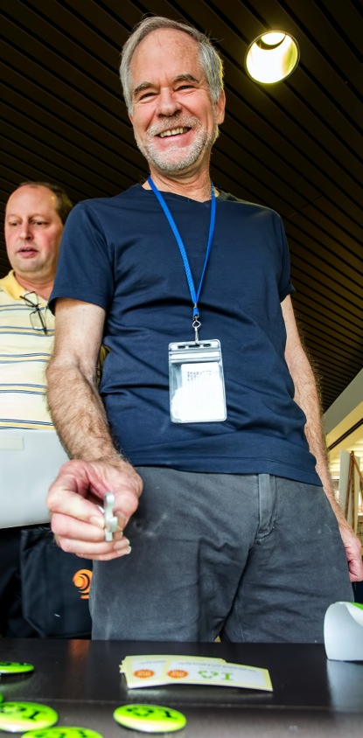
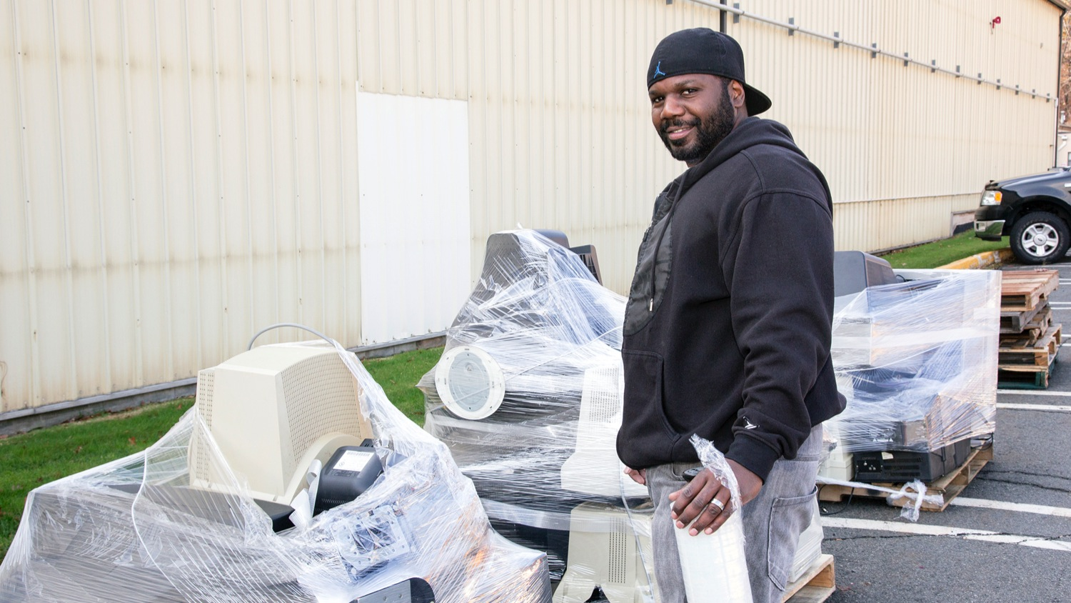
AMERICA RECYCLES DAY FESTIVITIES AT PPPL

Slide 8

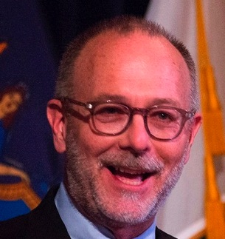
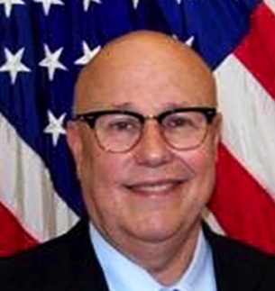
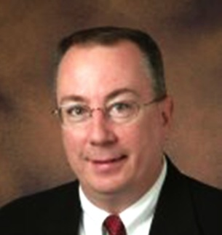
Welcome DOE Communicators
JOHN CARTER
Director of Communications Brookhaven Site Office
BRIAN QUIRKE
Director of Communications Chicago Field Office
RICK BORCHELT
Director of Communications and Public Affairs
DOE Office of Science

Slide 9

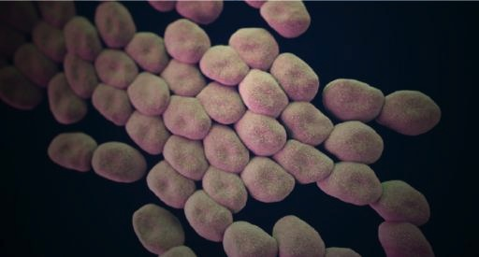
Antibiotic Resistance: A Global Challenge
Ramanan Laxminarayan – Princeton University – Princeton Environmental Institute
WEDNESDAY, NOVEMBER 19
4:15 p.m. • M.B.G. Auditorium

Slide 10


PPPL is once again taking part in the Princeton University United Way campaign to raise money for the United Way of Mercer County. The campaign kicks off when PPPL hosts a speaker from the United Way on Nov. 19 at 10:30 a.m. in the MBG Auditorium. Light refreshments will be served. A bake sale fundraiser is also planned for later this year.

Slide 11

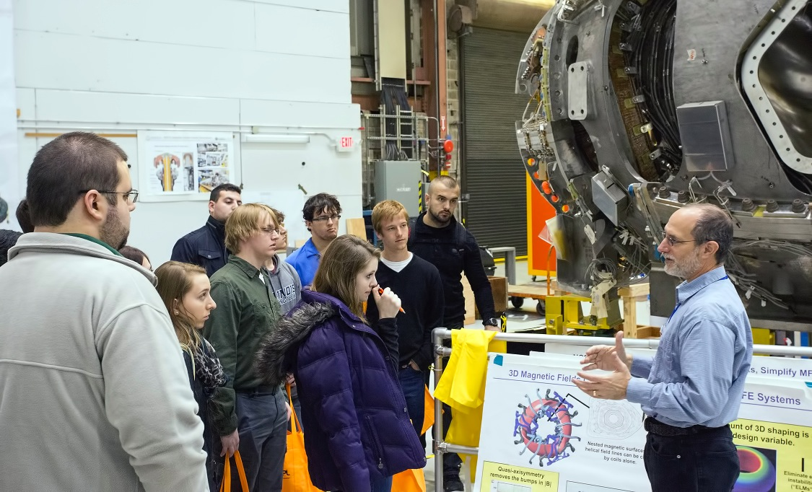
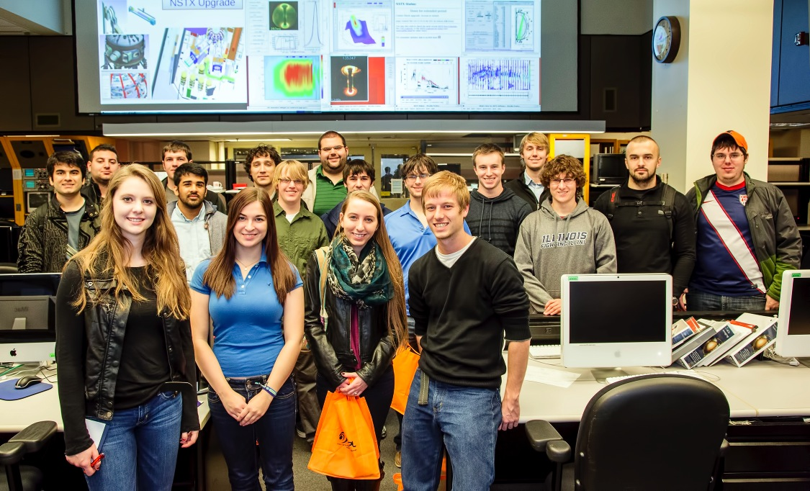
UNIVERSITY OF ILLINOIS STUDENTS VISIT PPPL

Slide 12


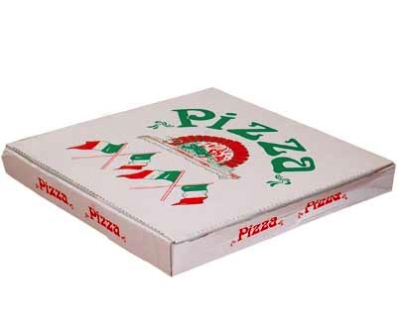

trivia
Which of the following items
CANNOT be recycled?
a) Cans and Bottles
b) Newspapers
c) Pizza Boxes
PIZZA BOXES SHOULD BE COMPOSTED
d) Yogurt Containers

Slide 13
