Slide 1
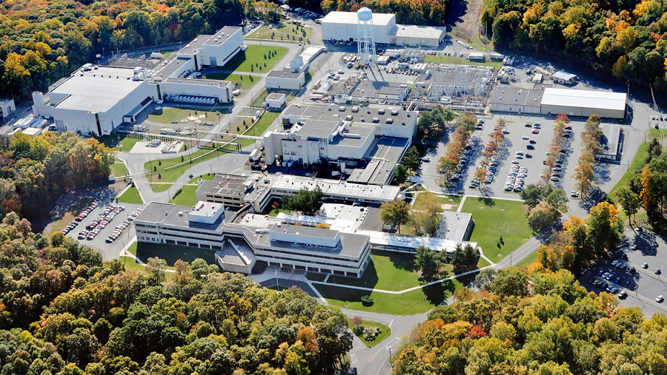
This Week @ PPPL
November 18 - 22, 2013
From the PPPL Office of Communications

Slide 2
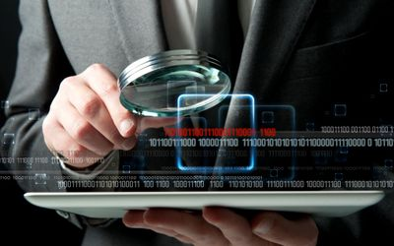

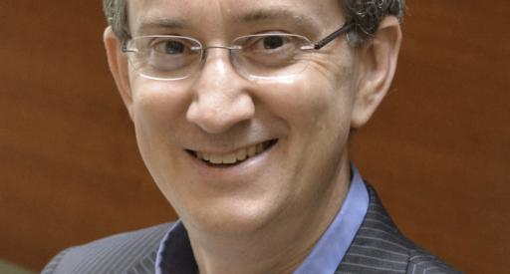
Cybersnooping: Collection and Analysis of Metadata & Content
Edward Felten
Princeton University
WEDNESDAY, NOVEMBER 20
4:15 p.m. (Coffee/Tea at 4 p.m.) • M.B.G. Auditorium

Slide 3


UPCOMING EVENTS
Wednesday, November 20
  PPPL Colloquium • 4:15 p.m. - MBG Auditorium – “Cybersnooping: Collection and Analysis of Metadata & Content”
Thursday, November 21
  United Way Bake Sale – 8 a.m. – LSB Lobby; United Way Presentation – 10 a.m. – MBG Auditorium
Friday, November 22
  Noon - Adam Cohen Lecture on PPPL at Princeton University – Princeton Deconstructed Fall Series
Friday, November 22
  Open Enrollment Ends
Thursday - Friday, November 28 - 29
  Lab Closed – Happy Thanksgiving!
Wednesday, December 4
  PPPL Colloquium • 4:15 p.m. - MBG Auditorium – “Observing the Deep Sea Globally”
Wednesday, December 11
  PPPL Colloquium • 4:15 p.m. - MBG Auditorium – “DIII-D Explorations of Fusion Science to Prepare for ITER and FNSF”

Slide 4


PPPL WELCOMES
Jorge Cham
creator of PhD Comics

Slide 5
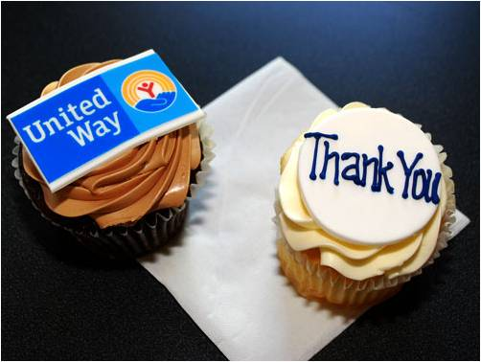

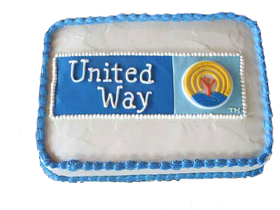
UNITED WAY BAKE SALE – THURSDAY, NOV. 21 – 8 a.m.
^{Baked goods available for $1.}
Please volunteer by bringing in home-baked goodies for the sale.
Contact Kim Mastromarino (kmastrom@pppl.gov).
Last week’s United Way Bake Sale raised $260! Thank you so much to those who volunteered and donated a baked item and also to those who purchased them!

Slide 6


Slide 7


Slide 8

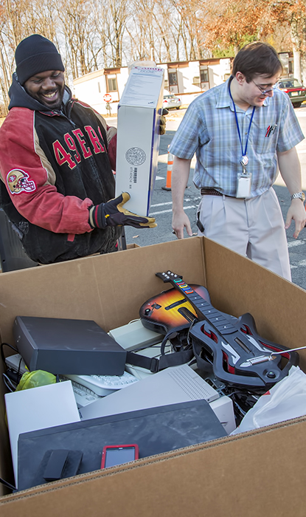
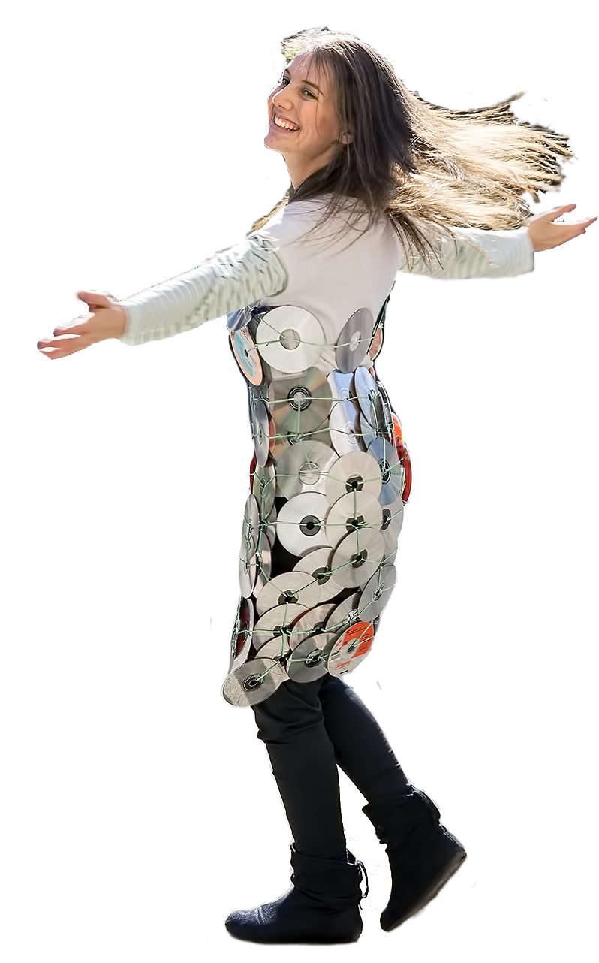
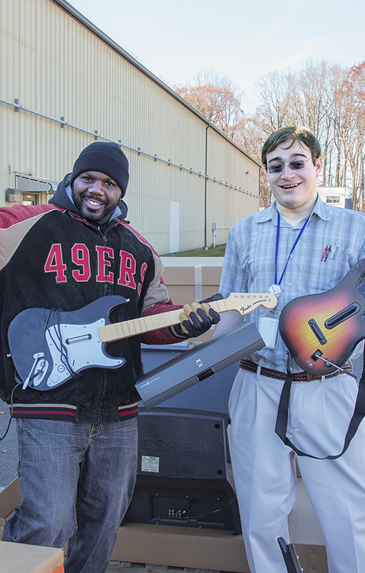
AMERICA RECYCLES DAY AT PPPL

Slide 9
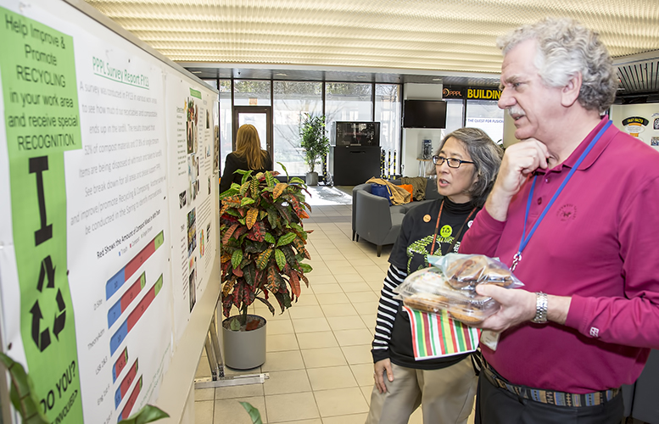
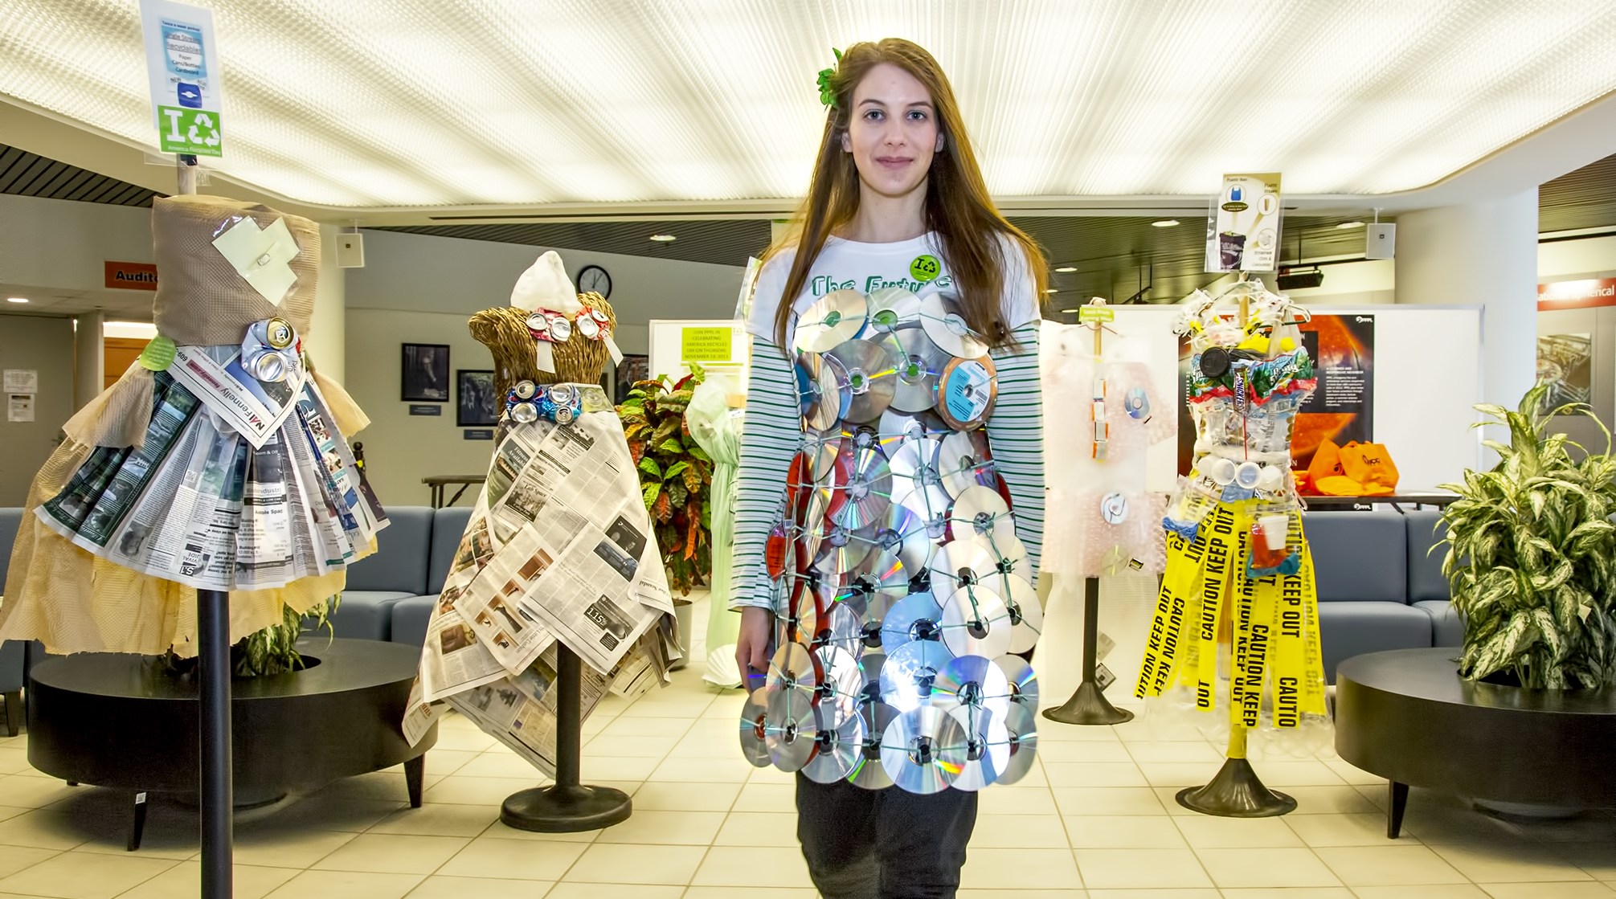
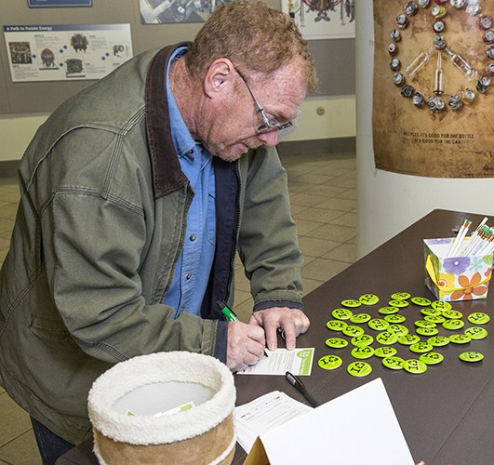
AMERICA RECYCLES DAY AT PPPL

Slide 10


Slide 11
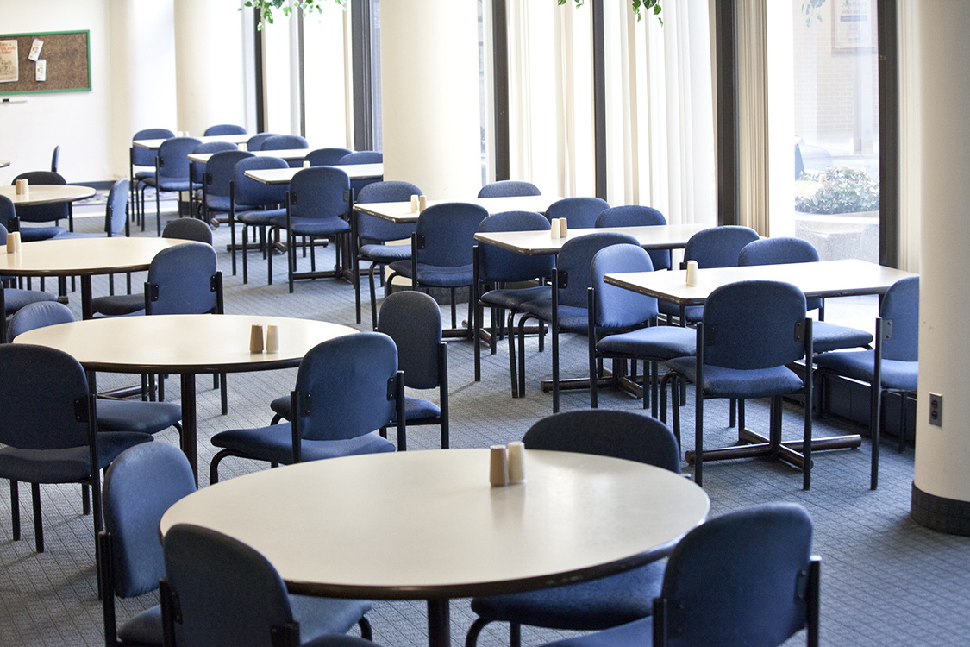
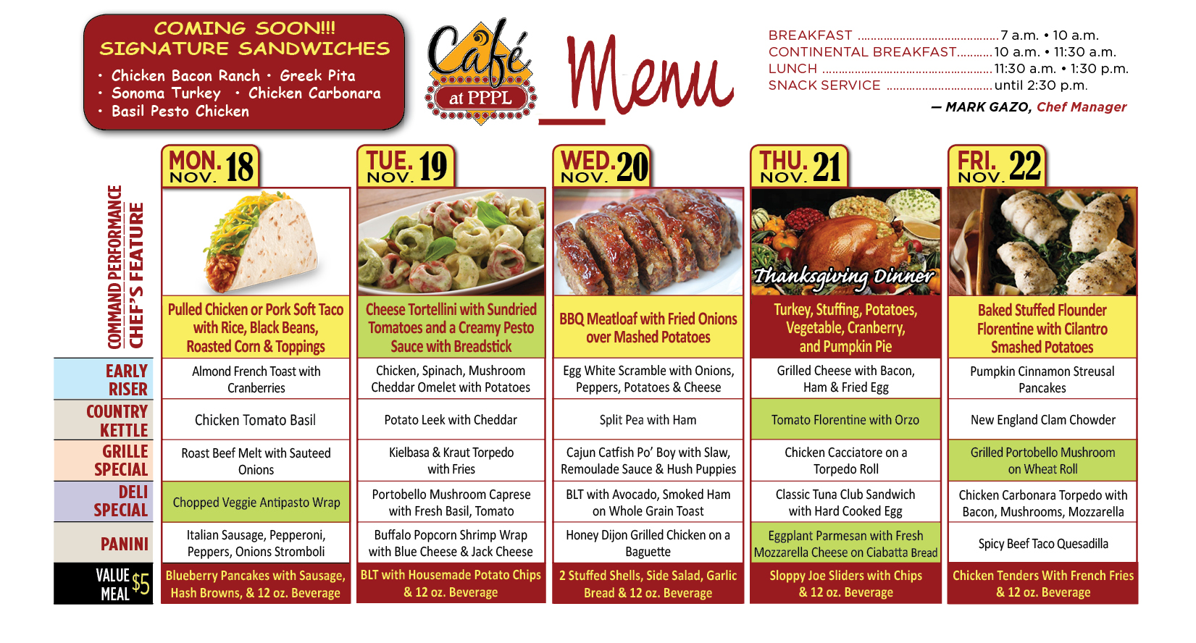
Menu subject to change without notice.

