Slide 1
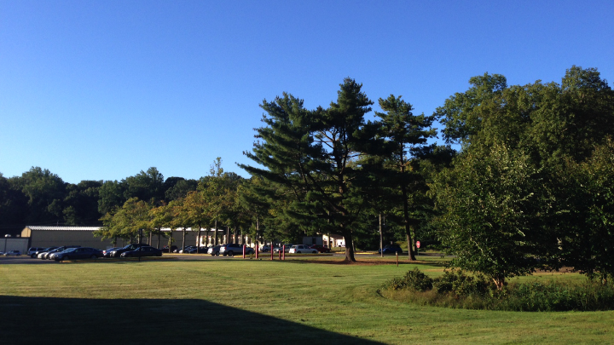
This Week @ PPPL
December 1 - 5, 2014
Brought to you by the PPPL Office of Communications

Slide 2
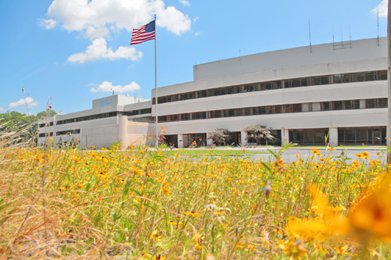


UPCOMING EVENTS
  Wednesday, Dec. 17
  PPPL COLLOQUIUM – Challenges of LTS & HTS Wire/Tape R&D & Manufacturing
  Wednesday, Dec. 23
  PPPL HOLIDAY LUNCHEON – Noon – LSB Lobby and Cafeteria
  Thu., Dec. 24 – Fri., Jan. 2, 2015
  LAB CLOSED – Happy Holidays
  Wednesday, Jan. 15, 2015
  PPPL’S RECORDS PAPER SHREDDING EVENT

Slide 4


Deadline is December 1

Slide 5

SAVE THE DATE
RECORDS/PAPER SHREDDING EVENT
When:
January 14, 2015 (9 a.m. – 4 p.m.)
Where:
Warehouse, PPPL Receiving Area #3
Restrictions:
Only PPPL departmental business-related records and documents will be shredded!

Slide 6


HOLIDAY
DINNER DANCE PARTY
Saturday, Dec. 20
6 – 10 p.m.
The Stone Terrace by John Henry’s
Hamilton, NJ
Dinner • Dancing • DJ Music • Fun
PAYMENTS DUE DEC. 5 TO ROSEMARIE FUCHS, MARIANNE TYRRELL OR DANA ECKSTEIN.
This event is not sponsored by PPPL

Slide 7


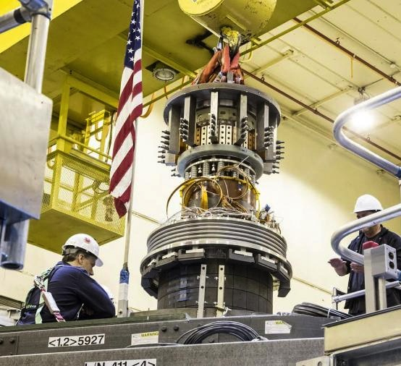
trivia
How much does the NSTX-U Center Stack weigh?
a) 15,000 pounds
b) 29,000 pounds
c) 39,000 pounds
d) 10,000 pounds
29,000 pounds

Slide 8
