Slide 1
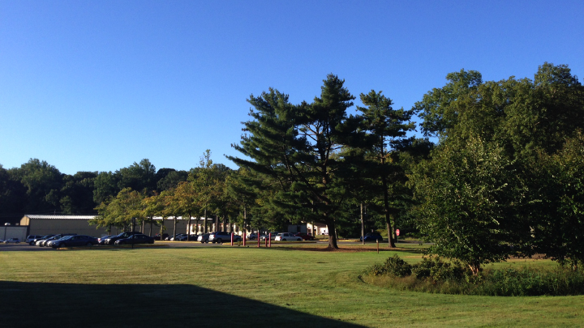
This Week @ PPPL
December 2-6, 2013
From the PPPL Office of Communications

Slide 2
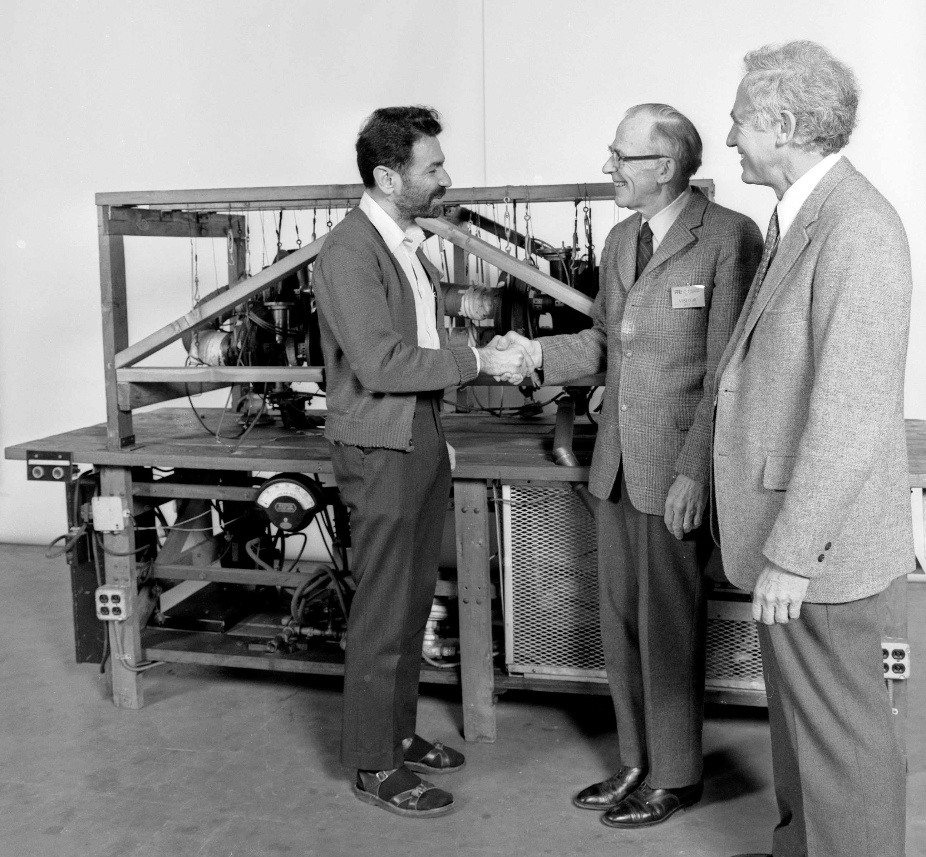

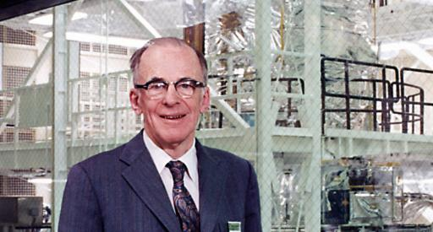
Spitzer’s 100th:
Founding PPPL & Pioneering Work in Fusion Energy
Greg Hammett, Russell Kulsrud
Princeton University
WEDNESDAY, DEC. 4
4:15 p.m. (Coffee/Tea at 4 p.m.) • M.B.G. Auditorium

Slide 3
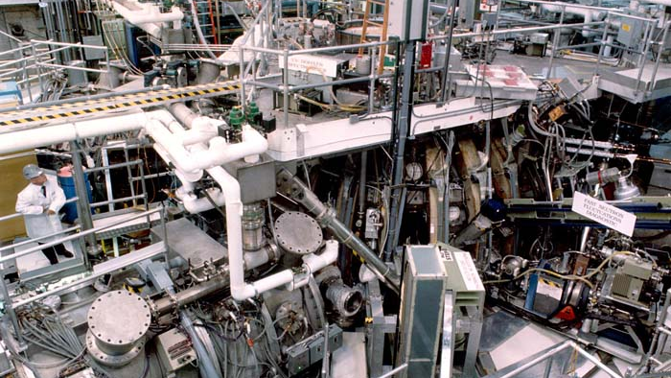
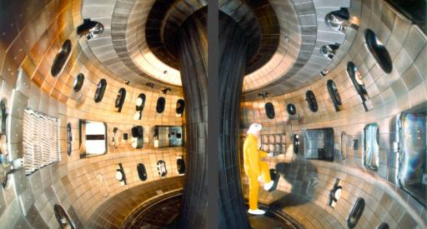
DIII-D Explorations of Fusion Science to Prepare for ITER and FNSF
Richard Buttery
Geberal Atomics, DIII-D
NEXT WEEK - TUESDAY, DEC. 10
11 a.m. (Coffee/Tea at 10:45 a.m.) • M.B.G. Auditorium
PLEASE NOTE DATE AND TIME CHANGE • PLEASE NOTE DATE AND TIME CHANGE

Slide 4
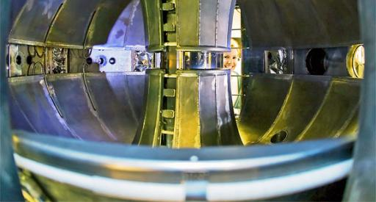
Lithium Tokamak Experiment (LTX)
Richard Majeski
Princeton University
WEDNESDAY, DEC. 18
4:15 p.m. (Coffee/Tea at 4 p.m.) • M.B.G. Auditorium

Slide 5


UPCOMING EVENTS
Wednesday, December 11
  PPPL Colloquium • 4:15 p.m. - MBG Auditorium – “DIII-D Explorations of Fusion Science to Prepare for ITER and FNSF”
Wednesday, December 18
  PPPL Colloquium • 4:15 p.m. - MBG Auditorium – “Lithium Tokamak Experiment (LTX)”
Friday, December 20
  PPPL Holiday Luncheon • Noon – LSB Lobby and Café
Mon., Dec. 23, 2013 to Wed., Jan. 1, 2014
  Lab Closed – Happy Holidays!
Saturday, January 11
  Science on Saturday Lecture Series begins.

Slide 6

Thank you to all PPPL’ers who have contributed $19,937.37
to the
United Way
as of Nov. 25

Slide 7
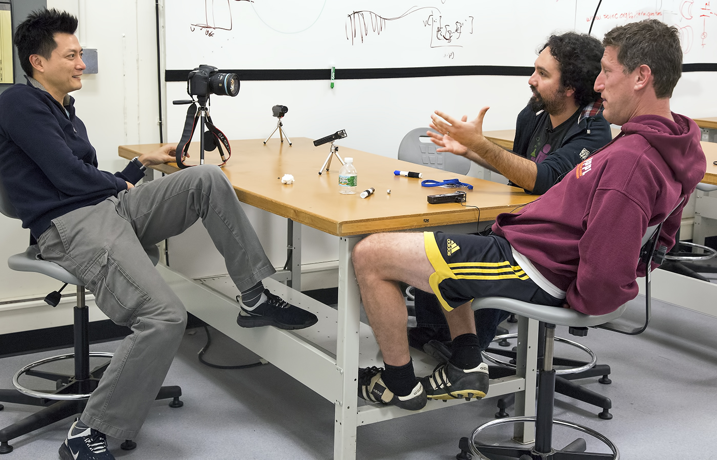
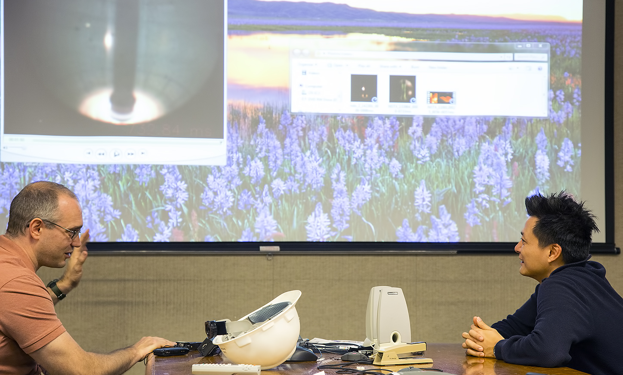
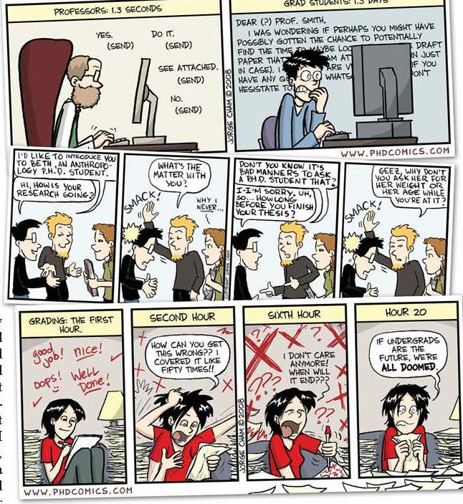
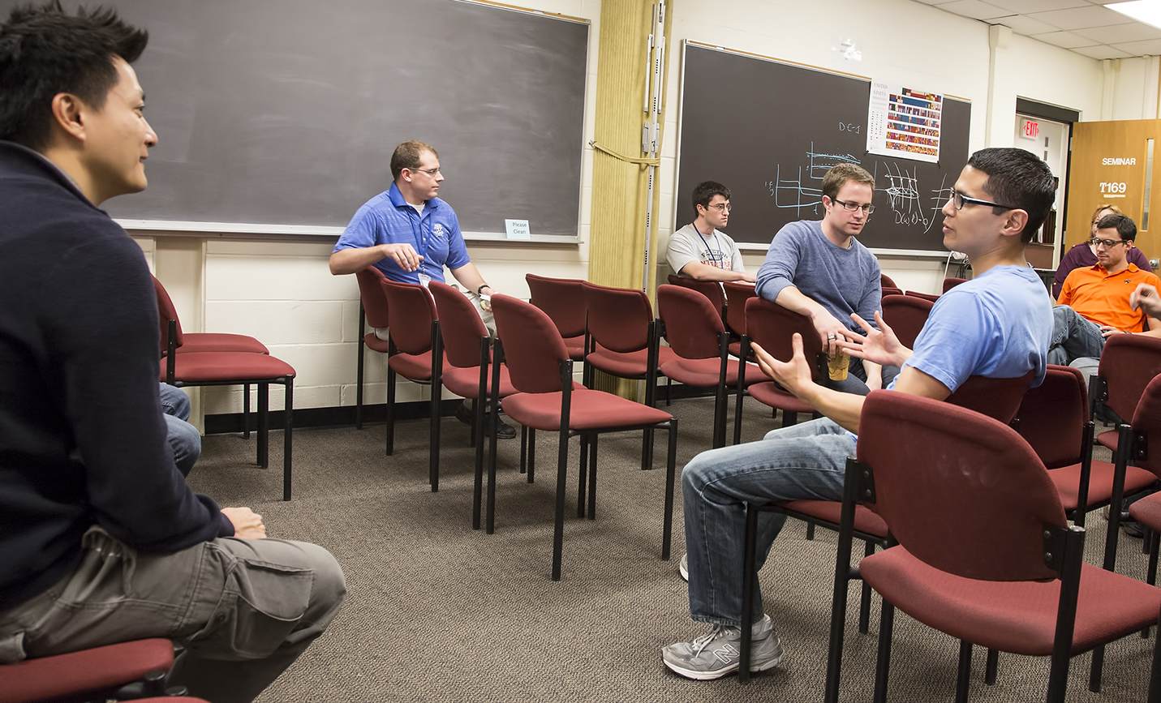
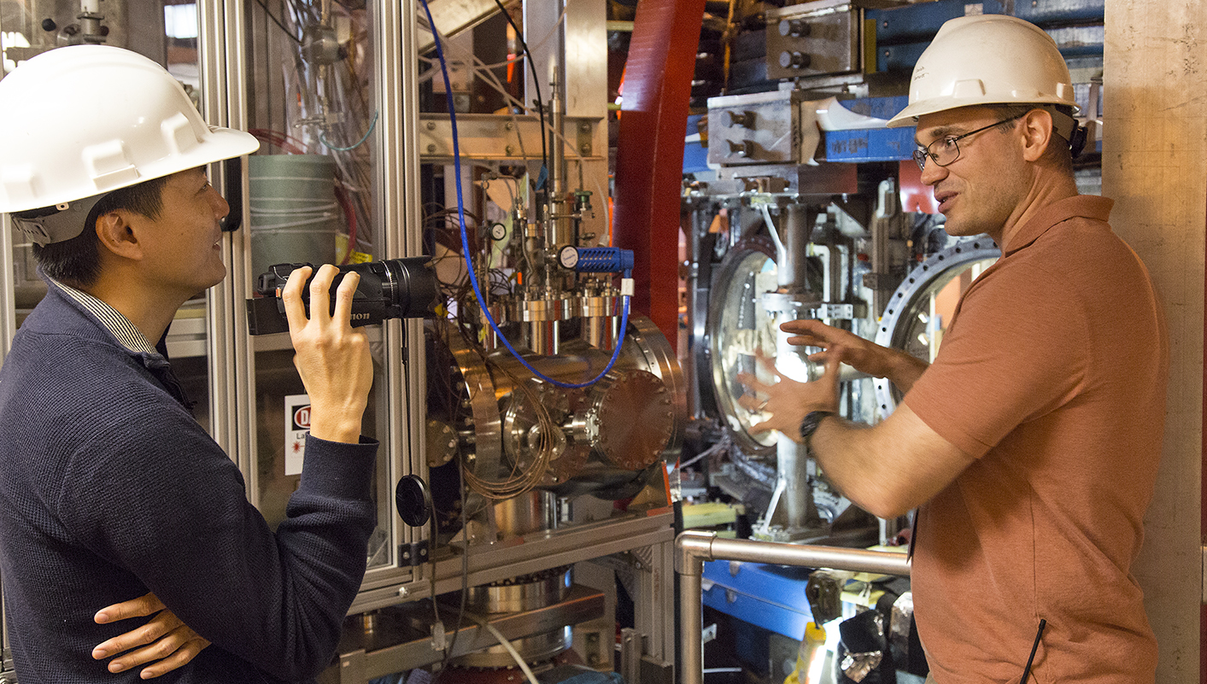
Jorge Cham, creator of PhD Comics, visits PPPL

Slide 8
WELCOME
Princeton University
SPIN GROUP
Friday, Dec. 6

Slide 9
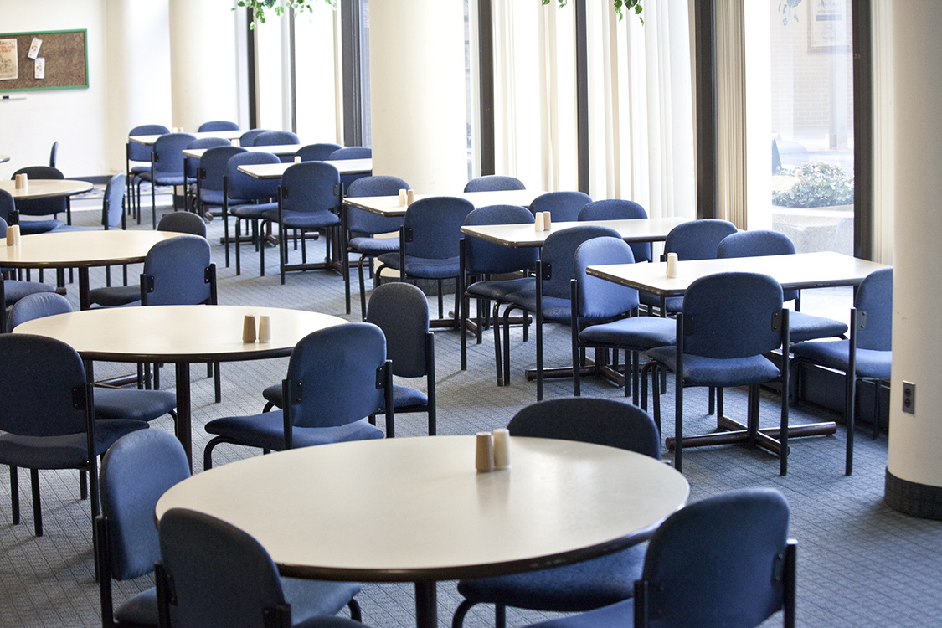

Menu subject to change without notice.

