Slide 1
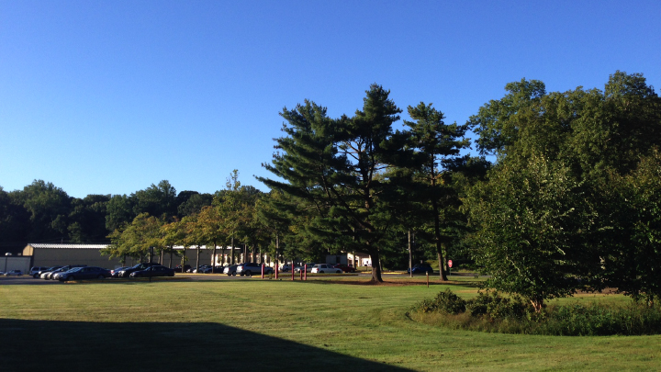
This Week @ PPPL
December 8 - 13, 2014
Brought to you by the PPPL Office of Communications

Slide 2

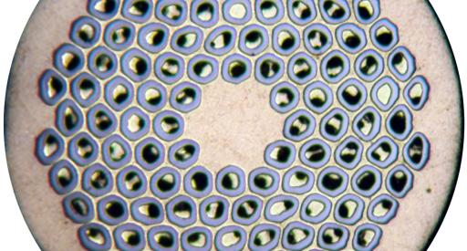
Industrialization of Nb₃Sn Conductor
Jeffrey Parrell – Oxford Instruments Superconductivity Technology
WEDNESDAY, DECEMBER 17
4:15 p.m. • M.B.G. Auditorium

Slide 3

UPCOMING EVENTS
  Wednesday, Dec. 17
  PPPL COLLOQUIUM – Industrialization of Nb₃Sn conductor
  Wednesday, Dec. 23
  PPPL HOLIDAY LUNCHEON – Noon – LSB Lobby and Cafeteria
  Thu., Dec. 24 – Fri., Jan. 2, 2015
  LAB CLOSED – Happy Holidays
  Saturday, Jan. 10, 2015
  RONALD D. HATCHER SCIENCE ON SATURDAY LECTURE SERIES – Consciousness and the Social Brain – Michael Graziano, Princeton University
  Wednesday, Jan. 15, 2015
  PPPL’S RECORDS PAPER SHREDDING EVENT - Warehouse, Receiving #3

Slide 5

SAVE THE DATE
RECORDS/PAPER SHREDDING EVENT
When:
January 14, 2015 (9 a.m. – 4 p.m.)
Where:
Warehouse, PPPL Receiving Area #3
Restrictions:
Only PPPL departmental business-related records and documents will be shredded!

Slide 6

Welcome New PPPL Employees…

Slide 7
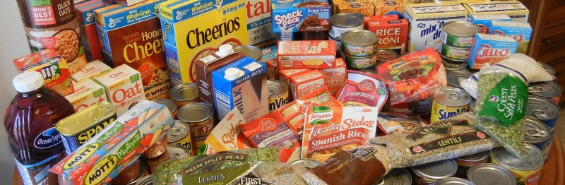
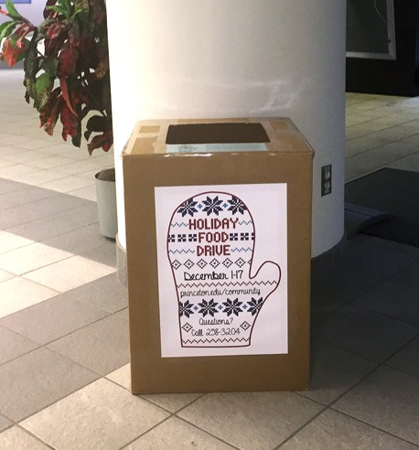
Donate food to feed the hungry
PPPL is collecting food and personal hygiene items for The Mercer Street Friends Food Bank through Dec. 17 as part of a University-wide effort. The food bank distributes food to hungry people in the greater Mercer County area through nearly 50 pantries, shelters, and soup kitchens. A collection box is located in the LSB lobby.

Slide 8


HOLIDAY
DINNER DANCE PARTY
Saturday, Dec. 20
6 – 10 p.m.
The Stone Terrace by John Henry’s
Hamilton, NJ
Dinner • Dancing • DJ Music • Fun
This event is not sponsored by PPPL

Slide 9
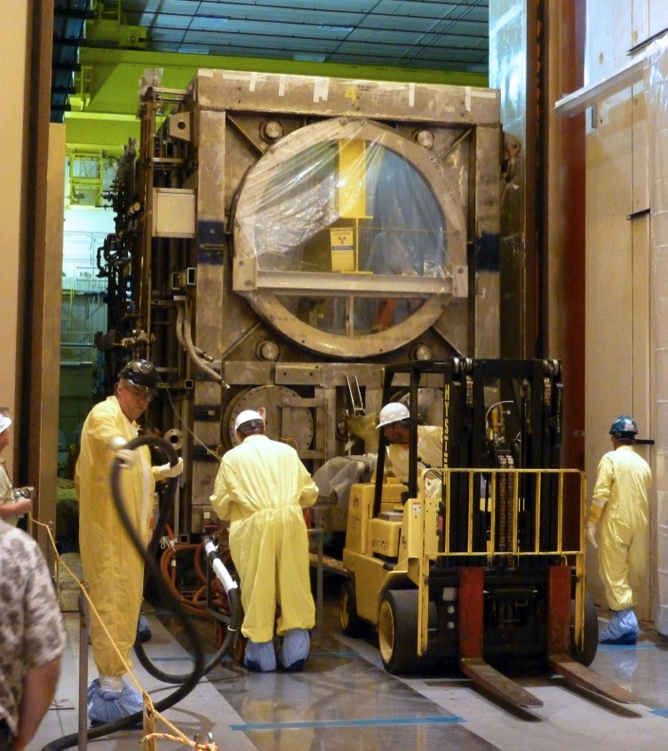
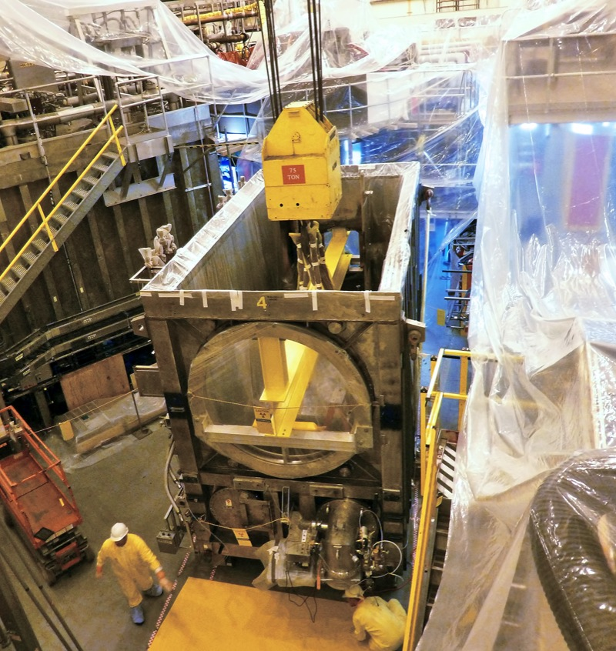
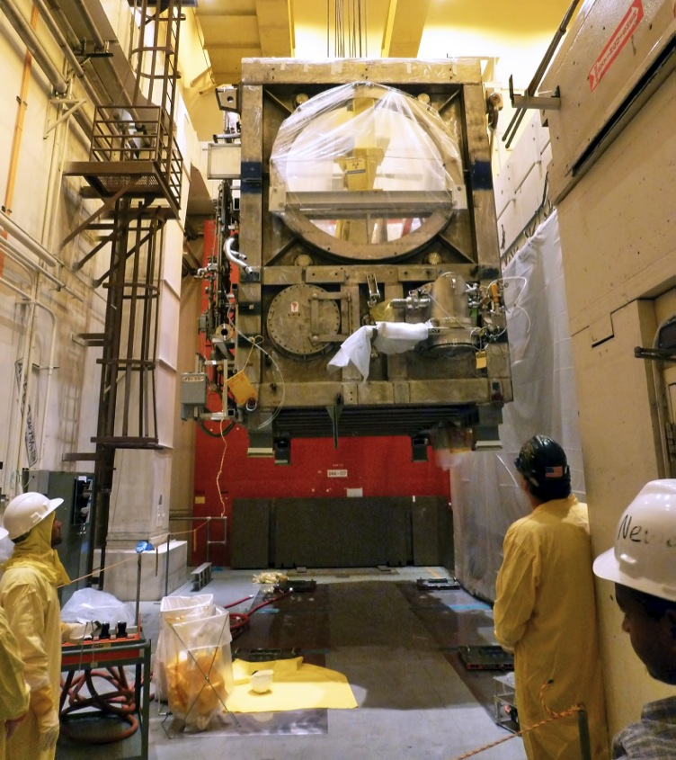
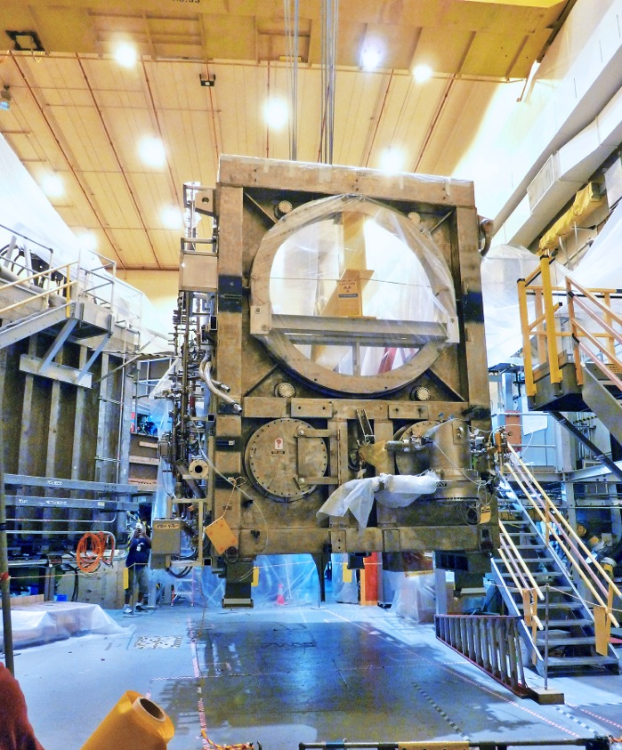
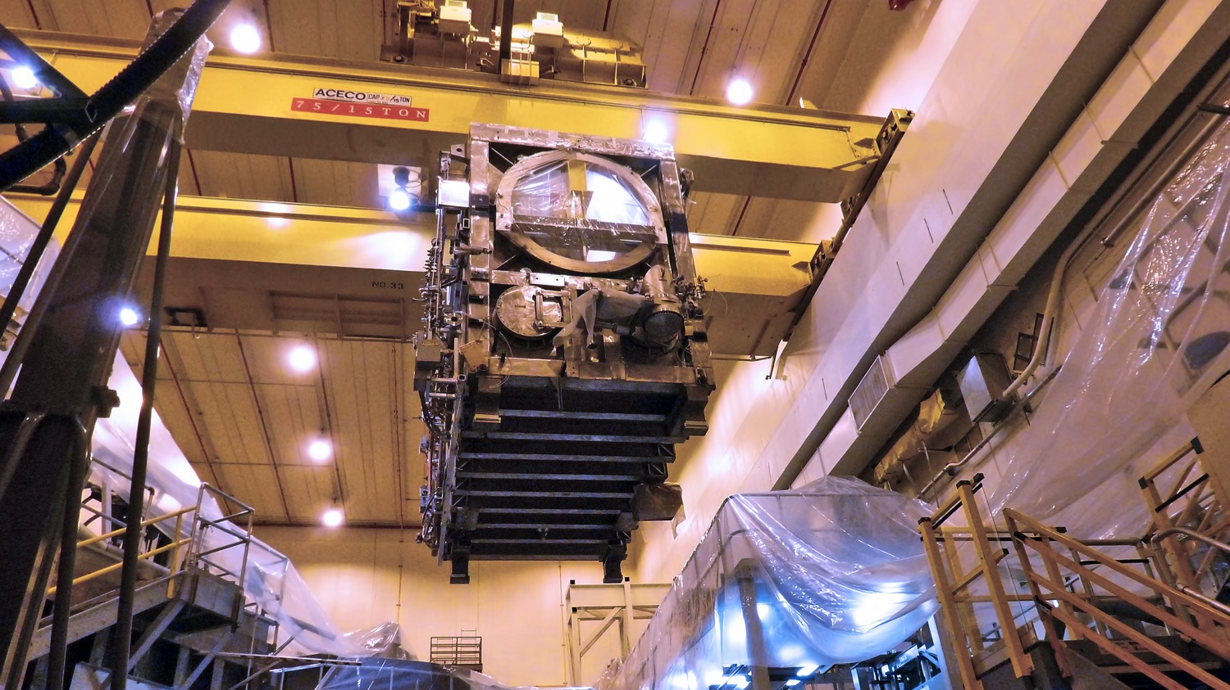
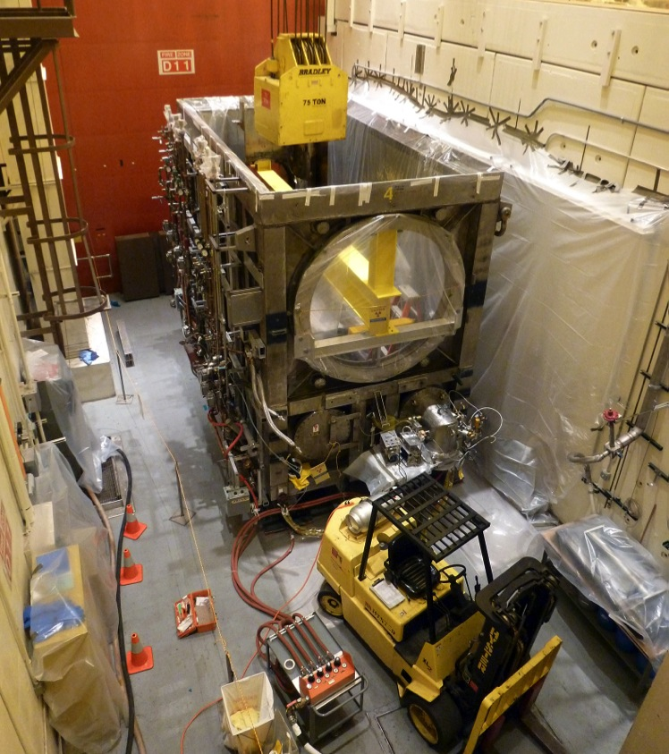
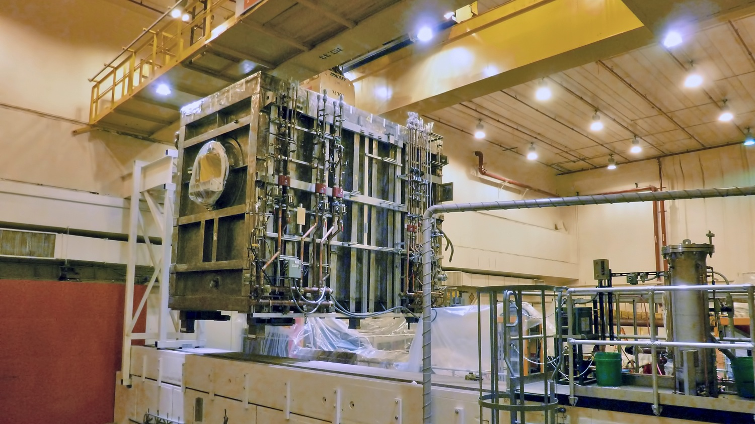
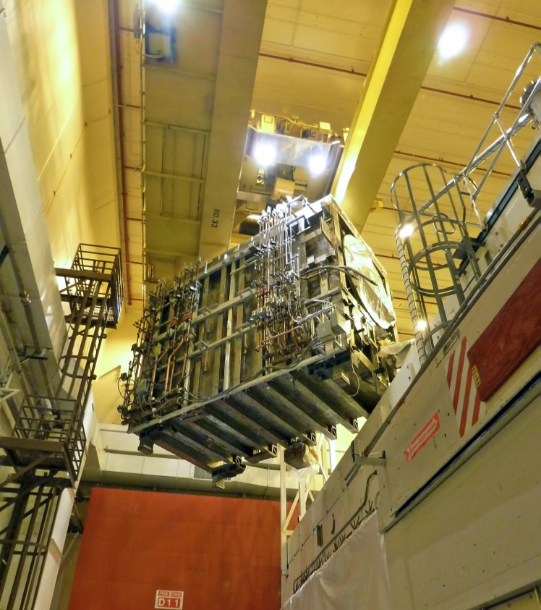
Neutral Beam Lift on NSTX-U. Photos by Mike Viola and Scott Gifford.

Slide 10
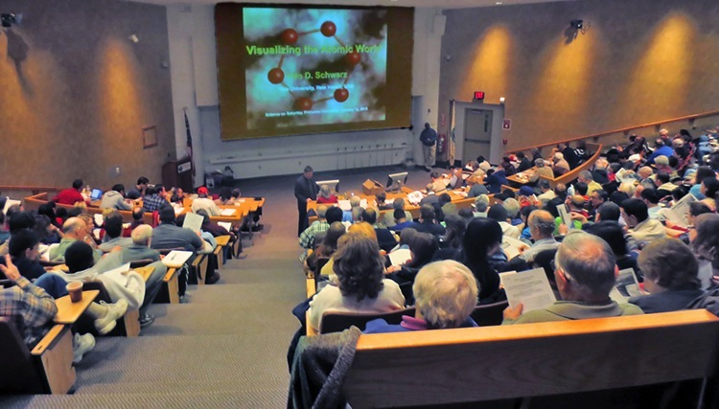

Consciousness and the Social Brain
Michael Graziano
Associate Professor of Psychology
Princeton University
Saturday, January 10, 2015
9:30 a.m. – MBG Auditorium

Slide 11
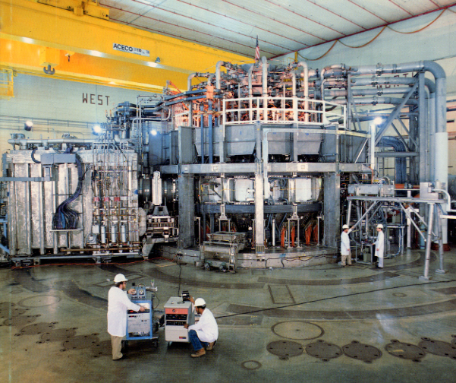


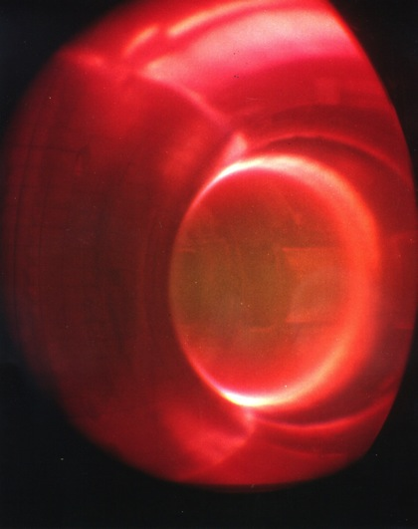
trivia
What was the highest ion temperature in the core of the TFTR DT plasma?
a) 38 million °C
b) 200 million °C
c) 350 million °C
d) 520 million °C
520 million °C

Slide 12

Please contribute to United Way by Dec. 14
Please help numerous charitable organizations in the Mercer County area by contributing to United Way Mercer County. Employees can make contributions by cash or check or through payroll deductions through Dec. 14. Princeton University will contribute an additional 15 percent for all gifts through payroll deductions or 10 percent for all gifts by cash or check.

Slide 13
