Slide 1
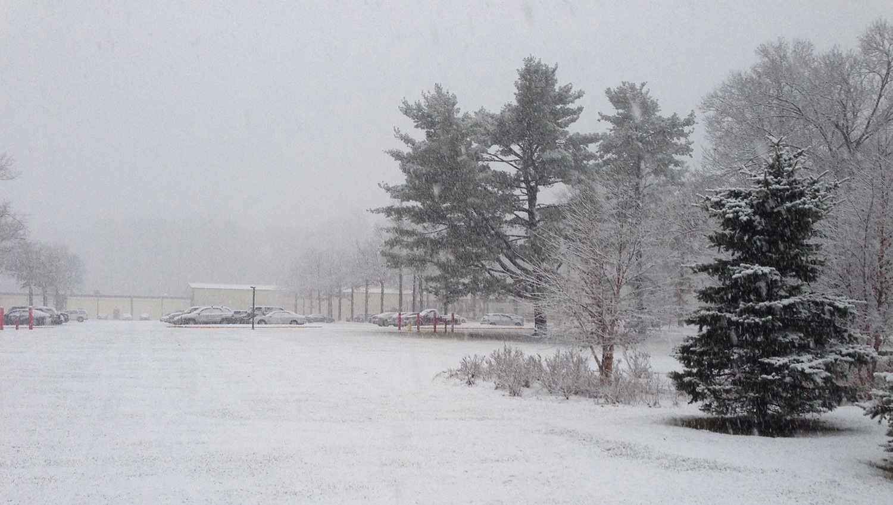
This Week @ PPPL
December 15 - 20, 2014
Brought to you by the PPPL Office of Communications

Slide 2

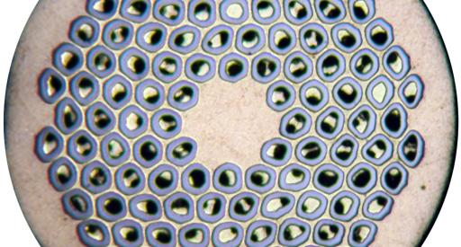
Industrialization of Nb₃Sn Conductor
Jeffrey Parrell – Oxford Instruments Superconductivity Technology
WEDNESDAY, DECEMBER 17
4:15 p.m. • M.B.G. Auditorium

Slide 3
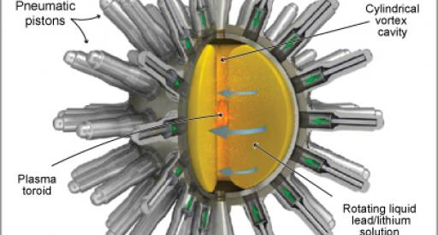
Magnetized Target Fusion Work at General Fusion
Michel Laberge – General Fusion
THURSDAY, DECEMBER 18
NOTE SPECIAL TIME — 12:30 p.m. • M.B.G. Auditorium — NOTE SPECIAL TIME

Slide 4

UPCOMING EVENTS
  Wednesday, Dec. 17
  PPPL COLLOQUIUM – Industrialization of Nb₃Sn Conductor
  Thursday, Dec. 18
  PPPL COLLOQUIUM – Magnetized Target Fusion Work at General Fusion • 12:30 p.m.
  Tuesday, Dec. 23
  PPPL HOLIDAY LUNCHEON – Noon – LSB Lobby and Cafeteria
  Wed., Dec. 24 – Fri., Jan. 2, 2015
  LAB CLOSED – Happy Holidays
  Saturday, Jan. 10, 2015
  RONALD E. HATCHER SCIENCE ON SATURDAY LECTURE SERIES – Consciousness and the Social Brain – Michael Graziano, Princeton University
  Wednesday, Jan. 14, 2015
  PPPL’S RECORDS PAPER SHREDDING EVENT - Warehouse, Receiving #3

Slide 5

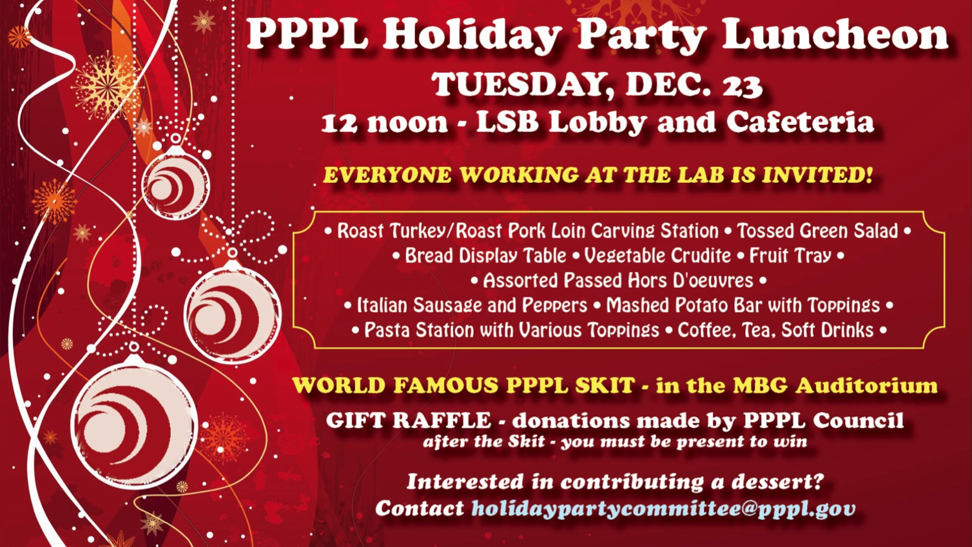

Slide 6

SAVE THE DATE
RECORDS/PAPER SHREDDING EVENT
When:
January 14, 2015 (9 a.m. – 4 p.m.)
Where:
Warehouse, PPPL Receiving Area #3
Restrictions:
Only PPPL departmental business-related records and documents will be shredded!

Slide 7
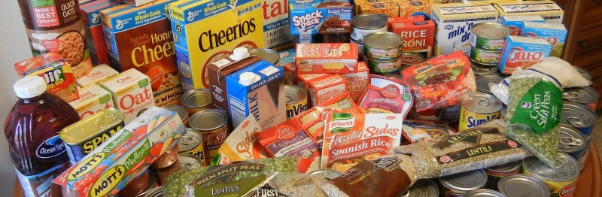
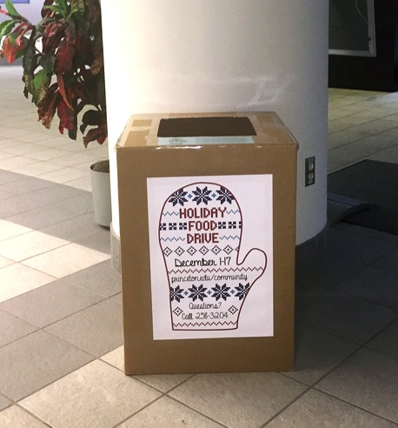
Donate food to feed the hungry
PPPL is collecting food and personal hygiene items for The Mercer Street Friends Food Bank through Dec. 17 as part of a University-wide effort. The food bank distributes food to hungry people in the greater Mercer County area through nearly 50 pantries, shelters, and soup kitchens. A collection box is located in the LSB lobby.

Slide 8
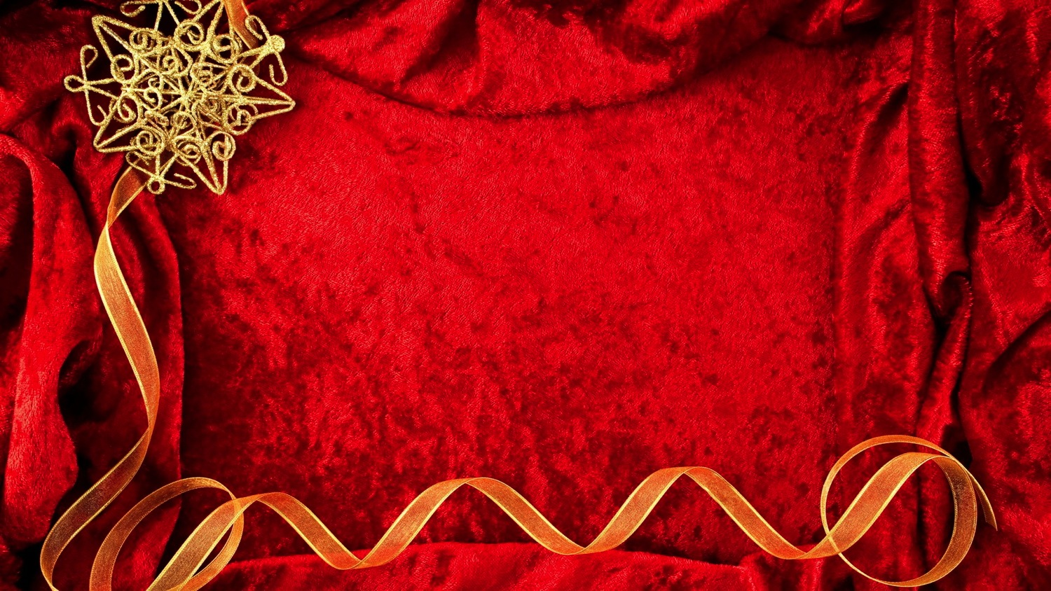

HOLIDAY
DINNER DANCE PARTY
Saturday, Dec. 20
6 – 10 p.m.
The Stone Terrace by John Henry’s
Hamilton, NJ
Dinner • Dancing • DJ Music • Fun
This event is not sponsored by PPPL

Slide 9
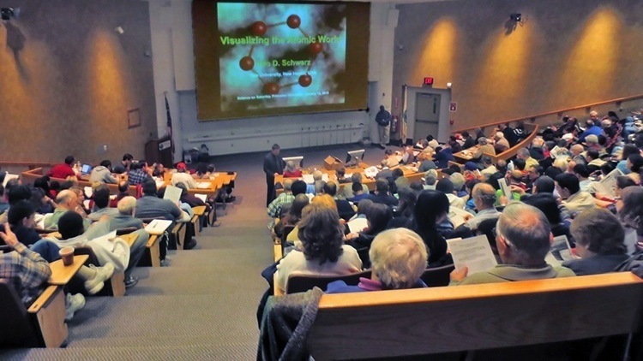

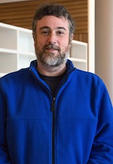
Consciousness and the Social Brain
Michael Graziano
Associate Professor of Psychology
Princeton University
Saturday, January 10, 2015
9:30 a.m. – MBG Auditorium

Slide 10
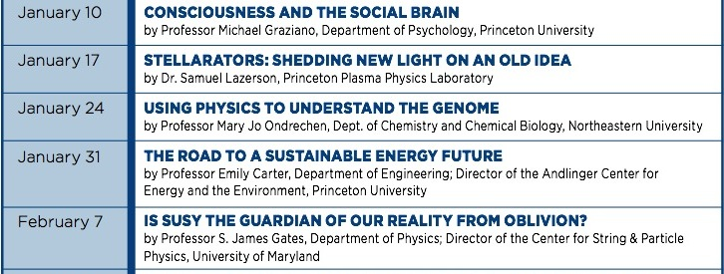

Slide 11

You can still contribute to United Way
Please help numerous charitable organizations in the Mercer County area by contributing to United Way Mercer County. Employees can make contributions by cash or check or through payroll deductions until the end of the year. Princeton University will contribute an additional 15% for all gifts through payroll deductions or 10% for all gifts by cash or check.

Slide 12
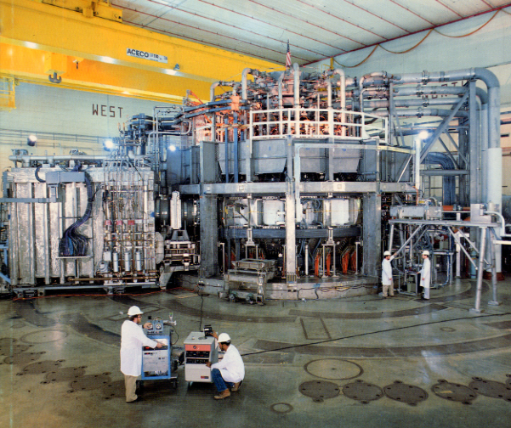


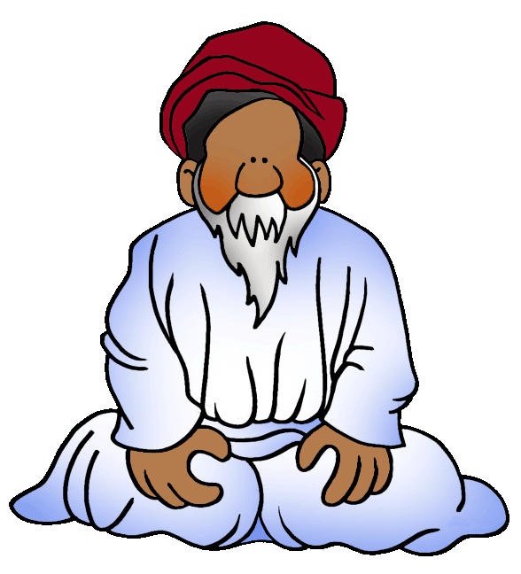
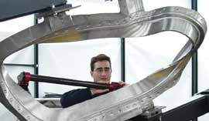
trivia
Who is PPPL’s guru of metrology?
a) Mike Williams
b) John Luckie
c) Mike Viola
d) Steve Raftopoulos

Slide 13
