Slide 1
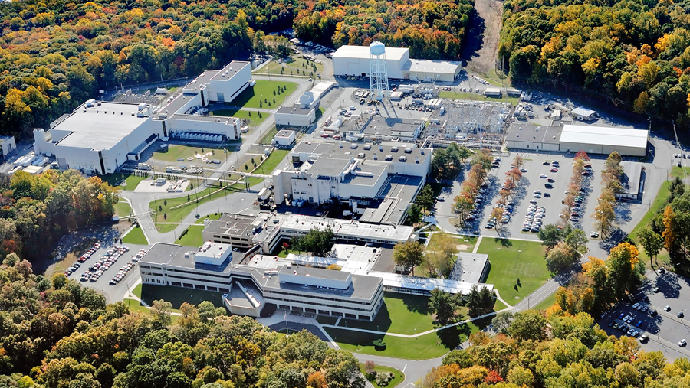
This Week @ PPPL
November 12 – 16, 2012
From the PPPL Office of Communications

Slide 2
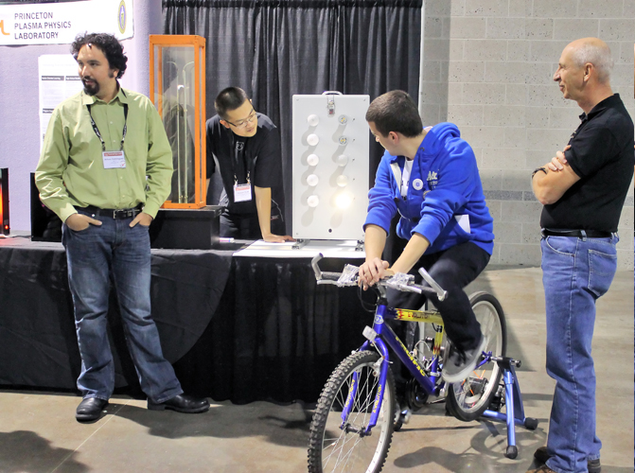
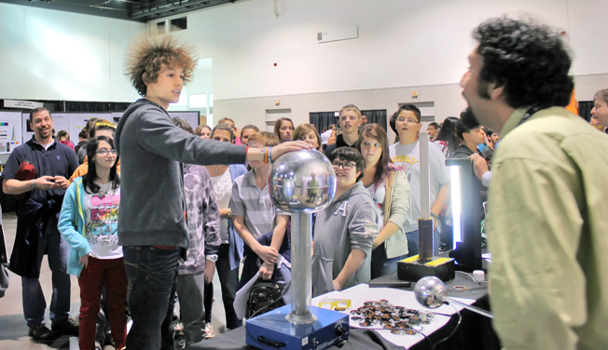
Plasma and energy demonstrations
given by PPPL Science Education staff and volunteers during the Plasma Science Expo at the American Physical Society’s Division of Plasma Physics Conference.

Slide 3
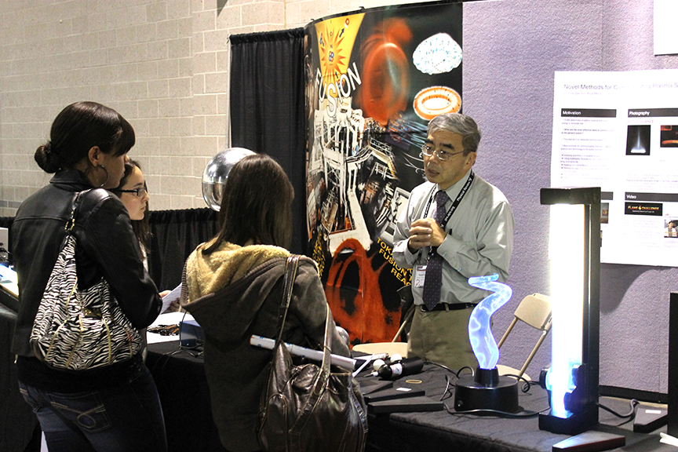
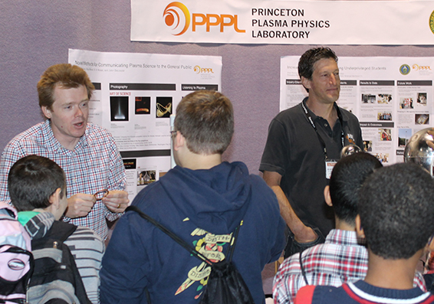
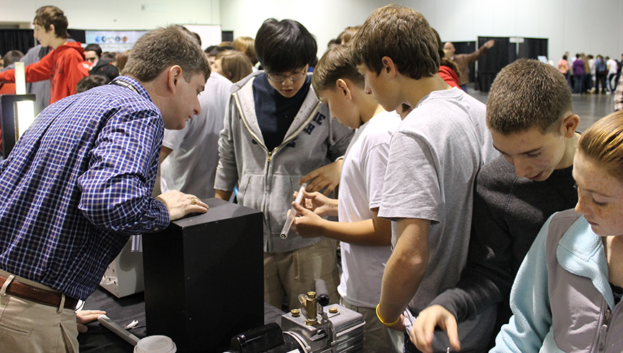
Plasma Science Expo at American Physical Society’s Division of Plasma Physics Conference.

Slide 4
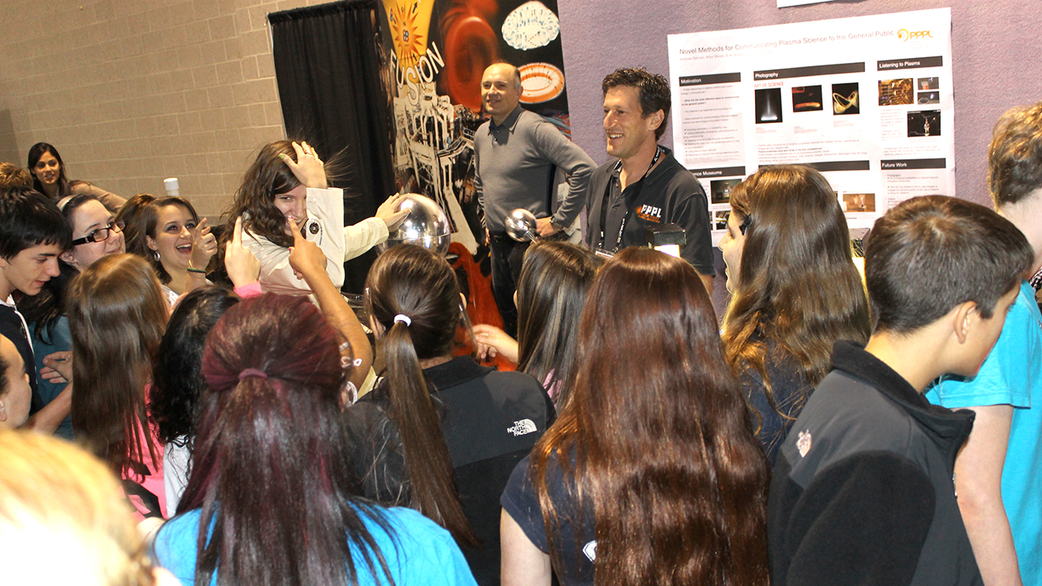
Plasma Science Expo at American Physical Society’s Division of Plasma Physics Conference.

Slide 5

Airborne Wind Energy - Harnessing
a Vast, Untapped Renewable Energy
Source
KENNETH JENSEN
MAKANI POWER INC.
WeDNESDAY, NOVEMBER 14
4:15 p.m. (Coffee/Tea at 4 p.m.) • M.B.G. Auditorium, Lyman Spitzer Building

Slide 6

Thursday, November 15
10:30 a.m. to 1:30 p.m. – LSB Lobby
Raffles • Giveaways • Recycling Information • Take a Pledge

Slide 7


YOU MAY BRING THE FOLLOWING ITEMS FROM HOME FOR RECYCLING ON NOVEMBER 15, 2012
ALL ELECTRONIC EQUIPMENT INCLUDING:
Electronic Gadgets:
Camera
Camcorder
MP3 Players
Gaming System (Handheld & TV Systems)
Calculators
Microscope
Telescopes
PDA’s
Household Equipment:
Televisions
DVR’s
Cable Boxes
Copiers/Printers/Faxes
Telephone System
Computer Equipment:
Laptops
Desktop Tower
Modems
Keyboard
Mouse
Monitors (CRT & LCD)
Printers
Computer Wires
Hard Drives
DVD/Tape
Circuit Boards Drivers
Any Questions Please Contact Matt Lawson at X2716 or Margaret King X3652
All items will be collected at the C Site Lower End Parking Lot, Warehouse Access Door Area from 7:30AM – 10AM, do not bring items to lobby.
Notes:
UNICOR Link/Poster

Slide 8

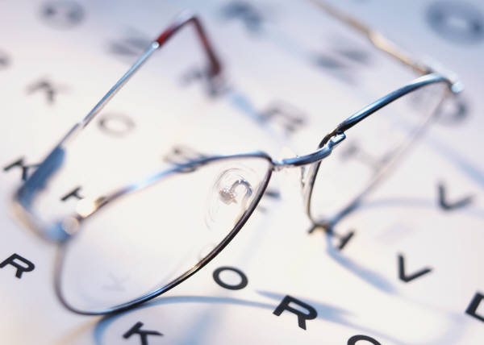
2013
OPEN ENROLLMENT
Extended to November 28th

Slide 9



Menu subject to change without notice.

