Slide 1
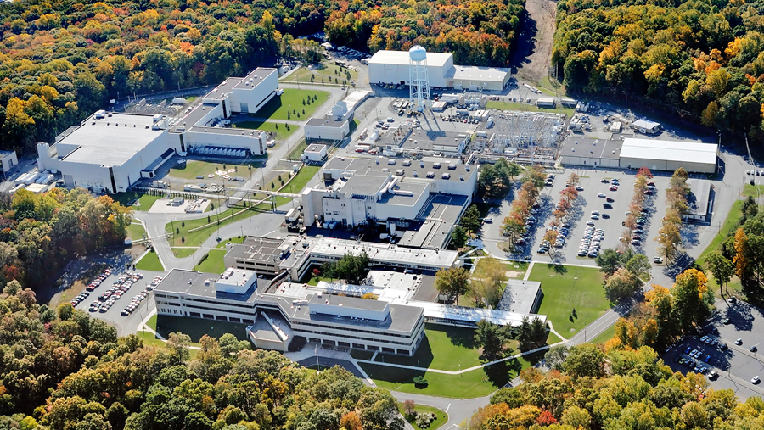
This Week @ PPPL
November 19 - 23, 2012
From the PPPL Office of Communications

Slide 2
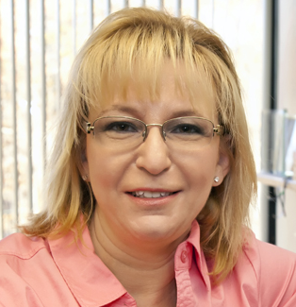
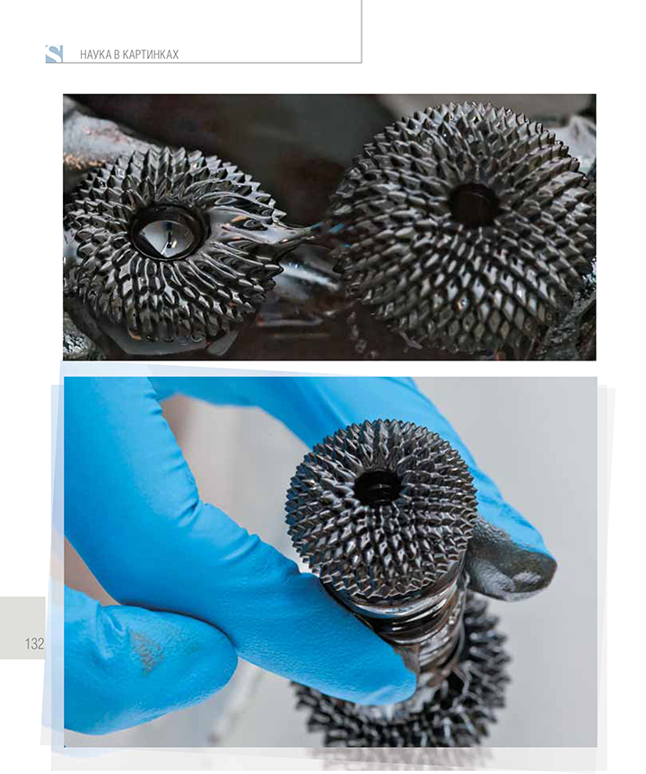
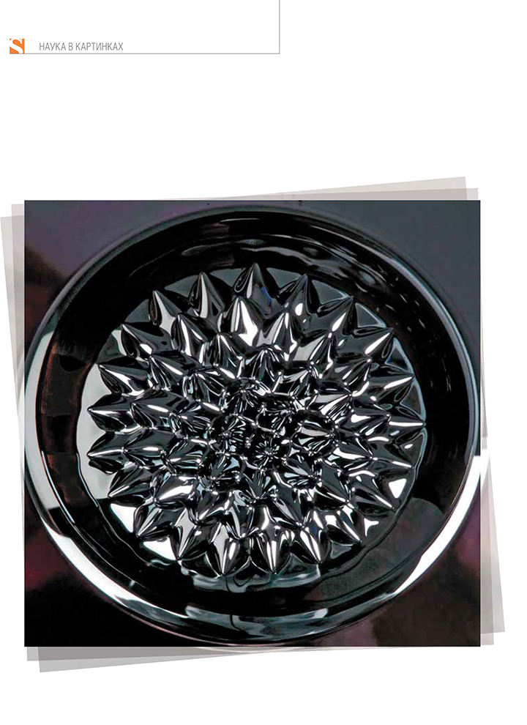
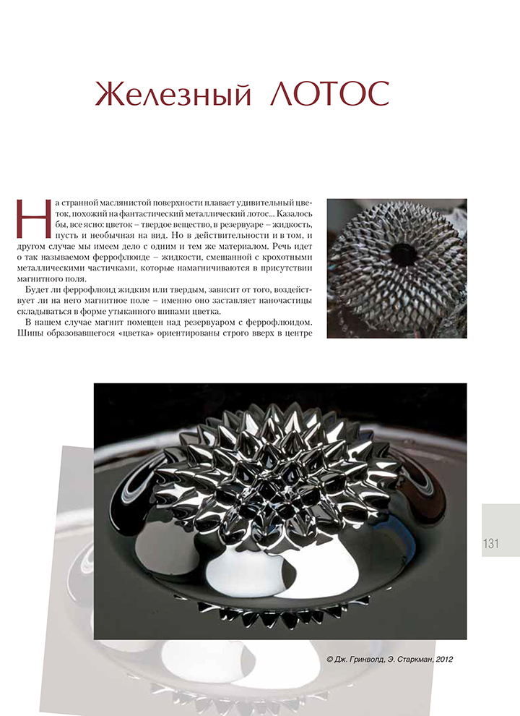
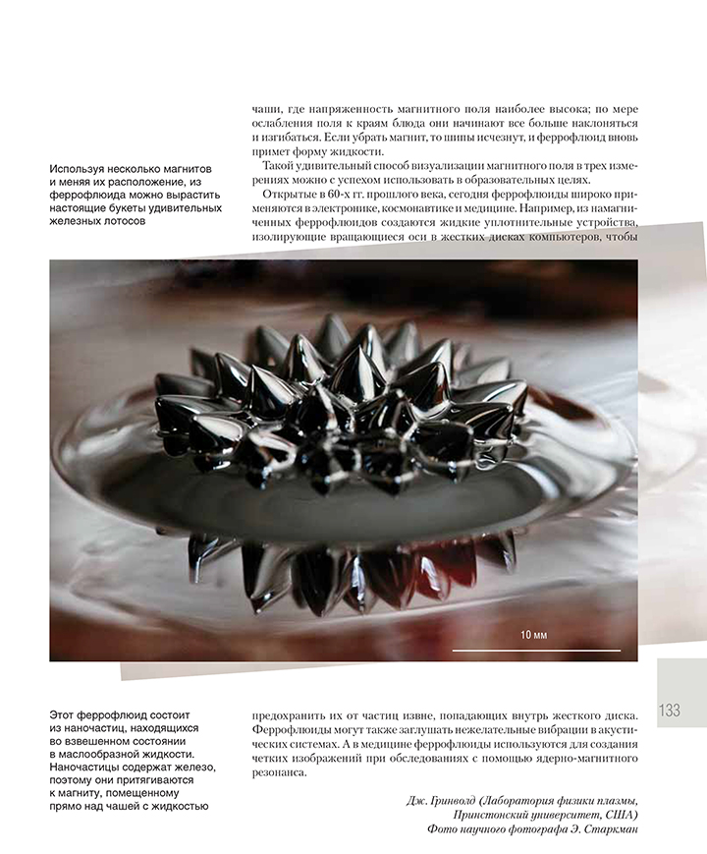
The Russian journal SCIENCE First Hand published these “Iron Lotus” photos by PPPL photographer Elle Starkman in its November issue in a photo essay called “World as Viewed by Science.”

Slide 3
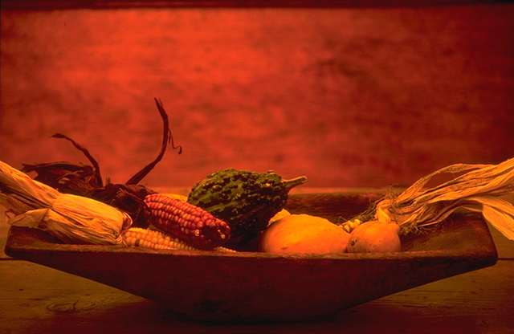

Welcome New PPPL Café Chef
Mark Gazo!

Slide 4
Engineering Challenges and
Updates on ITER
WAYNE T. REIERSEN
U.S. ITER
Next week - WeDNESDAY, NOV. 28
4:15 p.m. (Coffee/Tea at 4 p.m.) • M.B.G. Auditorium, Lyman Spitzer Building

Slide 5



2013
OPEN ENROLLMENT
Extended to November 28th

Slide 6



Menu subject to change without notice.

Slide 7



