Slide 1
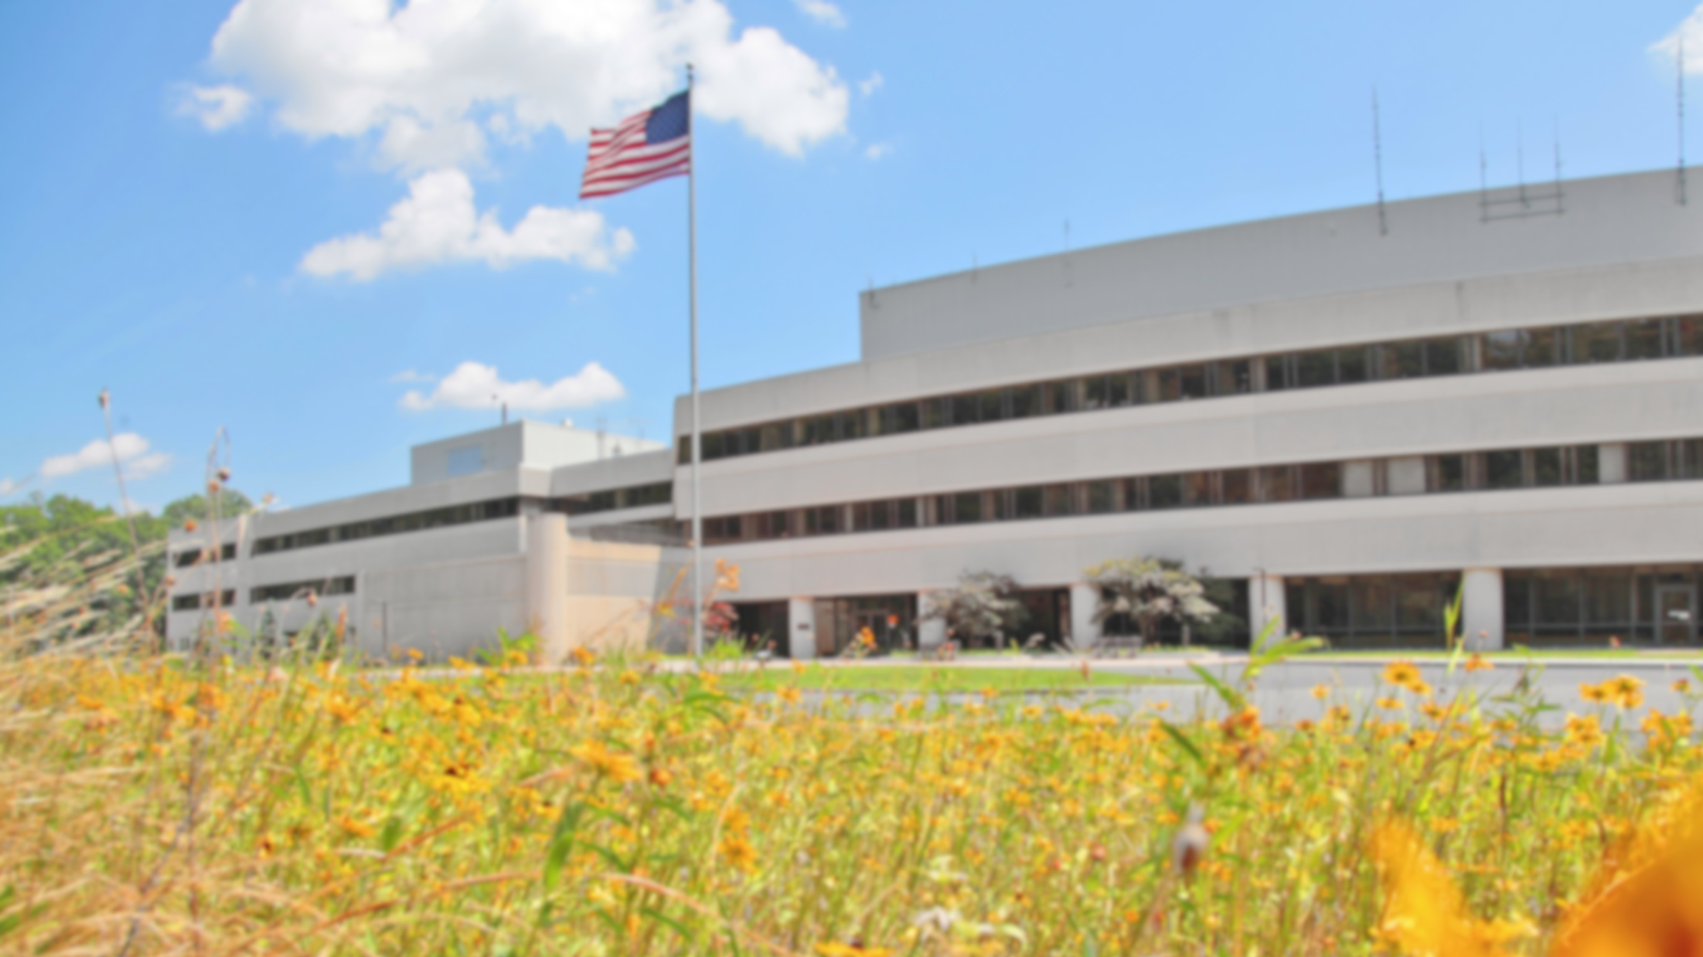
This Week @ PPPL
September 17-21, 2012
From the PPPL Office of Communications

Slide 2
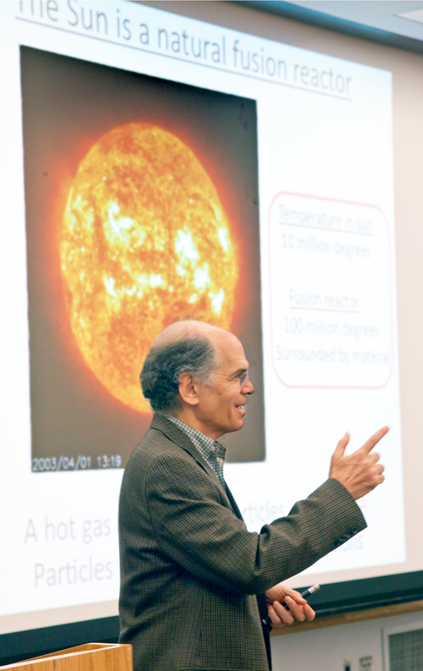
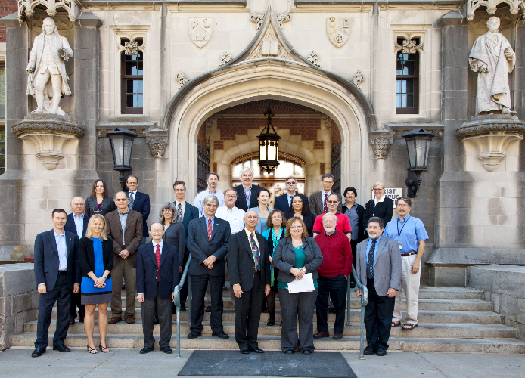
Communications Summit
September 12-13, 2012

Slide 3
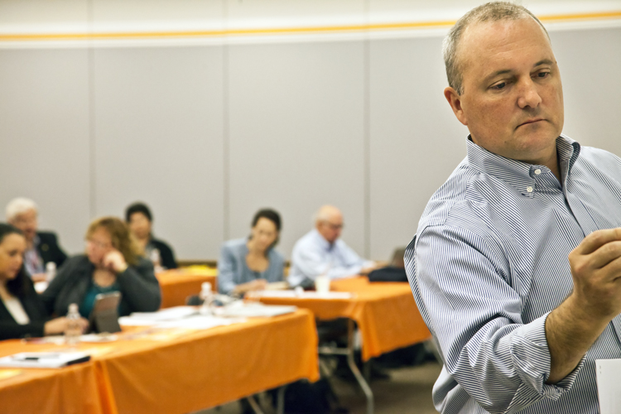
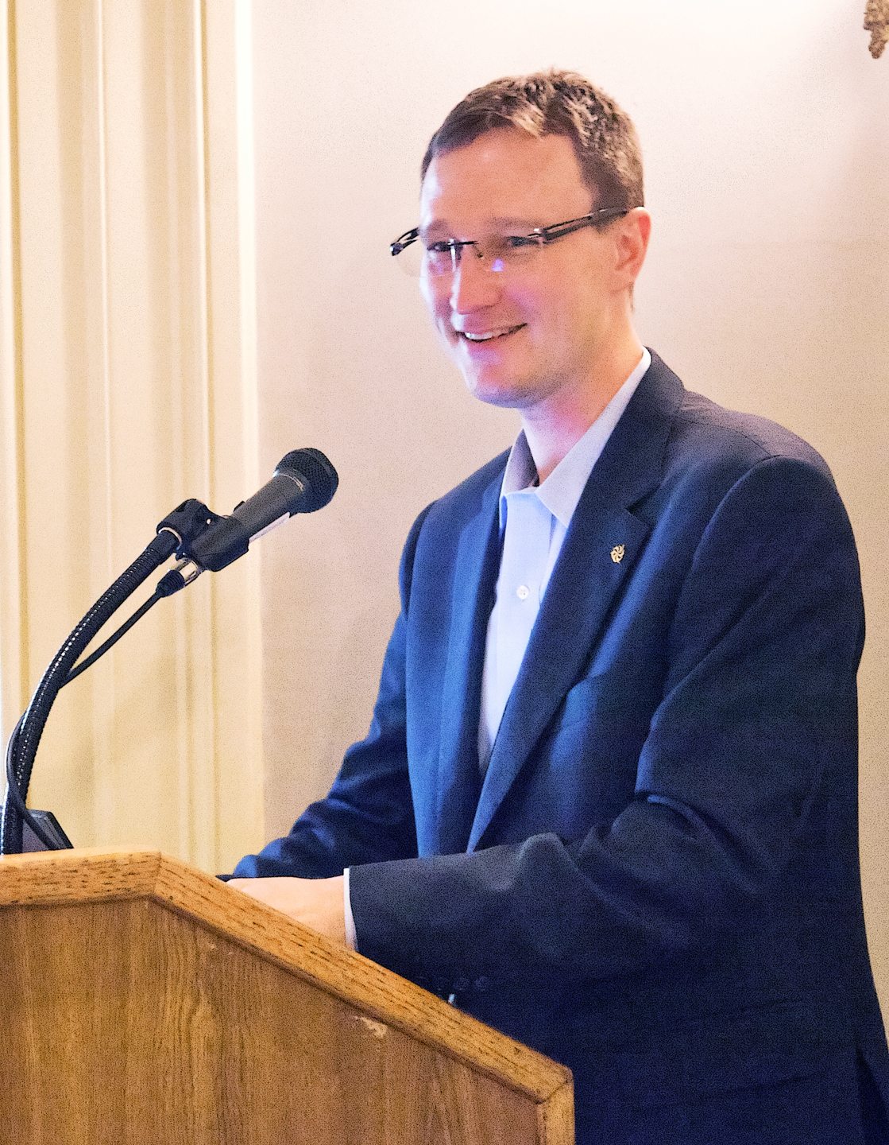
COMMUNICATIONS SUMMIT

Slide 4
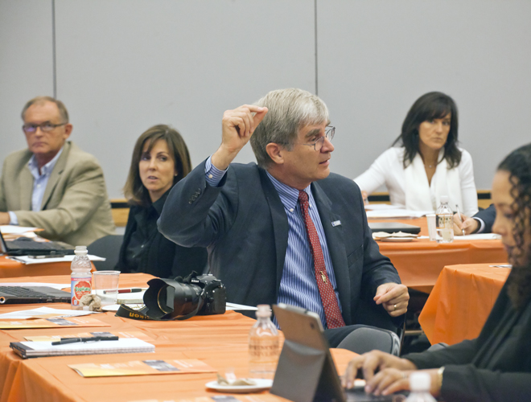
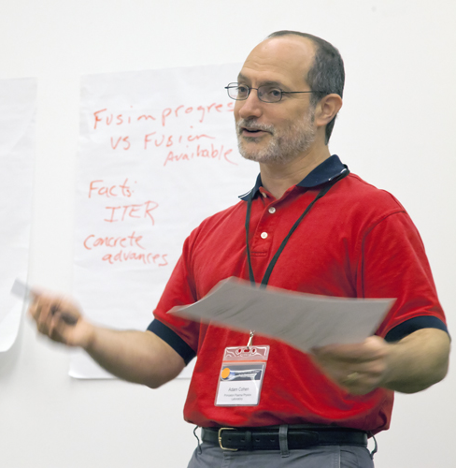
COMMUNICATIONS SUMMIT

Slide 5

PPPL END TO SUMMER PARTY AND CAKE FOR NEIL GERRISH
WHO IS BEING DEPLOYED FOR
ACTIVE DUTY THE END OF
SEPTEMBER
Wednesday, September 19th
At 2:30 PM in the LSB Lobby
Wear your flip flops, tropical shirts, and shades one more time and join us!

Slide 6


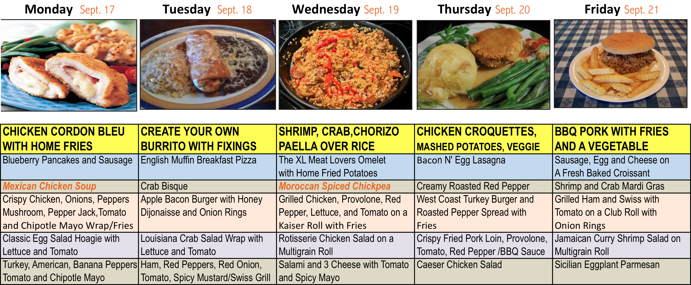
Menu subject to change without notice.

