Slide 1
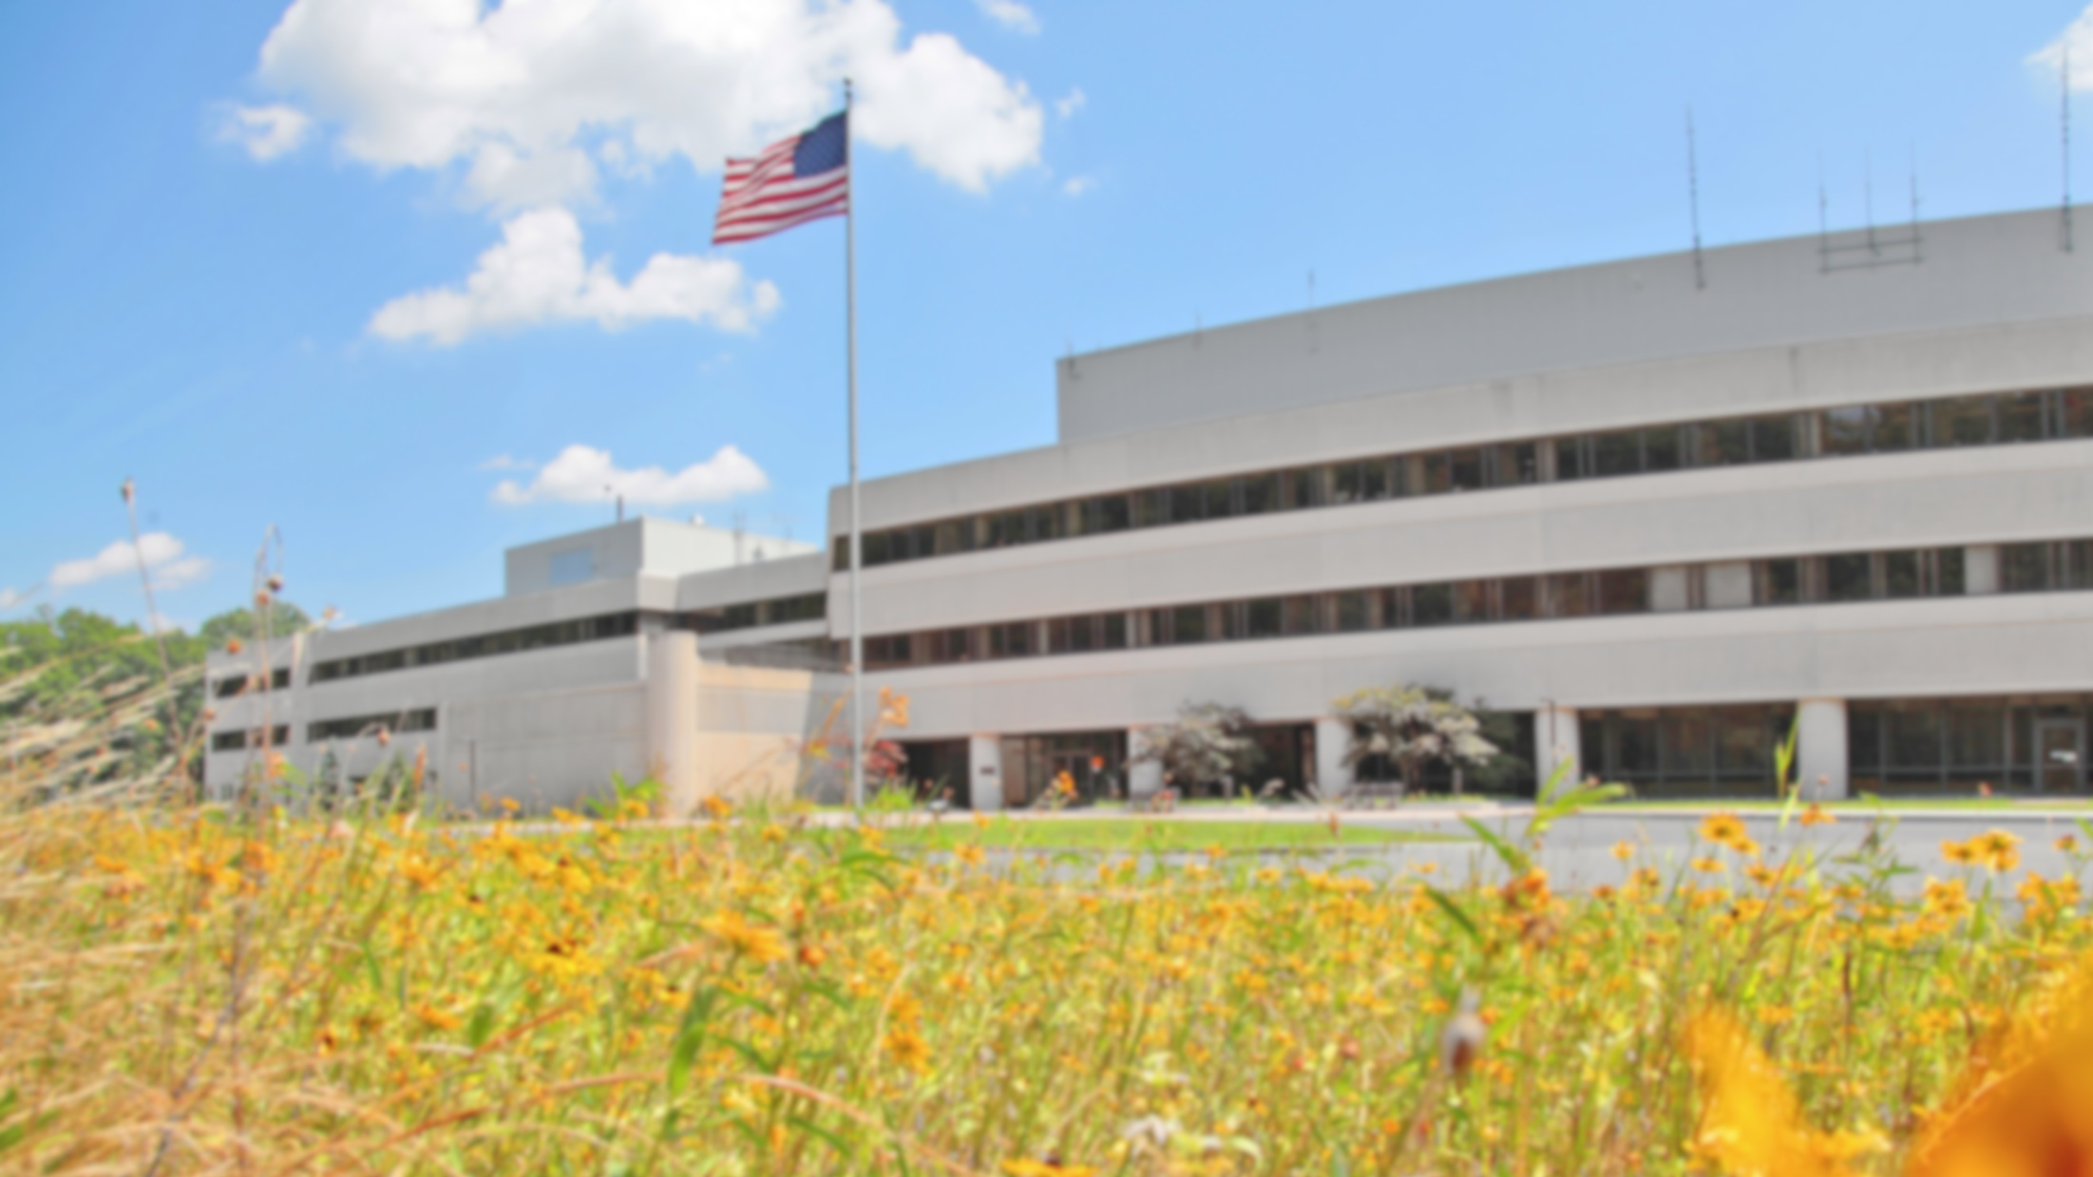
This Week @ PPPL
July 23 – 27, 2012
From the PPPL Office of Communications

Slide 2

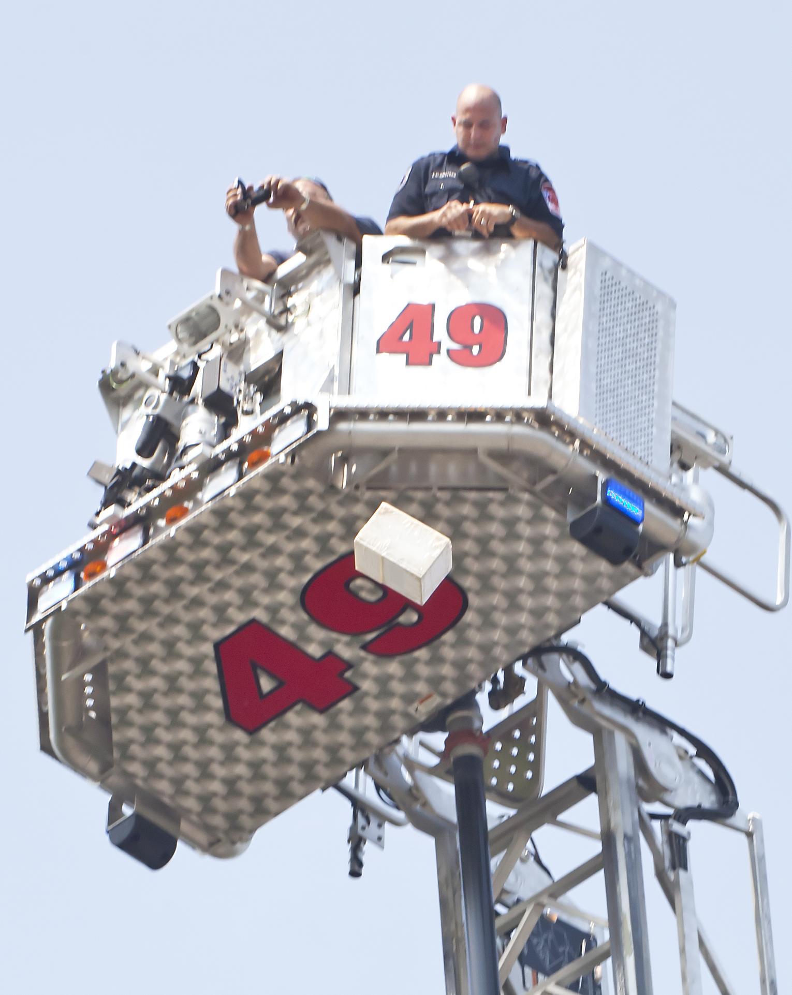
Free-fall
Drop Test
at PPPL

Slide 3
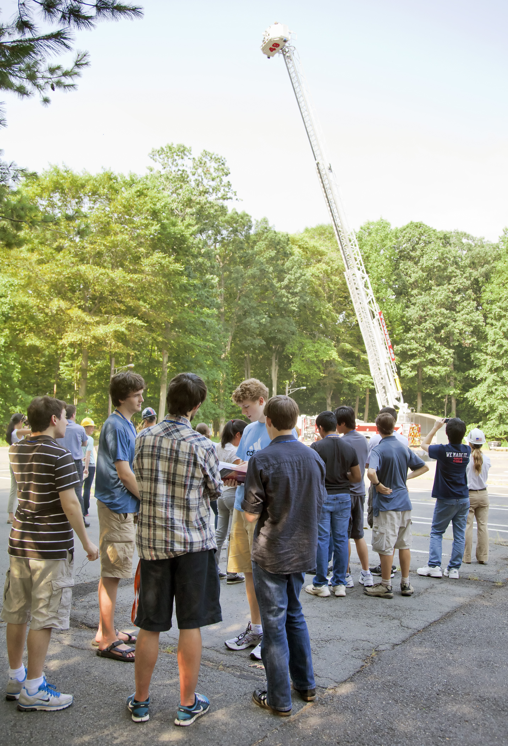
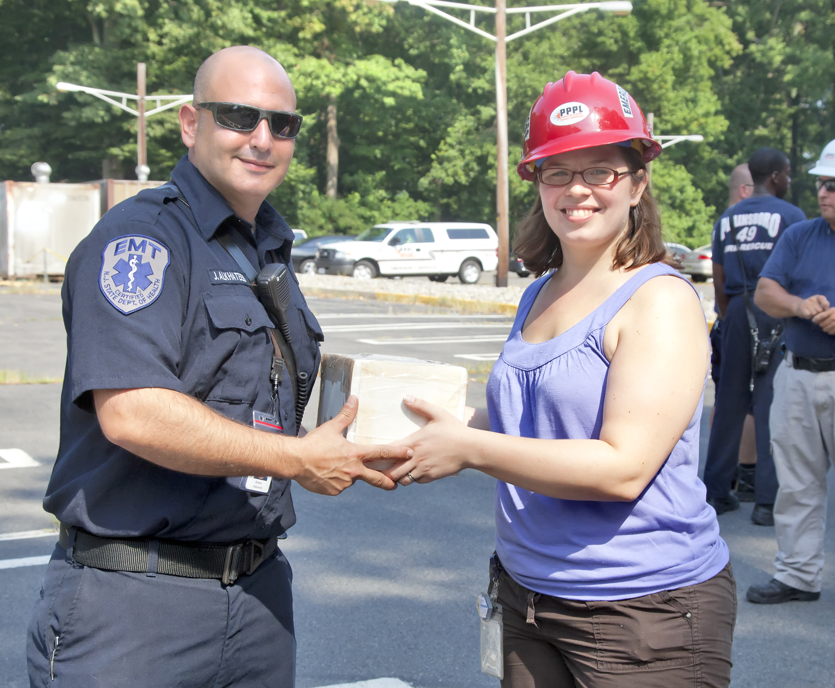
Free-fall Drop Test at PPPL

Slide 4
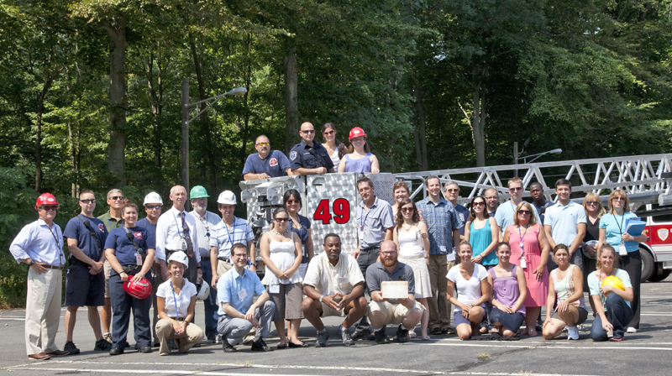
Free-fall Drop Test at PPPL

Slide 5

The This Week at PPPL Slideshow can also be viewed on the PPPL Internal Web Page at
www-local.pppl.gov/slideshow/

Slide 6

Daily Pickup
Twice a week pickup
Twice a week pickup
NEW
Office trash picked up ONCE per week
NEW Waste Signs & Collection SYSTEM
Notes:
WEEK #1

Slide 7
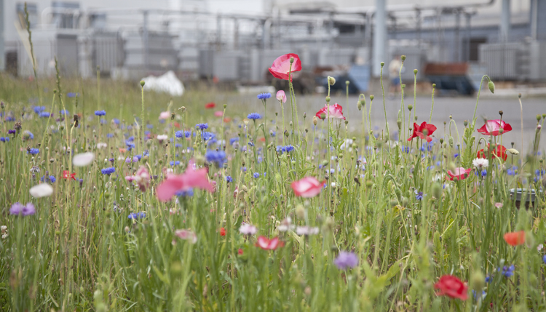
Wildflowers at PPPL
Photo by Elle Starkman

Slide 8


Menu subject to change without notice.

