Slide 1
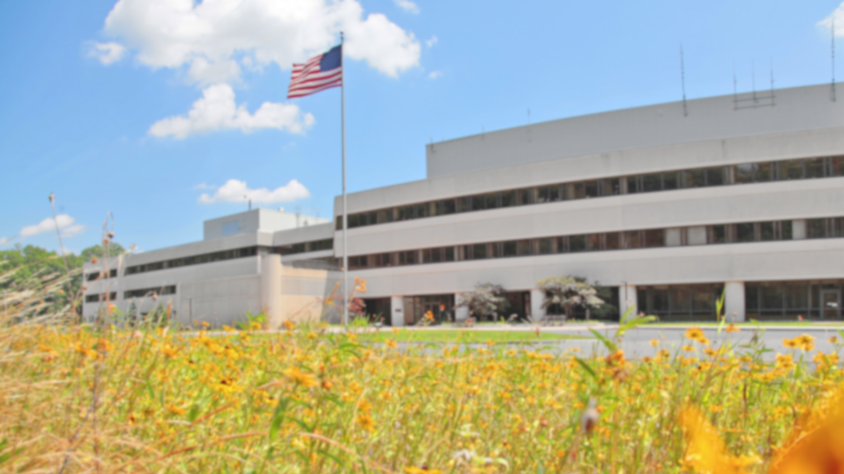
This Week @ PPPL
July 30 – Aug. 3, 2012
From the PPPL Office of Communications

Slide 2
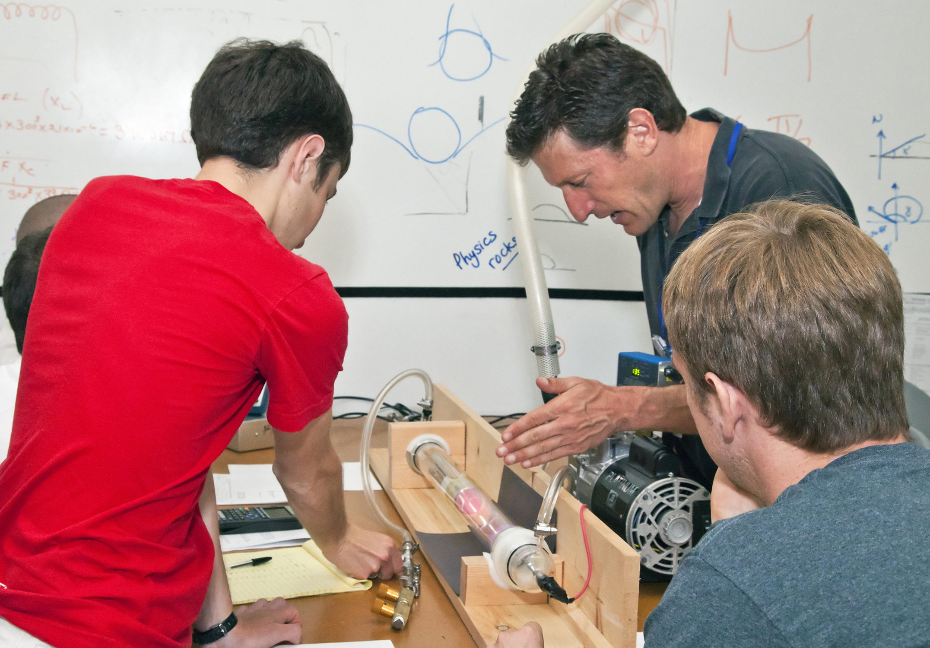
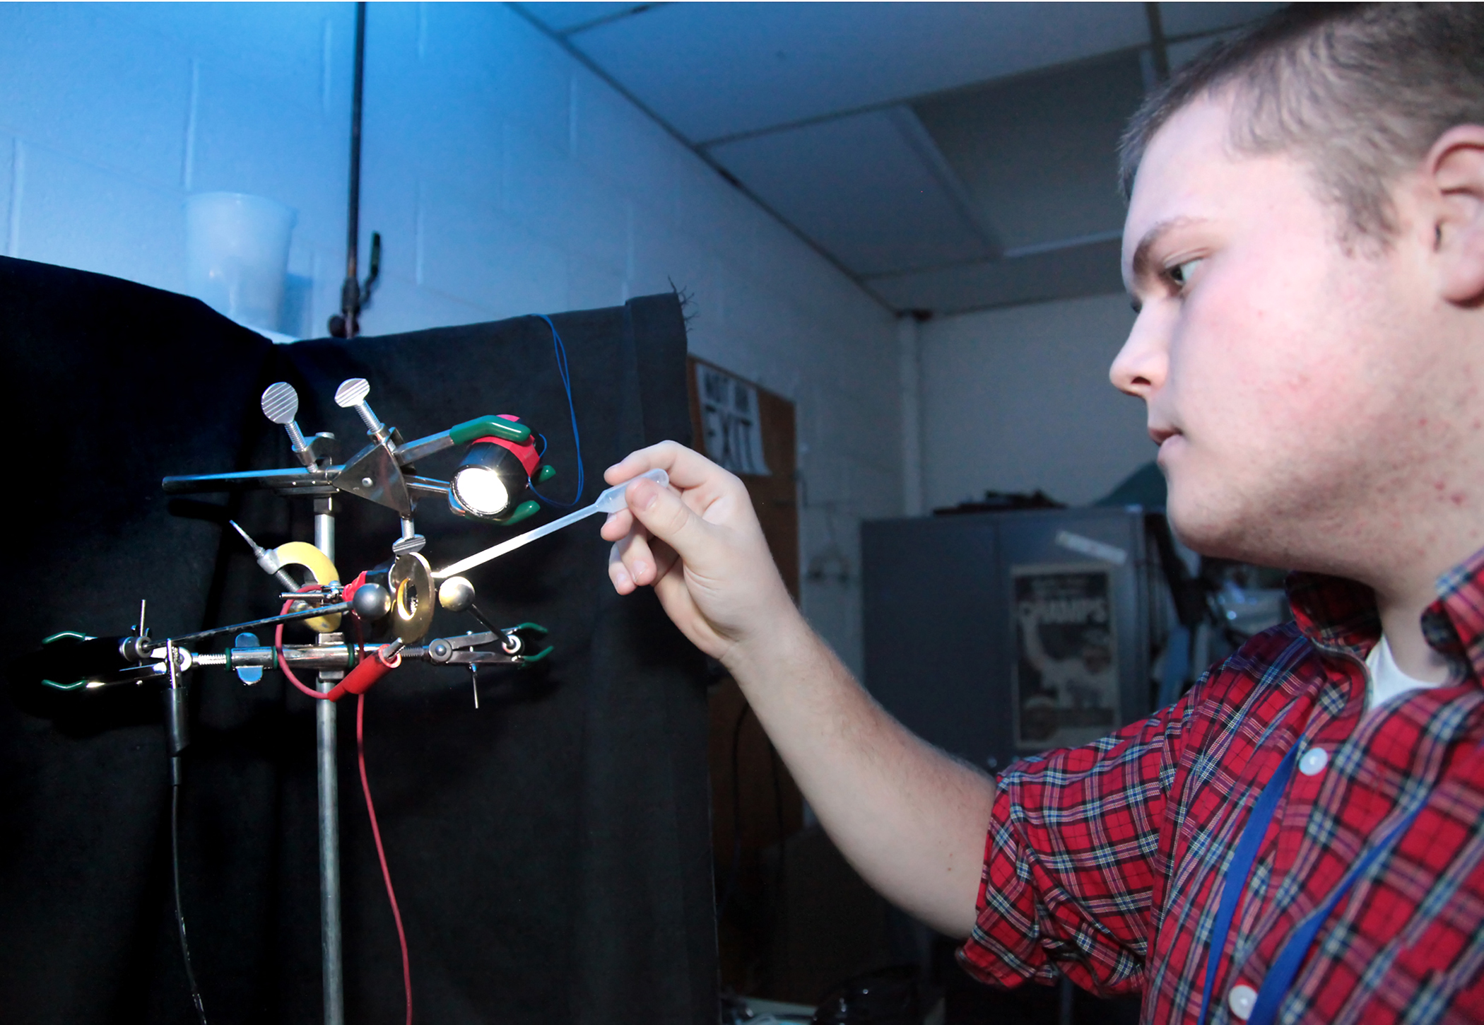
Summer Students Run Experiments at PPPL

Slide 3
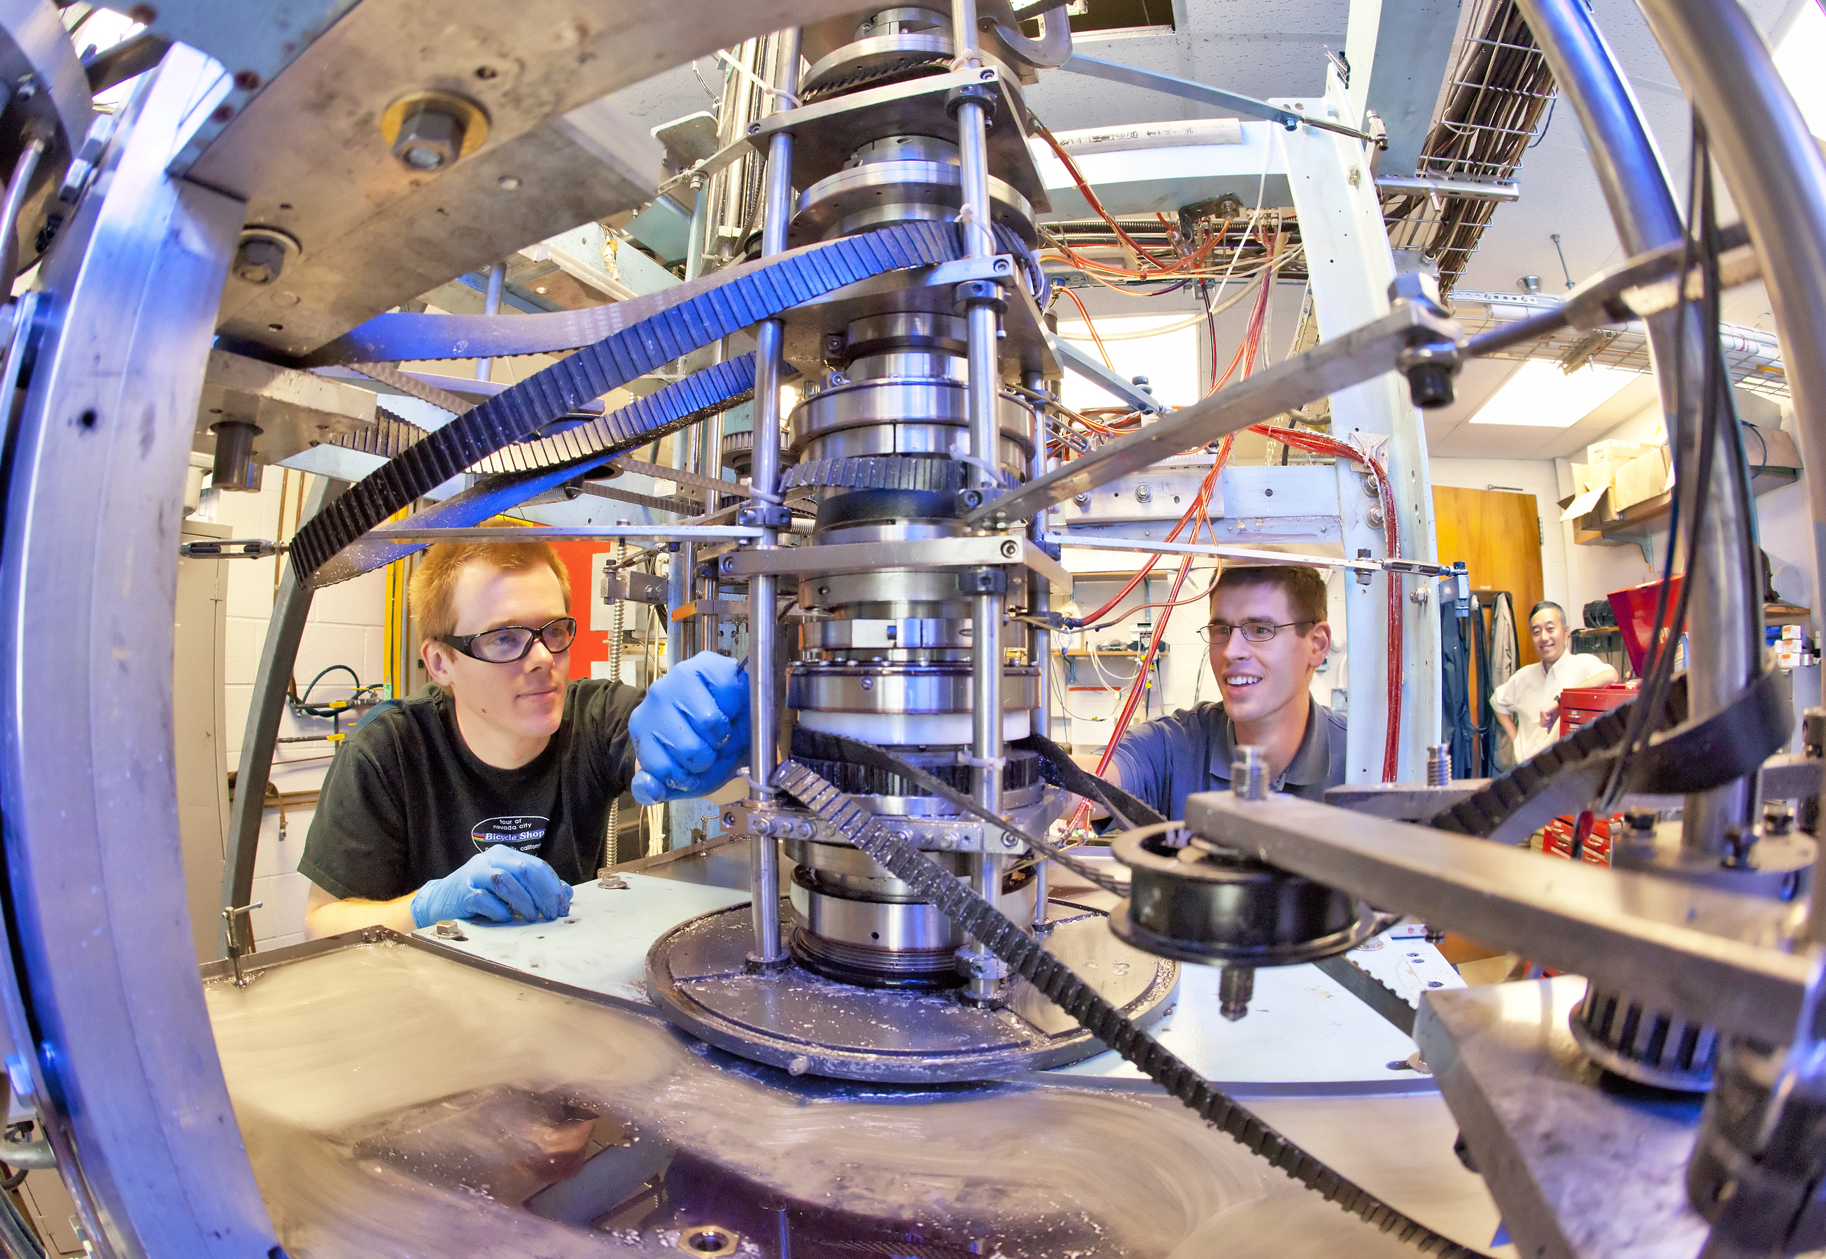
Summer Students Run Experiments
at PPPL

Slide 4
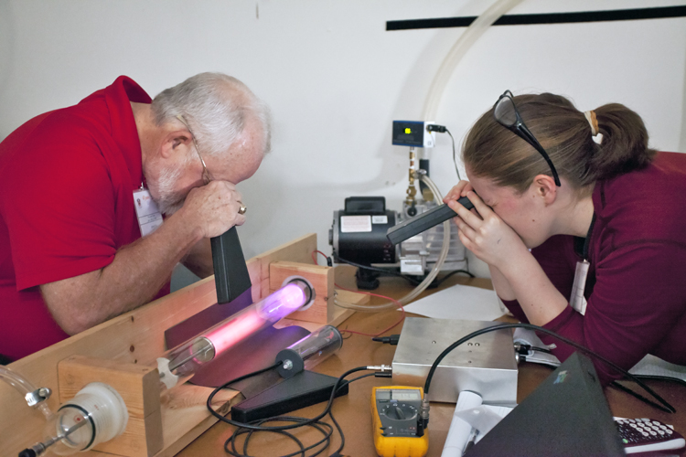
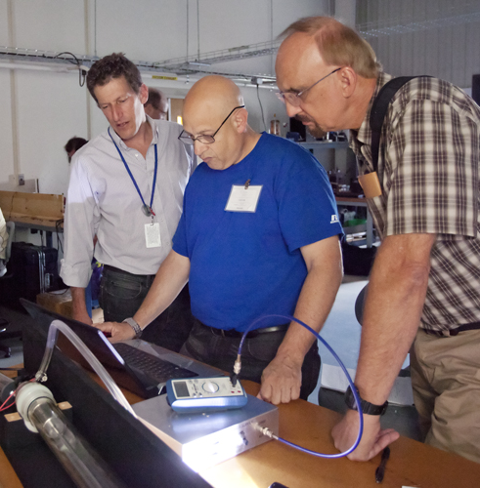
Plasma Camp at PPPL

Slide 5
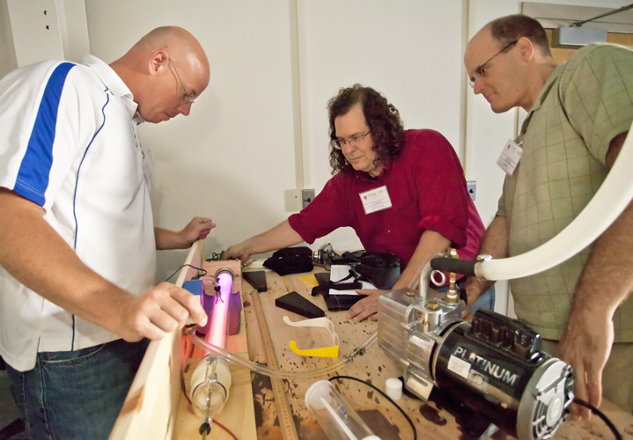
Plasma Camp at PPPL

Slide 6
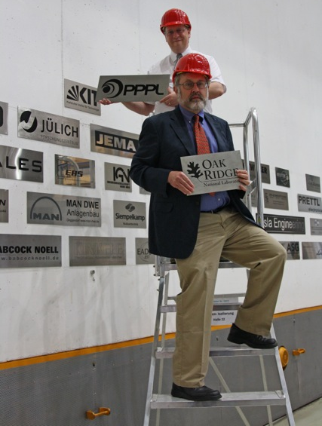
WALL OF FAME
David Gates adds PPPL logo to wall for W7-X contributors at Max Planck Institute for Plasma Physics in Germany.

Slide 7


Menu subject to change without notice.

