Slide 1
Open house 2013 slides
T. Brown

Slide 2
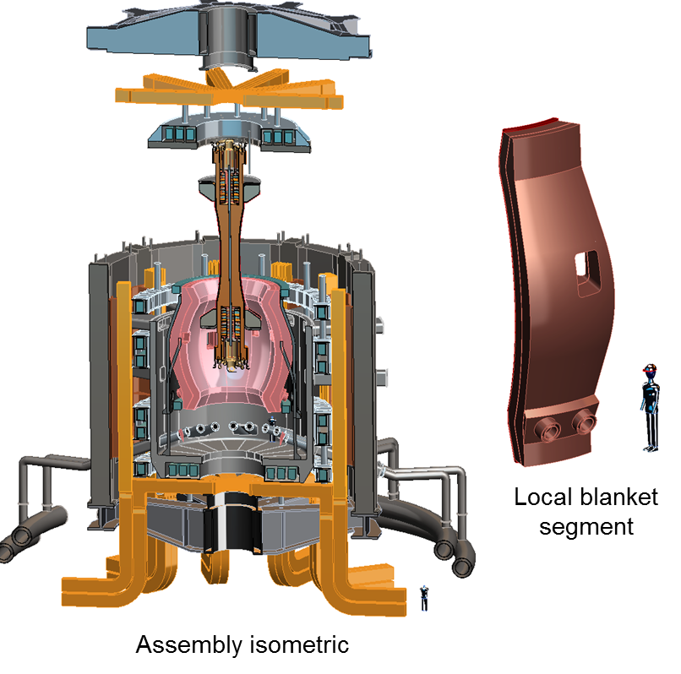
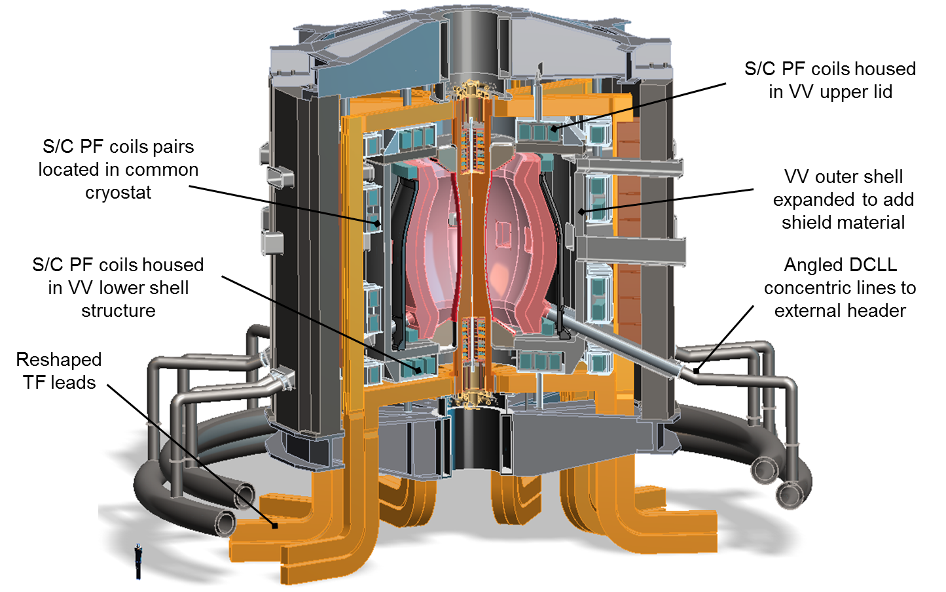
1.6-m FNSF Super-X Divertor Configuration

Slide 3
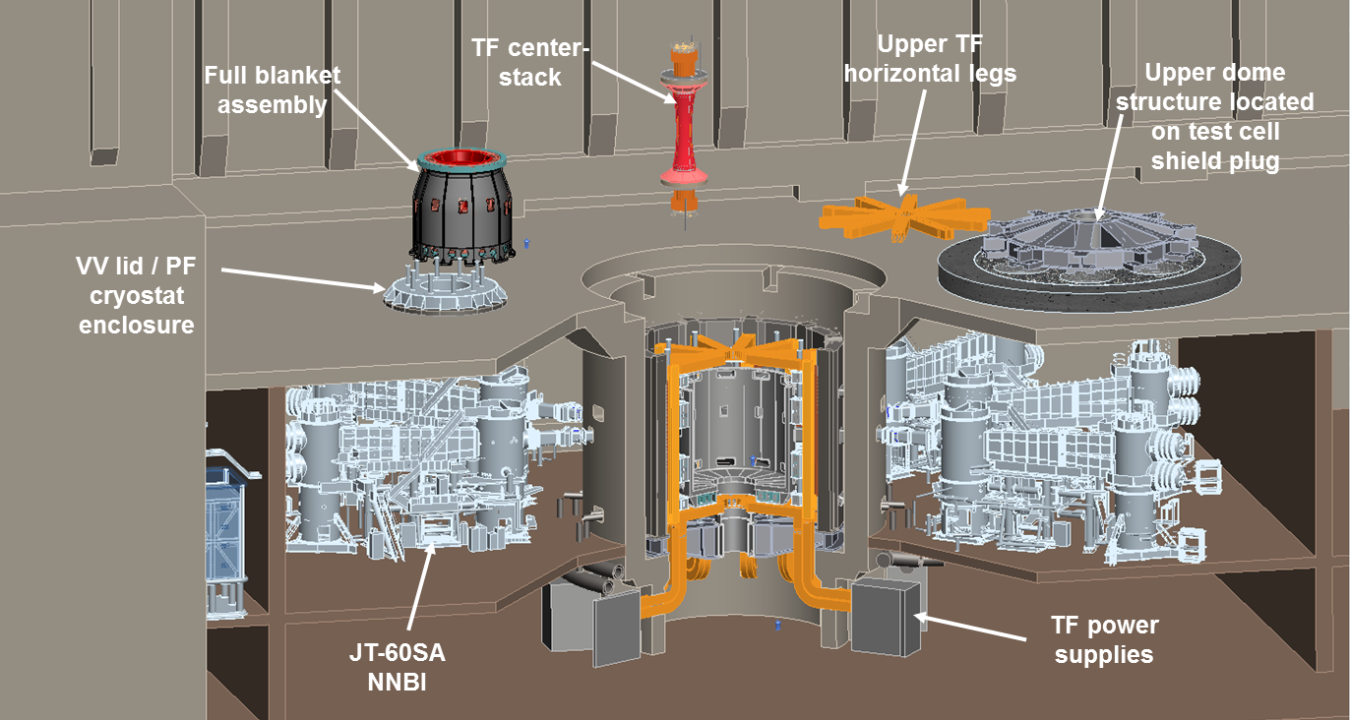
ST-FNS facility layout

Slide 4
Pilot plant Advanced Tokamak (AT) design
Vertical maintenance access
S/C TF and PF coils
Double-null divertor
Expanded VV space
Horizontal ports for Aux equipment and RM assistance
Machine support at the base
Coolant supply from below

Slide 5
AT Pilot plant device core / facility integration

Slide 6
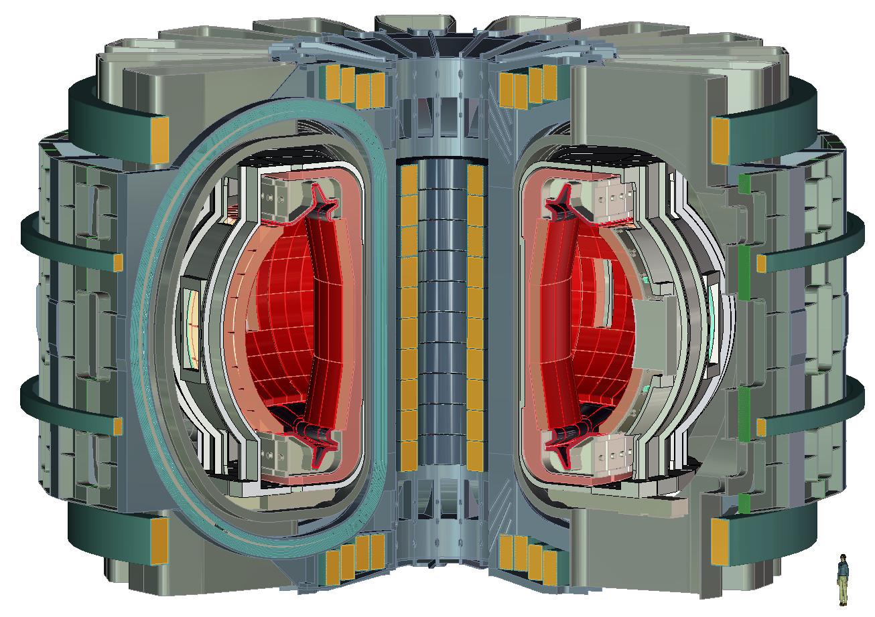
Republic of Korea K-DEMO Isometric View

Slide 7
K-DEMO two coil winding toroidal field coil
TF shown with quarter section cut
Local rib structure
Low field winding
High field winding
Low field winding
Inboard leg winding detail
Outboard leg winding detail

