Slide 1
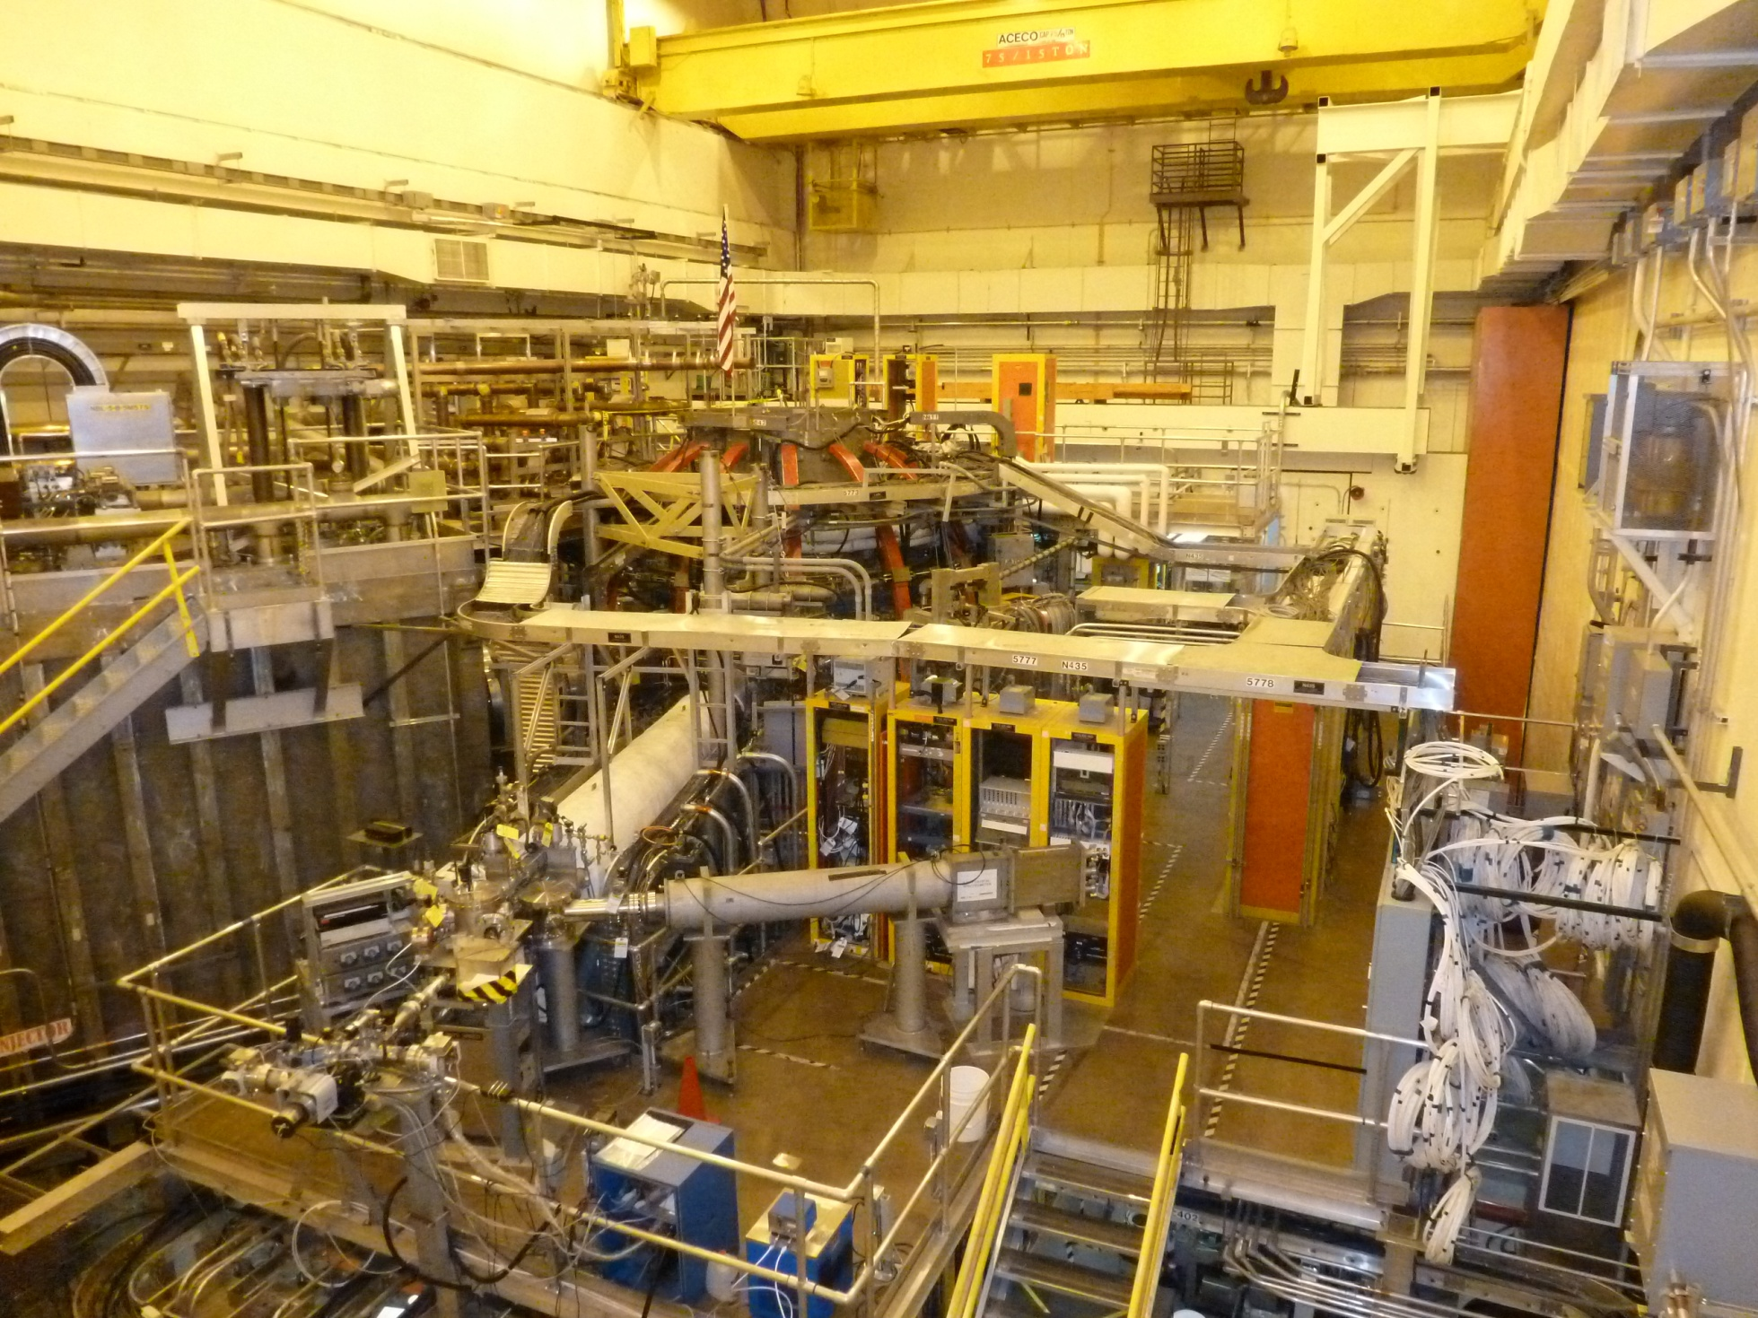
NSTX-U Construction November, 2011, Start of Upgrade Project

Slide 2
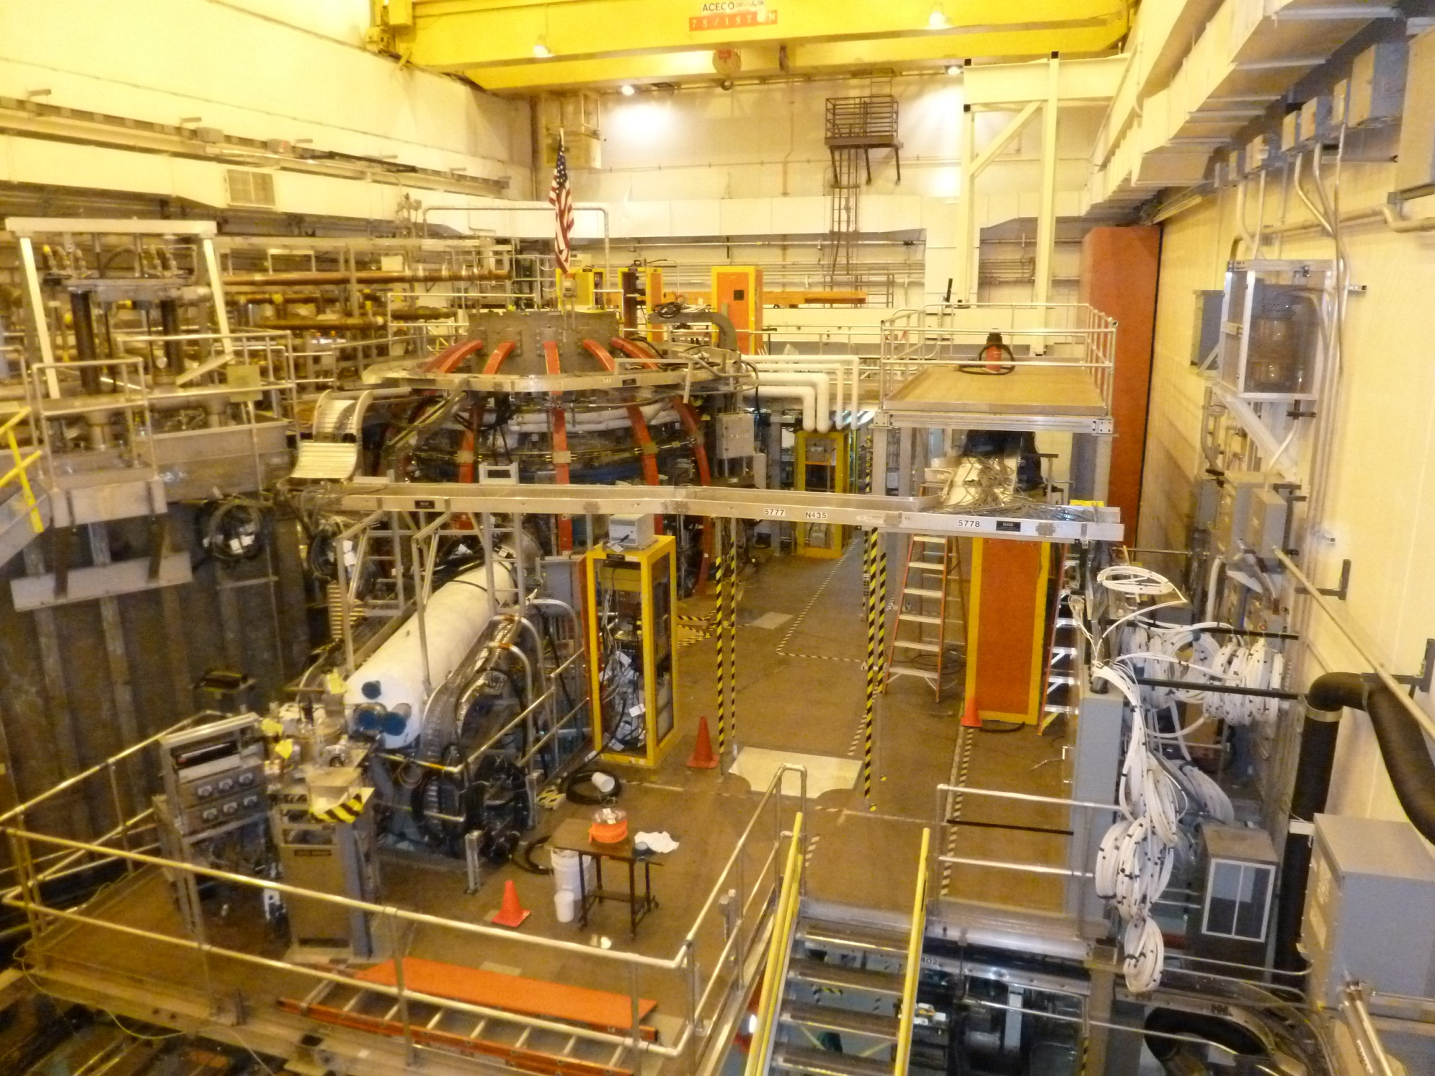
January, 2012, Plasma Diagnostics Removed

Slide 3
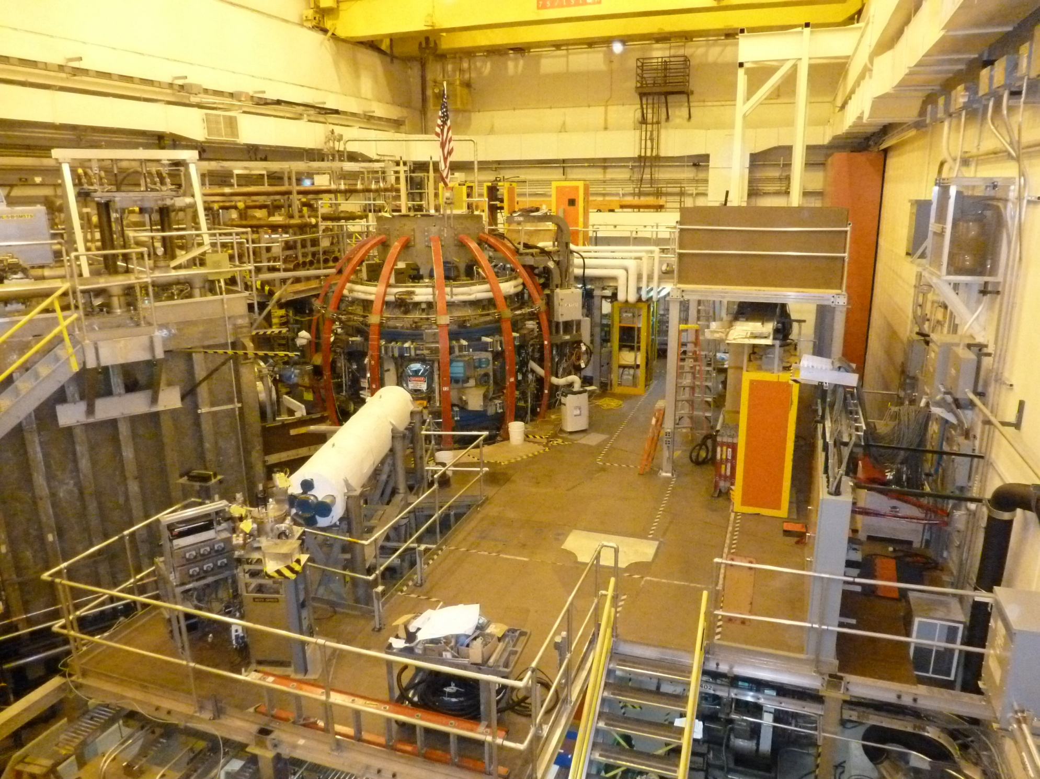
March, 2012, Vessel Ports Removed

Slide 4
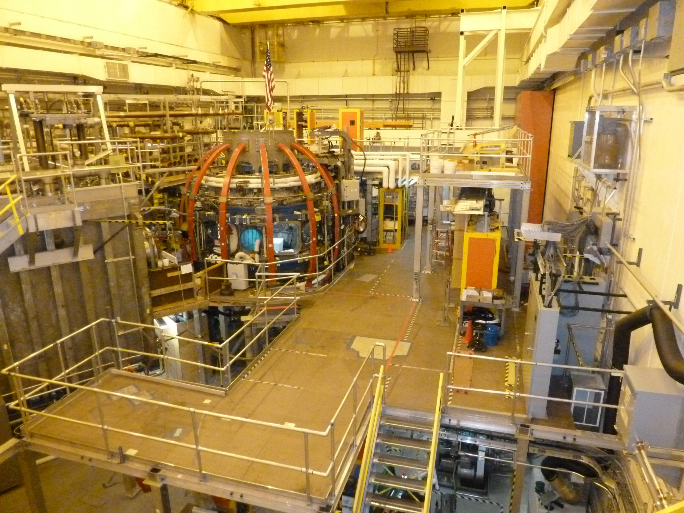
June, 2012, Vessel Pumping Duct Removed

Slide 5
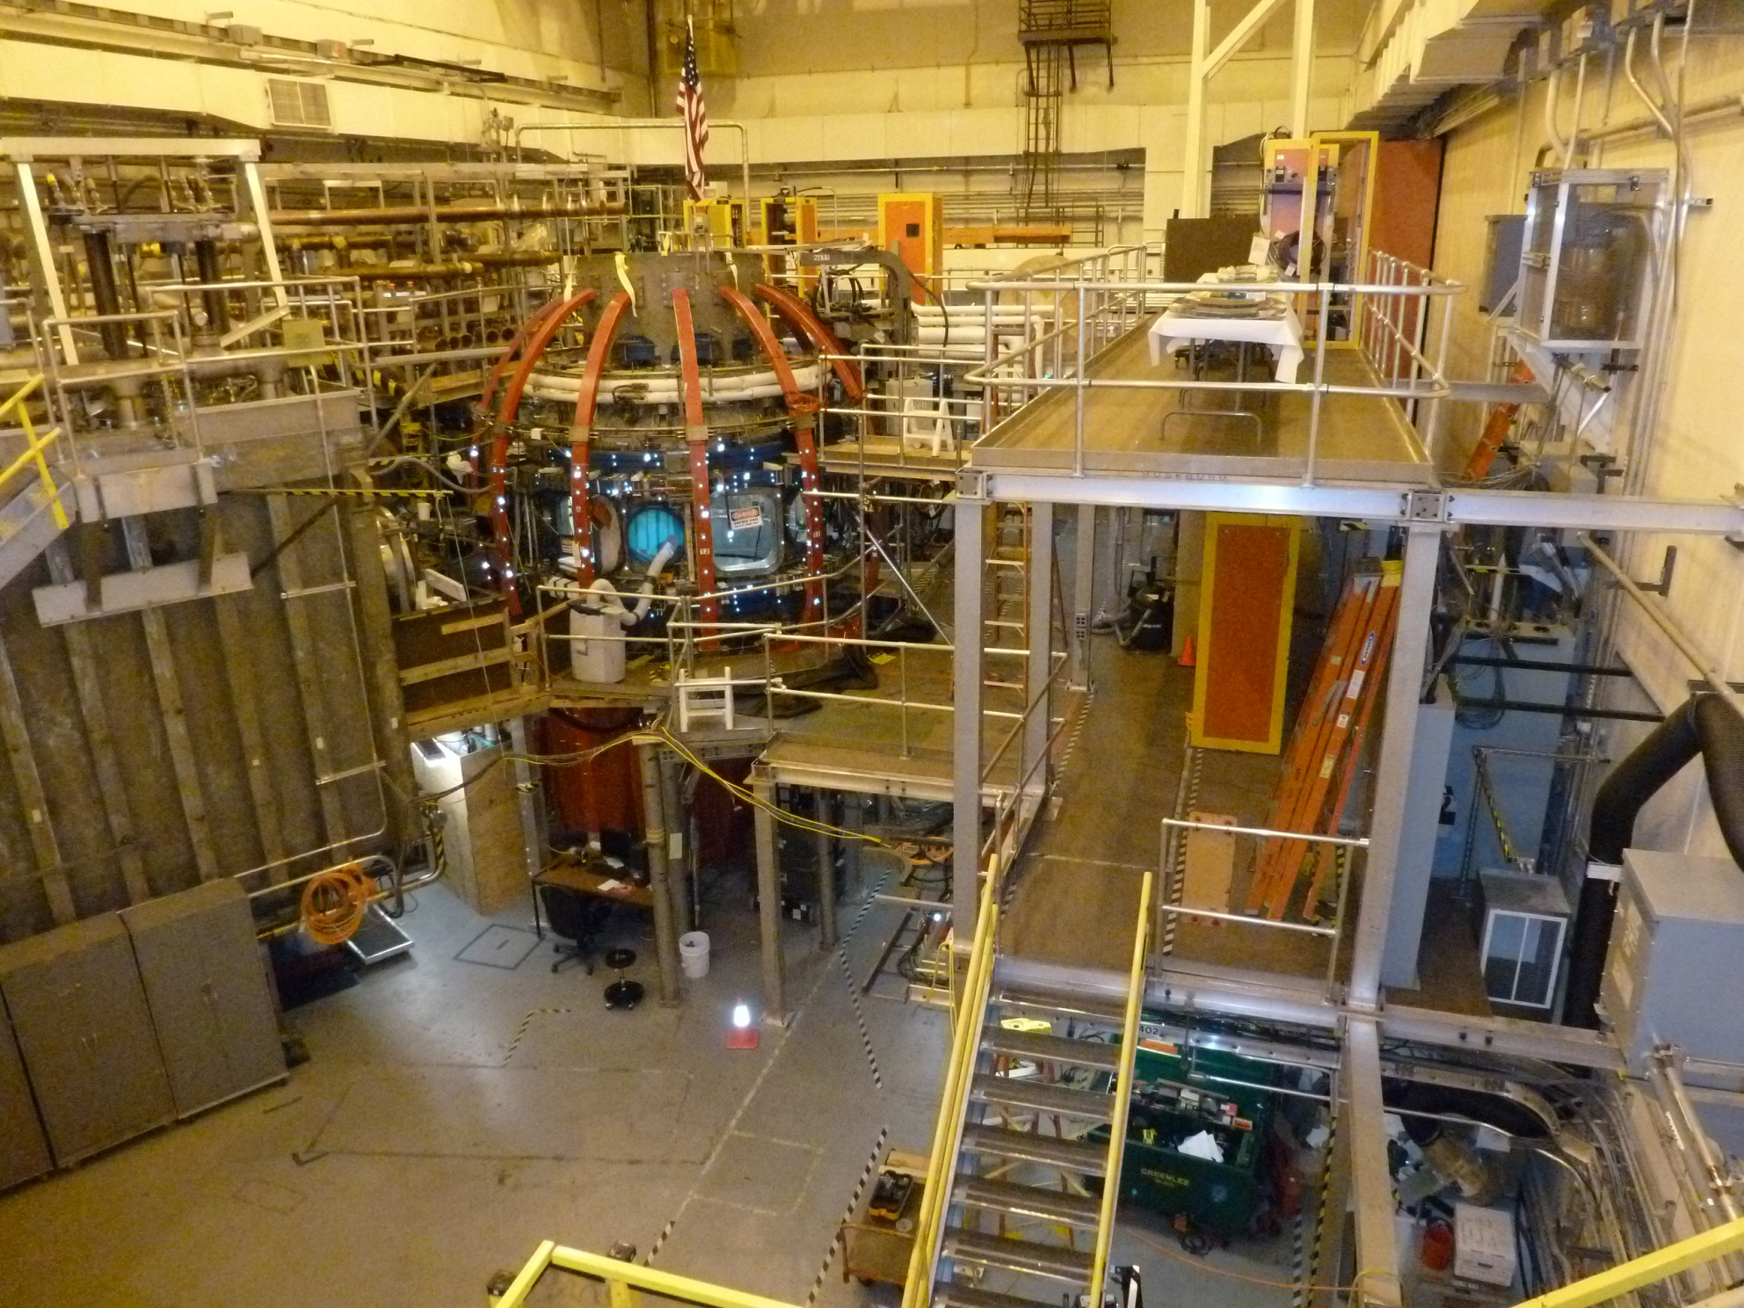
August, 2012, Machine Platforms Removed

Slide 6
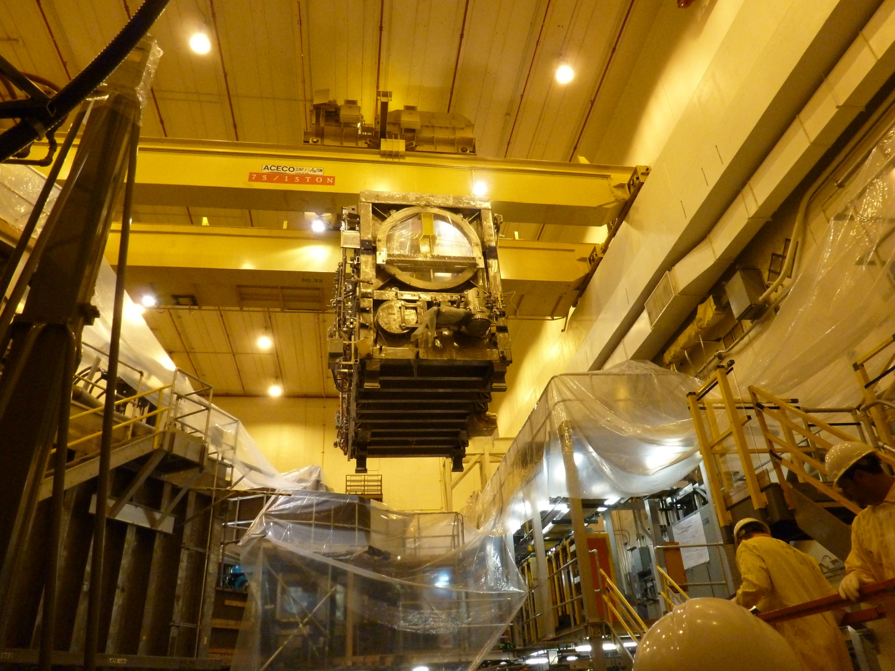
September, 2012, 40 Ton Neutral Beam “Flown” In

Slide 7
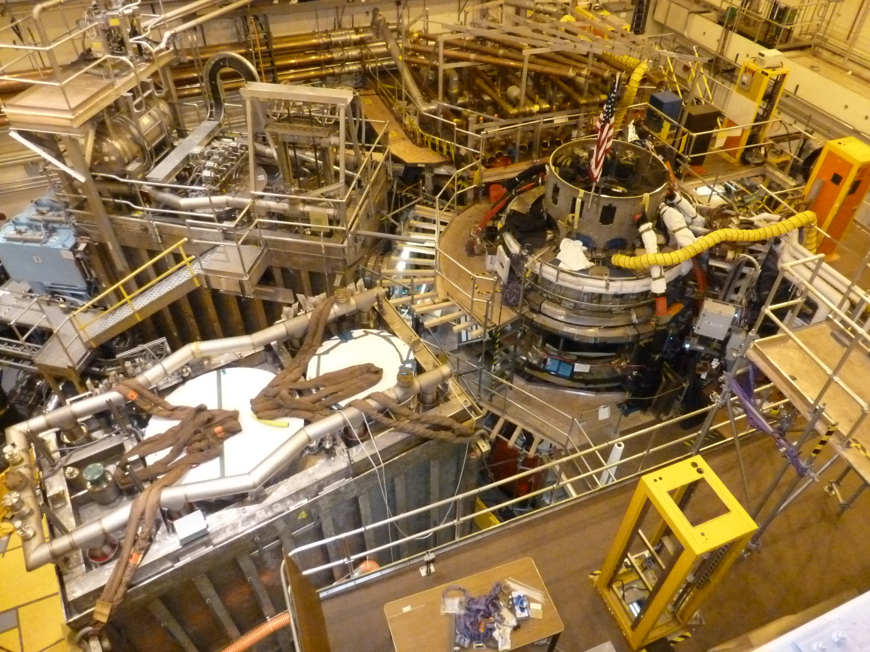
September, 2012, Neutral Beam in Place

Slide 8
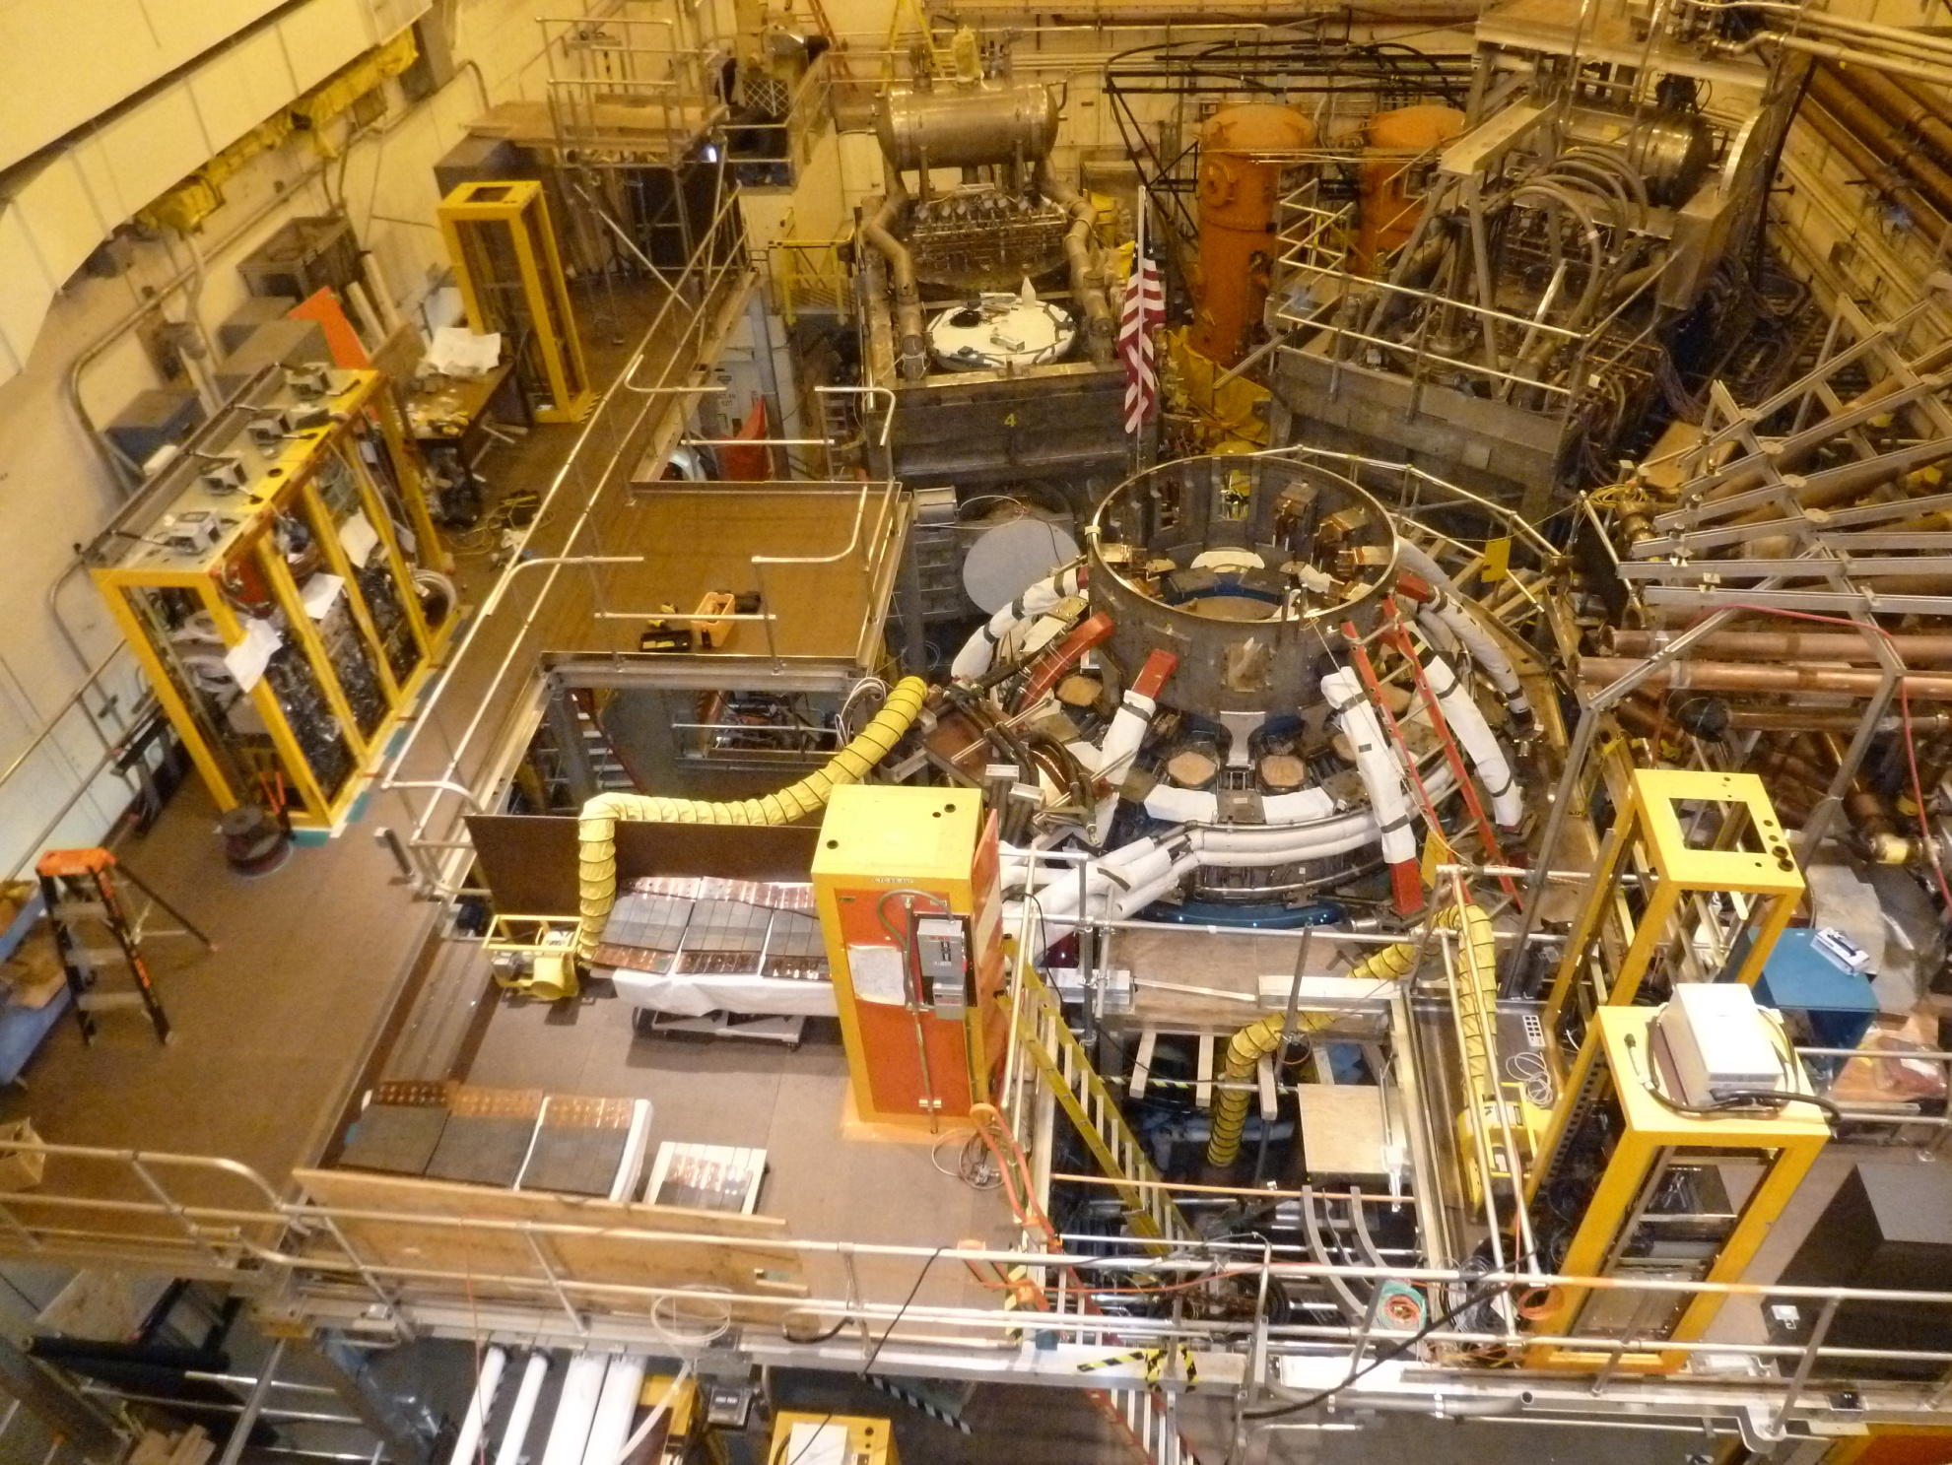
February, 2013, New Platforms for Diagnostics Installed

Slide 9
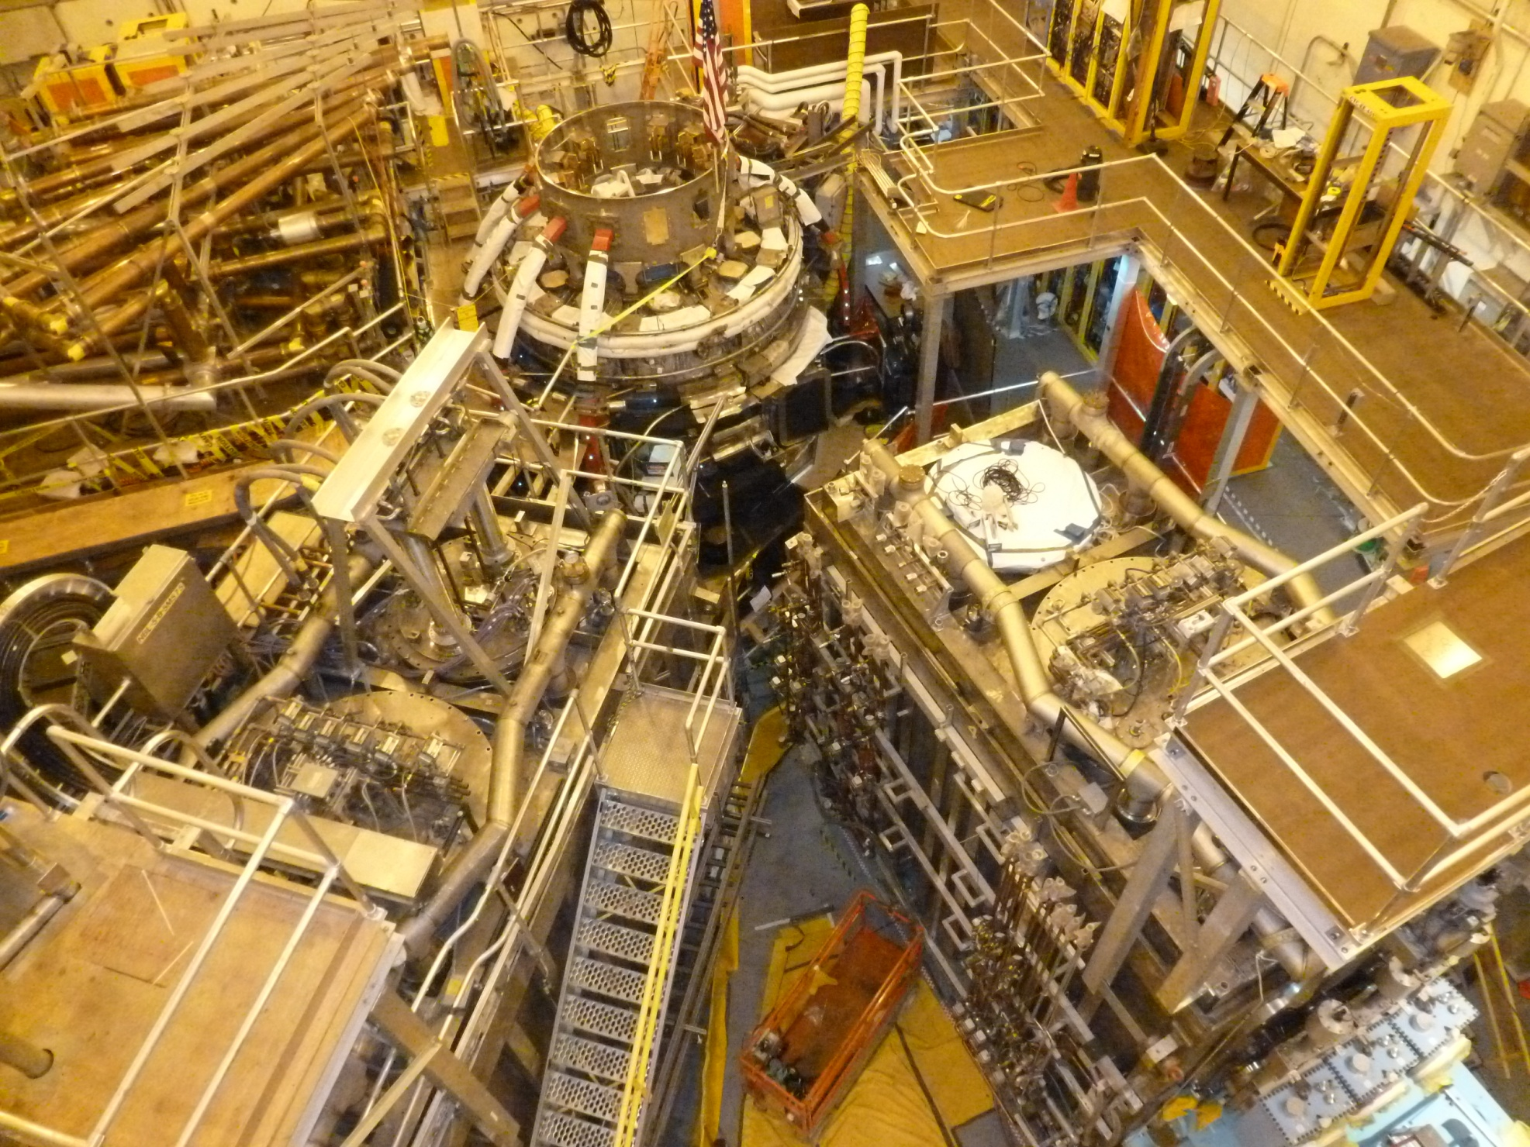
March, 2013, New Ports on Vessel, Commissioning the Neutral Beam

Slide 10
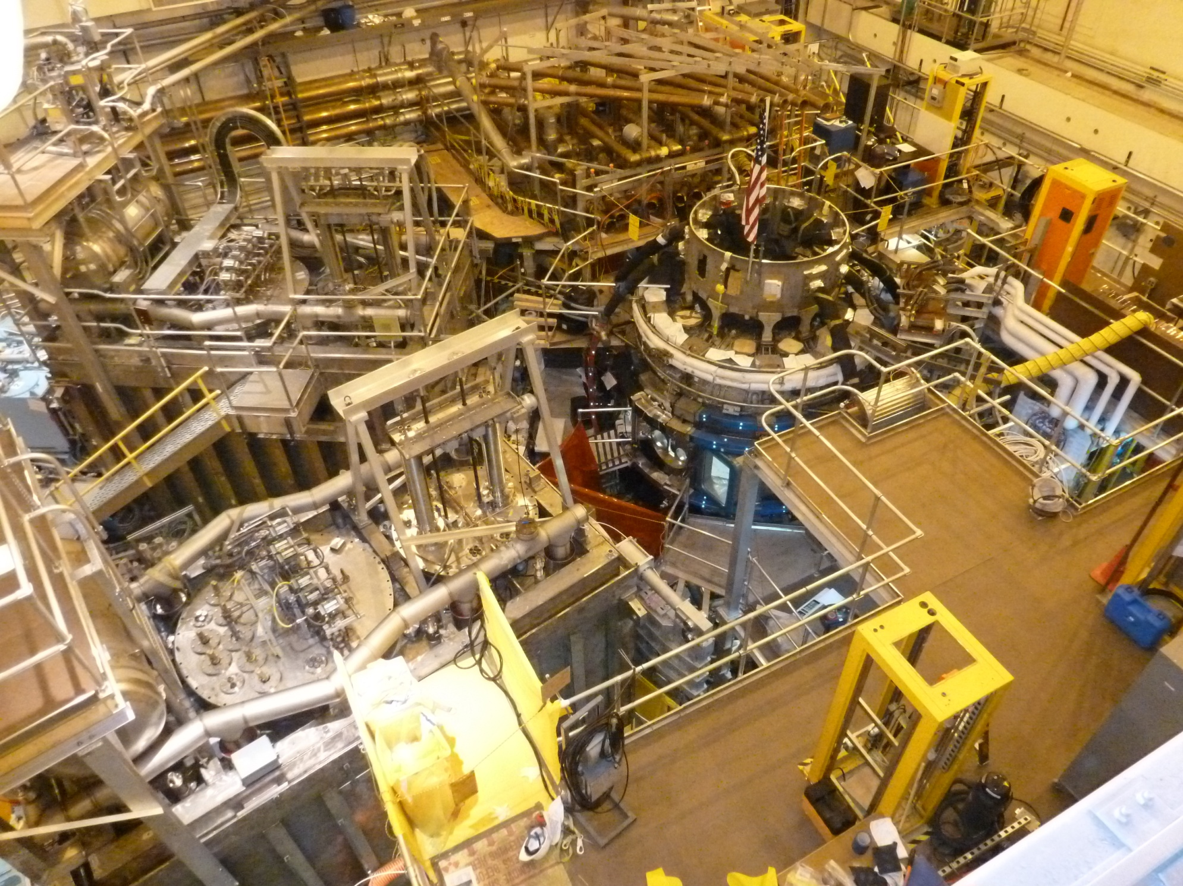
April, 2013, Neutral Beam Commissioning

Slide 11
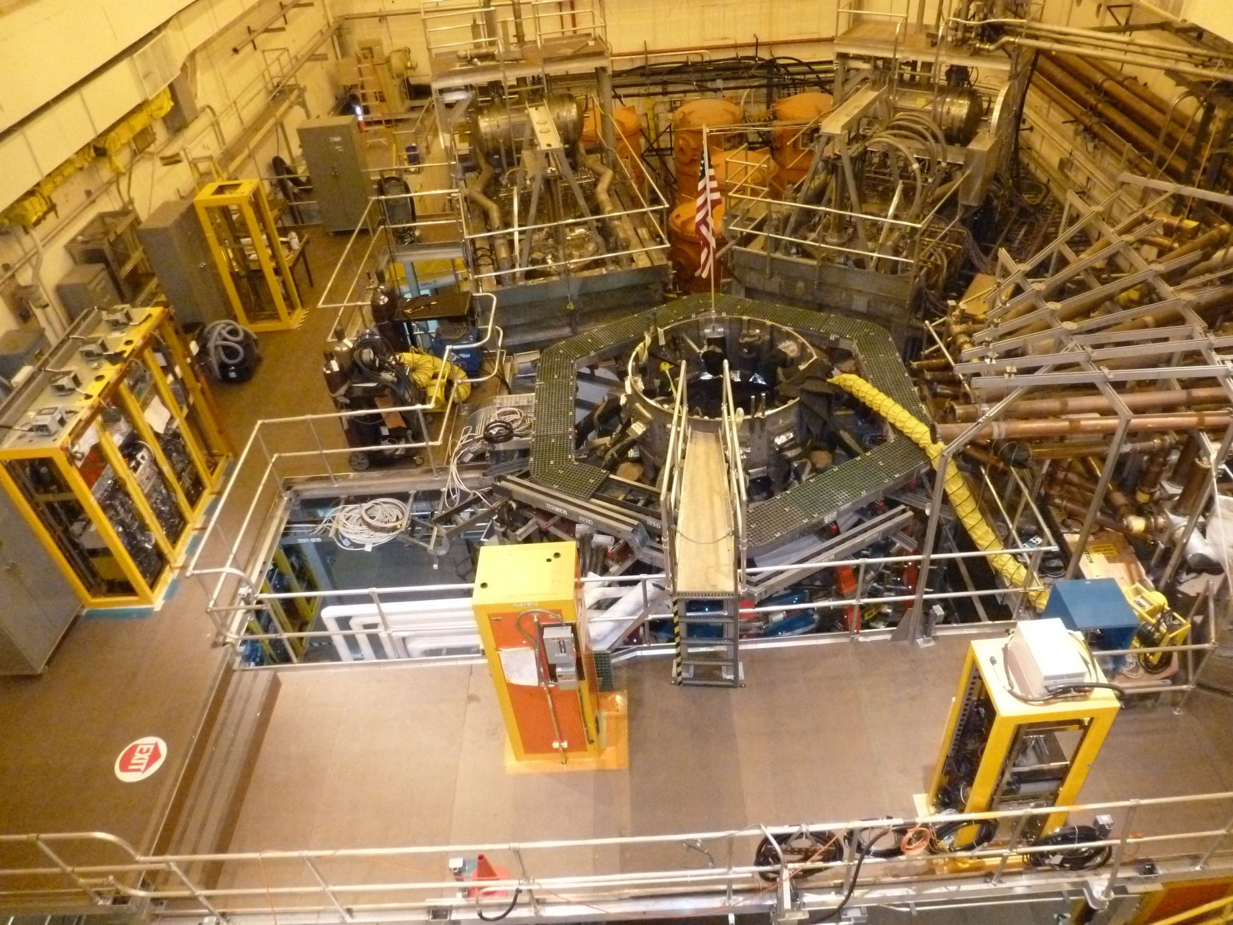
May, 2013, Tray-Work Installed on top of NSTX-U

Slide 12
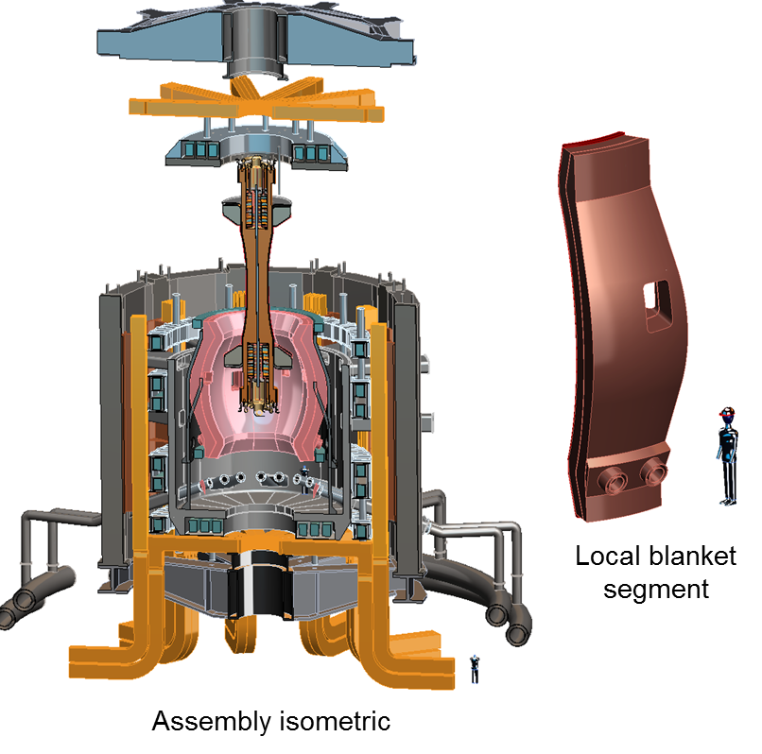
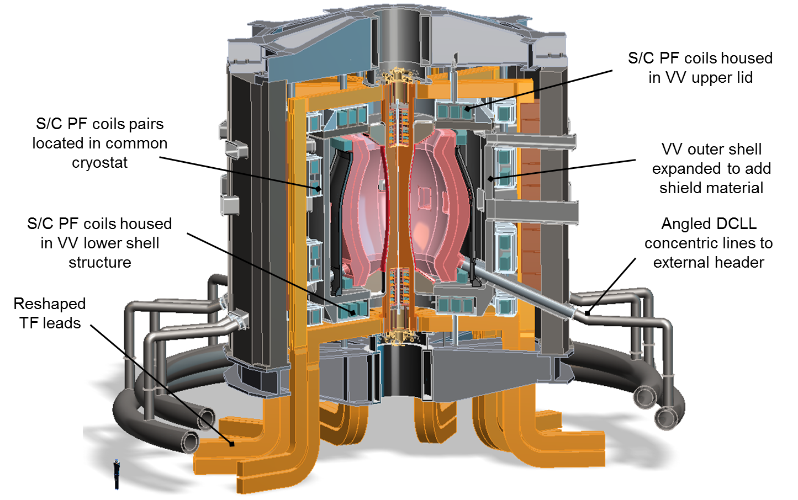
Fusion Nuclear Science Facility Extrapolated from NSTX

Slide 13
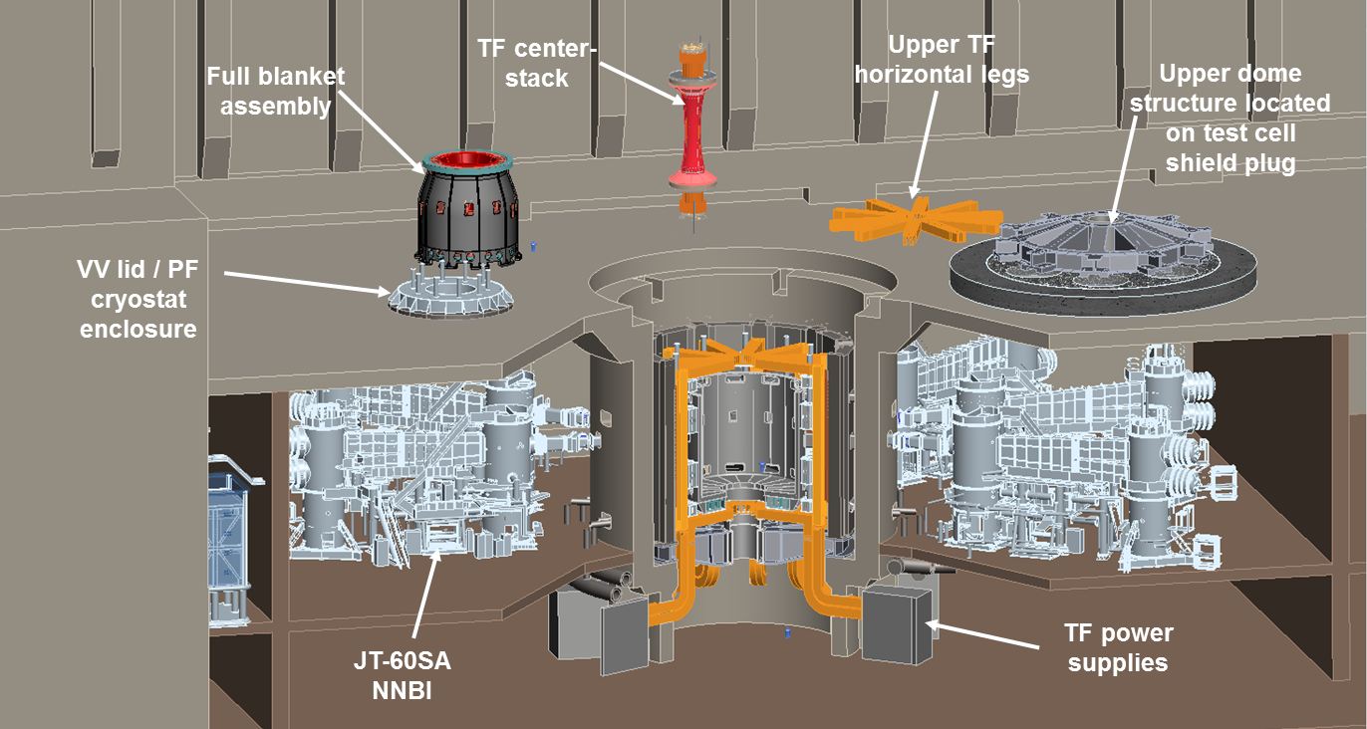
ST-FNS facility layout

Slide 14
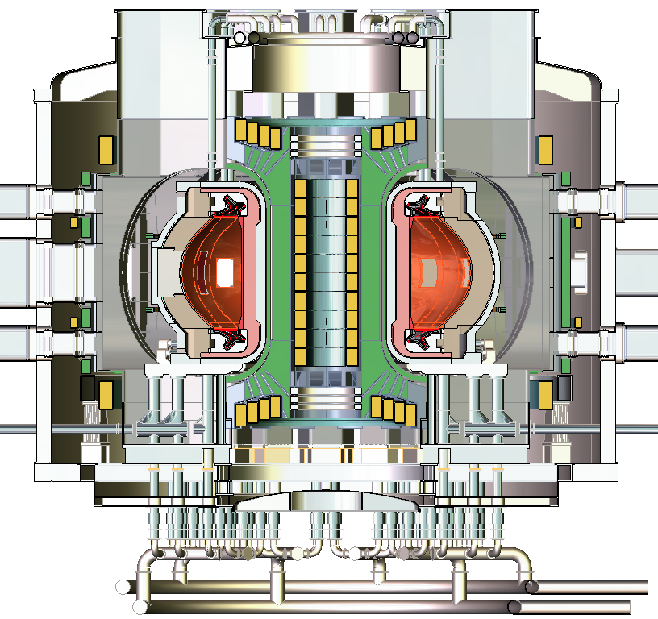
Pilot plant Advanced Tokamak (AT) design
Vertical maintenance access
S/C TF and PF coils
Double-null divertor
Expanded VV space
Horizontal ports for Aux equipment and RM assistance
Machine support at the base
Coolant supply from below

Slide 15
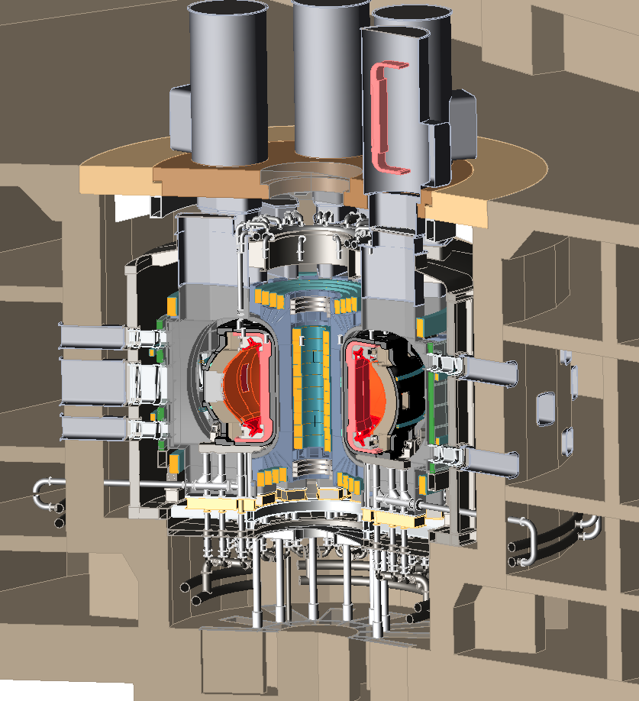
AT Pilot plant device core / facility integration

Slide 16
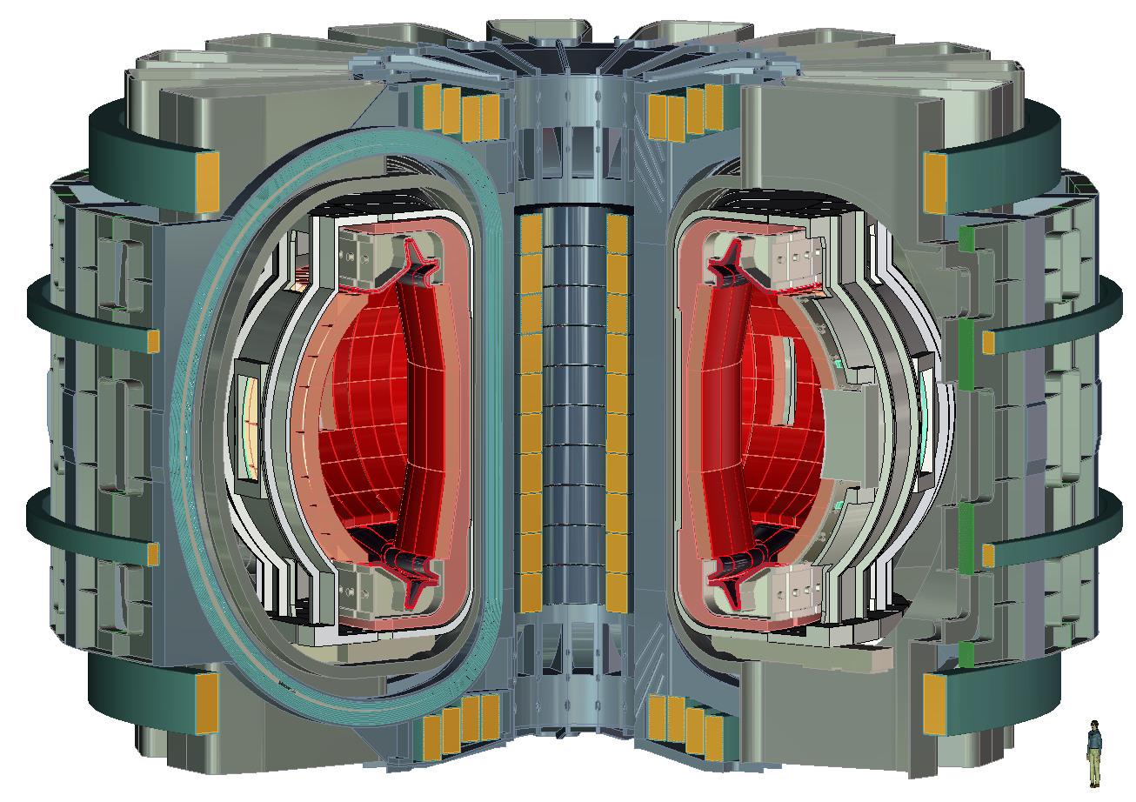
PPPL-Korean collaboration K-DEMO study

Slide 17
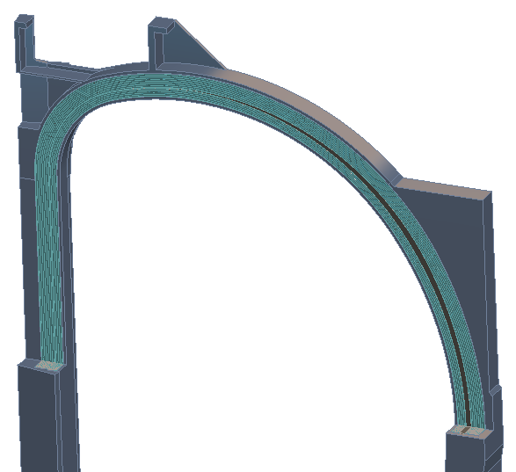
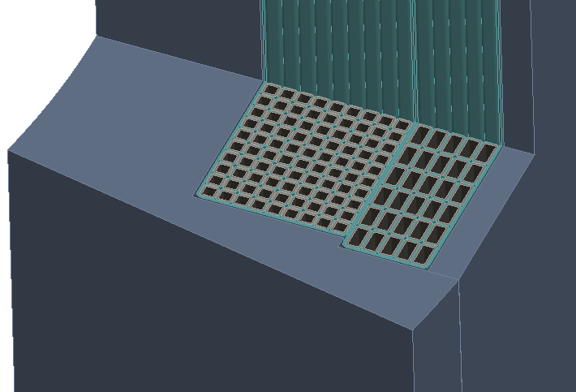
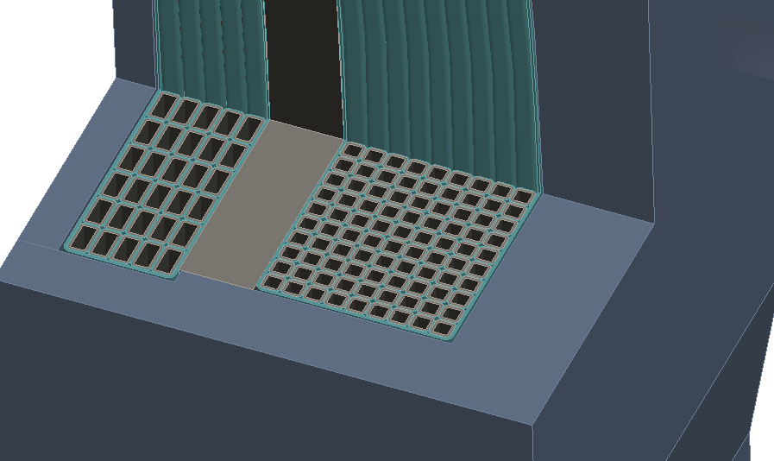
K-DEMO two coil winding toroidal field coil
TF shown with quarter section cut
Local rib structure
Low field winding
High field winding
Low field winding
Inboard leg winding detail
Outboard leg winding detail

Slide 18
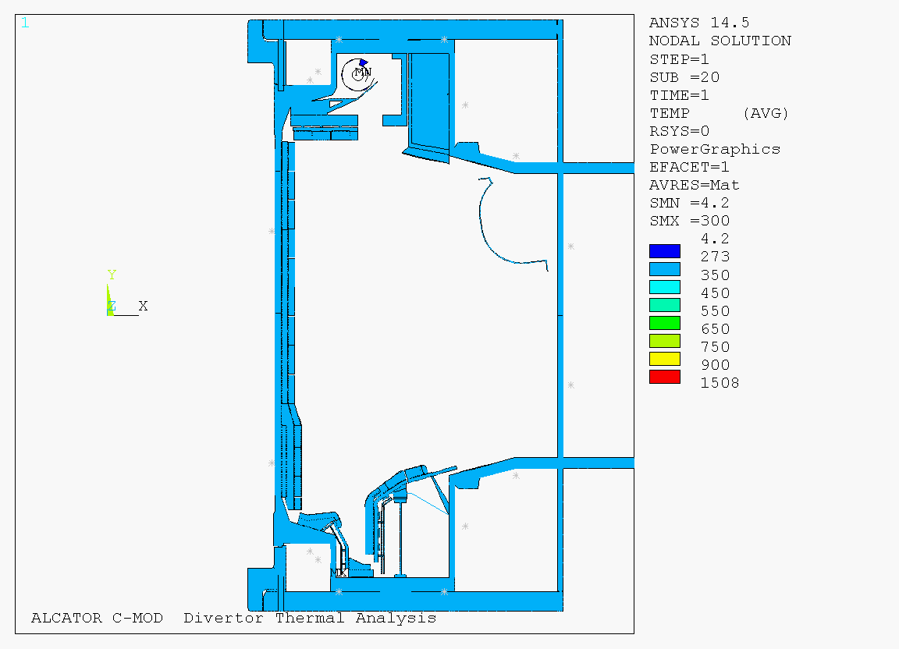
MIT’s Alcator CMOD 600 Deg C Divertor Upgrade

Slide 19
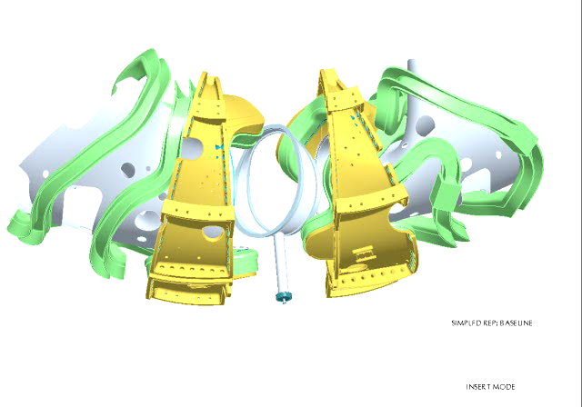
CAD Study of QUASAR assembly

Slide 20
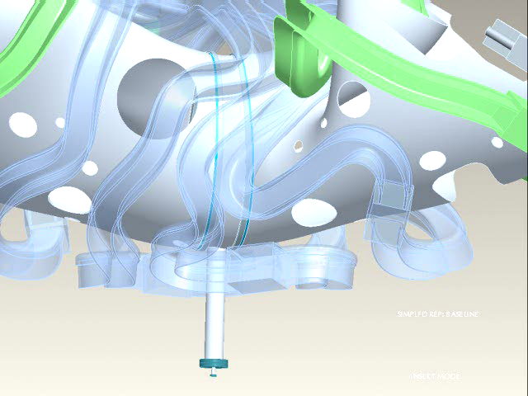
Coil & Vacuum Vessel Clearance Study

Slide 21
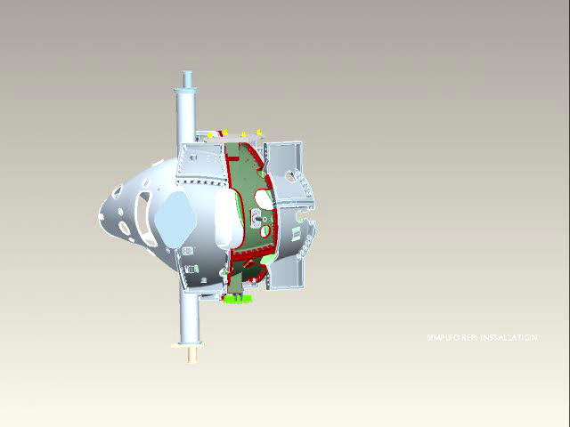
Animation of QUASAR Assembly

Slide 22
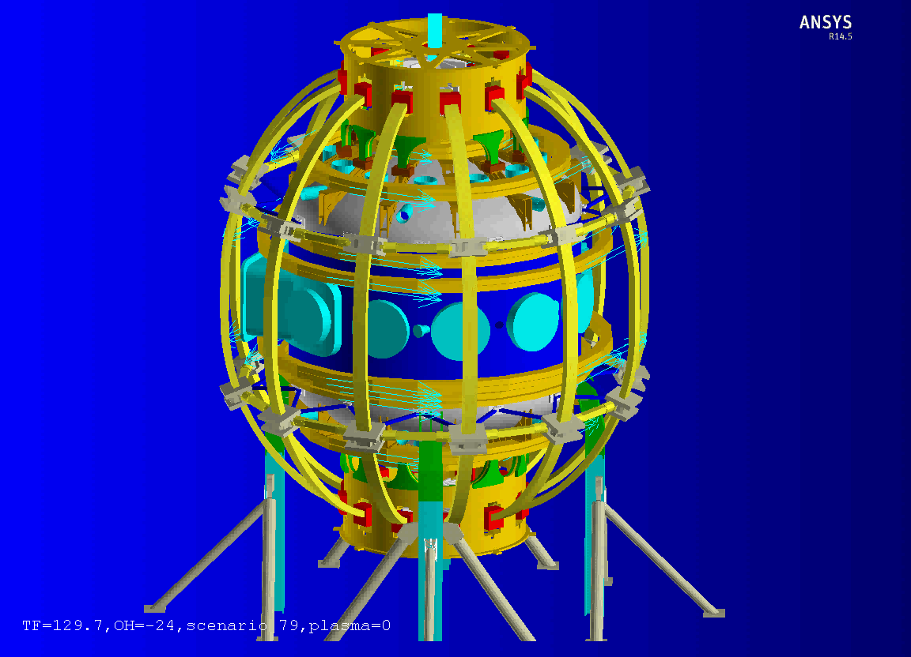
NSTX-U response to Out-of-Plane Electromagnetic Forces

Slide 23
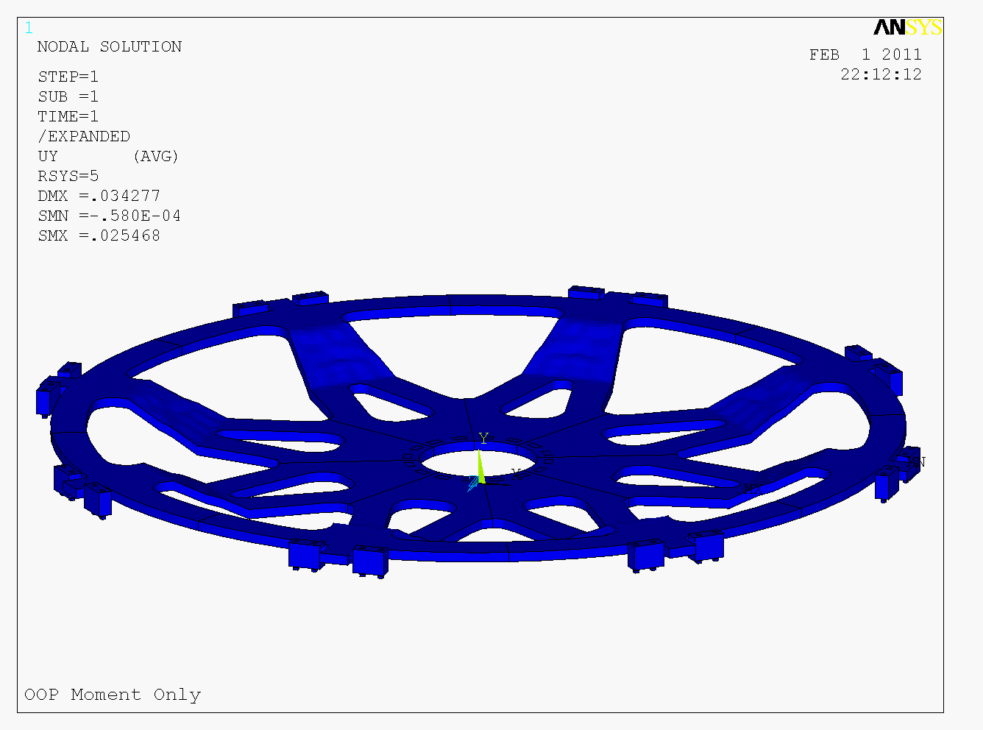

Slide 24
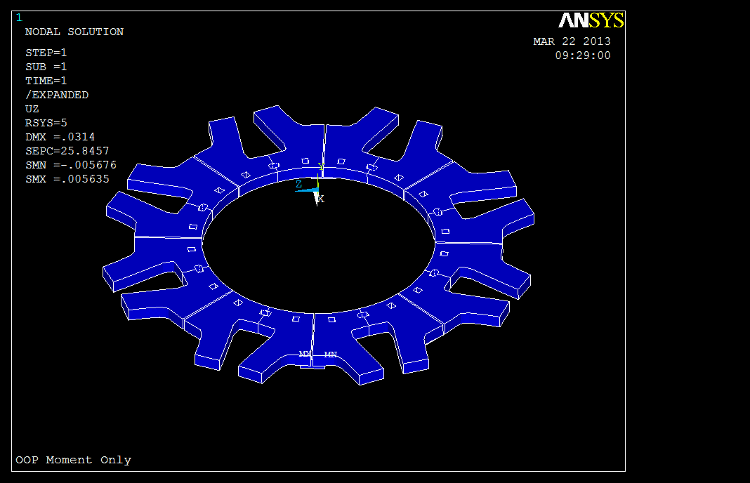

Slide 25
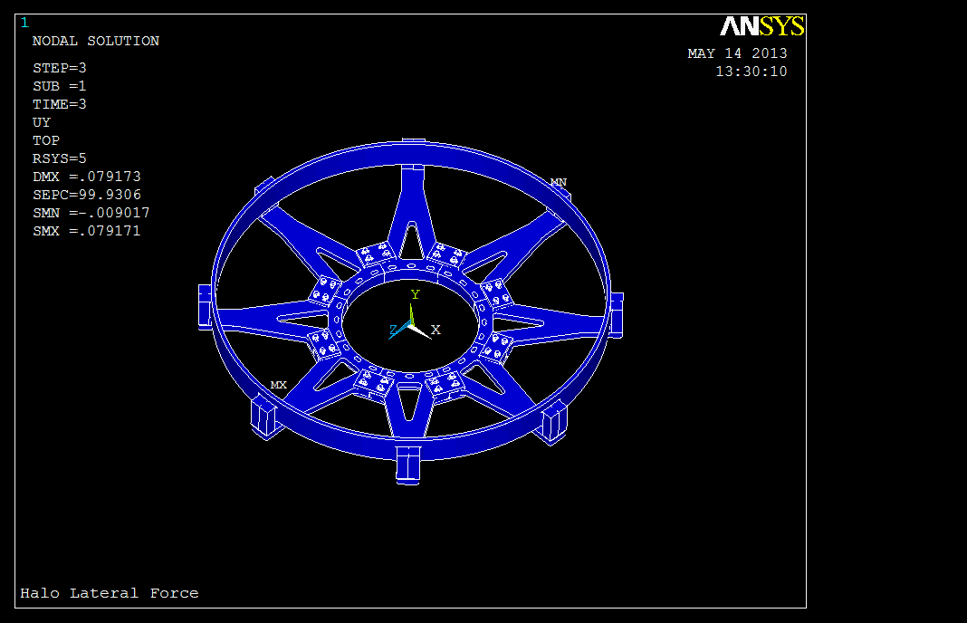

Slide 26
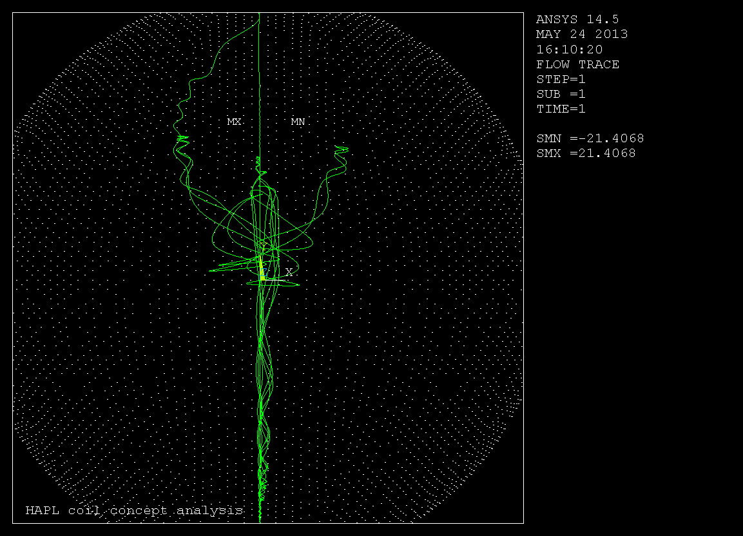
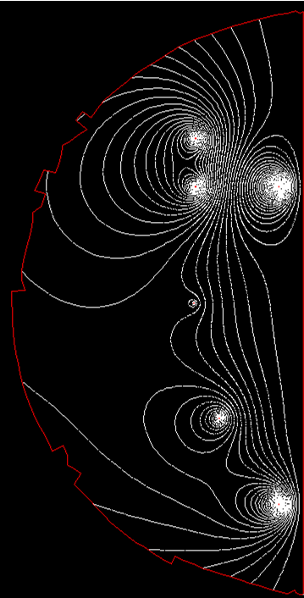
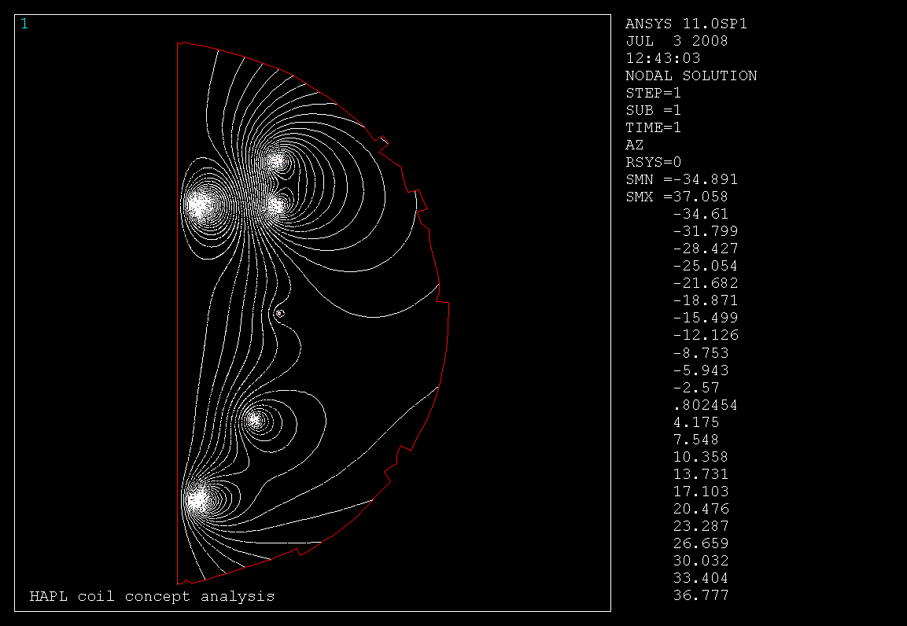

Charged ion trajectory in magnetic field

Slide 27
Charged ion trajectory in magnetic field

Slide 29
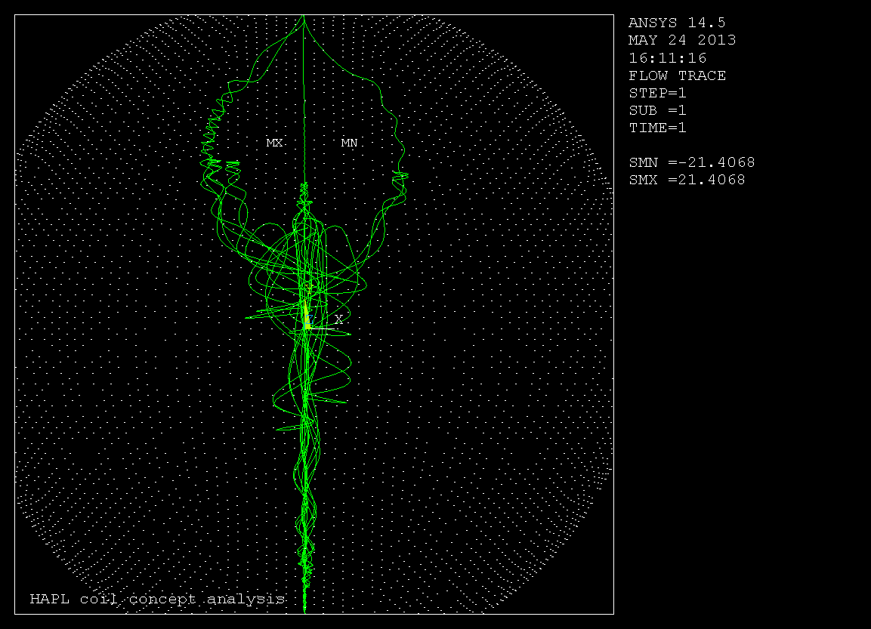

Slide 30
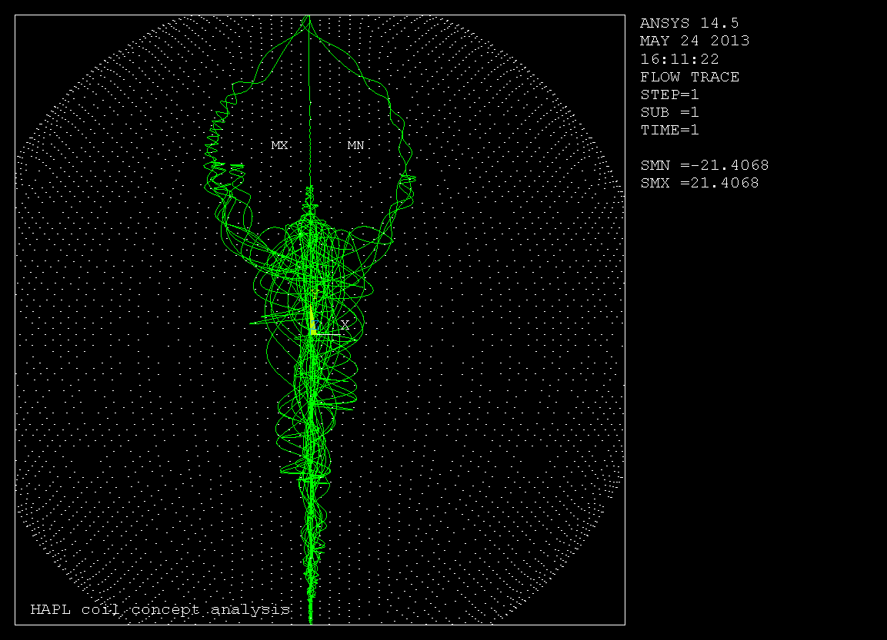

Slide 31
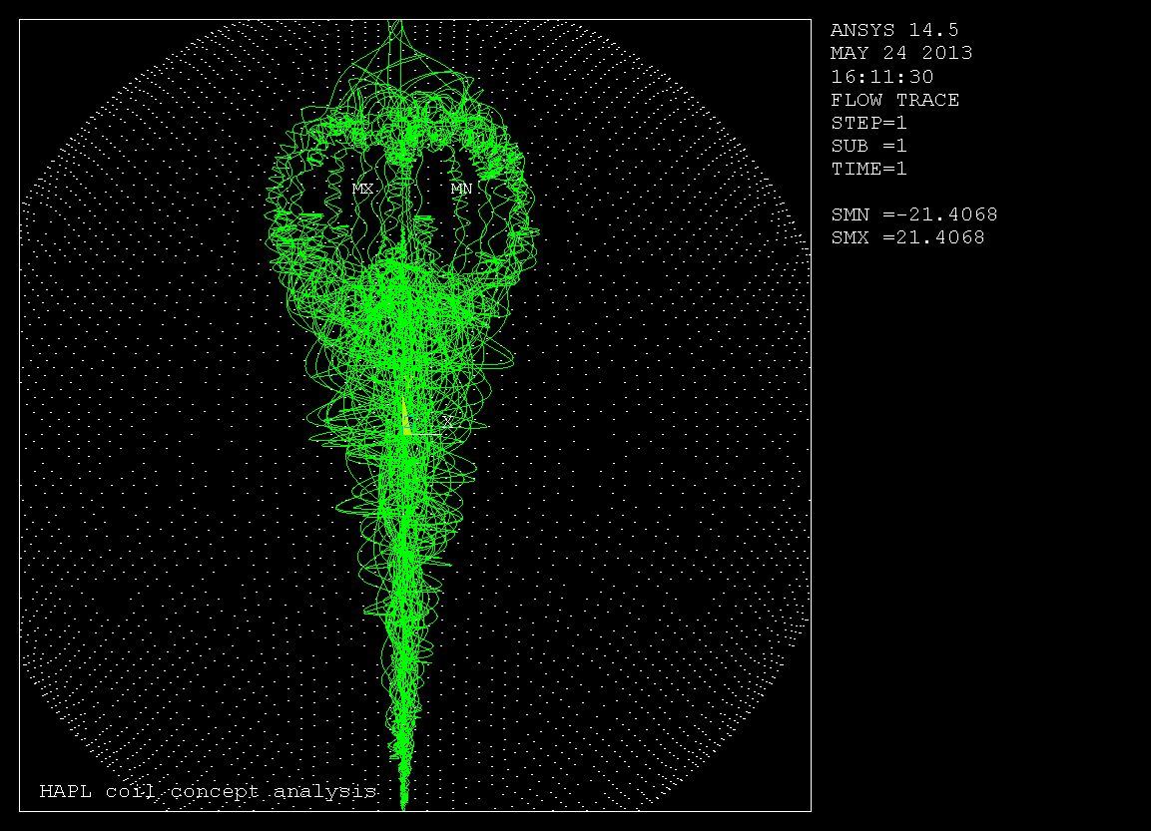

Slide 32
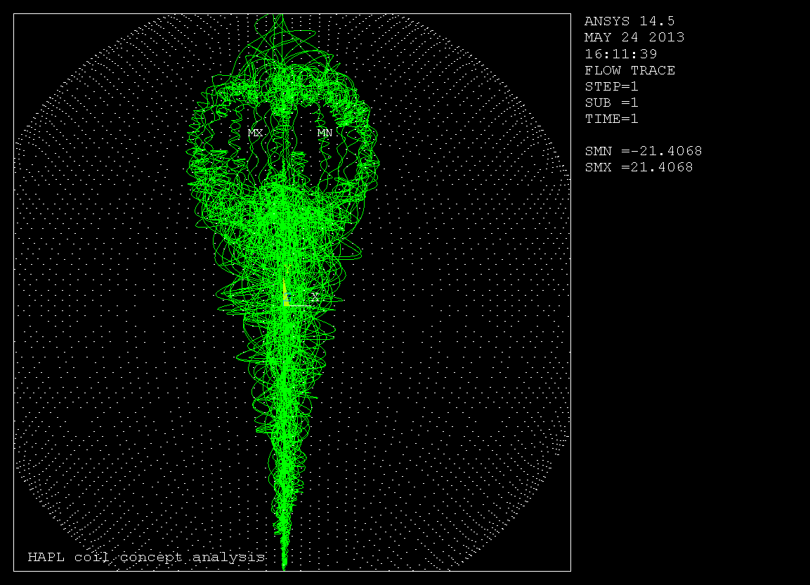

Slide 33
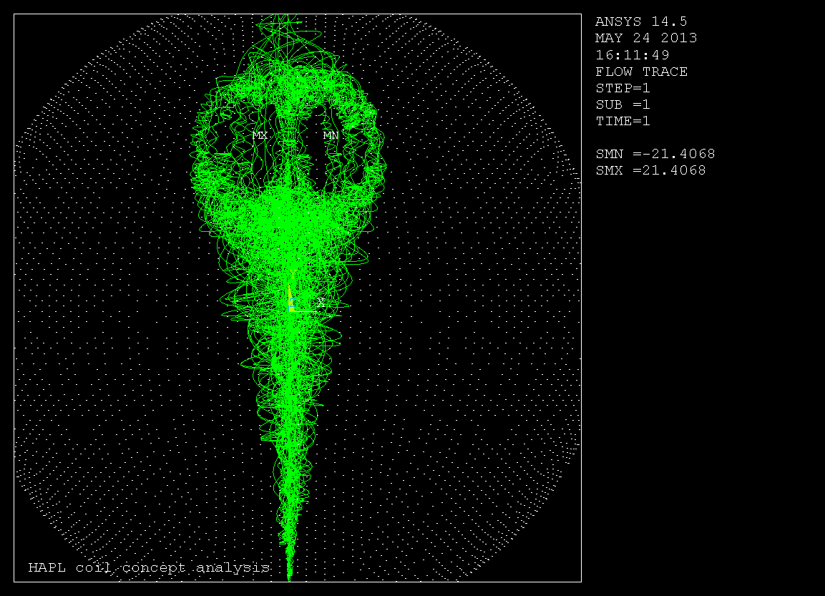

Slide 34
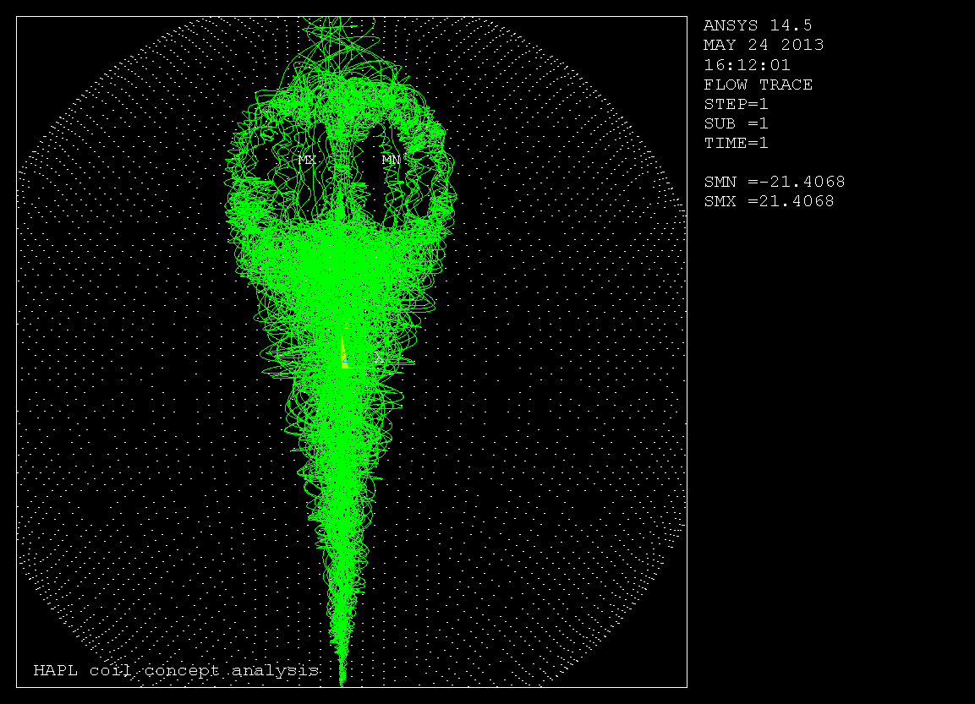

Slide 35
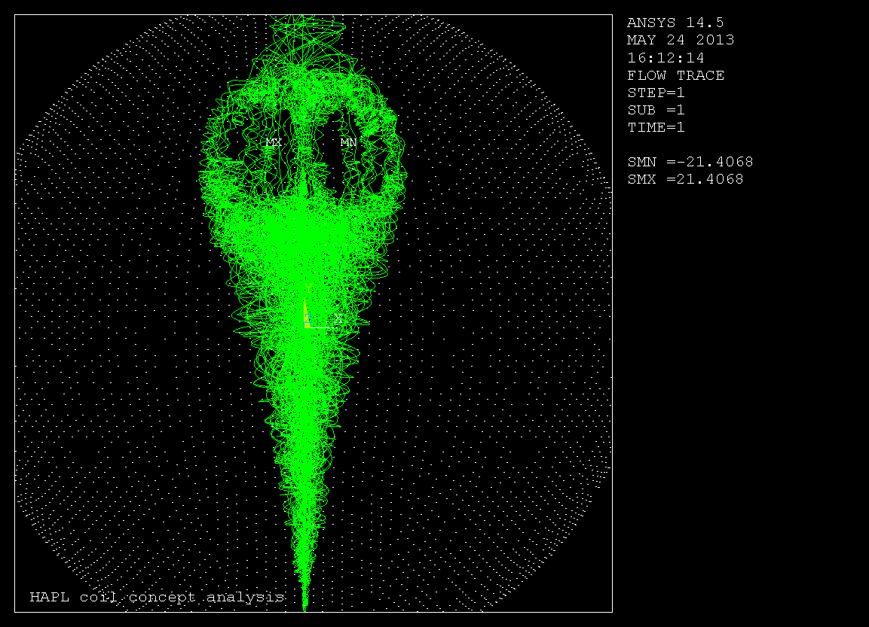

Slide 36
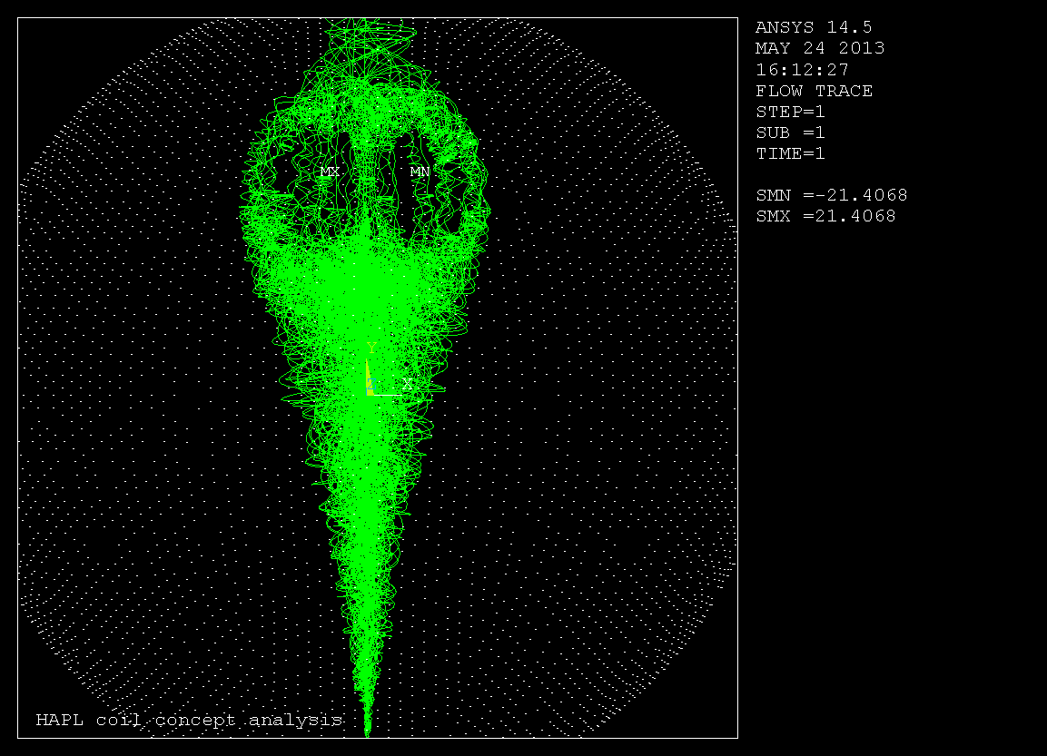

Slide 37


Slide 38
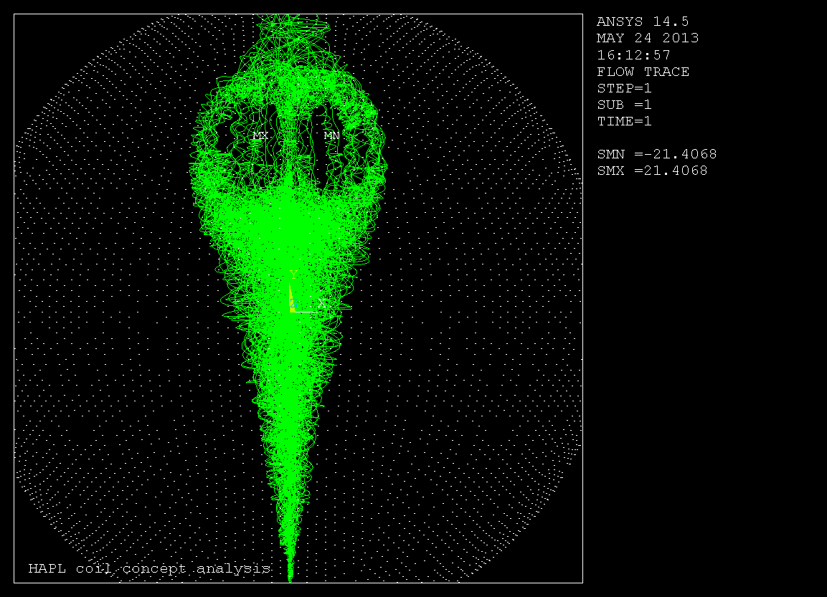

Slide 39
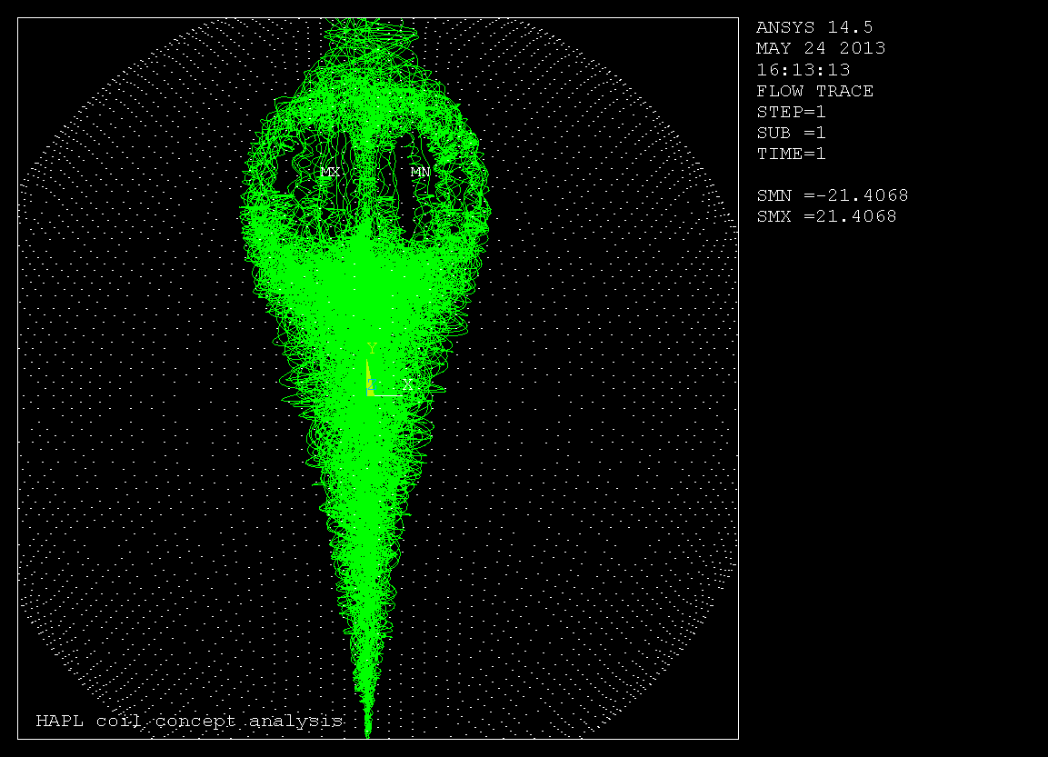

Slide 40
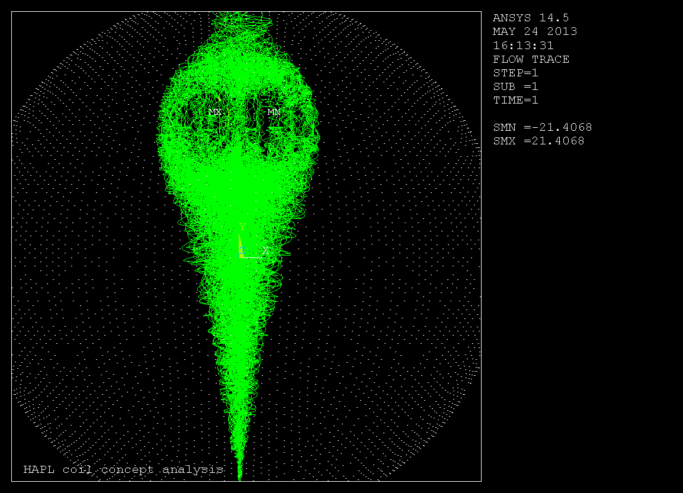

Slide 41


Slide 42
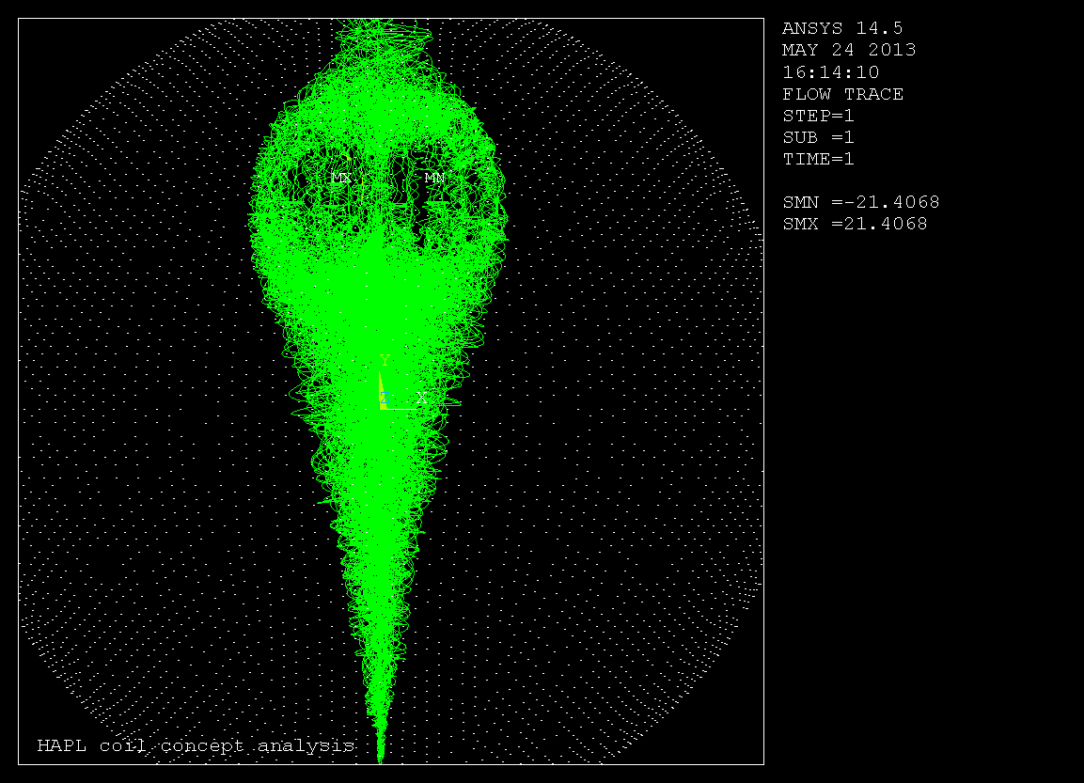

Slide 43


Slide 44


Slide 45


Slide 46
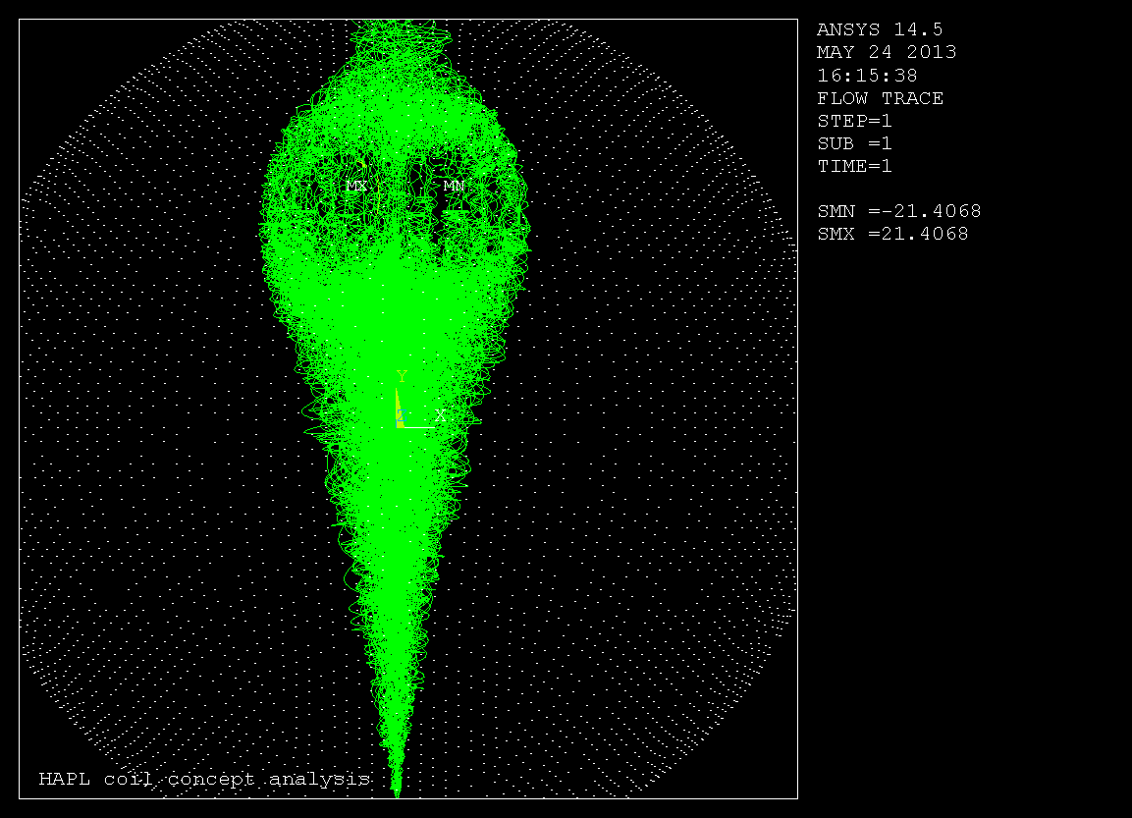

Slide 47


Slide 48
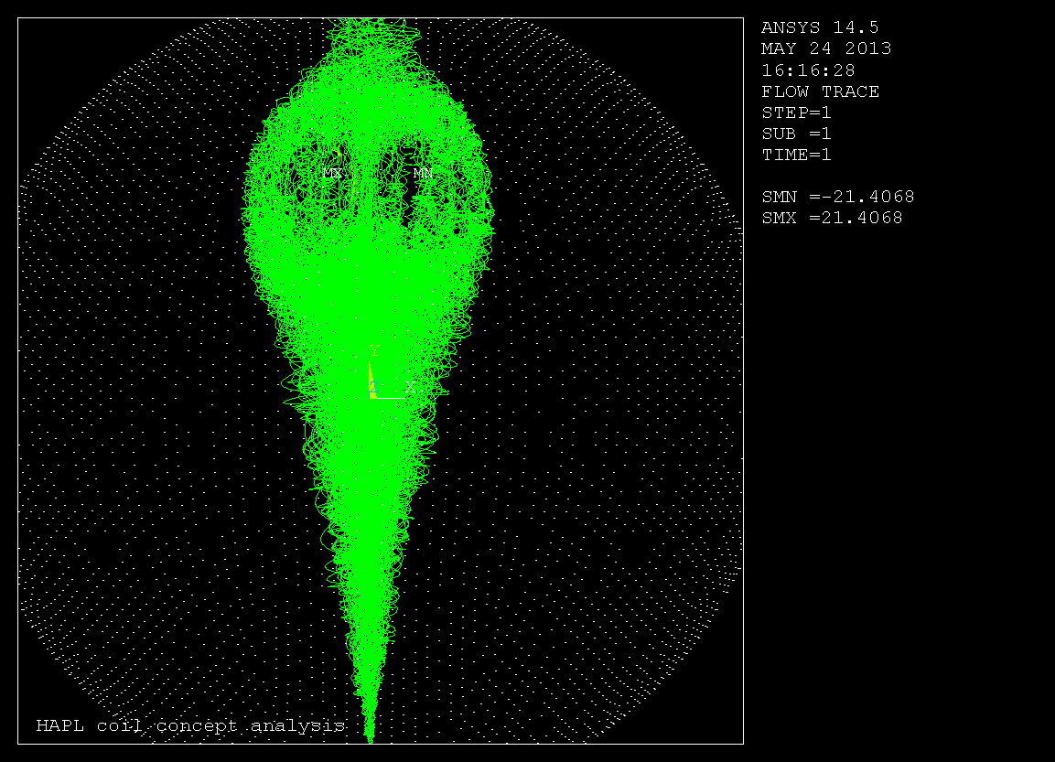

Slide 49
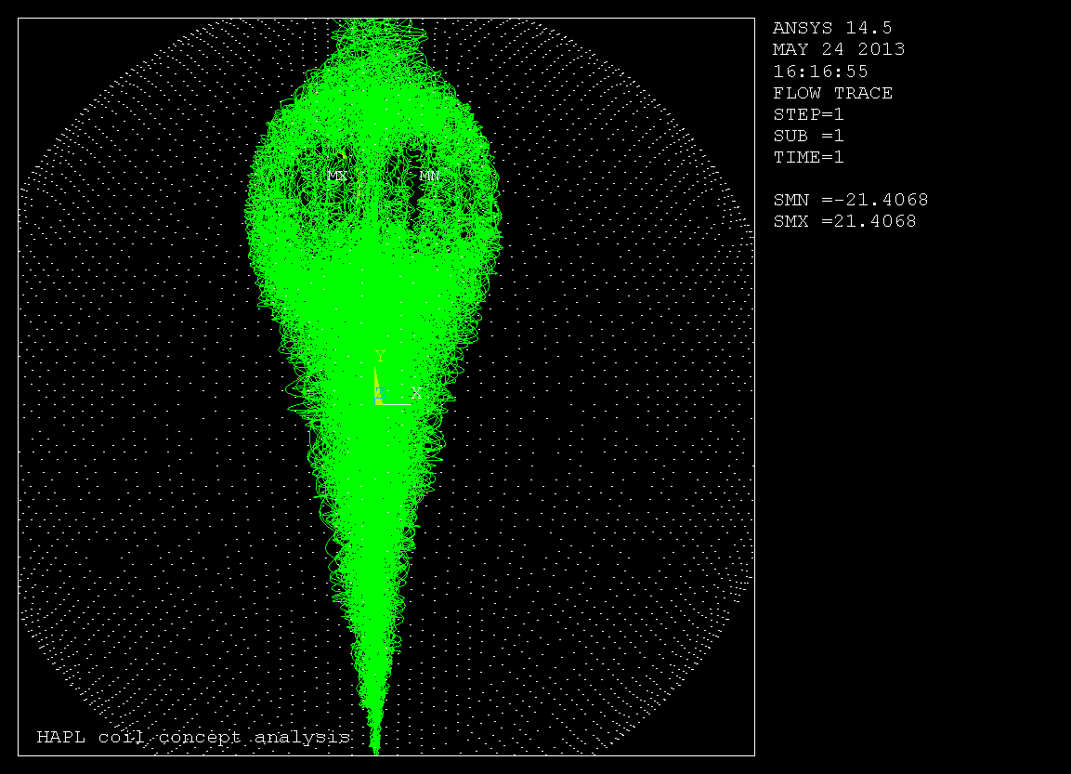

Slide 50


Slide 51


Slide 52


Slide 53


Slide 54


Slide 55


Slide 56


Slide 57


Slide 58


Slide 59


Slide 60


Slide 61


Slide 62


Slide 63
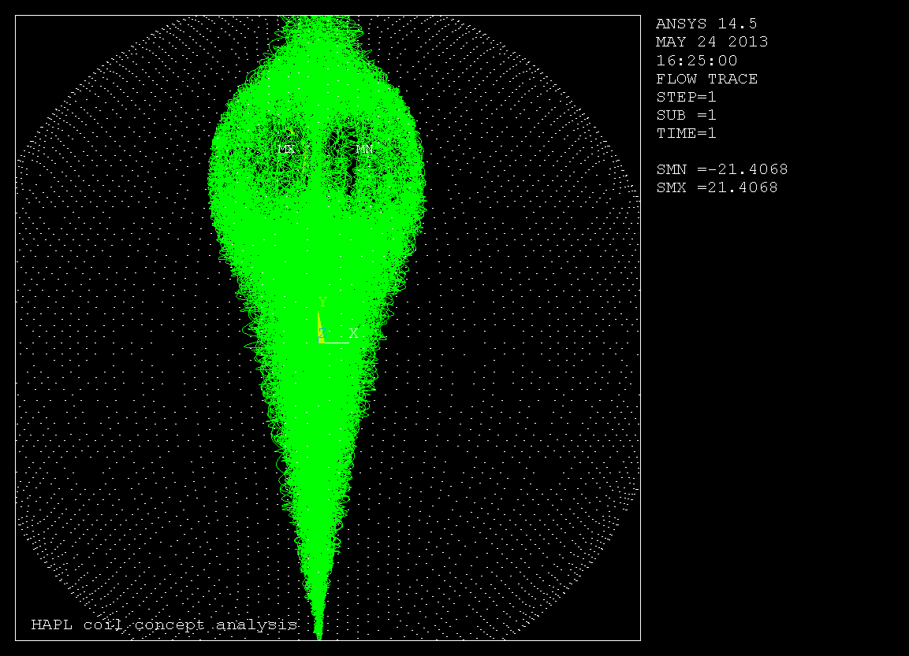

Slide 64


Slide 65


Slide 66


Slide 67


Slide 68


Slide 69


Slide 70


Slide 71


Slide 72


Slide 73
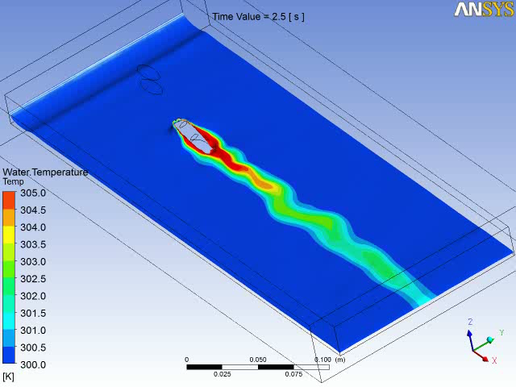

Slide 74
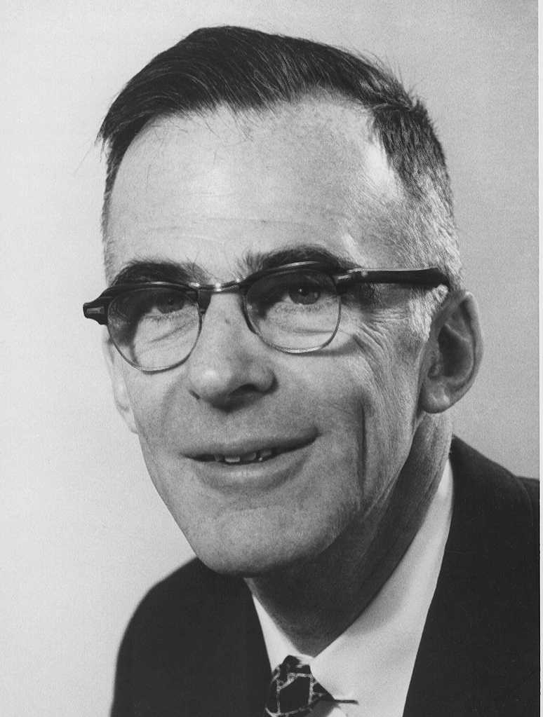
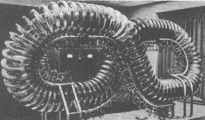
Lyman Spitzer was the founder and first director of the Princeton Plasma Physics Laboratory (originally called Project Matterhorn).

Slide 75


Lyman Spitzer’s Dream

Slide 76

Astronomy – the study of celestial objects,

Slide 77

and plasma, the 4th state of matter,

Slide 78

is said to occupy 95% of all observable matter in the universe.

Slide 79

Plasma physics is the branch of science,

Slide 80

that deals with plasmas and their interaction with magnetic fields.

Slide 81

And Lyman Spitzer studied plasma in its natural and manmade environment.

Slide 82

He was an American astronomer and theoretical physicist,

Slide 83

best known for his research in star formation and plasma physics.

Slide 84

He linked the two sciences, and envisioned how to harness the power of thermonuclear fusion,

Slide 85

the reaction that drives the stars,
into a usable source of energy here on earth.

Slide 86

The heart of Spitzer’s innovative stellerator generated plasma shape was produced

Slide 87

by poloidal and toroidal magnetic fields.

Slide 88

He further changed the shape from a conventional toroidial (donut) shape,

Slide 89

to a shape with a varying Mobius twist.

Slide 90


Slide 91


Slide 92


Slide 93


Slide 94


Slide 95


Slide 96


Slide 97


Slide 98


Slide 99


Slide 100


Slide 101


Slide 102


Richard Joseph Upcavage
Princeton Plasma Physics Lab
May 30, 2013
Modeled and Rendered by: Richard Joseph Upcavage
Princeton Plasma Physics Lab

Slide 103

QUASAR

Slide 104

ITER in Vessel Coils –Designed by PPPL

Slide 105


Slide 106


Slide 107



COILS MOUNTED ON DIAGNOSTIC PORT PLUGS
2007-2008
Coil 2x10 Configuration

Slide 108

PPPL Design for Vertical stabilization Coils

Slide 109
US ITER DIAGNOSTICS engineering led by PPPL

Slide 110



Diagnostic Shielding Module Arrangement

Slide 111

Electromagnetic Analysis Model
UPP
EPP

Slide 112

ITER Background Magnetic Field
B_{T}_dot
L
C
DFWs
Br varies slightly in time during mduplin36
4 T
R
B_{R}_dot

Slide 113


Transient Vertical Field
B_{Z}_dot at drawer mass center
1.2 T
0.5 T
B_{Z} at t=0
B_{Z} at t=32 ms

Slide 114

Eddy Current flow in Vacuum Vessel during plasma disruption

Slide 115

Eddy Current Flow in the Equatorial Port Plug
J (A/m²)
Current loop – Bz_dot dominant
5 mm gap to separate vertical drawers
– Largest eddy current appears at 20 ms during disruption
– Net current flowing in each eddy loop is over 100 kA
– ~16 MW power loss in full EPP at t = 0.032 s and ~0.5 MJ total energy loss

Slide 116
Summary of Disruption Loads
Full EPP | Total Force (kN) | Total Moment (MNm)
MD_UP_LIN36 | 223.1 | 4.51
MD_DW_LIN36 | 218.2 | 4.39
VDE_UP_LIN36 | 133.3 | 2.96
VDE_DW_LIN36 | 166.6 | 3.58

Slide 117

Deflection of the Diagnostic first wall under disruption load

