Slide 1

Studies of
Improved Confinement in Heliotron J
Presented by
MIZUUCHI Tohru
for Heliotron J Team

Slide 2
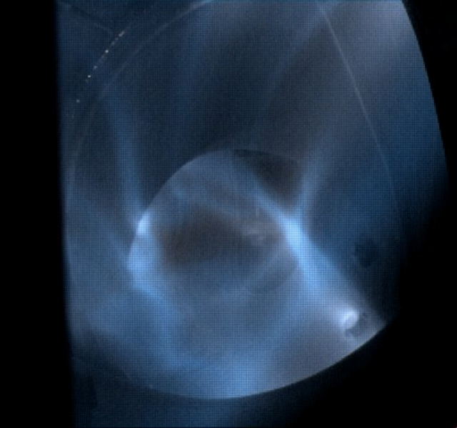
Studies of Improved Confinement in Heliotron J
Contents
Heliotron J
IAE, Kyoto University
Introduction
Transition to Improved Confinement
  Configuration Effects
  Effects of Heating Scenario
Fueling Control
Summary
Due to the time limitation, this talk will focused on “Transition”.
For other topics, please contact me or refer the proceeding

Slide 3
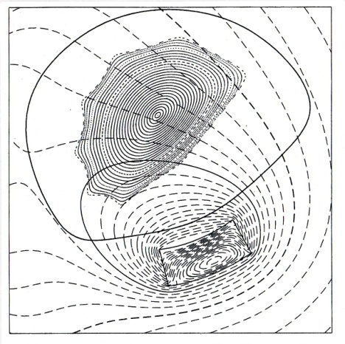
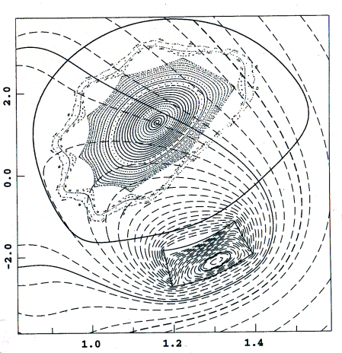
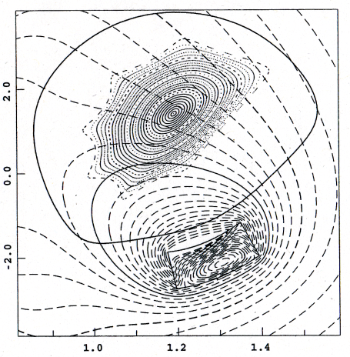
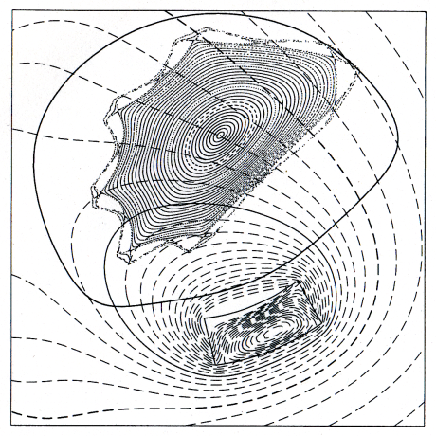
The edge magnetic surfaces are strongly modified by the resonant conditions.
Vacuum Rotational Transform
Ad. Ip
STD
HFC
ι(a)/2π=0.493
ι(a)/2π=0.498
Sub. Ip
The effects of rational surfaces have been studied is not only from the MHD activities but also from the appearance of transport barriers viewpoints.
ι(a)/2π=0.56
ι(a)/2π=0.62

Slide 4
Bumpiness Control
∇B drift can be suppressed with bumpiness control.
Magnetic field strength at plasma axis
Corner
Straight
Corner
High ε_{b}
Medium
Low
High ε_{b} : Higher mirror ripple
Low ε_{b} : Mirror field reversal (at axis)
Constant parameters :
- R_{ax}/<a_{p}> = 1.2 m/0.17 m, V_{p} ~ 0.7 m³
- Edge rotational transform
- Magnetic well in entire region

Slide 5
The Heliotron J experiments have revealed the existence of the spontaneous transition to improved confinement mode.
Observation with fast cameras revealed the existence of filament structure parallel to B in the peripheral plasma turbulence.
Phase image analysis suggests
  The CCW poloidal rotation of the filament structure during the L-mode.
  During the L-H transition, this rotation speed decreases.
  After the transition, it restarts the movement but in CW direction.
Ref. Nishino, C09 (Tue)
ECH-only plasma

Slide 6
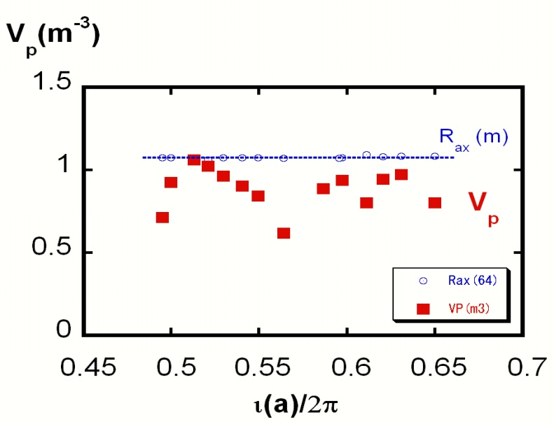
Before the transition, W_{p} strongly depends on
ι(a)/2π|_{vac}, but it is moderated after the transition.
The transition phenomena were observed almost all ι(a)/2π cases for the input power range in the experiment (ECH+NBI).
Some configurations show
a remarkable improvement but the others show a slight improvement.
V_{p} (m³), R (m)
P = P_{ECH} (∼ 0.29 MW) + P_{NBI} (∼ 0.57 MW)

Slide 7
One robust condition to the transition is the core density.
The value of the threshold line-averaged density is not sensitive to
the heating method, P_{inj} level, ι(a)/2π|_{vac}.
STD configuration
P_{ECH} (~ 0.29 MW)+P_{NBI} (~ 0.57 MW)
The threshold density is a robust condition of the transition.
The threshold density (lower density limit for the transition) is ~ 1-2×10¹⁹ m⁻³.
Only for higher values of ι/2π, some exceptional low threshold density cases are observed. ⬄ MHD activities?

Slide 8
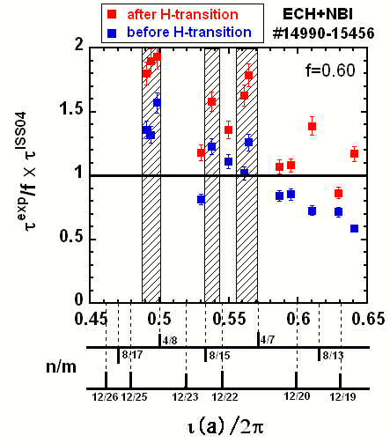
the “quality of improvement” based on ISS04 seems to depend on the configuration.
F. Sano, et al., Nucl. Fusion 45 (2005) 1557.
Iota-windows for high quality H-mode close to the low-mode rationals
All configurations basically have “stellarator shear” (vacuum)
⇒ hard to get edge flux surfaces on the “right-side” of the rationals.
Difference in the poloidal viscous damping among the configurations can cause the difference in the “quality”?
  Still open question.
    Bias experiment will give us some information.
τ^{exp}/(f×τ^{ISS04})
ι(a)/2π|_{vac}

Slide 9
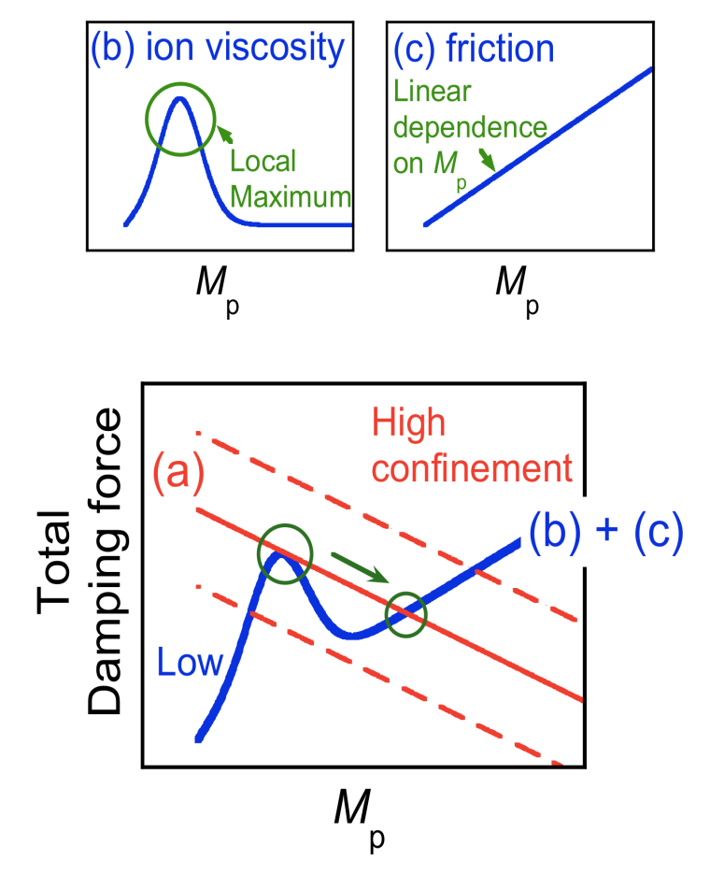
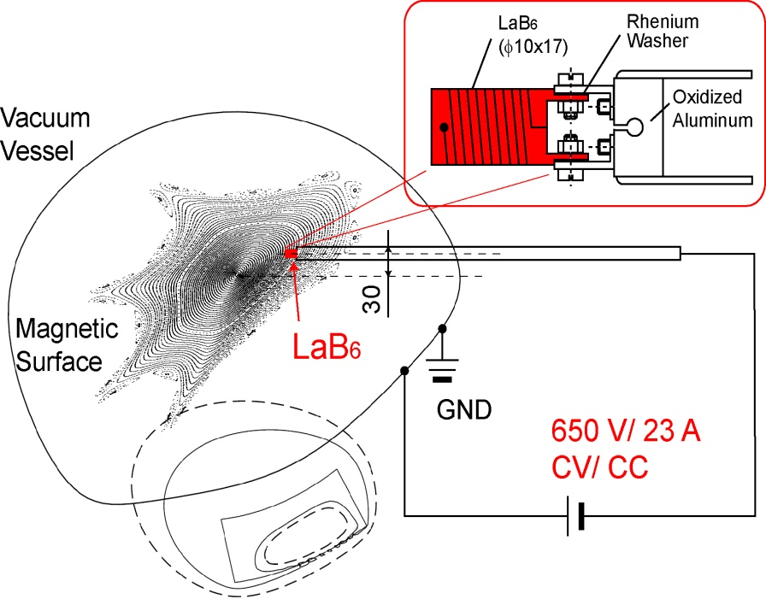
Electrode Bias Exp. in Heliotron J under a Low Field Condition
S. Kitajima, et al., Tohoku Univ.
Externally controlled torque could give us a lot of (but NOT sufficient) information on the viscous damping.
Electrode of LaB₆
(Hot Cathode)
3
Note: This experiment was performed
under a special configuration for 2.45GHz ECH discharge.

Slide 10
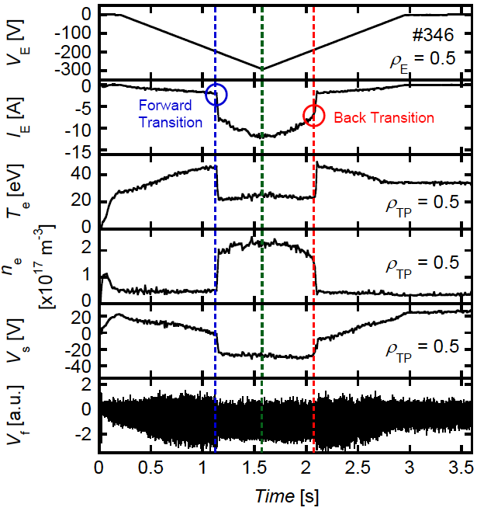
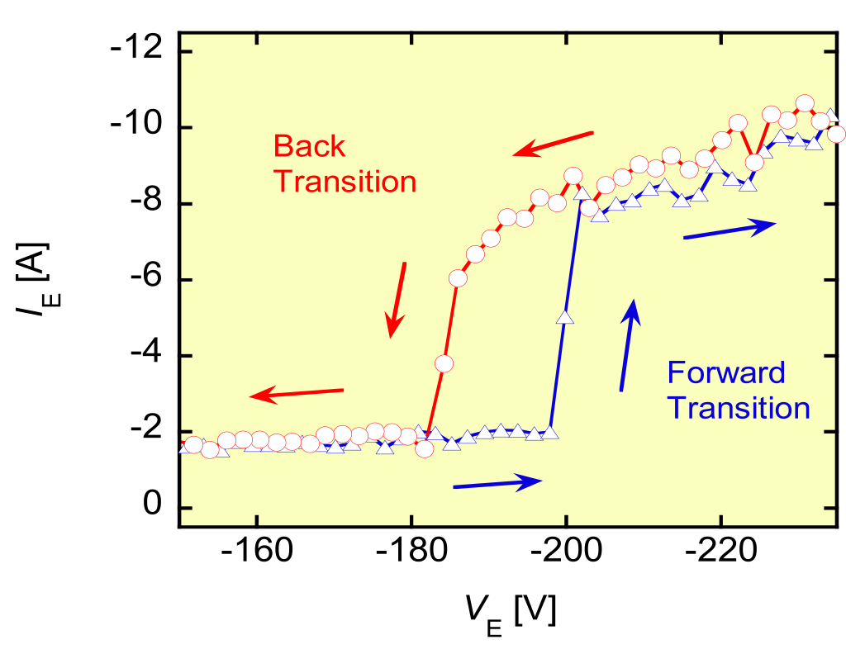
Time Evolution of a Biased Discharge
Triangular voltage was applied in order to give rise to forward/ back transition.
Rapid increase of I_{E} and n_{e}.
V_{s} changed from positive to negative.
Drop in the fluctuation level.
Clear hysteresis of I_{E}.

Slide 11
Bias Exp. suggests plasma rotation can modify the edge field topology.
Probe array
Time traces of ion-saturation currents at divertor probe array during biasing:
Increase for some channels,
but decrease for other channels.
→ Modification of edge field topology!

Slide 12
The “quality of improvement” based on ISS04 seems to depend on the configuration.
F. Sano, et al., Nucl. Fusion 45 (2005) 1557.
All configurations basically have “stellarator shear” (vacuum)
⇒ hard to get edge flux surfaces on the “right-side” of the rationals.
Difference in the poloidal viscous damping among the configurations?
But, is that all?
  How about the “plasma effects”, especially effects of
  (non-induction) plasma current.
  Experiments suggest the change of the iota and/or the size of the confinement region.
τ^{exp}/(f×τ^{ISS04})
ι(a)/2π|_{vac}

Slide 13
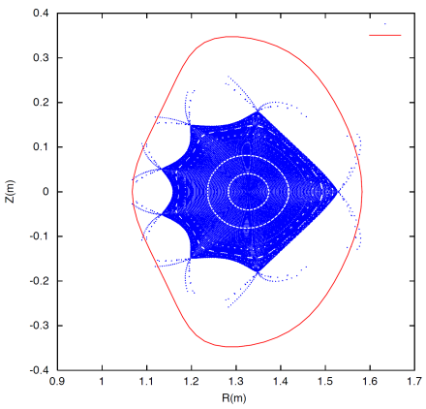
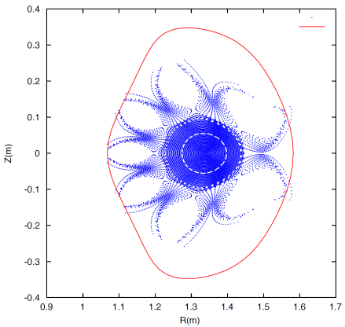
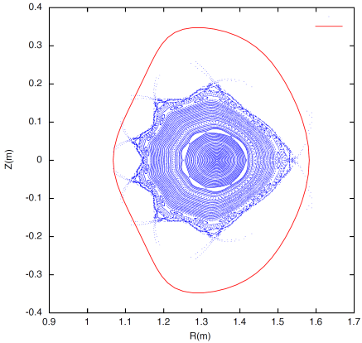
HINT2 predicts the change of the field topology caused by plasma current:
vacuum
β(s) = 0.5·(1-s)² [%], j_{p} = j_{p0}·(1-s)²
“Additive” plasma current can modify not only the ι/2π-profile
but also the “shape” of magnetic surfaces.
Asymmetric effect of plasma current due to the “proximity” to a low-mode rational number.
0kA
ad. 1kA
ad. 2kA
ad. 4kA
sub. 1kA
sub. 2kA
sub. 4kA

Slide 14
Experiments suggest the change of the edge field topology during a plasma shot.
ECH (≈ 0.3 MW) + NBI (≈ 0.7 MW, co-injection) @ STD
The observed non-inductive toroidal plasma current is gradually increases as increase of the stored energy.
  In the density range shown in the figure, the observed plasma current is considered to mainly consist of the bootstrap current and the NB induced current.
The profiles of the diverted plasma density
at t = 211 and 277 ms.
  At 211 ms, the density distribution is consistent with that expected from the vacuum field topology.
  At 277 ms, the density peak position shifts inward about 4 cm compared to the position at 211 ms.
The overall trend of the density-peak-position shift seems to be well synchronized with the change of W_{p} or I_{p}.

Slide 15
Comparison between Co/CTR
NBI-only plasmas
- No transition in CTR NBI -
In Co-NBI, the transition were observed, but no transition in CTR-NBI.
  Difference in the transition condition between these NBI-only plasmas due to
    Deformation of ι/2π
      Position of rational surface,
      Shear,
      Shape of LCFS,
    Direction of momentum input ?

Slide 16
The transition is observed when the plasma current reaches a critical value.
Dependence of I_{P} at transition on P_{NB}
The critical value of the plasma current depends on the configuration;
0.7±0.1kA in middle ε_{b}
1.3±0.2kA in high ε_{b} cases.
The observed time delay would be related to the growing-up time of the current.
High ε_{b}
drop (kA)
α
Dependence of delay time on P_{NB}
@ H
I
p
Medium ε_{b}
delay time (ms)
In high ε_{b} case, higher I_{p} was required.
The effects of the plasma current on the field configuration should depend on the vacuum rotational transform. → ι(a)/2π|_{vac}-scan experiment.

Slide 17
The critical current for NBI-only plasma
strongly depends on ι/2π|_{vac}.
Radial profile of iota
Close to Rationals?
12/23
12/22
8/17
4/8
8/15
4/7
8/13
(High ε_{b})
I_{p}@transition (kA)
I_{p} (kA)
So far, the transition was observed only in Co-NBI (ad. NBCD) plasmas (P_{inj} < 0.6 MW).
A “critical current” for the transition exists
for all config.
Does the change in the rotational transform caused by non-inductive plasma current trigger the transition? → Check other heating cases.
ι(a)/2π|_{vac}
0.25 MW < P_{inj} < 0.6 MW,
n_{e} ~ 1.5-2×10¹⁹ m⁻³

Slide 18
Comparison of the plasma current at the transition
for ECH-, NBI-, and ECH+NBI-plasmas
ECH-only
NBI-only
ECH+NBI
8/17
4/8
12/23
12/22
8/15
4/7
8/13
(High ε_{b})
I_{p} (kA)
I_{p}@transition (kA)
ι(a)/2π|_{vac}
I_{p,NET} itself seems not a key factor?
  ➔ Need profile data!

Slide 19
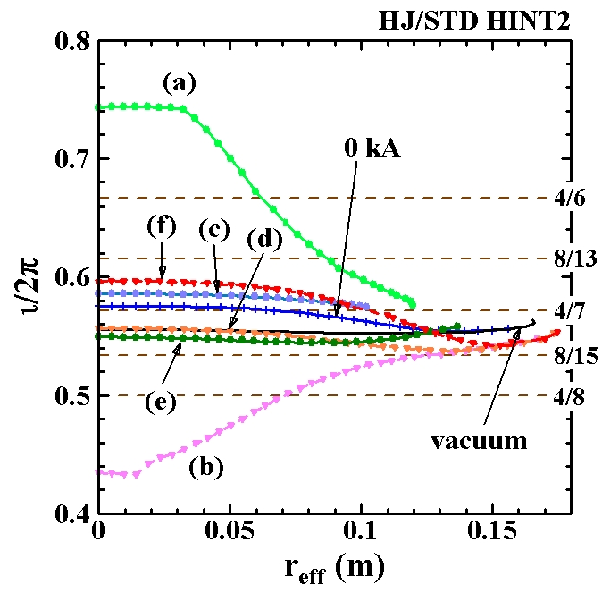
Even for the same net current, the deformation of ι/2π and the shape of the magnetic surface strongly depend the current profile.
- MODEL CALCULATION -
<β> ~ 0.32 %, p=p₀(1-s²)²
(a) j = j₀(1-s)⁸, I_{net} = +2.0 kA
(b) j = j₀(1-s)⁸, I_{net} = -2.0 kA
(c) j = j₀(1-s⁴)², I_{net} = +2.0 kA
(d) j = j₀(1-s⁴)², I_{net} = -2.0 kA
(e) j = j₀(60(1-s²)s²-5(1-s²)),
I_{net} = +2.0 kA
(f) j = j₀(60(1-s²)s²-5(1-s²)),
I_{net} = -2.0 kA

Slide 20
Comparison of the plasma current at the transition
for ECH-, NBI-, and ECH+NBI-plasmas
ECH-only
NBI-only
ECH+NBI
8/17
4/8
12/23
12/22
8/15
4/7
8/13
(High ε_{b})
I_{p} (kA)
I_{p}@transition (kA)
ι(a)/2π|_{vac}
I_{p,NET} itself seems not a key factor?
  ➔ Need profile data!
  Even in low density ECH-only plasma lower than the threshold density, the transition can be observed when the EC driven “additive” current is high enough.
Transition is observed in ECH+NBI plasmas even in the low ε_{b} case.

Slide 21
Transition to a better confinement mode was observed in a high ECCD current discharges.
Low-ε_{b}, ι/2π(a) ~ 0.56,
ECH-only with P_{ECH} > 0.3 MW
The line-averaged density is much lower than the critical low-density limit observed in the previous experiments.
No enough experiments, from this point of view, in sub. high ECCD condition.

Slide 22
Summary (1)
− Transition to improved confinement −
No transition in CTR-NBI-only plasma
Existence of the “critical current” in Co-NBI-only plasma
→ Change in the rotational transform (and/or its radial profile) caused by plasma current and/or the direction of momentum input can trigger the transition in NBI plasma.
No clear current dependence in ECH-only plasma
→ Difference in the transition condition
between NBI-only and ECH-only plasmas.
→ ECH should have some effect on the transition condition in NBI plasma.
In low density (lower than the threshold density) ECH-only plasma, the transition can be observed
when the EC driven “additive” current is high enough.
→ Change in the rotational transform (and/or its radial profile) is effective even for ECH-only plasma.

Slide 23
Summary (2)
− Transition to improved confinement −
for n_{e} > n_{e,th}
 | ECH-only | NBI-only (Co) | NBI-only (CTR) | NBI (Balance) ECH+NBI (Balance) | ECH+NBI (Co) | ECH+NBI(CTR)
i(a)/2π|_{vac} | X only for 0.493 | OK | X | No Data | OK | No Data
ε_{b}* | △ for high-ε_{b} | X for low-ε_{b} | X | No Data | OK | No Data
I_{p,th}** | No | Yes | − |  | Yes
remarks | Transition is observed in low n_{e}, high I_{p}
* Data for different ι(a)/2π|_{vac} are necessary.
** Data @ Ip=0 are necessary.

Slide 24
Thank you for your attention!
&
Thank you All Contributors for Nice Collaborations!
F. Sano, K. Nagasaki, H. Okada, T. Minami, S. Kobayashi, S. Yamamoto,
S. Ohshima, K. Hanatani, S. Konoshima
Institute of Advanced Energy, Kyoto University
Y. Nakamura, K. Mukai, S. Kishi, H.Y. Lee, K. Minami, Y. Takabatake
Graduate School of Energy Science, Kyoto University
T. Mutoh, S. Okamura, Y. Takeiri, K. Y. Watanabe, M. Yokoyama,
K. Nagaoka, Y. Yoshimura, Y. Suzuki, H. Takahashi
National Institute for Fusion Science
N. Nishino
Graduate School of Engineering, Hiroshima University
S. Murakami
Graduate School of Engineering, Kyoto University
S. Kitajima, H. Utoh
Graduate School of Engineering, Tohoku University
Y. Nakashima
Plasma Research Center, University of Tsukuba
I. Pankratov
National Science Center, Kharikov Institute of Physics and Technology, Ukrina
Q. Yang, L. Yao, W. Chen
Southwestern Institute of Physics, China

Slide 25
No clear threshold power for Phase-I
No clear/simple relation between n_{th} and P_{abs}.
At the ι(a)/2π ≈ 0.493, ECH-only discharges cannot make a transition. → configuration effects on the power threshold.
Different power dependence for
Phase-I and II?
F. Sano, et al., Nucl. Fusion 45 (2005) 1557.

