Slide 1

Full-F gyrokinetic simulations of the LAPD device with open field lines and sheath boundary conditions
Greg W. Hammett, Eric L. Shi*, Ammar Hakim
* Ph.D. student who did the vast majority of the work (graduating soon)
Princeton Plasma Physics Laboratory
Princeton University
Oxford Plasma Theory Group Seminar
Nov. 17, 2016
(2018.09.28 corrected
typo on p. 23, 2020.10.18 corrected typos p. 21)
Fusion Energy 2016 IAEA paper TH/P6-2, https://arxiv.org/abs/1610.09056
Supported by the Max-Planck/Princeton Center for Plasma Physics, by a PPPL LDRD project, and by the DOE Scientific Discovery Through Advanced Computing (SciDAC) Program, through the Center for the Study of Plasma Microturbulence.

Slide 2
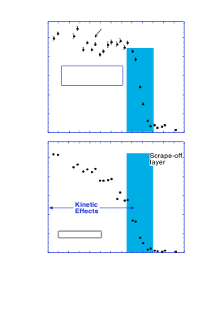
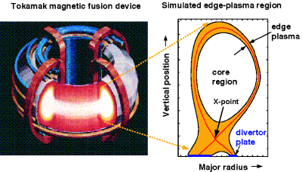
Edge region very difficult
1000
Temp. (eV)
500
0
R (cm)
Edge pedestal temperature profile near the edge of an H-mode discharge in the DIII-D tokamak. [Porter2000]. Pedestal is shaded region.
Present core gyrokinetic codes are highly optimized for core, need new codes (or major upgrades) to handle complications of edge region of tokamaks (& stellarators):
open & closed field lines (sheath boundary conditions, plasma-wall-interactions), large amplitude fluctuations (positivity constraints, non-Maxwellian full-F), atomic physics, non-symmetric RMP/stellarator coils, magnetic fluctuations near beta limit…
Hard problem: but success of core gyrokinetic codes and progress of XGC PIC code makes us believe this is tractable, with a major initiative

Slide 3
Appear to be the first continuum gyrokinetic simulations of SOL turbulence
There have been a few pioneering explorations in past, but they were not continued, apparently because of various numerical difficulties
  Pioneering work with finite-difference TEMPEST (LLNL, ~2006), focused on 4D axisymmetric neoclassical calc. Switched to 4th-order finite-volume COGENT code, better conservation/numerical properties (APS 2016: 5D slab, not yet SOL).
  "Use of the FEFI nonlocal gyrokinetic model is planned but a sheath model compatible with violent shear Alfvén dynamics in front of the divertor plate remains to be found.” (Zweben, Scott, et al., 2009)
  “Comparison of scrape-off layer turbulence in Alcator C-Mod with three dimensional gyrofluid computations”, PoP, http://dx.doi.org/10.1063/1.3191721
Numerical challenges of edge:
  Large amplitude fluctuations, need f>0 (sheath instabilities if f<0 ?)
  Conservation properties (small charge imbalances drive large potentials)
  Stable interaction of gyrokinetics w/ sheath
  High frequency “Ω_{H}” mode / “Ampere cancellation problem”?
  Complications, but not main roadblocks: Coordinate singularies, collisions, …
  ...

Slide 4
2cd order Symplectic or Arakawa methods for fluids/PDEs equivalent to 2cd order Finite-Differencing
Advection paradigm test problem:
Symplectic / Arakawa algorithm
= standard 2cd order centered finite-difference
Exactly conserves particles:
and “free energy” / “entropy” / L₂ norm:

Slide 5
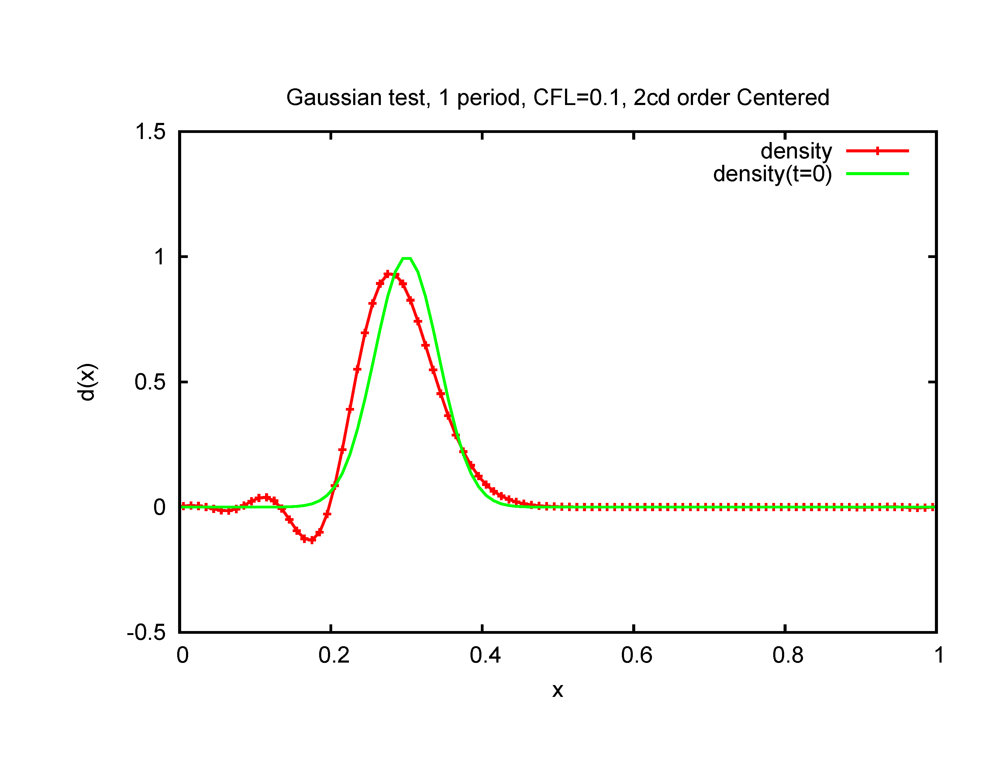
Simple test: Advection of Gaussian pulse in periodic box
F(x)
Relatively okay solution, will converge to exact solution as Δx --> 0. But disappointing it requires so many grid points, that there are artificial oscillations, and that F<0.

Slide 6
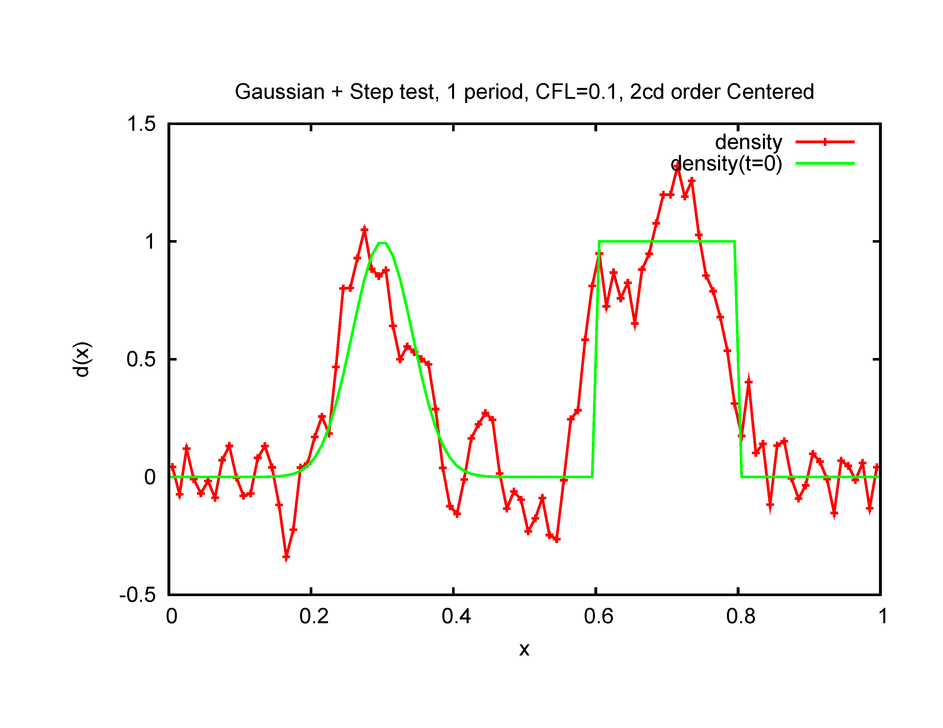
Harder test: Advection of Gaussian + Top Hat in periodic box
F(x)

Slide 7
Many common continuum algorithms (Arakawa, high-order upwind, spectral) can have difficulties in the edge
F(x)
Even high-order (3rd) upwind with (hyper)diffusion has overshoots. Godunov’s theorem: linear algorithm can’t avoid artificial overshoots unless very diffusive 1st order upwind is used. Negative density doesn’t make physical sense, could cause sheath problems.

Slide 8
Nonlinear limiters developed in 1970s-1990s do fairly well
(except for some clipping of extrema)
(Eliminates artificial overshoots. Gets around Godunov’s theorem because of nonlinear filtering.)
F(x)
Uses 3rd order initial spatial interpolation before limiter, 3rd order SSP-RK. Seems better at CFL=0.5 with 2cd order time-space-coupled time step, (exact at CFL=1), but for complex flows, will be regions at wide range of CFL=v*dt/dx, incl. CFL<<1.

Slide 9
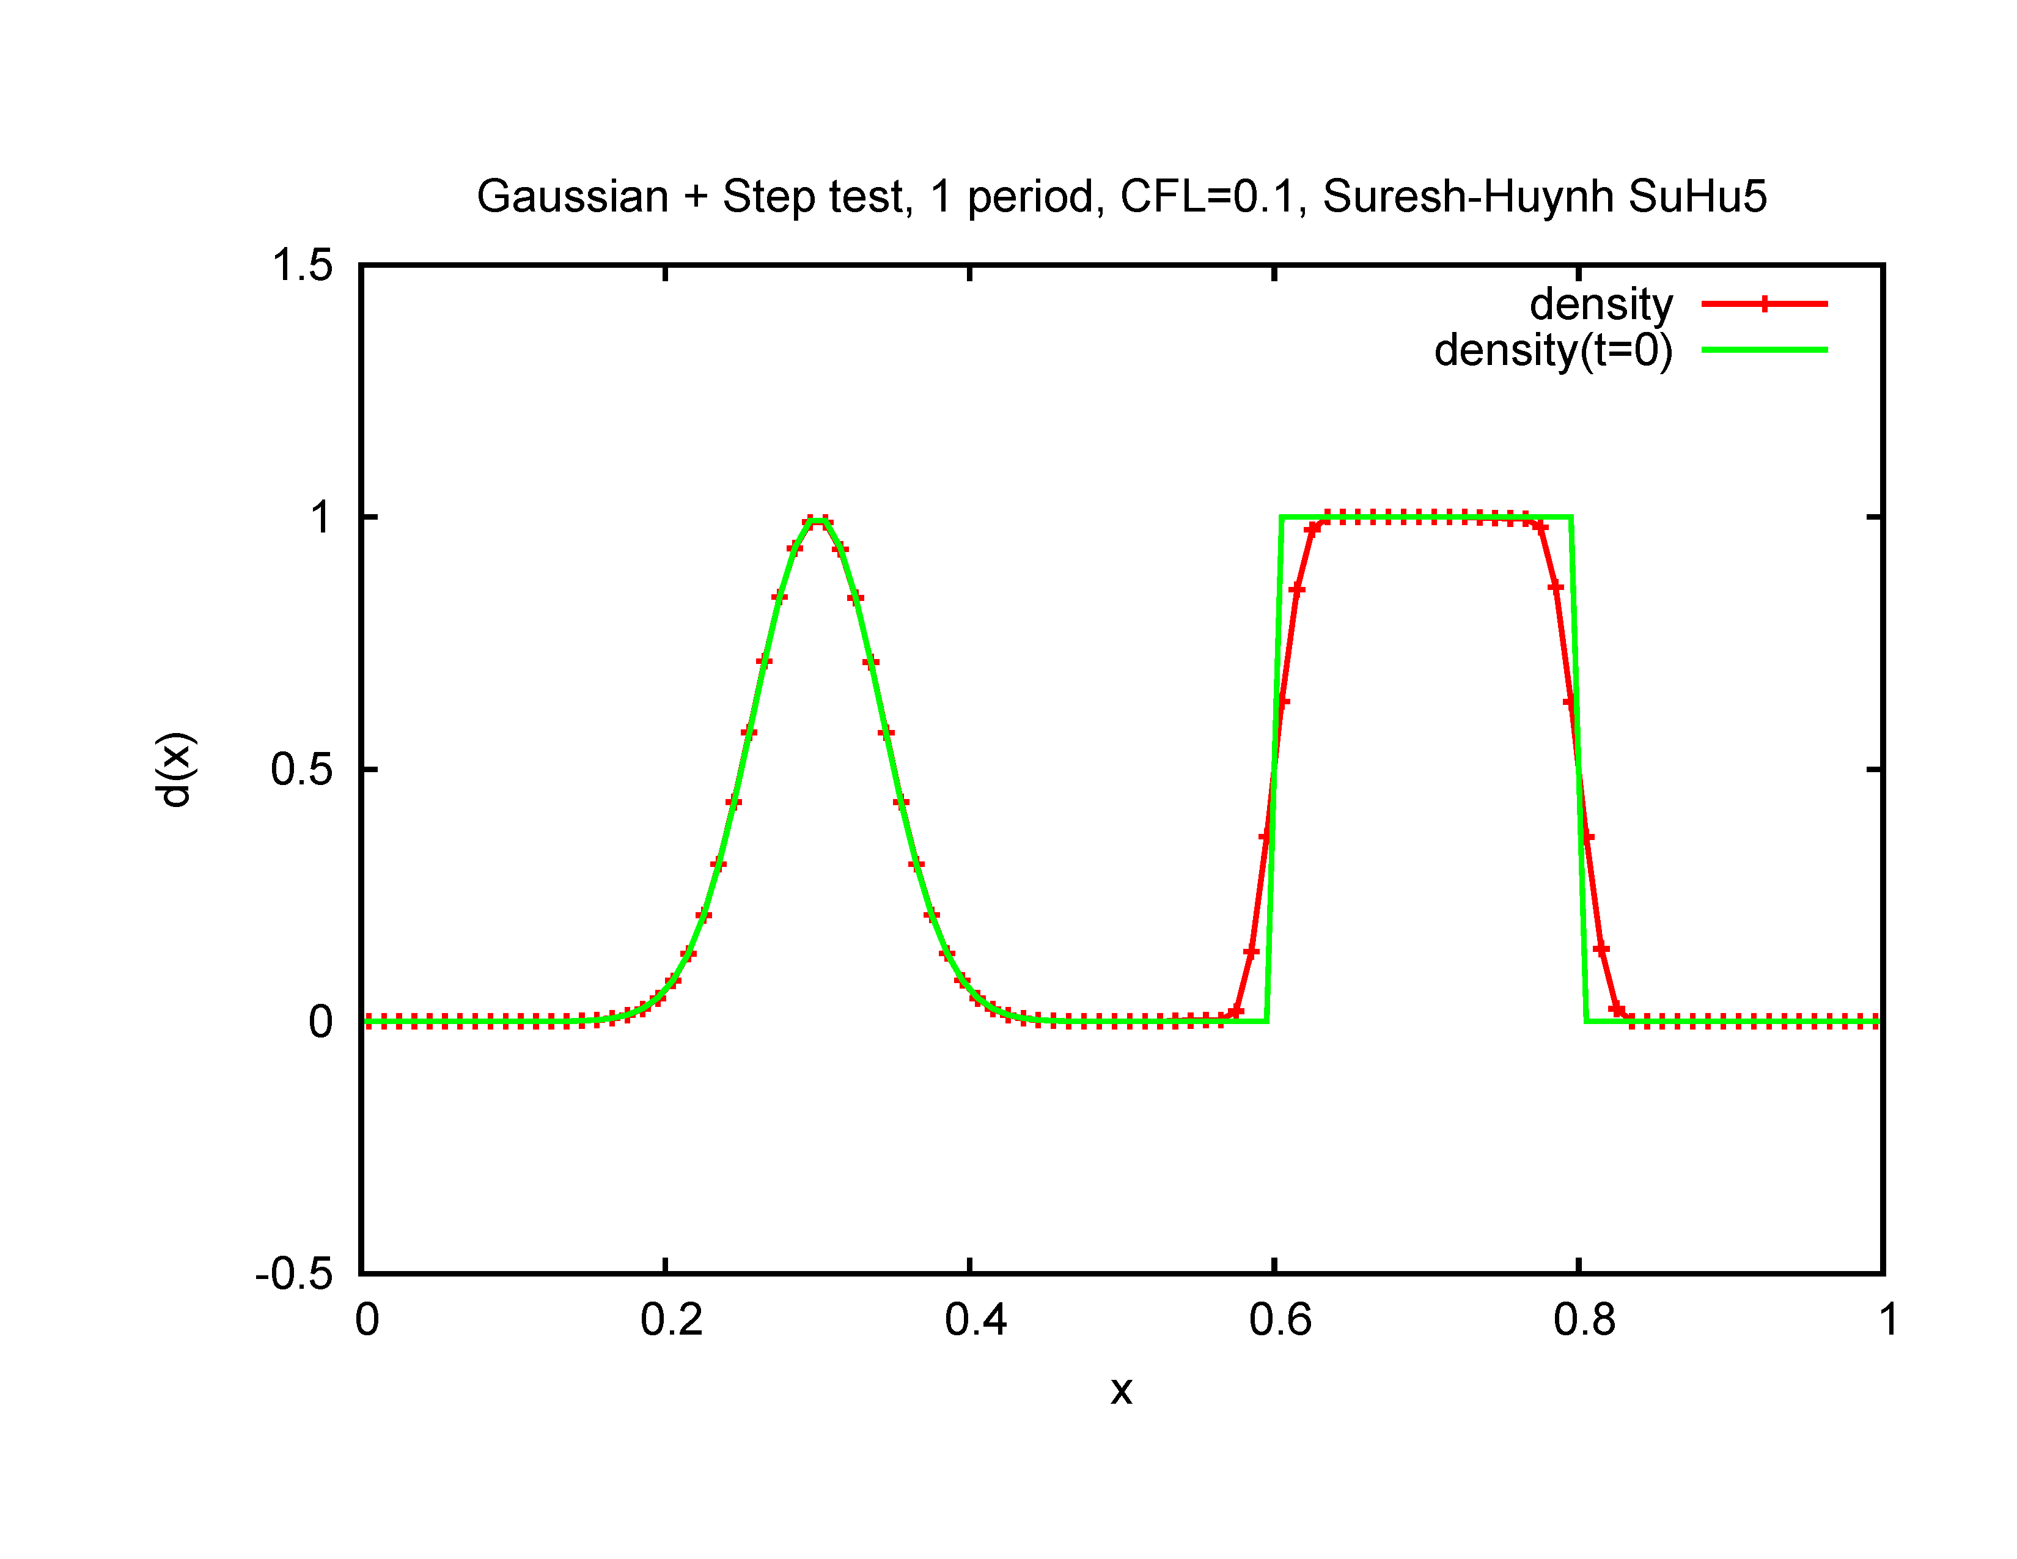
State-of-the-Art (1997-2011) Nonlinear Limiters (Aerospace/CFD)
Introduce minimal diffusion only near sharp gradients
F(x)
Good limiters can be implemented in finite-volume (COGENT code, Dorf et al.) or DG algorithm (GKEYLL code, Shi, Hakim, Hammett).
(Suresh-Huynh 1997, Colella-Sekora 2008 comparable)
(From algorithm tests in Peterson & Hammett, SIAM J. Sci. Comput, 2013,
http://w3.pppl.gov/~hammett/gyrofluid/papers/2013/peterson_positivity.pdf )
9

Slide 10
Progress & Plans for Discontinuous Galerkin Gyrokinetic Code Gkeyll
Developing new gyrokinetic code using advanced continuum/Eulerian algorithms (Discontinuous Galerkin, DG) that can help with challenges of edge region of fusion devices. Want to study edge problems like the height of the pedestal, SOL width, how much improvement can be made with lithium walls. Eventually could be a major component of a whole-device simulation using exascale computers.
Essential to have independent codes to cross-check each other for difficult problems.
Code & techniques could eventually be applied to a wider range of problems where kinetic effects become important, including astrophysics and non-plasma problems.
Good progress:
  Extensive tests in lower dimensions, http://www.ammar-hakim.org/sj/
  Invented several DG algorithm improvements. Improved treatment of diffusion
  terms: Hakim, Hammett, Shi (2014) http://arxiv.org/abs/1405.5907
  Demonstrated 1D SOL Test problem of ELM on JET (Shi et al. (Phys. Plasmas 2015)
  Demonstrated ability to handle magnetic fluctuations in an efficient way.
  Now full 3D+2v (x, y, z, v||, v⊥) long-wavelength gyrokinetics in SOL (simplified
  helical geometry), incl. Lenard-Bernstein collisions, conducting sheath B.C.s.

Slide 11
Why consider Discontinuous Galerkin (DG) Algorithms
for (Gyro)kinetics at Exascale?
Higher order methods do more FLOPS to extract more out of data, need fewer data points, reduce communications that can be a bottleneck on exascale computers.
DG allows use of limiters / upwinding to avoid negative density overshoots, which can be a major problem in the edge region of fusion devices.
We found a version of DG that can conserve energy exactly for Hamiltonian systems like gyrokinetics, even with upwinding / limiters (for continuous time)
DG flexibility to use Maxwellian-weighted basis functions, sparse grid ideas.
Locality of DG means it should scale well like other continuum codes (GENE continuum code has demonstrated excellent strong scaling to 262,000 cores)
DG: Efficient Gaussian integration --> ~ twice the accuracy / interpolation point:
  Standard interpolation: p uniformly-spaced points to get p order accuracy
  DG interpolates p optimally-located points to get 2p-1 order accuracy
  (DG has ~2x accuracy per point of Finite-Volume. We typically use p=2 or 3.)
Kinetic turbulence very challenging, benefits from all tricks we can find. Potentially big win: Factor of 2 reduction in resolution --> 64x speedup in 5D gyrokinetics

Slide 12
Discontinuous Galerkin (DG) Combines Attractive Features of Finite-Volume & Finite Element Methods
Standard finite-volume (FV) methods evolve cell averages + interpolations.
DG evolves higher-order moments in each cell. I.e. uses higher-order basis functions, like finite-element methods, but, allows discontinuities at boundary like shock-capturing finite-volume methods --> (1) easier flux limiters like shock-capturing finite-volume methods (preserve positivity) (2) calculations local so easier to parallelize.
Hot topic in CFD & Applied Math: >1500 citations to Cockburn & Shu JCP/SIAM 1998

Slide 13
Discontinuous Galerkin (DG) Combines Attractive Features of Finite-Volume & Finite Element Methods
Don’t get hung up on the word “discontinuous”. Simplest DG is piecewise constant: equivalent to standard finite volume methods that evolve just cell averaged quantities. Can reconstruct smooth interpolations between adjacent cells when needed.
Need at least piecewise linear DG for energy conservation (conserves energy even with upwinding). Standard Finite Volume methods do not conserve energy exactly (except Arakawa, which has overshoots). Unlike Navier-Stokes fluid eqs., energy conservation in kinetic/Vlasov-Boltzmann equations is indirect, involving integration-by-parts and particle-field energy exchange.

Slide 14
Standard DG Polynomial Basis Functions:
(This is the essence of general Galerkin formulations. DG combines this with a Godunov approach of a Riemann solver / upwind fluxes at discontinuous boundaries and efficient evaluation of integrals.)

Slide 15
Standard Maxwellian-Weighted DG Basis Functions:
For many plasma problems of interest, we know Maxwellian-weighted basis functions would be more efficient. Polynomial basis functions are ill-behaved at high v, can’t integrate to v = ∞, where asymptotic behavior is Maxwellian (sometimes at higher “temperature”). Helps handle moderate collision frequencies of edge region.
Standard energy conservation doesn’t hold either.

Slide 16
Conservative Maxwellian-Weighted DG Basis Functions:

Slide 18
(Similar to Gaussian Radial Basis Functions but conserves energy and applied only piecewise in velocity)

Slide 19
1D Test problem: Classical Parallel Heat Conduction

Slide 20
Maxwellian-weighted basis functions much more efficient
4x faster in 1v,
16x faster in 2v
4x improvement
(Exponential-weighted basis functions not yet implemented in main Gkeyll code, but utility demonstrated in standalone code.)

Slide 21
Energy Balance in full F GK (with linear polarization):
For simplicity, consider long-wavelength full-F gyrokinetics, curvature drifts turned off, and time-independent dielectric coefficient ε_{⊥0}(x) = c²/v_{A}² = c²4π Σ_{s} n₀(x) m/B² :
(guiding center charge
+ polarization charge = 0)
Can write the GK equation in Hamiltonian form with
Can show conserved total energy (in a periodic domain with no sources) is:

Slide 22
Proof (fill in the details as homework):
In first term of dW_{tot}/dt,

Slide 23

Energy Balance in full F GK (with nonlinear polarization)
In the edge/SOL region, there are large density fluctuations on the time scale of the turbulence, so can’t assume n(x,t) factor in polarization density is independent of time. Generalize to time-dependent dielectric coefficient ε⊥(x,t) = c²/v_{A}² = c²4π Σ_{s} n(x,t) m/B² :
General Poisson-bracket form of GK eq. unchanged, but Hamiltonian modified to include a second order contribution:
As described in papers by Sugama, Brizard, Scott, Krommes, et al., in a field-theory approach to GK one needs 2cd order contributions to H that scale as ϕ², so taking variations w.r.t. ϕ leads to the term in the GK Poisson equation that is linear in ϕ.
Now the conserved total energy is just:
(typo corrected: $n$ had been $n_{0}$.)

Slide 24
First 5D Continuum Gyrokinetic Simulations with With Gkeyll w/ Open Field Lines & Sheath b.c.
Builds on earlier pioneering fluid simulations of LAPD by Rogers and Ricci (predecessor to GBS code), and by Umansky, Friedman, et al. (BOUT++).
(Fig from Carter 2013)

Slide 28
Fluid Simulations of LAPD
(Rogers & Ricci PRL 2010)

Slide 29
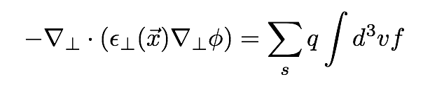
Model Sheath Boundary Conditions
x
ϕ(x,y,0) ≠ 0
ϕ = 0
B || z
GK Poisson Eq. solved in 2D planes at fixed z, only needs bcs on side walls
(on x or y boundaries). Discontinuous jump between ϕ(x,y,0) just inside plasma and ϕ=0 end plates represents unresolved sheath. Determines reflected electrons:
This is gyrokinetic version of electron sheath boundary condition used in early fluid edge simulations (Ricci, Rogers, et al., Friedman et al.), without assuming Maxwellian f. (Further generalizations possible in future.)
Unlike some logical sheath models, allows j||≠0, in which case guiding center charge builds up and ϕ in plasma rises. Allows currents to flow through walls.

Slide 30
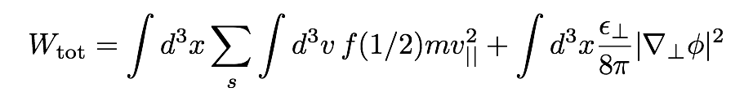
Energy Balance in SOL (with linearized polarization):
If side walls at zero potential, then there is no energy input from ion polarization current to side walls. Total energy W_{tot} is sum of parallel kinetic energy and perpendicular ExB flow energy, which satisfies:
RHS represents (1) power input from the source, (2) kinetic energy flux to top of sheath, and (3) acceleration of ions and deceleration of electrons by sheath before they hit wall. If j|| through the sheath is non-zero, puts energy into ExB flows.

Slide 31
Initially worried about complications in interactions between sheaths (10¹¹ Hz) & gyrokinetics (~10⁵ Hz)
In a gyrokinetic code, don’t want to directly resolve tiny Debye-scale sheath (~10⁻³ cm), evolves on extremely rapid time scale.
“Logical sheath”: adjust phi at boundary to reflect most electrons and let through just enough electrons to match ion flux, j|| = 0 (Parker, Procassini, Birdsall, Cohen 1993)
Used in our 1D SOL ELM heat-pulse tests (Shi, Hakim, Hammett 2015), compares well with full PIC code, but how to interface with multi-dimensional GK?
Eventually implemented gyrokinetic equivalent of sheath boundary conditions in early fluid edge simulations (Ricci, Rogers, GBS; Umansky, Friedman, BOUT++):
Use GK Poisson eq. to determine potential everywhere in simulation, use jump between that at edge & 𝜙= 0 plates to determine what fraction of electrons to reflect. Allows currents to flow into walls, steady state gives usual 𝜙_{s} ~ 3 T_{e}.
Tried to increase side wall potential to avoid sharp gradients with sheath potential, was like biasing system with a power supply, drove huge potentials.
Forgot collisions at first (because of previous ELM work), drives ultra-high frequencies
Initially started with too much density near side walls, drove huge potentials.

Slide 32
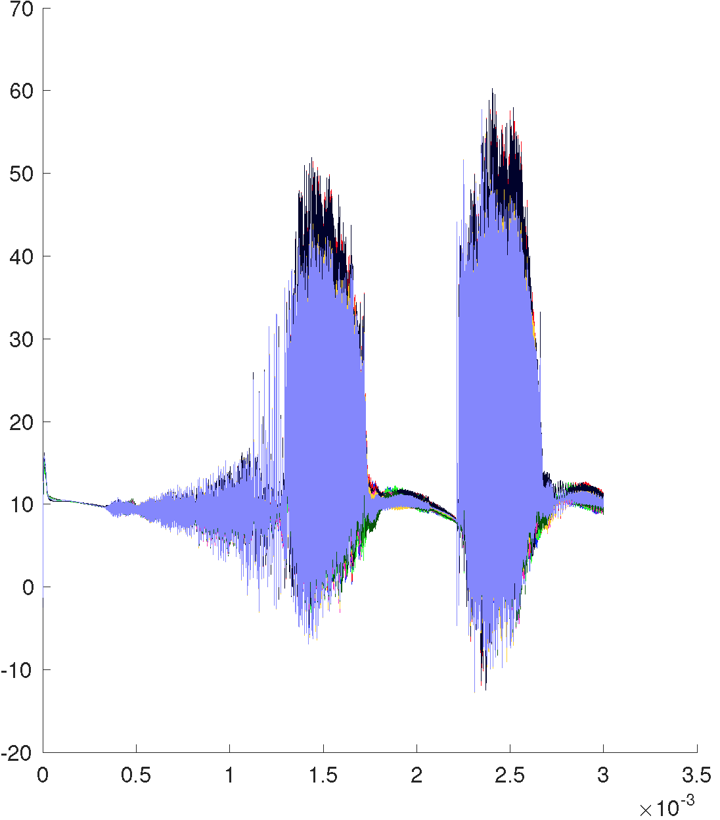
Some collisions needed for normal steady-state sheath
Left: Collisionless simulation, ϕ vs. time near simulation center, for a case with spatially uniform source. The potential is initially at a normal sheath level of ~3 T_{e}, but get huge, very-high-frequency oscillations after an ion connection time L||/v_{ti} ~ 0.7 ms.
Right: Collisions included, density vs. time. Normal sheath & turbulence level.
Sheath potential confines most electrons. Essential to have some collisions to scatter some electrons over the sheath barrier.

Slide 33
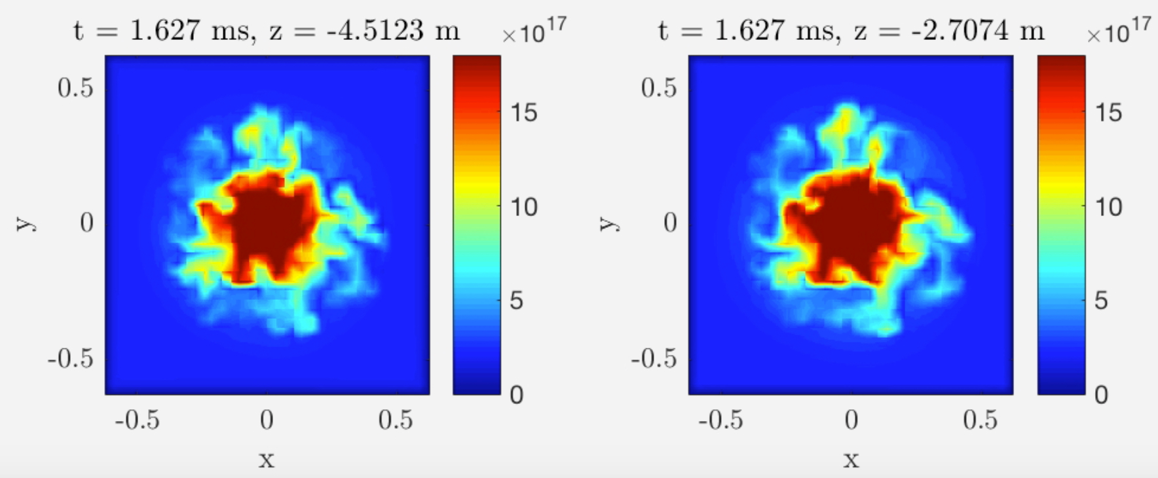
First Gkeyll Simulation of 3D+2v Gyrokinetic Turbulence in Scrape Off Layer (SOL) / LAPD.
Density snapshots in LAPD simulation at 2 locations
Was worried about difficulties in gyrokinetic-sheath interactions and other edge computational challenges. Indeed ran into & fixed several problems that drove high frequency, large amplitude fluctuations (special DG algorithms helped). Now appears fairly robust. (Working to reduce positivity and numerical heating issues.)
Grid : N_{x} × N_{y} × N_{z} × N_{v||} × N_{μ} = 36x36x10x10x5 cells with 2 nodes in each dimension, approx. equiv. to 72×72×20×20×10 points (200 velocity grid points per spatial grid point).
Gyrokinetic extension of pioneering fluid work (Rogers & Ricci, Umansky, Friedman et al.)

Slide 34
Simulation of LAPD: strong turbulent transport
Turbulent fluctuations causes significant radial broadening of the density profile ⟨n⟩(r) relative to density source.
Electron Density (m⁻³)
uniform
source
RMS fluctuation level in qualitative good agreement with LAPD observations (Friedman et al. PoP (2013)). (More precise simulations of specific experiment in future.)

Slide 35
Simulations of biasing on LAPD show turbulence is quickly suppressed
LAPD experiments with biasable limiter show suppression of turbulence by sheared rotation.¹
Can model limiter bias by modifying sheath boundary condition
Starting from turbulent state, adding +20V biasing of limiter, simulation finds rapid suppression of turbulence
¹ Schaffner et al,. PRL 2012

Slide 36
Future positivity/energy improvements to DG algorithm & code
Although DG limiters on boundary fluxes could ensure cell averaged positivity, the local density somewhere within a cell can go negative.
Small diffusion used within a cell to restore positivity. This can add energy. Added an energy correction operator within the order of accuracy of the algorithm (similar to Taitano, Chacon, et al. JCP 2015).
At present, still have some numerical heating near the end plates where T|| gets smaller than the minimum energy representable on μ (v⊥) grid, when collision operator tries to isotropize.
Can be fixed in the future with non-uniform μ grid, or with exponential-basis functions (which have no limit on minimum energy).
Other algorithmic improvements: super-time-stepping / implicit collision operator, exponential basis functions, sparse quadrature methods to reduce number of basis functions in high dimensions...

Slide 37
Sparse Grid Methods Might Give
Major Speedup to DG

Slide 38
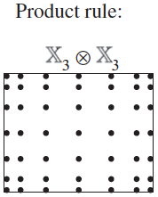
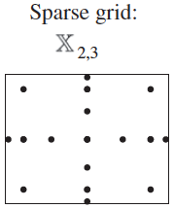
Sparse Grid Methods Should Give
Major Speedup to DG
standard 7x7 grid
Equivalent sparse grid with same order of accuracy:
2D
6th order
example:
Standard 2cd order basis functions requires 3 points in each direction:
3⁵ = 243 points total
Equivalent order of accuracy sparse basis functions can be represented with only 21 points, ~10x savings.
5D
2^{cd} order
case:
Heiss & Winschel, J. Econometrics 2008

Slide 39
Conclusions
First results from Gkeyll code of 5D continuum gyrokinetic simulations on open field lines with model sheath boundary conditions.
Simulation of LAPD-like configuration shows density fluctuation levels in the right ballpark. Have also done TORPEX/Helimak type geometry with bad curvature drive of toroidal magnetic field.
Using various simplifications at present, such as simple helical magnetic field model without separatrix, but sufficient to demonstrate feasibility of approach and contains some key physics of the SOL (such as bad curvature drive of toroidal instabilities, rapid parallel losses to divertor plates and interactions with sheaths).
Could begin physics studies about the nature of SOL turbulence, such as:
Why doesn't this turbulence spread power more widely on divertor plates.
What are effects of reduced recycling with lithium?
Future work: More detailed atomic physics, viscosity from neutral. Extensions to general geometry to handle open and closed field lines simultaneously with a separatrix. Algorithmic improvements.

