Slide 1
Lyman Spitzer’s
Legacy of Innovation in the
Quest for Fusion Energy
Greg Hammett, May 4, 2024
w3.pppl.gov/~hammett/
Princeton Plasma Physics Laboratory (PPPL)
& Princeton University Ph.D. Program in Plasma Physics
Science on Saturday Lecture / Fusion Energy Week
(fixed typos, 2024-07-11)

Slide 2
Lyman Spitzer’s Legacy of Innovation in the
Quest for Fusion Energy
An informal history of early PPPL fusion research
Some history of Spitzer’s big ideas / innovations:
  1946: Telescopes in space (Hubble Space Telescope)
  1951: Figure-8 stellarator trick to make a fusion power source
A fluid picture of the trick for how a figure-8 stellarator works (and basis for later stellarators).
Continuing innovations at PPPL and elsewhere to improve fusion energy concepts
  including ideas for further improving the stellarator concept, which is undergoing a renaissance.
I never officially met Prof. Spitzer, though I saw him at a few seminars, and was friends with his last graduate student. (I was a grad student here 1980-1986.) Heard many stories from Prof. Tom Stix, Prof. Russell Kulsrud, & others, learned from the insights in his book and his ideas in other books.
2

Slide 3
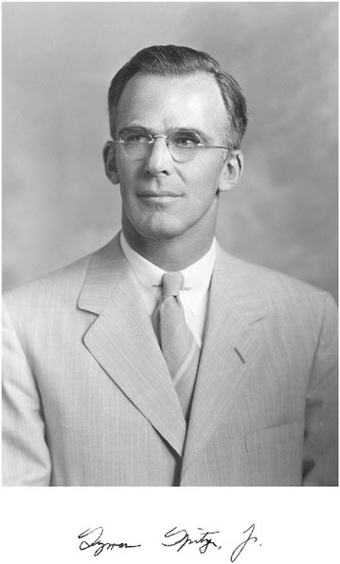
Lyman Spitzer, Jr.
1914-1997
Born in Toledo, Ohio.
Yale B.S. (1935), Cambridge (1936)
Princeton Ph.D. Physics (1938)
Yale professor
World War 2: worked on sonar
Chair of Princeton Department of Astrophysical Sciences, 1947-1979
Photo by Orren Jack Turner, from Biographical Memoirs V. 90 (2009), National Academies Press, by Jeremiah P. Ostriker. http://www.nasonline.org/publications/biographical-memoirs/memoir-pdfs/spitzer-lyman.pdf
Notes:
From a very good biography for Prof. Jeremy Ostriker. I never met Spitzer officially, but I saw him a few times at lectures and seminars, and I heard many stories about him over the years, from Tom Stix-a professor I took courses from who was hired by Spitzer. I also heard many stories from Russell Kulsrud, many other

Slide 4
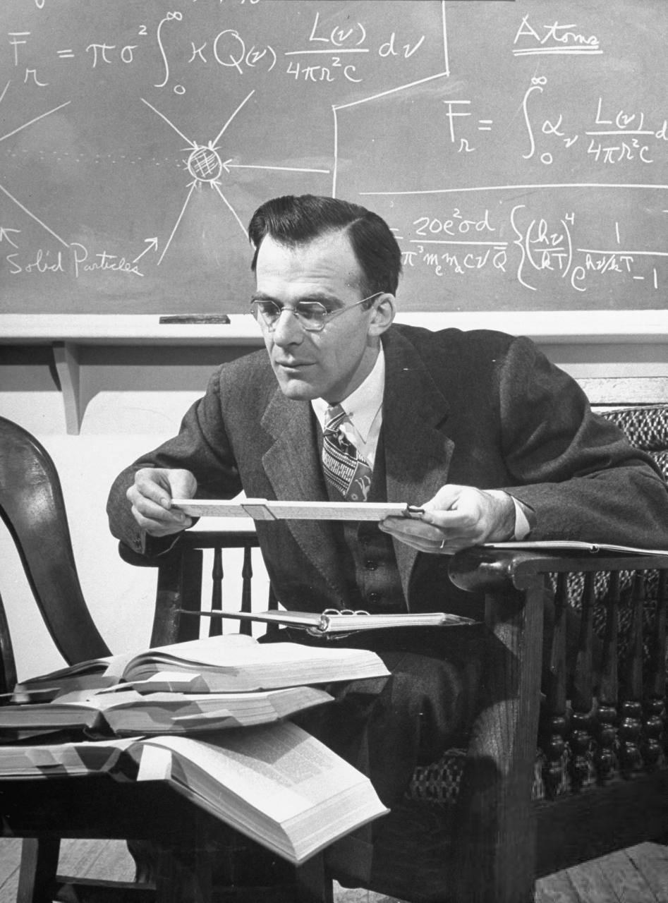
LIFE Magazine, Apr 28, 1948
LIFE Photo Collection, March 1948
http://sliderulemuseum.com/SR_Ephemera.htm
http://www.google.com/culturalinstitute/asset-viewer/uwHIsK8XRqgCXw?hl=en
https://books.google.com/books?id=d0EEAAAAMBAJ&pg=PA98&dq=spitzer&hl=en&sa=X&ved=2ahUKEwjZkJzN5fKFAxVxD1kFHfrCAMsQ6AF6BAgBEAI#v=onepage&q=spitzer&f=false
Notes:
Who knows what this is? None of the younger people know what this brilliant mathematical instrument is, a “Slide Rule”
Life Magazine – Very popular, weekly magazine, ¼ of the population saw it. , vivid photojournalism that documented all aspects of American life, movie stars and ordinary people and scientists. Had an article about the solar system, with pictures of several important astronomers.

Slide 5
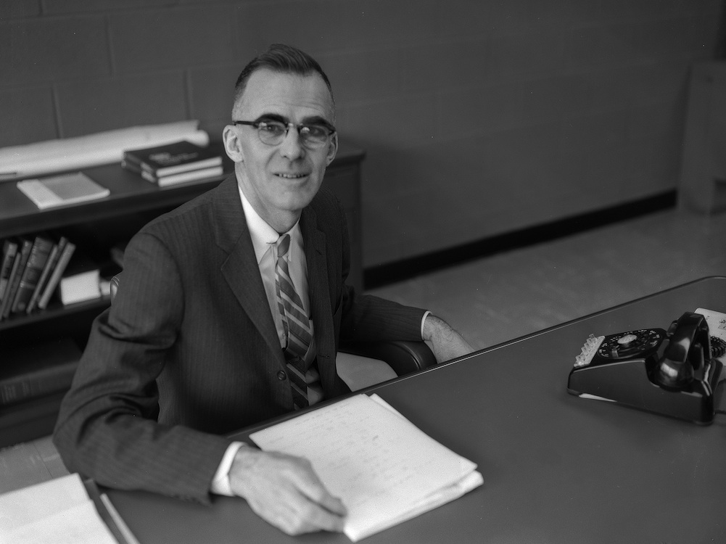
1960, director of PPPL (1951-1961, and simultaneously, chair of Dept. of Astrophysical Sciences, 1947-1979.)
5

Slide 6
1946: Spitzer Proposes Telescopes in Space
In 1946, Spitzer wrote a report for the RAND Corporation on “Astronomical Advantages of an Extra-Terrestrial Observatory”
Spitzer credited with being “a visionary behind the Hubble Space Telescope” [1], documenting the advantages it would have, and seeing that it would be feasible. “While the fundamental concept of sending a large telescope into space wasn’t new, the reality of doing so was.” [1]
“The most important champion of the project was Lyman Spitzer” [2].
Hubble Space Telescope launched 1990 (optics fixed in 1993)
(predecessor to the James Webb Telescope)
NASA infrared space observatory: the Spitzer Space Telescope (2003-2020)
Others had independently proposed a telescope in space, such “as 1923 by the German rocket pioneer Hermann Oberth” [2]
[1] https://science.nasa.gov/people/lyman-spitzer-making-space-for-hubble
[2] https://www.amnh.org/learn-teach/curriculum-collections/cosmic-horizons-book/lyman-spitzer-hubble-telescope
Notes:
Point out it took 50 years (1946 – 1993)

Slide 7
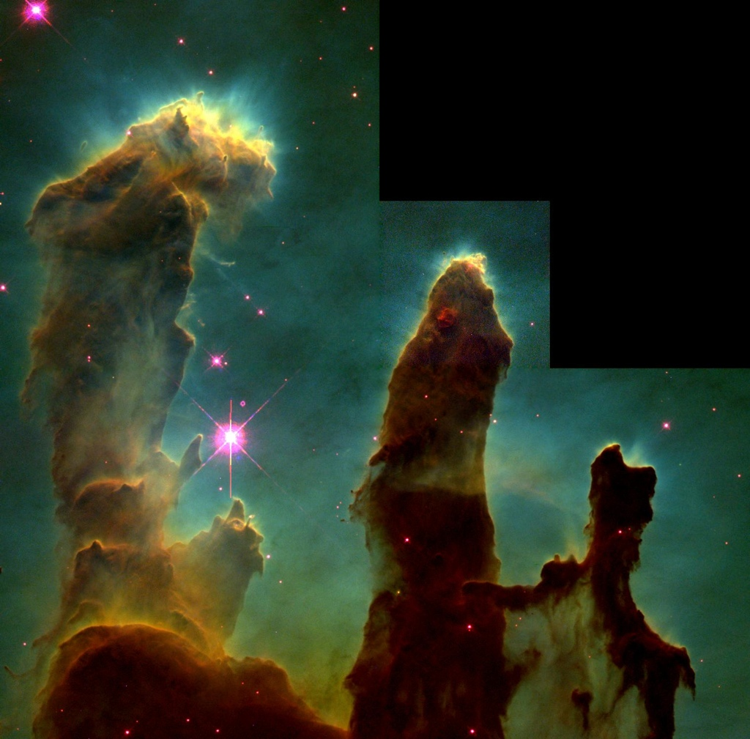
Famous image from the Hubble Space Telescope.
The Eagle Nebula:
“Pillars of Creation”
gas pillars in a star-forming region.
Text
http://hubblesite.org/gallery/album/pr1995044a/

Slide 8
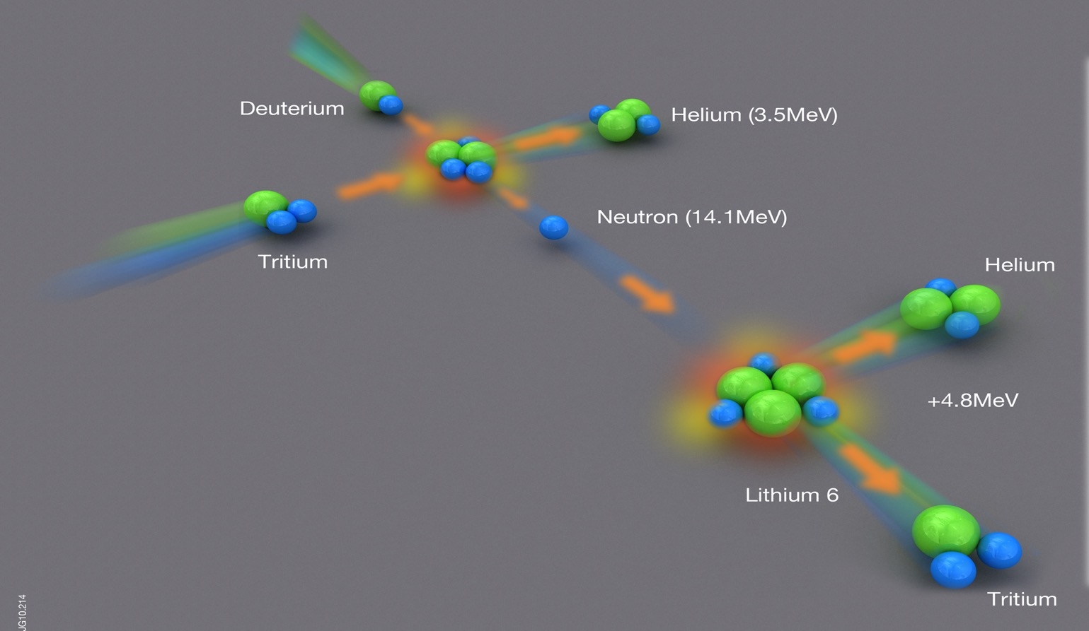
Which fusion?
Deuterium and tritium: isotopes of hydrogen that fuse much more easily
Self Heating
1/5 fusion power
Plasma at 200 million degrees
(20 keV)
Enough lithium in sea to supply 30 million years of world energy needs
Huge energy gain: 17.6 MeV out / 40 keV in = 440
But need to heat plasma to extreme temperatures

Slide 9
Spitzer’s First Exploration of Fusion
25 June, 1950, Korean war started.
Lyman Spitzer and John Wheeler think about starting a theoretical program at Princeton studying thermonuclear explosions. (Spitzer worked on sonar in WWII)
March 24, 1951, President Peron of Argentina claimed his scientist, Ronald Richter, had produced controlled fusion energy in the lab. Quickly dismissed by many (later shown to be bogus), but got Spitzer thinking on the Aspen ski slopes.
Spitzer had been studying hot interstellar gas/plasma for several years & had recently heard a series of lectures by Hans Alfven on plasmas* (Alfven later got Nobel prize)
Spitzer knew a simple toroidal magnetic field couldn’t confine a plasma. The story (partially apocryphal?) is that on the chair lift rides in March 1951, he invented the tokamak (later invented in Russia by Igor Tamm and Andrei Sakharov), but dismissed it because it wasn’t steady state. Somehow came up with the idea of twisting a torus into a figure-8.
May 11, 1951, meeting at AEC to describe figure-8 and other approaches to fusion.
May 12, Spitzer submits proposal to AEC to build a figure-8 stellarator.
July 1, gets $50k (= $600k in 2024) from AEC for 1 year (Bromberg, p. 21, http://en.wikipedia.org/wiki/Perhapsatron)
CPI = 26.0 in 1951, 230. in 2013.
* John Johnson, personal communication.
Notes:
John Wheeler in Manhattan Project during WWII. Both felt a duty to contribute in some way.
“President Juan Peron of Argentina”, or should I say the Dictator of Argentina”.
Sakharov: Inventor of the Russian Hydrogen Bomb, later a famous Soviet dissident who protested for freedom in his country.
May 11 AEC meeting: joint with guys from Los Alamos, who proposed a different approach to fusion…

Slide 10
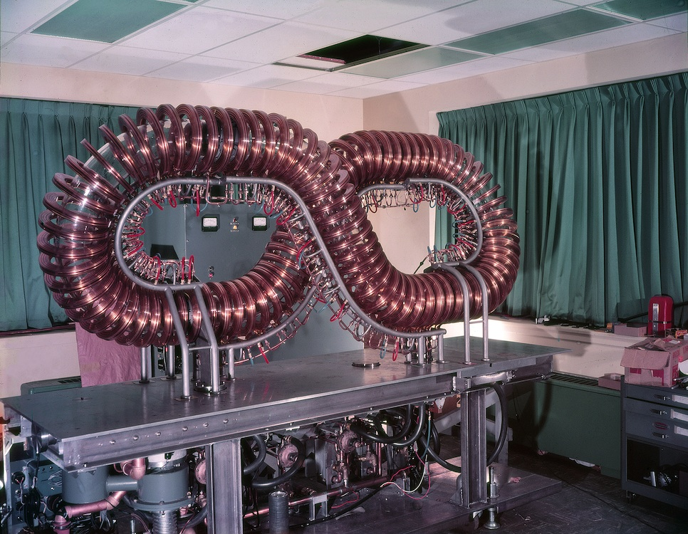
2cd UN Atoms For Peace Conference, Geneva 1958.
SIM-8, one of the simulator stellarators (w/ e-beam) used in demonstrations at the 2cd Atoms-For-Peace Conference, Geneva (1958)

Slide 11
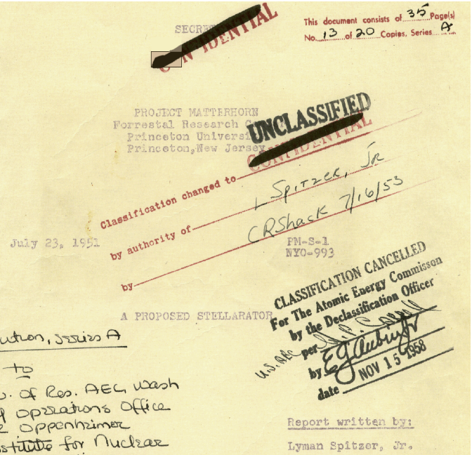
Spitzer’s Original May 12, 1951 Proposal
July 23 reprint of original May 12, 1951 proposal
All early PM-S reports available online:
http://findingaids.princeton.edu/collections/PPL001/c0001
http://diglib.princeton.edu/pdfs/PPL001/c0002.pdf
http://library.pppl.gov/
(large PDFs > 100MB)
11

Slide 12
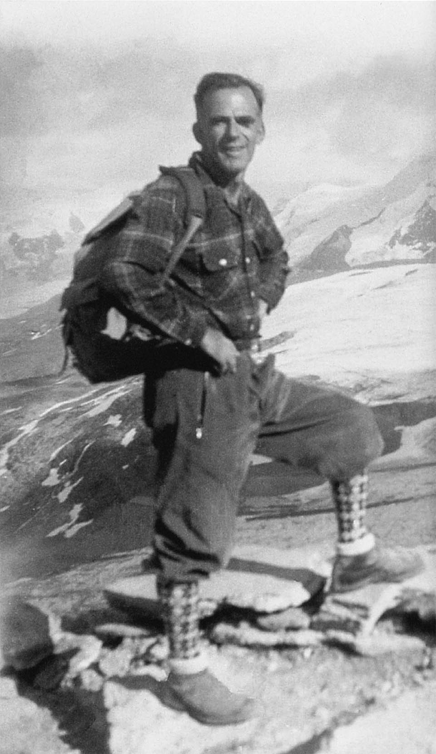
July 1, 1951 Project Matterhorn Begins
Two sections:
  S: headed by Spitzer, studying the stellarator concept
  B: headed by John Wheeler
“Project Matterhorn” name recommended by Spitzer, because “The work at hand seemed difficult, like the ascent of a mountain”*.
“Stellarator” named by Wheeler, “a star generator”
A serious mountain climber:
The American Alpine Club annually awards the Lyman Spitzer Cutting Edge Climbing Award.
Lyman Spitzer, Jr. once climbed the outside of the Graduate College tower...
*Tanner, Project Matterhorn
Notes:
Hopefully he used belay ropes to make it safer. The police were called and were waiting for him at the top to arrest him when he got there. He insisted that he wasn’t a nut, that he was a professor at Princeton and it was okay. There was a big argument and he said just call the President of the University to verify. Eventually they did call and verified that he was a professor and President said to please not arrest him. The police were still very upset with him, and so the Dean of the University had to write an official letter of reprimand that went into his files to document that he shouldn’t do this again.

Slide 13
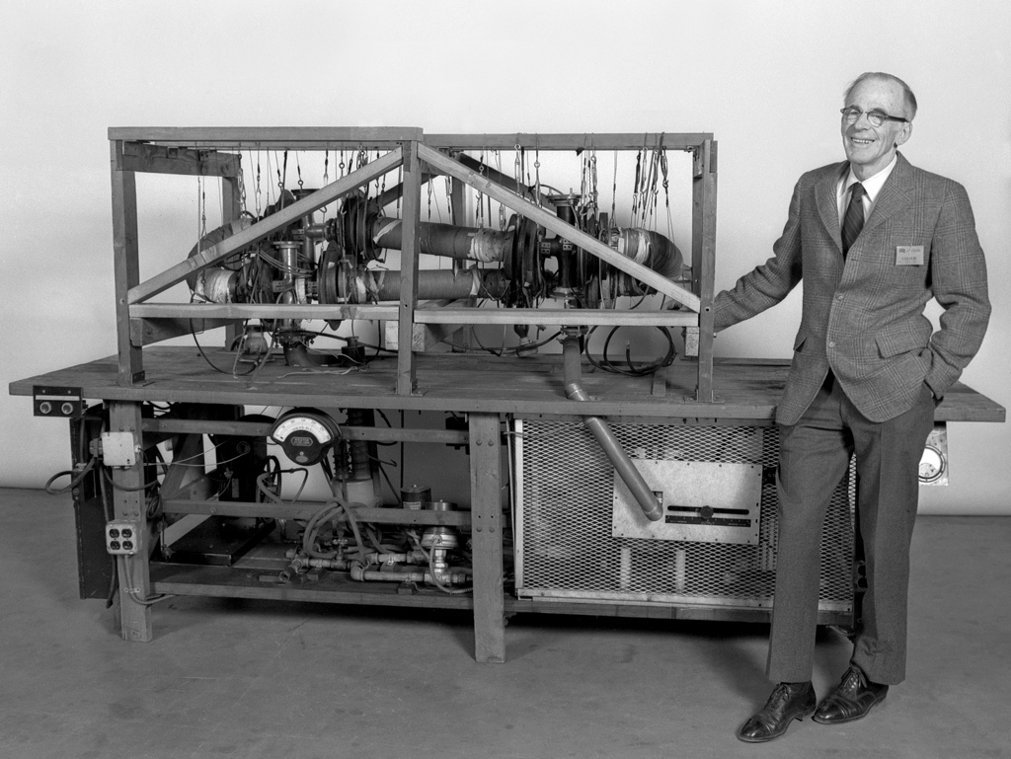
Spitzer’s Model-A Stellarator
Operated in early 1953, as figure-8 or racetrack. Showed that figure 8 could make plasmas much more easily (at lower voltage & field).
Spitzer and his friend Prof. Martin Schwarzchild (both theorists) wound copper coils by hand, while sitting on the floor of “rabbit hutch” on Forrestal campus (formerly Rockefeller Inst. for Medical Research). Tanner, “Project Matterhorn”: Model-A fabricated under direction of Profs. C.H. Willis (chief engineer for Model-A & B) and N. Mather.
Hired Prof. James Van Allen to run experimental program, 1953-1954. Mel Gotlieb came in 1954
This picture in 1983, just before donated to the Smithsonian.
13
Notes:
Van Allen Prof. at the University of Iowa. He later discovered the “Van Allen Radiation Belts” that surround the earth, which you might have heard of.

Slide 14
2cd UN Atoms For Peace Conference, Geneva 1958.
SIM-8, one of the simulator stellarators (w/ e-beam) used in demonstrations at the 2cd Atoms-For-Peace Conference, Geneva (1958)

Slide 15
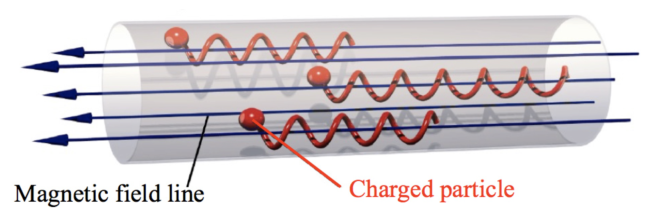
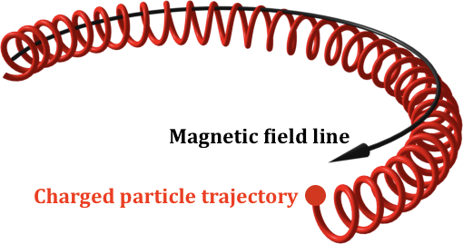
Magnetic confinement of particles

Slide 16




Stable Pendulum
Unstable Inverted Pendulum
(rigid rod)
L
g
-L
M
F=Mg
ω=(g/L)^{1/2}
ω= (-g/|L|)^{1/2} = i(g/|L|)^{1/2} = iγ
instability
$$X\left(t\right)=X_{0} cos\left(ωt\right)+…$$
$$X\left(t\right)=X_{0} e^{γt}+…$$
Famous Euler’s Formula:
$$e^{−iωt}=\cos\left(ωt\right)−i sin⁡(ωt)$$
Replace $ω$ with $i γ:$
$$e^{−iωt}=e^{−i\left(i γ\right)t}=e^{γt}$$
(broom demonstration)

Slide 17
Stable Pendulum
Unstable Inverted Pendulum
(rigid rod)
L
g
L
M
F=Mg
ω=(g/L)^{1/2}
ω= (-g/|L|)^{1/2} = i(g/|L|)^{1/2} = iγ
Instability
Density-stratified Fluid
Inverted-density fluid
⇒Rayleigh-Taylor Instability
ρ=exp(-y/L)
ρ=exp(y/L)
stable ω=(g/L)^{1/2}
Max growth rate γ=(g/L)^{1/2}

Slide 18
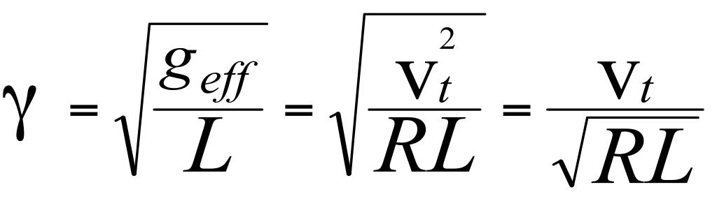
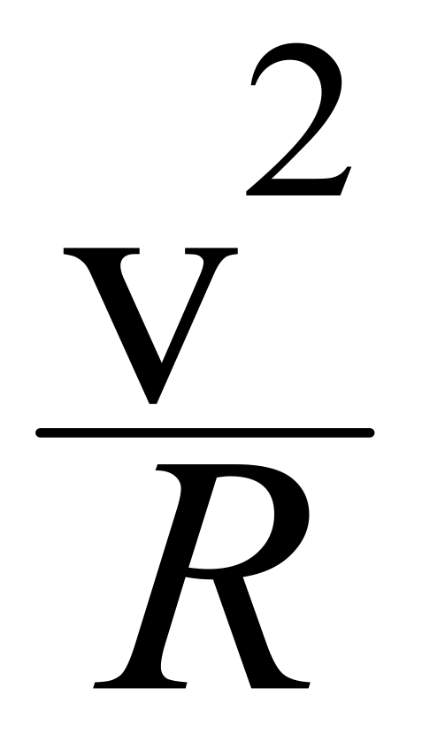
Why a simple magnetic torus is unstable:
≈ Inverted Pendulum / Rayleigh-Taylor Instability
Top view of toroidal plasma:
Growth rate:
Similar instability mechanism
in MHD & drift/microinstabilities
1/L = ∇p/p in MHD,
∝ combination of ∇n & ∇T
in microinstabilities.
R
plasma = heavy fluid
B = “light fluid”
g_{eff} = centrifugal force
Notes:
Not just an analogy between gravity and centrifugal force. Einstein taught us that there was a deep equivalence between gravity and forces in an accelerating frame of reference.

Slide 19
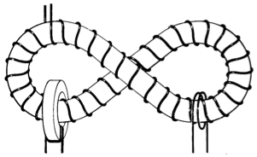
Spitzer’s stellarator trick: twist torus into figure-8
Centrifugal force alternates directions on each side (relative to the plasma center – the green line)
R. A. Ellis, Jr,, Princeton Alumni Weekly, Sept. 19, 1958

Slide 20
A Demonstration

Slide 21
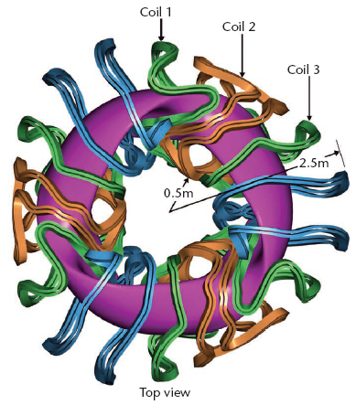
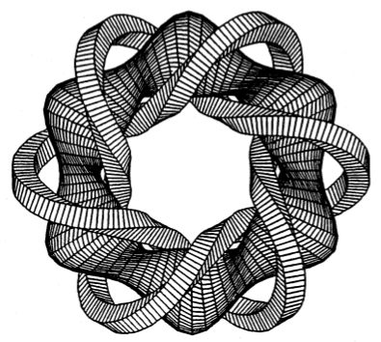
Modern stellarators
Spitzer et al. later realized that particles can be confined by a net poloidal twist in the magnetic field produced by helical coils. (First realization of the “Berry Phase”*.) Eventually evolved into modern stellarator designs with modular, unlinked coils.
JF Lyon et al., 1997 http://aries.ucsd.edu/LIB/REPORT/SPPS/FINAL/chap2.pdf
Princeton Quasar (Quasi-axisymmetric Stellarator)
/ NCSX
* pointed out in Bhattacharjee, 1992

Slide 22
2cd Atoms-For-Peace Conference, Geneva 1958.
Controlled fusion energy declassified worldwide in 1958. Roald Sagdeev, then a young physicist, said that going from Soviet Union to meet western scientists was like meeting Martians.
Both sides invented pinches, mirror machines, symmetric toroidal devices. But the one unique idea invented only by one side was the stellarator.
Rosenbluth went to the meeting, surprised to see Russians had a stellarator:
“... the Stellarator always seemed to me like something ... I never quite understood how Spitzer was ever able to envision it. His geometrical intuition was better than mine. Sure enough, the Russians showed up with a Stellarator. And Sagdeev later told me that that was just a fake. Artsimovich had heard about our Stellarator and told them we couldn’t claim that we had something they hadn’t thought of, so they just added it on.”
SIM-8, one of the simulator stellarators (w/ e-beam) used in demonstrations at the 2cd Atoms-For-Peace Conference, Geneva (1958)
“... That’s one of the few examples I know that that sort of chicanery was going on in this business.” AIP oral history, Marshall Rosenbluth, 2003, http://www.aip.org/history/ohilist/28636_1.html
Notes:
“Shi-cane-ery”

Slide 23
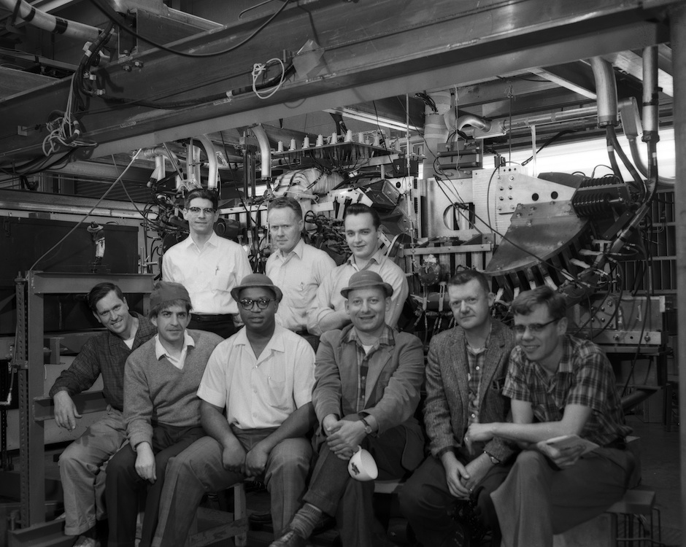
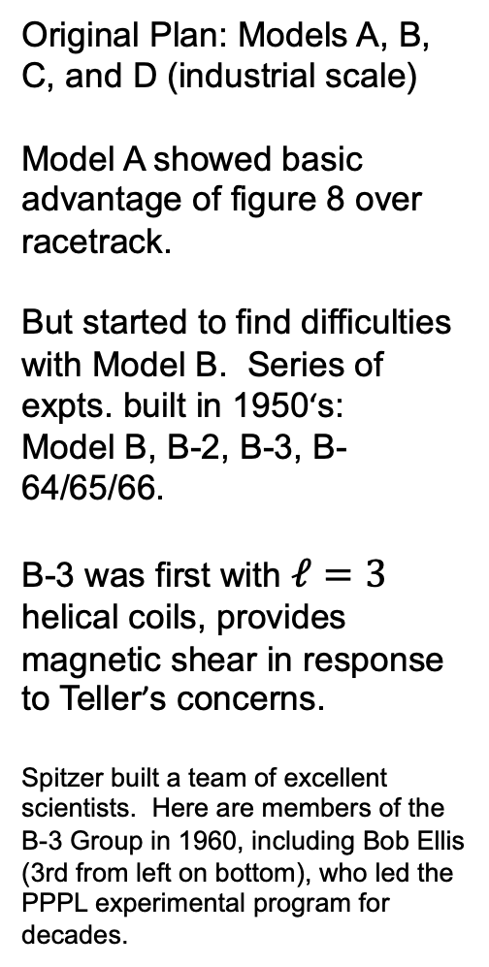
B-3 Stellarator Group
Original Plan: Models A, B, C, and D (industrial scale)
Model A showed basic advantage of figure 8 over racetrack.
But started to find difficulties with Model B. Series of expts. built in 1950‘s:
Model B, B-2, B-3, B-64/65/66.
B-3 was first with $ℓ=3$ helical coils, provides magnetic shear in response to Teller’s concerns.
Spitzer built a team of excellent scientists. Here are members of the B-3 Group in 1960, including Bob Ellis (3rd from left on bottom), who led the PPPL experimental program for decades.

Slide 24
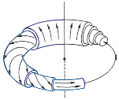
Sheared helical magnetic fields improves stability
Extreme example, magnetic field is mostly in toroidal direction in standard tokamak.
magnetic shear can help stabilize instabilities
(negative & zero average shear can be better, average ≠ local shear)
From F.F. Chen, “An Indispensable Truth”, 2011

Slide 25
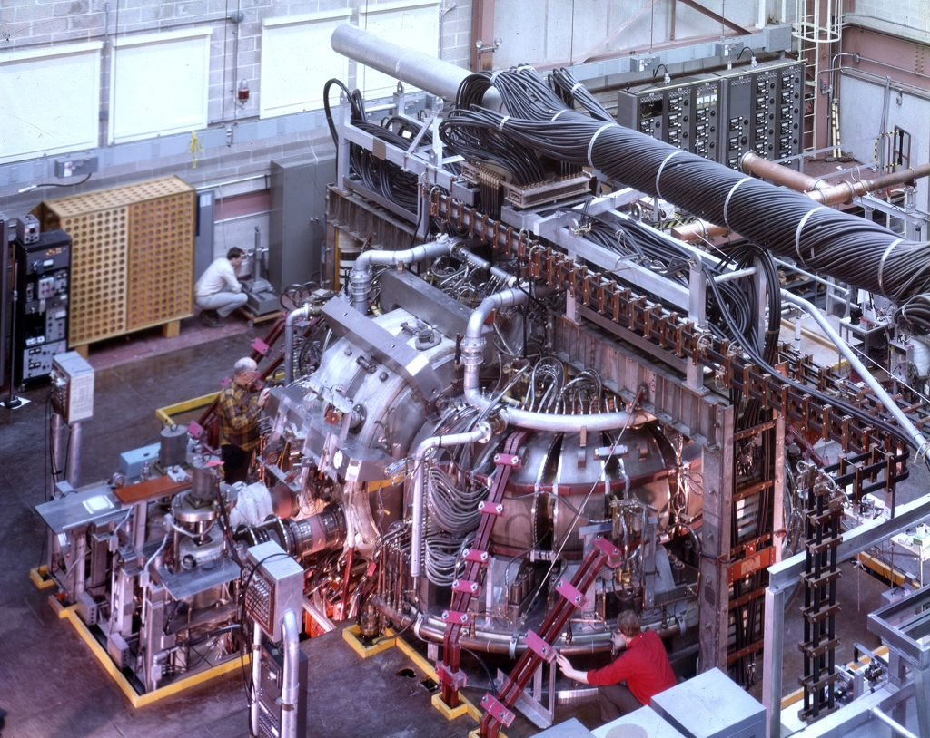
Model-C Stellarator, 1961-1969
R ~ 1.9 m
a = 5 - 7.5 cm
Principal finding: strong turbulent diffusion limited performance:
D ~ DBohm
~ Te/(eB)
But with 4MW ICRF heating, got mirror trapped
Ti ~ 8 keV,
avg Ti ~ 400 eV
Stix, 1998
(1967). Converted to ST Symmetric Tokamak in 1970, in 4 months, after breakthrough results by Russian tokamak reported at 1968 IAEA meeting, much better than Bohm diffusion. British laser team went to Russia, confirmed Te ~ 1 keV with just ohmic heating (Nature, Nov. 1969).

Slide 26
December 9-10,1993: Momentous Days for
Two of Spitzer’s Biggest Ideas:
Fusion Energy & Space Telescopes
Sequence of larger Princeton tokamaks built starting in 1970: ST, ATC, PLT, PDX ... (and others elsewhere). Arab Oil Embargo & 1st Energy Crisis led to large funding of alternative energy. Combined with good performance of tokamaks, motivated a large tokamak experiment to actually use tritium. 1974: Design of TFTR began, 1976: construction authorized, 1982: first plasma (construction ~$1.4B in 2012$), 1993: DT experiments.
December 9, 1993, TFTR (Tokamak Fusion Test Reactor) does first DT shots, eventually made 10 MW of fusion power. Joint European Torus (JET) eventually make 17 MW.
Fusion power gain Q = (Fusion power out) / (Heating power in)
“Increased the fusion power gain by a factor of 1 million over the value when it was designed in 1975, to Q = 0.3 in 1995”
December 10, 1993: Space shuttle fixed Hubble Space Telescope optics.
http://www.nytimes.com/1993/12/10/us/scientists-at-princeton-produce-world-s-largest-fusion-reaction.html
http://www.nytimes.com/1993/12/11/us/shuttle-releases-hubble-telescope.html
fire.pppl.gov
GAO: construction cost ~$0.5B as spent, 2012/1981 CPI = 229.6/82.4
26
Notes:
Spitzer was the father of the Hubble Space Telescope. He was a major proponent, and advised and help lead the team that built it, that had lobbied for its construction

Slide 27
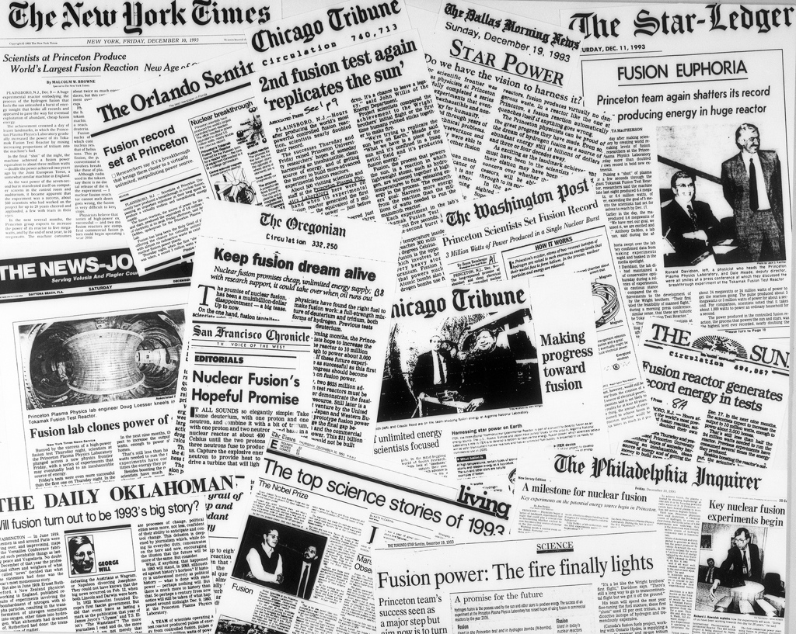
27

Slide 28
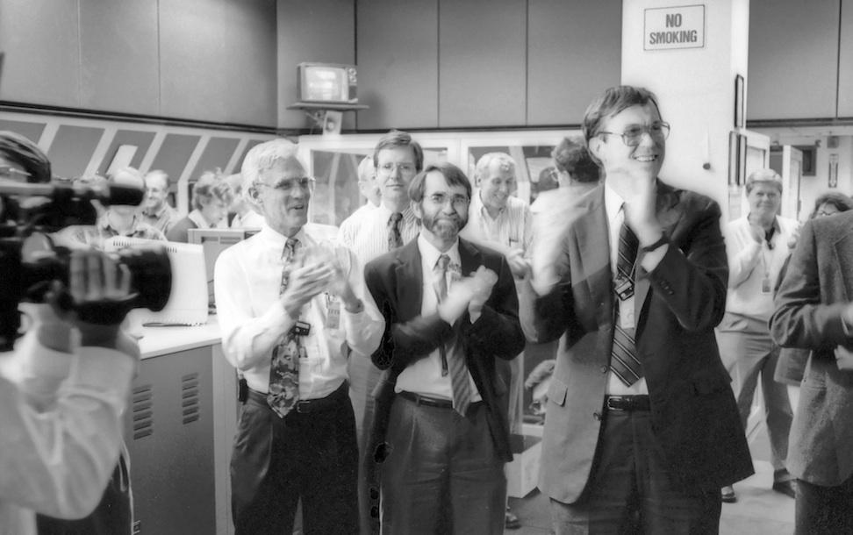
TFTR First DT Fusion Shot, Dec. 9, 1993
December 9, 1993. TFTR does first DT shots, eventually making 10 MW of fusion power.
http://www.nytimes.com/1993/12/10/us/scientists-at-princeton-produce-world-s-largest-fusion-reaction.html
28

Slide 29
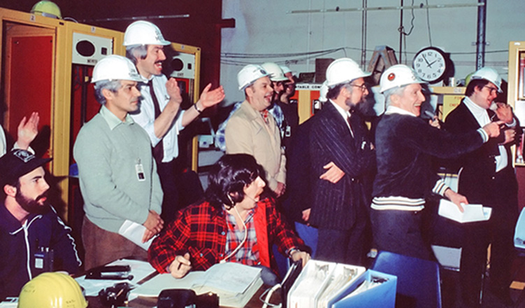
TFTR First Plasma, 3:06 am, Dec. 24, 1982
Notes:
Great picture from TFTR. Not when tritium was used and they made megawatts of fusion power. This is when the first plasma was made, 11 years earlier.
Notice this was Christmas Eve. They had been working hard all day on Dec. 23 trying to make a plasma. Dale Meade (project director for TFTR) wanted to make the schedule promised to DOE of first plasma in 1982,. Harold Furth (director of PPPL) was threatening to shut down and send everyone home for Christmas, but then they wouldn’t have been able to try to make a plasma again until 1983. So Dale unplugged the clock --- so Harold wouldn’t know how late it was.

Slide 30
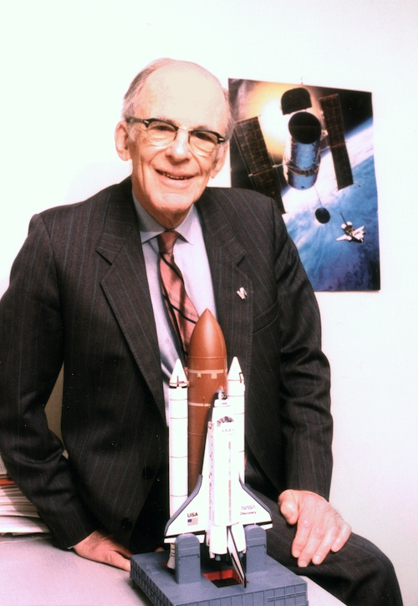
December 10, 1993: Space Shuttfle fixed Hubble Space Telescope optics.
http://www.nytimes.com/1993/12/11/us/shuttle-releases-hubble-telescope.html

Slide 31
The Eagle Nebula:
“Pillars of Creation”
gas pillars in a star-forming region.
Text
http://hubblesite.org/gallery/album/pr1995044a/

Slide 32
The road ahead for fusion:
  Continuing innovation: Interesting ideas being pursued in fusion, & reduce the cost of power plants
32

Slide 33
My Perspective on Fusion Energy
Need to pursue many energy sources. All have tradeoffs & uncertainties. Challenging to supply all energy needed in the long term. Energy demand expected to triple throughout this century as poor countries continue to develop.
Fusion energy is hard, but it’s an important problem, we’ve been making progress, and there are interesting ideas to pursue that could make it more competitive.
Notes:
Need to pursue many energy sources: wind, solar, natural gas with CO2 capture and sequestration

Slide 34
Improving Confinement Can Significantly
↓ Size & Construction Cost of Fusion Reactor
Well known that improving confinement & stability limits can lower Cost of Electricity / kWh, at fixed power output.
Even stronger effect if consider smaller power: better confinement allows significantly smaller size/cost at same fusion gain Q (nTτ_{E}).
Crude Relative Construction Cost
Comprehensive computer simulations on supercomputers are helping us search for improved fusion concepts. Want to be confident of extrapolation to larger sizes when building billion $ experiments.
n ~ const.
n ∝ nGreenwald
H₉₈ (Confinement
Time Multiplier)
Hammett & Dorland, “The Impact of Potential Breakthroughs on Fusion”, Community Workshop on U.S. Magnetic Fusion Research (MFR) Strategic Directions , Madison, Wisconsin, July 24-28, 2017.
34

Slide 35
Interesting Ideas To Improve Fusion
* Liquid metal (lithium, tin) films or flows on walls: (1) protects solid wall (2) absorbs incident hydrogen ions, reduces turbulence, and improves global performance.
* Spherical Tokamaks (STs) appear to be able to suppress much of the ion turbulence: PPPL upgrading the National Spherical Tokamak Experiment (NSTX-U) to test scaling
* Advanced tokamaks, alternative operating regimes (reverse magnetic shear or “hybrid”), methods to control Edge Localized Modes, negative triangularity. Tokamaks sometimes spontaneously spin (like a smoke ring vortex) and reduce the turbulence some.
* Many possible stellarator designs, room for further optimization: Quasi-symmetry / quasi-omnigenity improvements discovered relatively recently, after 40 years of fusion research. Stellarators fix disruptions, steady-state, density limit.
* Tokamaks & stellarators furthest along, but some researchers & companies pursuing more speculative concepts (mirrors, FRCs, pinches, …), sometimes with interesting new twists. Might be cheaper. Can shear flow help stabilize one of these concepts? Plasma smoke ring?
* Advances in magnet technology (high-temperature superconductors, higher field) and other fusion-related technologies could help all fusion concepts.
* Robotic manufacturing advances: reduce cost of complex, precision, specialty items

Slide 36
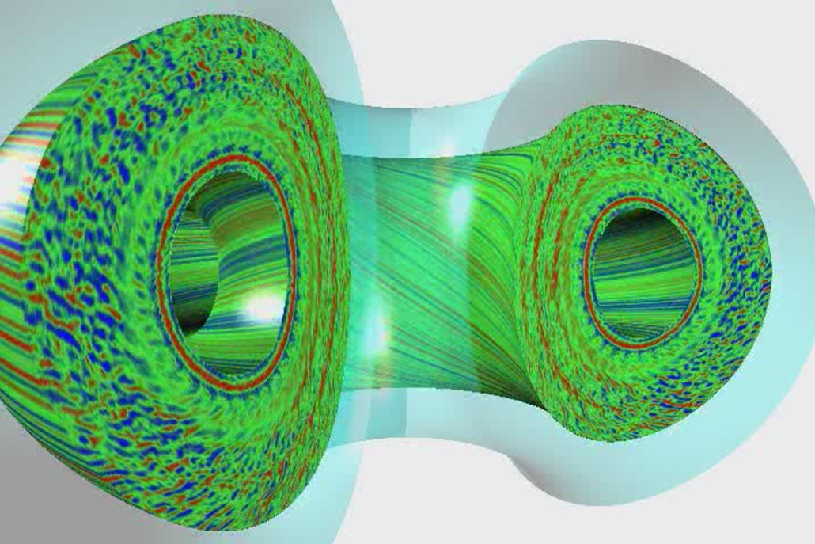
Fairly Comprehensive 5-D Gyrokinetic Turbulence Codes Have Been Developed
Major progress in developing computer simulations of plasma turbulence,
but still important unfinished work, including edge region.
Movie of density fluctuations from GYRO simulation http://fusion.gat.com/THEORY/images/0/0f/N32o6d0.8.mpg from http://fusion.gat.com/theory/Gyromovies
500 radii x 32 complex toroidal modes (96 binormal grid points) x 10 parallel points along half-orbits x 8 energies x 16 v||/v, 12 hours on ORNL Cray X1E with 256 MSPs
Waltz, Austin, Burrell, Candy, PoP 2006

Slide 37
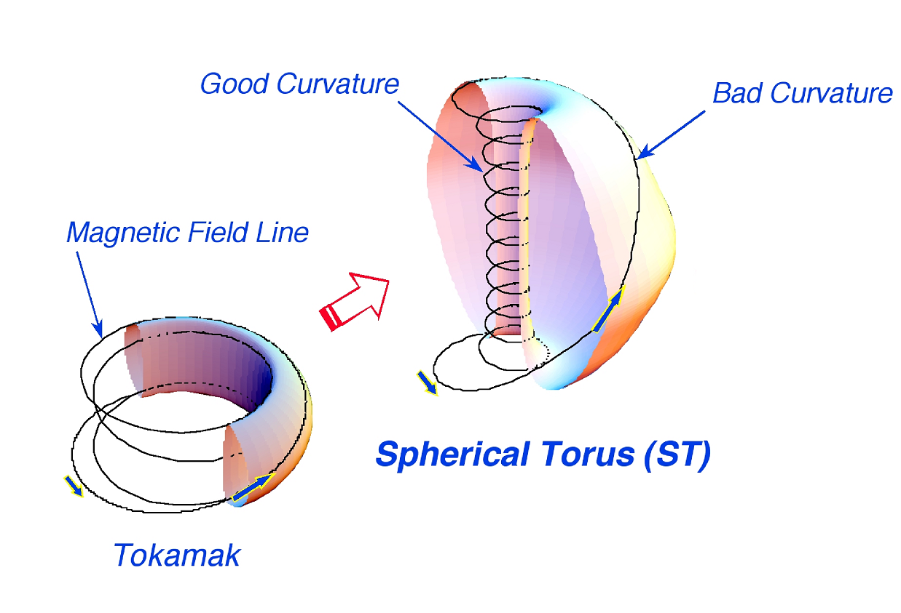


Spherical Torus has improved confinement and pressure limits (but less room in center for coils)
$$β≈10−40\%$$
$$β≈3−10\%$$
National Spherical Tokamak Experiment Upgrade (NSTX-U) at PPPL being rebuilt and enhanced. Has twice the magnetic field and heating power as original NSTX, to see how performance scales towards a real reactor scale.

Slide 38
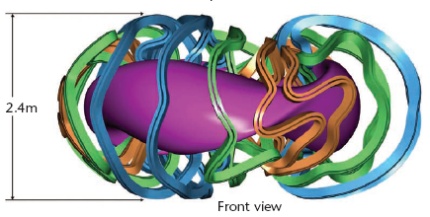
Improved Stellarators Being Studied
Originally invented by Spitzer (’51), the unique idea when fusion declassified (’57)
Mostly abandoned for tokamaks in 1969. But computer designs now much better.
Hidden quasi-symmetry discovered in 80’s-90’s: don’t need vector B exactly symmetric toroidally, |B| symmetric in field-aligned coordinates sufficient to be as good as tokamak.
Magnetic field provided by external coils, inherently more stable, intrinsically steady state, no hard stability limit.
Robotic manufacturing / 3-D printing might reduce cost a lot?
~$1B W7-X stellarator in Germany getting good performance.

Slide 39

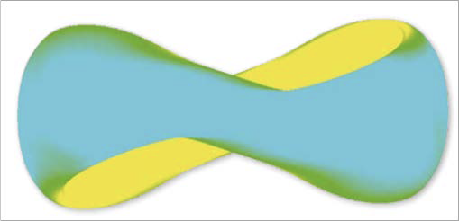
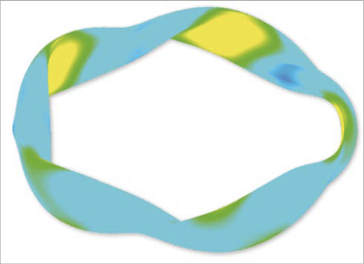
Many types of stellarators possible
QH, quasi-helical
Quasisymmetry discovered in 80’s, but full range of possibilities still being explored.
(Color contours indicate magnetic field strength.)
Recently discovered designs that confine single-particle orbits extremely well, even for energetic particles. (Paul & Landreman PRL 2022.)
Ongoing research: particles can interact collectively and cause small scale turbulent fluctuations. Not sure how these will scale to a larger reactor-scale. Comprehensive computer codes being developed.
QA, quasi-axisymetric
QI, quasi-isodynamic
39

Slide 40
Lyman Spitzer’s Legacy of Innovation in the
Quest for Fusion Energy
Some history of Spitzer’s big ideas / innovations:
  1946: Telescopes in space (Hubble Space Telescope)
  1951: Figure-8 stellarator trick to make a fusion power source
A fluid picture of the trick for how a figure-8 stellarator works (and basis for later stellarators).
Continuing innovations at PPPL and elsewhere to improve fusion energy concepts
  including ideas for further improving the stellarator concept, which is undergoing a renaissance.
40

Slide 41
December 10, 1993: Space Shuttfle fixed Hubble Space Telescope optics.
http://www.nytimes.com/1993/12/11/us/shuttle-releases-hubble-telescope.html

Slide 42
The Eagle Nebula:
“Pillars of Creation”
gas pillars in a star-forming region.
Text
http://hubblesite.org/gallery/album/pr1995044a/

Slide 43
References (1/2)
Earl C. Tanner, Project Matterhorn, 1977 (revised 1982).
Earl C. Tanner, The Model C Decade, (revised 1982).
Earl C. Tanner, The First Princeton Tokamaks, 1982.
Amasa S. Bishop, Project Sherwood: The U.S. Program in Controlled Fusion, 1958.
“Lyman Spitzer Jr., 1914-1997”, A Biographical memor by J. P. Ostriker, Biographical Memoirs, V.90 (2009), (biographies of members of the National Academy of Sciences) http://www.nap.edu/openbook.php?record_id=12562&page=354, National Academies Press. http://www.nasonline.org/publications/biographical-memoirs/memoir-pdfs/spitzer-lyman.pdf
Thomas H. Stix, personal communications (c. 1980-1998), from stories Stix told in classes and elsewhere.
Thomas H. Stix, “Highlights in Early Stellarator Research at Princeton”, J. Plasma Fusion Res. Series, V. 1, 3 (1998).
http://fire.pppl.gov , http://fire.pppl.gov/fusion_library.htm
Dale Meade, 50 years of fusion research, Nuclear Fusion and IAEA meetings, http://fire.pppl.gov/IAEA08_Geneva_Meade.ppt, http://fire.pppl.gov/nf_50th_6_Meade.pdf
Dale Meade, “A Brief History of Fusion and Fusion Basics” and other talks at the 2005 Spring Princeton Graduate Seminars, http://fire.pppl.gov/ast558_2005.html
Bromberg, Joan Lisa (1982) Fusion: Science, Politics, and the Invention of a New Energy Source MIT Press, Cambridge, Massachusetts, p. 44, ISBN 0-262-02180-3
http://en.wikipedia.org/wiki/Project_Sherwood
Robin Herman, "Fusion: the search for endless energy", Cambridge University Press, 1990
James Phillips, "Magnetic Fusion", Los Alamos Science, Winter/Spring 1983
http://en.wikipedia.org/wiki/Perhapsatron

Slide 44
References (2/2)
A. Bhattacharjee, G.M. Schreiber, & J. B. Taylor, “Geometric phase, rotational transforms, and adiabatic invariants in toroidal magnetic fields”, Phys. Fluids B 4, 2737 (1992). (Points out that the magnetic twist in Spitzer’s stellarator concept is the first realization of the geometrical Berry phase of quantum & classical dynamics.
http://www.amnh.org/education/resources/rfl/web/essaybooks/cosmic/p_spitzer.html
AIP oral history interviews:
  Lyman Spitzer (1978) http://www.aip.org/history/ohilist/4900.html,
  Marshall Rosenbluth (2003) http://www.aip.org/history/ohilist/28636_1.html
...

