Slide 1
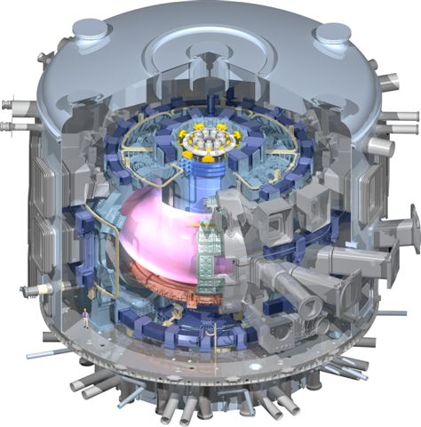
IVC Physical Design and Layout
Presented by P. Heitzenroeder for the IVC Team

Slide 2
Outline
System overview
ELM and VS coil construction
  Mineral insulated cable; forged SS structure
  In-vessel joints
VS coil details
  Failure recovery features
  Coil forces
  In-vessel assembly
  Lead-out details
ELM coil details

Slide 3
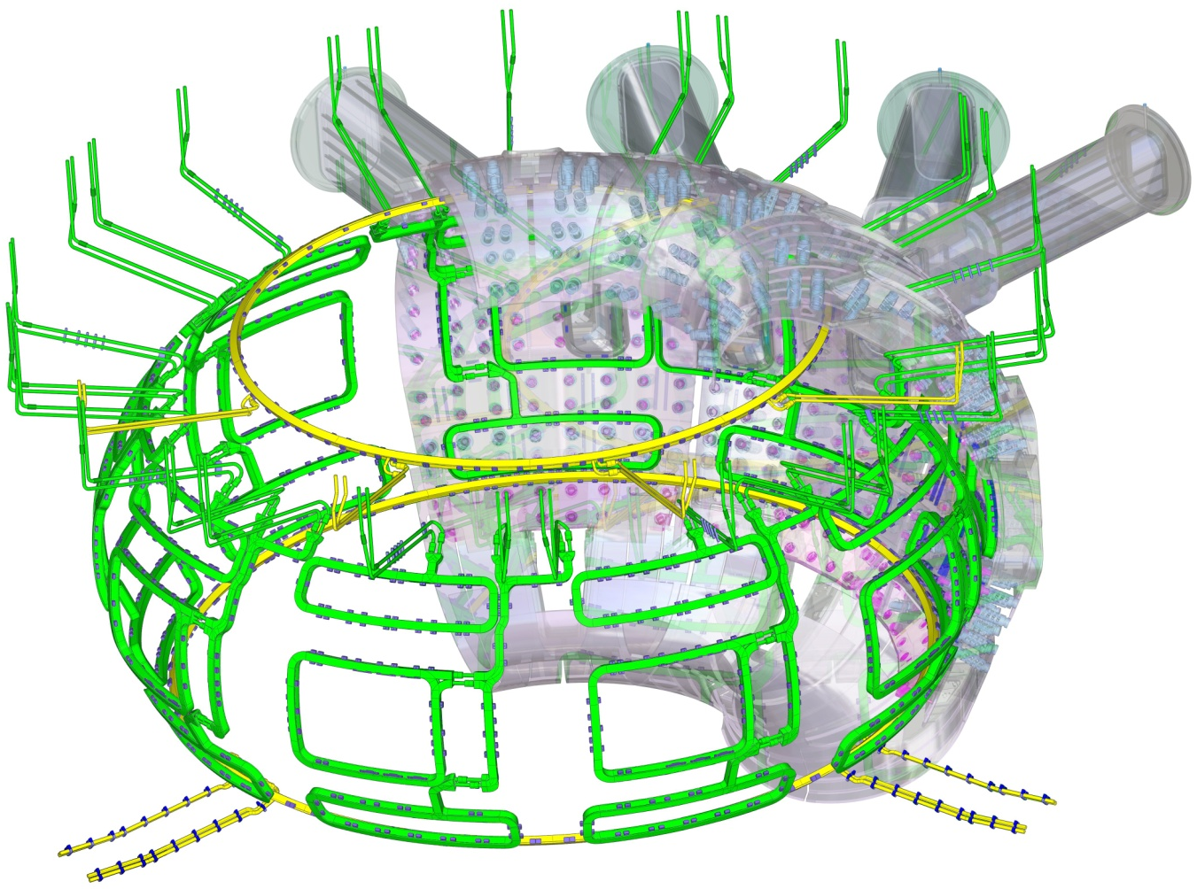
System Overview
ELM Feeders
(27 sets in Upper Ports)
Upper VS Coil
Upper VS Feeders
(1 set in 4 upper ports)
ELM Coils
(3 per sector)
Lower VS Feeders
(2 sets in 2 lower ports)
Lower VS Coil
27 ELM (Edge Localized Mode) water-cooled “picture frame” coils fabricated of SS jacketed, mineral insulated cable.
9 lower, 9 equatorial, and 9 upper coils
  6 turns/coil
  1 flow path/coil
2 VS (Vertical Stability) “ring coils” fabricated of SS jacketed, mineral insulated cable.
4 turns/coil
Each turn is a flow path.

Slide 4
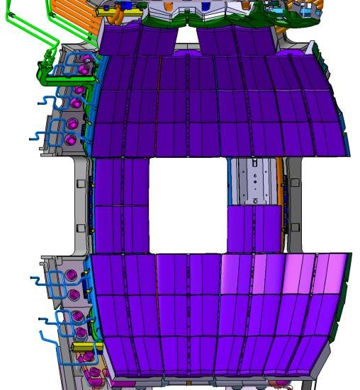
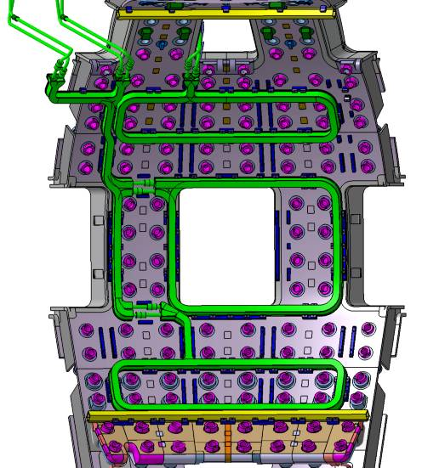
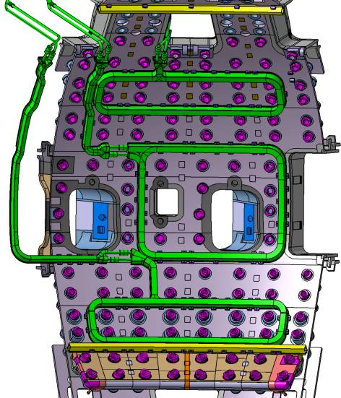
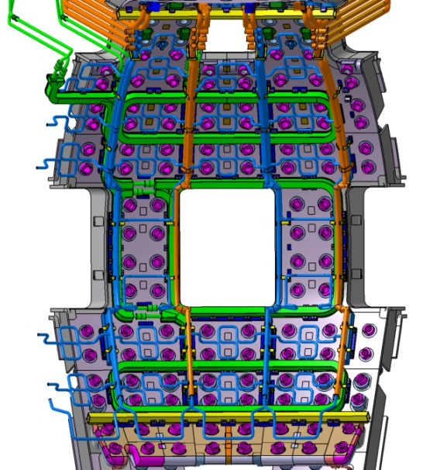
In-Vessel Arrangements
Coils & Manifolds
Coils, Manifolds & Blanket
VS & ELM Coils
VS & ELM Coils – NB sector

Slide 5
Operational parameters
VS Coils | Normal Operation
Number | 2 coils - 4 turns each
Maximum current (pulsed) | ± 60 kA (240 kAt/coil)
Voltage | ± 2.3 kV
Total Weight | 15 t (estimate)
ELM Coils
Number | 27 coils - 6 turns each
Maximum current | ± 15 kA (+ 90 kAt/coil)
Voltage | ± 230 V
Total Weight | 62 t (estimate)

Slide 6
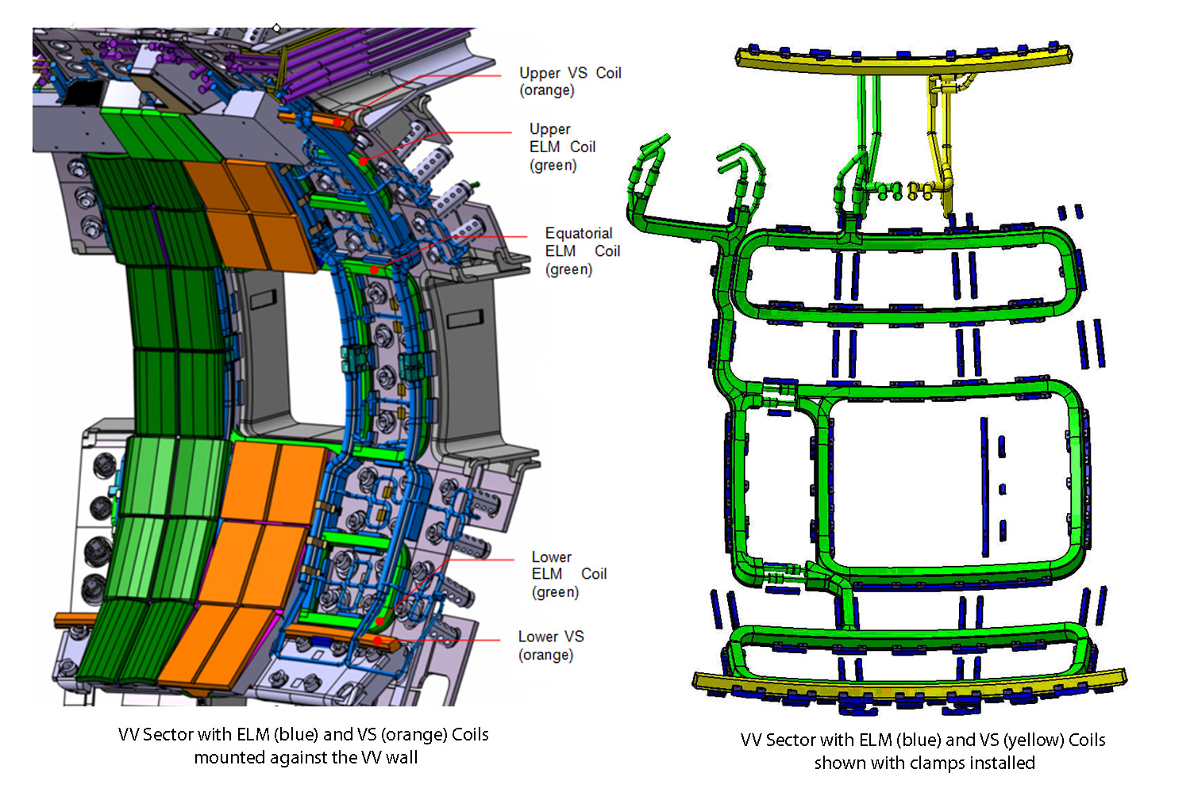
IVCs will be protected by the first wall shield blocks

Slide 7

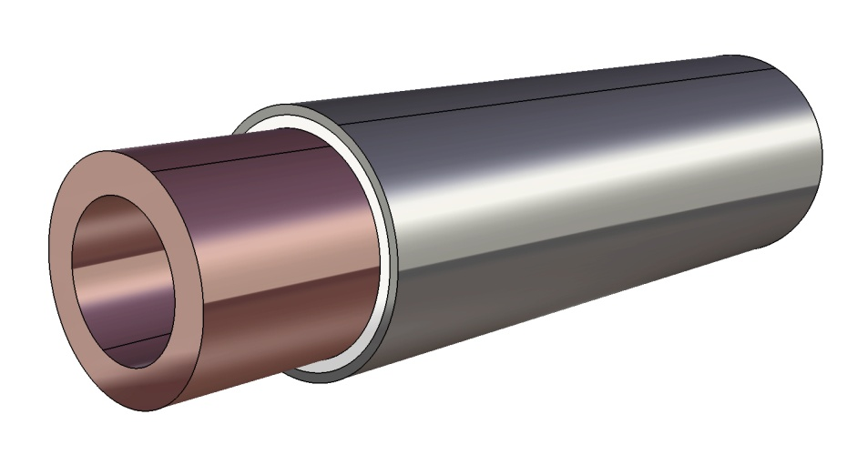
Stainless steel jacketed mineral insulated cable is used for both the ELM & VS coils.
 | ELM | VS
SS OD | 54 mm | 59 mm
SS ID | 50 mm | 55 mm
Cu OD | 45 mm | 45 mm
Cu ID | 30 mm | 30 mm
Mineral Insulation thickness | 2.5 mm | 5.0 mm
Same hollow Cu conductor in both – major difference is the insulation thickness req’d. by the higher VS voltage.
Magnesium oxide (MgO) is the likely insulation. It is the most commonly used insulation – its major drawback is that it is hydroscopic.
Spinel (MgAl₂O₄) is a possible option – it is not hydroscopic, but its thermal conductivity is not as good (MgO: 15 W/cm-deg. KMgAl2O4 45)
(Reference: Physical Review, Volume 126, No.2, April 15, 1962)
Prototype cable lengths are being produced by TYCO and ASIPP. They are considering both mineral types.
Mineral insulation
Copper
316 LN (IG) jacket

Slide 8
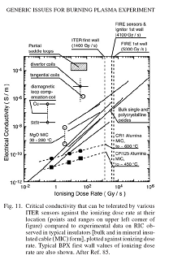
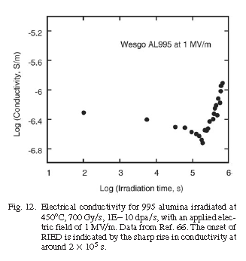
Radiation effects on MgO-
Comments from George Vayakis
(1) Radiation Induced Conductivity. This depends on the exact composition, compactness, neutron spectrum etc. You can see this in the scatter below. For our pickup coils we aim for 1 order of magnitude clearance from the cloud of points for signal droop purposes. We also prefer Alumina to MgO again to minimise signal droop. For a power coil the considerations are different (dissipation?). Dose rate related. See Fig 11, below.
(2) Radiation Induced Electrical Degradation. Associated, but not conclusively, with metal colloid formation in the insulator. Dose related. Our internal guideline: keep insulation below 250 kV / m. Test if plan to use higher. See Fig 12, below.
    VS coils: < 150kV/m (133kV/m with two VS interleaves and symmetric grounding)
Peak ELM dose rate is ~170G/s

Slide 9
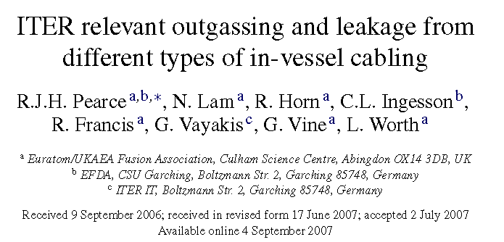
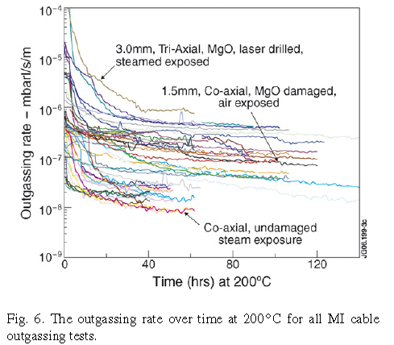
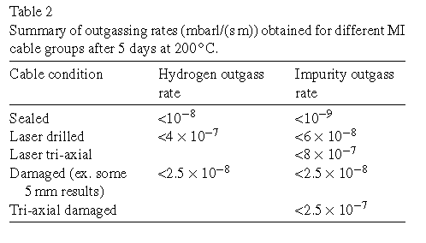
Information from:
“A base pressure is defined in the ITER Project Integration Document (PID) [3] of <10−7 mbar for hydrogen isotopes and <10−9 mbar for impurities at the planned operating temperature of 100 ◦C.
The deliberate perforation of cabling was performed to ascertain if the postulated prolonged gas supply from damaged cable, in the form of virtual leaks, could be mitigated.
All sealed cables reached an outgassing rate in the low 10−8 mbar l/(s m) in a relatively short period (2days at 200 ◦C).
The outgassing was predominately hydrogen with the largest impurity being water at approximately one-tenth of the hydrogen outgassing. This gives water outgassing at 200 ◦C of ∼1×10−9 mbar l/(s m). ”

Slide 10
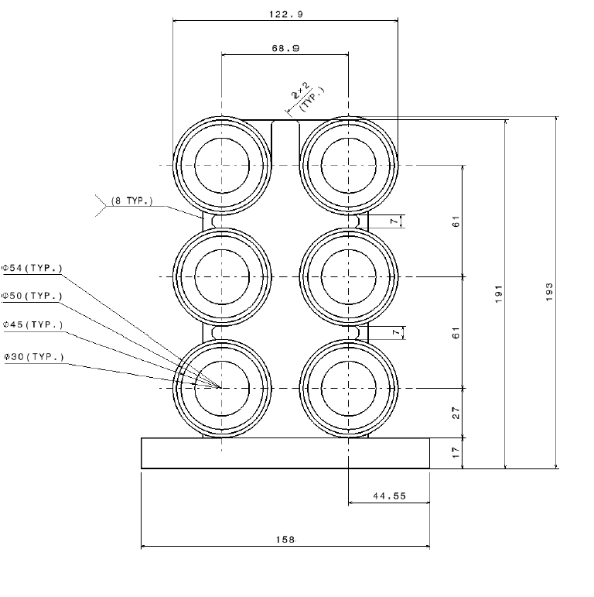
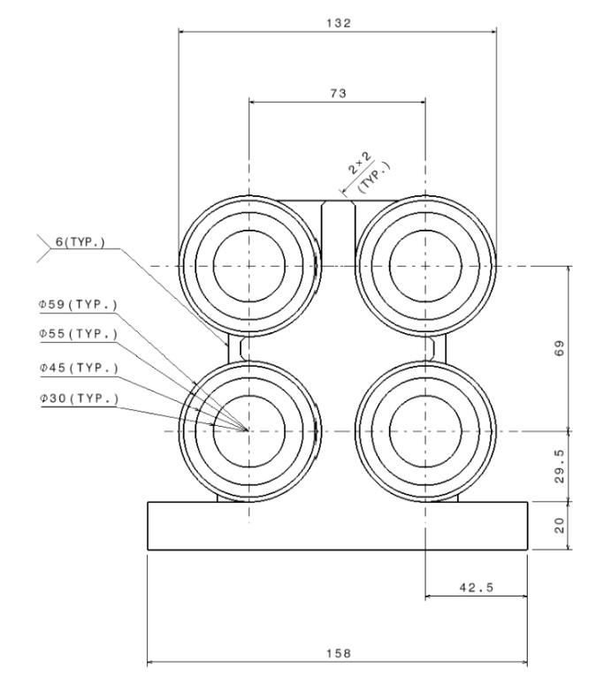
ELM and VS coil construction
316-LN (IG) forged structure
Welds (typ.)
Mineral insulated cable
Water channel
Cable welded onto forged SS structures; Similar construction for both coil types.
ELM coils will be delivered as 27 factory fabricated units; the VS coils will be assembled in the vessel from segments.

Slide 11
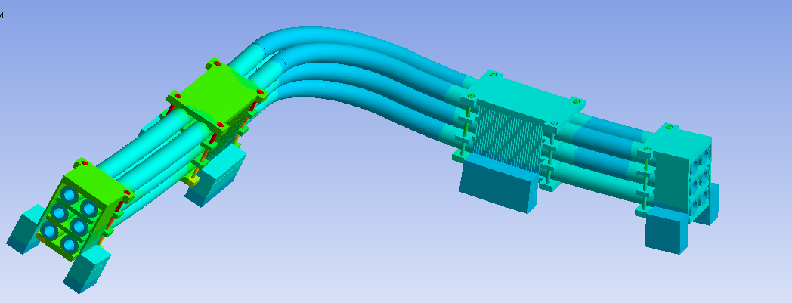
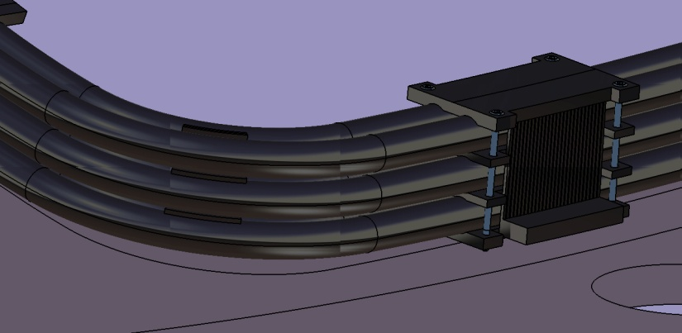
A secondary analysis effort is underway to evaluate another structural option
Motivation: to determine if the flexible straps of this design can reduce thermal stresses.
Reduced thermal stresses would permit higher operating temperatures and therefore lower water velocities.
This may provide a way to reduce water erosion concerns.
It will probably require a few more weeks of analyses to determine if this is feasible.
Larry Bryant will give an overview of the present status of the analyses of this design option.

Slide 12
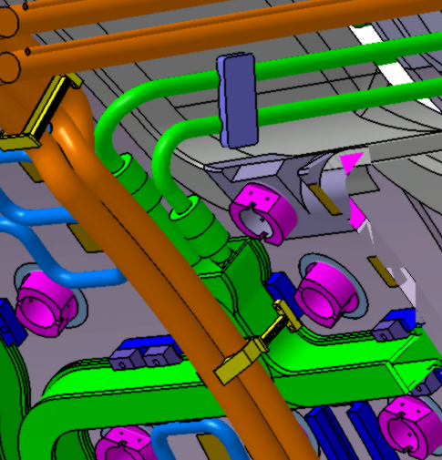
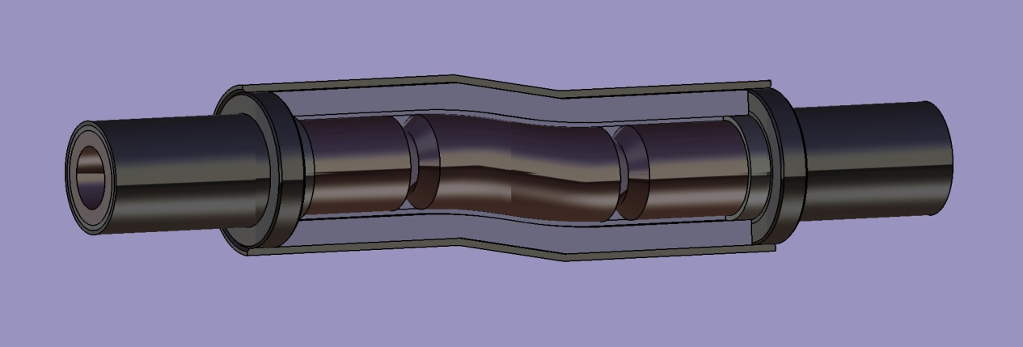
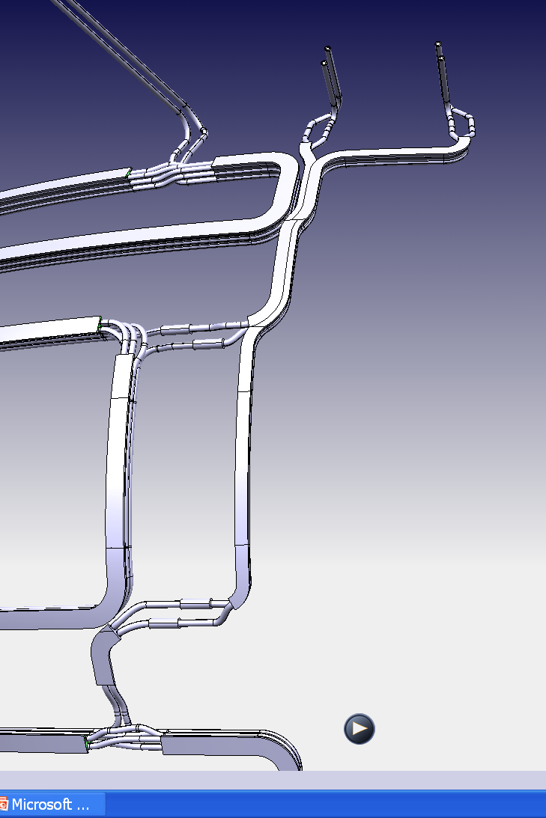
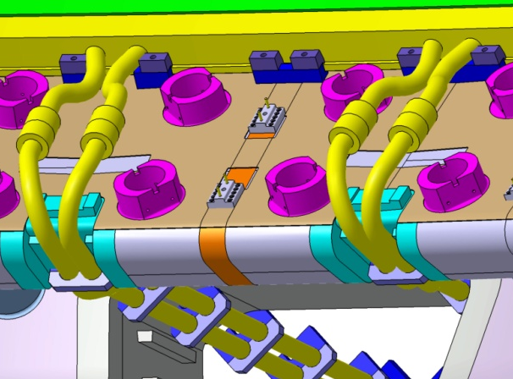
Welded connections are planned for in-vessel feeder connections
Custom made to accommodate misalignments
Welds
Same type of joint for VS and ELM connections.
  Insulation: compacted MgO or ceramic polymer.
Highly reliable.
We hope to qualify the IVC design as RH Category 3, meaning that replacement is not expected.
  Still need to demonstrate the feasibility of replacing coil(s) in the event of failures.
  RH welded connections and replacement connections of other designs will be considered; a RFP for joining R&D is underway.
Upper ELM Coil Joints
Lower VS Coil Joints

Slide 13
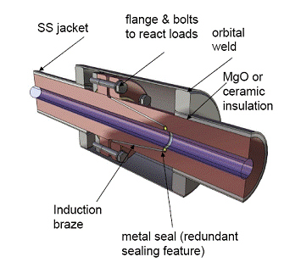
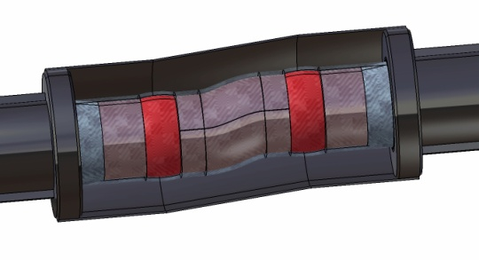
Other joint concepts are still being pursued
The Joining R&D Subcontract includes evaluations of these concepts and the possible development of others.
Hybrid bolted & soldered joint
Welded joint with custom bridge piece
Front facing soldered joint with custom bridge pieces.

Slide 14
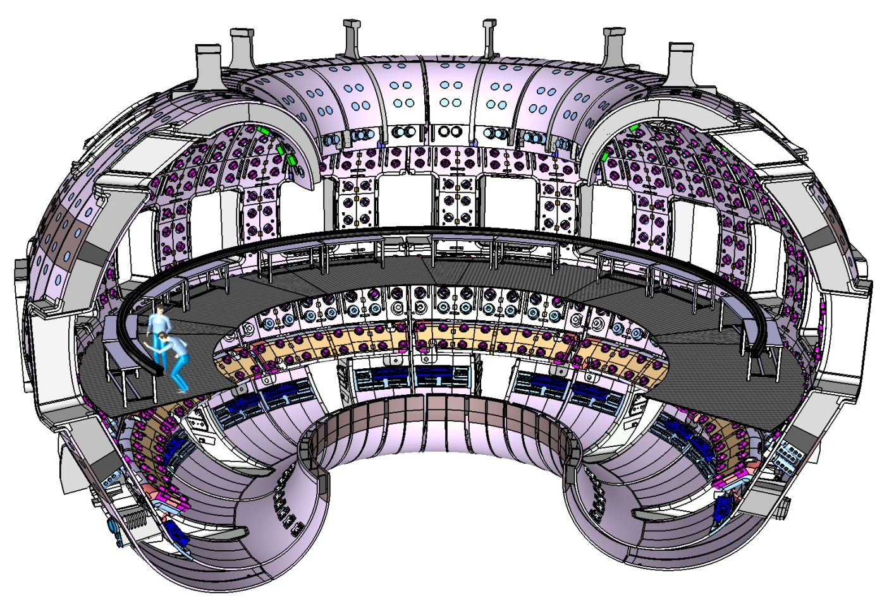
The VS coils will be constructed in the VV from pre-formed segments
Coil is constructed as 4 individual turns for failure recovery in the event of a turn failure.

Slide 15
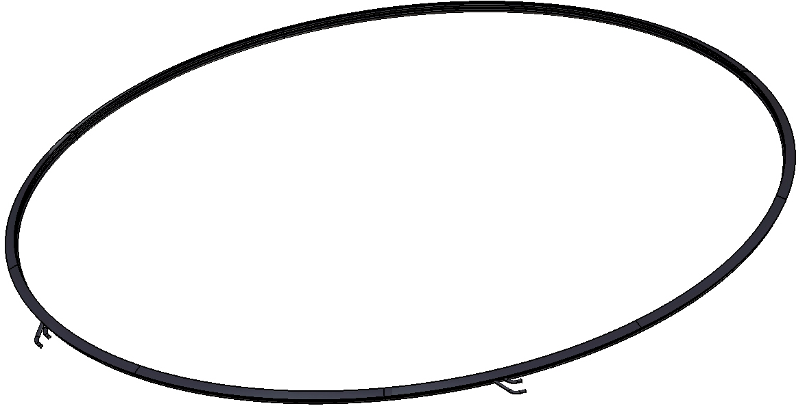
UPPER VS COIL
314 MM
12,199.4 MM DIA.
Coil weight (Cu + structure) = 4015 kg / 8,844 LBS.

Slide 16
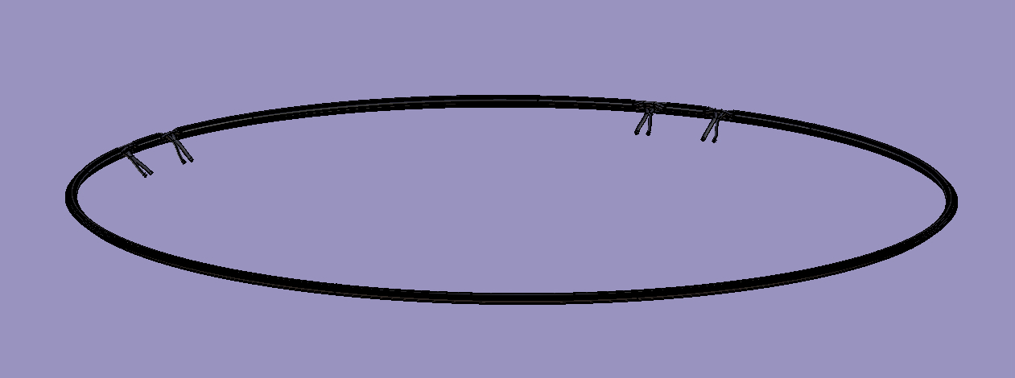
Lower VS Coil
DIA = 15,242.285 mm
Coil weight (Cu + structure) = 5107 kg/ 11250 lbs.

Slide 17
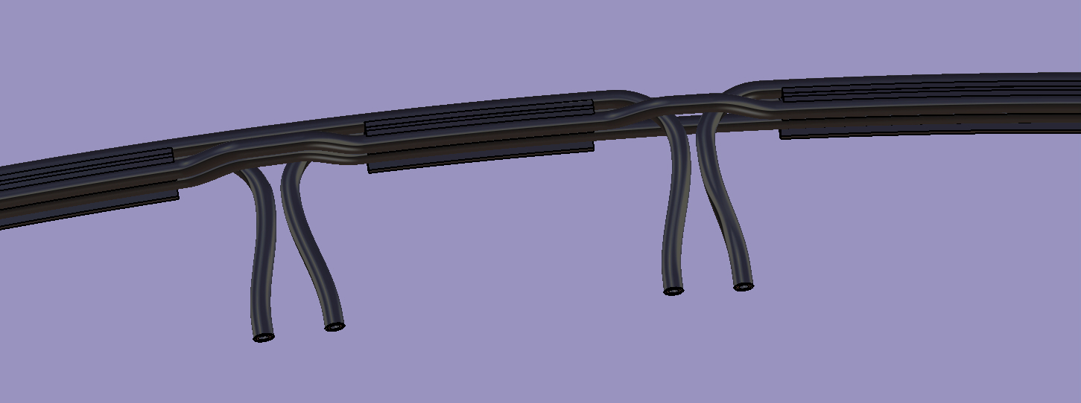
VS coil lead region details

Slide 18
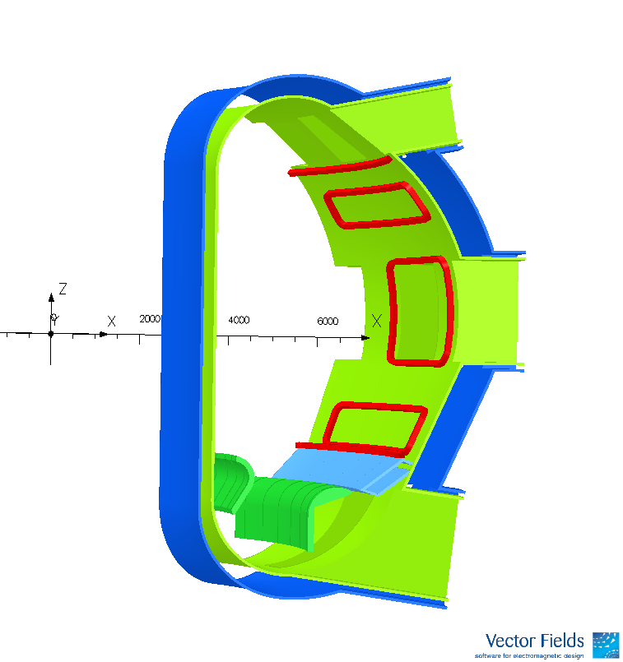
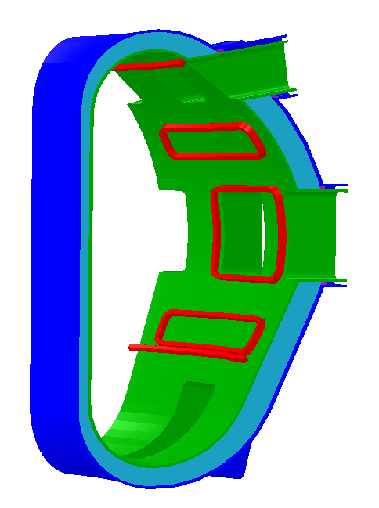
VS Coil Forces Have Decreased since the CDR
Upper forces significantly reduced by coil relocation.
CDR
IDR
COIL Leg | CDR |F| (N) | IDR |F| (N)
VS_UP | 1,087,207 | 381,519
VS_DN | 1,295,501 | 1,152,627
Bob Pillsbury will present more on the EM loads and Pete Titus will present information on the VS coil stress analyses.

Slide 19
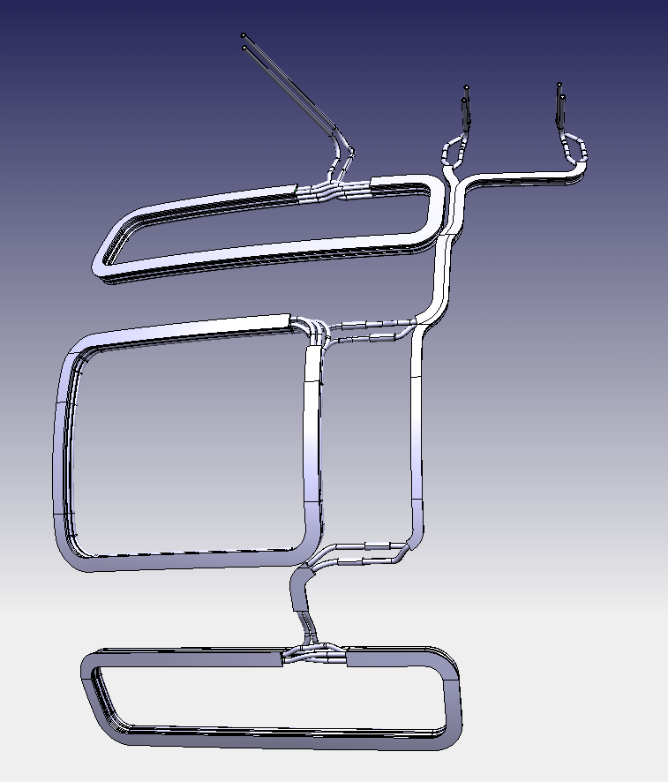
ELM coil / feeder assembly sizes & weights
Mass [tonne]: | Upper ELM Coil = 2.1 EQ ELM Coil = 2.3 Lower ELM Coil = 2.2 In-vessel Feeder = 1.3
Outside dimensions [m]: | Upper ELM Coil = 0.9H×4.0W×0.3T EQ ELM Coil = 2.4H×3.1W×0.5T Lower ELM Coil = 1.0H×4.2W×0.3T In-vessel Feeder = 4.8H×1.0W×0.5T H=Poloidal, W=Toroidal, T= Radial
Material(s): | Conductor = CuCrZr-IG alloy Insulation = MgO Powder Outer Jacket = 316L(N)-IG Clamps = 316L(N)-IG Bolts = 316L(N)-IG with MoS2 lubricant coating Rails - Body = 316L(N)-IG - Threaded Insert = C63200 Ni-Al bronze
Mid ELM length: 63,000mm
Upper ELM length 58,500mm
Lower ELM length 61,500mm
Art Brooks will present details of the feeder thermal and structural analyses.

Slide 20
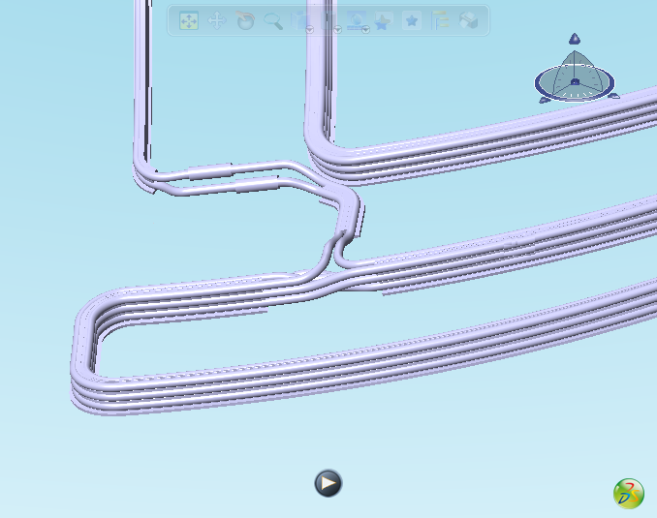
Lower ELM Coil Details
Care is taken to provide a minimum radius of 150 mm – i.e., R/r=150/15=10

Slide 21
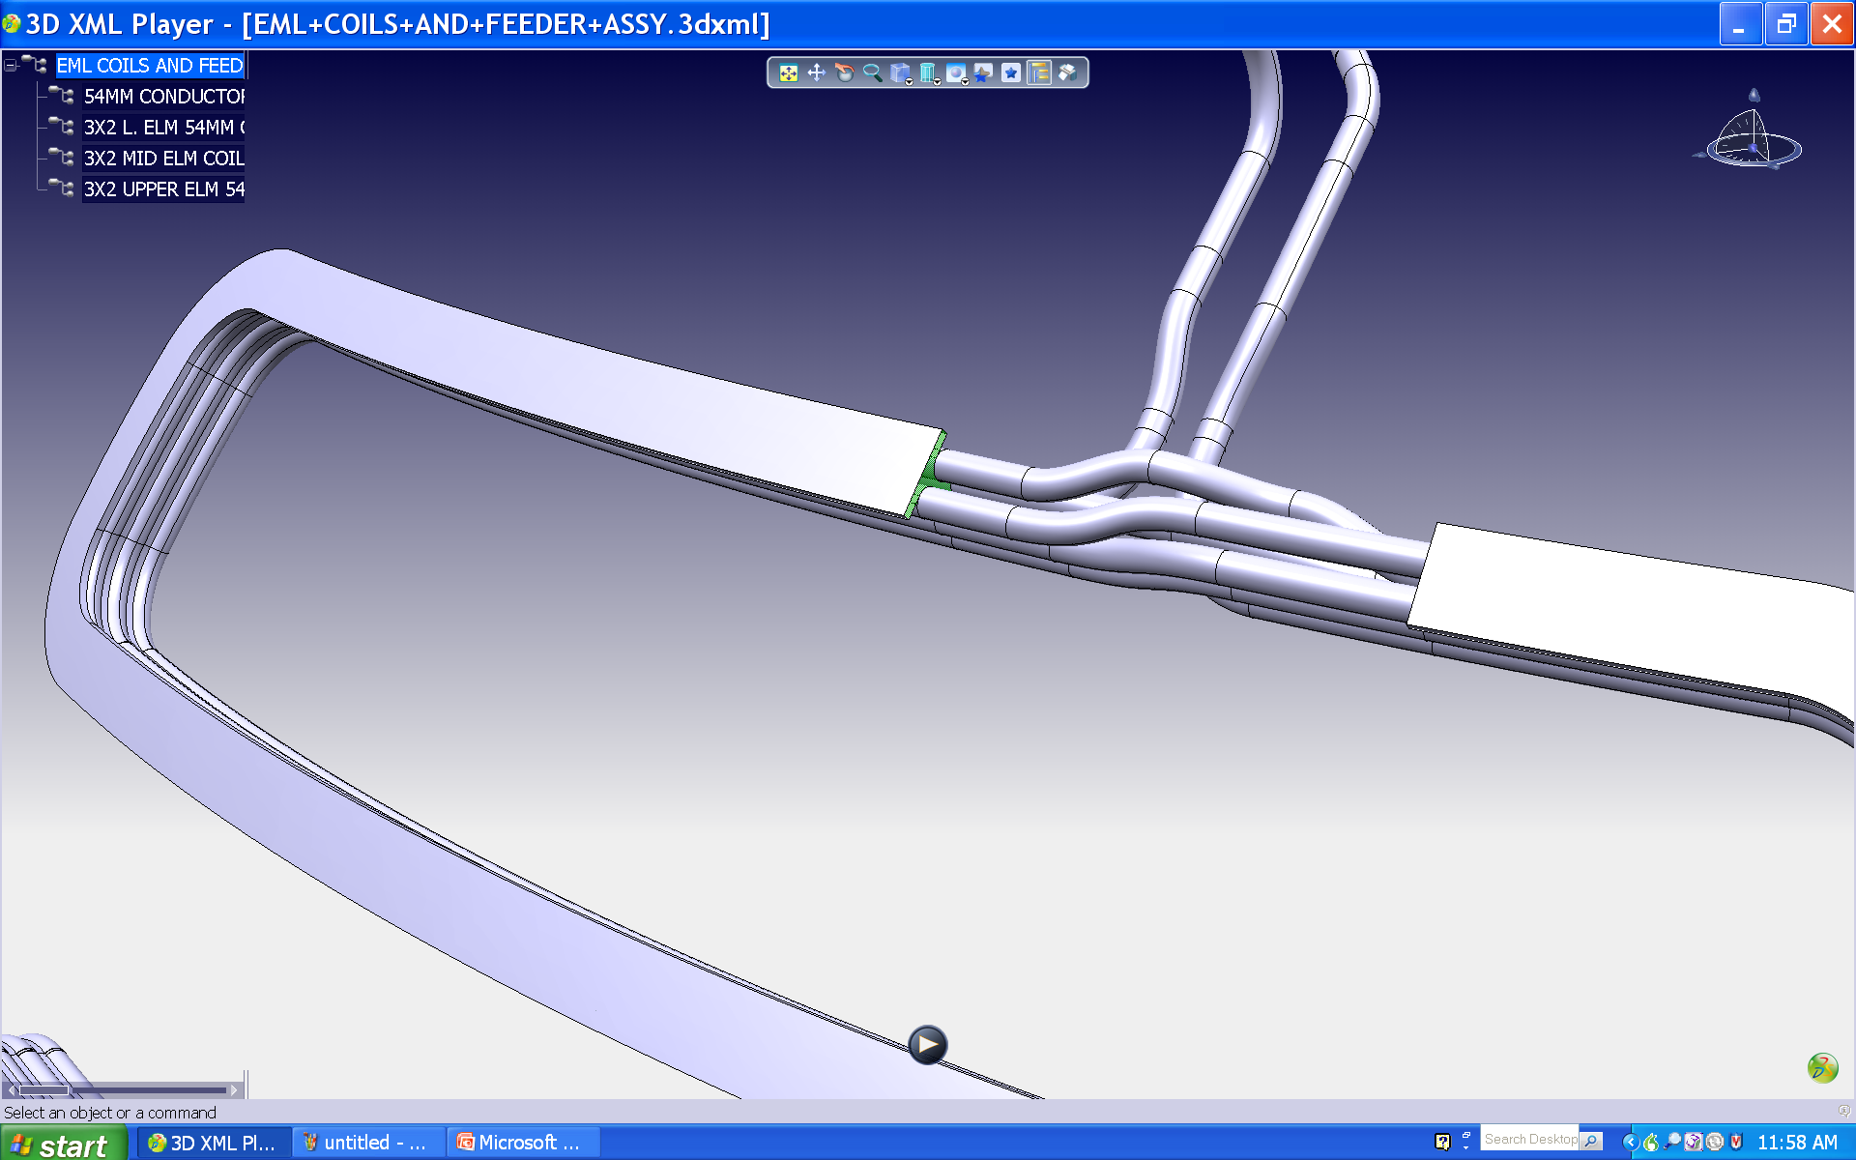
Upper ELM Coil Details

Slide 22
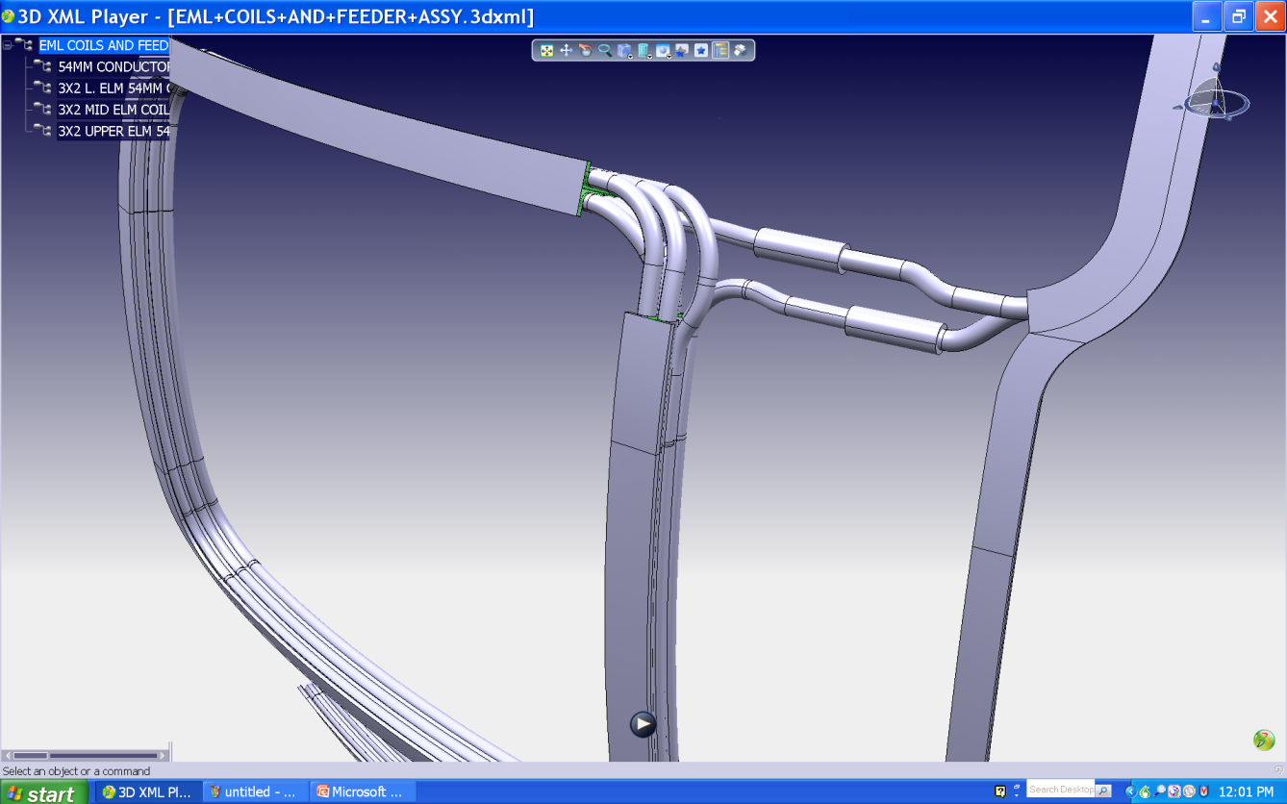
Mid ELM Coil Details

Slide 23
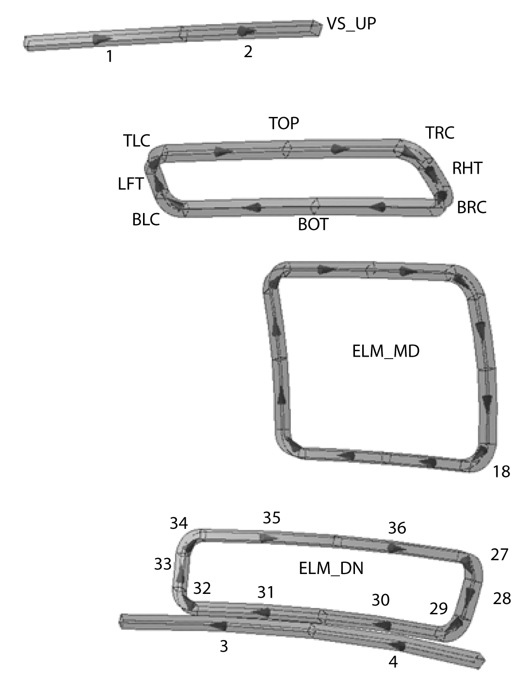
Maximum Leg Force Magnitudes During Normal Operation
(EOB) are slightly lower compared to the CDR results
COIL Leg | CDR |F| (N) | IDR |F| (N)
VS_UP | 1,087,207 | 381,519
VS_DN | 1,295,501 | 1,152,627
ELM_DN_BOT | 378,852 | 340,856²
ELM_DN_LFT | 298,633 | 258,377²
ELM_DN_RHT | 304,296 | 262,099²
ELM_DN_TOP | 423,028 | 393,116²
ELM_MD_BOT | 327,356 | 294,637⁵
ELM_MD_LFT | 785,900 | 697,772⁵
ELM_MD_RHT | 788,347 | 700,642⁶
ELM_MD_TOP | 332,249 | 306,742⁶
ELM_UP_BOT | 424,960 | 385,279⁷
ELM_UP_LFT | 256,980 | 250,991⁷
ELM_UP_RHT | 252,753 | 247,446⁷
ELM_UP_TOP | 333,599 | 298,618⁷
Details of the EM analyses will be presented by Bob Pillsbury

Slide 24
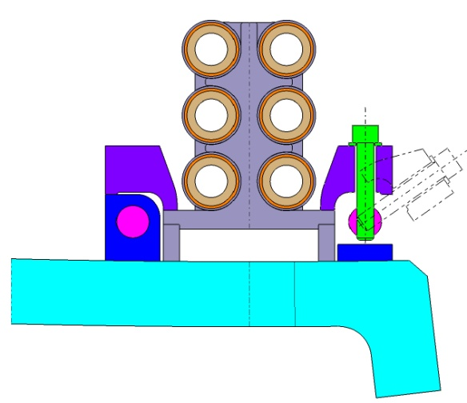
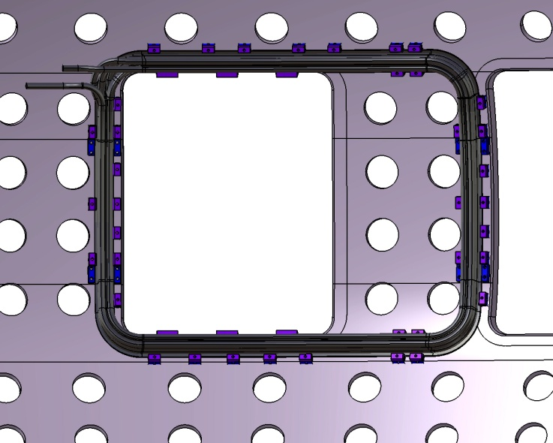
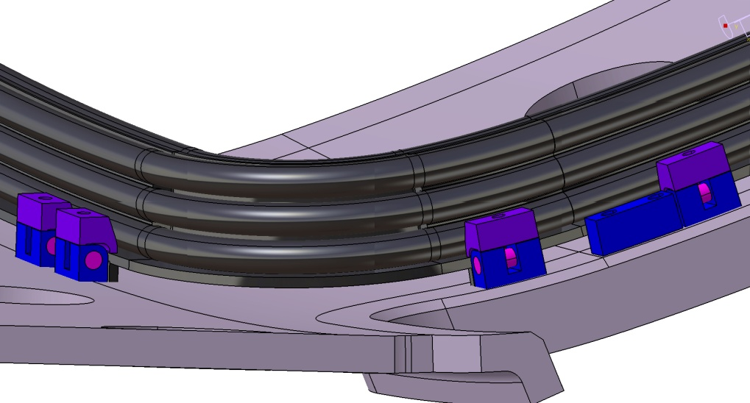
Coil to vessel attachments
Same design for VS and ELM coils.
Clamping force is adequate to prevent sliding in vacuum.
Removable shim pieces are custom machined to properly locate the coil.

Slide 25
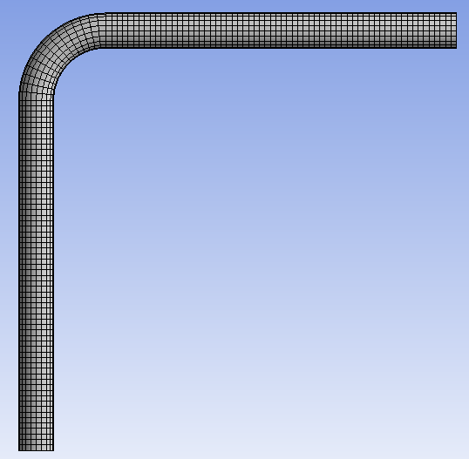
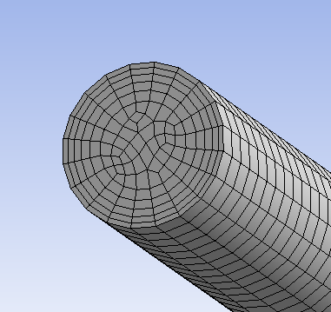
ANSYS CFX Cavitation Studies Were Performed
Make fluid mesh
  First element off wall is < 0.1 mm
Mass flow rate 5.65 kg/s
  Ave. velocity 10 m/s
Assume turbulent flow
Downstream P P_{relative}= 0
Saturation P of H2O at 25 C
  3170 Pa (absolute)

Slide 26
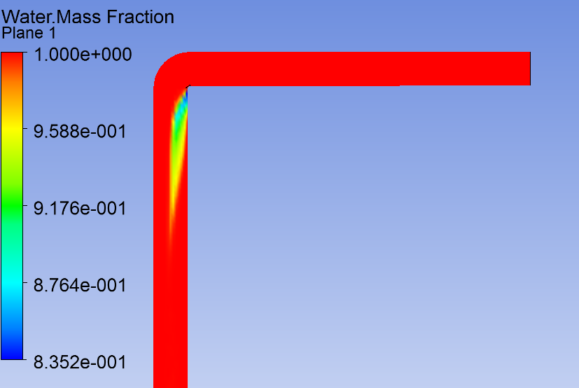
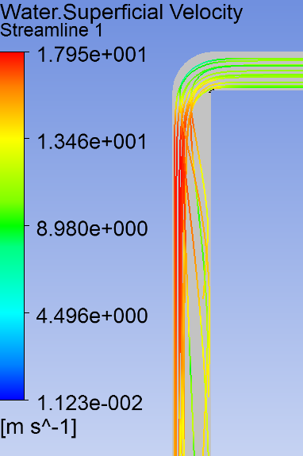
CFX Results Indicate that Cavitation in smooth ELM pipes with high R/r is not an issue
Results at 100 C
Decrease back pressure to 0 Bar
  Qualitatively correct
(R/r = 1.1)

Slide 27
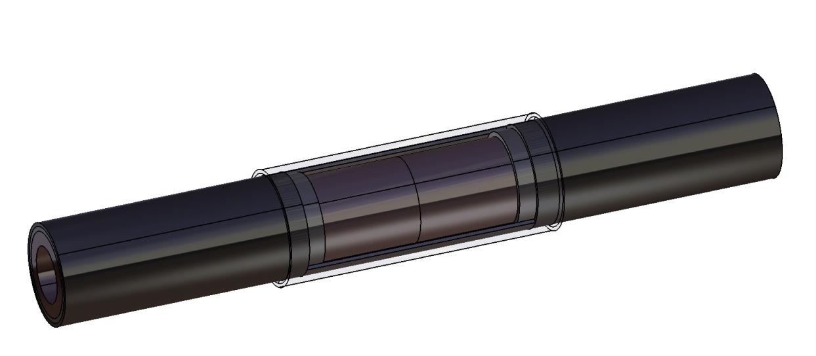
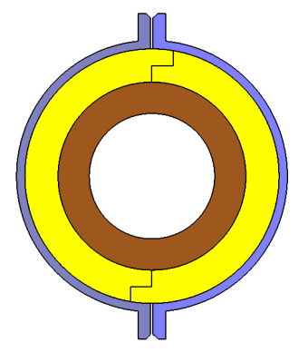
MgO production lengths are limited – cable splices are needed.
Ceramic Insulator
Conductor SS Jacket
SS Sleeve
Copper conductor
Typical Coil Joint
Joining of copper conductor:
  Induction brazing is the most likely joining process, but we plan to also research welding processes (friction stir, laser, e-beam).
  NDT methods of checking joint need to be developed.
The joint will be insulated with compacted MgO or split ceramic sleeves with overlapping seams.
A stainless steel sleeve will be slid over the joint and orbitally welded and leak checked.
  To be developed: details of leak checking method; NDT of welds.
A Request for Proposal for Joining R&D is in progress.

Slide 28
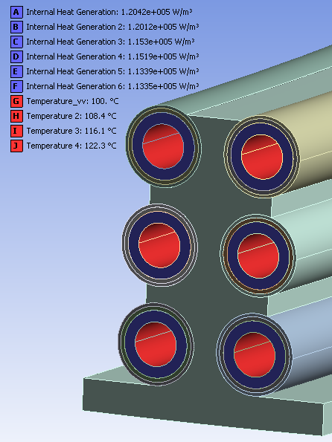
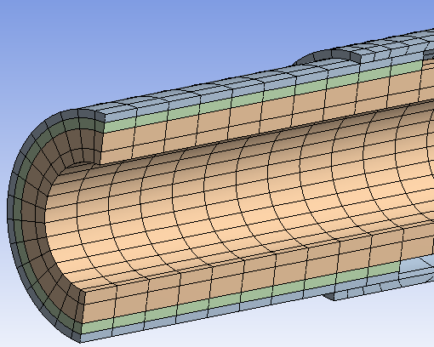
Thermal analyses were performed of the cable splices
Exposed bodies to nuclear heating
  Take average of toroidal and poloidal heating by q₀exp(-r/0.06)
  Copper nuclear heating added to Joule heating (10%)
Assume no radial conduction from Sleeve to MgO
Copper surface T = 140 C (warmest turn)
Assume bonded contact between Sleeve and Jacket
Assume thin copper cladding on inner surface of Sleeve

Slide 29
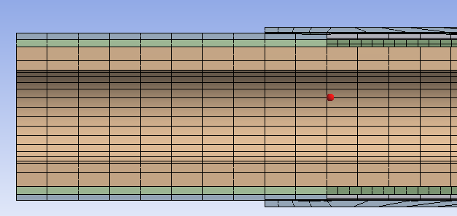
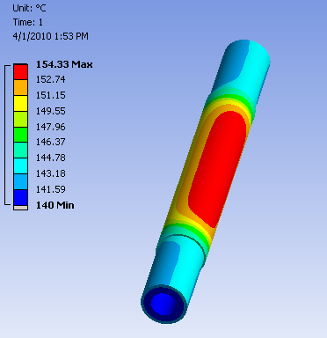
Spice sleeve temperature is very acceptable with MgO refilling
Improving on radial heat transfer by refilling the gap with MgO
Case 5: Assume K_{eff} (refilled) MgO 0.75 W/m-C
  K_{eff} is 1/3 of standard K MgO 2.5 W/m-C
  Sleeve 13 cm, Overlap 2 cm
Case 6: Vary cladding thickness, allow refilled MgO
  L1 = 13 cm, L2 = 2 cm
  Assuming K_{eff} refilled MgO= 0.75 W/m-C
  0 cladding 154.3 C
  100 mic cladding 153.7
  300 mic cladding 152.9
  500 mic cladding 152.3

Slide 30
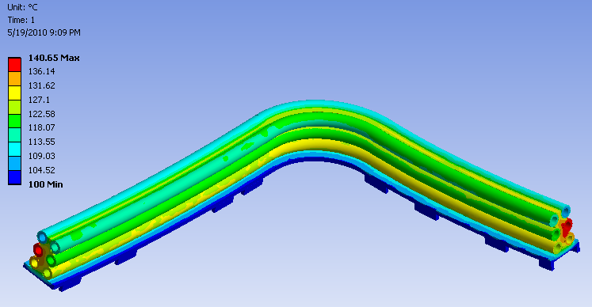
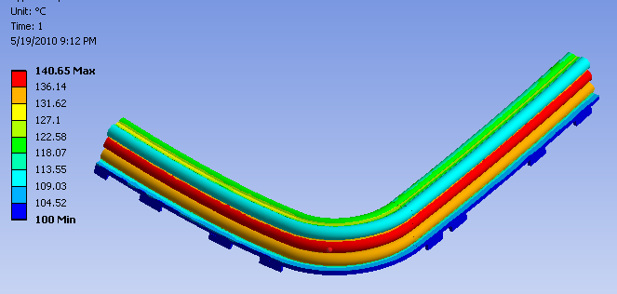
ELM Thermal Analyses
Nuclear + Joule, and water cooling
Max. T=140.7 C
Back View
Front View

Slide 31
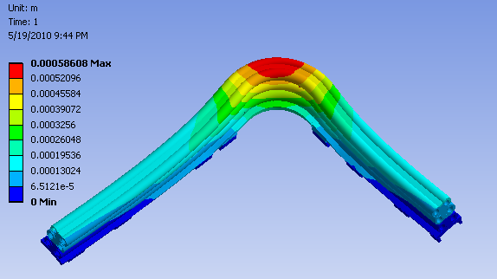
Thermal Deformation
Max Deformation 0.58 mm

Slide 32
Physical Properties of CuCrZr
Tensile Property of CuCrZr Alloy (average)
Material Yield strength(MPa) UTS(MPa)
Low strength (L) 78 248
Intermediate strength (I) 199.4 318.6
High strength (H) 297 405.3
Estimated Endurance limit (MPa)
Low strength (L) ~ 74
Intermediate strength (I) ~ 96
High strength (H) ~ 122
K1c for CuCrZr was estimated from J1c=200 at RT.
K1c was taken as =150MPaRoot m at 100C

Slide 33
Physical Properties for 316LN
The Sm and ultimate tensile strength material properties of 316L(N)-IG taken from the SDC-IC Appendix A (222RLN)

Slide 34

Fatigue Curve for 316LN

Slide 35


Thermal Stress
Max Deformation 0.58 mm

Slide 36



Stress-Thermal and Lorentz effect
Max =226 Mpa – this can be reduced by design changes.

Slide 37
Stress / Thermal Plus Lorentz Summary
 | Calculated Stress | Sm | Endurance Limit (No Defects)
Conductor, Intermediate Strength CuCrZr | 56 MPa | 133 MPa | 96 MPa
Conduit, 316LN | 90 MPa | 147 MPa | 196 MPa
Support, 316LN | 226 MPa | 147 MPa | 196 MPa

Slide 38

Failed Coil thermal analysis
No water cooling
Stainless steel is subject to neutron heating
Copper is subject to neutron heating
Conduction and radiation are main mechanisms of heat dissipation
Assumes that copper cladding maintains base at 100 C
  This assumption needs verification, as does thermal conduction between cable & structure.

Slide 39
Most important failure modes and effects
Failure | Effect & mitigation
Water leak in copper conductor | Insulation resistance to ground will decrease and picked up by monitoring. Coil would have to be de-energized and abandoned in place.
Vacuum leak in jacket | See slide 9. Outgassing is primarily hydrogen and water ; small leaks will have minimal effect on VV background pressure
Double wall failure in an ELM coil– i.e., water leak in Cu and SS jacket. | This is an unlikely double failure. Water would become present in the VV. Vessel & coil would have to be baked out to remove moisture, and coil abandoned in place. Initial analyses indicates this may be possible Ultimately, the coil will be replaced by RH. Moisture removal from MgO needs to be investigated yet.
Individual ELM coils inoperative due to coil or PS failures. | One coil inoperative will have minimal effect on operation. Can operate with 2 coils inoperative with some decrease in ELM performance.
VS coil turn failure, (either electrical breakdown or water leak). | Each of the 4 turns will have individual leads. Failed turn can be bypassed. There is sufficient thermal margin in the remaining turns to operate at higher current to compensate. The power supplies would have to be modified.
Total failure of in-vessel VS coils. | Very unlikely. Limited vertical stabilization could be provided by the PF coils.

Slide 40
Our goal is to be able to qualify the IVCs as RH Class 3
1.1.1.1.1 Remote maintenance provisions
Remote maintenance capability shall be provided such that personnel exposure during maintenance operations do not exceed ITER administrative limits. Provisions for remote maintenance shall be made for all equipment inside the vacuum vessel and for ex-vessel equipment which will be come activated to the point where hands-on maintenance would result in ITER administrative limits (<100 µSv/hr) being exceeded.
Provisions for remote maintenance shall include the following:
· Class 1 components are those that require scheduled remote maintenance or replacement (P~1) during the lifetime of ITER. Remote handling equipment for Class 1 components shall be designed in detail prior to ITER construction. The feasibility of Class I remote handling activities shall be verified prior to ITER construction and may involve the use of mock-ups.
· Class 2 components are those that do not require scheduled maintenance but are likely to require unscheduled maintenance or replacement (P>0.01) during the lifetime of ITER. Remote handling equipment for Class 2 components shall be designed in detail prior to ITER construction. The feasibility of Class 2 remote handling activities shall be verified prior to ITER construction where deemed practical and necessary by the Project and may involve the use of mock-ups.
· Class 3 components are those that do not require scheduled maintenance and are unlikely to require unscheduled maintenance (P<0.01) during the lifetime of ITER. The procedure for maintenance of Class 3 components shall be defined prior to ITER construction.

Slide 41

Remote Handling Assessment
A RH assessment was performed. earlier this year.
  It verified that the coils will fit through the ports.
  Major issue is the joints.
    Welding the joints remotely judged to be problematic.
    We continue to work with the RH group to address the weak areas of the current design.
This wil be discussed more by Masa Nikahira

Slide 42
Remaining Issues
Issue | Resolution | Pre/Post October
Mineral insulated cable fabrication needs to be demonstrated. | Prototypes are being developed by two sources. | Likely post.
Joining processes need to be developed. | Hope to award R&D contracts in early August. | Post
Properties of MgO cable need to be determined. | In process for 500 MCM copper jacketed cable. | Pre
“ “ | Will be performed on SS jacketed prototypes. | Post
Need to decide between the two structural concepts (Tree or flex) | Analyses underway. | Pre
More studies of thermal conduction between the cable and structure are needed. | Will be addressed by analyses. | Pre
Need to decide between OFHC copper and CuCrZr. | Need to decide on structural concept, refine analyses, and perform detailed fatigue analyses. | Pre
Need to determine if ribs over the SSMIC are needed to react lateral loads away from the structure. | Will be addressed by analyses. | Pre

