Slide 1
OPERA Analyses of the In-vessel Coils for the IDR
R D Pillsbury
Sherbrooke Consulting, Inc.

Slide 2
Contents
What’s New
Comparison of CDR and IDR IVCs
Nomenclature
Normal Operating Force – EOB
Assumptions for the OPERA Analyses
OPERA Model
Forces on IVCs During Normal Operation
Typical Eddy Current Patterns
Induced Currents During Disruptions
Forces on IVCs During Disruptions
Issues and Resolutions
Summary
Backup
  Comparison of IVC DC Forces At Maximum Current to Spatial Variation
  Impact of Plasma Disruption Model on Currents in IVCs
  Impact of Toroidal Flux Driver of Poloidal Currents in VV
  Induced Currents in the Vacuum Vessel During a Disruption
  2007 Plasma Disruption Scenarios
  Comparison of 2007 and 2010 MD_UP Disruption Scenario
  Plasma Models
  Impact of Blanket on IVC Induced Currents (Modified Alternate Design)
  Impact of Blanket on IVC Disruption Forces (Modified Alternate Design)

Slide 3
What’s New
Positions of the IVCs have changed slightly – except for VS_UP which has moved a significant distance – see next figure.
Maximum VS current stayed at 60 kA (240 kA-t).
ELM Coils went from 4 turns at 23.5 kA to 6 turns at 15 kA (94 kA-t versus 90 kA-t).
The conductor has changed significantly – R/l (Ohm/m) has about doubled – implications for the IVC current decay during the slow drift phases of the disruptions.
IVC Feeder routing has changed.
New disruption scenarios have been posted.

Slide 4
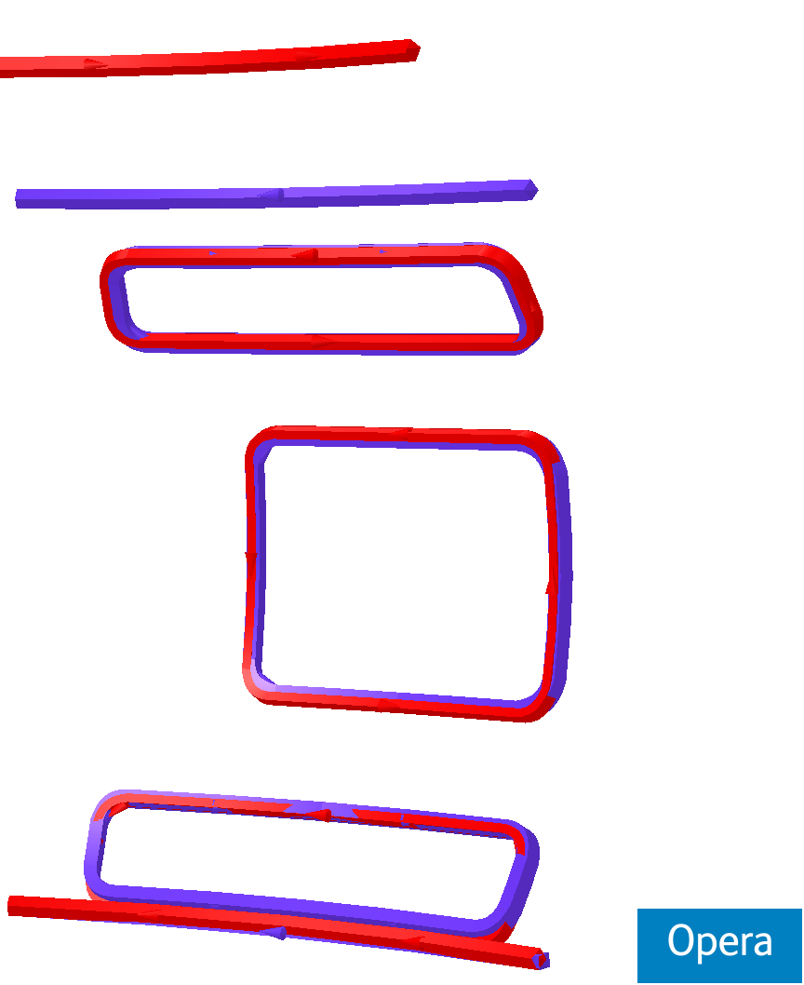
Comparing CDR (purple) and IDR(red)
The most significant difference is the position of the upper VS coil
The other coils have only minor perturbations.

Slide 5
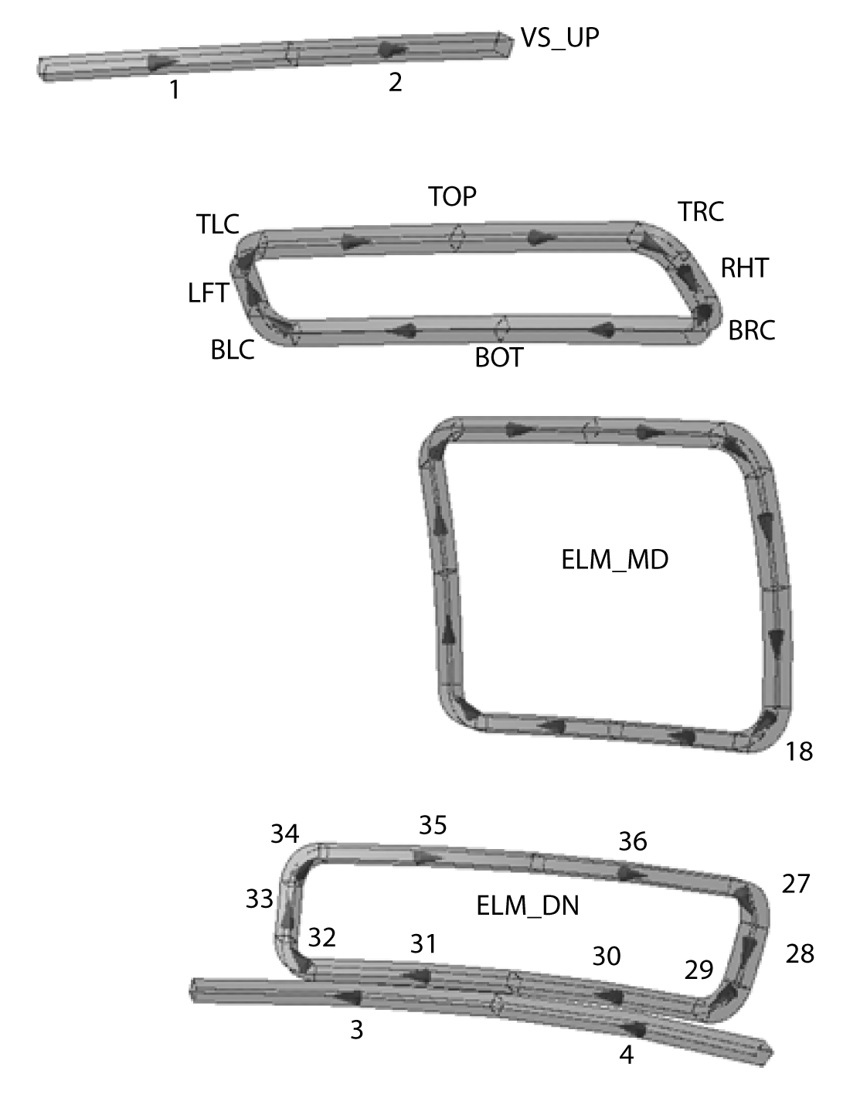
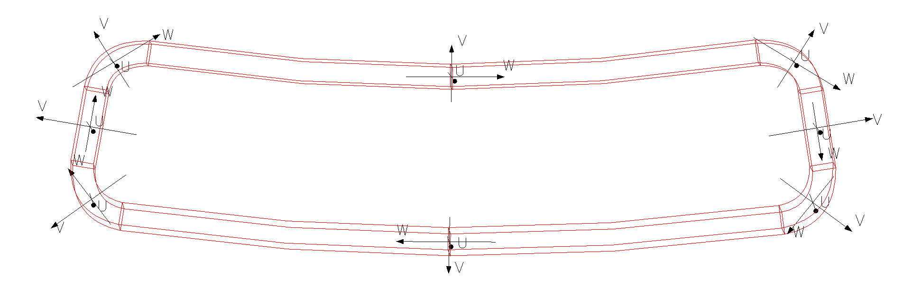
IVC Force Nomenclature
There are 36 20-node bricks in a sector.
Forces are output at 2 points per VS and 10 - 12 points per ELM.
Summation reduces these to 1 point per VS and 8 per ELM.
Forces are provided in Cartesian coordinates and in local coordinates U – radial – into or outward from the VV, V – bursting, W - shear
Notes:
There are 36 20-node bricks in a sector.
Forces are output at 2 points per VS and 8 points per ELM.
Forces are provided in Cartesian coordinates and in local coordinates U – radial – into or outward from the VV, V – bursting, W - shear

Slide 6
PF and ELM Coil Currents

Slide 7
Maximum Leg Force Magnitudes During Normal Operation (EOB)
COIL Leg | CDR |F| (N) | IDR |F| (N)
VS_UP | 1,087,207 | 381,519
VS_DN | 1,295,501 | 1,152,627
ELM_DN_BOT | 378,852 | 340,856²
ELM_DN_LFT | 298,633 | 258,377²
ELM_DN_RHT | 304,296 | 262,099²
ELM_DN_TOP | 423,028 | 393,116²
ELM_MD_BOT | 327,356 | 294,637⁵
ELM_MD_LFT | 785,900 | 697,772⁵
ELM_MD_RHT | 788,347 | 700,642⁶
ELM_MD_TOP | 332,249 | 306,742⁶
ELM_UP_BOT | 424,960 | 385,279⁷
ELM_UP_LFT | 256,980 | 250,991⁷
ELM_UP_RHT | 252,753 | 247,446⁷
ELM_UP_TOP | 333,599 | 298,618⁷
Notes:
VS +/- 60kA (240 kA-t)
ELM at spatial variation from previous slide
Superscript for IDR forces indicates the sector were the maximum occurs
All forces are down somewhat from CDR. VS_UP is most significant

Slide 8
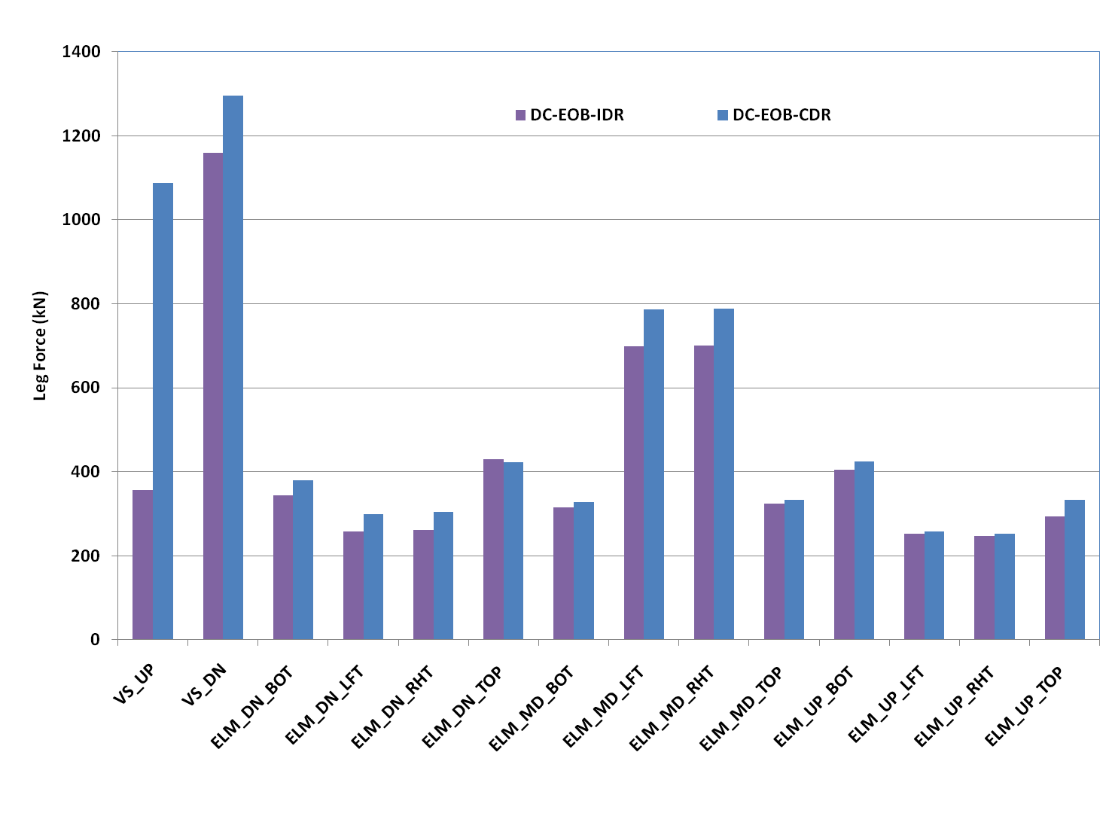
Maximum Leg Force Magnitudes During Normal Operation (EOB)
Notes:
VS +/- 60kA (240 kA-t)
ELM +/- 15 kA (90 kA-t)
All forces are down somewhat from CDR. VS_UP is most significant

Slide 9
Assumptions in OPERA Modeling of Plasma Disruptions
1/9th rotational symmetry of all coils and structure is assumed.
Poloidal ribs are included.
Blanket modules, support beam, divertor rail, and divertor are omitted.
All conducting structures have an electrical conductivity of 1350 Siemens/mm .
PF and TF Coils at fixed currents at End-of-Burn.
Plasma disruption events are 2007 models.
Plasma modeled by 25 - 30 coaxial solenoids with currents “turning on” and “turning off” to simulate motion and current decay. One run w/ 100 solenoids.
For comparison w/ CDR no toroidal flux drive. One case run w/.
IVCs are shorted at the start of the plasma disruption events.
IVC structure and feeders are not included in the eddy current model .
Induced currents in the IVC Feeders do not contribute to VV eddy currents.
Maximum IVC current for normal operation 60 kA (VS) & 15 kA (ELM)

Slide 10
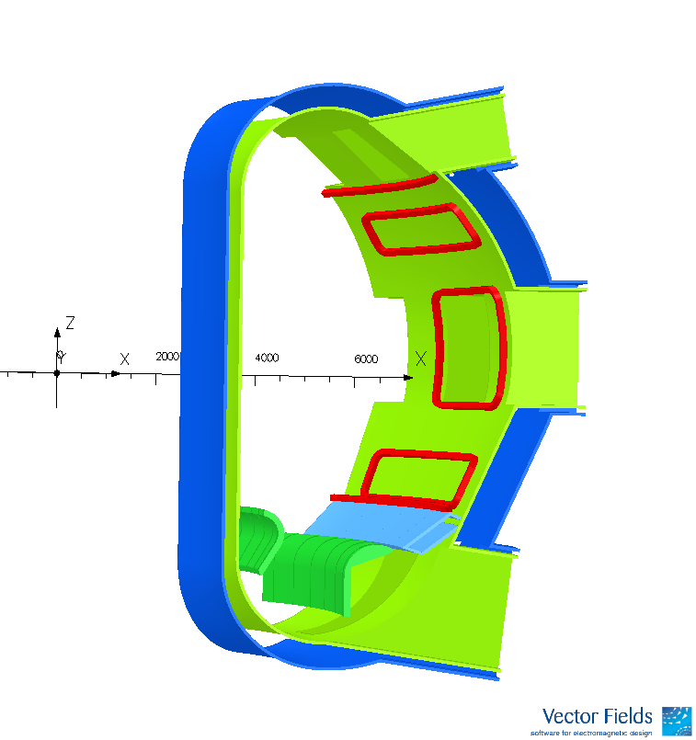
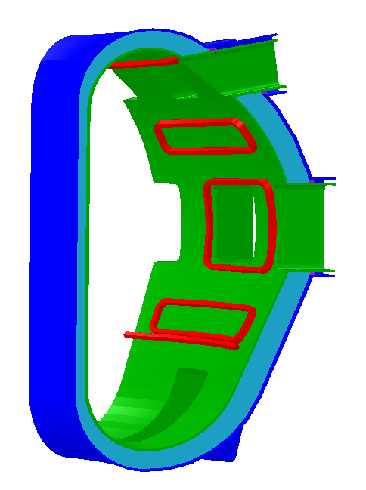
OPERA 3D Models
VS
ELM
CDR
IDR
Notes:
40 degree sector model. All coils (including feeders, structure, etc) assumed to be cyclically symmetric.
VV torrodially continuous
Support Beam continuous within a 40 degree sector
Divertor in 8 degree sections

Slide 11
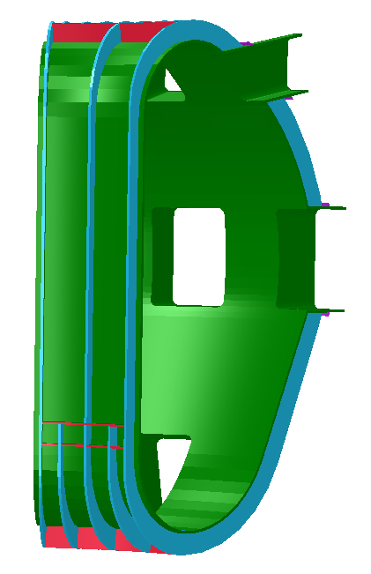
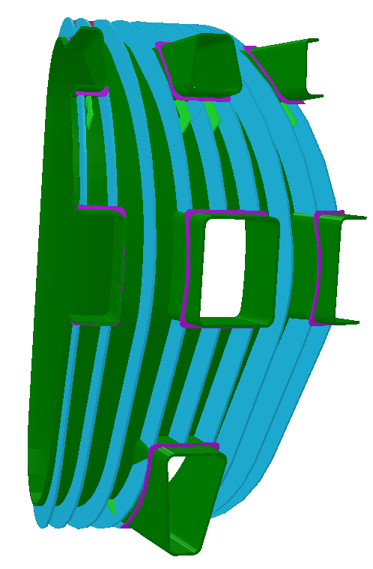
OPERA 3D Models
Notes:
40 degree sector model. All coils (including feeders, structure, etc) assumed to be cyclically symmetric.
VV torrodially continuous
Support Beam continuous within a 40 degree sector
Divertor in 8 degree sections

Slide 12
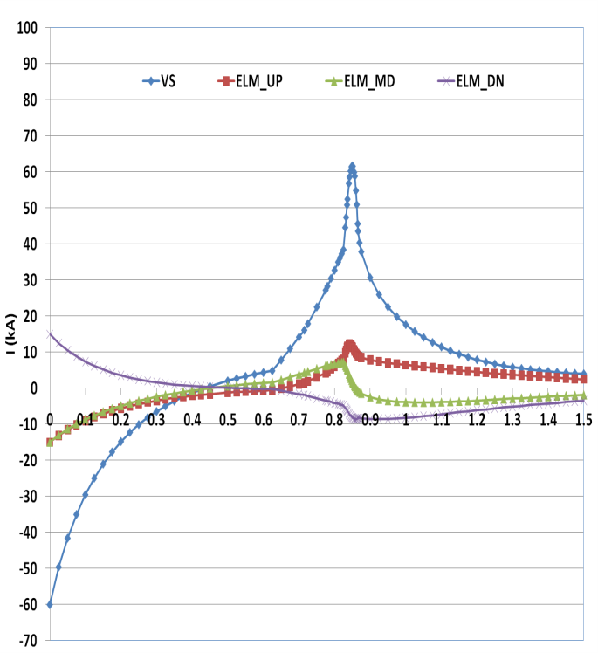
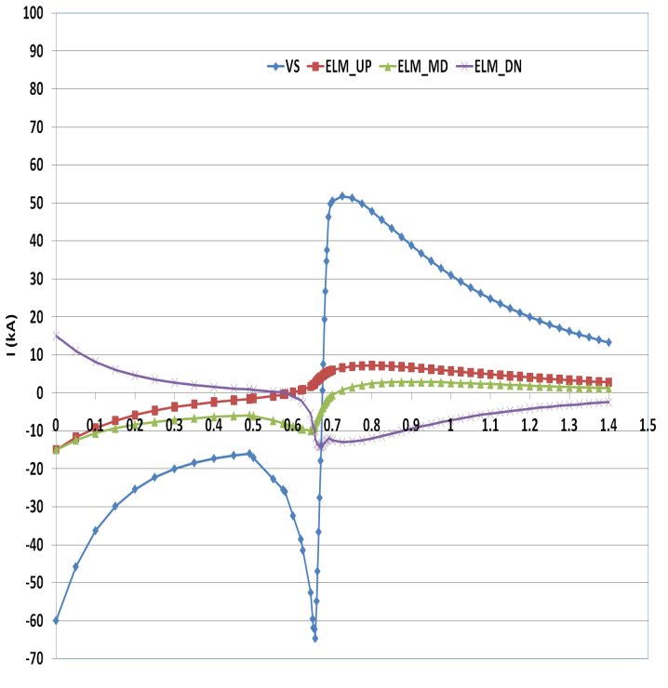
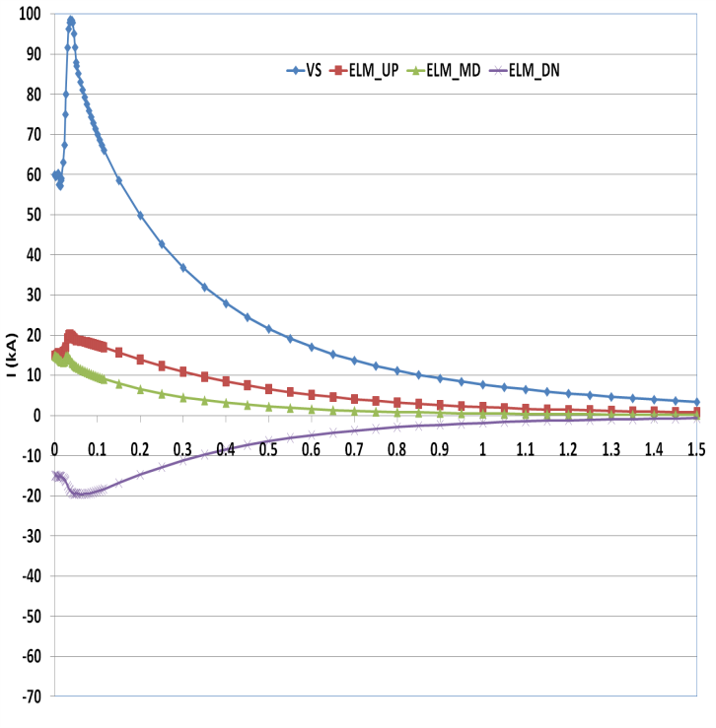
Induced Current in IVCs During the Three Disruption Scenarios
VDE- UP
VDE-DN
MD
IVCs start at their current maxima and are shorted at time t=0
VS Coils are connected in a saddle (anti-series) configuration.

Slide 13
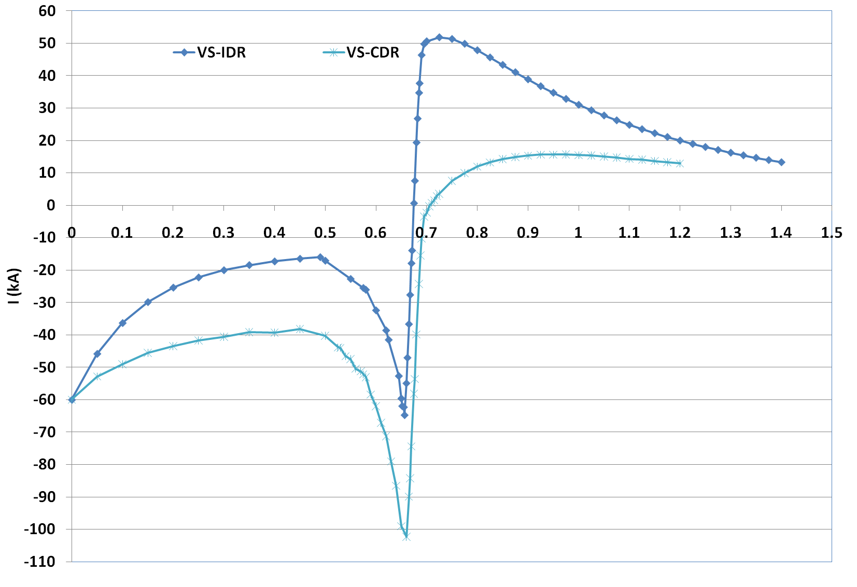
Currents Induced in the VS During a VDE-DN Disruption – 36 ms Linear Decay – CDR & IDR
Notes:
The R/l change is evident in the drift phase.

Slide 14
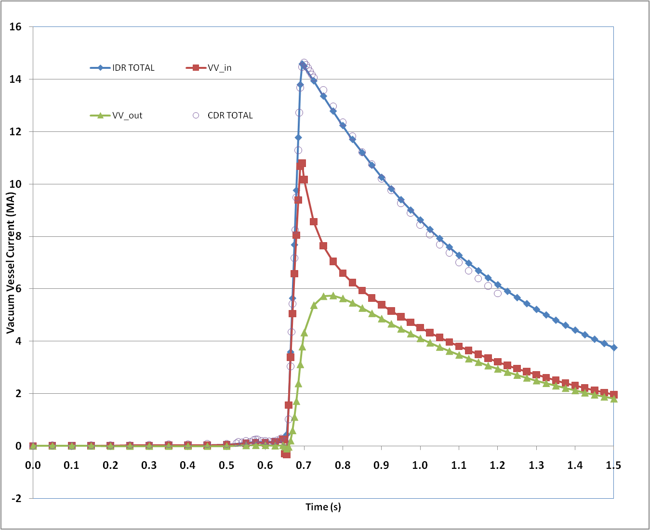
Eddy Currents in the Vacuum Vessel – Vertical Disruption Down (36 ms linear Current Decay)

Slide 15
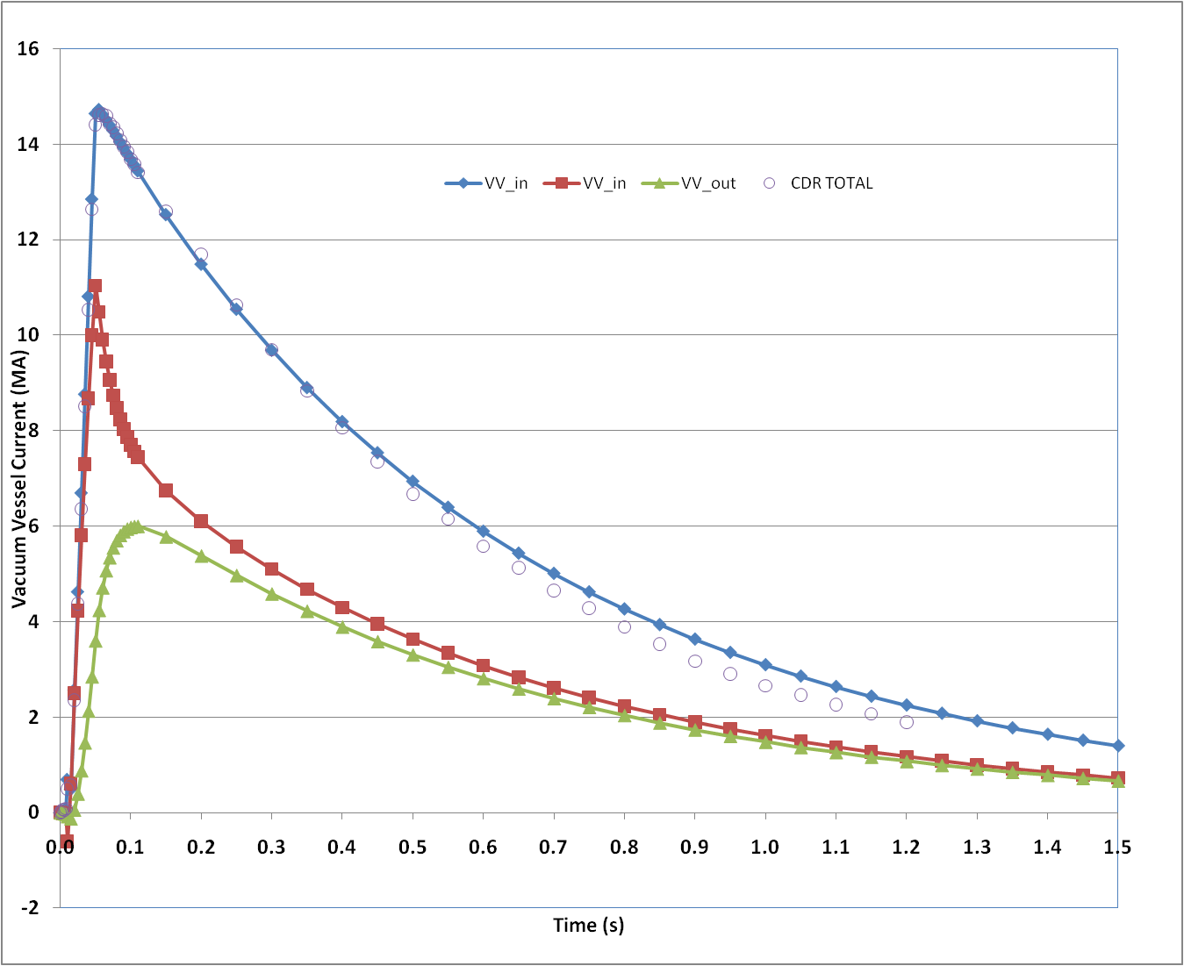
Eddy Currents in the Vacuum Vessel – Major Disruption Up (36 ms linear Current Decay)

Slide 16
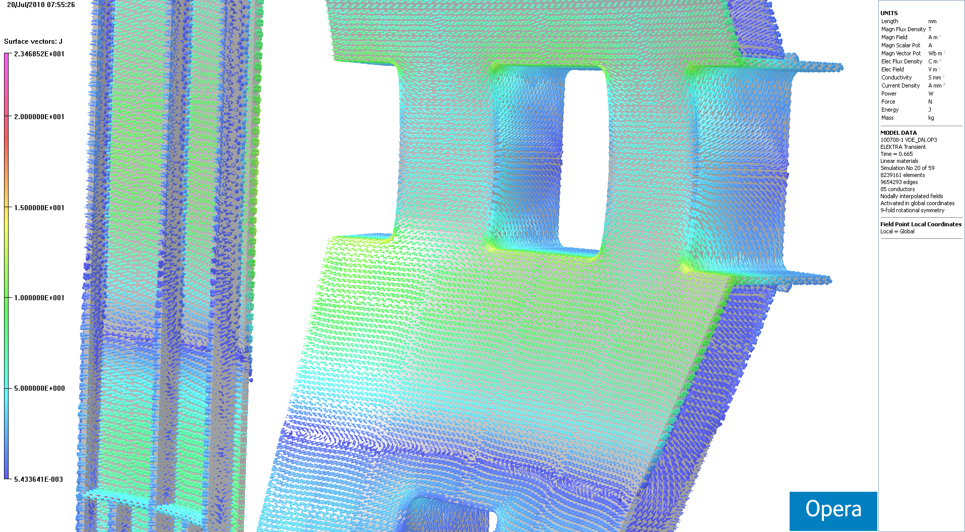
Typical Eddy Currents in the Structure
Notes:
VDE-DN Just before current quench

Slide 17
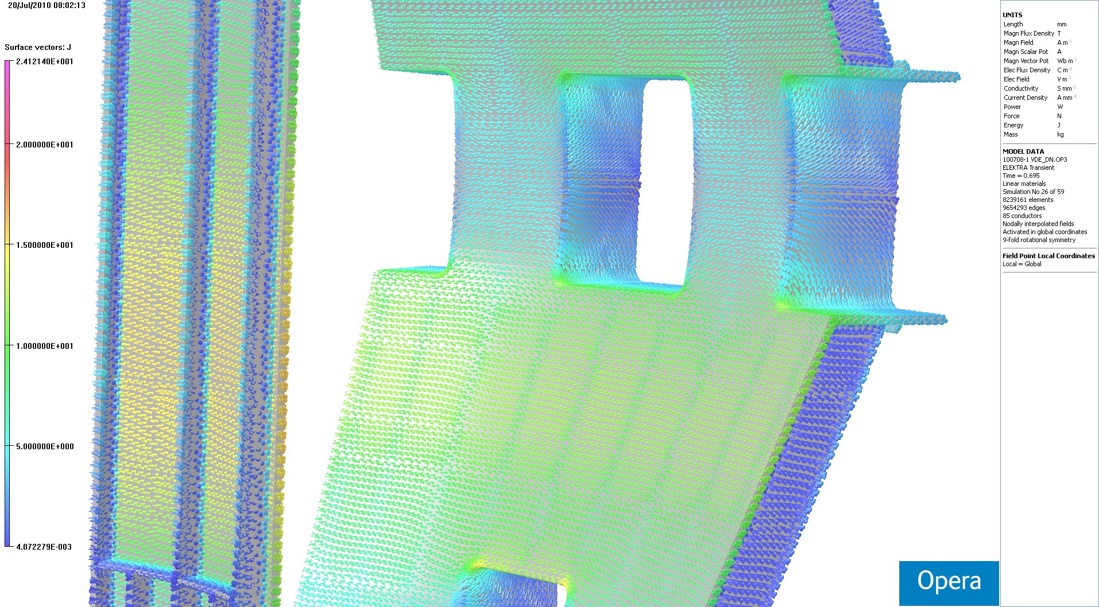
Typical Eddy Currents in the Structure
Notes:
VDE-DN time of max VV current

Slide 18
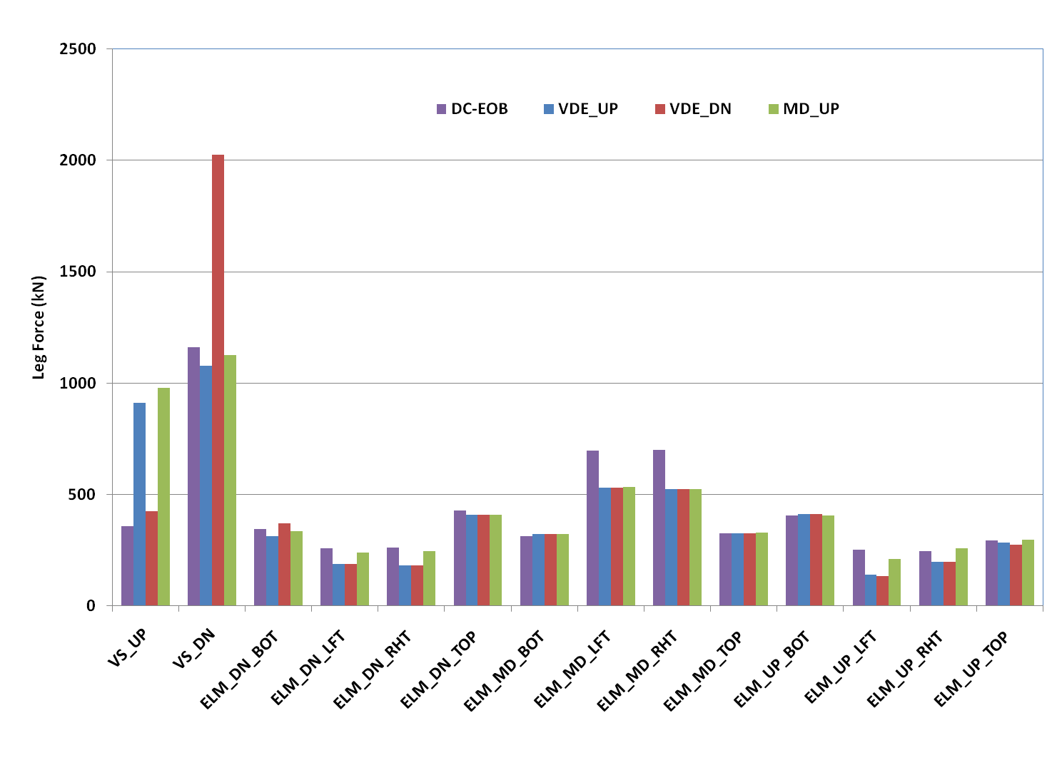
Maximum Forces on the IVC For EOB and Across Three Disruption Scenarios
Notes:
Different Ordering than previous memos – consistent with CDR
VS coils have roughly twice the peak of the EOB – since the almost 15 MA plasma is much closer and interacting strongly with the VS current
ELM coil forces appear to be driven by the scenario (normal operation) and the VS driven by the disruption.

Slide 19
Summary
IVC geometry is close to the CDR except for VS_UP
DC Leg forces are similar to the CDR except for VS_UP
IDR vessel currents induced by 2007 disruption events have not changed appreciably from the CDR
The increased IVC resistance impacts the peak currents and forces during the disruption events
ELM coil forces appear to be driven by the scenario (normal operation) and the VS driven by the disruption.

Slide 20
Issues and Resolution Plan
Issue | Resolution | Pre/Post October
Modeling of Blanket, Divertor, Support Beam, etc. | Update model post-IDR. Generate new OPERA FEA model | Pre
Appropriate PD Scenarios | Generate new PD models and rerun OPERA | Pre
Feeder Forces | Generate new model from CATIA files. Use OPERA to calculate forces. | Pre
Due Diligence | FEA mesh/time step/plasma model sensitivity | Pre
Appropriate Initial Conditions/ Model of IVCs During a Disruption | Seek guidance from other groups | Pre
Assess impact of different PF currents and off-normal events | Two fold approach. (1) Quasi-static analyses (no induced eddy currents in the cold-structure). (2) New disruption scenarios or use existing scenarios with different PF currents. | Pre

Slide 21
Backup

Slide 22
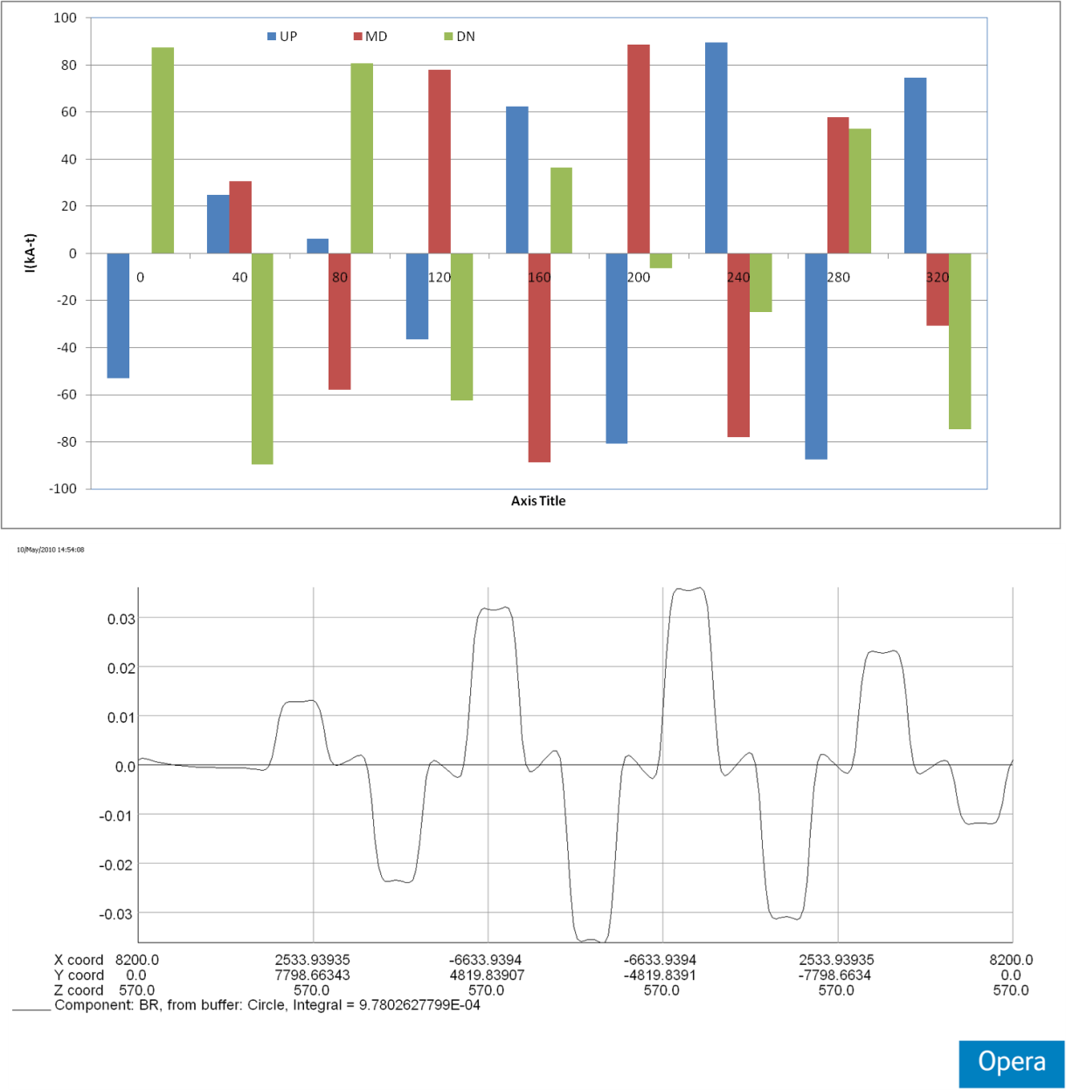
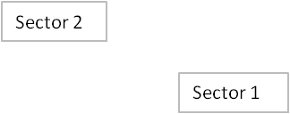
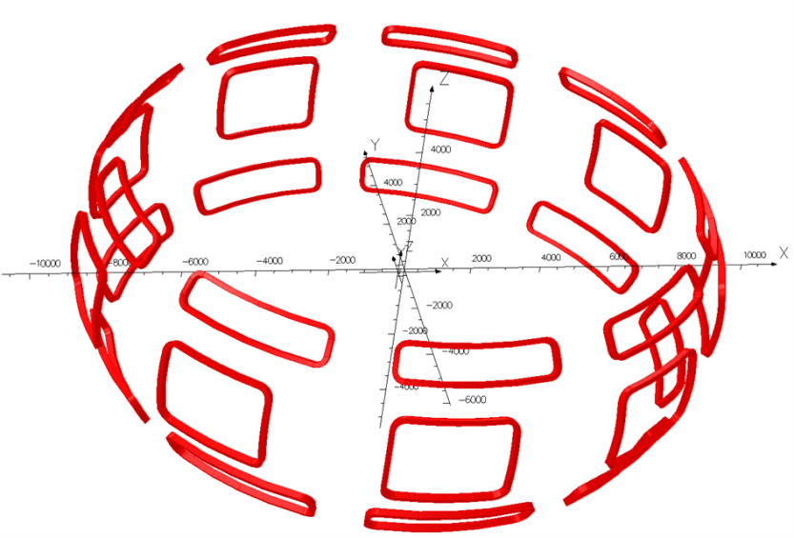
ELM COIL CURRENTS
ELM Coil current versus toroidal angle
Flux Density vs. Toroidal Position at Plasma Boundary

Slide 23
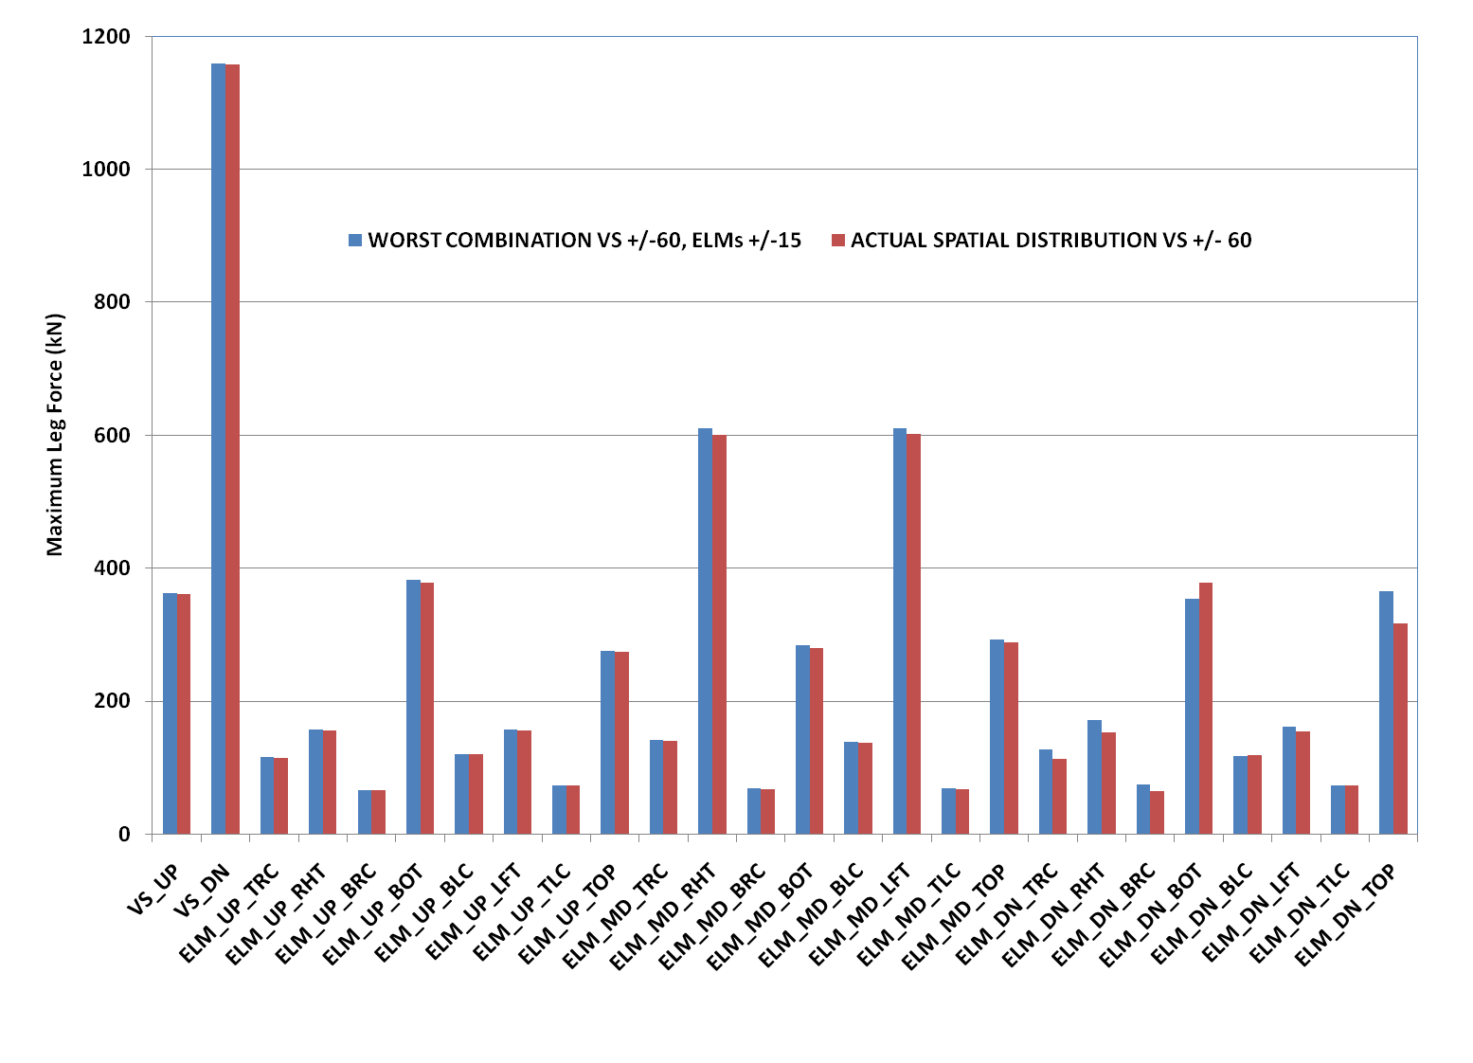
Comparison of EOB Forces from Spatial Variation of ELM Coil Currents with Maximum Possible

Slide 24
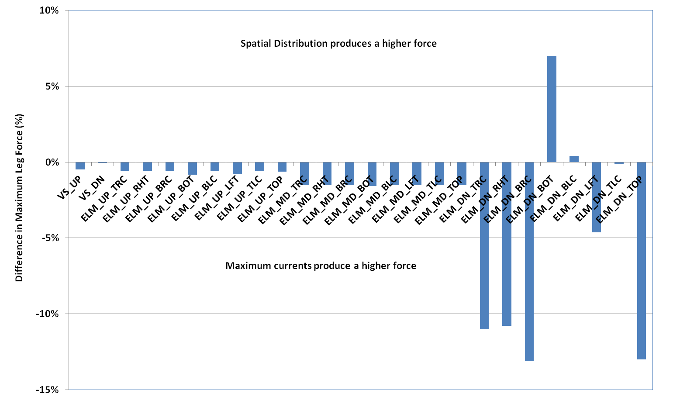
Comparison of EOB Forces from Spatial Variation of ELM Coil Currents with Maximum Possible
Notes:
Difference in %

Slide 25
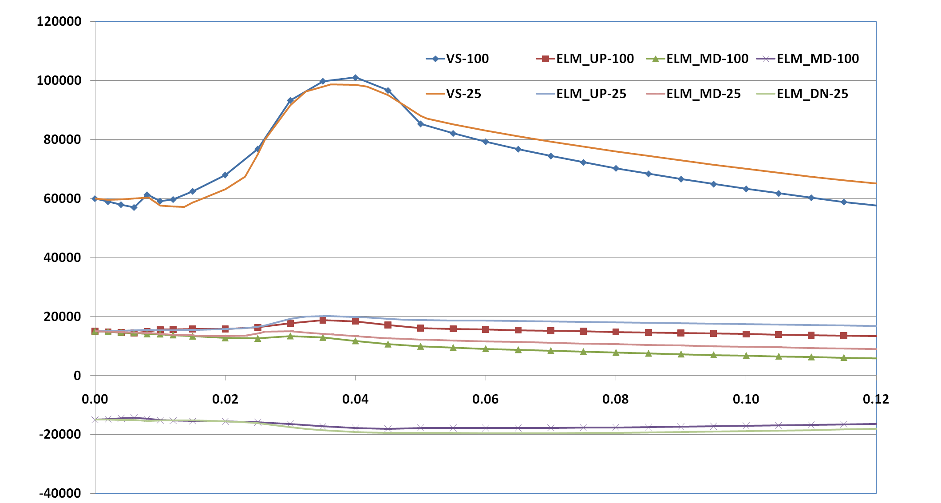
COMPARISON OF 25 and 100 Element Models of the MD_UP (36 ms linear decay)

Slide 26
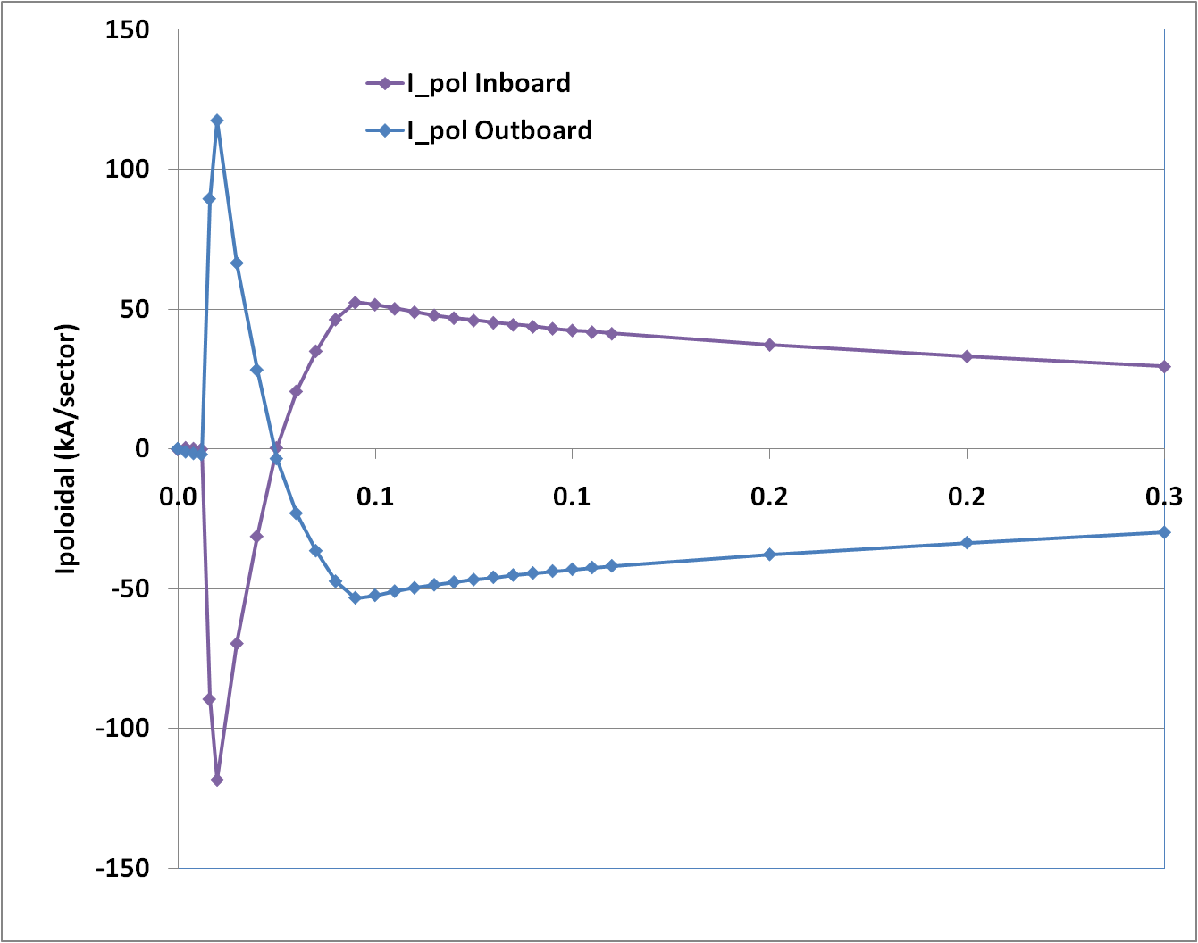
Impact of Toroidal Flux Drive on VV Currents

Slide 27
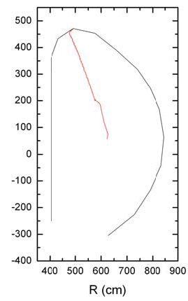
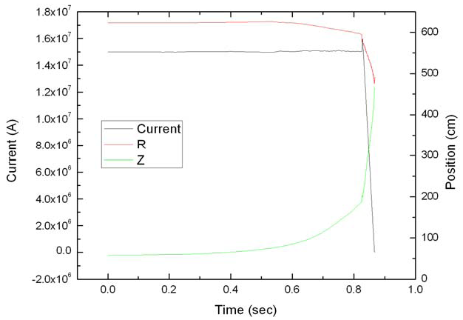
2007 VDE-UP Linear Decay
Notes:
Courtesy of Art Brooks

Slide 28
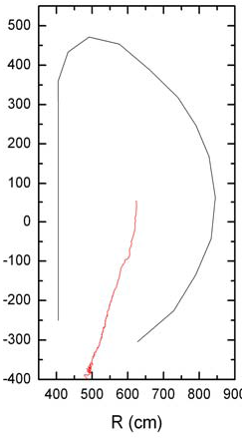
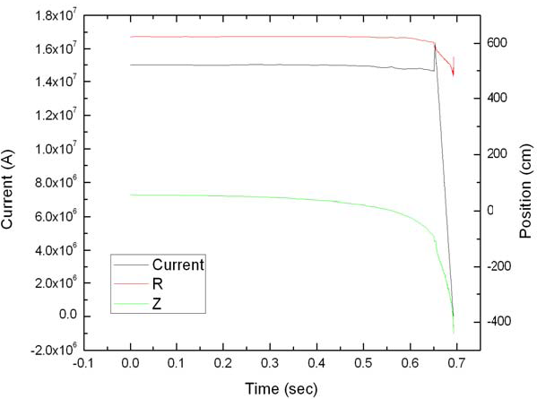
2007 VDE-DN Linear Decay
Notes:
Courtesy of Art Brooks

Slide 29
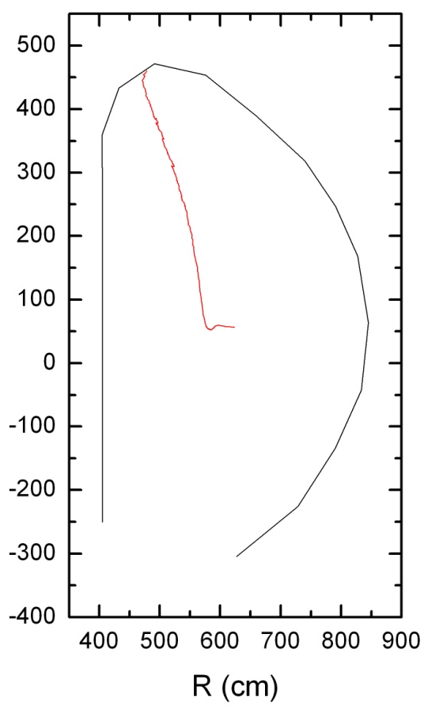
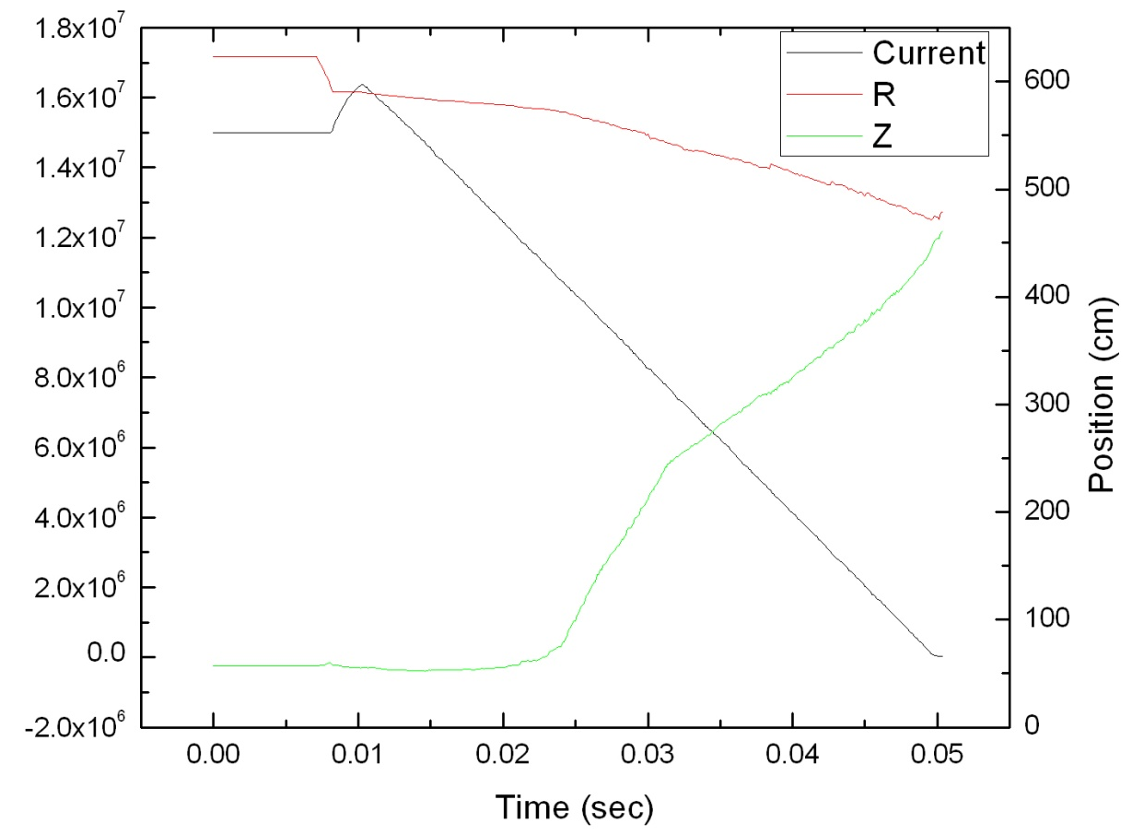
2007 Major Disruption – Linear Decay
Notes:
Courtesy of Art Brooks

Slide 30
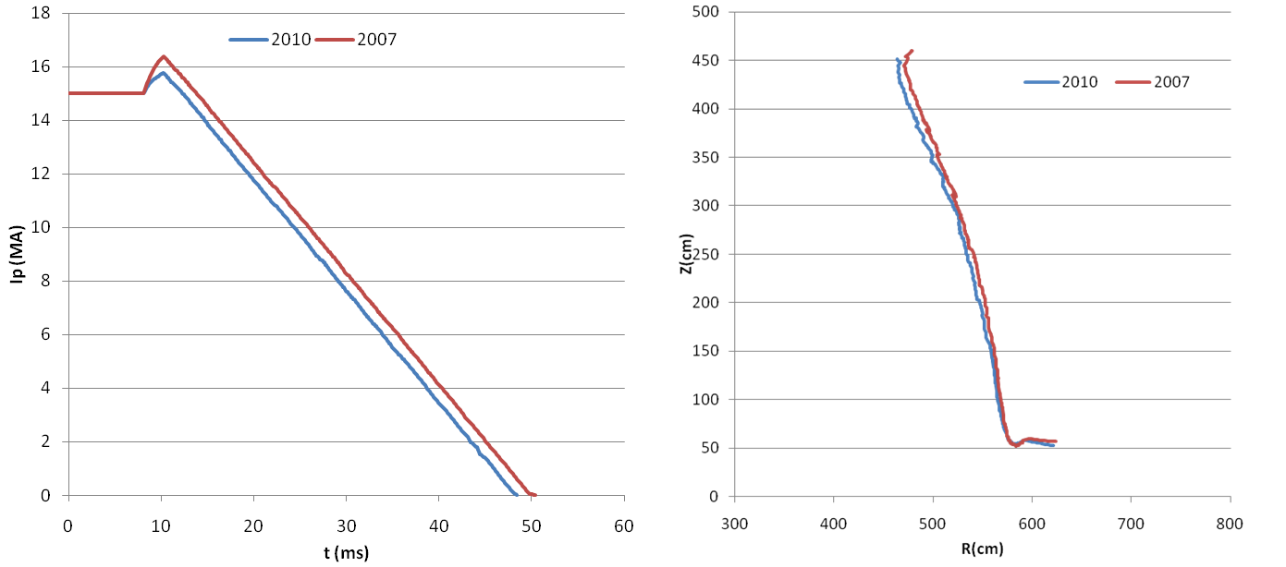
Comparison of 2007 and 2010 Disruptions (MD_UP 36 ms linear decay)

Slide 31
2007 Plasma Model of a VDE - UP with linear current decay
Rc (mm) | Zc(mm) | a(mm) | I (MA) | t(ms)
6232.7 | 567.01 | 1994.50 | 15.0000 | 0.0
6231.6 | 582.11 | 1996.50 | 15.0000 | 10.0
6208.6 | 901.85 | 2016.30 | 15.0590 | 625.0
6105.4 | 1211.90 | 1915.50 | 15.0650 | 715.0
6026.5 | 1540.60 | 1804.80 | 15.0470 | 775.0
5949.2 | 1878.70 | 1697.30 | 15.0500 | 825.0
5760.5 | 2000.10 | 1675.60 | 15.8150 | 827.5
5729.4 | 2095.00 | 1643.70 | 15.0310 | 830.5
5701.5 | 2188.70 | 1608.90 | 14.2620 | 832.4
5658.4 | 2297.30 | 1567.80 | 13.4800 | 834.3
5625.5 | 2418.90 | 1530.30 | 12.6930 | 836.2
5585.5 | 2543.40 | 1485.60 | 11.9180 | 838.0
5519.7 | 2661.60 | 1441.40 | 11.1030 | 840.0
5487.8 | 2782.80 | 1402.40 | 10.3040 | 841.9
5433.8 | 2881.00 | 1354.00 | 95.115 | 843.8
5416.1 | 2989.30 | 1297.80 | 87.580 | 845.7
5364.2 | 3107.60 | 1229.20 | 79.800 | 847.6
5328.4 | 3208.30 | 1154.00 | 72.276 | 849.4
5283.8 | 3314.60 | 1091.00 | 64.598 | 851.2
5252.4 | 3412.30 | 1002.00 | 57.008 | 853.0
5198.4 | 3527.80 | 914.010 | 49.234 | 854.9
5153.2 | 3665.40 | 810.669 | 41.442 | 856.8
5116.6 | 3765.30 | 707.70 | 33.752 | 858.6
5041.8 | 3919.90 | 546.40 | 25.928 | 860.5
4974.4 | 4070.00 | 373.28 | 18.190 | 862.3
4921.6 | 4220.40 | 582.65 | 10.657 | 864.1
4800.9 | 4452.50 | 319.58 | 2.9215 | 866.0
Notes:
Courtesy of Art Brooks

Slide 32
Plasma Model of a VDE - DN with linear current decay
Rc (mm) | Zc(mm) | a(mm) | I (MA) | t(ms)
6232.7 | 567.01 | 1994.5 | 15.000 | 0.0
6234.6 | 548.17 | 1992.0 | 15.000 | 10.0
6230.0 | 227.30 | 1923.3 | 14.930 | 490.0
6203.8 | -105.42 | 1850.1 | 14.764 | 580.0
6121.7 | -444.54 | 1760.8 | 14.787 | 620.0
6057.6 | -806.31 | 1605.5 | 14.642 | 645.0
5863.0 | -1088.4 | 1498.1 | 15.460 | 651.7
5860.0 | -1081.3 | 1507.6 | 16.247 | 653.0
5866.2 | -1078.7 | 1502.1 | 15.488 | 654.6
5763.9 | -1395.6 | 1386.0 | 14.889 | 656.4
5714.3 | -1514.0 | 1330.3 | 14.107 | 658.2
5684.6 | -1621.5 | 1277.4 | 13.332 | 660.1
5631.7 | -1711.5 | 1219.6 | 12.550 | 662.0
5602.2 | -1797.2 | 1183.9 | 11.797 | 663.8
5572.2 | -1886.4 | 1133.3 | 11.044 | 665.6
5539.8 | -1972.2 | 1087.8 | 10.275 | 667.4
5496.5 | -2094.1 | 1031.0 | 9.5102 | 669.3
5482.7 | -2156.2 | 976.36 | 8.7259 | 671.2
5437.7 | -2257.0 | 906.84 | 7.9468 | 673.0
5414.7 | -2378.3 | 825.48 | 7.1945 | 674.9
5370.8 | -2495.8 | 716.90 | 6.4198 | 676.7
5356.8 | -2637.8 | 636.77 | 5.6392 | 678.5
5305.4 | -2772.4 | 523.25 | 4.8663 | 680.4
5257.4 | -2864.9 | 416.04 | 4.0985 | 682.1
5230.6 | -2988.6 | 334.42 | 3.3317 | 684.1
5176.5 | -3198.6 | 742.54 | 2.5449 | 686.0
5070.0 | -3311.0 | 628.67 | 1.7935 | 687.8
4995.3 | -3537.0 | 478.85 | 1.0349 | 689.6
4996.3 | -3860.2 | 271.49 | 0.323 | 691.3
5506.7 | -4419.2 | 55.26 | 0.022565 | 693.1
Notes:
Courtesy of Art Brooks

Slide 33
2007 Plasma Model of a MD with linear current decay
Rc (mm) | Zc(mm) | a(mm) | I (MA) | t(ms)
6232.7 | 567.07 | 1994.5 | 15 | 0
6232.7 | 567.07 | 1994.5 | 15 | 1
5907.4 | 579.78 | 1916.4 | 15.064 | 8.2
5903.7 | 563.34 | 1921.8 | 15.84 | 9.1
5850.7 | 524.09 | 1861.7 | 15.086 | 13.7
5825.8 | 535.56 | 1824.5 | 14.301 | 15.5
5810.5 | 539.96 | 1786.7 | 13.525 | 17.4
5788.9 | 546.62 | 1747.8 | 12.732 | 19.3
5763.5 | 577.36 | 1704.9 | 11.972 | 21.1
5742.2 | 658.05 | 1676.8 | 11.194 | 23
5688.5 | 982.72 | 1653.9 | 10.423 | 24.9
5651.5 | 1301.1 | 1592.6 | 9.9301 | 26.1
5591.7 | 1613.7 | 1522.1 | 9.3614 | 27.5
5544.8 | 1941.3 | 1444.6 | 8.6891 | 29.1
5461.2 | 2254.3 | 1361.1 | 8.0358 | 30.6
5380.1 | 2553.3 | 1264.3 | 7.2831 | 32.4
5327.2 | 2719.5 | 1172.8 | 6.4941 | 34.3
5277.1 | 2914.6 | 1062.7 | 5.7143 | 36.2
5200.6 | 3096.7 | 943.6 | 4.9329 | 38.1
5156.6 | 3234 | 811.5 | 4.1588 | 39.9
5076.9 | 3433.2 | 669.46 | 3.3821 | 41.8
5017.1 | 3647.2 | 488.63 | 2.5939 | 43.7
4934.3 | 3854.6 | 266.58 | 1.8044 | 45.5
4843.6 | 4063.2 | 632.47 | 1.0424 | 47.4
4735.6 | 4340.4 | 346.01 | 0.2852 | 49.2
Notes:
Courtesy of Art Brooks

Slide 34
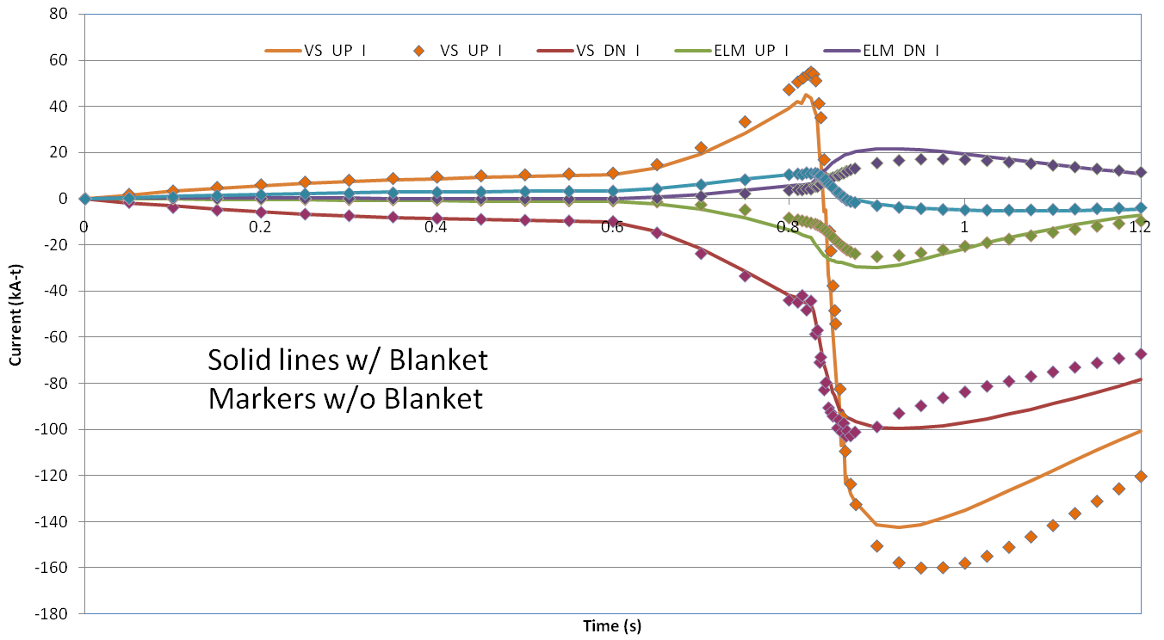
Comparison of IVC Induced Currents for the Alternate Design w/ and w/o the Blanket – VDE UP
Notes:
I=0 Initial Currents

Slide 35
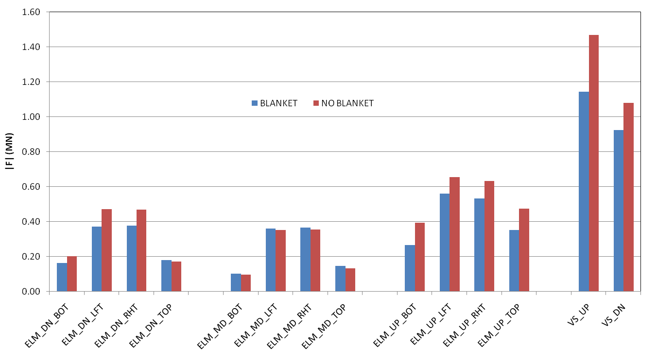
Comparison of IVC Induced Currents for the Alternate Design w/ and w/o the Blanket – VDE UP
Notes:
Maximum Leg Force with and without blanket

