Slide 1
ITER In-Vessel Coils (IVC) Interim Design Review Integration with Interfacing Systems
C Neumeyer
July 28, 2010

Slide 2
Outline
Interfacing Systems and Open Issues
Issues and Resolution Plan Summary

Slide 3
400kV
Grid
Plasma Control
Central
Interlock
CODAC
Flow
& Temp
Typ.
Coil
Local
Control
Local
Interlock
Cryostat
UPS
VV
PPEN
Plasma
AC/DC
Conv
Component
CWS
Tokamak
CWS
Port Bulkhead/Vacuum feed-thrus
Coil-feeder
Jumpers typ.
SSEN
Coil Jacket
DCCT typ.
DC Bus
Jacketed Feeder typ.

Slide 4
Primary Interfaces
Coil Power Supply & Distribution System (CPSDS) PBS 41
Current flow through DC bus bar input/output
Measurement of voltage and current
Grounding and ground fault detection
Switches and links for isolation and grounding
Tokamak Cooling Water System (TCWS) PBS 26
Water flow through insulating supply/return lines
Measurement of pressure, flow, temperature, chemistry and conductivity
Valves for isolation and draining
Draining and drying
Vacuum vessel (VV) PBS 31
Structural support
Vacuum feed-thru’s for feeders at port penetrations
CODAC PBS 45
Pressure, flow, temperature, voltage, current, input power, cooling power, ground current, etc.
Central Interlock System (CIS) PBS 46
Fault status (multi-level)

Slide 5
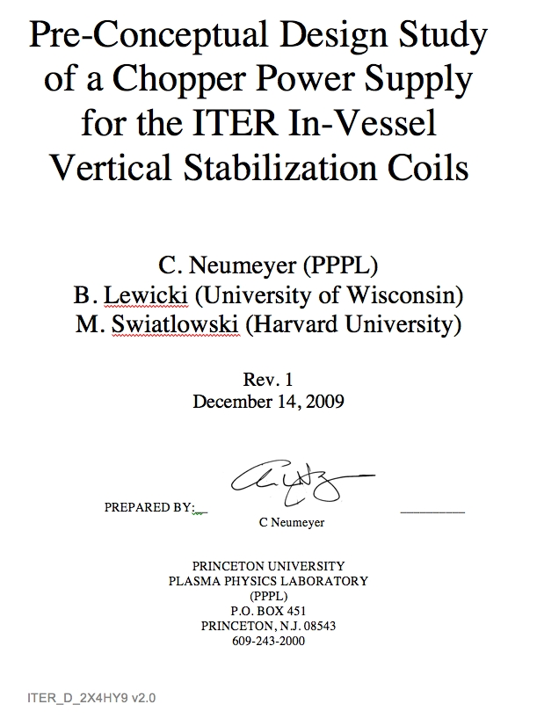
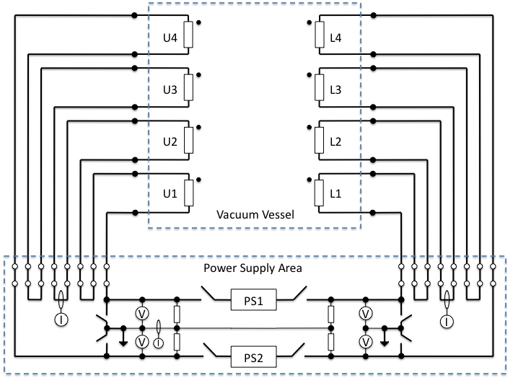
Integration with CPSDS
Voltage, current, power described by design point spreadsheets
VS power supply implementation previously studied and presented at CDR
Extension of VS chopper concept to two interleaves now being studied
ELM power supply is standard thyristor rectifier
Grounding and ground fault detection is new issue now being addressed

Slide 6
Grounding and Ground Fault Detection
Typical method relies on high resistance grounding from each terminal to ground
a
V-gnd
a
E/2
R_{G1}
R_{G2}
E
x
I=0
R_{G1}
-E/2
b
b
normal
a
fault
V-gnd
a
R_{G1}
E
R_{G2}
E
x
I≠0
R_{G1}
0
b
b
Ground fault detection by measuring ground current
Sensitivity set by selection of grounding resistors R_{G}

Slide 7
Grounding and Ground Fault Detection
Resistance of
Relatively low and highly variable resistance to ground
MIC insulation resistivity varies substantially with both radiation (RIC) and temperature
Cooling water has relatively low conductivity at high temperatures and strong temperature dependence
All turns directly face ground since MIC is jacketed
Stray capacitance to ground is relatively high
Chopper power supply (VS)
R_{water_supply}
R_{stray}
R_{water} will vary with T
R_{stray} will vary with radiation
Asymmetry in R_{water} and R_{stray} will appear as ground fault
R_{G} will determine selectivity between asymmetry effects and true ground fault
C_{stray}
R_{G1}
R_{G2}
E
I
R_{G1}
C_{stray}
R_{stray}
R_{water_return}

Slide 8
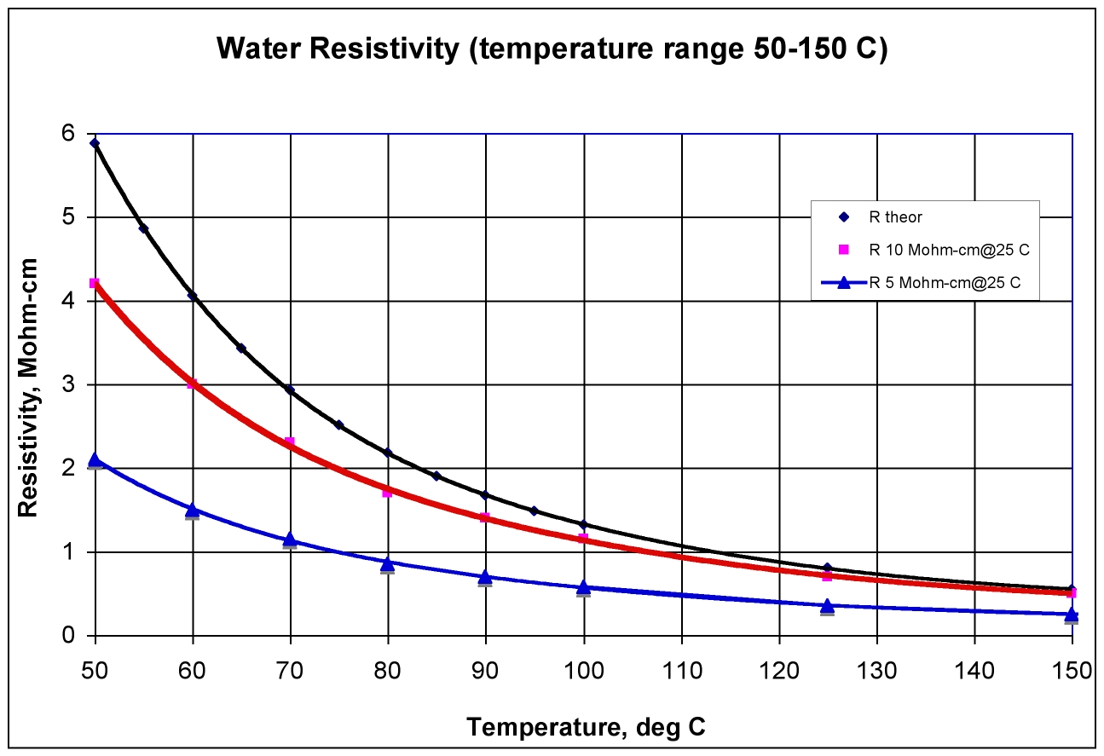
Grounding and Ground Fault Detection
Courtesy of
Andre Petrov
ORNL
Water initially at 5MΩ-cm at RT will decrease by factor of 8.7 at 100ºC
Water initially at 5MΩ-cm at RT will decrease by factor of 20 at 150ºC
With 100ºC supply and 150ºC return the resistivity ratio will be 2.3
Will result in asymmetry in stray insulation resistance to ground

Slide 9
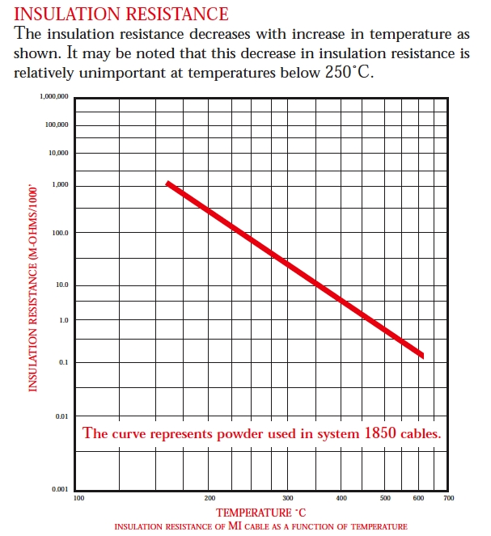
Grounding and Ground Fault Detection
Ratio of un-irradiated mineral insulation resistivity at 150ºC
vs. 100ºC ~ 25
Will result in asymmetry in stray resistance to ground
From Tyco Pyrotenax
Engineering Guide, p. 12

Slide 10
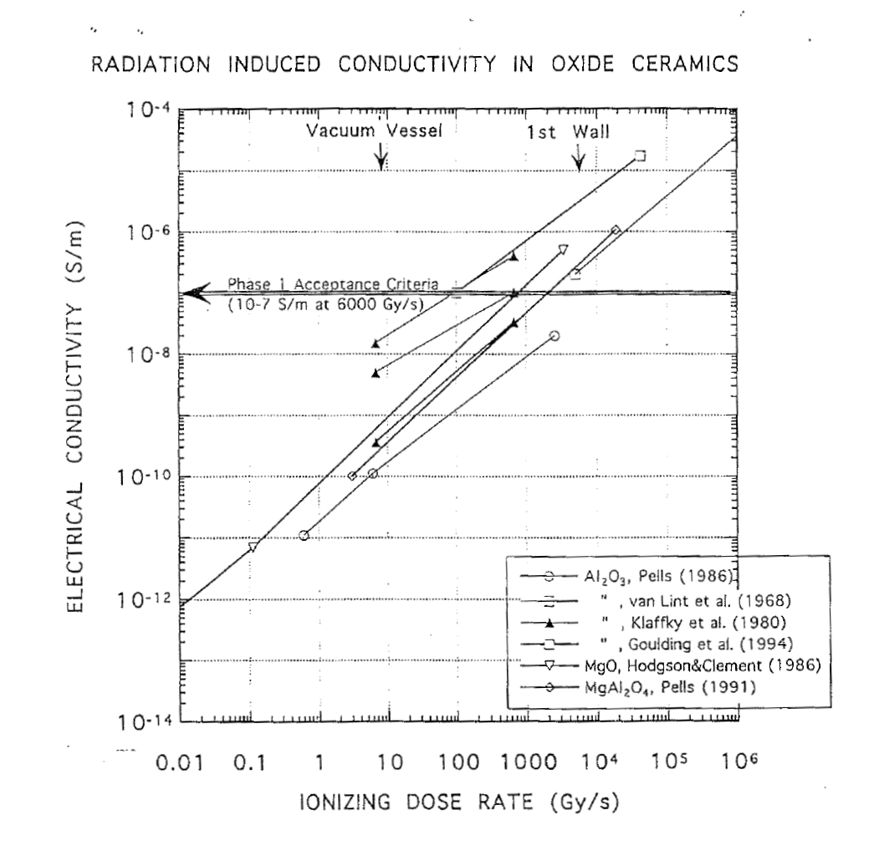
Grounding and Ground Fault Detection
Ratio of un-irradiated mineral insulation resistivity to radiated at 100 Gy/s is approximately 10,000
Asymmetry effect in stray insulation resistance to ground will depend on distribution of flux along winding
L. Snead et al, ORNL, CRADA Report 94-0301,
“Improved Mineral Insulated Cables for High Radiation Environment”, Fig. 2

Slide 11
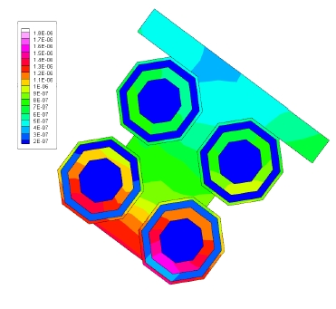
Grounding and Ground Fault Detection
Radiation flux varies along turns of winding by ~ factor of 2
Advantageous to place turns with maximum exposure toward voltage null and to distribute with symmetry about null
Voltage null
Nuclear heating in VS bundle

Slide 12
Grounding and Ground Fault Detection
Choice of grounding resistance, water supply/return resistance, and ground fault detection scheme has to consider
Resistance variation with temperature and radiation, both symmetric and asymmetric components
Stray capacitance effects
Available data suggests that stray insulation resistance of SSMIC may decrease
to several 10’s of kilohms under high temperature irradiated conditions

Slide 13
Grounding and Ground Fault Detection
Work now underway to evaluate VS grounding and ground fault detection using PSCAD simulation tool, including chopper power supply model
For hipot testing, four conditions should be considered
Un-irradiated, bakeout (~ 200ºC)
Un-irradiated, ready for operations (100ºC)
Un-irradiated, room temperature (25ºC)
Un-irradiated, drained and dry (25ºC)

Slide 14
Integration with TCWS
Flow, pressure, temperature, wetted Cu area, etc., described by design point spreadsheets
Cooling water resistivity should be ~ 5MΩ-cm at 25ºC
Supply/return insulating break geometry and implementation remains an open issue
Diameter could be reduced, e.g. to 20mm, to increase R by (30/20)^2=2.25 but the flow velocity would increase by the same factor

Slide 15
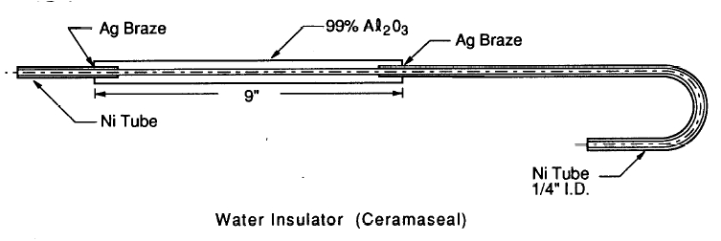
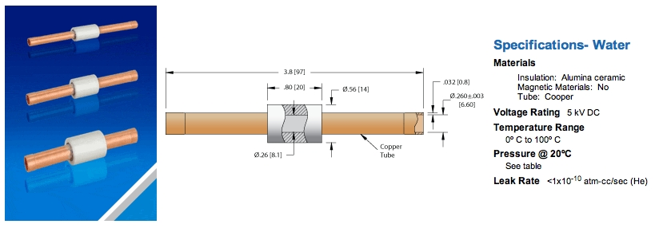
Integration with TCWS
Water supply/return design remains an open issue
Ceramic-based design favored for radiation and chemical resistance
Would require feature to allow for thermal expansion
Would require containment in case of cracking
TCWS can be contaminated with T
Water line configuration
Used at LAMPF
Commercial product from Ceramaseal

Slide 16
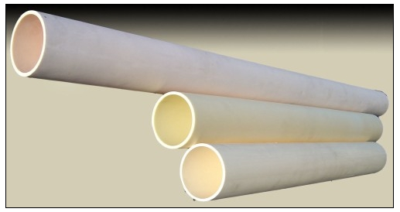
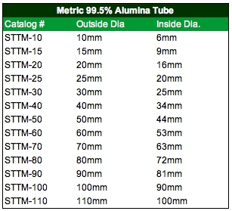
Integration with TCWS
Water supply/return design remains an open issue
Custom design based on IVC requirement is needed
Large ceramic tubes are available
http://www.sentrotech.com/

Slide 17
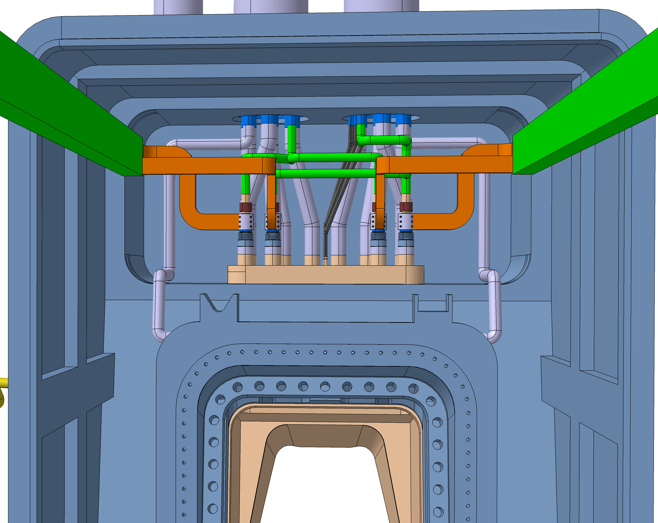
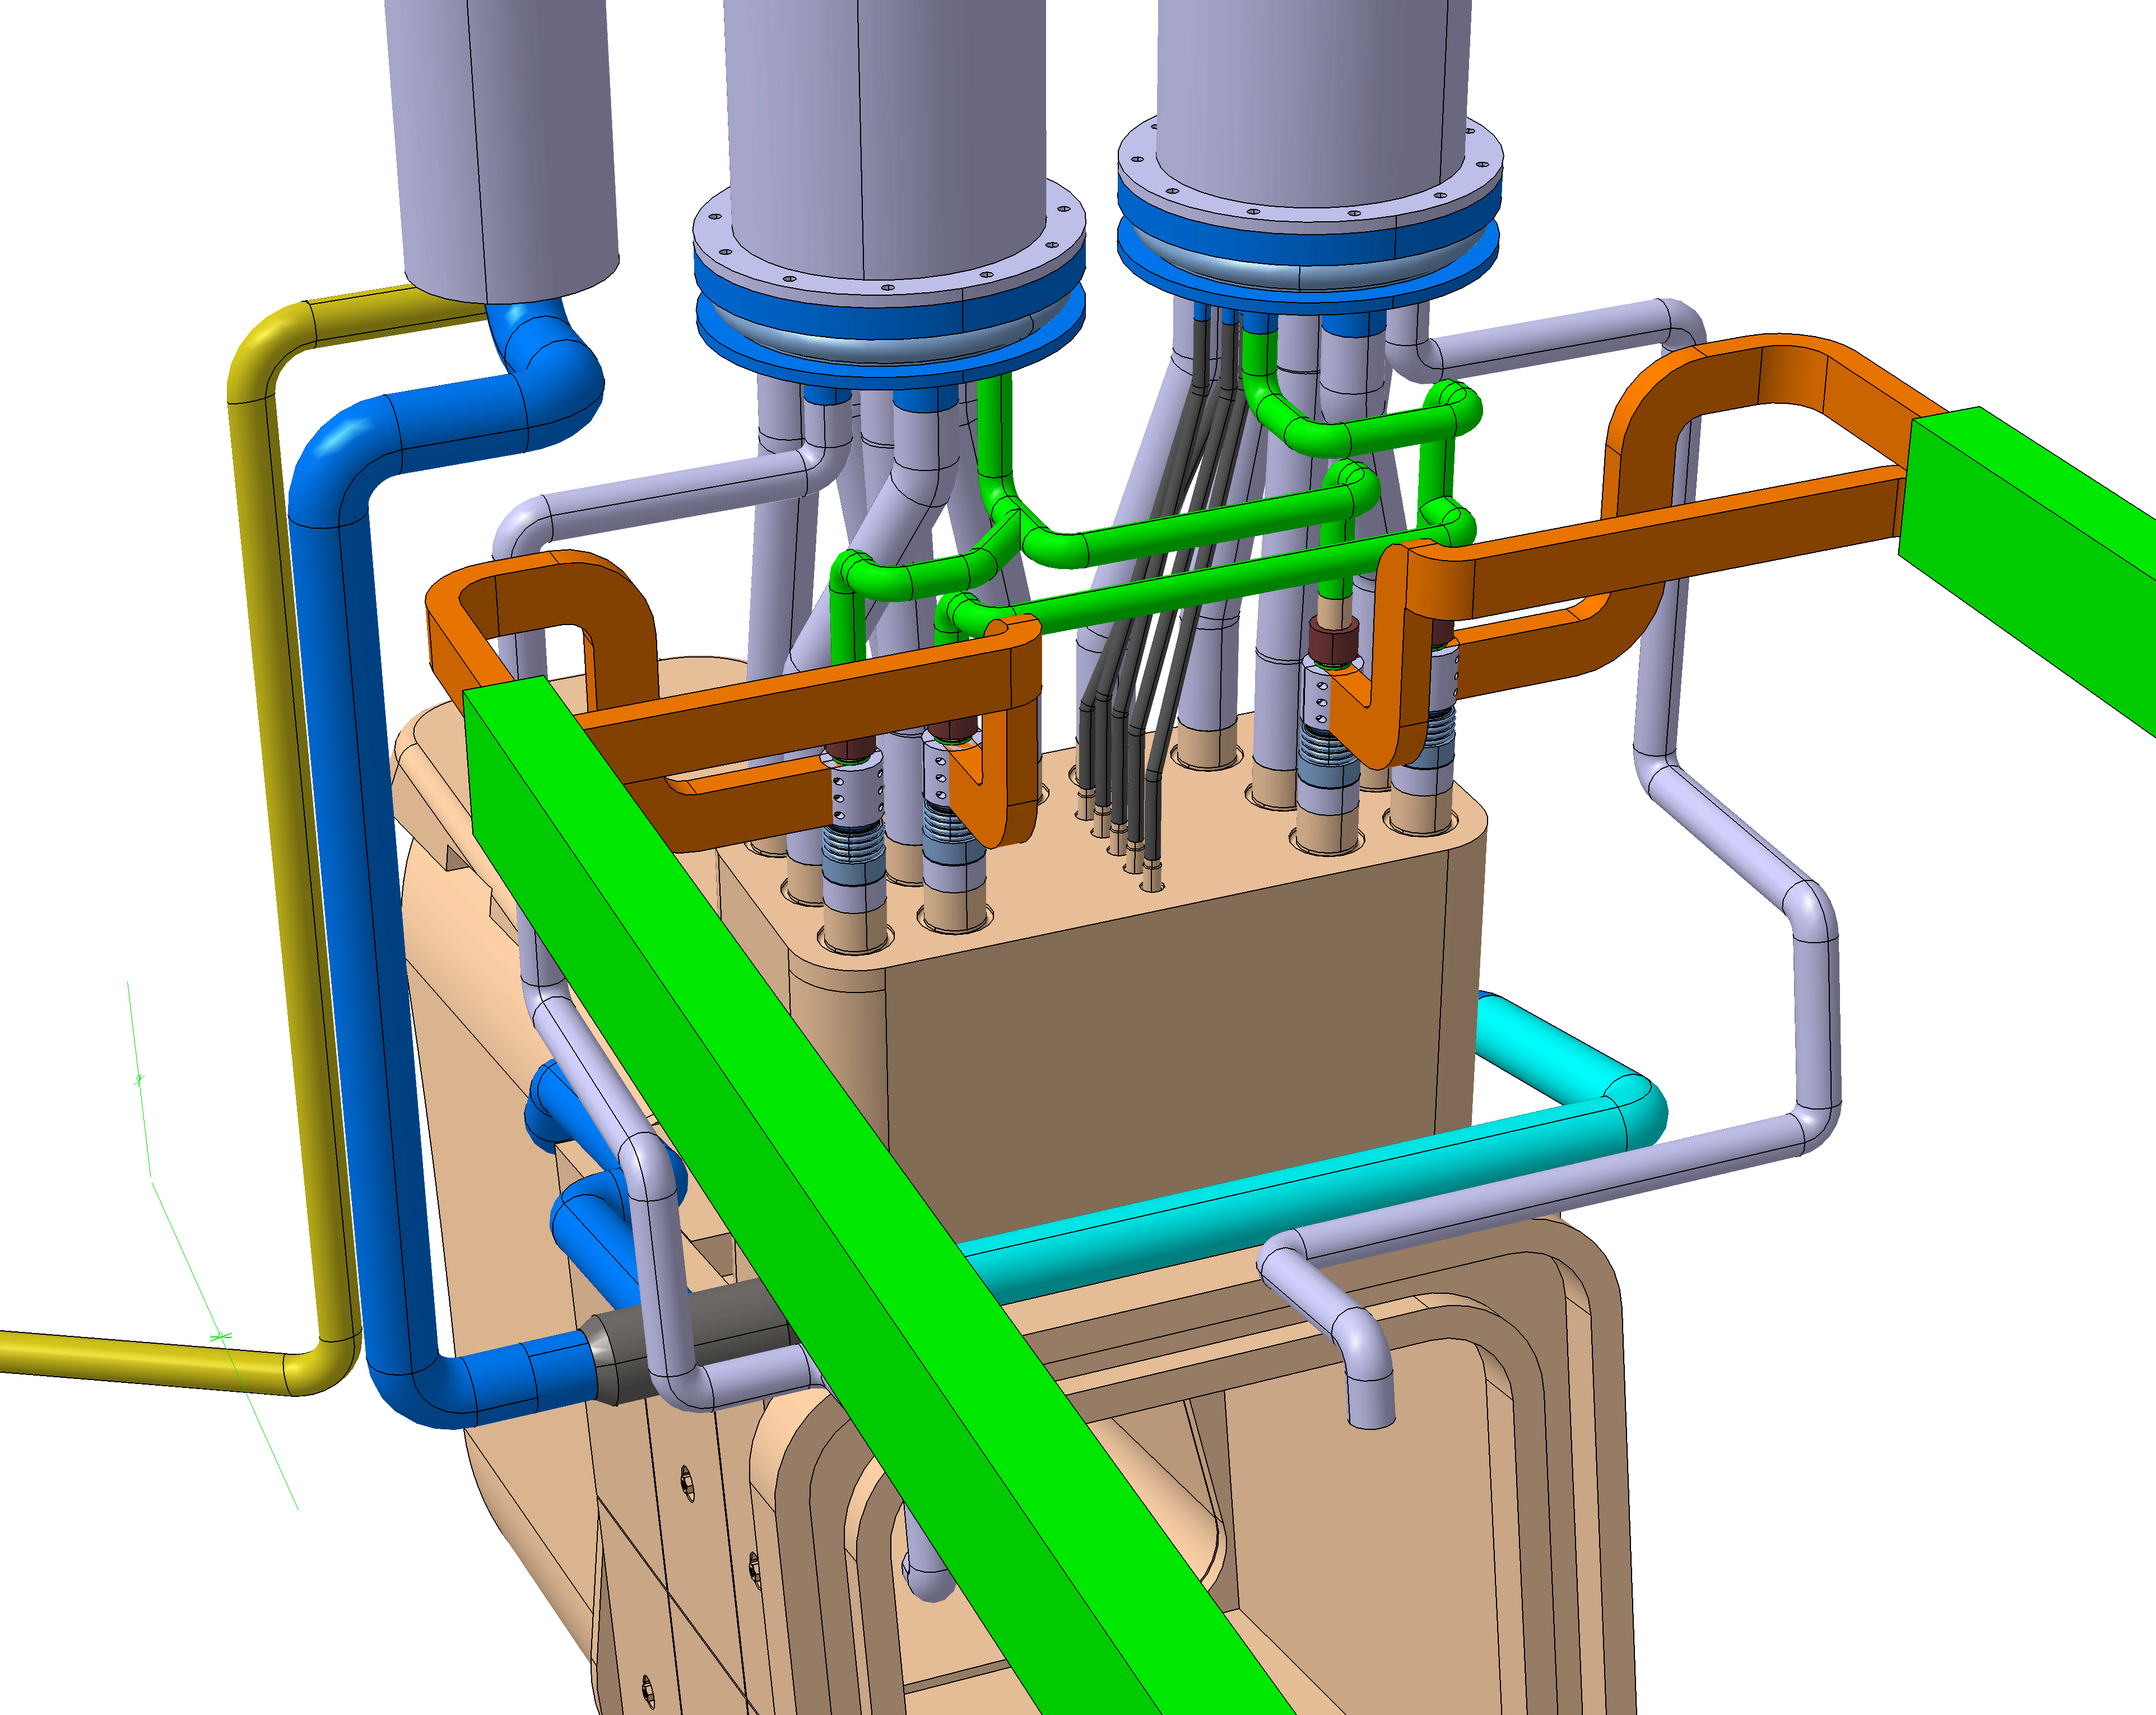
Interface with VV Ports and DC Bus and TCWS
Bolted Connection at ELM/VS Pole
Provides clamping force for electrical connection
Flexible Length
Minimize length
Allow compliance
Rigid Bus Bar
+ pole has cooling water supply
- pole has cooling water return
Water “jumper” needs electrical isolation between supply/return
Bolted Connection to ELM/VS Pole
Flexible Bus Bar
End of Bus Bar (green)
Water Jumper (red)
Cartoon-level design needs further development

Slide 18
Issues and Resolution Plan
Issue | Resolution | Pre/Post October
Determine optimum resistance values for grounding resistors and water supply/return lines for ELM and VS | Perform studies to investigate effect of resistance on ground current in normal and ground fault modes for ELM and VS | Pre
Develop agreement on scope boundary for interfaces (e.g. supply/return lines, electrical and hydraulic measurements, local I&C | Discuss with interfacing PBS RO’s and reflect in SRD/ICDs | Pre
Develop design for water supply/return lines for ELM and VS | Develop designs and perform R&D to fabricate prototype | Post (out of scope of present task, but required for FDR)
Develop design for feed-through of feeders through port covers | Perform detailed design activity | Post (out of scope of present task, but required for FDR)
Develop design for electrical connection to DC bus bar | Perform detailed design activity | Post (out of scope of present task, but required for FDR
Develop local interlock and I&C plan for IVC | Determine appropriate measurements, identify instruments, develop interlock logic, determine CODAC interface | Post (out of scope of present task, but required for FDR)

Slide 19
Summary
ICD development underway
Some technical issues remain unresolved
Grounding and ground fault detection
Some design details remain incomplete
Design concept for water supply/return lines with insulating breaks
Port vacuum feed-thru’s
DC bus bar connections

