Slide 1
ITER In-Vessel Coils (IVC) Interim Design Review Introduction
C Neumeyer
July 26, 2010

Slide 2
Outline
Scope
Objectives
Procedure
Chits
Presentations
Context
Issues and Resolution Plan Summary

Slide 3
Scope (1)
This review covers work scope defined in Task Agreement “Support for Preliminary Design of the ITER In-Vessel Coils”, Task Number C15TD70FU, ITER_D_3CNGUT
Advance the design of the IVC toward preliminary design review readiness
SRD completion
Design drawings complete to PDR level
Interfaces defined and documented
CDR chits resolved
Analysis and R&D at PDR level
RH assessment
Failure Modes & Effects Criticality Analysis (FMECA)
Work description
Continuation of design development and integration
Neutronics/thermal/hydraulic/structural/EM analysis
Development of Stainless Steel jacketed Mineral Insulated Conductor (SSMIC)
Water erosion studies
Coil-feeder joint
welding process development
Bolted feeder joint backup
C18150 Copper alloy stress relieving/re-aging studies
Preliminary Design Review (PDR)
Final Task Report

Slide 4
Scope (2)
Scope of task (and this review) includes coils and feeders
Scope of task (and this review) does not include:
DC bus bars
power supplies
cooling water systems
I&C
However, in some cases (e.g. electrical) it is necessary to develop a concept for out-of-scope items to reach closure on design of in-scope items

Slide 5
Objectives
The review shall assess progress and determine if the IVC design team is on track for a formal PDR in Oct/Nov;
The assessment of progress shall be with respect to the specific areas defined in the Task Agreement;
The determination of the readiness for the PDR shall be based on a comparison against the IO Design Review Procedure, ITER_D_2832CF.

Slide 6
Procedure
The review will be informal but will be structured according to the framework of the IO Design Review Procedure including participants and roles as follows:
Design Approver will approve this agenda and the summary report – Gary Johnson
Design Coordinator will coordinate the review and define the objectives – Ed Daly
Design Developer will prepare the documentation required for the review and
follow-up on action items (chits) – Charles Neumeyer
Design Review Secretary will upload documentation and presentations into IDM and will record the minutes of the meeting including the collection of chits and preparation of a chit summary spreadsheet – Skip Schoen
Design Review Chairman will be a technically qualified person not directly involved in the development of the design – Doug Loesser
Design Review Panel will be the group of peers on the IVC design team and other key experts

Slide 7
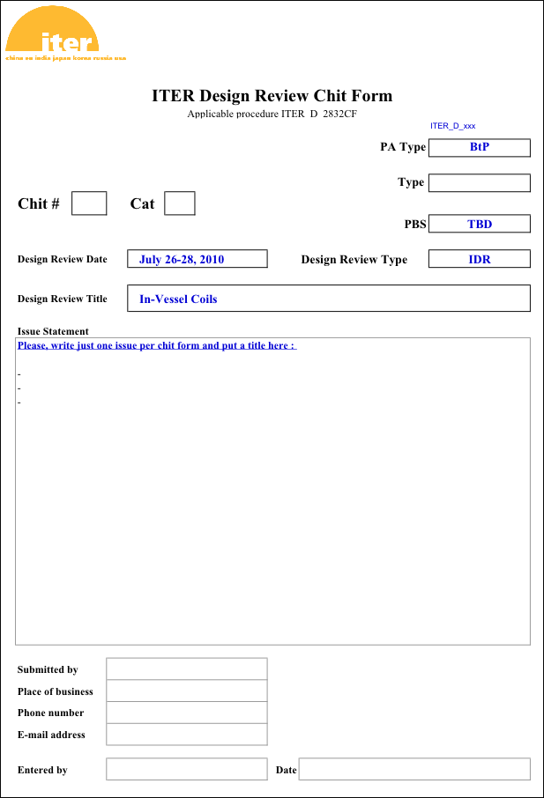
Chits
Please submit chits via e-mail
to Skip Schoen
sschoen@pppl.gov
Please include just one issue per chit

Slide 8
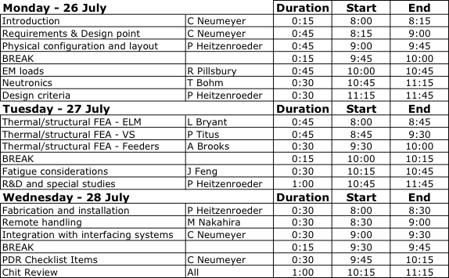
Presentations

Slide 9
Context
March
April
May
June
July
Aug
Sept
Oct
Nov
TA
Design point
Conductor R&D Contracts Established
Phase 1 Design & Analysis
500MCM Sample Tests
IDR
Prototype Conductor Fabrication
Supporting R&D
Phase 2 Design & Analysis
PDR
Final Report

Slide 10
Issues and Resolution Plan
Presentations will include summary at conclusion to facilitate objective of PDR feasibility assessment issue
Issue | Resolution | Pre/Post October

