Slide 1
ITER In-Vessel Coils (IVC) Interim Design Review Requirements & Design Point
C Neumeyer
July 26, 2010

Slide 2
Requirements
System Req’ts Document (SRD) ITER_D_2MFYMW
CDR version approved Sept 2009
STAC version approved May 2010
Major revision ongoing
Main design-driving requirements
Physical location and envelope
Current and voltage waveforms
Operability in degraded modes

Slide 3
Requirements - Physical location and envelope
Dictated by IO as part of overall in-vessel design integration

Slide 4
Requirements - Current and voltage waveforms
VS based on physics simulation of VDE
Physics simulation of minor VDE with
Z₀ = 16.5 cm plus noise
Engineering interpretation

Slide 5
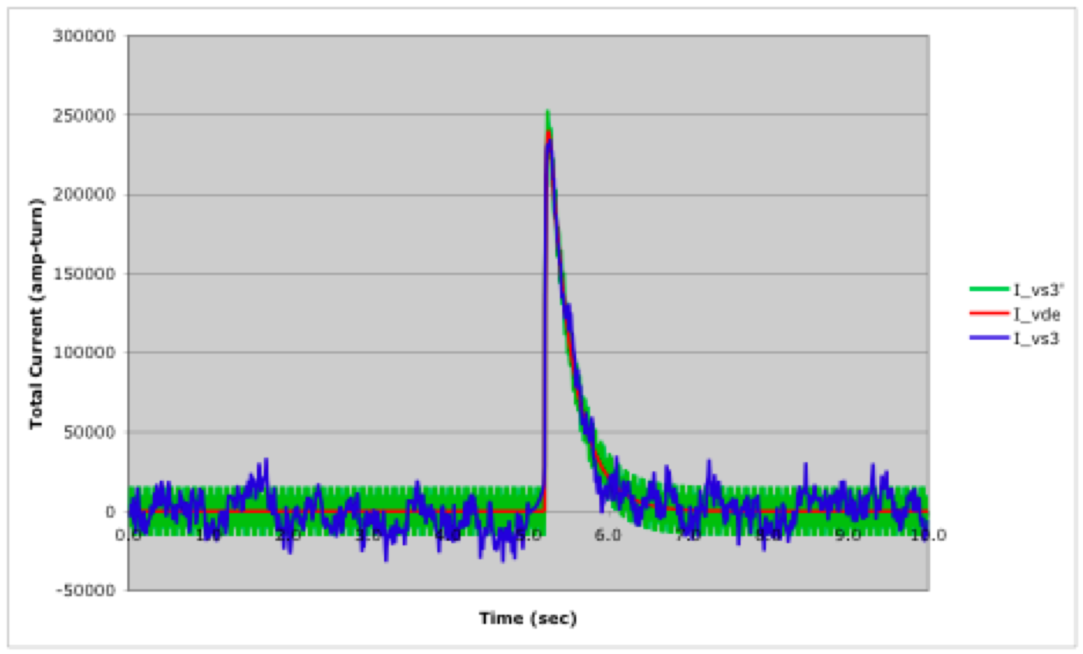
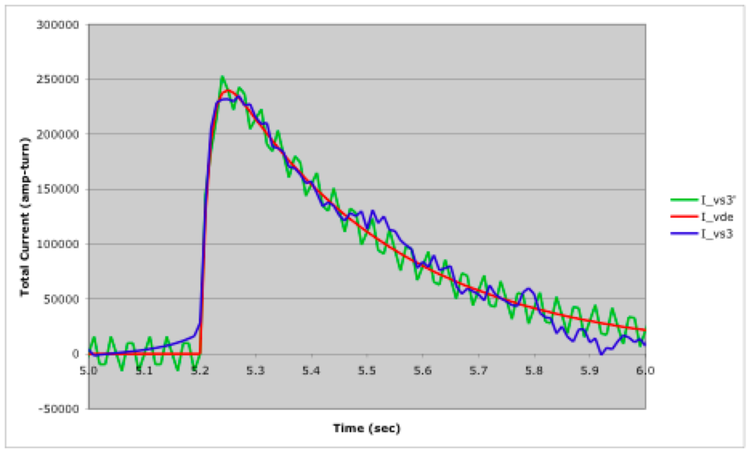
Requirements - Current and voltage waveforms
VS (con’t)
Synthesized waveform parameters
Zoom

Slide 6
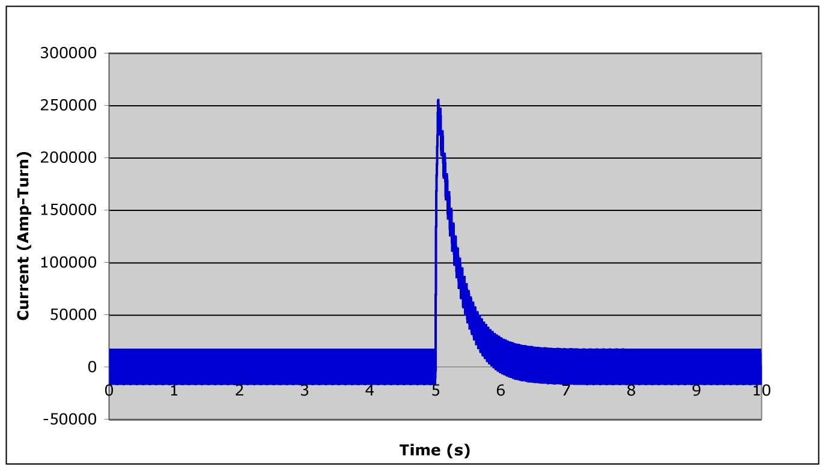
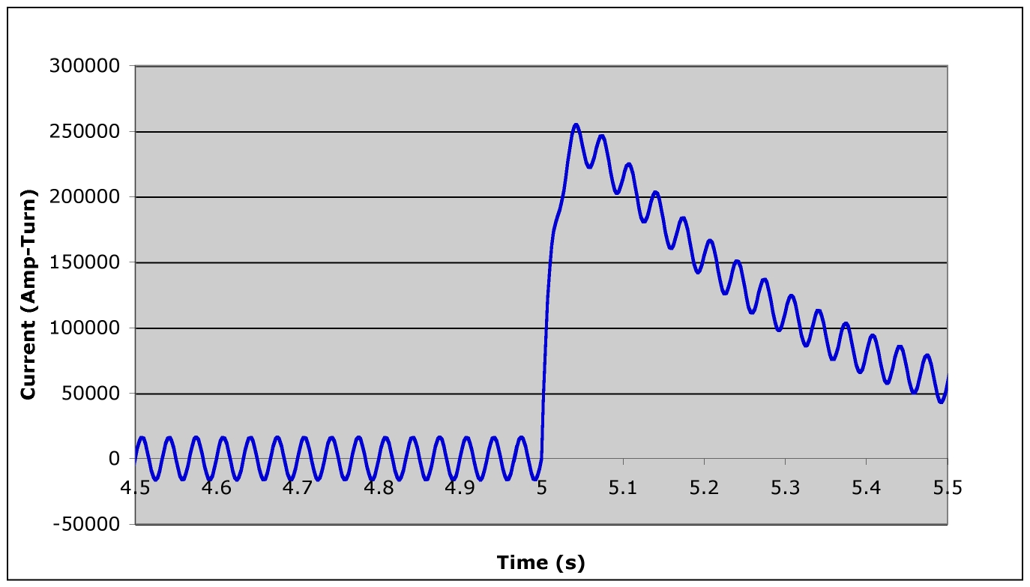
Requirements - Current and voltage waveforms
VS (con’t)
I_{noise_rms} chosen such that the ∫i²(t)dt taken over the 10 sec period for the synthetic waveform equals that for the reference, namely 12845 kAt²-sec
At frequency of 30Hz the voltage required to drive the noise current is 50% of the maximum voltage. Note that, for sinusoids the rms value is independent of frequency.
Voltage requirement directly specified in physics document = 575V/turn
Freq and # of occurrences per pulse of the waveform shall be ≤0.1 Hz (10 sec period) and three, respectively.
The total number of events shall be < 30000 over the lifetime of ITER.
Zoom

Slide 7
Requirements - Current and voltage waveforms
ELM
Each ELM coil shall be designed to carry a current of 90kA-turn over a range from continuous DC to 5Hz sinusoidal
The voltage rating of the ELM coil shall be determined based on the required coil current and circuit impedance at 5Hz

Slide 8
Requirements – Operability in Degraded Modes
Because of the difficulty of repair and replacement, the IVCs shall be designed to operate in degraded modes as follows:
In case of an ELM coil failure which compromises its ability to perform its normal electrical function but does not compromise its ability to withstand the in-vessel electromagnetic and vacuum environment, removal of the coil from the tokamak shall not be required
In case of a VS coil failure which compromises the ability of a single turn to perform its normal electrical function but does not compromise that turn’s ability to withstand the in-vessel electromagnetic and vacuum environment, removal of that turn from the tokamak shall not be required, and the remaining turns shall be capable of delivering the full rated current waveforms

Slide 9
Design Point
Selection of conductor technology
Selection of conductor geometry and # turns
#turns
Insulation thickness
Conductor and water channel cross sections
Electrical characterization
Overall characterization at circuit and system levels
electrical
thermal
hydraulic

Slide 10
Design Point - selection of conductor technology
Mineral insulated conductor (MIC) is the chosen solution
Tolerant of radiation environment (~ 170 Gy/s and 3000 MGy)
Use of MIC in magnets operating in high radiation fields was pioneered by accelerator community beginning in late 1960’s (e.g. LAMPF, SIN, TRIUMF meson factories)
Decades of experience in radiation fields ~ 10 – 100x the IVC requirement
Use of MIC has been/is being considered for various fusion applications
Magnets for various fusion reactor studies (NET, MARS, FED)
Diagnostics for ITER
JT60-SA internal coils
Swelling may occur but not an issue in compacted powder with finite void fraction
Flux results in Radiation Induced Conductivity (RIC) but fluence is not an issue
Radiation Induced Electrical Degradation (RIED) not likely a concern
Tolerant of thermal environment (Operation 100 ~ 150ºC, bakeout to ~ 240ºC)
MIC is typically used in heating elements and fireproof wiring
Commercial cables rated for continuous operation at 250ºC, transient operation up to 1000ºC

Slide 11
Design Point - selection of conductor geometry and # turns
# Turns
Increasing #turns
Higher voltage (bad for insulation)
Thicker insulation (difficult for manufacturing)
Lower packing fraction (reduced performance)
Longer cooling path length (reduced performance, difficult hydraulics)
Higher current (bad for PS and bus bar)
Larger conductor (difficult for manufacturing)
Decreasing #turns
NOTE: scheme was already developed for VS based on 4 turns with each turn penetrating a port and routed to PS area allowing option to abandon failed turn(s) and operate others
- Additional VS turns and bus bars considered highly unattractive, therefore n_VS = 4

Slide 12
Design Point - selection of conductor geometry and # turns
Insulation thickness – a complex and critical issue
Electrical breakdown
Basic dielectric strength limitation
Thermal runaway
Ohmic resistance highly dependant on RIC and operating temperature
Current through insulation depends on resistance and capacitive displacement currents
High frequency chopper power supply may cause substantial AC component
Ohmic heating could cause breakdown due to thermal runaway
Thermal conductivity
Removal of nuclear heat deposited on structures
Structural behavior
Ground fault detection
Low stray resistance due to RIC and temperature will limit sensitivity detection
Manufacturing feasibility
Limited prior experience with large size MIC
Winding feasibility (minimum bend radius)
Maintain adequate thickness at bends
Starting point: set ELM ~ same thickness as Pyrotenax 500MCM, 600V cable, VS to 2x
Largest commercial product and insulation thickness
Assume processes can be adapted via R&D to produce 2x thickness

Slide 13
Design Point - selection of conductor geometry and # turns
Trade study performed using XL solver
Compute water temperature rise based on ohmic + nuclear heat input to flowing water
Neglect film resistance and delta T between water and Cu
Assume copper and water properties based on average of T_inlet and T_outlet
Manual inputs
Conductor shape (rectangular or circular)
Conductor material (100% IACS Cu, 80% IACS CuCrZr (ELM only))
# turns
Coolant inlet temperature (100ºC)
Allowable coolant temperature rise (30,40,50ºC)
Allowable water flow rate (4,6,8 m/s)
Solver variables
Fraction of overall coil envelope taken by conductor + insulation + jacket
Cooling hole diameter and straight for racetrack (rectangular only)
Coolant flow rate
Constraints
Flow rate ≤ allowable
Cooling hole dimension ≤ 2/3 conductor width, height (rectangular) or diameter (circular)
Fixed
Coil cross section envelope 128 x 193 mm (ELM), 158 x 173 mm (VS)
Length per turn 10m (ELM), 48m (VS)
2 turns across width (allowing central “backbone”)
2mm jacket thickness, 2.5mm insulation thickness (ELM), 5mm thickness (VS)
96kA-turn continuous and rms ELM), 27kA-turn continous VS*
nuclear heating (over entire coil envelope) 0.5 watt/cc (ELM), 0.2 watt/cc (VS)
Optimization criteria
Minimize fraction of coil envelope taken by conductor + insulation + jacket (maximize fraction for structure)

Slide 14
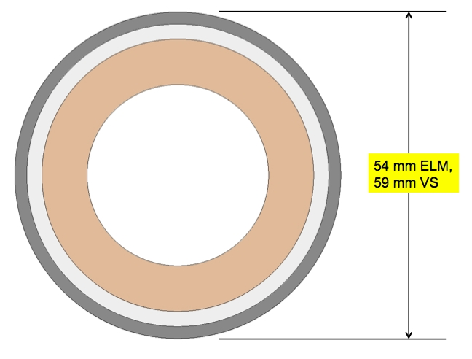
Design Point - selection of conductor geometry and # turns
After considering range of options
settled on design with common inner
Cu conductor size, different insulation
thicknesses
 | ELM | VS
SS OD | 54 mm | 59 mm
SS ID | 50 mm | 55 mm
Cu OD | 45 mm | 45 mm
Cu ID | 30 mm | 30 mm
Mineral Insulation thickness | 2.5 mm | 5.0 mm

Slide 15
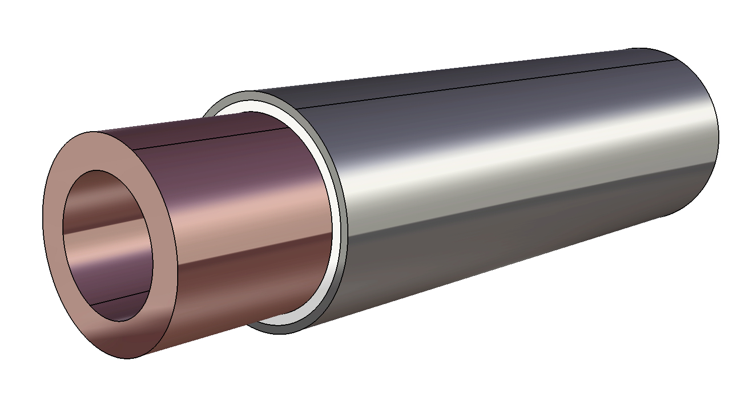
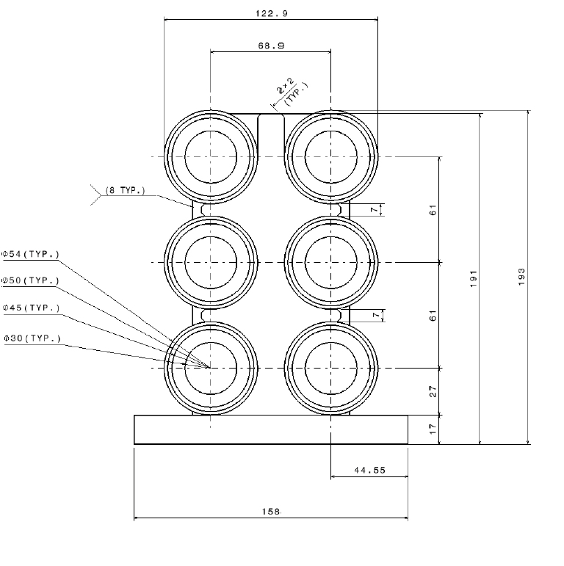
Design Point - selection of conductor geometry and # turns
Nominal
Alt
Alt
ELM

Slide 16
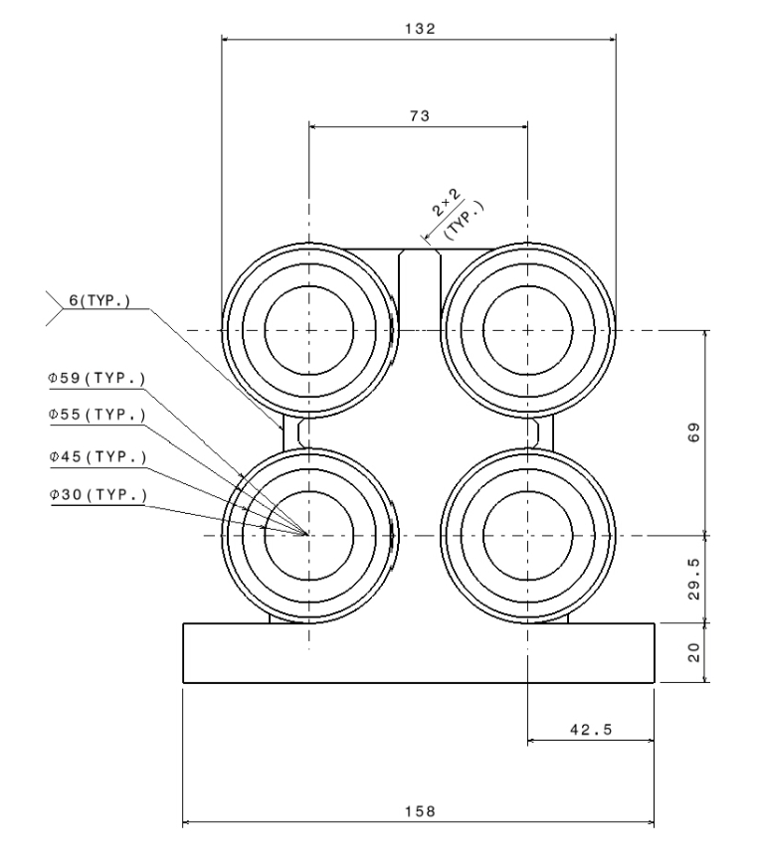
Design Point - selection of conductor geometry and # turns
Nominal
Degraded
VS

Slide 17
Design point – electrical characterization
Electrical – DC bus bar
DC bus bar needs to be sized to determine total circuit impedance
Lengths from feeder terminals to power supply area specified by IO
Utilize conductor cross section of 50 mm x 100 mm with 17.5 mm circular hole
similar to the largest cross section made by Luvata*
based on their billet limit (250kG)
allows for individual sections of 6m length.
Considered two options:
2 parallel conductors per pole with 1 water loop which goes from the PS area through one pole to the VV interface and then back through the other pole to the PS area
set water flow to limit water dT to 10C to limit thermal stresses between the poles in case they are bundled
1 conductor per pole with 2 water loops, one water loop per pole.
set the water flow to limit dT to 25C
additional piping would be needed to return the water to the PS area from the VV interface
Selected first option
*http://www.luvata.com/en/Products--Markets/Products/Hollow-Conductors/

Slide 18
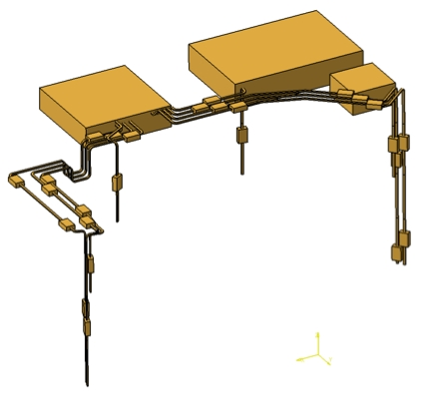
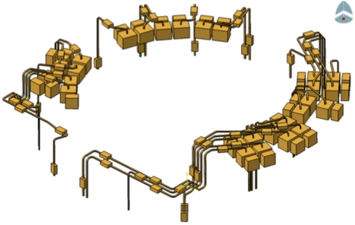
Design point – electrical characterization
ELM
DC Bus
VS
DC Bus

Slide 19
Design point – electrical characterization
Coil and bus bar inductance estimates in XL
ELM
Self-inductances of coils and bus bar estimated using analytic formulae from Grover
VS
Self-inductances of coils estimated using elliptic integral solutions in XL format
Mutual inductances estimated using Maxwell’s coax filament formula
Self-inductances of bus bar estimated using analytic formulae from Grover
Voltages
ELM
V_{min} = I *Z , I=15kA, Z = R+jωL, ω=2πf, f=5Hz = 128V
Chose 180V to include margin and cover for mutual inductance effects
Confirmed adequate based on full R + ΣM*dI/dt calculation
VS
V is specified based directly in physics requirement
2.3kV based on same coil geometry but slightly different (higher impedance) bus bar
Chose 2.4kV to include margin

Slide 20
Design point – electrical characterization
Electrical summary
Notes:
Resistance at operating temperature
For VS, “coil” values include upper and lower coil in anti-series
For ELM, “coil” values are maximum of upper, midplane, and lower coils

Slide 21
Design Point – electrical characterization
Insulation Electrical Stress
Pyrotenax Engr Guide data quotes 5kV AC breakdown voltage
Extrapolates to peak electric field (accounting for geometry) = 3kV/mm
Can predict breakdown voltage (RT and no radiation field) of ELM and VS geometry
Operating stresses
< 100V/mm for ELM
266V/mm for VS (one interleaf), < 150V/mm (two interleaves)
Overall stresses on insulation are close to the guidelines suggested by Vayakis et al for mineral insulated cables used for ITER diagnostics
< 100 Gy./sec (peak ELM = 170 Gy/s, should be much less for VS TBD)
< 473ºK (max ELM ~ 140ºC = 413ºK during electrical operations, ~ 200ºC = 473ºK during bakeout)
< 150V/mm (133V/mm with two VS interleaves and symmetric grounding)
Note that above are peak values and most of the coil conductor sees less flux and voltage

Slide 22
Design point – circuit and system characterization
http://www.pppl.gov/~neumeyer/ITER_IVC/Design_Point.html
ELM
Power supply
information
Total system power input,
water flow, heat loss, etc.

Slide 23
Design point – circuit and system characterization
http://www.pppl.gov/~neumeyer/ITER_IVC/Design_Point.html
VS
Current waveform specifications
Power supply
information
Total system power input,
water flow, heat loss, etc.

Slide 24
Issues and Resolution Plan
Issue | Resolution | Pre/Post October
Change ELM to CuCrZr if req’d by structural/fatigue considerations or other | Reconsider optimization of flow, delta T, and cross section based on CuCrZr | Pre
Erosion issue due to high water flow velocity | Reduce 15kA DC continuous requirement to 15kA DC pulsed w/duty cycle spectrum, or switch to CuCrZr, or adopt variable speed pumps | Pre
Update nuclear heating term | Obtain more accurate nuclear heating data for both ELM and VS | Pre
Refine thermal/hydraulic calculations | Run transient thermal analysis using FCOOL or equivalent | Pre
Optimization of conductor geometry (copper and jacket) | Obtain feedback from R&D prototyping and analysis and determine if adjustments needed | Pre
Optimization of insulation thickness and VS interleaving | Develop better understanding of breakdown, RIC, etc., through literature, gain experience with R&D prototyping and tests, adjust thickness accordingly, possibly use single VS interleaf | Pre/Post (tests on proto not avail)
Confirmation of SSMIC behavior in radiation field at temperature | Perform tests on final proto conductor samples in radiation field, at temperature and voltage | Post

Slide 25
Summary
Requirements are defined including traceability to suitable IDM documents
SS jacketed Mineral Insulated Cable (SSMIC) is the appropriate technology choice
Design point analysis provides coordinated basis for selection of conductor geometry and parameters of interfacing electrical and cooling water systems
Design point details are accessible on web site

