Slide 1
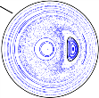
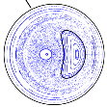
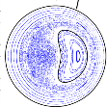
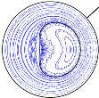
SPEC computes extrema of the
multi-region, relaxed MHD energy principle
The plasma is partitioned into N “relaxed volumes”, separated by “ideal interfaces”.
Minimize the total energy, subject to the constraints of conserved fluxes and helicity in each region
In the relaxed volumes, ∇×B=μB, and islands and chaotic fields are allowed.
Across the ideal interfaces, [[p+B²/2]]=0, and pressure gradients are allowed.
If N = 1 , obtain a globally-relaxed, Taylor state.
If N→∞, recover ideal MHD ∇p=j×B.
If N = 2 , explains helical states in RFP
Overview of RFX-mod results,
P. Martin et al., NF, (2009)
Fig.6. . . . transition from a QSH state . . to a fully developed SHAx state .
Numerical Calculation using Stepped Pressure Equilibrium Code,
G. Dennis et al., PRL, (2013)
Topological features correctly reproduced
Notes:
1

