Slide 1



Magnetic islands and singular currents at rational surfaces in 3D MHD equilibria
Joaquim Loizu
joaquim.loizu@ipp.mpg.de
Stuart Hudson, Amitava Bhattacharjee, Per Helander
MPPC video-conference, December 8th 2014

Slide 2
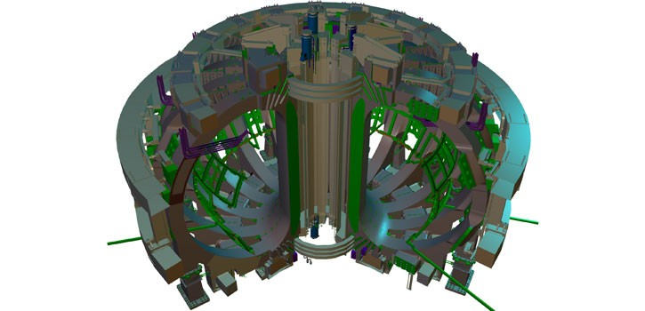
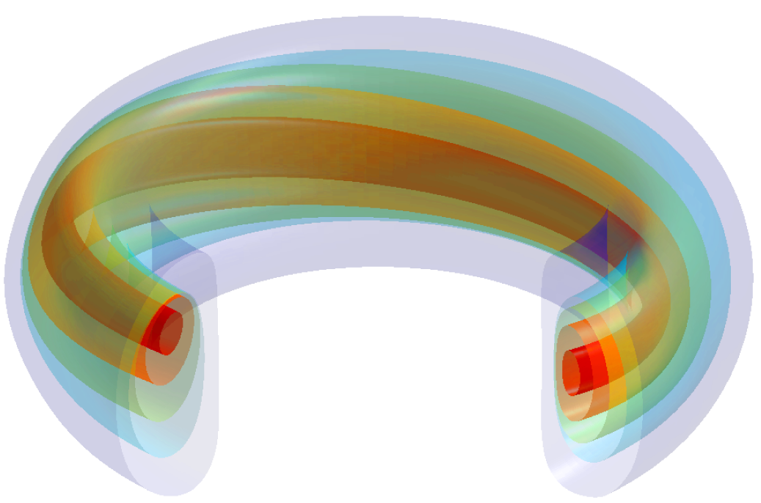
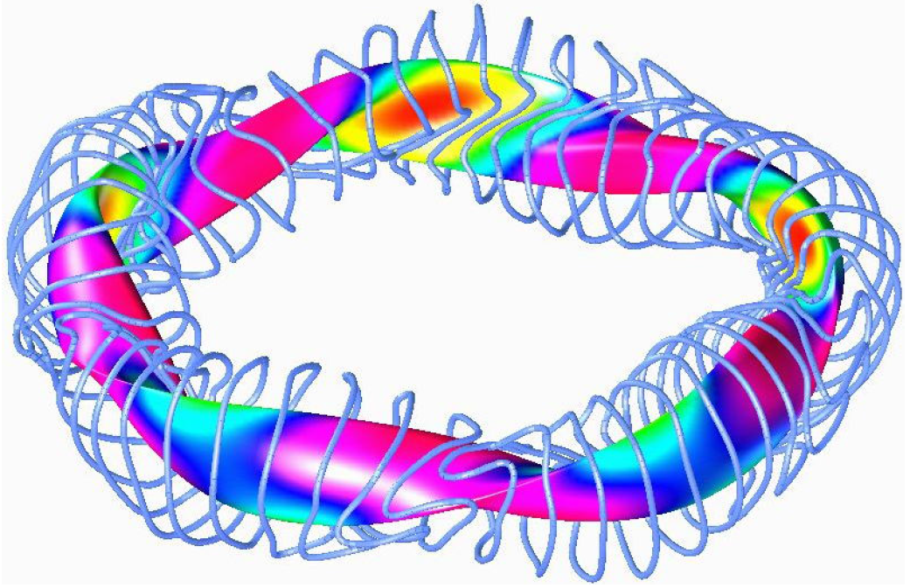
3D MHD brings together tokamaks and stellarators
Tokamak non-axisymmetric designs
(magnetic ripple, resonant magnetic perturbations,…)
Tokamak MHD helical modes and bifurcations
(saturated internal kink, sawteeth)
Stellarator three-dimensional topology

Slide 3
Computational 3D MHD is an outstanding challenge
Ideal MHD predicts the existence of singular currents in 3D
Critical for 3D equilibrium (magnetic islands, confinement)
Critical for 3D macroscopic stability (kink modes, sawteeth)
Computation of 3D equilibria is an outstanding numerical challenge
Can we predict the magnitude of these singular currents?
Can we compute 3D MHD equilibria with magnetic islands?

Slide 4
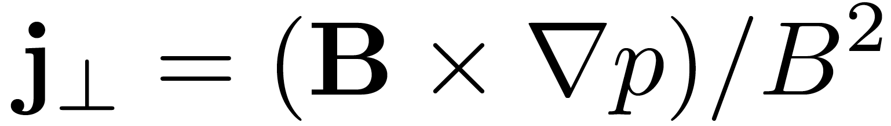
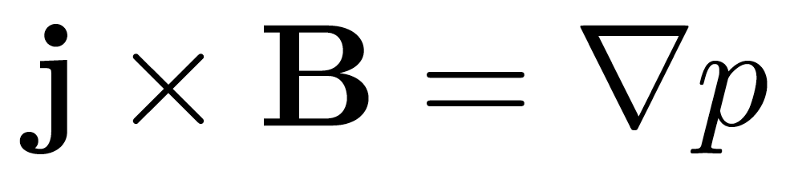

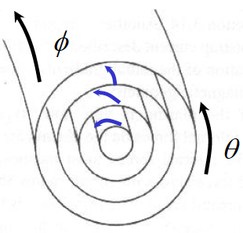
Ideal MHD predicts singular currents
ideal MHD
Magnetic coordinates
Fourier decomposition
Equation type
Pfirsch-Schlutter current
Dirac δ-current

Slide 5
How to calculate 3D MHD equilibrium?
EITHER Insist on nested flux surfaces (ideal MHD)
VMEC
– based on energy functional with ideal constraints
– cannot resolve rational surfaces
OR Relax assumption of flux surfaces
Resistive MHD
– initial value calculation, not based on energy minimum
– islands develop and break rational surfaces
Relaxed MHD
– based on energy functional with fewer constraints
– islands develop at rational surfaces

Slide 6
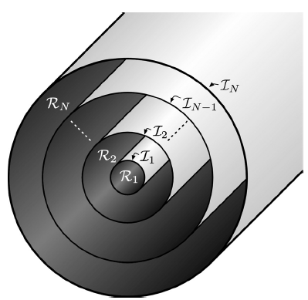
Multiregion Relaxed MHD
Taylor’s theory
MRxMHD
Ideal MHD
Fewer constraints
More constraints
Helicity is conserved globally
Helicity is conserved discretely
Helicity is conserved locally
[Taylor, 1974]
[Dewar, Hole, Hudson, 2006]
[Kruskal, Kulsrud, 1958]

Slide 7
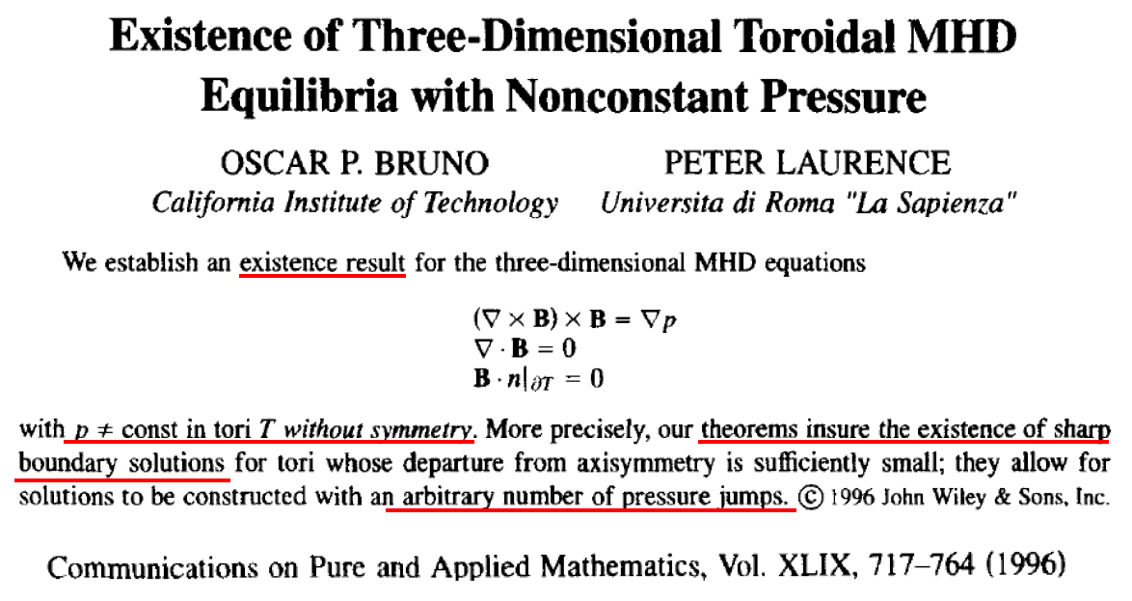
Existence of stepped-pressure equilibria?

Slide 8
Stepped-Pressure Equilibrium Code (SPEC)
Implementation of MRxMHD
Finds minimum of
p₃
p₂
or
or
[Hudson et al, PoP, 2012]

Slide 9
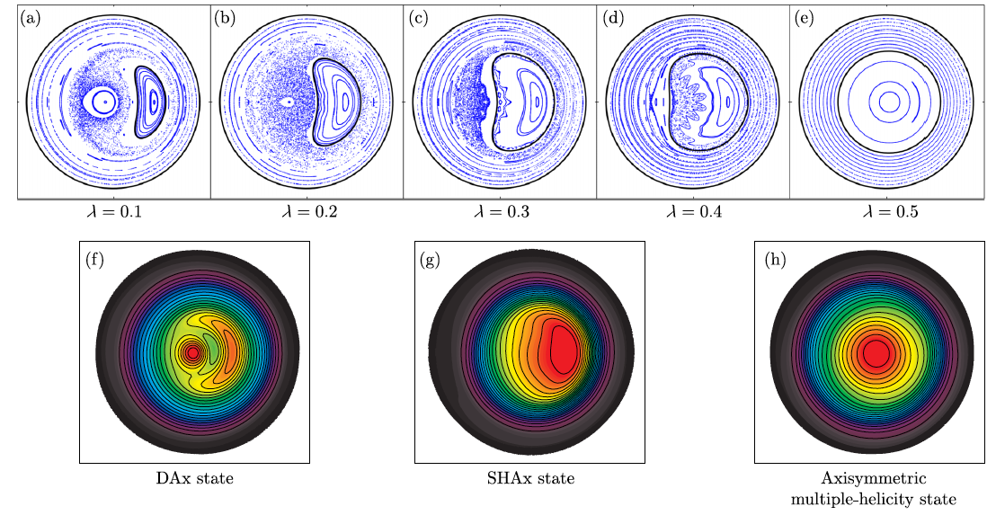
SPEC successfully reproduced helical states in RFPs
[Dennis et al, PRL, 2013]

Slide 10
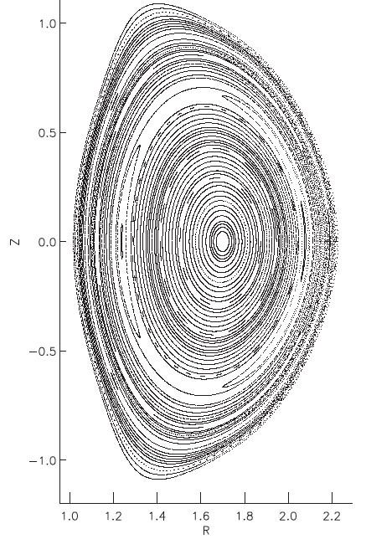
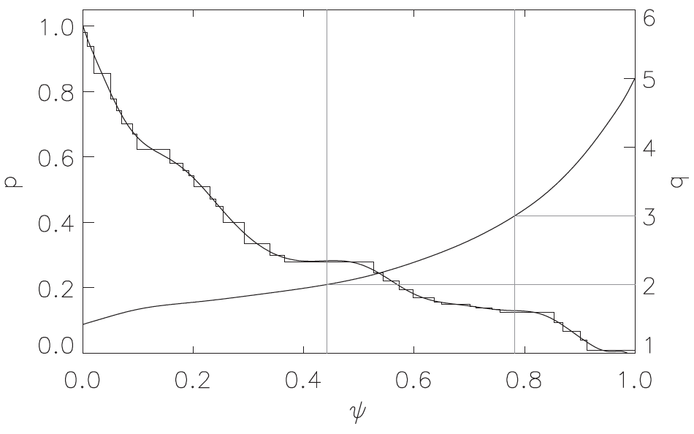
SPEC computed DIII-D equilibrium
with perturbed boundary
Magnetic island at q=2 rational surface
[Hudson et al, PoP, 2012]

Slide 11
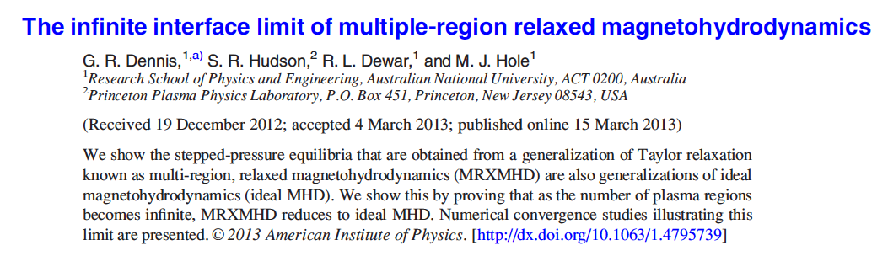
Ideal MHD is a limit of MRxMHD
Corollary for large N:
Axisymmetry: Grad-Shafranov equilibrium should be retrieved
Non-axisymmetry: singular currents should arise

Slide 12
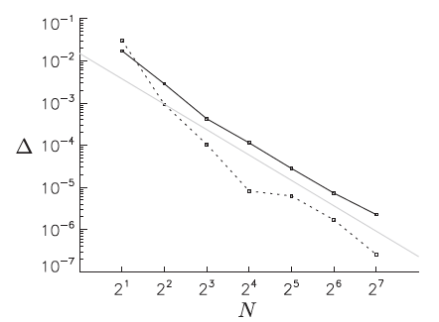
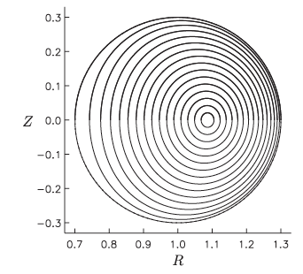

SPEC benchmarked against VMEC in axisymmetry
VMEC
SPEC (N=16)
[Hudson et al, PoP, 2012]

Slide 13
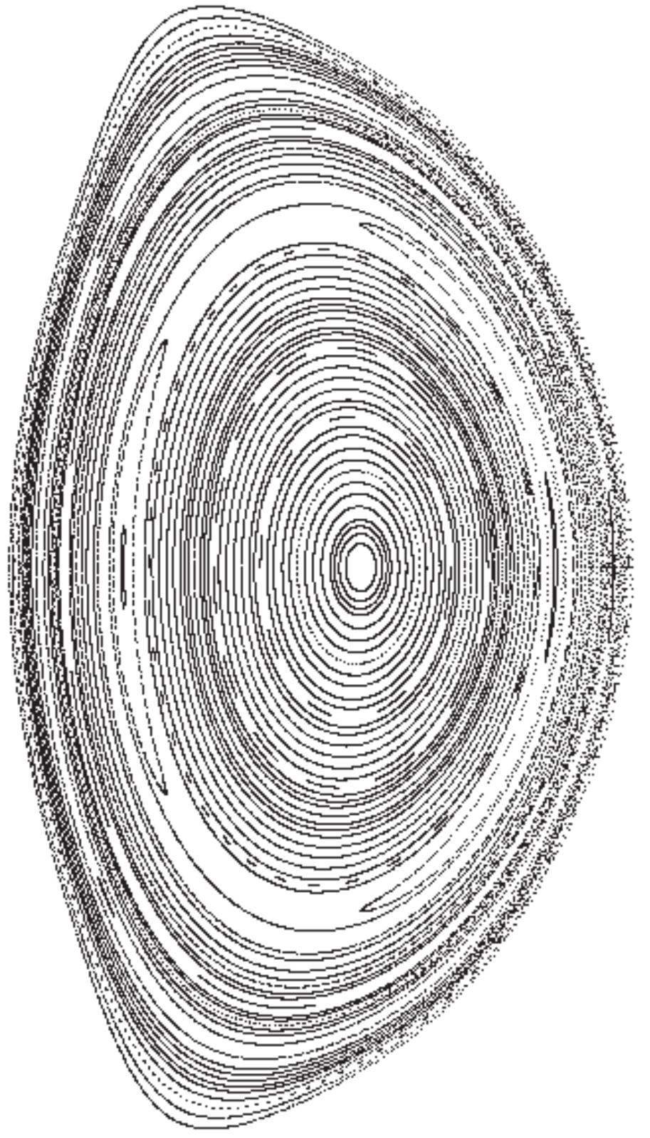
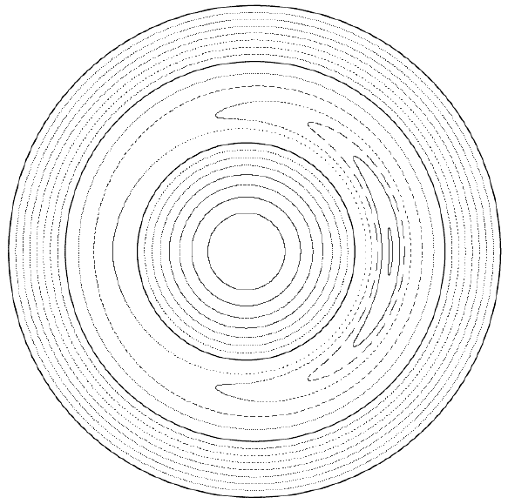
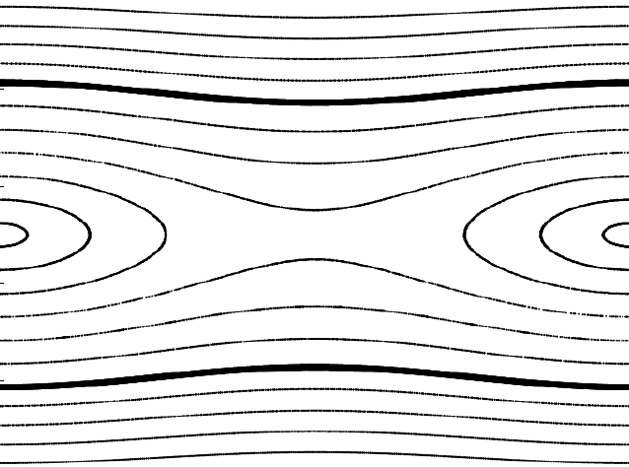
Philosophy: build up understanding
by steps of increasing complexity
There are two superimposed singularities in the parallel current
Start with constant-pressure plasma to isolate the δ-current
Geometry introduces most of the complexity
Start with slab geometry
Hahm-Kulsrud-Taylor
available solution (1985)
Rosenbluth-Dagazian-Rutherford
available solution (1973)

Slide 14
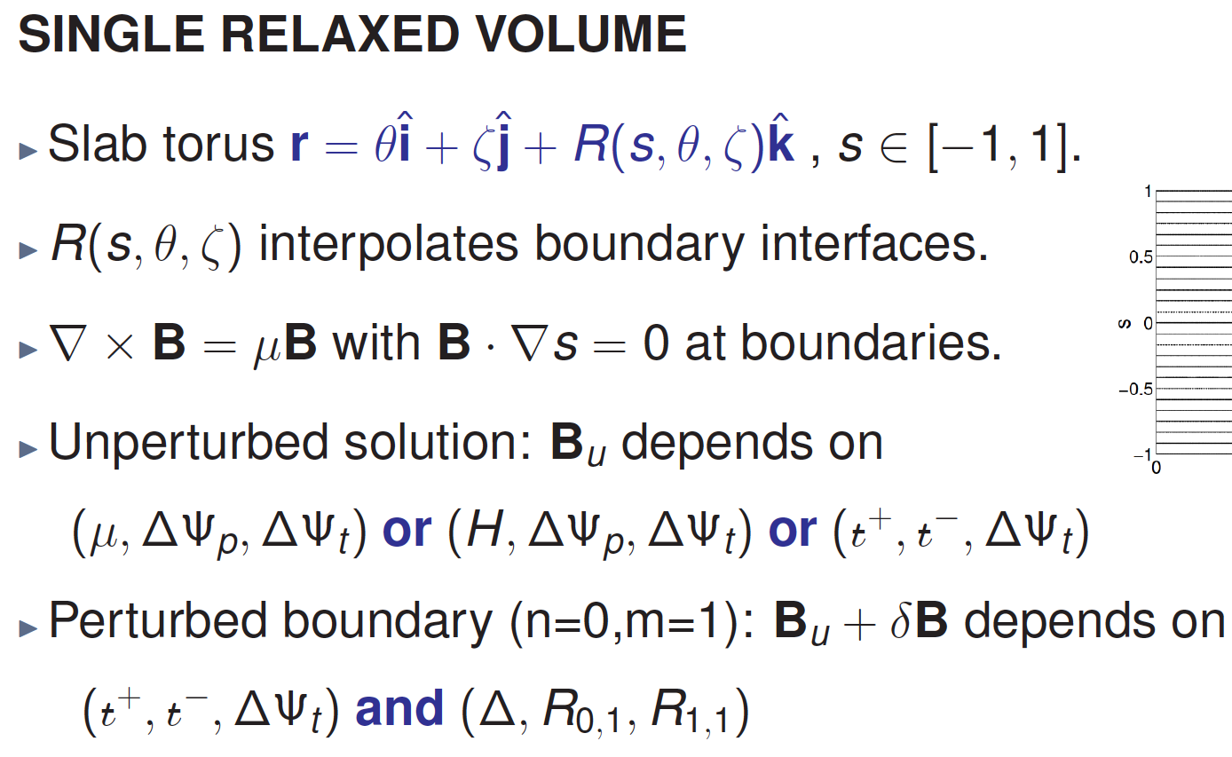
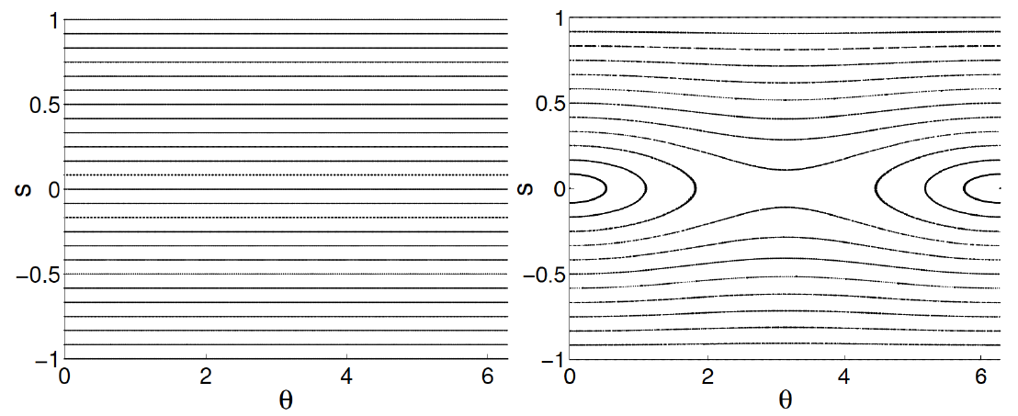
MRxMHD in slab can be treated analytically
linearized solution (R₁₁<<Δ)
UNPERTURBED (R₁₁ = R₀₁ = 0)
PERTURBED (R₁₁ = -R₀₁ = 10⁻²)
R = R₁₀ + R₁₁cos(θ)
Impose ι > 0
Resonant rational ι=0
R = R₀₀ + R₀₁cos(θ)
Impose ι < 0

Slide 15
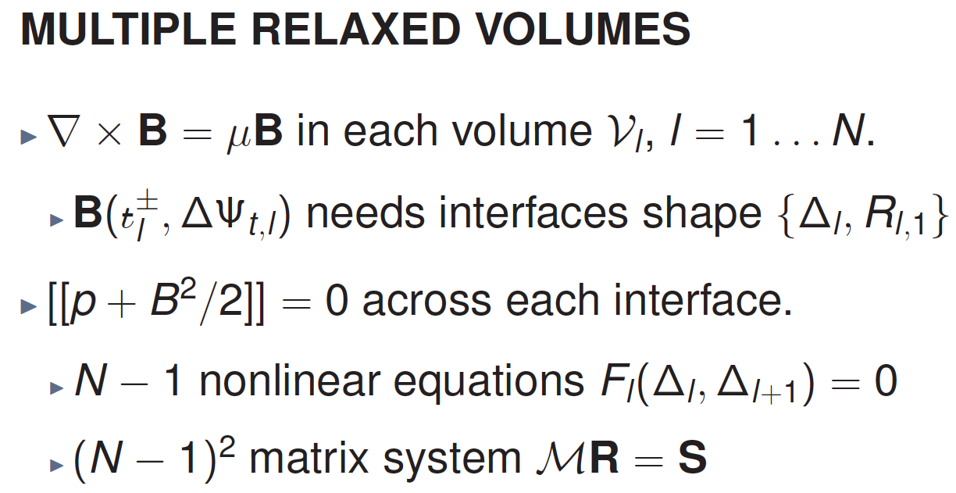

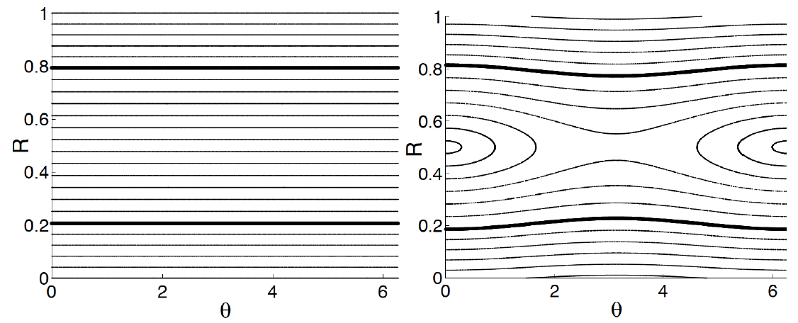
MRxMHD in slab can be treated analytically
Need to specify how we take the limit
UNPERTURBED (R₃₁ = R₀₁ = 0)
PERTURBED (R₃₁ = -R₀₁ = 10⁻²)
IDEA: shield the island by reducing flux and transform in the resonant volume

Slide 16
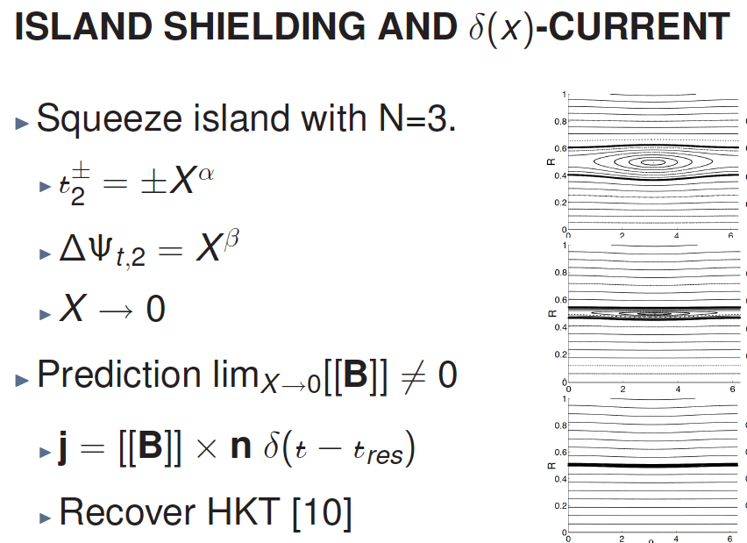
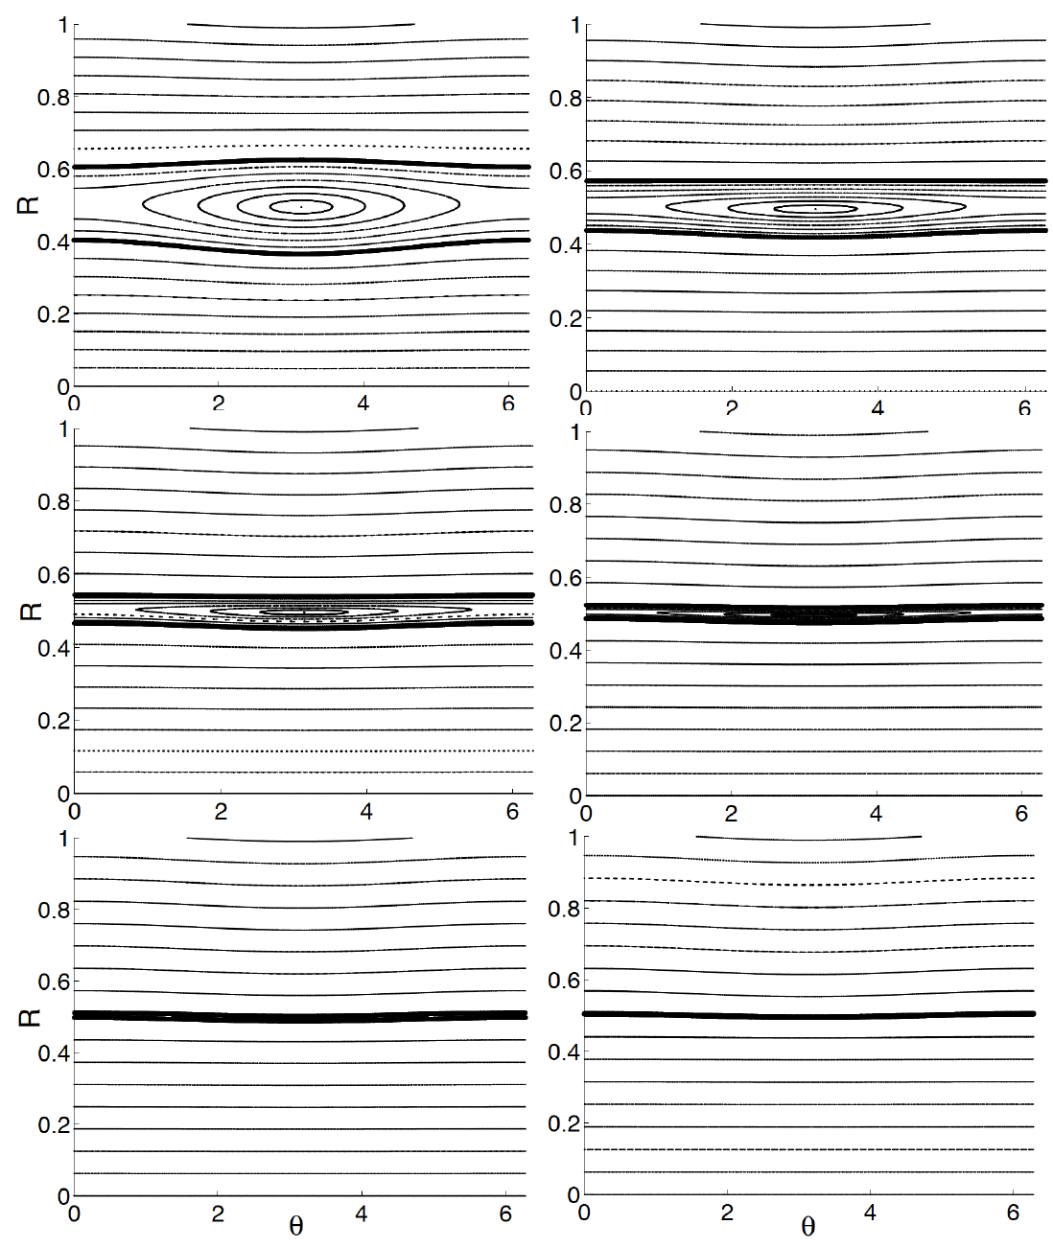
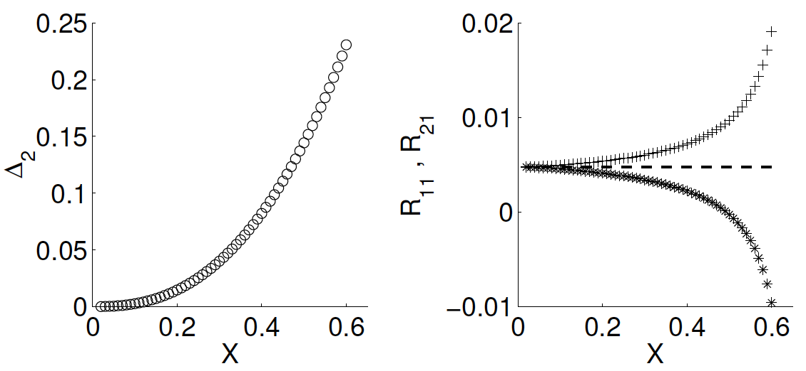
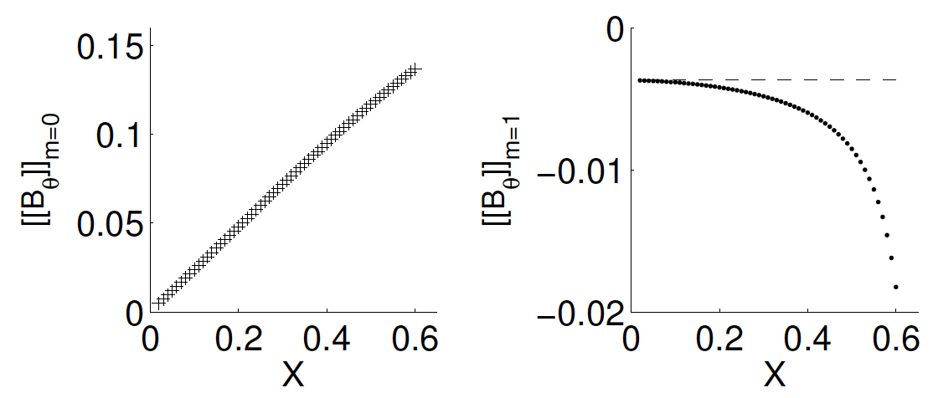
MRxMHD in slab can be treated analytically
retrieves exactly HKT solution in the limit of small shear

Slide 17

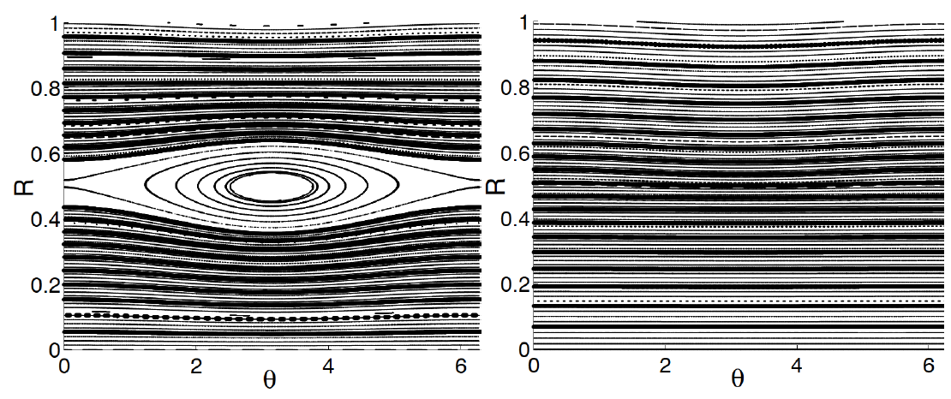


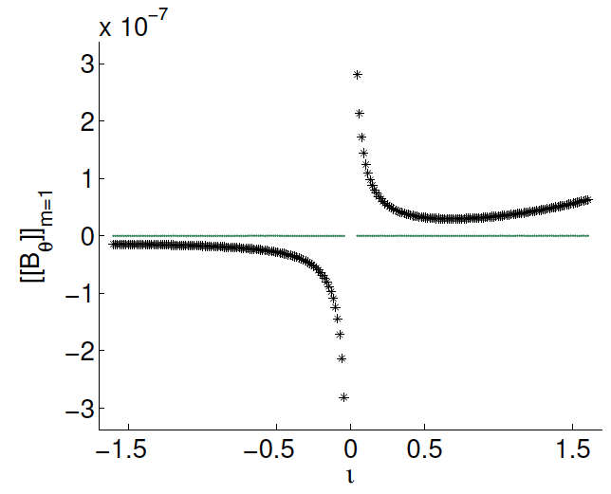
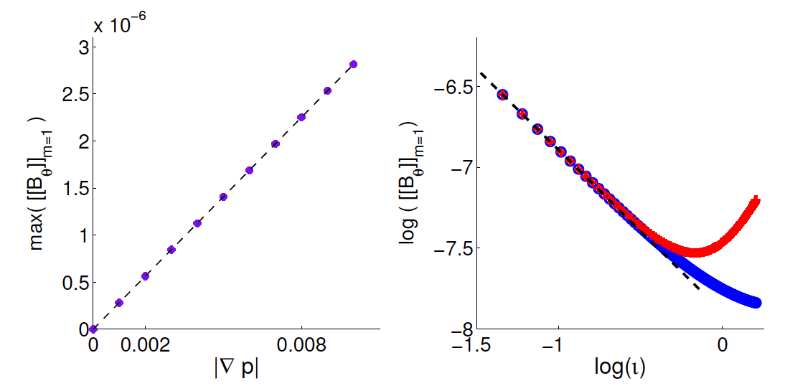
MRxMHD in slab can be treated analytically
p₀≠0
p₀=0

Slide 18
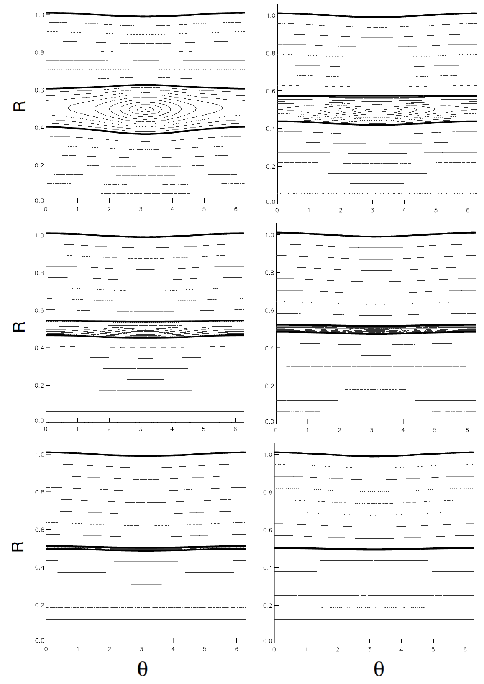
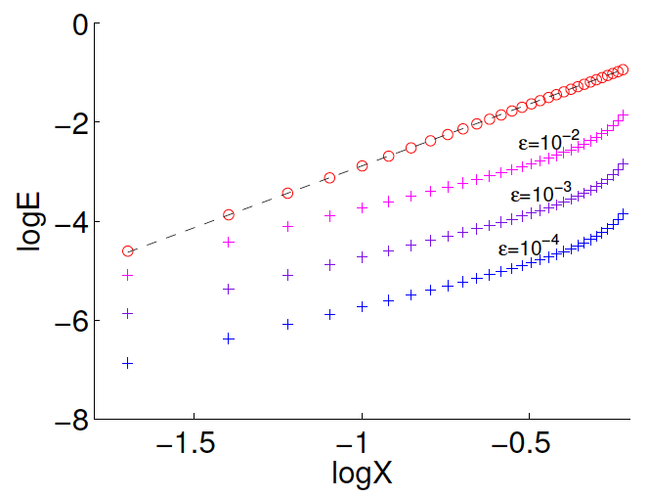
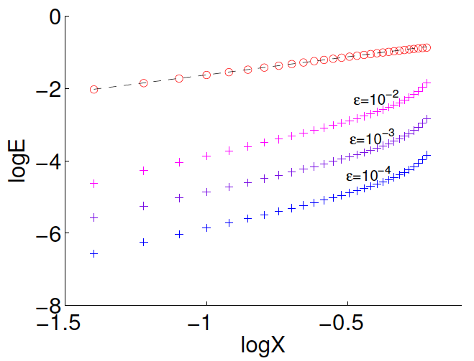
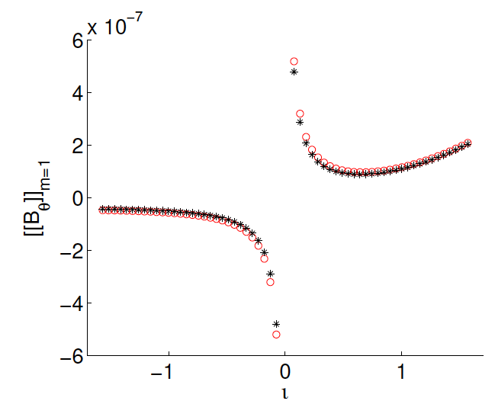
SPEC reproduces the analytical results
Interface geometry
Field discontinuity
m=0
m=1
The agreement between SPEC and the linear analytical
prediction improves with decreasing perturbation

Slide 19
Summary and outlook
Ideal MHD predicts two types of singular currents at rational surfaces in 3D
We have provided the first numerical proof of their mutual existence
We have developed an analytical linear slab model that
(1) describes the formation of islands around resonant rational surfaces
(2) retrieves the ideal MHD limit in which magnetic islands are shielded
(3) computes the subsequent formation of δ-currents and 1/x-currents
SPEC is capable of computing 3D equilibria in slab, cylindrical, toroidal
Currently using SPEC to obtain the nonlinearly saturated internal kink
and the current sheet associated with it

Slide 20
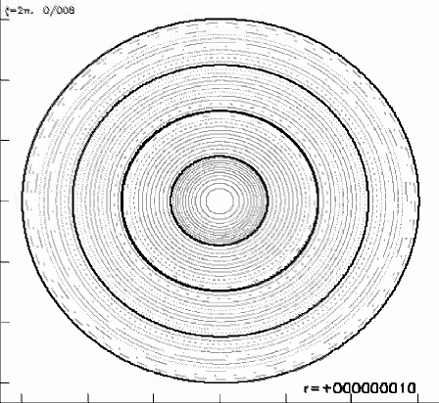
Summary and outlook

