Slide 1
A new class of magnetic confinement device in the shape of a knot
S.R. Hudson, E. Startsev and E. Feibush
Princeton Plasma Physics Laboratory (to appear in Physics of Plasmas, March 2014)
Abstract
We describe a new class of magnetic conﬁnement device, with the magnetic axis in the shape of a knot. We call such devices “knotatrons”. Examples are given that have a large volume ﬁlled with magnetic surfaces, with signiﬁcant rotational-transform, and with the magnetic ﬁeld produced entirely by external circular coils.

Slide 2
Charged particles are confined perpendicularly in a strong magnetic field, but are “lost” in the parallel direction.
An open-ended cylinder has good perpendicular confinement of charged particles,
but particles are lost through the ends.
end-loss
end-loss

Slide 3
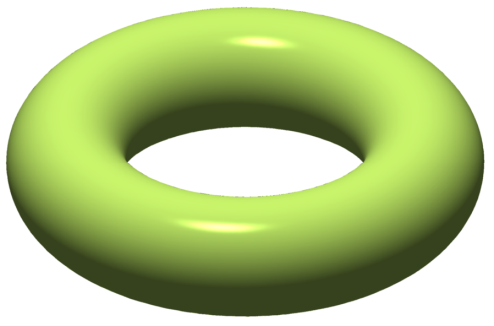
To eliminate end-losses the magnetic field must “close” upon itself. Joining the ends of a cylinder makes a tokamak.
In an axisymmetric tokamak, the magnetic axis is a circle in real space
no end-loss
no end-loss
Because rotational-transform is required to cancel particle drifts,
axisymmetric configurations need toroidal plasma current;
and toroidal plasma current leads to disruptions, . . .
An alternative for producing rotational-transform is by non-axisymmetric shape.

Slide 4
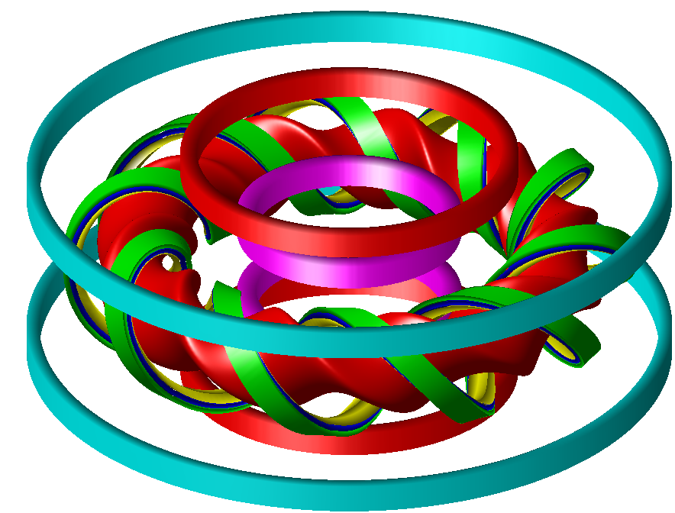
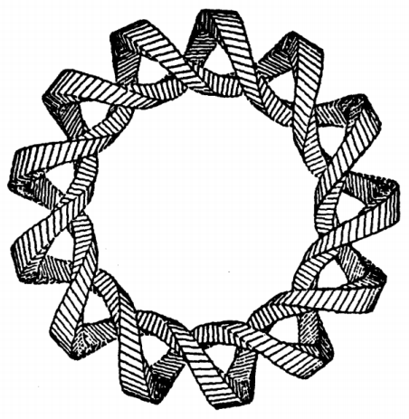
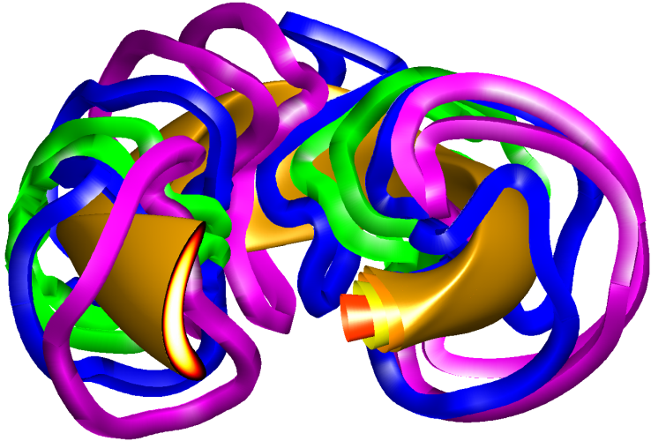
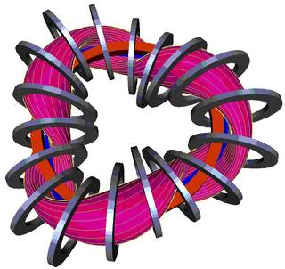
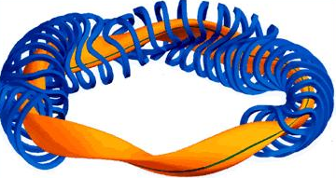
In the non-axisymmetric stellarator the confining magnetic field is produced by external coils, and stellarators are more stable.
heliotron: helical coils; e.g. LHD
torsatron: continuous, helical coils;
e.g. ATF
NCSX: optimized, modular coils
helias: helical axis, modular coils;
e.g. W7X
heliac: helical axis; e.g. H-1NF, TJ-II.

Slide 5
The magnetic axis of a tokamak is a circle. The magnetic axis of a conventional stellarator is smoothly deformable into a circle.
There is another class of confinement device that:
is closed, in that the magnetic axis is topologically a circle ( a closed, one-dimensional curve ) ;
has a large volume of “good flux-surfaces” ( as will be shown in following slides ) ;
has significant rotational-transform without plasma current ( because the magnetic axis is non-planar ) ;
has a magnetic axis that is not smoothly deformable into a circle.
( without cutting or passing through itself )

Slide 6
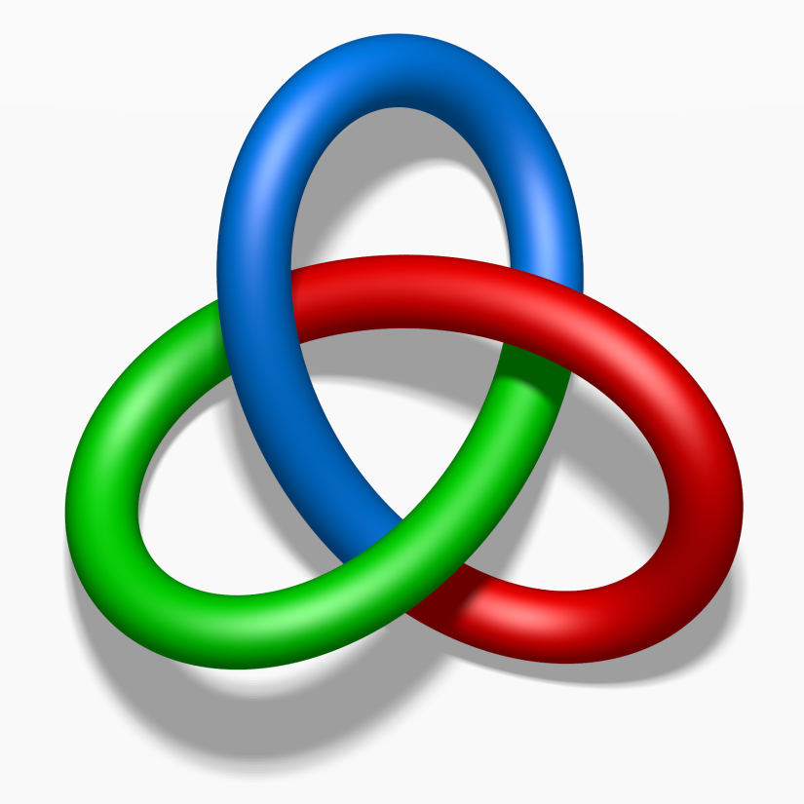
The magnetic axis of a tokamak is a circle. The magnetic axis of a conventional stellarator is smoothly deformable into a circle.
There is another class of confinement device that:
is closed, in that the magnetic axis is topologically a circle ( a closed, one-dimensional curve ) ;
has a large volume of “good flux-surfaces” ( as will be shown in following slides ) ;
has significant rotational-transform without plasma current ( because the magnetic axis is non-planar ) ;
has a magnetic axis that is not smoothly deformable into a circle.
( without cutting or passing through itself )
The magnetic field may be closed
by forming a knot!
e.g. a colored trefoil knot

Slide 7
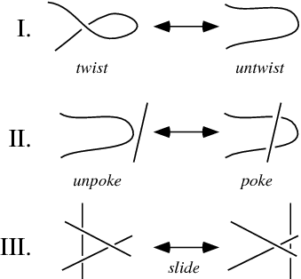
Mathematically, a knot, K: S¹ → S³, is an embedding of the circle, S¹, into real space, S³≡ R³.
Reidemeister moves

Slide 8
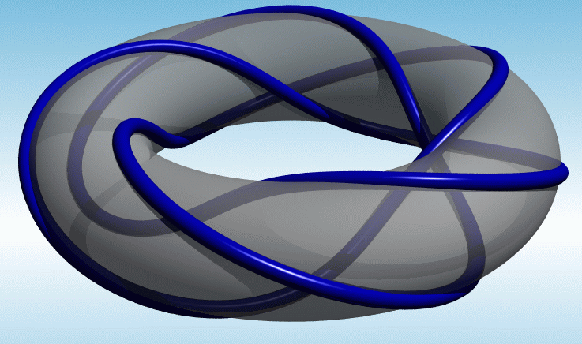
A (p,q) torus knot, with p, q co-prime, wraps p times around poloidally and q times around toroidally on a torus.

Slide 9
A suitably placed set of circular current coils can produce a magnetic field with an axis in the shape of a knot.

Slide 10
The orientation of a set of circular coils is adjusted to produce the required magnetic axis.
given proxy magnetic axis
evenly spaced along reference curve,
reference curve ≡ proxy magnetic axis
circular current loops
given proxy magnetic axis
magnetic field

Slide 11
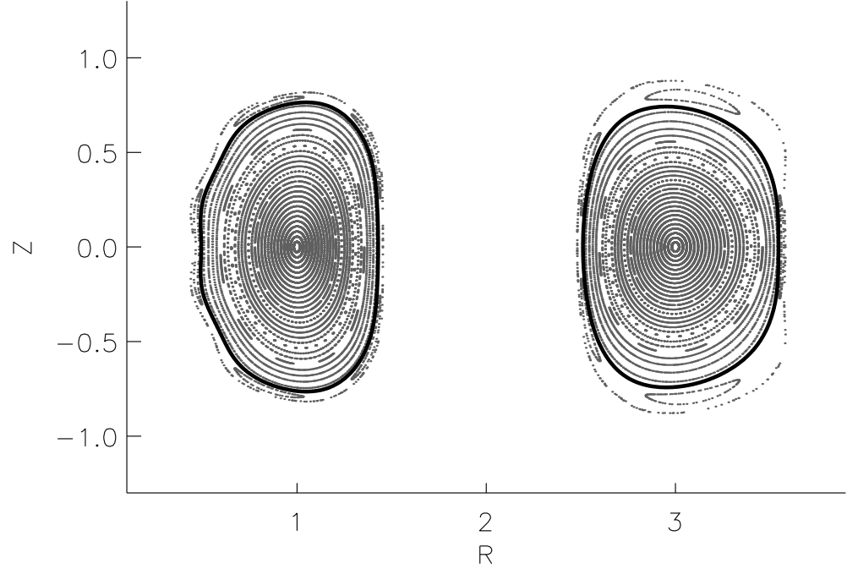
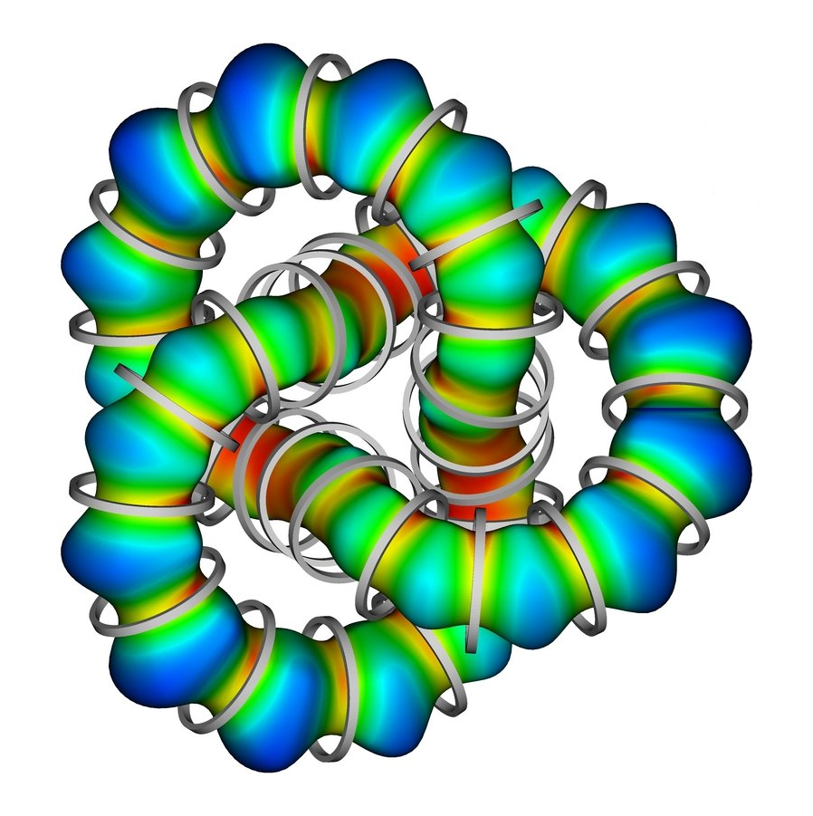
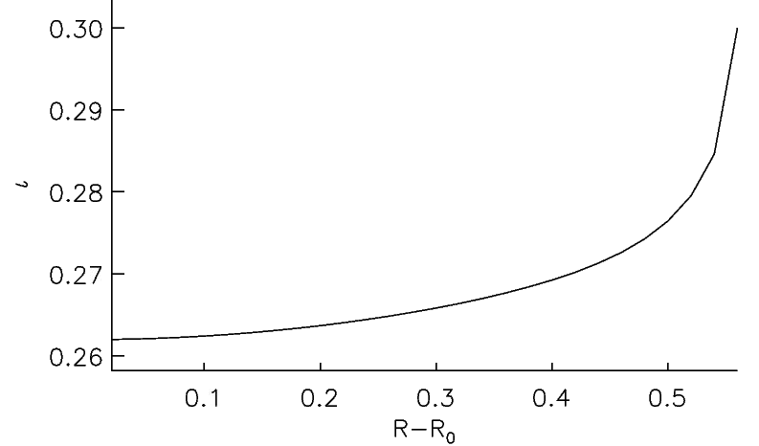
Example: (2,3) torus knotatron
A flux surface in a (2,3) torus-knotatron
with 36 circular coils.
The color indicates |B|.
Poincaré plot
cylindrical coordinates
rotational-transform

Slide 12
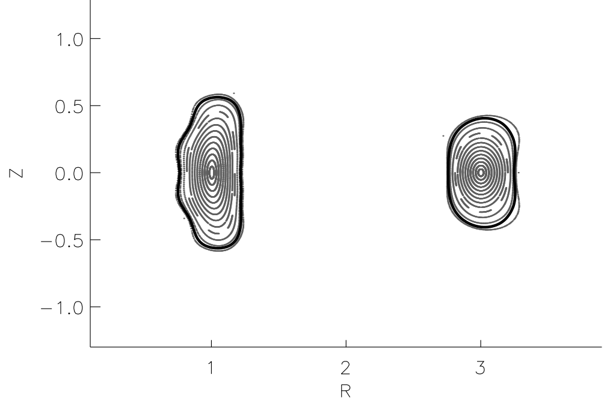
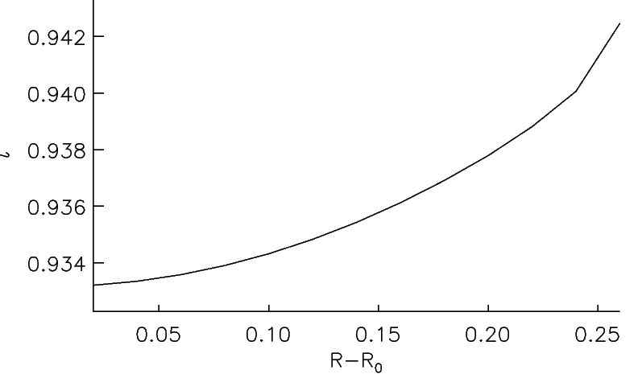
Example: (2,5) torus knotatron

Slide 13
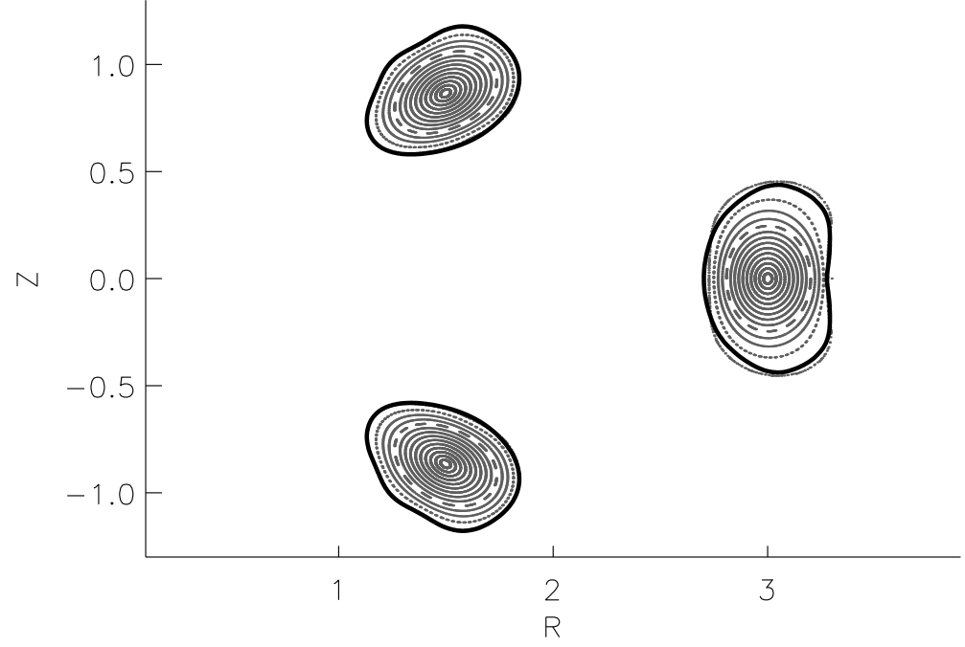
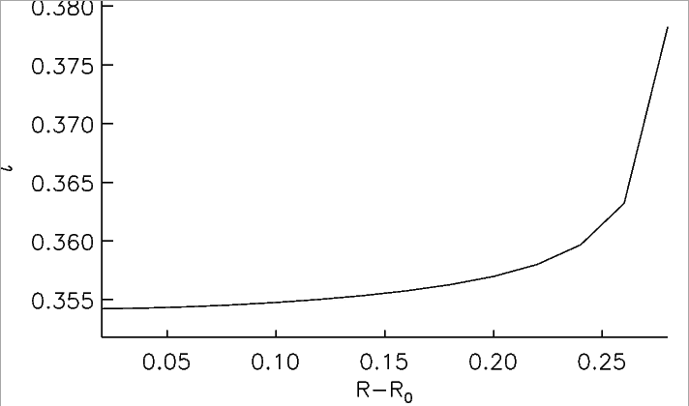
Example: (3,5) torus knotatron

Slide 14
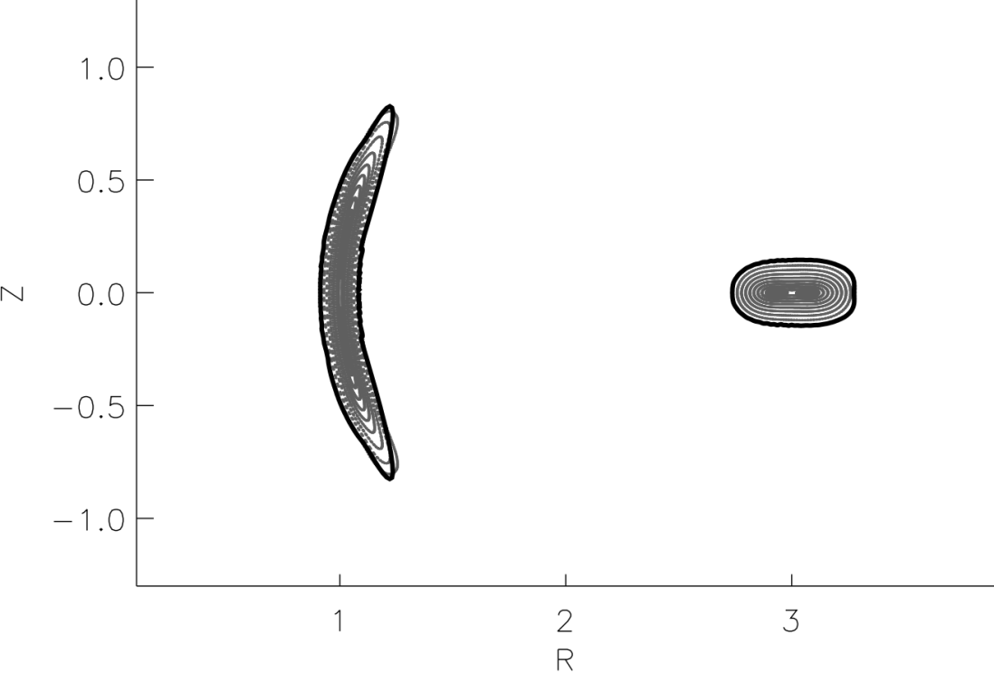
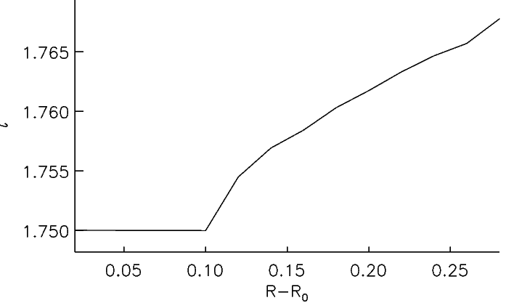
Example: (2,7) torus knotatron

Slide 15
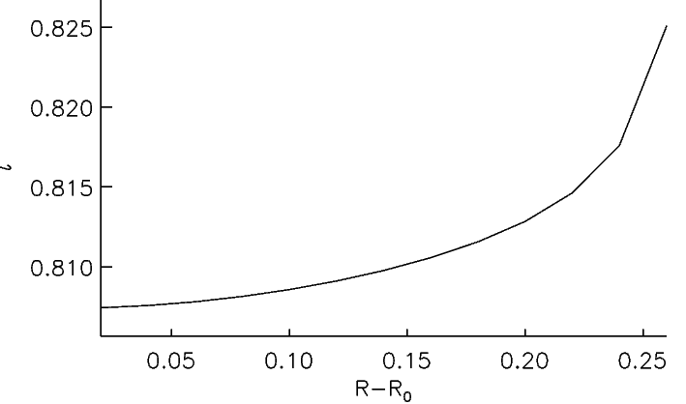
Example: (3,7) torus knotatron

Slide 16
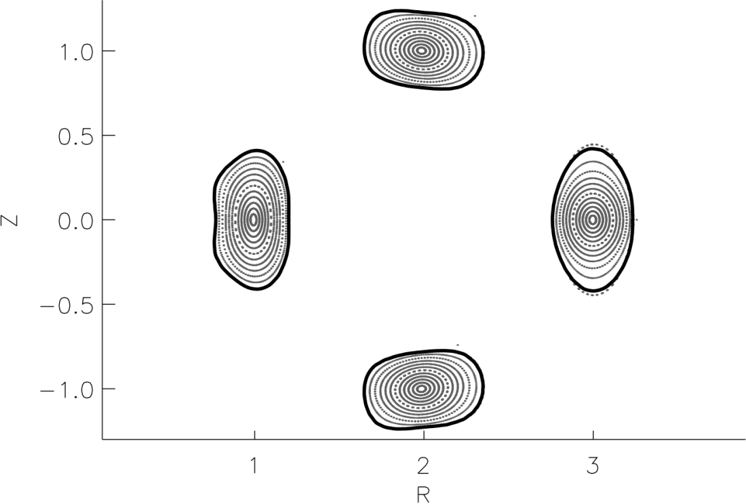
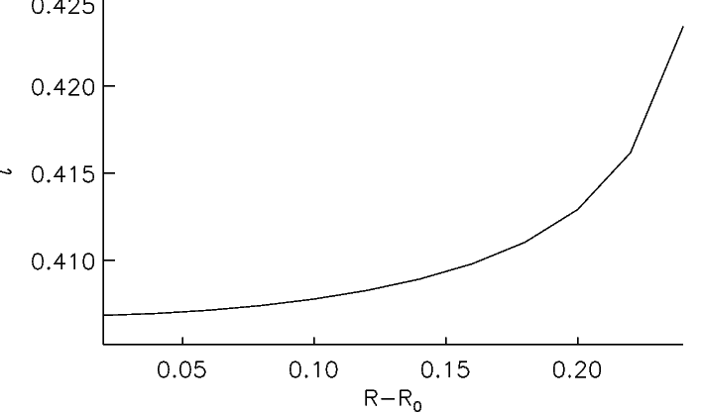
Example: (4,7) torus knotatron

Slide 17
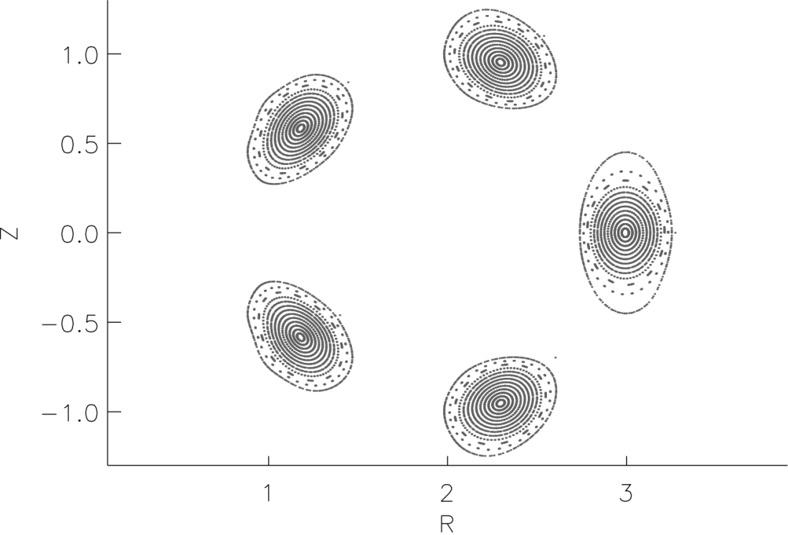
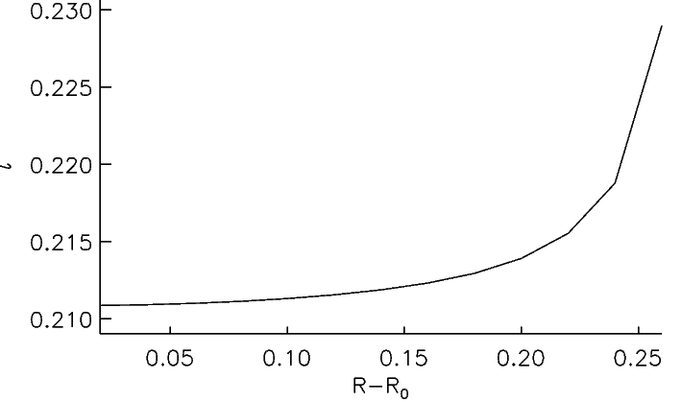
Example: (5,7) torus knotatron

Slide 18
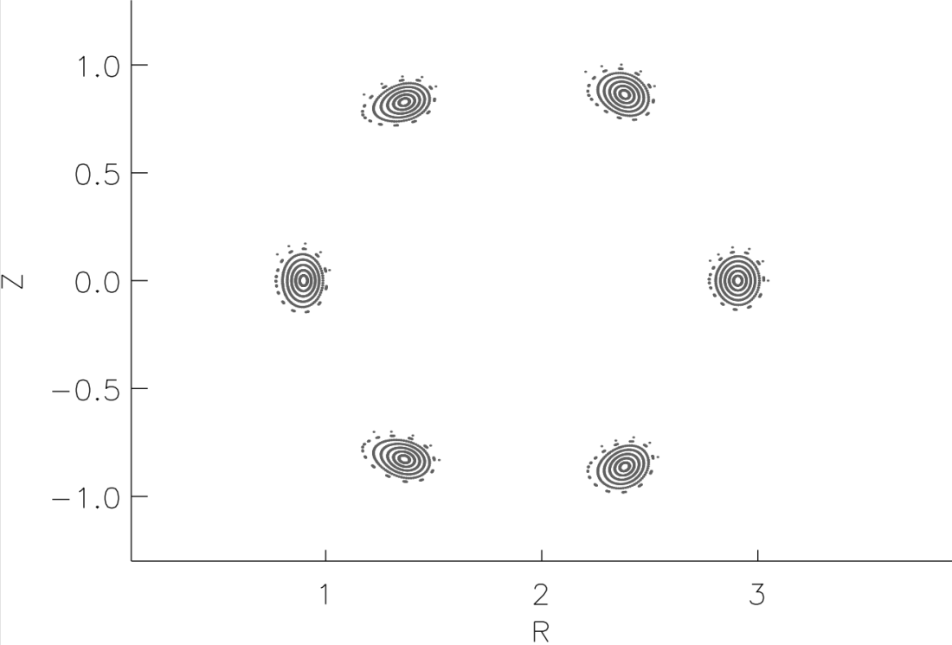
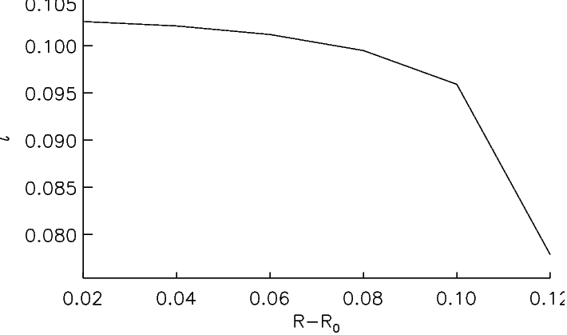
Example: (6,7) torus knotatron

Slide 19
The knotatron is a new class of stellarator. Both tokamaks & stellarators are unknotatrons.
A knotatron is a magnetic confinement device with a magnetic axis that is ambient isotopic to a knot.
The confining magnetic field in a knotatron is produced by currents external to the plasma. Thus, the knotatron is a new example of a stellarator.
Tokamaks, conventional stellarators have magnetic axes that are ambient isotopic to the circle. The circle is ambient isotopic to the trivial knot, which is called the unknot.
Tokamaks, conventional stellarators are unknotatrons.

Slide 20
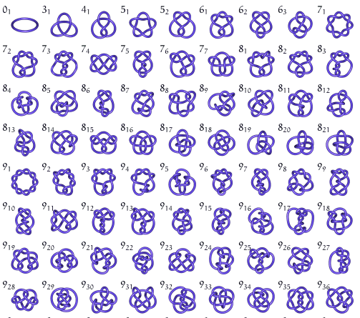
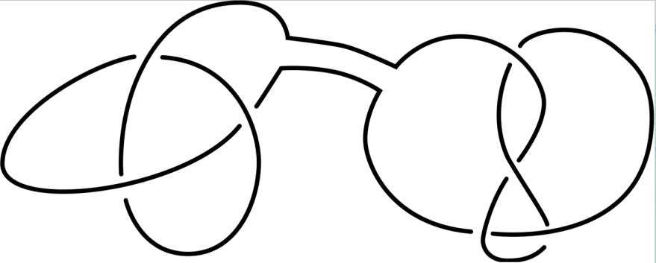
There is a seemingly infinite variety of knots. Composite knots are formed from simple knots.
composition of knots
and many more . . . . . . . . . .
Is there a knot that is optimal for confinement?

Slide 22
Does the knotatron have advantages?
It is not known if knotatrons have advantages over conventional stellarators.
Knotatrons will probably have stability and transport properties similar to stellarators.
Modern stellarators must be carefully designed to have favorable properties.
A greater variety of geometrical shapes are allowed in the knotatron class.
Equilibrium, stability and transport studies will be needed to explore the properties of knotatrons.
Stellarator design algorithms could be used to search for knotatrons with favorable properties.
Is there a quasi-symmetric knotatron?

Slide 23
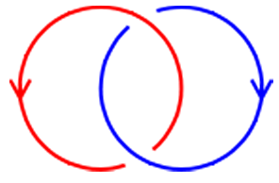
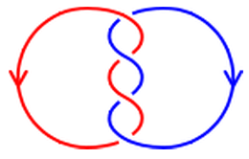
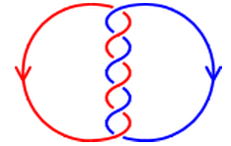
The helicity integral measures the “linked-ness” of a magnetic field.
How many times do two closed curves link each other?
How ‘linked’ is a magnetic field?
Does the theory of knots and links play a role in plasma confinement?
Taylor Relaxation: weakly resistive plasmas will relax to minimize the energy, but the plasma cannot easily “unlink” itself i.e. constraint of conserved helicity

Slide 24
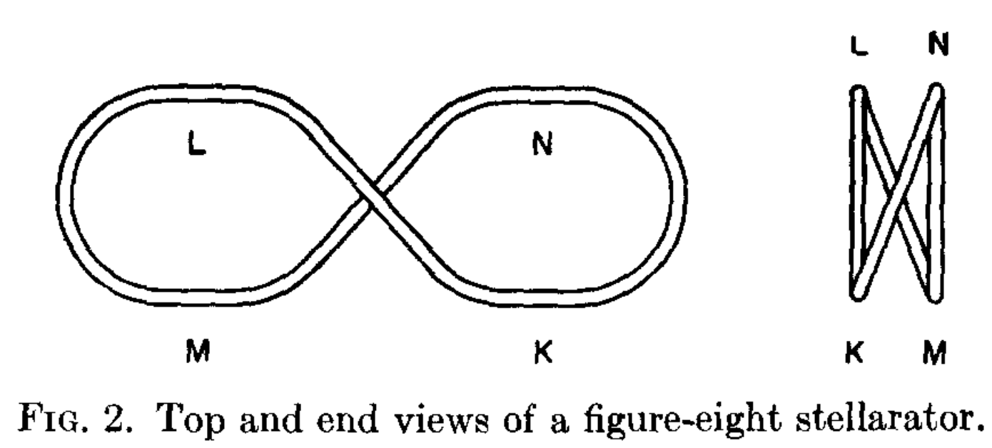
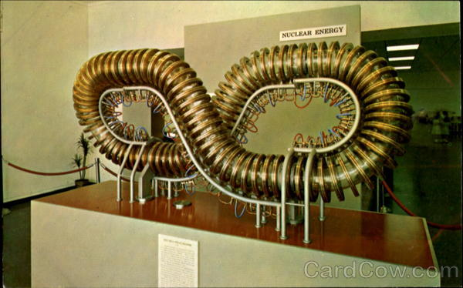
The figure-eight stellarator
Spitzer, 1958

