Slide 1
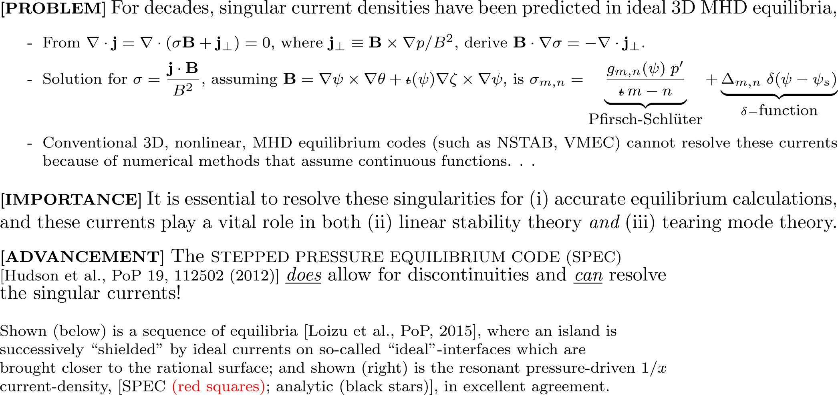
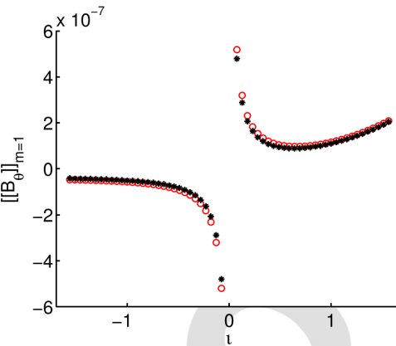
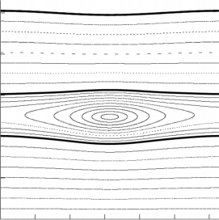
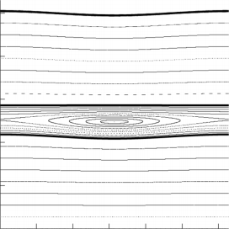
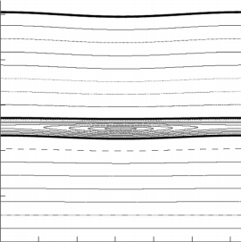
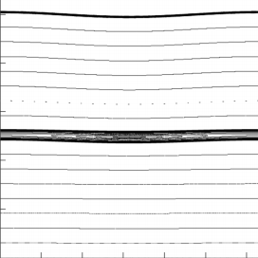
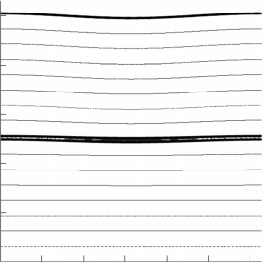
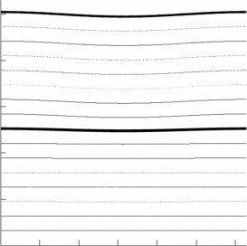
Accurate calculation of Singular Current Densities
in non-linear, ideal MHD equilibrium solutions
Max-Planck-Institut fur Plasmaphysik (Dr. J. Loizu) & Princeton Plasma Physics Laboratory (Dr. S.R. Hudson)
constant perturbed boundary
fully “relaxed” island,
no singular currents.
fully “shielded” state,
no island.

