Slide 1
Ghost-surfaces and island detection.
S.R.Hudson
Abstract
Various routines for
constructing quadratic-flux minimizing surfaces & ghost surfaces,
estimating island widths,
locating the homoclinic tangle, homoclinic points,
identifying the last closed flux surface,
locating cantori, flux across cantori,
almost straight fieldline coordinates for arbitrary, non-integrable fields,
have now been incorporated into HINT2, SPEC (of course), M3D-C1, . . .
This poster is online at http://w3.pppl.gov/~shudson/Papers/Conference/2015Sherwood/Hudson2015SherwoodCEMM.pdf

Slide 2
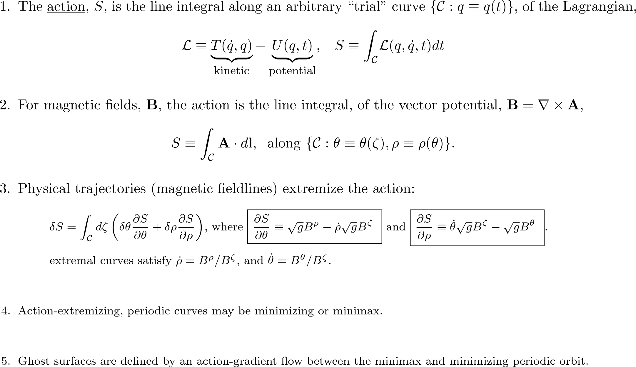
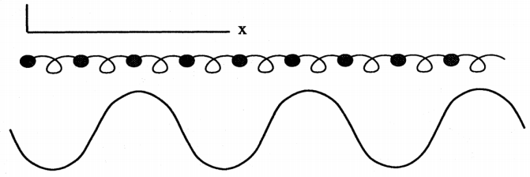
Classical Mechanics 101:
The action integral is a functional of a curve in phase space.

Slide 3
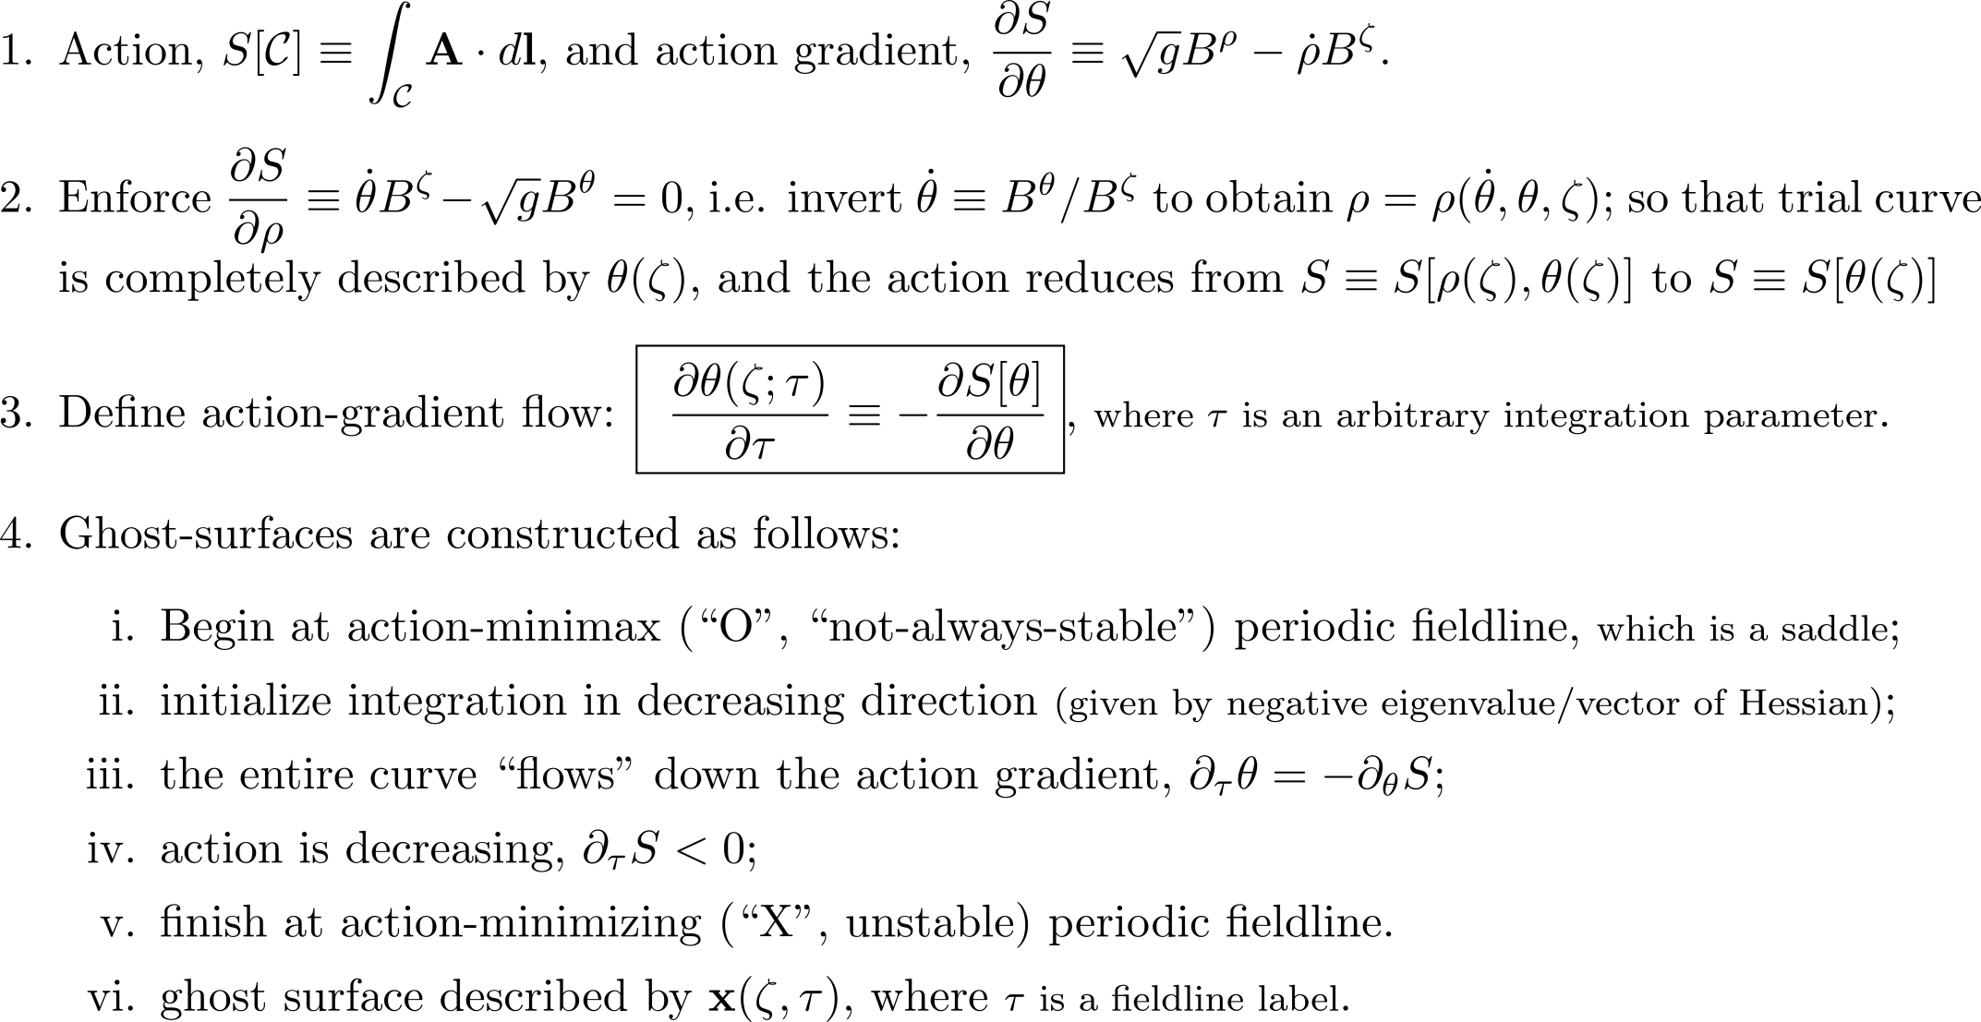
Ghost surfaces, a class of almost-invariant surface, are defined by an action-gradient flow between the action minimax and minimizing fieldline.

Slide 4
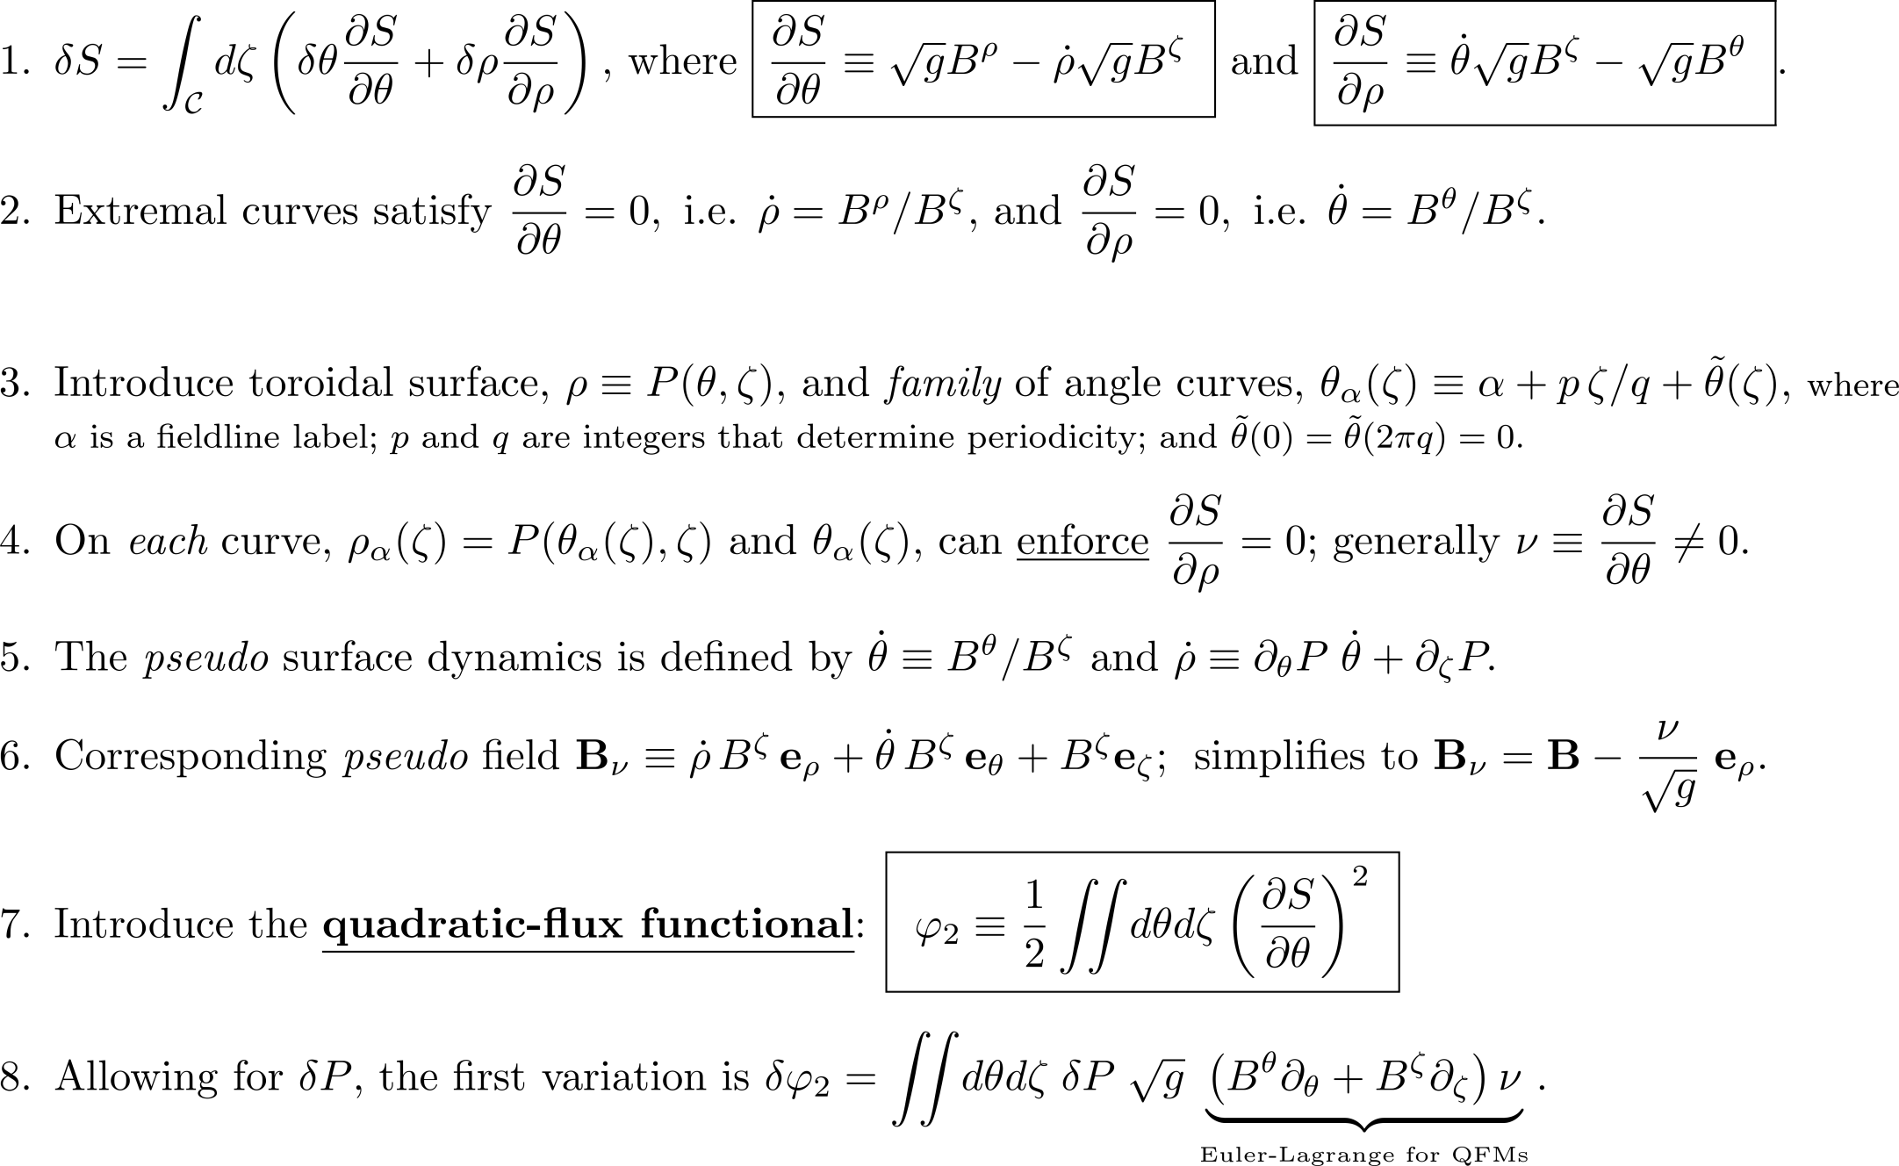
The construction of extremizing curves of the action
generalized extremizing surfaces of the quadratic-flux

Slide 5
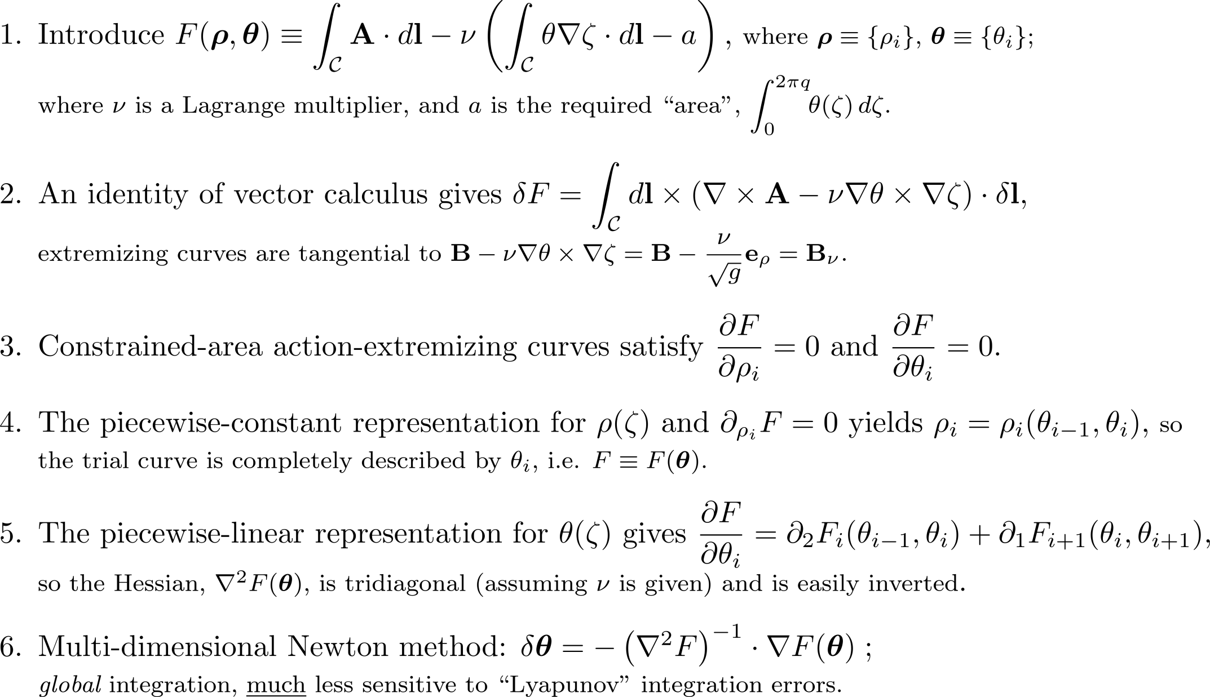
Alternative Lagrangian integration construction:
QFM surfaces are families of extremal curves of the
constrained-area action integral.

Slide 6
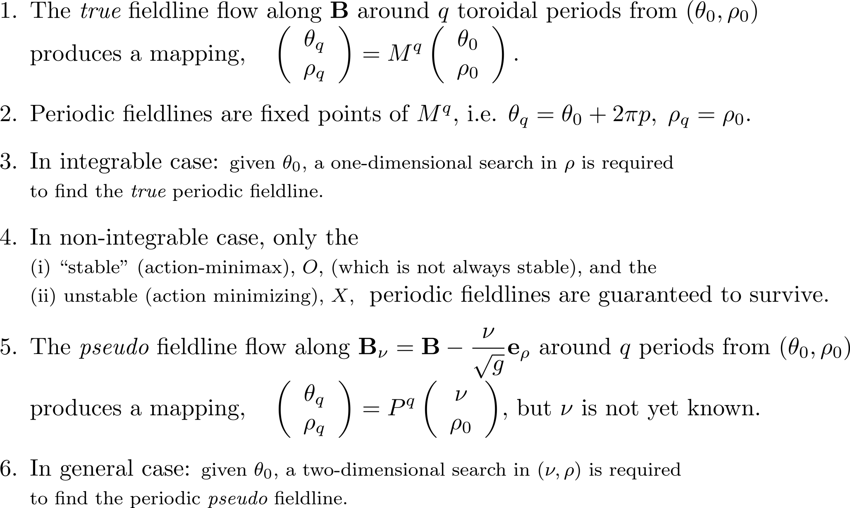
The action gradient, ν, is constant along the pseudo fieldlines; construct Quadratic Flux Minimzing (QFM) surfaces by pseudo fieldline (local) integration.

Slide 7
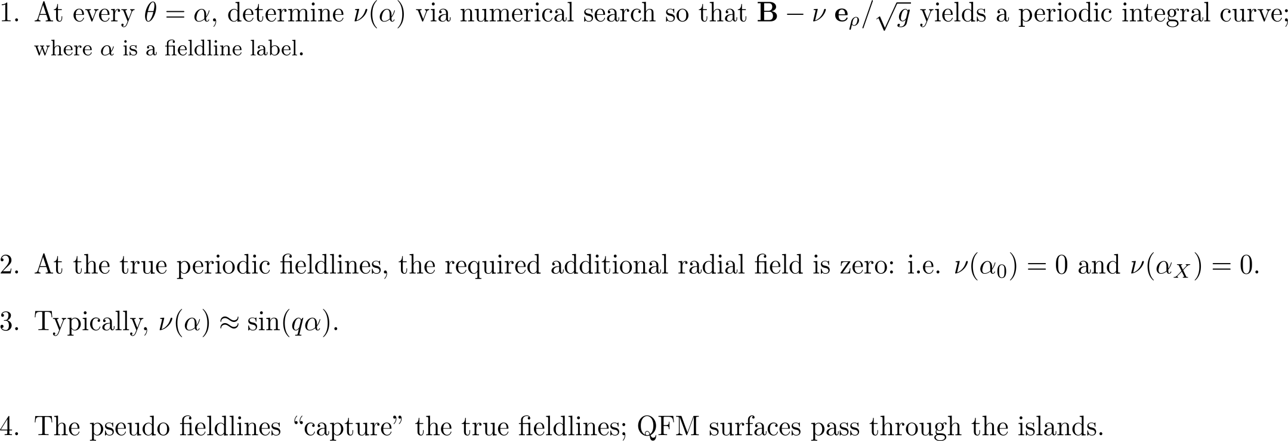
Lagrangian integration is sometimes preferable,
but not essential:
can iteratively compute radial “error” field
0. Usually, there are only the “stable” periodic fieldline and the unstable periodic fieldline,
true fieldlines
ρ
poloidal angle, θ
pseudo fieldlines

Slide 8
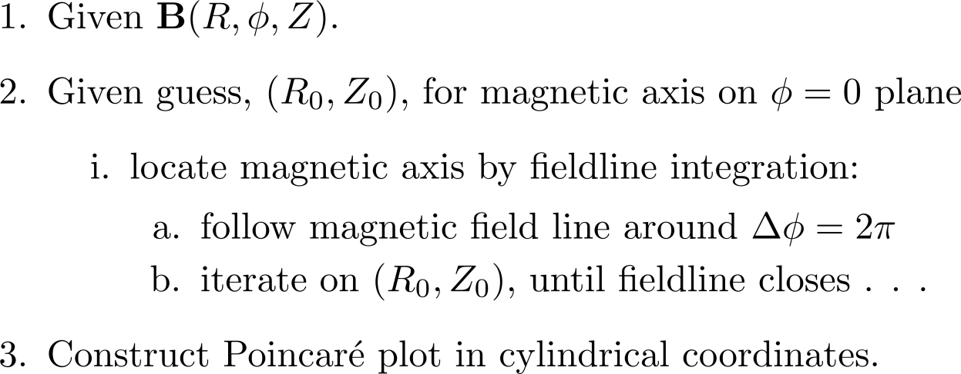
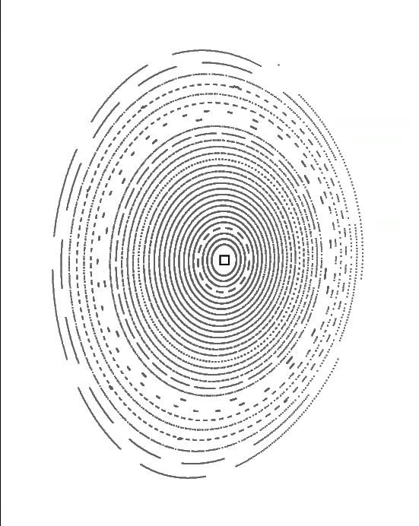
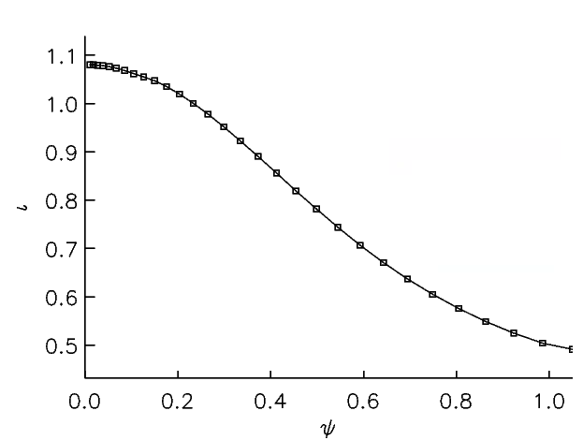
Algorithm
Step 1: start with some magnetic field, in this case provided by M3D-C1, in cylindrical coordinates . . .

Slide 9
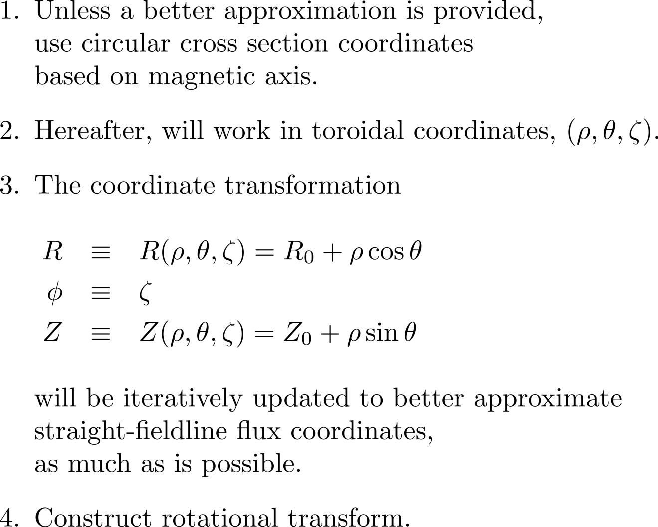
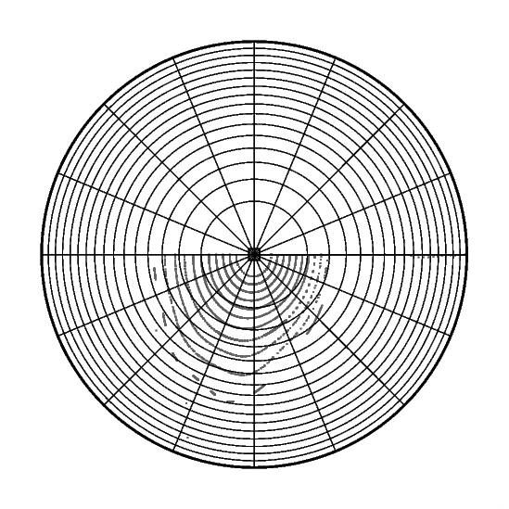
Algorithm
Step 2: construct initial set of toroidal coordinates

Slide 10
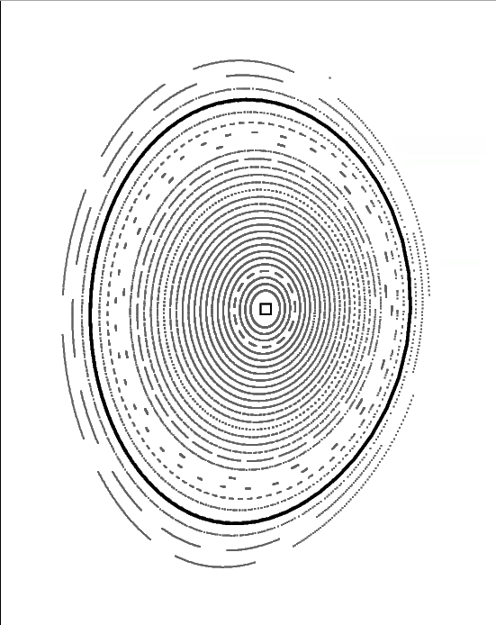
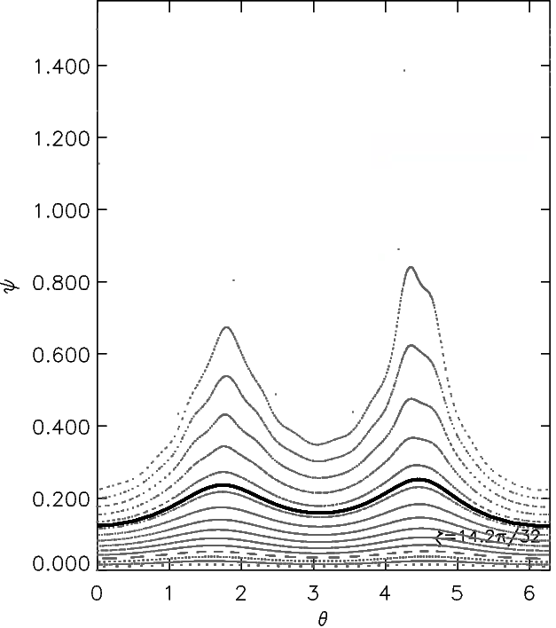
Algorithm
Step 3: construct rational pseudo-surface

Slide 11
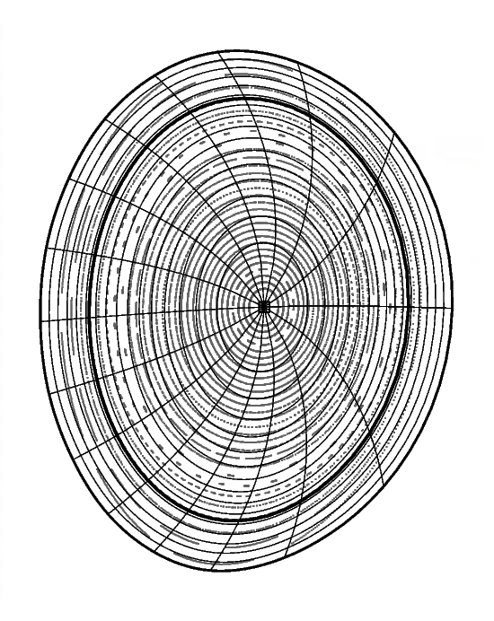
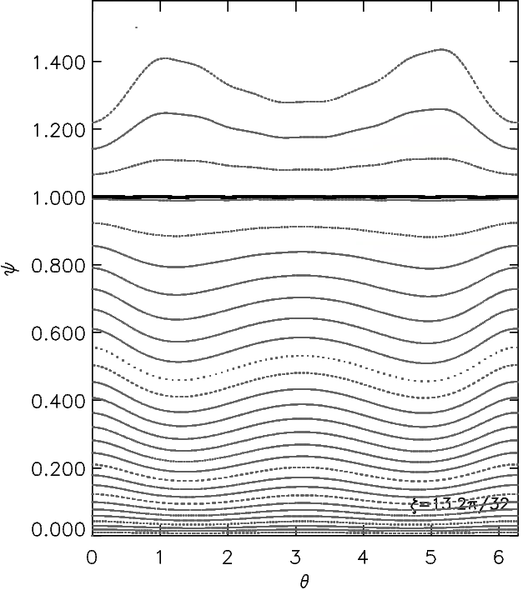
Algorithm
Step 3: update toroidal coordinates

Slide 12
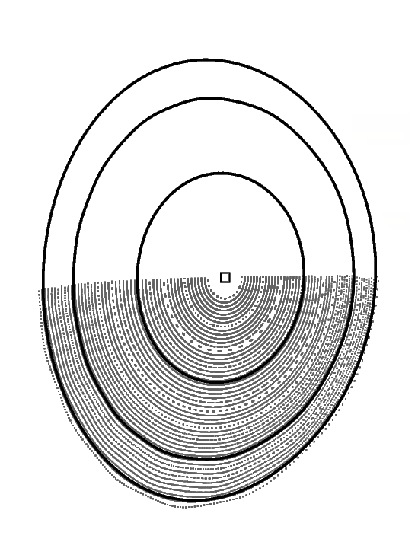
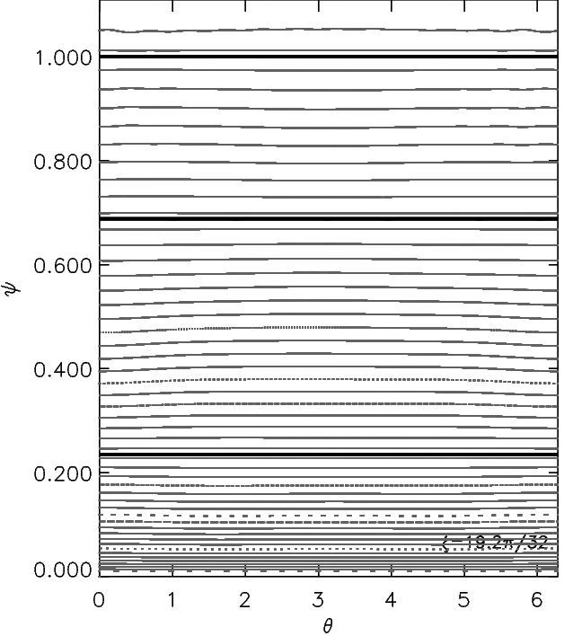
Algorithm
Step 3: repeat:

Slide 13
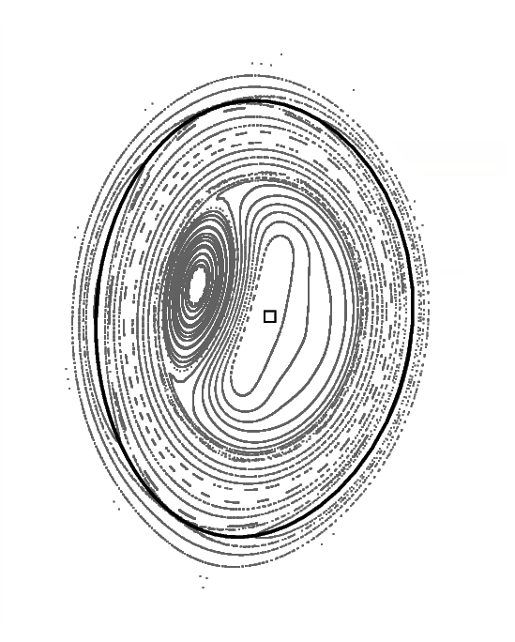
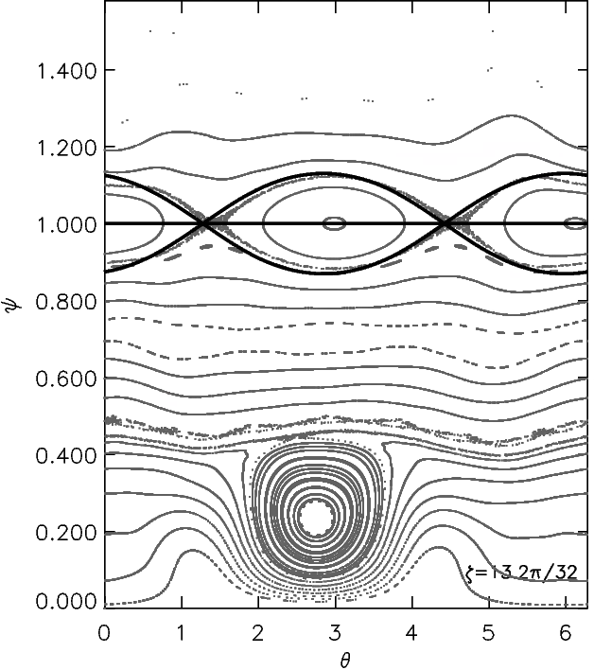
Algorithm
Step 3: repeat:
Given the
“rational surface”,
and shear,
it is easy
to determine
the island separatrix.
(1,1) sawteeth

Slide 14
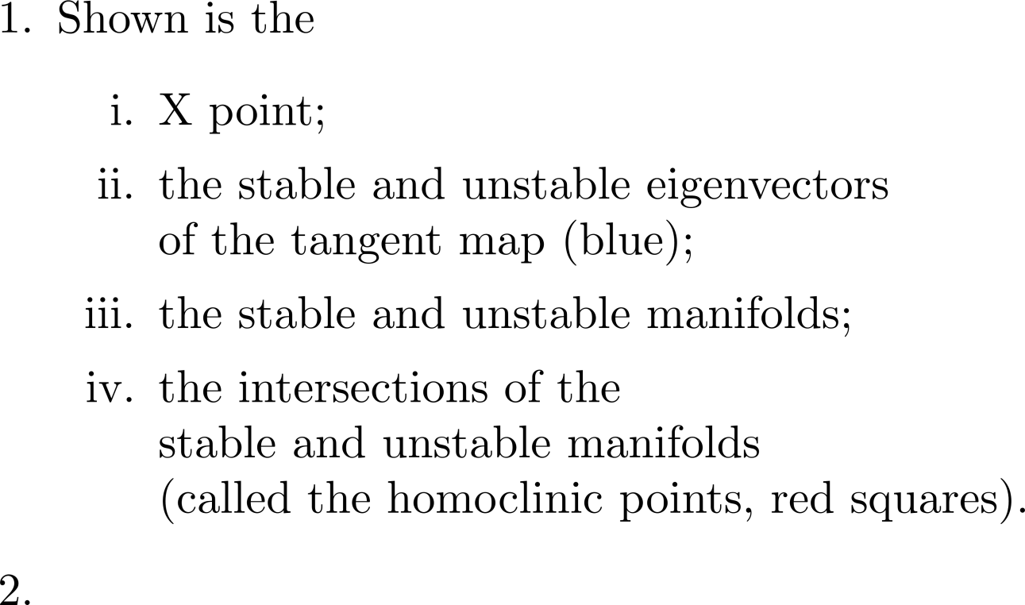
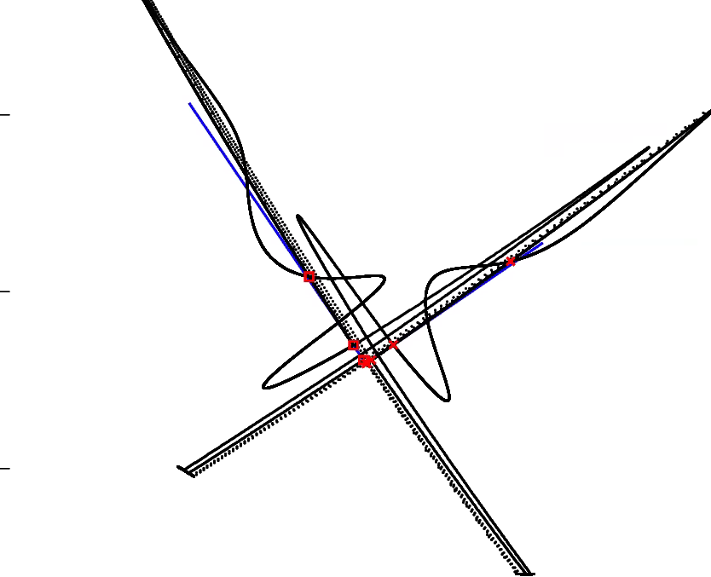
Can also construct separatrix/homoclinic tangle

Slide 15
Plan is to construct a flexible library of routines to be made freely available.
(No two users ever seem to want the same thing!)
Usually, I like to use the magnetic axis as the coordinate axis, but this has problems when “sawteeth” are present;
coordinate axis = magnetic axis is now a user option.
Usually, I like to construct the magnetic vector potential and introduce an almost-straight fieldline angle;
but sometimes it is better to work directly with the cylindrical field provided.
The separatrix is a singularity in straight fieldline coordinates;
under construction.
Plan is to construct a collection of subroutines that can be used for a variety of purposes;
I plan to visit NIFS this summer and continue to develop these routines . . .

Slide 16
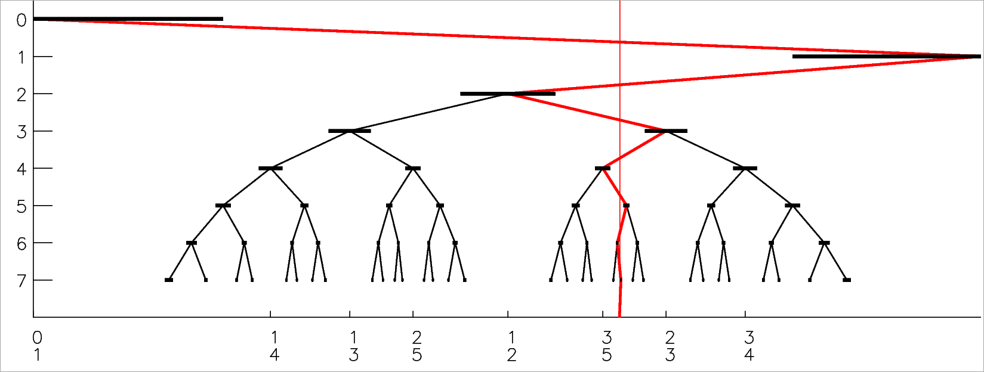
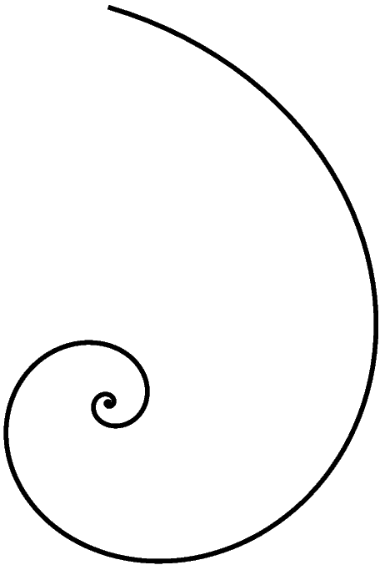
The structure of phase space is related to the structure of rationals and irrationals.
THE FAREY TREE;
or, according to Wikipedia,
THE STERN–BROCOT TREE.
alternating path→
(excluded region)
←alternating path
→
←
→

Slide 17
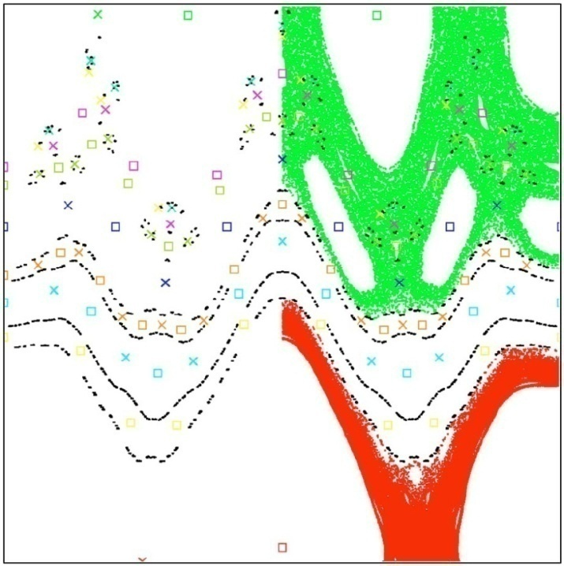
Irrational KAM surfaces break into cantori when perturbation exceeds critical value. Both KAM surfaces and cantori restrict transport.
KAM surface
delete middle third
complete barrier
→∞
Cantor set
→ gap ←
partial barrier
KAM surfaces are closed, toroidal surfaces
that stop radial field line transport
Cantori have “gaps” that fieldlines can pass through;
however, cantori can severely restrict radial transport
Example: all flux surfaces destroyed by chaos,
but even after 100 000 transits around torus
the fieldlines don’t get past cantori !
Regions of chaotic fields can provide some
confinement because of the cantori partial barriers.
“noble”
cantori
(black dots)
← radial coordinate →

Slide 18
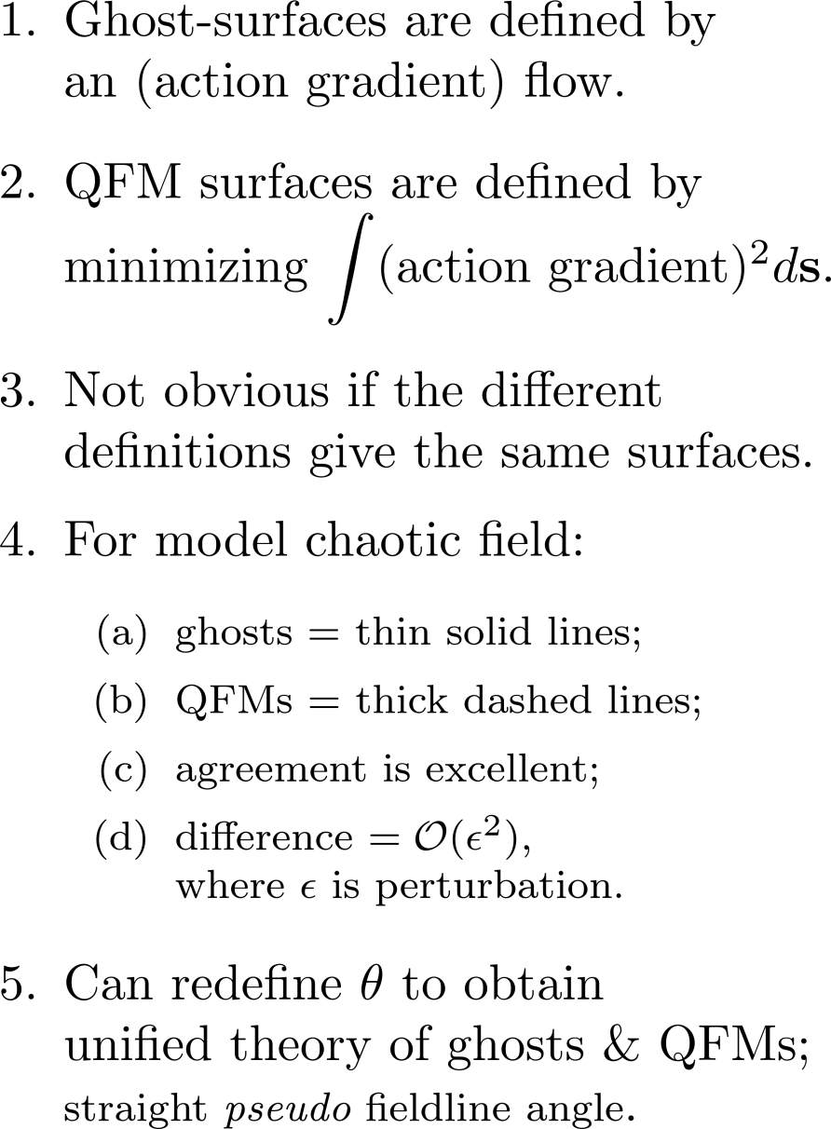
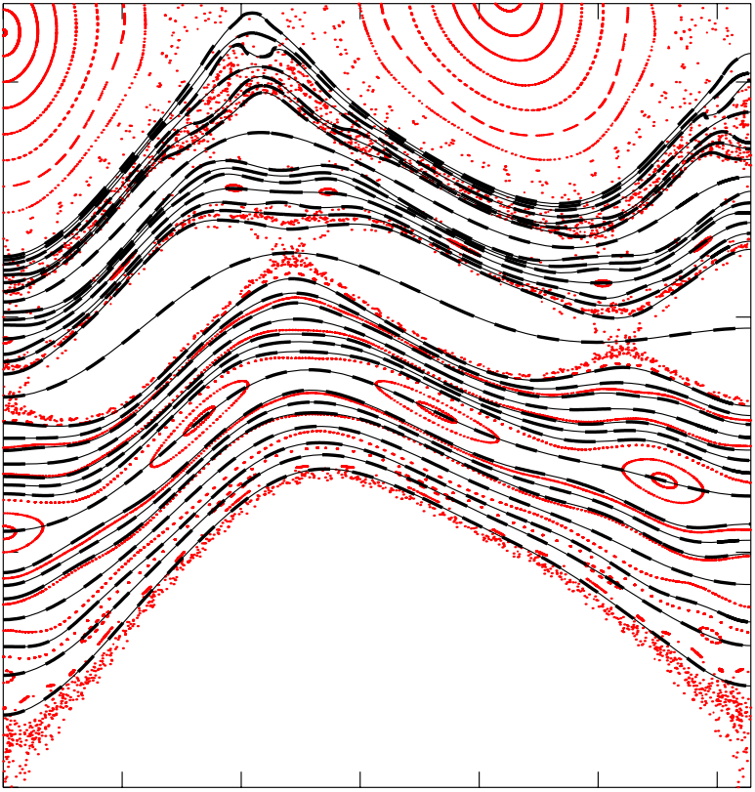
Ghost surfaces are (almost) indistinguishable from QFM surfaces
can redefine poloidal angle to unify ghost surfaces with QFMs.

Slide 19
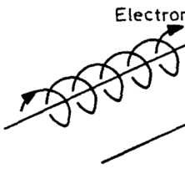
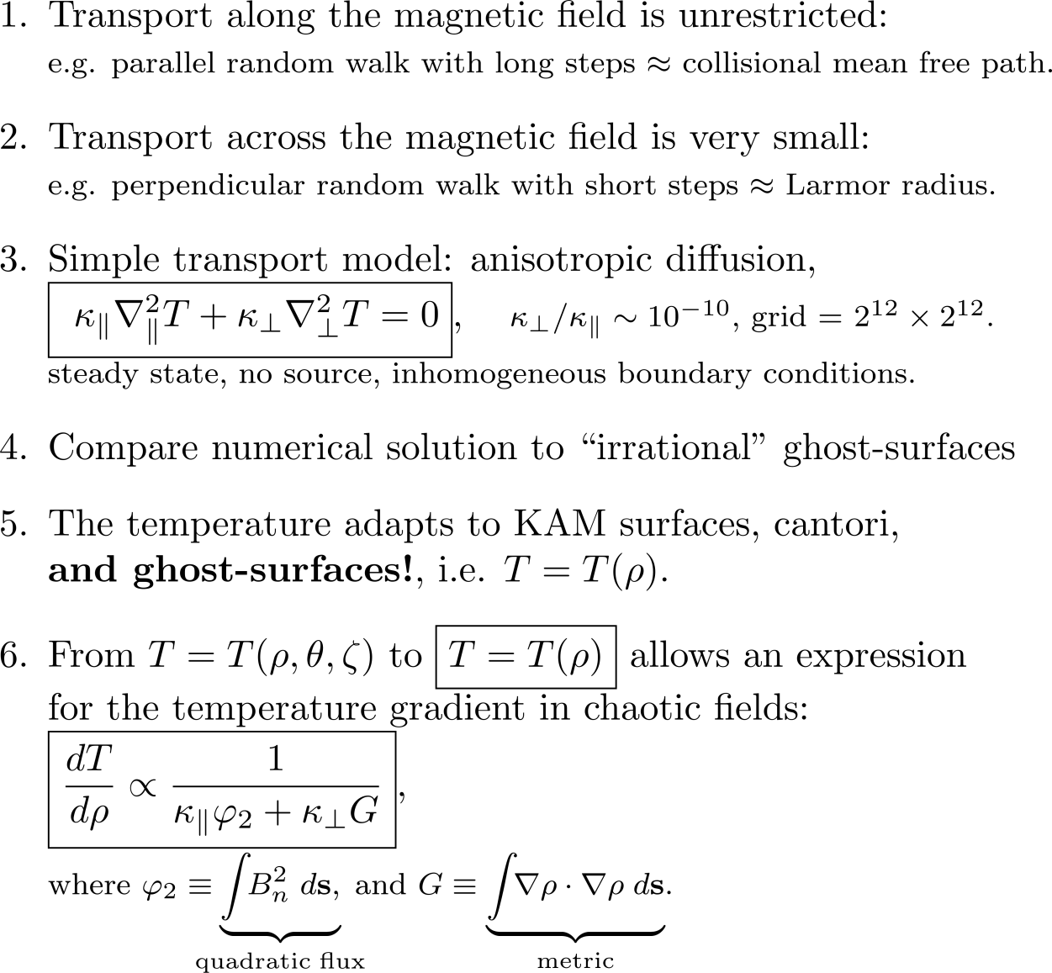
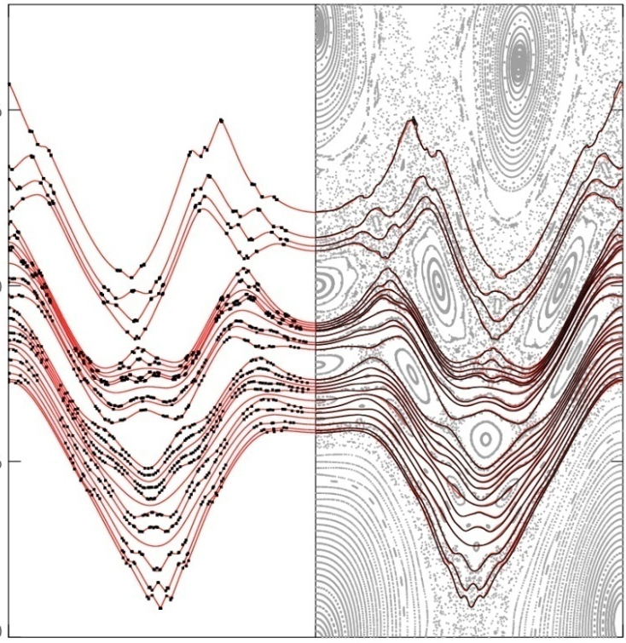
Isotherms of the steady state solution to the anisotropic diffusion coincide with ghost surfaces;
analytic, 1-D solution is possible.
free-streaming along field line
particle “knocked”
onto nearby field line
ghost-surface
cold
ghost-surface
isotherm
[Hudson & Breslau, 2008]
hot

