Slide 1
PP11.00062
Multiregion Relaxed MHD toroidal states with flow
Robert L Dewar^{1,2}, Zhisong Qu¹, Naoki Sato³, Stuart Hudson⁴, Matthew J. Hole¹, Joshua W. Burby²
¹Australian Natl Univ, ²MSRI Berkeley, ³Kyoto University, ⁴Princeton Plasma Phys Lab
Abstract
The action-based formulation [1] of Multiregion Relaxed MHD (MRxMHD) encompasses both steady-flow statics, and dynamics on a slower timescale than Taylor relaxation. An extension of the 3D-MRxMHD-based equilibrium code SPEC3 to allow plasma flow with reasonably general flow profiles is now under development, but the formulation of Ref. 1, which describes the plasma in each region as an ideal Euler fluid is too general for practical purposes as it allows all the turbulent complexity of such a fluid. This motivates seeking a relaxation model for fluids that maintains compatibility with ideal-MHD flow-equilibrium theory, at least in the axisymmetric limit.
[1] R.L. Dewar, Z. Yoshida, A. Bhattacharjee and S.R. Hudson, J. Plasma Phys., 81, 515810604-1–22, (2015).
Support
Australian Research Council Discovery Grant DP170102606
Mathematical Sciences Research Institute, Berkeley CA, under National Science Foundation Grant DMS-1440140

Slide 2
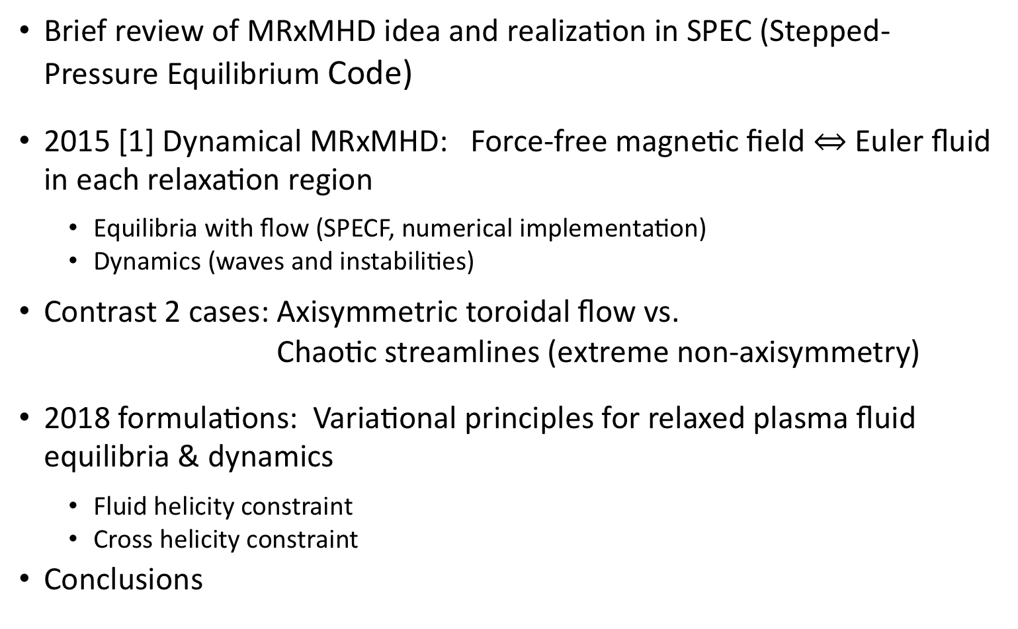
Plan of poster
Brief review of MRxMHD idea and realization in SPEC (Stepped-Pressure Equilibrium Code)
2015 [1] Dynamical MRxMHD: Force-free magnetic field $⇔$ Euler fluid in each relaxation region
  Equilibria with flow (SPECF, numerical implementation)
  Dynamics (waves and instabilities)
Contrast 2 cases: Axisymmetric toroidal flow vs.
Chaotic streamlines (extreme non-axisymmetry)
2018 formulations: Variational principles for relaxed plasma fluid equilibria & dynamics
  Fluid helicity constraint
  Cross helicity constraint
Conclusions

Slide 3
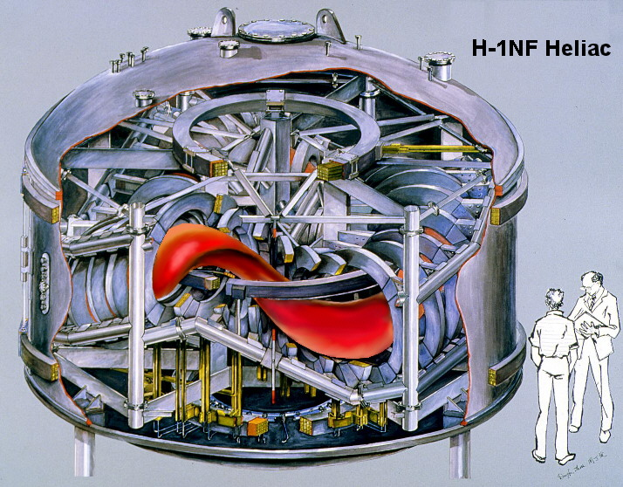
MRxMHD: M stands for Multi-region (aka waterbag); Rx stands for (Taylor) Relaxed; MH for Magneto-Hydro; D stands for Dynamics
Some abbreviations
“2D” = possessing a continuous symmetry, giving integrable magnetic field
e.g axisymmetric Tokamaks (without Resonant Magnetic Perturbations = RMPs):
“3D” = no continuous symmetry, allowing field-line chaos and islands
e.g. non-axisymmetric Stellarators (without quasisymmetry?)

Slide 4
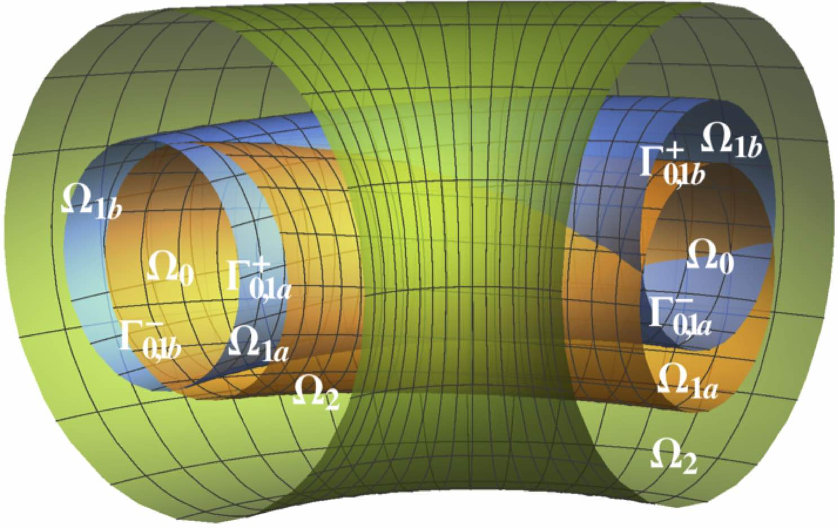
Multiregion MHD concept
Aim: Simplest ideal-like MHD model that works in 3D
Confinement is maintained by thin transport barriers (interfaces) Γ_{i,j} dividing the plasma into toroidal sub-regions Ω_{i}
Force balance across interfaces Γ_{i,j} allows stepped pressure (& flow) profiles
Within the sub-regions Ω_{i}, use force-free magnetic fields, so no jXB force — field and fluid are decoupled
Dual goals
  Numerical: well-posed “smart finite element” discretization for fast, convergent calculations
  Theoretical: MHD model allowing islands, chaos & flow in 3D equilibria and dynamics
Flexible geometry: Interfaces not necessarily simple tori –may be separatrices of magnetic & fluid islands (“Kelvin’s cat’s eyes”)

Slide 5

MRxMHD implemented in SPEC
Stepped-Pressure (static) Equilibrium code (SPEC) has already demonstrated convergence, utility for data fitting, and physics interpret-ation of helical axis bifurcations in RFX.
pressure p
q = 2 island
safety factor q
q = 3 island
surface $ψ$
Challenge now is to include flow.
SPEC reconstruction of DIIID RMP equilibrium using many interfaces constructed using highly irrational q using a Farey tree algorithm: Hudson et al PoP 2012

Slide 6
2015 MRxMHD theory
Generalize Taylor-type minimum energy equilibrium approach by instead extremizing the MHD action (Hamilton’s Principle). Details in [1] Dewar et al, J. Plasma Phys. 2015:
Full ideal-MHD constraints apply only within the interfaces Γ_{i,j}
Within the sub-regions Ω_{i} relax nearly all the ideal-MHD constraints except for conservation of macroscopic magnetic helicity, entropy, and microscopic mass
Cross-helicity not constrained, so fluid and magnetic field couple only at interfaces, which are current/vortex sheets

Slide 7
kinetic energy – MHD potential energy + Lagrange multiplier constraint terms:
2015 theory derived from MRxMHD Lagrangian:
MHD Lagrangian density in region i
Helicity and entropy macroscopic invariants
Constrained Lagrangian in region i
Form MRxMHD action integral:
Physics given by Euler-Lagrange equations.

Slide 8
2015 Euler-Lagrange dynamical equations
(NB Mass conservation is built in holonomically)
δp in Ω_{i} ➮ Isothermal equations of state in relaxed regions:
δA in Ω_{i} ➮ Beltrami equations in relaxed regions: :
Taylor relaxed B — simple (but no coupling to v)
ξ in $Ω_{i}$ ➮ Momentum equations in relaxed regions: :
Euler fluid v (no coupling to B but, even so, full fluid dynamics is not simple but will consider some simple test cases)
ξ on $Γ_{i,j}$ ➮ Force balance across interfaces: $\left[\frac{B^{2}}{2μ_{0}}+p\right]|_{i,i+1}=0$
NB Centrifugal force balance does not appear explicitly — mediated by pressure

Slide 9
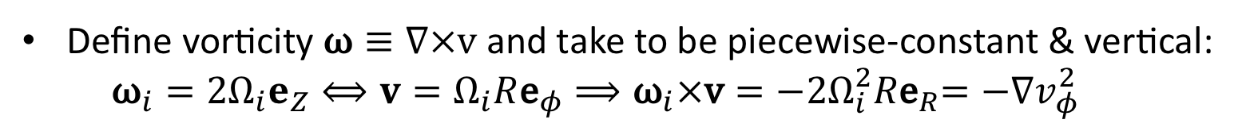


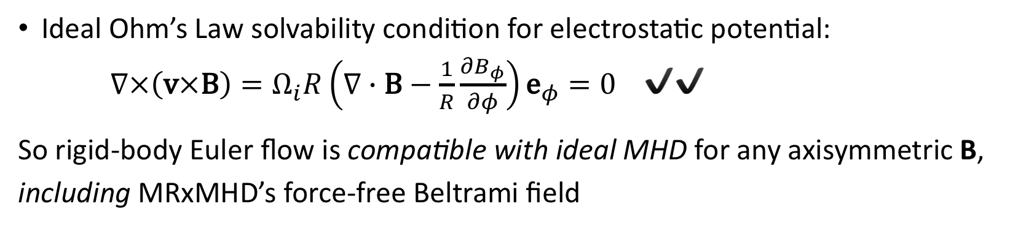
Define vorticity $\text{ω}≡∇×\text{v}$ and take to be piecewise-constant & vertical:
${\text{ω}}_{i}={2Ω}_{i}e_{Z}⟺v=Ω_{i}R{\text{e}}_{φ}⟹{\text{ω}}_{i}×\text{v}={−{2Ω}_{i}^{2}R\text{e}}_{R}=−∇v_{φ}^{2}$
A steady axisymmetric (2D) toroidal Euler flow sol^{n}
Steady toroidal Euler flow momentum equation:
$$ω×v+∇\left(\frac{v_{φ}^{2}}{2}+ln\frac{ρ}{ρ_{0}}\right)=0$$
Gives Bernoulli equation $−\frac{v_{φ}^{2}}{2}+ln\frac{ρ}{ρ_{0}}=0$: in agreement with, e.g., McClements & Hole, Phys. Plasmas 17, 082509 (2010)’s ideal MHD result ✔️
Ideal Ohm’s Law solvability condition for electrostatic potential:
$∇×\left(\text{v}×\text{B}\right)=Ω_{i}R\left(∇∙\text{B}−\frac{1}{R}\frac{∂B_{φ}}{∂φ}\right){\text{e}}_{φ}=0$ ✔️✔️
So rigid-body Euler flow is compatible with ideal MHD for any axisymmetric B, including MRxMHD’s force-free Beltrami field

Slide 10
Seek general static solution of Compressible Euler Fluid equation. in arbitrary toroid Ω (Sato & Dewar 2017 https://arxiv.org/pdf/1708.06193.pdf):
A non-axisymmetric (3D) steady Euler flow sol^{n}
Dot momentum equation
with and integrate to give Bernoulli equation on each flow line:
Only solution valid for arbitrarily chaotic flow within Ω is (with suitable choice of global constant)
So most general steady 3D toroidal flow obeys a nonlinear Beltrami equation:

Slide 11
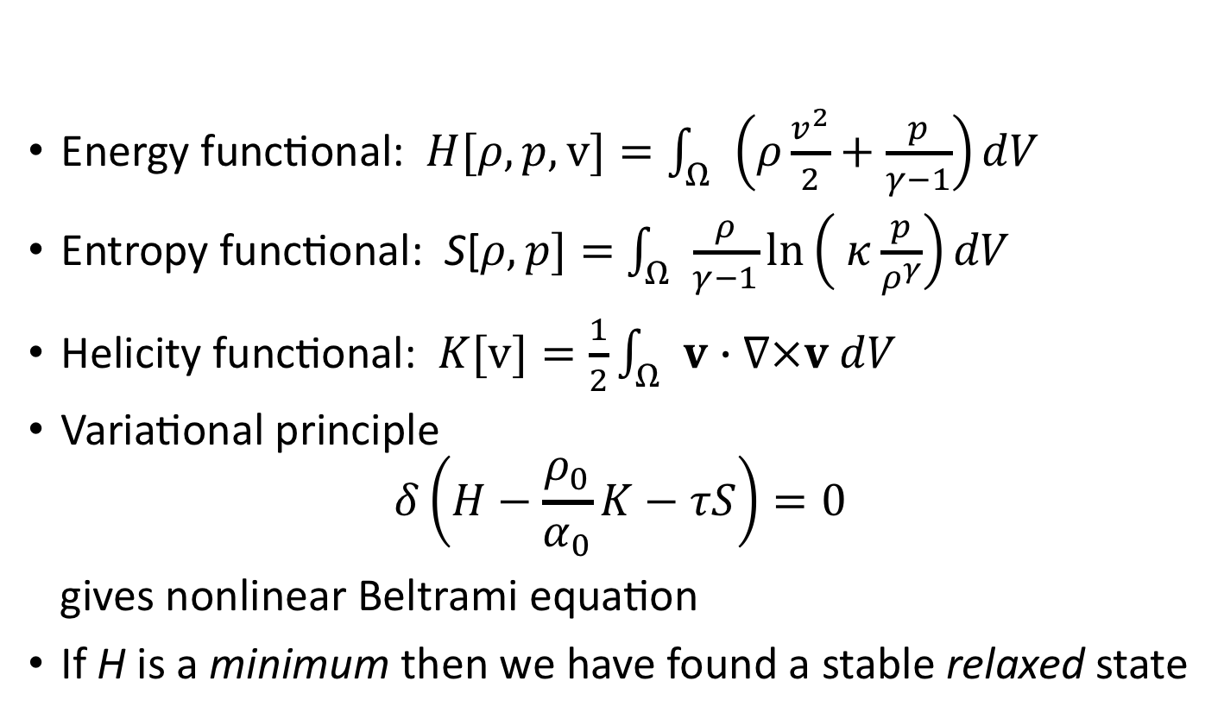
Nonlinear Beltrami from fluid energy relaxation
Extremize energy with entropy and fluid vorticity constraints:
Energy functional: $H[ρ,p,v]=\int_{Ω}{\left(ρ\frac{v^{2}}{2}+\frac{p}{γ−1}\right)dV}$
Entropy functional: S[$ρ,p]=$ $\int_{Ω}{\frac{ρ}{γ−1}ln\left( κ\frac{p}{ρ^{γ}}\right)dV}$
Helicity functional: $K[v]=\frac{1}{2}\int_{Ω}{v∙∇×v dV}$
Variational principle
$$δ\left(H−\frac{ρ_{0}}{α_{0}}K−τS\right)=0$$
gives nonlinear Beltrami equation
If H is a minimum then we have found a stable relaxed state

Slide 12

Problem: Incompatibility of 2D & 3D solutions
2D and 3D examples both satisfy Euler flow equations, but are very different:
Relaxed (3D Beltrami) fluid solution: vorticity parallel to flow
Rigid toroidal flow 2D solution: vorticity perpendicular to flow
Toroidal kinetic energy terms in Bernoulli
equations have opposite signs in the two solns.
Unlike rigid toroidal flow, relaxed fluid does not in general satisfy ideal Ohm’s Law solvability condition $∇×\left(\text{v}×\text{B}\right)=0$.

Slide 13
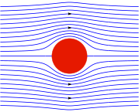
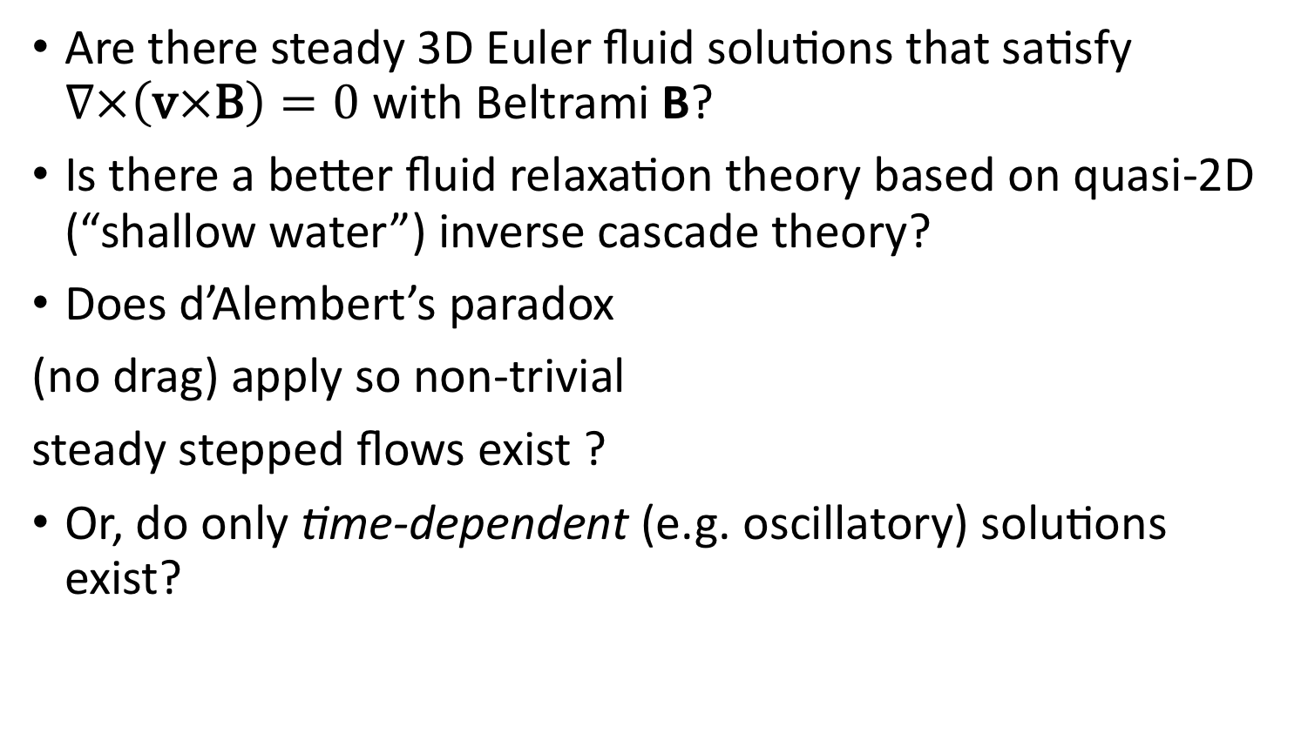
Questions re 3D Euler flow equilibria
Are there steady 3D Euler fluid solutions that satisfy $∇×\left(\text{v}×\text{B}\right)=0$ with Beltrami B?
Is there a better fluid relaxation theory based on quasi-2D (“shallow water”) inverse cascade theory?
Does d’Alembert’s paradox
(no drag) apply so non-trivial
steady stepped flows exist ?
Or, do only time-dependent (e.g. oscillatory) solutions exist?
Wikipedia: D'Alembert's paradox
Notes:
Do adjacent non-axisymmetric layers with different mean velocities necessarily exchange angular momentum?

Slide 14
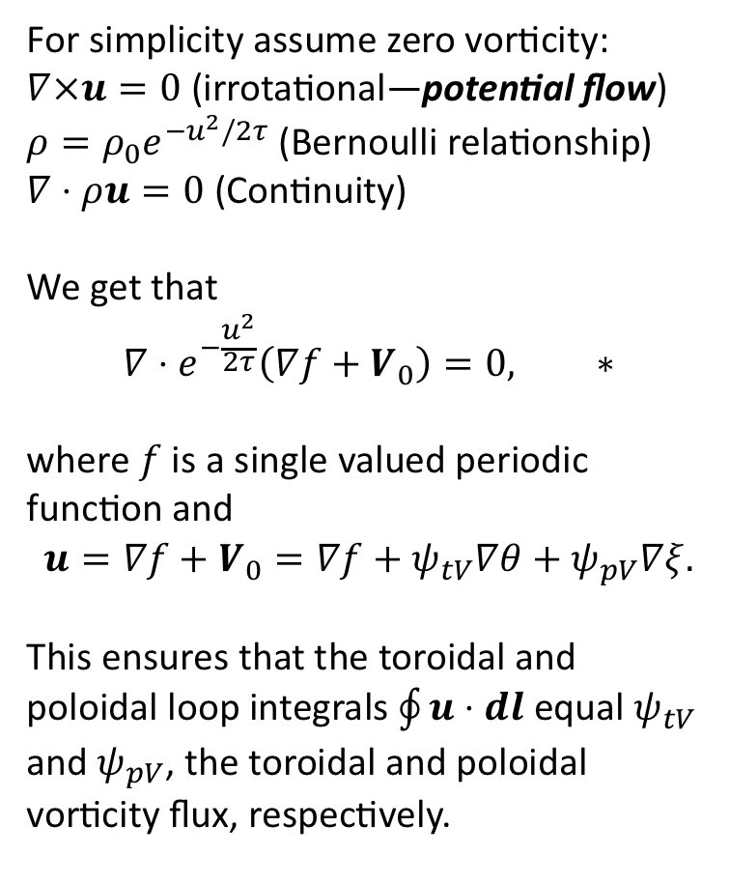
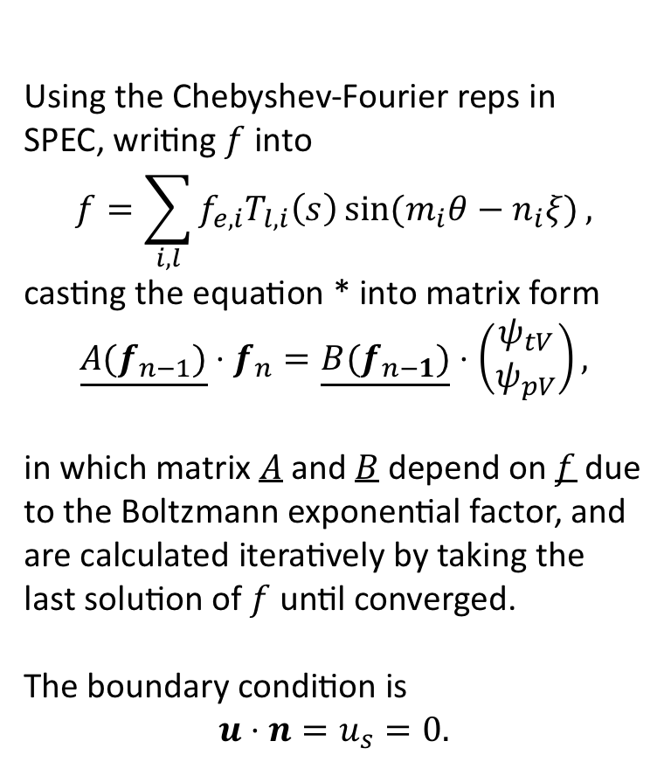
Preliminary SPECF based on 2015 formulation
For simplicity assume zero vorticity:
$∇×u=0$ (irrotational—potential flow)
$ρ=ρ_{0}e^{−u^{2}/2τ}$ (Bernoulli relationship)
$∇⋅ρu=0$ (Continuity)
We get that
$$∇⋅e^{−\frac{u^{2}}{2τ}}\left(∇f+V_{0}\right)=0, ∗$$
where $f$ is a single valued periodic function and
$$u={∇f+V}_{0}=∇f+ψ_{tV}∇θ+ψ_{pV}∇ξ.$$
This ensures that the toroidal and poloidal loop integrals $\oint{u⋅dl}$ equal $ψ_{tV}$ and $ψ_{pV}$, the toroidal and poloidal vorticity flux, respectively.
Using the Chebyshev-Fourier reps in SPEC, writing $f$ into
$$f=\sum_{i,l}{f_{e,i}T_{l,i}\left(s\right)\sin{(m_{i}θ−n_{i}ξ)},}$$
casting the equation * into matrix form
$$\underline{A(f_{n−1})}⋅f_{n}=\underline{B(f_{n−1})}⋅\left(\begin{matrix}ψ_{tV} \\ ψ_{pV}\end{matrix}\right),$$
in which matrix $A$ and $B$ depend on $f$ due to the Boltzmann exponential factor, and are calculated iteratively by taking the last solution of $f$ until converged.
The boundary condition is
$$u⋅n=u_{s}=0.$$
NB Flow enters force balance only through pressure: $[[p_{0}e^{−\frac{u^{2}}{2τ}}+\frac{1}{2}B^{2}]]=0$

Slide 15
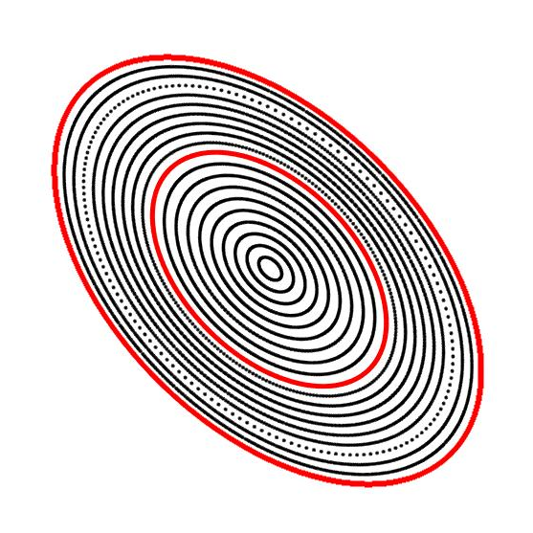
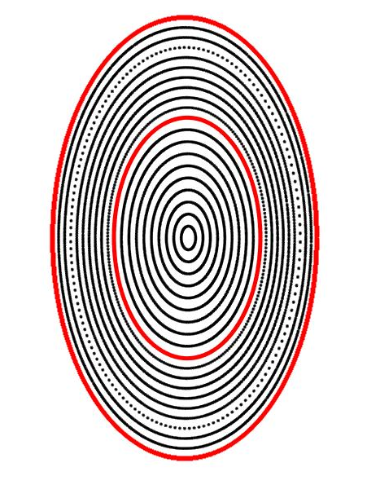
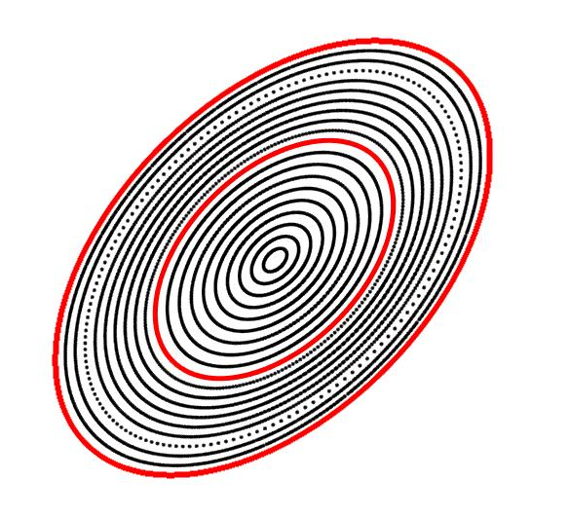
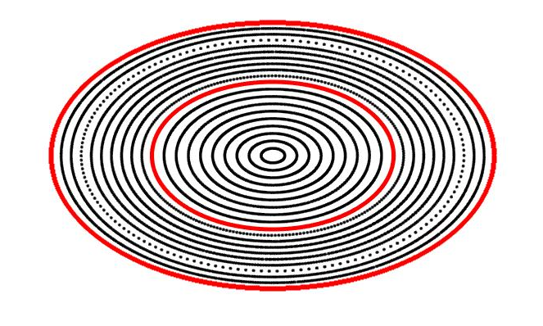
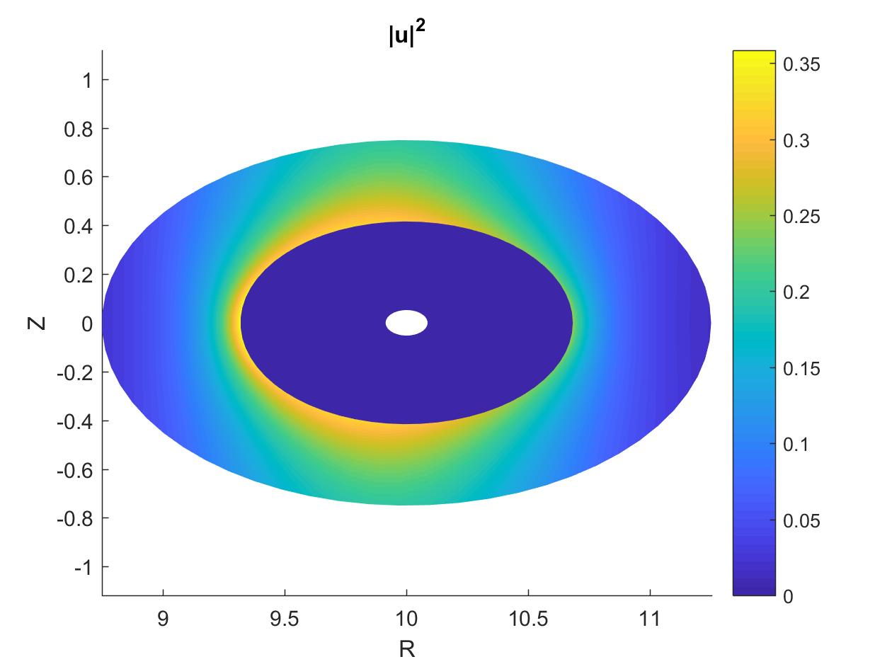
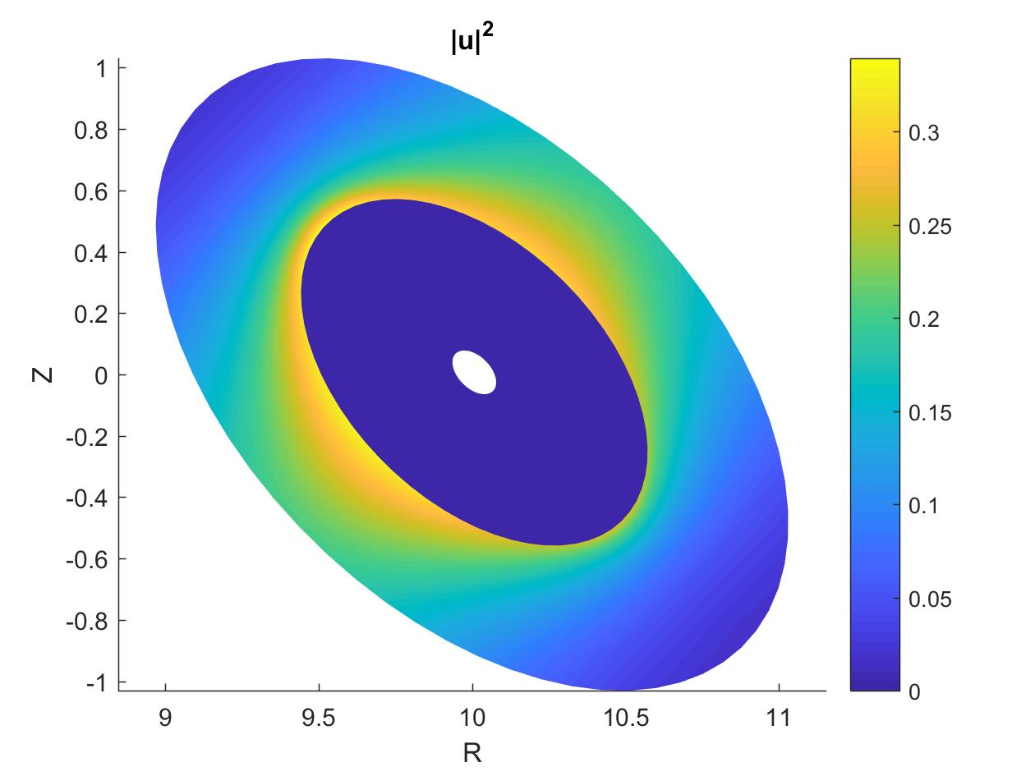
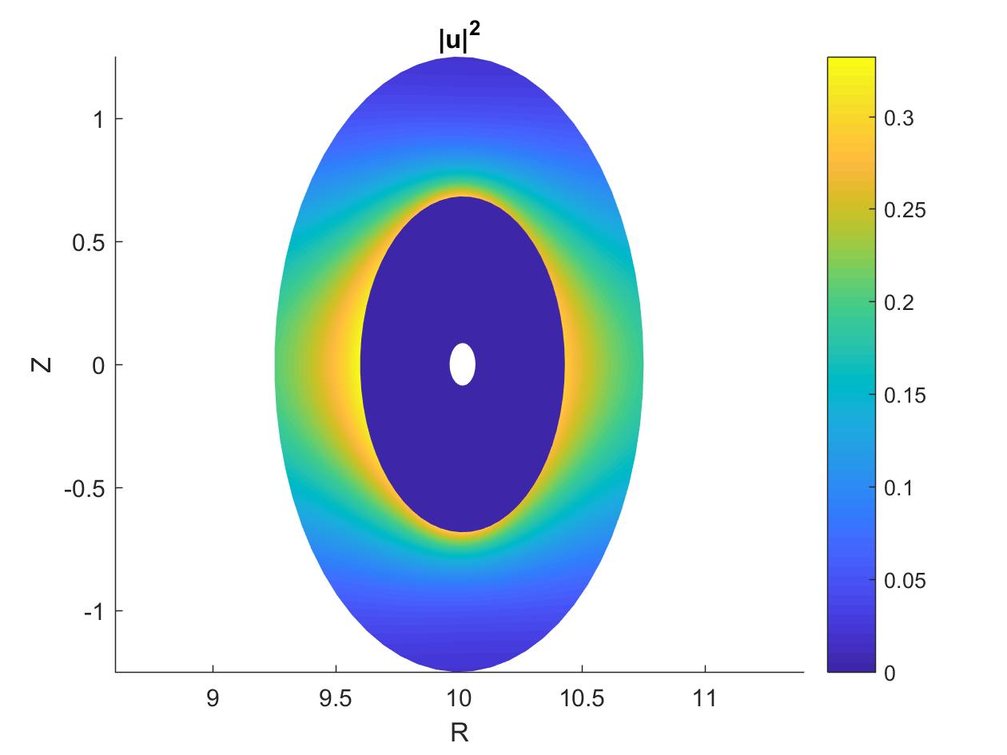
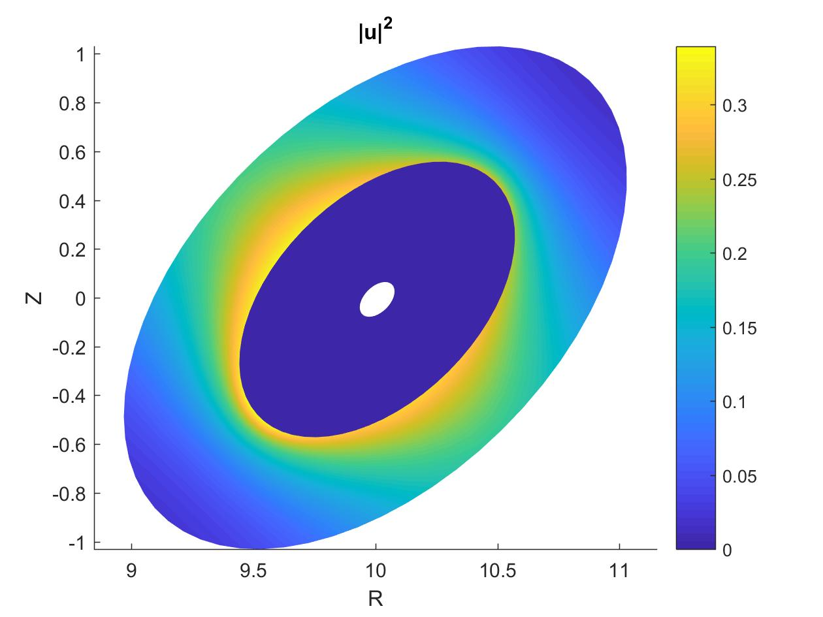
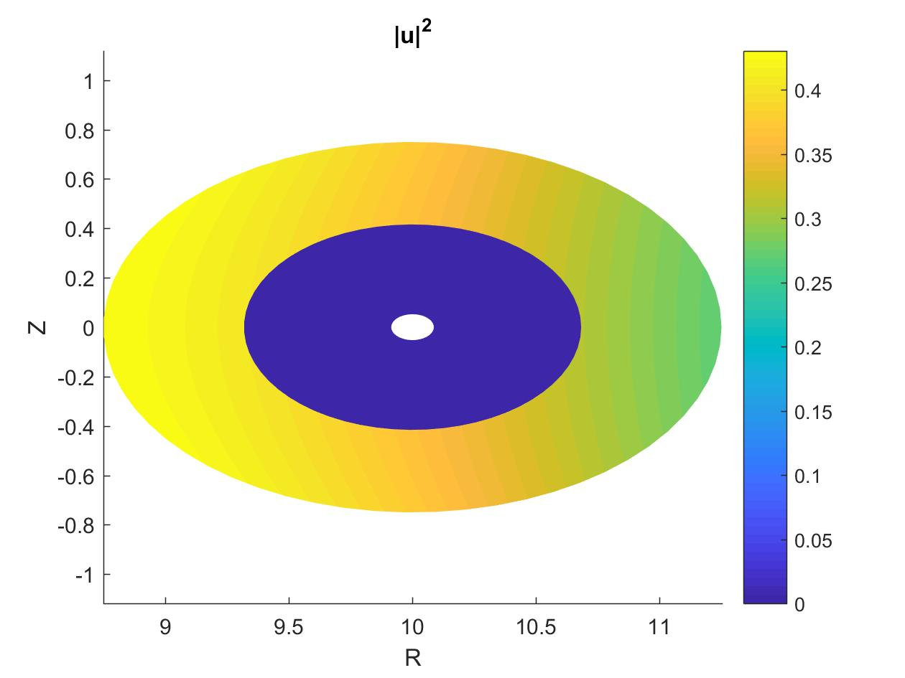
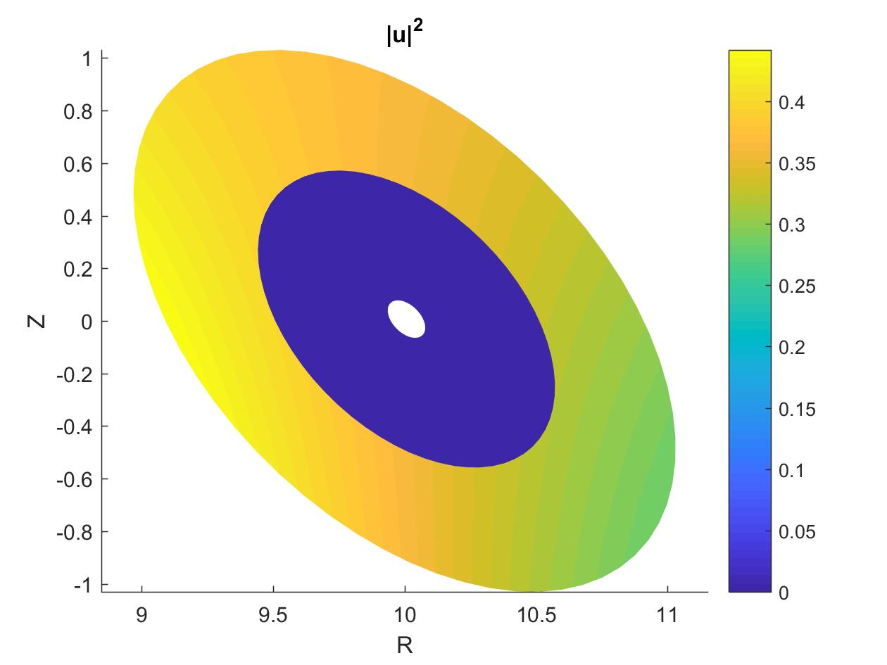
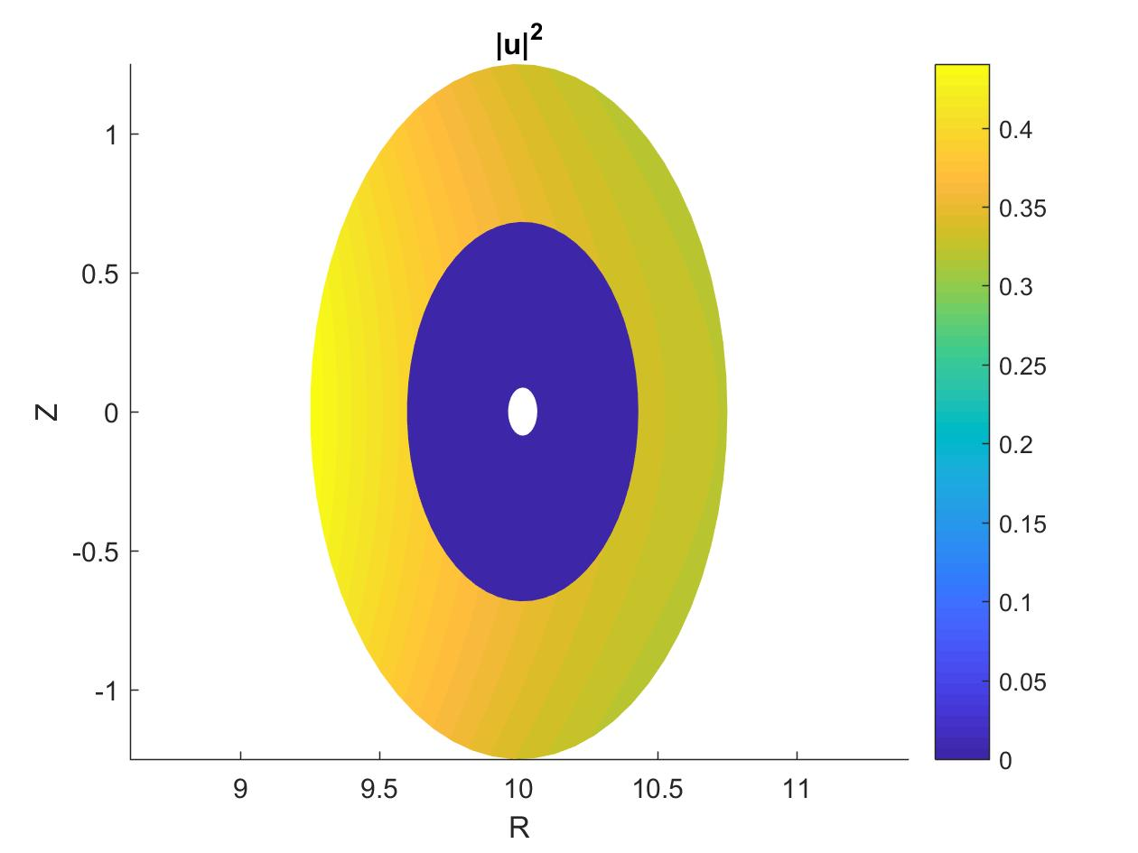
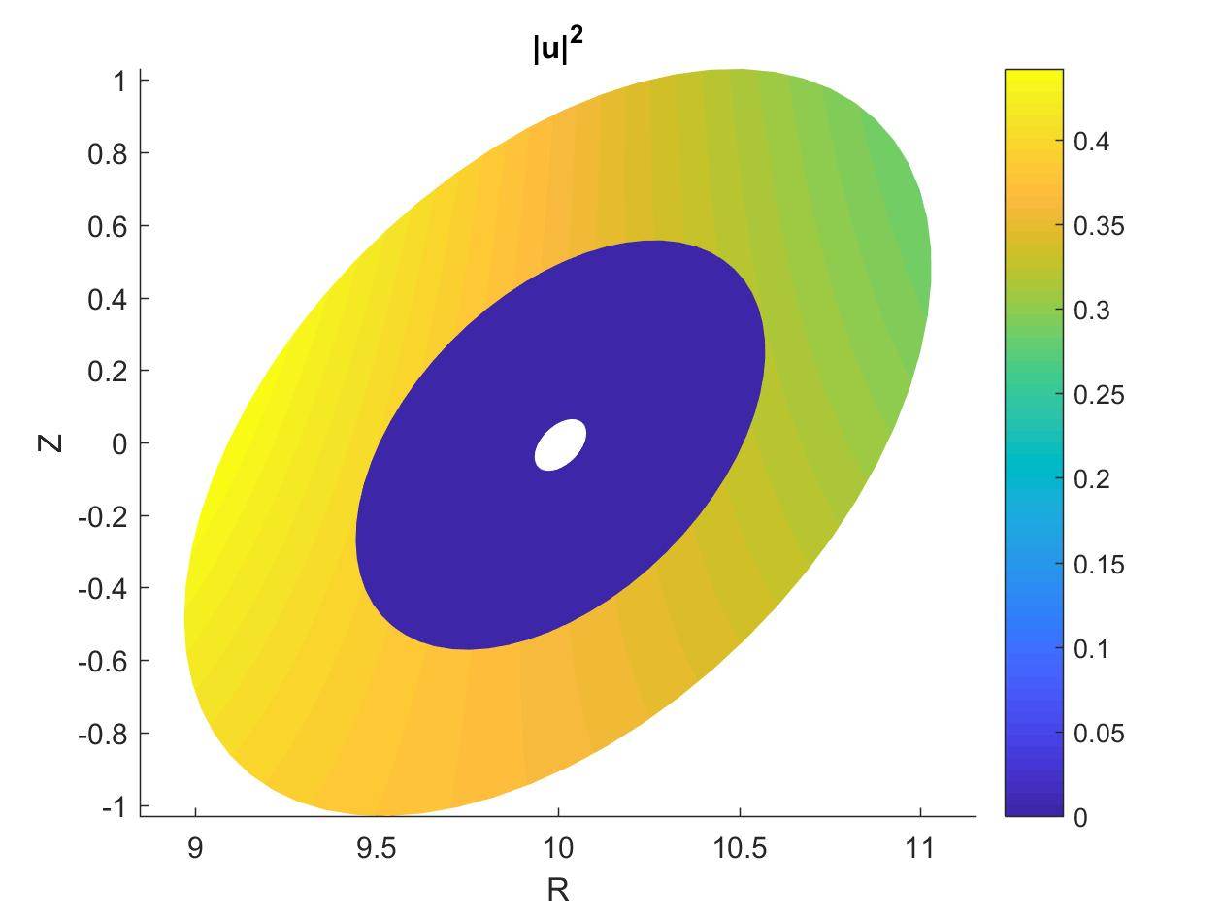
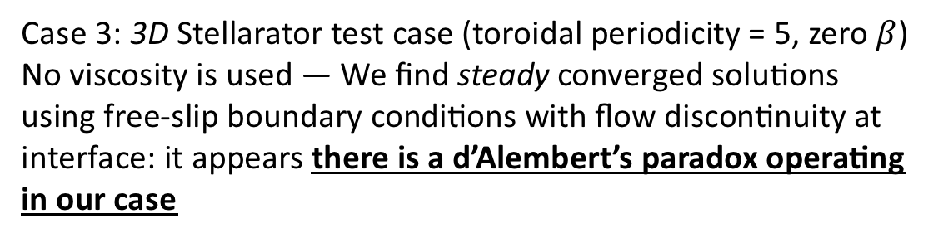
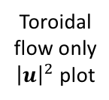
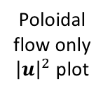
Preliminary SPECF implementation 4
Case 3: 3D Stellarator test case (toroidal periodicity = 5, zero $β$)
No viscosity is used — We find steady converged solutions using free-slip boundary conditions with flow discontinuity at interface: it appears there is a d’Alembert’s paradox operating in our case
Field
Poincaré
Poloidal flow only
${\left|u\right|}^{2}$ plot
Toroidal flow only
${\left|u\right|}^{2}$ plot

Slide 16
Summary
Have shown that MRxMHD is compatible with ideal MHD for axisymmetric toroidal flow equilibria
Have found that the most general non-axisymmetric “relaxed Euler flow” equilibria cannot reduce to the axisymmetric toroidal flow equilibria
Have implemented a preliminary version of the SPEC code with flow (SPECF)
Have enunciated some questions that are being addressed as we develop a “2018” formulation of dynamical MRxMHD (see remainder of poster for progress report)

