Slide 1
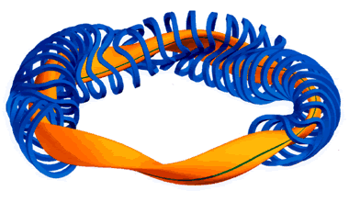
Multiregion Relaxed MHD toroidal states with flow
Tokamak
W7X stellarator
Germany
Robert L. Dewar,¹ Zhisong Qu,¹ Naoki Sato,²
Stuart Hudson,³ Matthew Hole¹
¹Mathematical Sciences Institute, ANU
²University of Kyoto
³Princeton Plasma Physics Laboratory

Slide 2
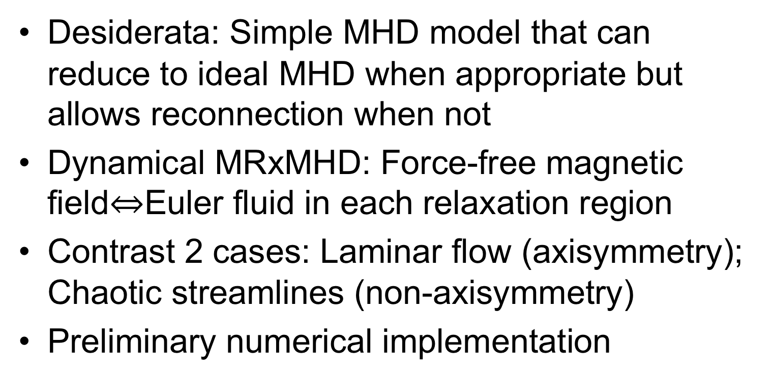
Plan of talk
Desiderata: Simple MHD model that can reduce to ideal MHD when appropriate but allows reconnection when not
Dynamical MRxMHD: Force-free magnetic field$⇔$Euler fluid in each relaxation region
Contrast 2 cases: Laminar flow (axisymmetry); Chaotic streamlines (non-axisymmetry)
Preliminary numerical implementation

Slide 3
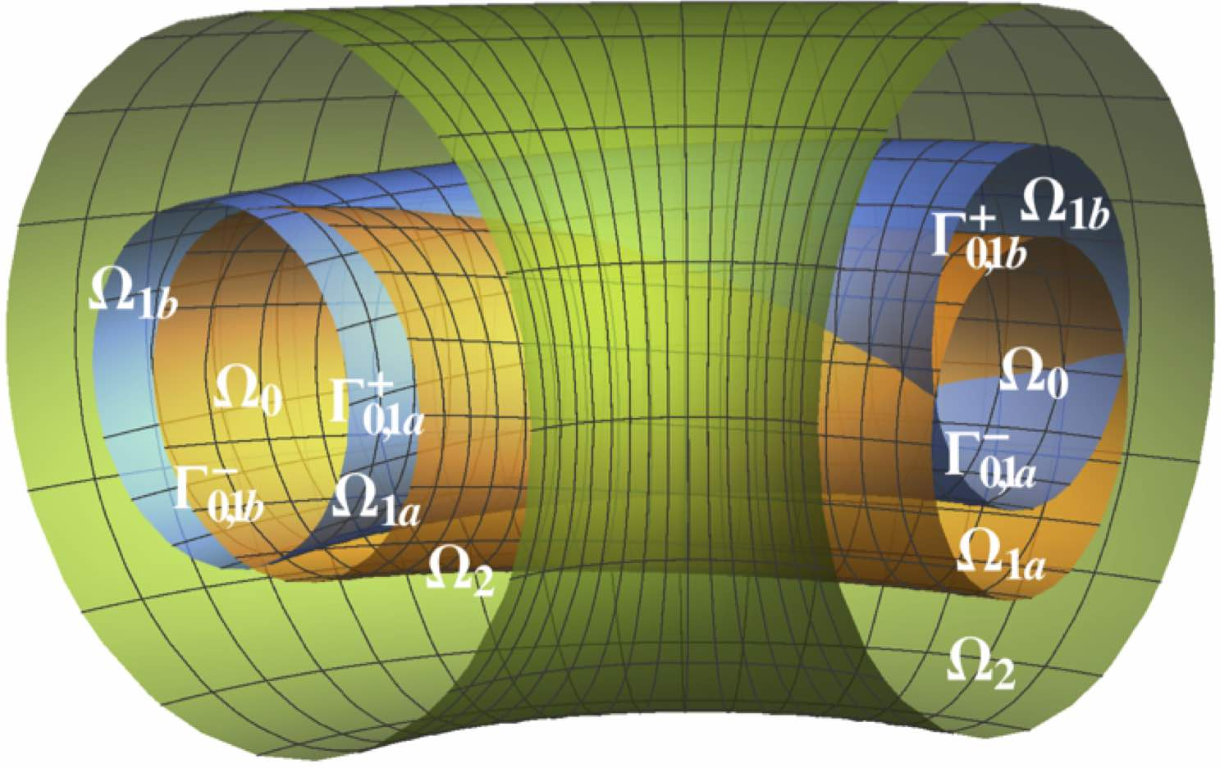
Laminated MHD concept
Basic ideas
Confinement is maintained by thin transport barriers (interfaces) Γ_{i,j} dividing the plasma into toroidal sub-regions Ω_{i}
Force balance across interfaces Γ_{i,j} allows stepped pressure & flow profiles
Within the sub-regions Ω_{i}, use force-free magnetic fields, so no jXB force — field and fluid are decoupled
Scope of applicability
  “smart finite element” discretization for ideal- MHD 2D equilibrium calculations (incl. flow)
  new, quasi-relaxed, MHD allowing islands & chaos in 3D equilibrium and dynamics
Interfaces may be separ-atrices of magnetic islands / Kelvin’s cat’s eyes in fluid

Slide 4
MRxMHD: M stands for Multi-region (aka waterbag)
Rx stands for Relaxed; ..D stands for Dynamics
MRxMHD theory
Full ideal-MHD constraints apply only within the interfaces Γ_{i,j}
Within the sub-regions Ω_{i} use generalized Taylor relaxation theory – relax nearly all the ideal-MHD constraints except for conservation of macroscopic magnetic helicity, entropy, and microscopic mass
Cross-helicity not constrained, so fluid and magnetic field couple only at interfaces, which are current/vortex sheets
Generalize minimum energy equilibrium approach by instead extremizing the MHD action (Hamilton’s Principle)
Details in Dewar et al 2015

Slide 5
Euler-Lagrange Equations within Ω_{i}
Result: Euler-Lagrange equations
Mass conservation (microscopic constraint)
δp ➮ Isothermal equation of state
δA ➮ Beltrami equation
ξ ➮ Momentum equation (Euler fluid)

Slide 6
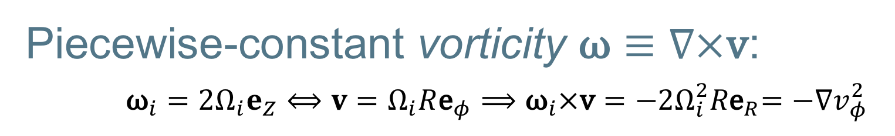
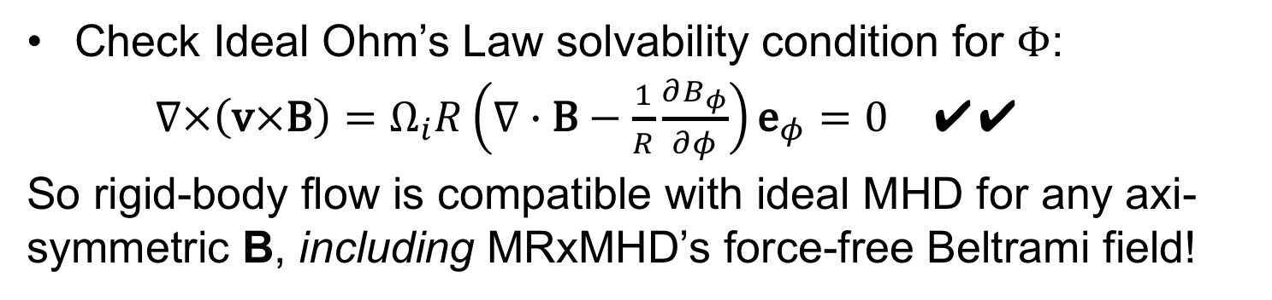
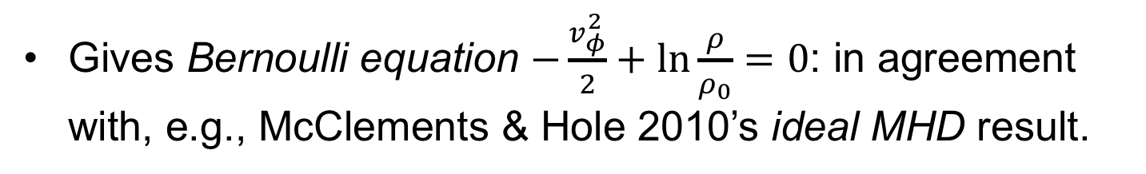
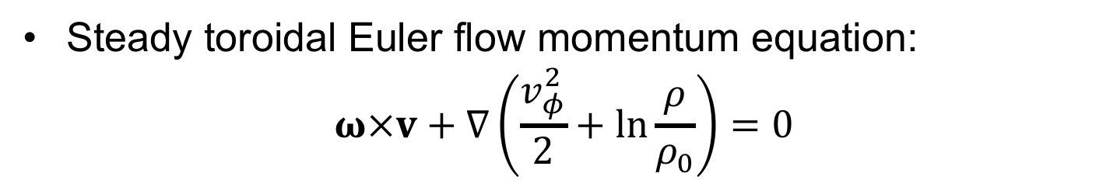
Piecewise-constant vorticity $\text{ω}≡∇×\text{v}$:
${\text{ω}}_{i}={2Ω}_{i}e_{Z}⟺v=Ω_{i}R{\text{e}}_{φ}⟹{\text{ω}}_{i}×\text{v}={−{2Ω}_{i}^{2}R\text{e}}_{R}=−∇v_{φ}^{2}$
Steady axisymmetric toroidal flow
Check Ideal Ohm’s Law solvability condition for $Φ$:
$∇×\left(\text{v}×\text{B}\right)=Ω_{i}R\left(∇∙\text{B}−\frac{1}{R}\frac{∂B_{φ}}{∂φ}\right){\text{e}}_{φ}=0$ ✔️✔️
So rigid-body flow is compatible with ideal MHD for any axi-symmetric B, including MRxMHD’s force-free Beltrami field!
Steady toroidal Euler flow momentum equation:
$$ω×v+∇\left(\frac{v_{φ}^{2}}{2}+ln\frac{ρ}{ρ_{0}}\right)=0$$
Gives Bernoulli equation $−\frac{v_{φ}^{2}}{2}+ln\frac{ρ}{ρ_{0}}=0$: in agreement with, e.g., McClements & Hole 2010’s ideal MHD result.

Slide 7
Static solution of Compressible Euler Fluid eqs in arb. Ω (Sato & Dewar arxiv):
“Relaxed” non-axisymmetric flow
Dot momentum equation
with and integrate to give Bernoulli equation
on each flow line.
Only solution valid for arbitrarily chaotic flow within Ω is (with suitable choice of global constant )
Gives nonlinear Beltrami equation:

Slide 8
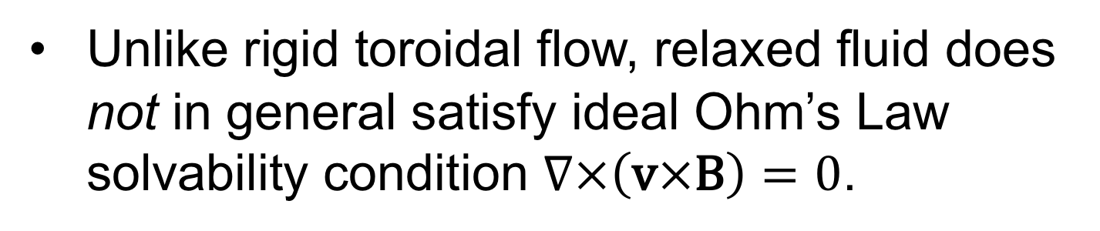
Incompatibility of the two solutions
Relaxed (Beltrami) fluid solution: vorticity parallel to flow
Rigid toroidal flow solution: vorticity perpendicular to flow
Toroidal kinetic energy terms in Bernoulli
equations have opposite signs in the two solns.
Unlike rigid toroidal flow, relaxed fluid does not in general satisfy ideal Ohm’s Law solvability condition $∇×\left(\text{v}×\text{B}\right)=0$.

Slide 9
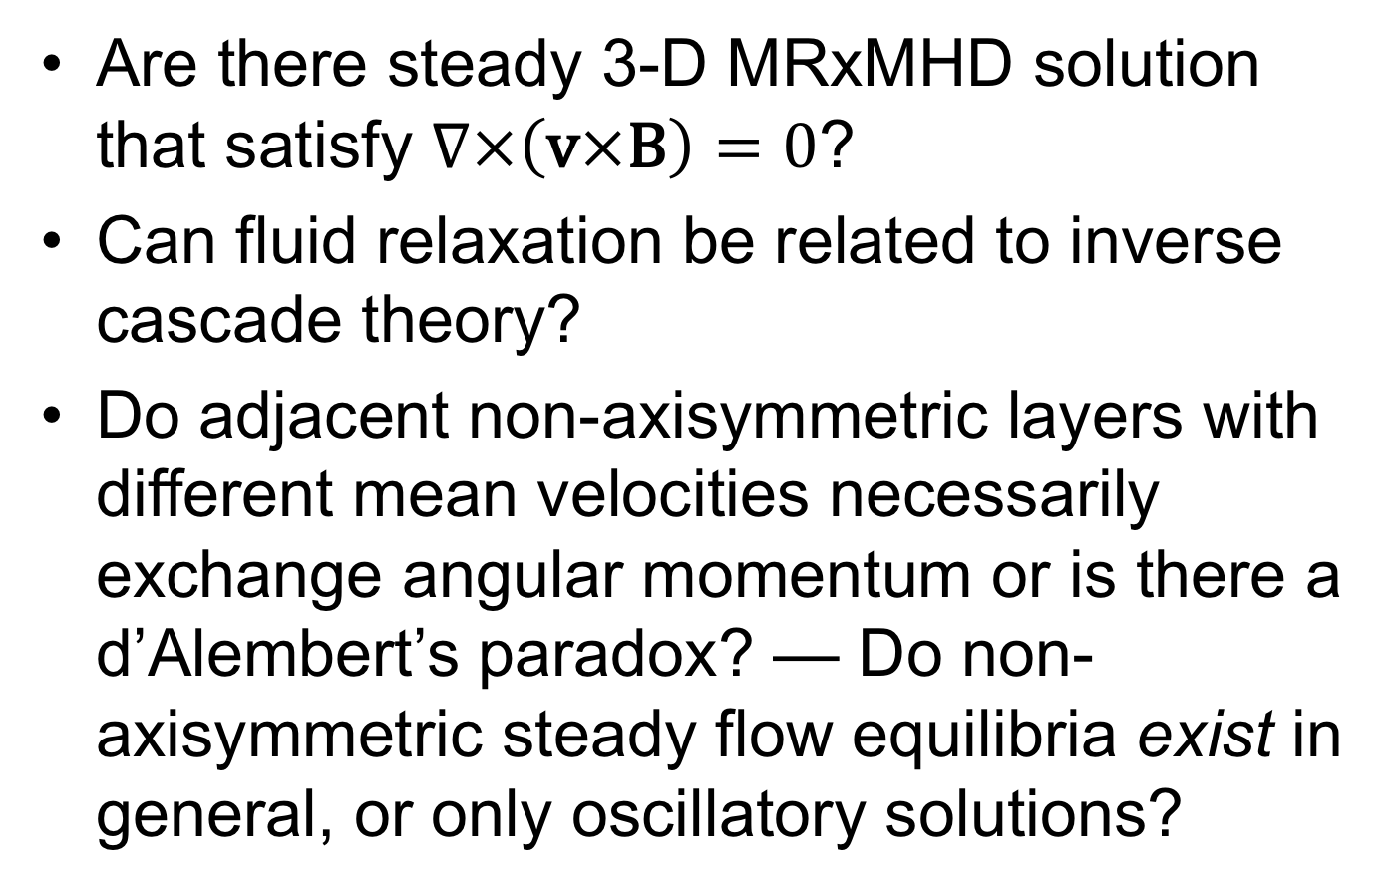
Open questions
Are there steady 3-D MRxMHD solution that satisfy $∇×\left(\text{v}×\text{B}\right)=0$?
Can fluid relaxation be related to inverse cascade theory?
Do adjacent non-axisymmetric layers with different mean velocities necessarily exchange angular momentum or is there a d’Alembert’s paradox? — Do non-axisymmetric steady flow equilibria exist in general, or only oscillatory solutions?

Slide 10
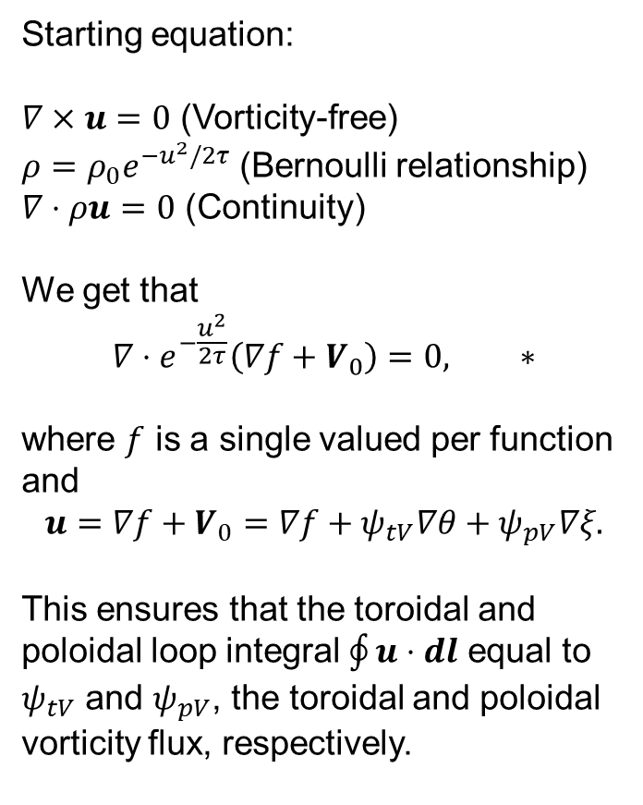
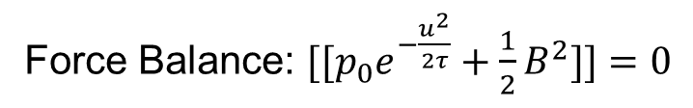
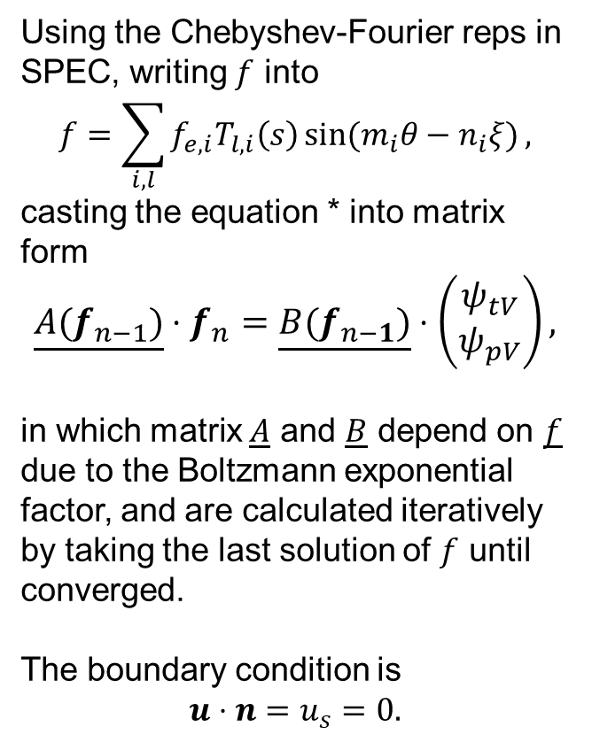
Preliminary SPECF implementation I
Starting equation:
$∇×u=0$ (Vorticity-free)
$ρ=ρ_{0}e^{−u^{2}/2τ}$ (Bernoulli relationship)
$∇⋅ρu=0$ (Continuity)
We get that
$$∇⋅e^{−\frac{u^{2}}{2τ}}\left(∇f+V_{0}\right)=0, ∗$$
where $f$ is a single valued per function and
$$u={∇f+V}_{0}=∇f+ψ_{tV}∇θ+ψ_{pV}∇ξ.$$
This ensures that the toroidal and poloidal loop integral $\oint{u⋅dl}$ equal to $ψ_{tV}$ and $ψ_{pV}$, the toroidal and poloidal vorticity flux, respectively.
Using the Chebyshev-Fourier reps in SPEC, writing $f$ into
$$f=\sum_{i,l}{f_{e,i}T_{l,i}\left(s\right)\sin{(m_{i}θ−n_{i}ξ)},}$$
casting the equation * into matrix form
$$\underline{A(f_{n−1})}⋅f_{n}=\underline{B(f_{n−1})}⋅\left(\begin{matrix}ψ_{tV} \\ ψ_{pV}\end{matrix}\right),$$
in which matrix $A$ and $B$ depend on $f$ due to the Boltzmann exponential factor, and are calculated iteratively by taking the last solution of $f$ until converged.
The boundary condition is
$$u⋅n=u_{s}=0.$$
Force Balance: $[[p_{0}e^{−\frac{u^{2}}{2τ}}+\frac{1}{2}B^{2}]]=0$

Slide 11
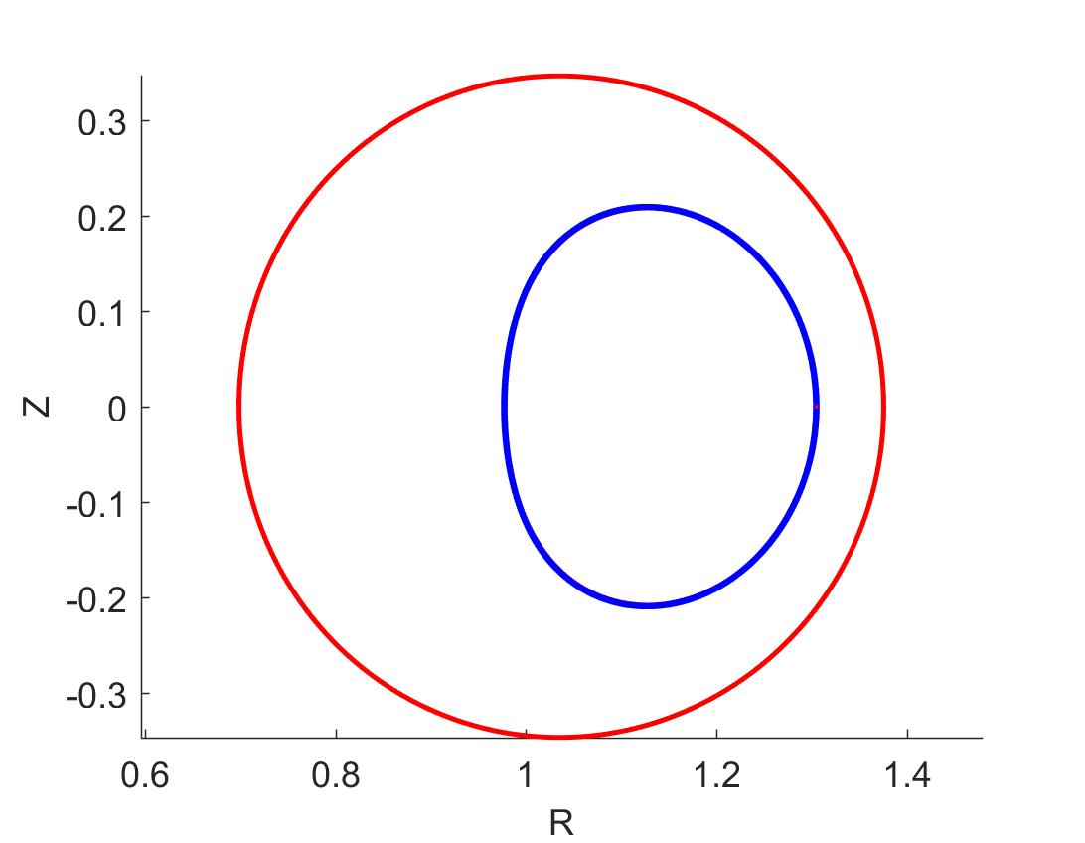
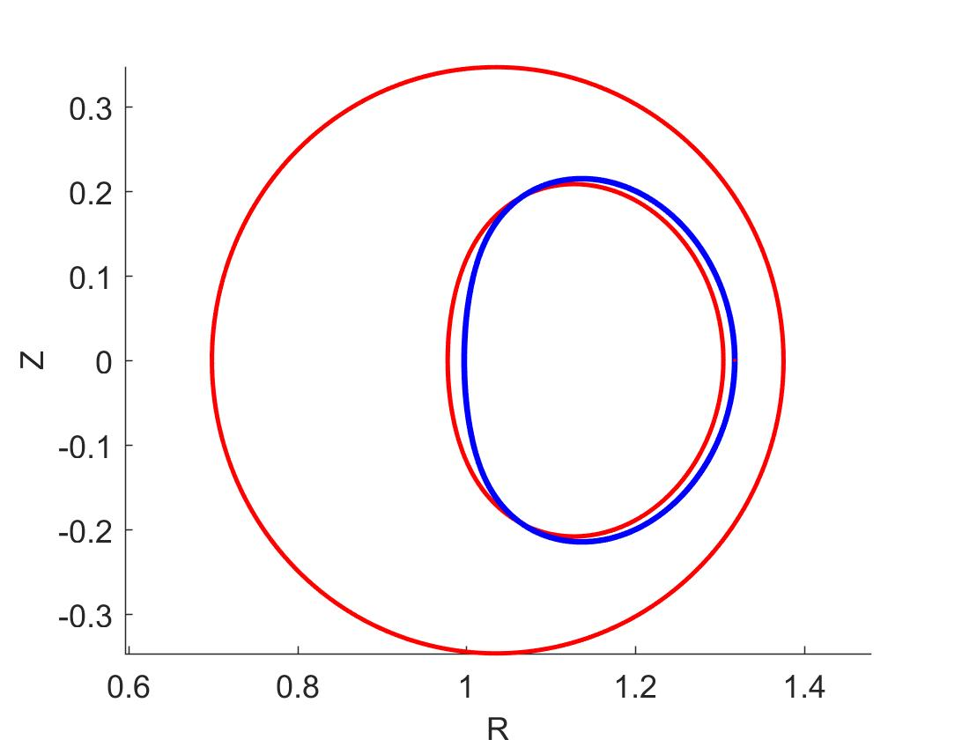
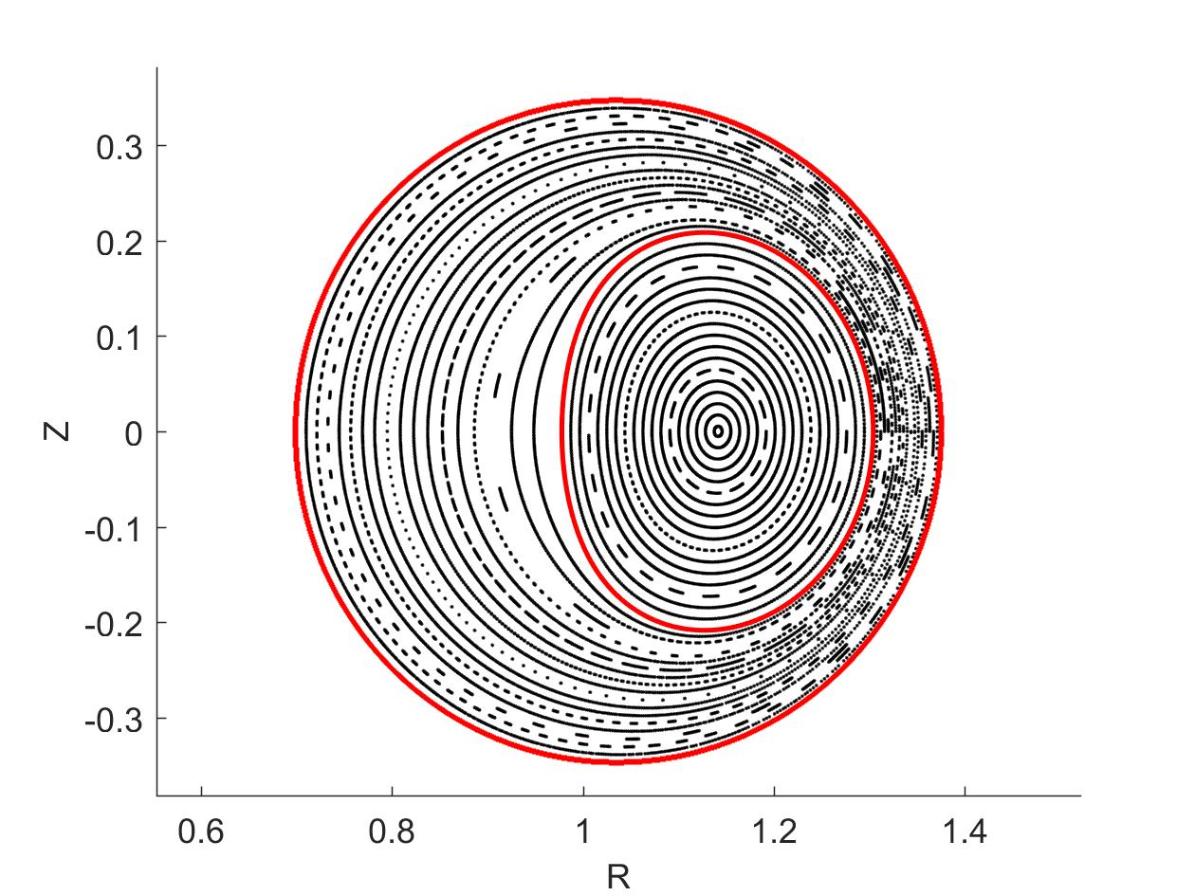
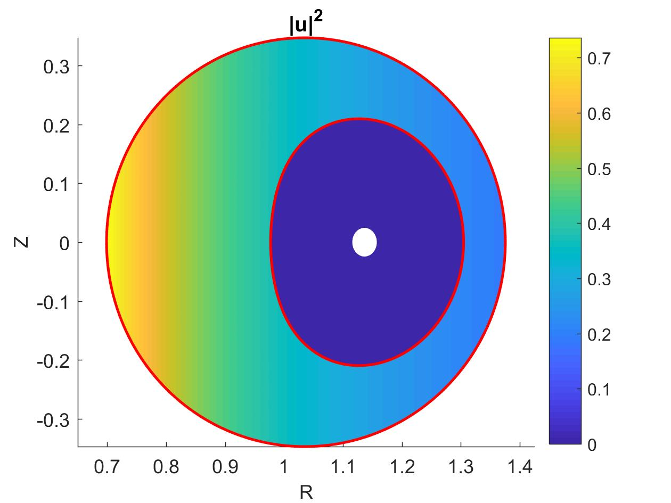
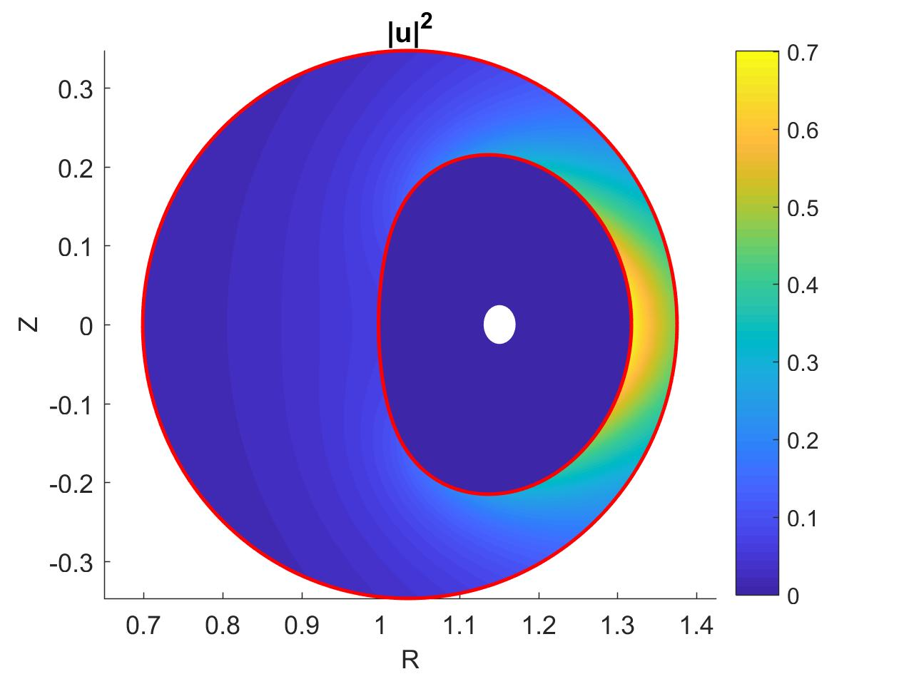
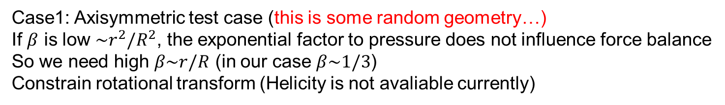

Preliminary SPECF implementation 2
Case1: Axisymmetric test case (this is some random geometry…)
If $β$ is low $\sim r^{2}/R^{2}$, the exponential factor to pressure does not influence force balance
So we need high $β\sim r/R$ (in our case $β\sim 1/3$)
Constrain rotational transform (Helicity is not avaliable currently)
No flow
Toroidal flow
Max Mach² ~ 0.7
Poloidal flow
Max Mach² ~ 0.7
Force balance
not much
changed
Force
balance
changed
Flow faster in narrower region
$$u\sim 1/R$$
I know I need to add many interfaces to match Michael’s solution…
No flow at core because illly defined vorticity flux

Slide 12
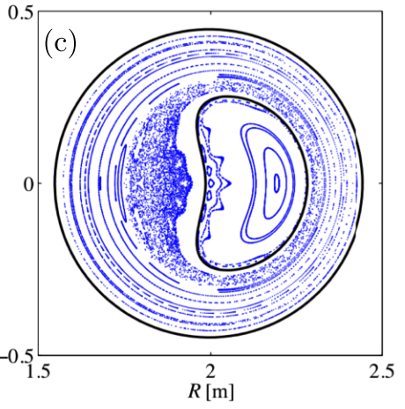
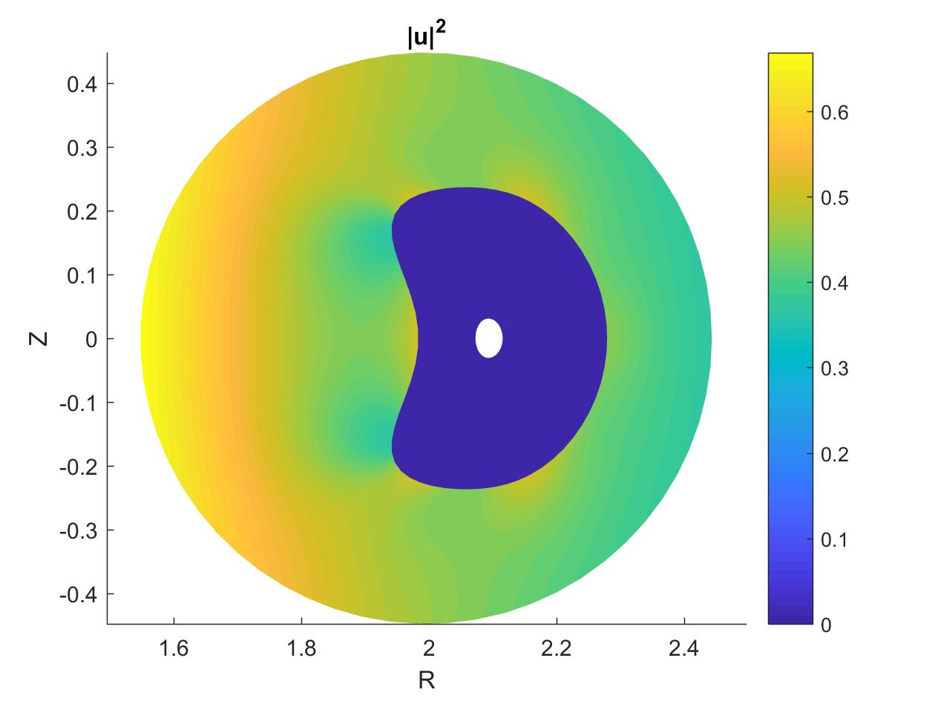
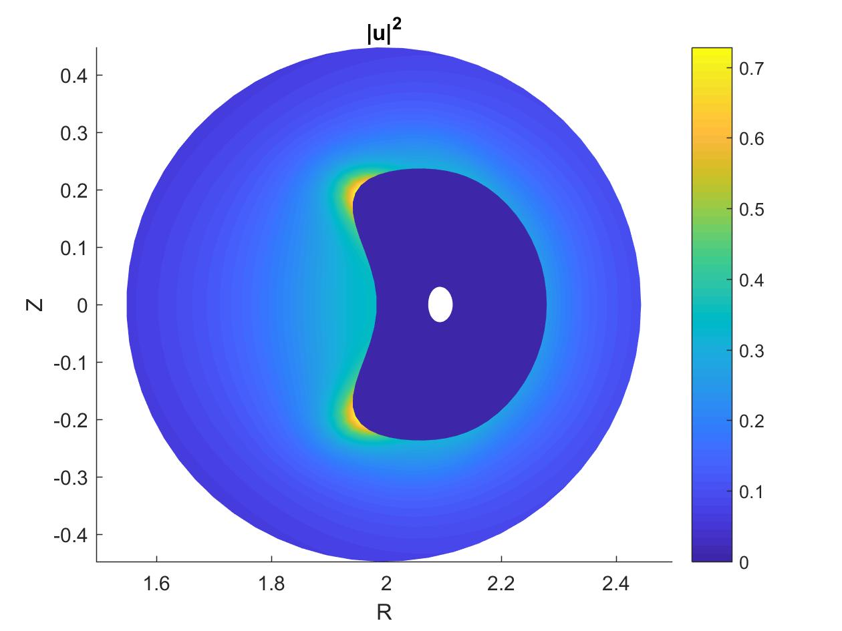
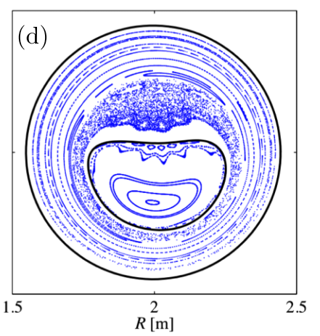
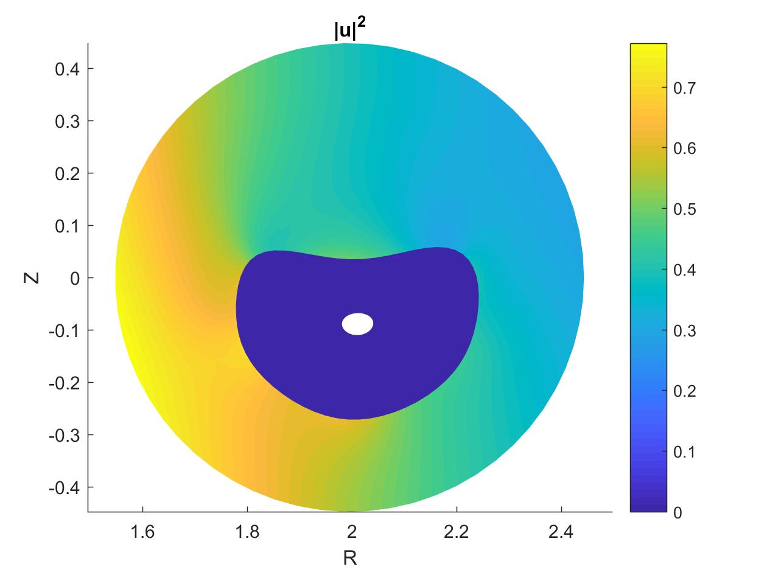
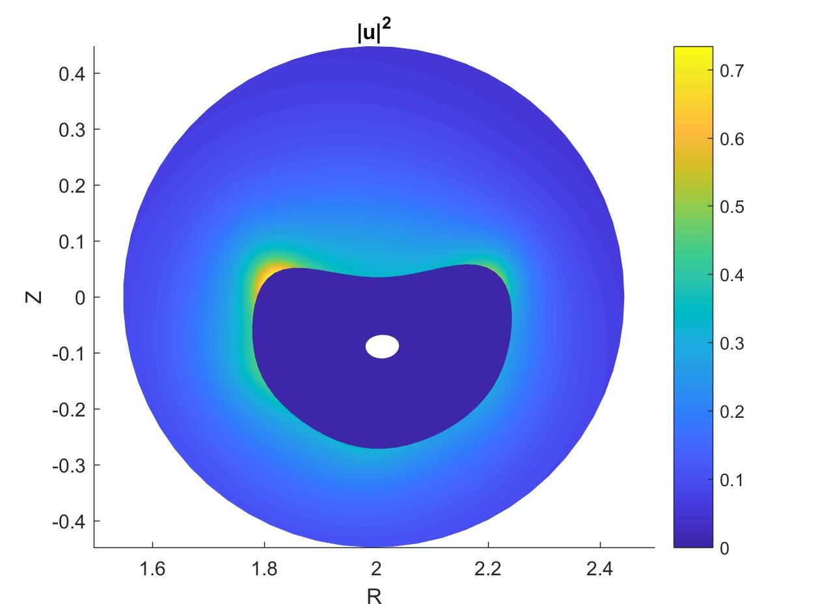
Preliminary SPECF implementation 3
Case 2: Reverse field pinches, single helical axis (SHAx)
Very small beta, flow plays no role in force balance
No flow
Toroidal flow
Max Mach² ~ 0.7
Poloidal flow
Max Mach² ~ 0.7

Slide 13
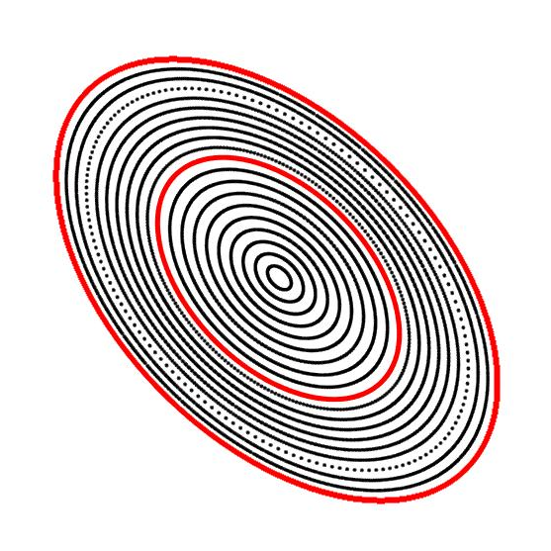
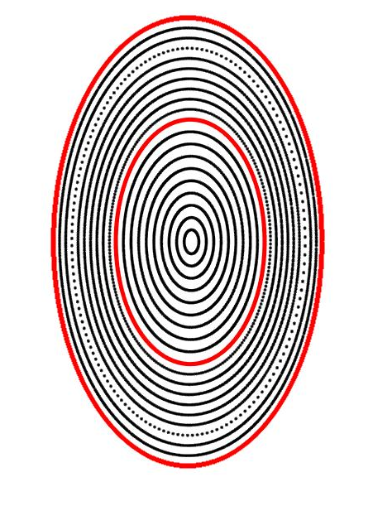
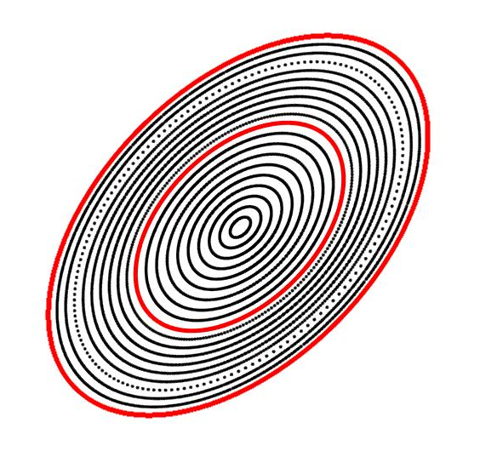
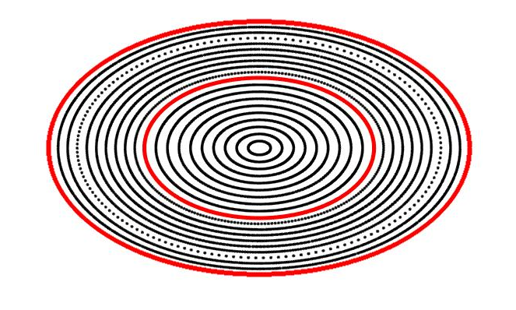
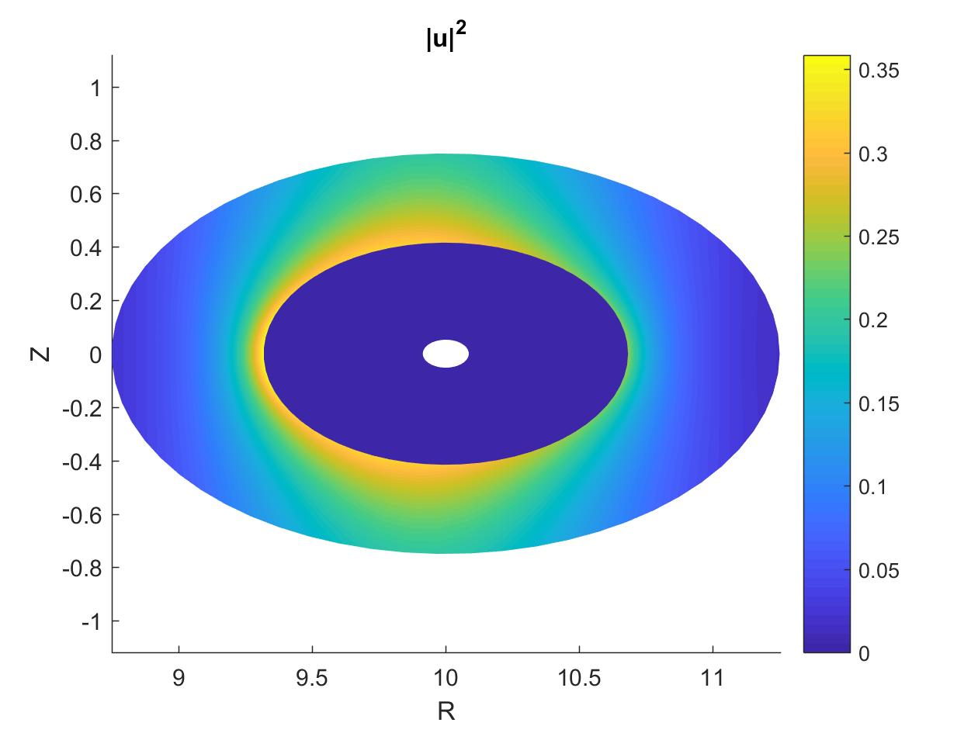
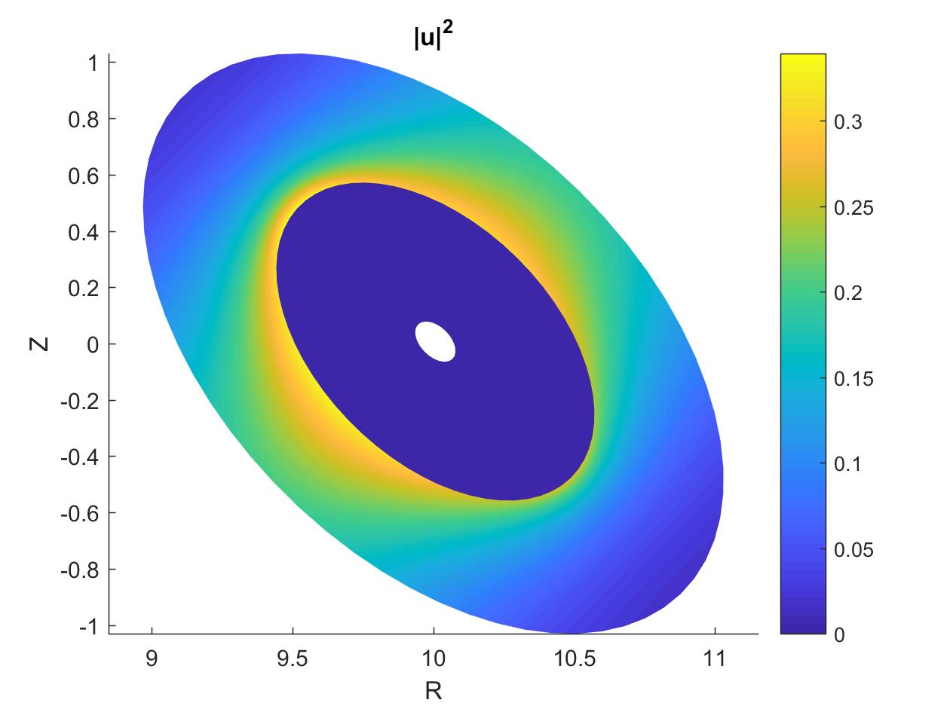
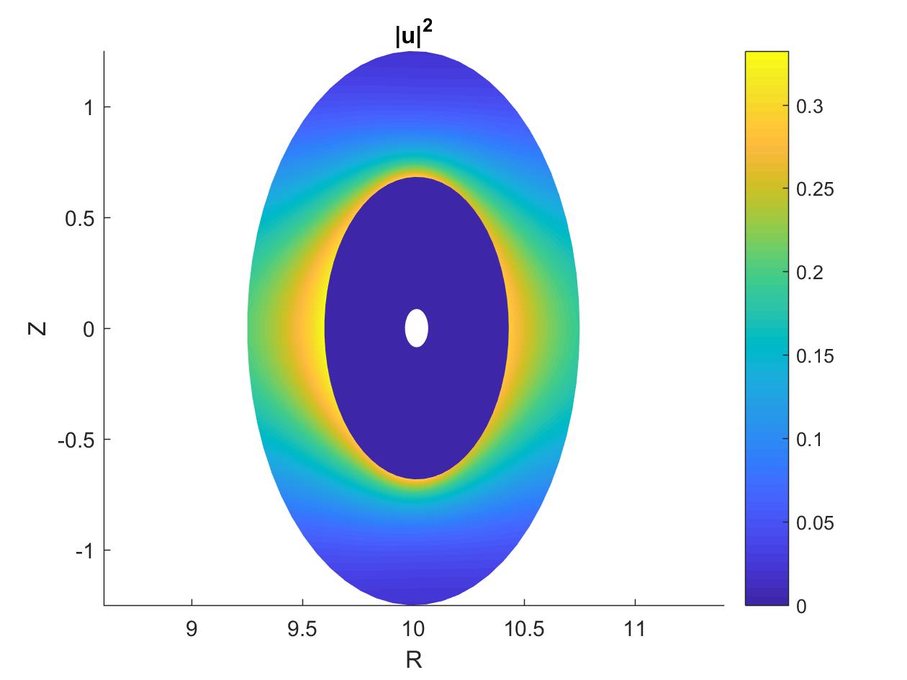
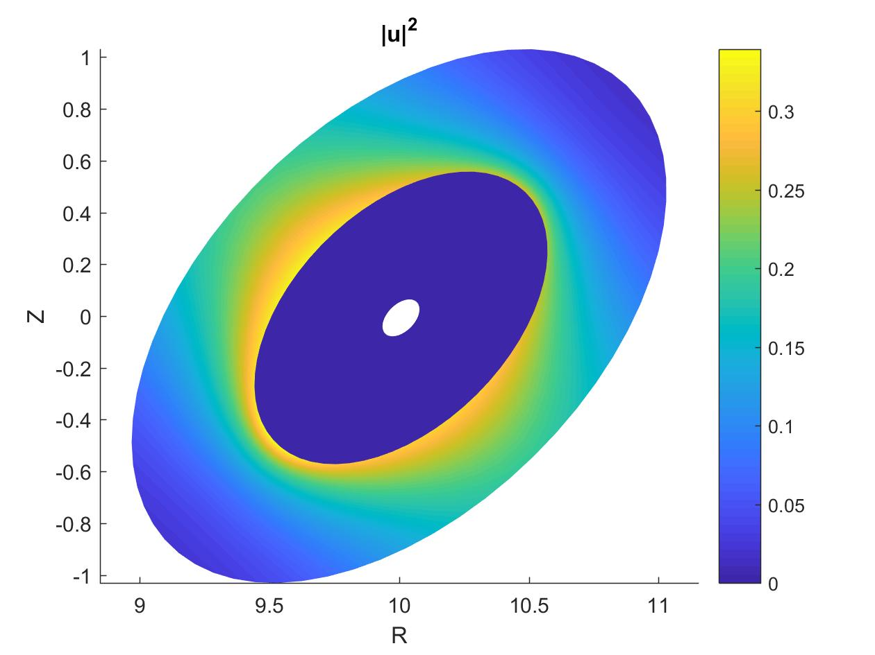
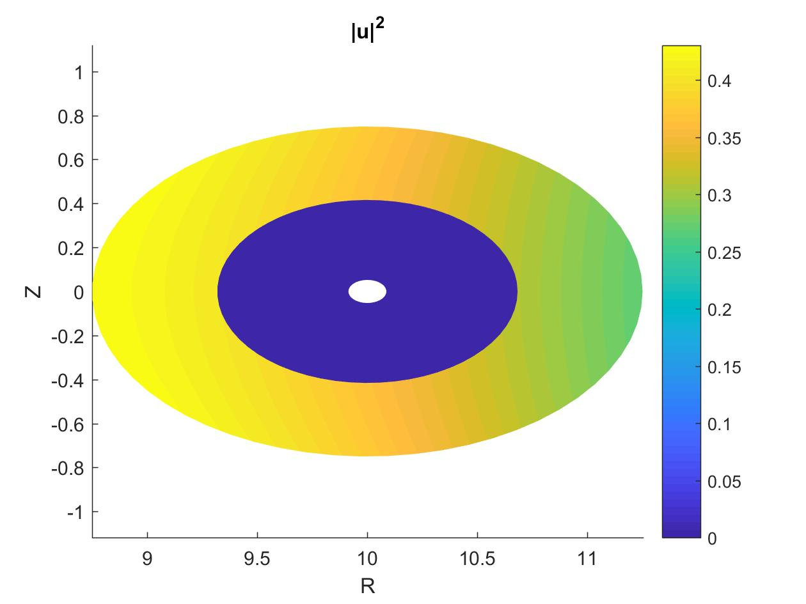
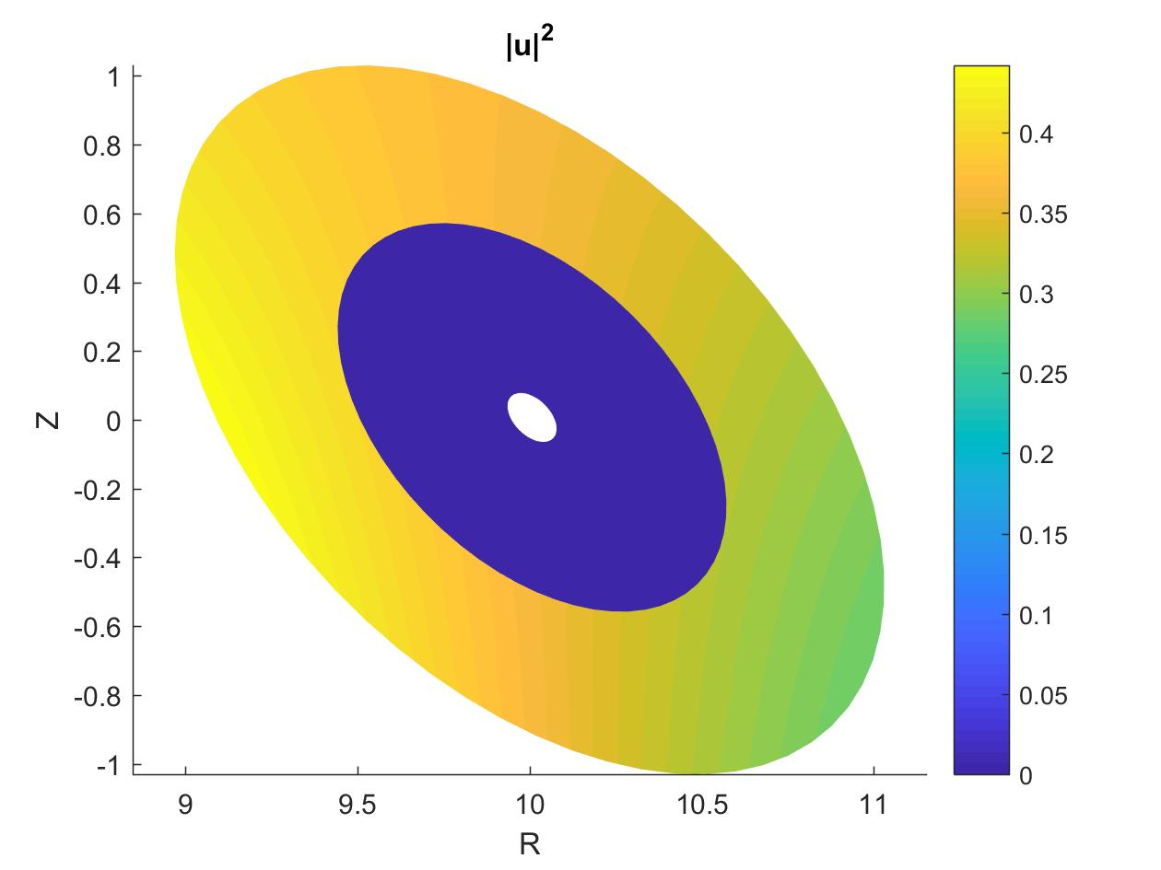
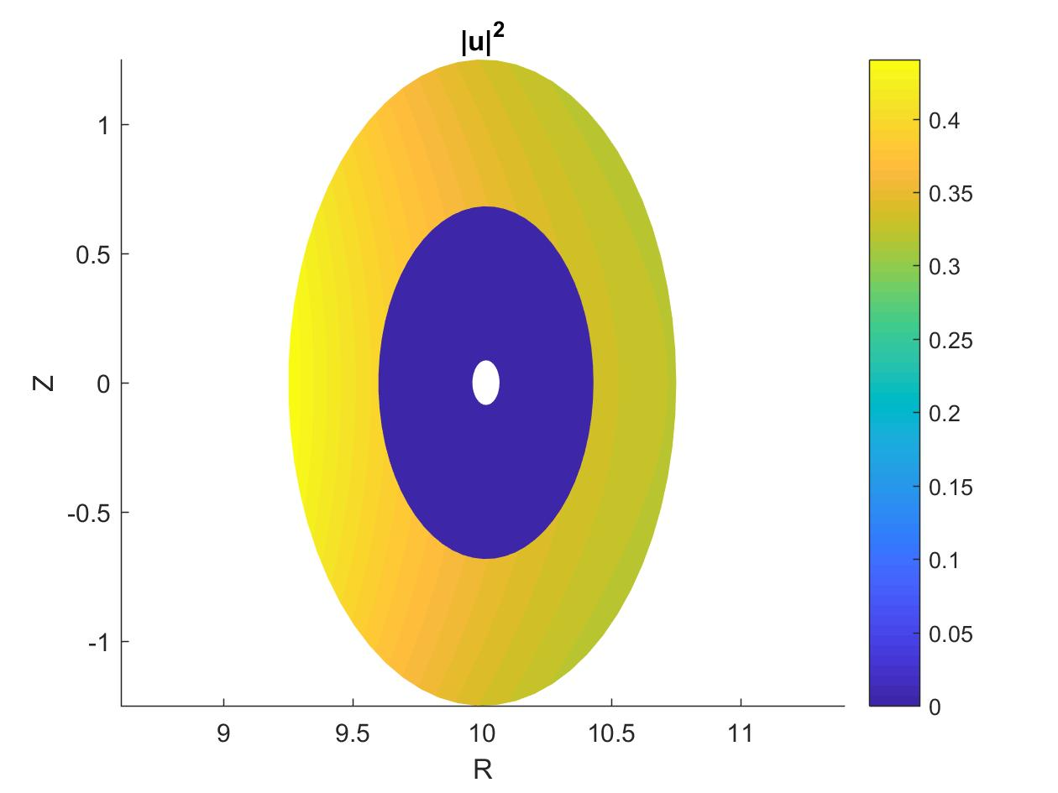
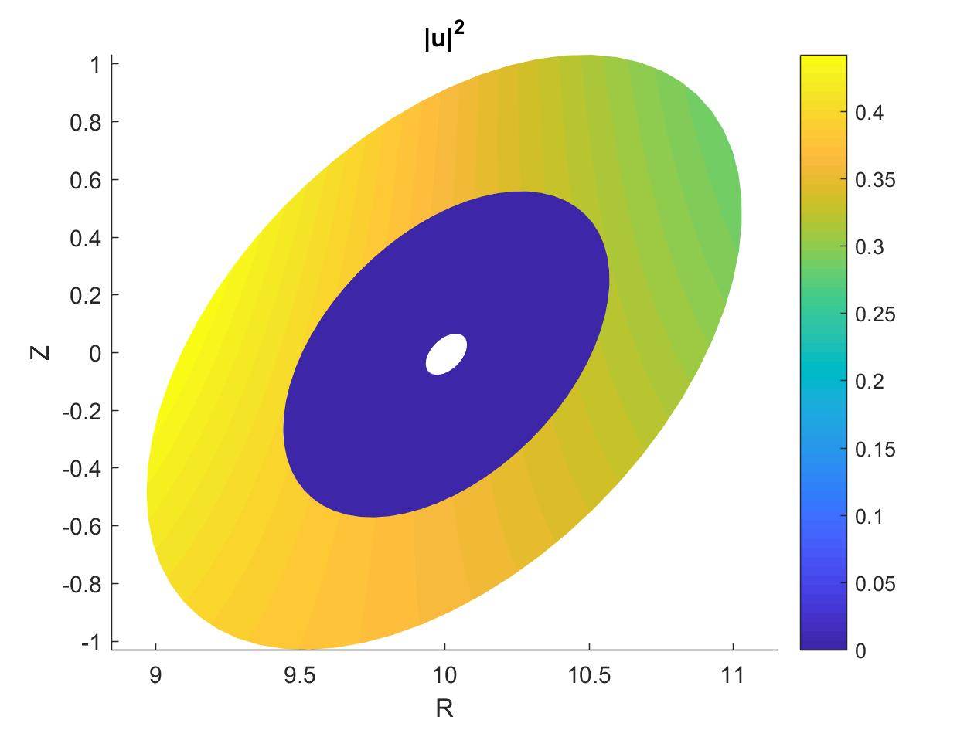
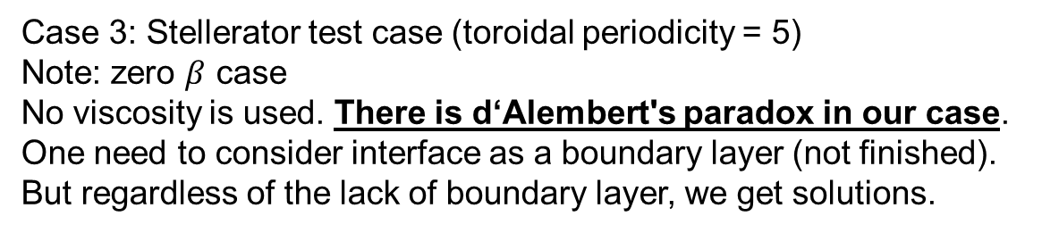
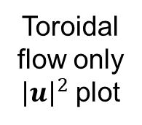
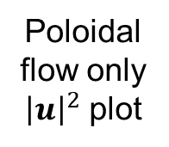
Preliminary SPECF implementation 4
Case 3: Stellerator test case (toroidal periodicity = 5)
Note: zero $β$ case
No viscosity is used. There is d‘Alembert's paradox in our case.
One need to consider interface as a boundary layer (not finished).
But regardless of the lack of boundary layer, we get solutions.
Field
Poincaré
Poloidal flow only
${\left|u\right|}^{2}$ plot
Toroidal flow only
${\left|u\right|}^{2}$ plot

Slide 14
Conclusion
Have shown that MRxMHD is compatible with ideal MHD for axisymmetric toroidal flow equilibria
Have found that the most general non-axisymmetric “relaxed Euler flow” equilibria cannot reduce to the axisymmetric toroidal flow equilibria
Have implemented a preliminary version of the SPEC code with flow (SPECF)
Have enunciated some open questions that need to be addressed

Slide 15
Abstract

Slide 16
kinetic energy – MHD potential energy + Lagrange multiplier constraint terms:
Derived from MRxMHD Lagrangian
MHD Lagrangian density in region i
Constrained Lagrangian in region i
Helicity and entropy macroscopic invariants

