Slide 1
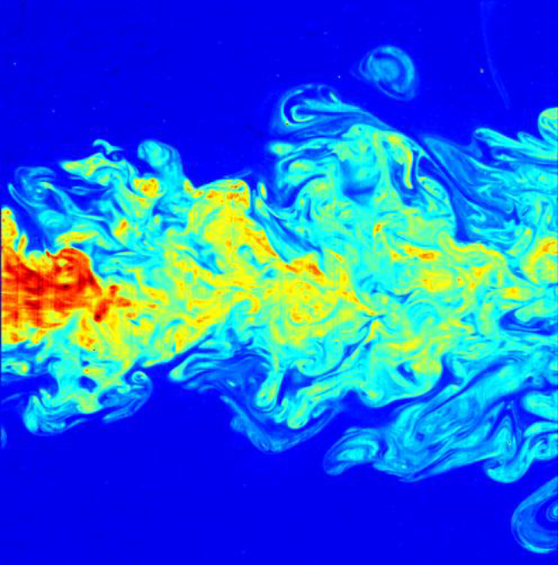

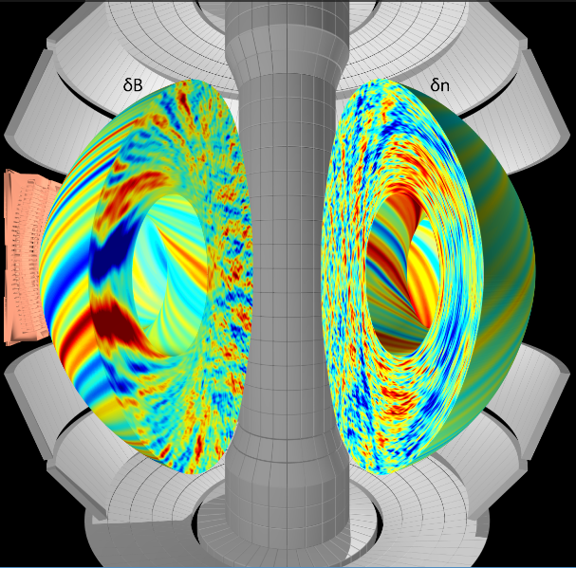
Intro to neutral & magnetized plasma turbulence
Walter Guttenfelder
PPPL Graduate Student Seminar
Feb. 18, 2019

Slide 2
Some additional sources & references
Greg Hammett has a lot of great introductory material to fusion, tokamaks, drift waves, ITG turbulence, gyrokinetics, etc… (w3.pppl.gov/~hammett)
Greg & I recently gave five 90 minute lectures on turbulence at the 2018 Graduate Summer School (gss.pppl.gov)
See the following for broader reviews and thousands of useful references
Transport & Turbulence reviews:
  Liewer, Nuclear Fusion (1985)
  Wootton, Phys. Fluids B (1990)
  Carreras, IEEE Trans. Plasma Science (1997)
  Wolf, PPCF (2003)
  Tynan, PPCF (2009)
  ITER Physics Basis (IPB), Nuclear Fusion (1999)
  Progress in ITER Physics Basis (PIPB), Nuclear Fusion (2007)
Drift wave reviews:
  Horton, Rev. Modern Physics (1999)
  Tang, Nuclear Fusion (1978)
Gyrokinetic simulation review:
  Garbet, Nuclear Fusion (2010)
Zonal flow/GAM reviews:
  Diamond et al., PPCF (2005)
  Fujisawa, Nuclear Fusion (2009)
Measurement techniques:
  Bretz, RSI (1997)

Slide 3
Outline
Neutral fluid turbulence
  Examples & concepts
  Energy cascade
Magnetized plasma turbulence (e.g. in MFE)
  Examples (measurements & simulations)
  Micro-instabilities (ITG dynamics)
  Saturation (zonal flows)

Slide 4
Examples of turbulence

Slide 5
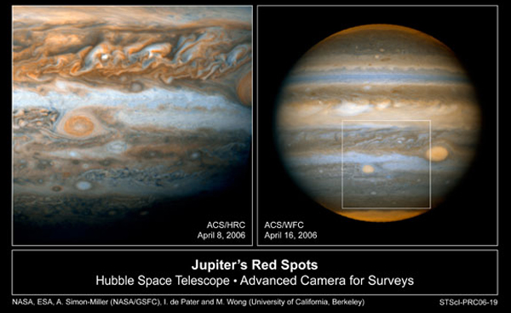
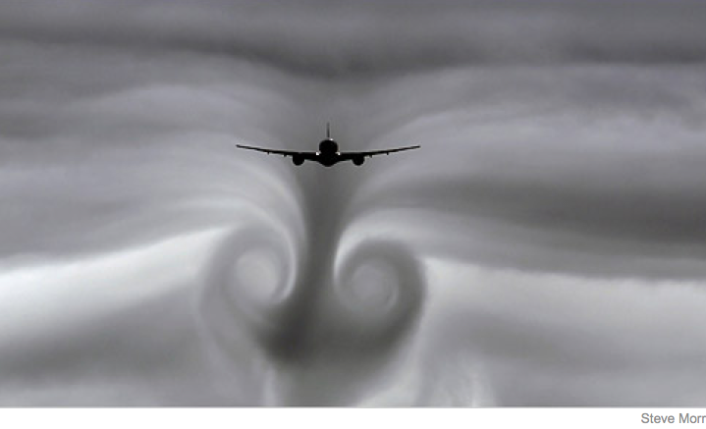
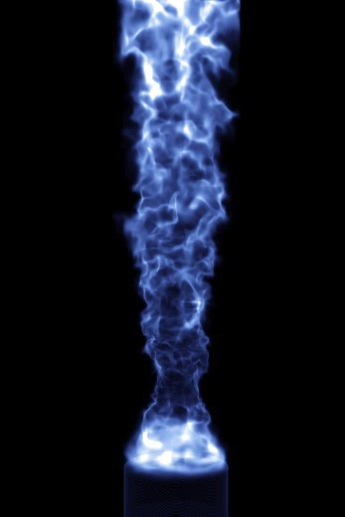
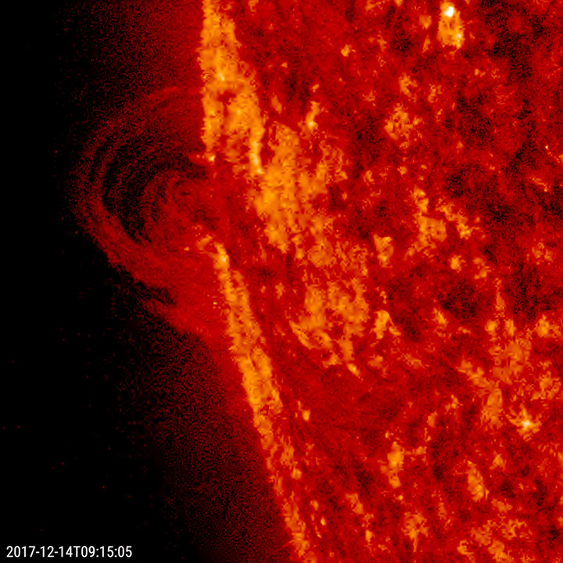
Turbulence found throughout the universe
Universität Duisburg-Essen
https://sdo.gsfc.nasa.gov/gallery

Slide 6
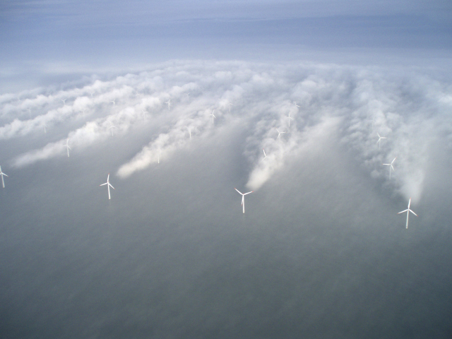
Turbulence is ubiquitous throughout planetary atmospheres

Slide 7
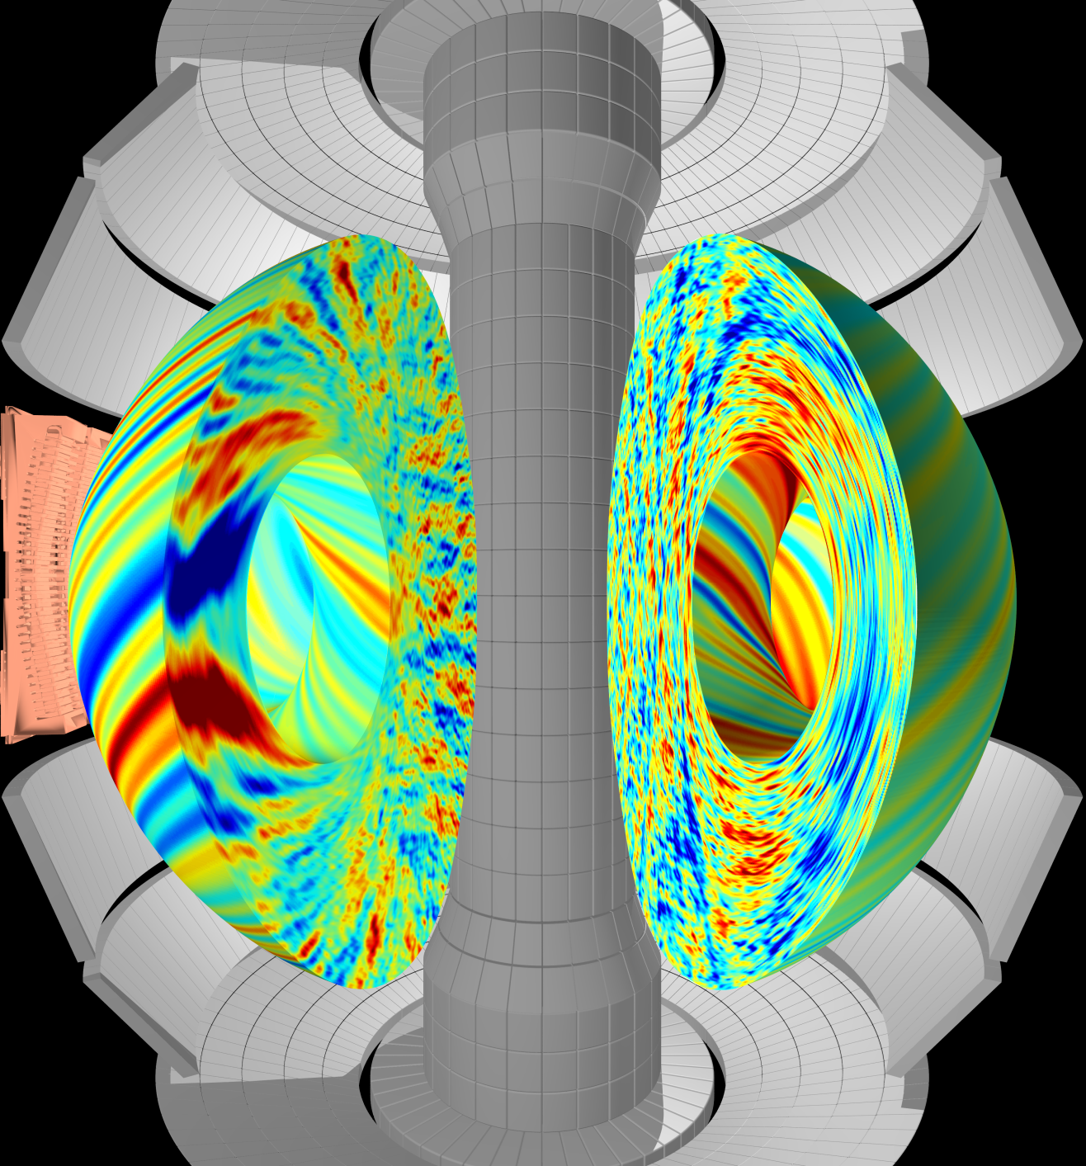

Plasma turbulence degrades energy confinement / insulation in magnetic fusion energy devices
Supercomputer simulation of
plasma turbulence
(this is what I do )
Heat
loss
W. Guttenfelder, F. Scotti

Slide 8
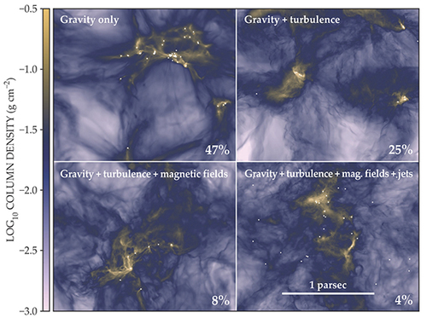
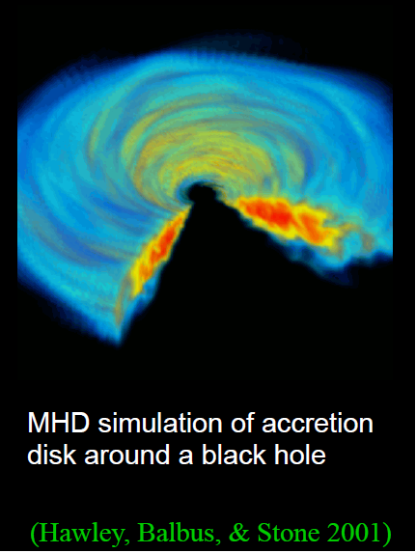
Turbulence is important throughout astrophysics
Plays a role in star formation (C. Federrath, Physics Today, June 2018)

Slide 9
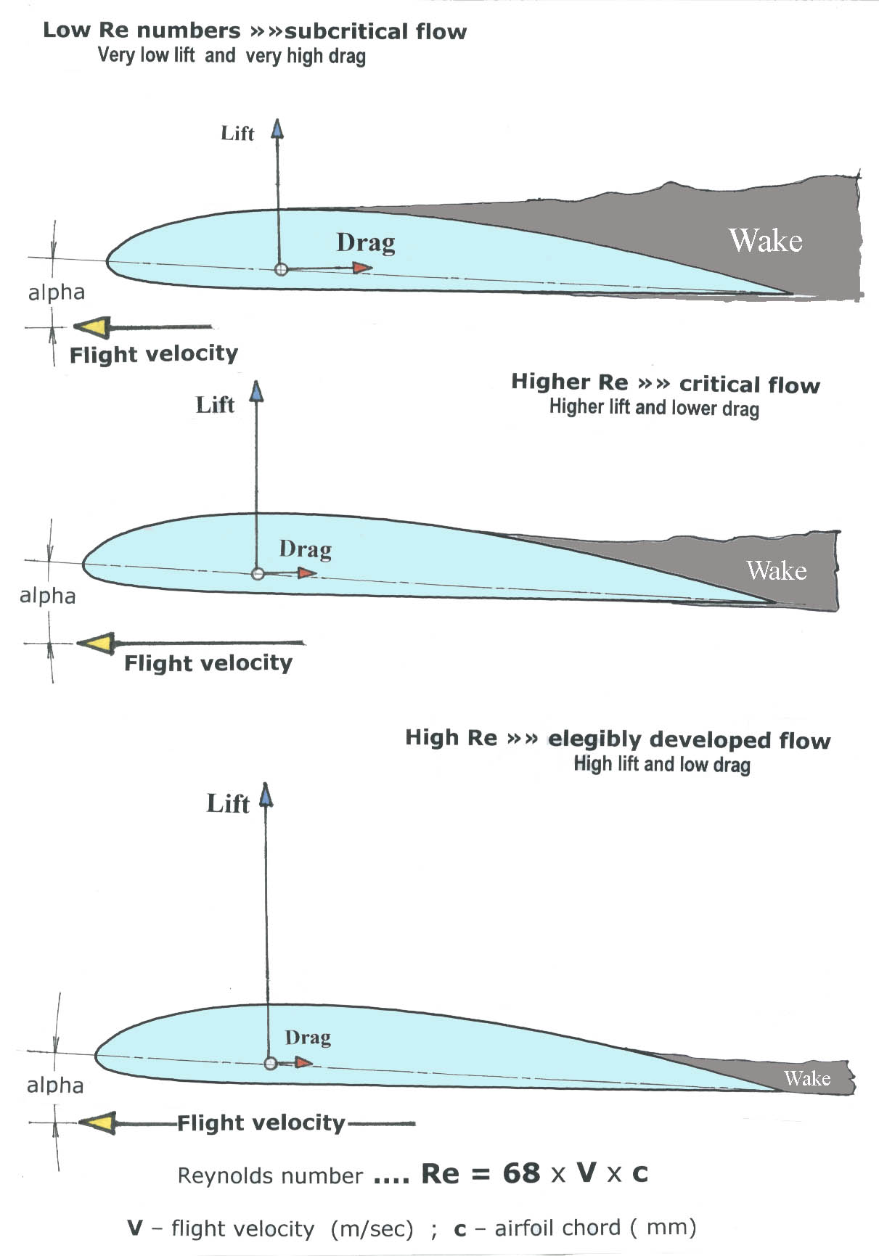
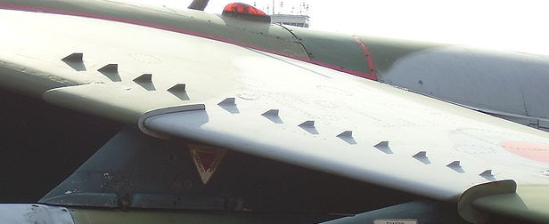
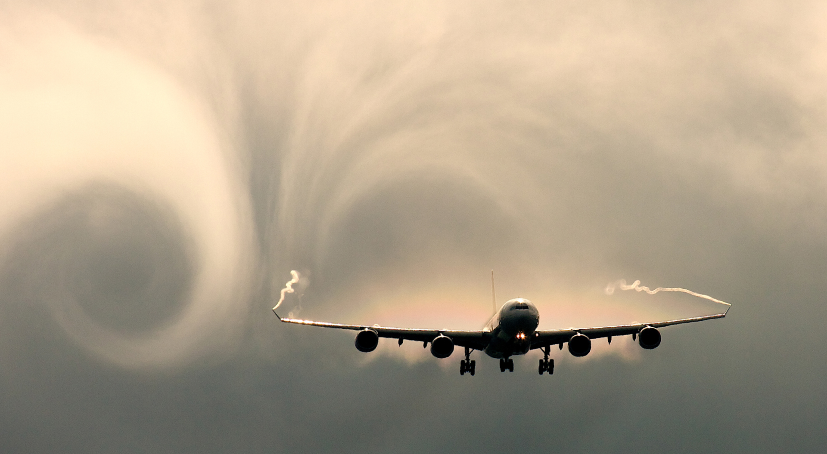
Turbulence is crucial to lift, drag & stall characteristics of airfoils
Increased turbulence on airfoil helps minimize boundary-layer separation and drag from adverse pressure gradient
Turbulence generators
Notes:
Combined with atmospheric turbulence, is crucial for the comfort of passengers and dryness of their clothing

Slide 10
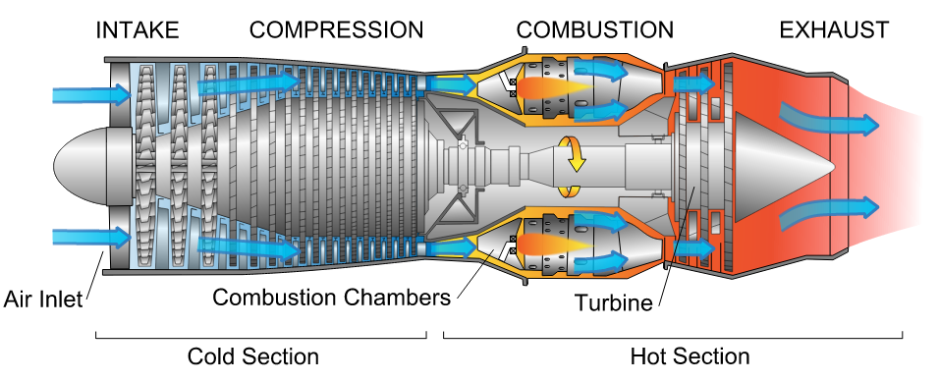

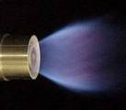
L/D~100-200 in non-premixed jet flames
L/D much smaller in swirling burner
Turbulent mixing of fuel and air is critical for efficient & economical jet engines
Notes:
L/D ~ 100-200 for non-premixed jet flames
Combustors use swirl-stabilized flames that more effectively mix fuel and air

Slide 11
What is turbulence?

Slide 12
Concepts of turbulence to remember
Turbulence is deterministic yet unpredictable (chaotic), appears random
  We often treat & diagnose statistically, but also rely on first-principles direct numerical simulation (DNS)
Turbulence causes increased mixing, transport larger than collisional transport
  Transport is the key application of why we care about turbulence
Turbulence spans a wide range of spatial and temporal scales
  Or in the case of hot, low-collisionality plasma, a wide range of scales in 6D phase-space (x,v)
Turbulence is not a property of the fluid, it’s a feature of the flow

Slide 13
Concepts of turbulence to remember
Turbulence is deterministic yet unpredictable (chaotic), appears random
  We often treat & diagnose statistically, but also rely on first-principles direct numerical simulation (DNS)
Turbulence causes increased mixing, transport larger than collisional transport
  Transport is the key application of why we care about turbulence
Turbulence spans a wide range of spatial and temporal scales
  Or in the case of hot, low-collisionality plasma, a wide range of scales in 6D phase-space (x,v)
Turbulence is not a property of the fluid, it’s a feature of the flow
It’s cool! “Turbulence is the most important unsolved problem in classical physics” (~Feynman)

Slide 14
Turbulence is an advective process
Transport a result of finite average correlation between perturbed drift velocity (δv) and perturbed fluid moments (δn, δT, δv)
  Particle flux, Γ = ⟨δvδn⟩
  Heat flux, Q = 3/2n₀⟨δvδT⟩ + 3/2T₀⟨δvδn⟩
  Momentum flux, Π ~ ⟨δvδv⟩ (“Reynolds stress”)
Electrostatic turbulence often most relevant in tokamaks → E×B drift from potential perturbations: δv_{E}=B×∇(δϕ)/B² ~ k_{θ}(δϕ)/B
Can also have magnetic contributions at high beta, δv_{B}~v||(δB_{r}/B) (magnetic “flutter” transport)

Slide 15
Why such a broad range of scale lengths?
(Enter the Reynolds number)

Slide 16
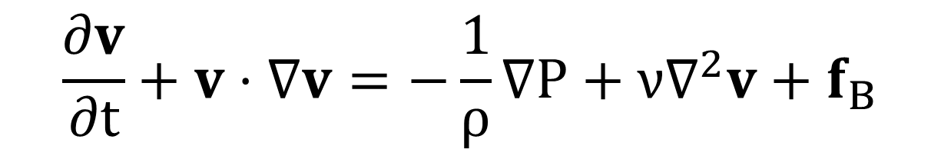

Incompressible Navier-Stokes (neutral fluids)
Momentum conservation law:
Assuming incompressible, from mass conservation:
Unsteady
flow
Convective acceleration
Pressure force
Viscosity
Body forces (g, J×B, qE)
Notes:
Body force, for instance gravity, JxB, qE

Slide 17
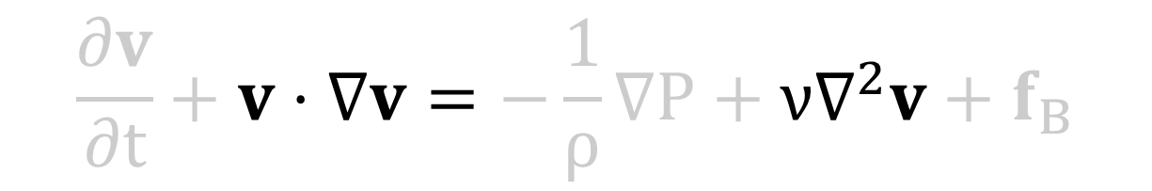
Consider externally forced flow, no body forces or pressure drop
Momentum conservation law:
Assuming incompressible, from mass conservation:
Unsteady
flow
Convective acceleration
Pressure force
Viscosity
Body forces (g, J×B, qE)
Notes:
Body force, for instance gravity, JxB, qE
Or, for RANS, body force would be like injected NBI momentum in tokamaks

Slide 18
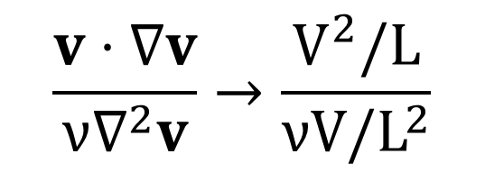
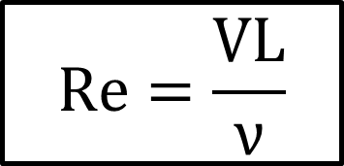
Use dimensionless ratios to estimate dominant dynamics
Reynolds number gives order-of-magnitude estimate of inertial force to viscous force
  Analogous to magnetic Reynolds number, S=VL/(η/μ₀) (reconnection)
For similar Reynolds numbers, we expect similar behavior, regardless of fluid type, viscosity or magnitude of V & L (as long as we are at low Mach #)
Viscosities (m²/s)
Air ~1.5×10⁻⁵
Water ~1.0×10⁻⁶
For L~1 m scale sizes and V~10 m/s, Re~10⁶-10⁷
Notes:
Low mach number limit → incompressible

Slide 19
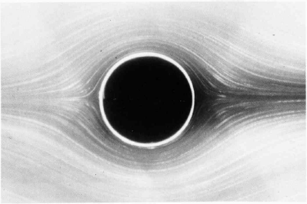
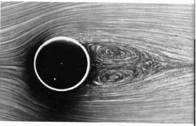
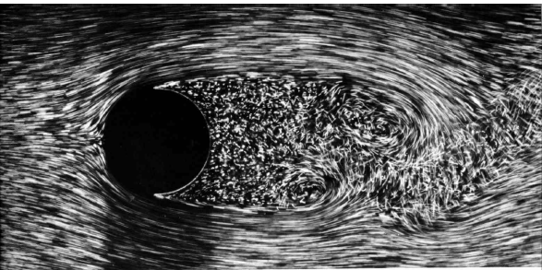
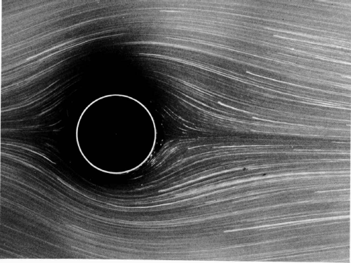
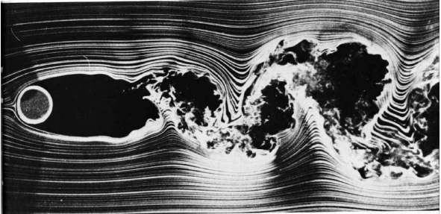
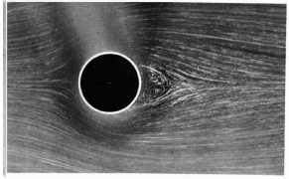
Transition from laminar to turbulent flow with increasing Re #
Re=26
Cylinders or spheres
Re=0.16
Re=2,000
Re=1.54
Re=10,000
Re=13.1
“An Album of Fluid Motion”, M. Van Dyke (1982)

Slide 20
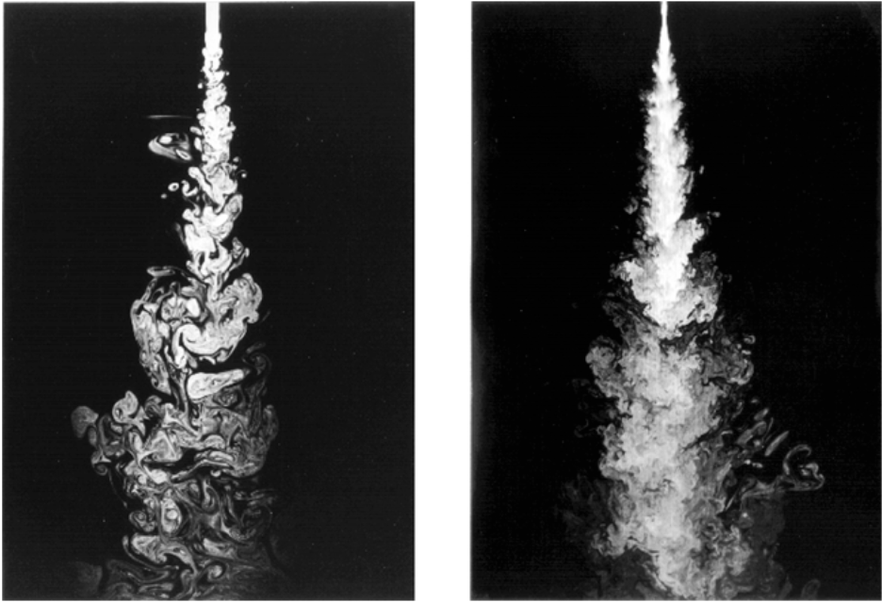
Increasing Re # in jet flow (what is changing?)
Re=2,300
Re=10,000
P. Dimotakis, J. Fluid Mech (2000)
Notes:
What is changing as Reynolds number is increased ???
Finer scales are apparent (Intermittency also apparent)
(In a movie, could possibly see faster small scales?)
And – what is happening to flow issuing into stationary fluid? Spreading out → transport / entrainment
Faster flow, comparable spread → larger momentum transport

Slide 21
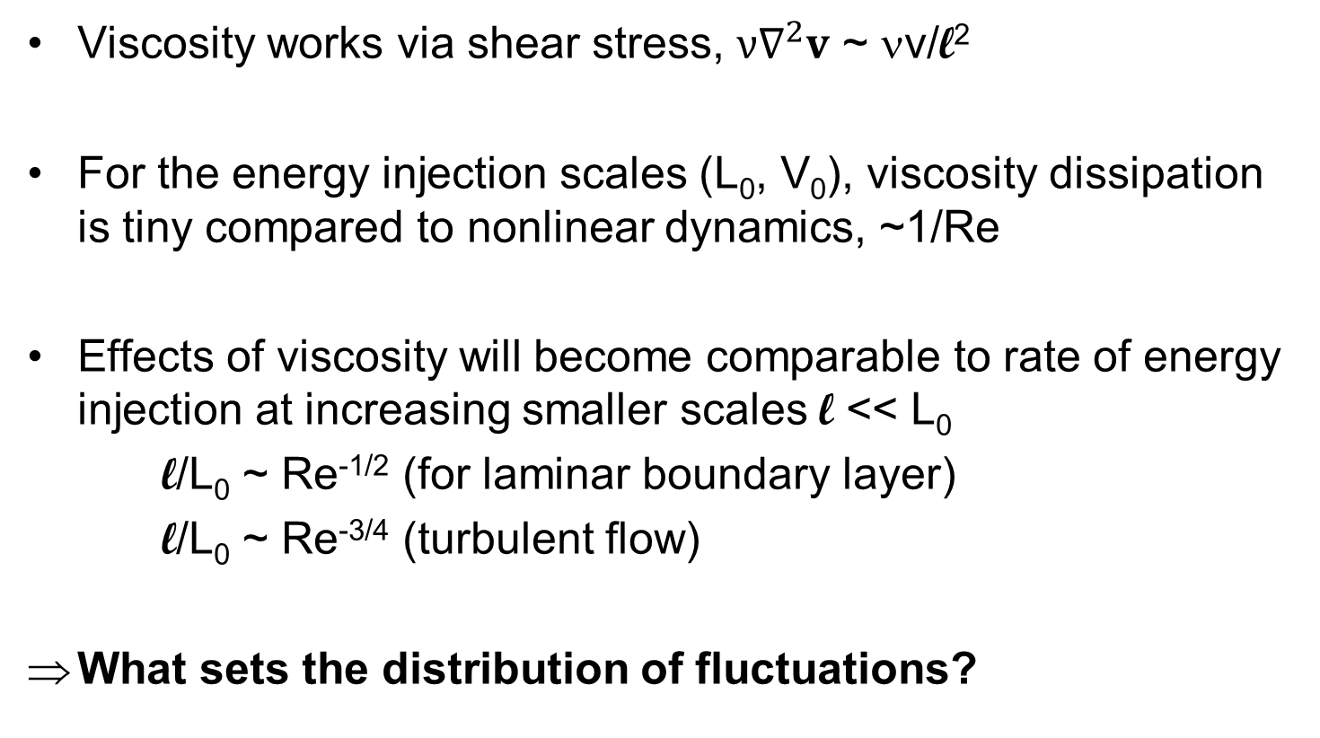
For large Reynolds #, we expect a large range of scale lengths

Slide 22
Kolmogorov scaling
(energy cascade through the inertial range)

Slide 23
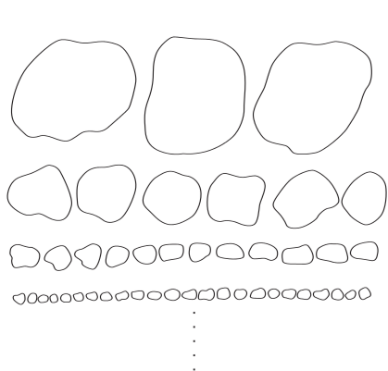
E.g., imagine there are eddies distributed at various scale lengths
Of course these different wavenumber eddies are not spatially separated but co-exist in space
Increasing wavenumber (k) eddies
Notes:
If small scales become non-space filling → intermittency
Intermittency at small scales does lead to corrections to K41

Slide 24
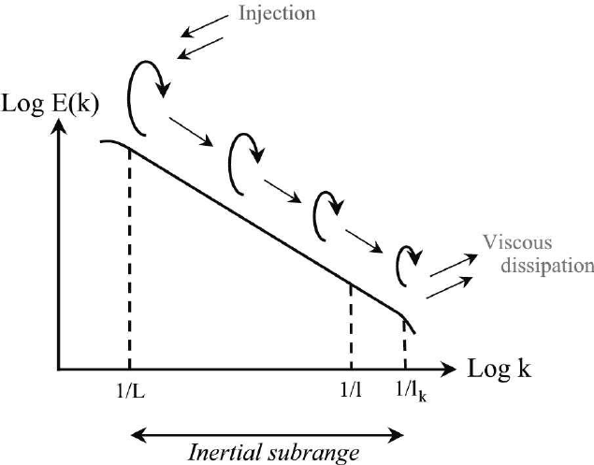
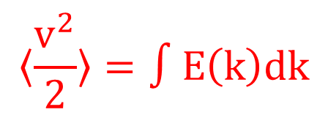


Want to predict distribution of energy with scale length (or wavenumber)
Turbulent energy spectrum

Slide 25
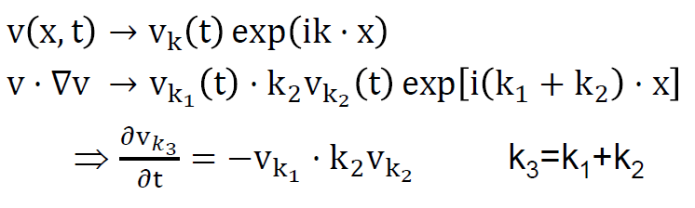
A.N. Kolmogorov (1941) provides a well known derivation of turbulent energy spectrum
Assumptions
For sufficient separation of scales (L >> l >> l_{ν}, i.e. Re >>>> 1), assume non-linear interactions independent of energy injection or dissipation (so called “inertial range”)
  Energy injected at large scales ~ L₀ (k_{forcing} ~ 1/L₀)
  Viscosity only matters at very small scales ~ l_{ν} (k_{ν} ~1/l_{ν})
Turbulence assumed to be homogeneous and isotropic in the inertial range
Assume that interactions occur locally in wavenumber space (for interacting triads k₁+k₂=k₃, |k₁|~|k₂|~|k₃|)

Slide 26
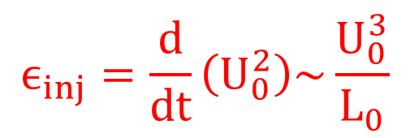
Energy injection occurs at large scales (low k)
Notes:
E_inj = integral (d/dt U_0^2 / \Delta-k)

Slide 27

Viscous dissipation strong at small scales (high k)
Notes:
Energy density ~ 1/Delta-k

Slide 28

Constant forward energy cascade (from large eddies to small eddies) through the “inertial range”
NL v⋅∇v interactions occur locally in wavenumber space (e.g. between ~k/2 < ~2*k)
  Very large eddy will not distort smaller eddy very much (~rigid translation/rotation)
  Smaller eddies will not distort much larger eddies as they don’t act coherently
Notes:
Energy density ~ 1/Delta-k

Slide 29

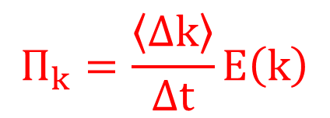
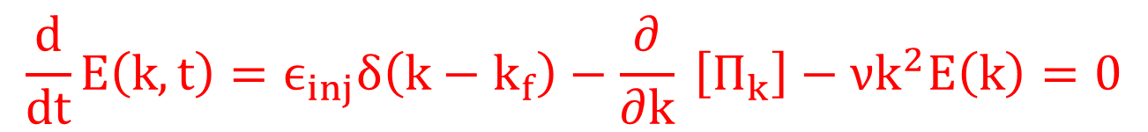
Consider a Fokker-Plank / advection equation for energy transfer through k-space
(Hammett class notes)
Notes:
Energy density ~ 1/Delta-k
Forcing at large scales
Viscosity at all scales but really only strong at small scales (~k^2)

Slide 30
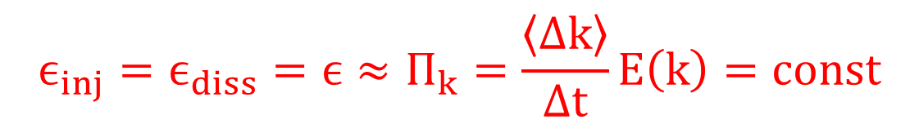
Consider a Fokker-Plank / advection equation for energy transfer through k-space
Notes:
Energy density ~ 1/Delta-k

Slide 31
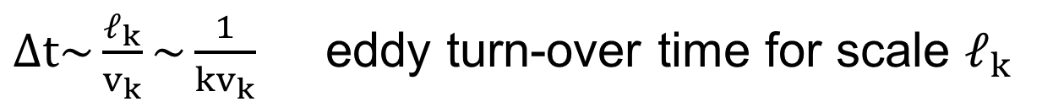
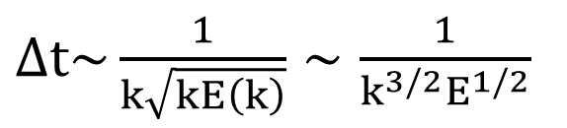
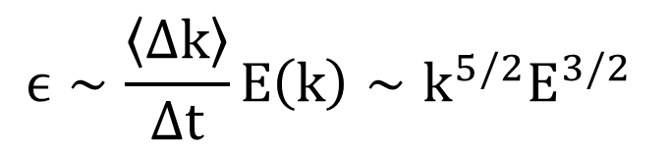
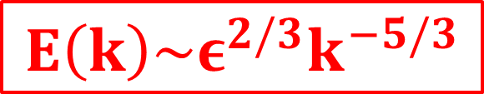
Constant cascade of energy through the inertial range gives Kolmogorov spectrum E(k)~ε^{2/3}k^{-5/3}
Energy cascades also important in plasma turbulence, but driving and dissipation can co-exist at similar scales
Notes:
Energy density ~ 1/Delta-k

Slide 32
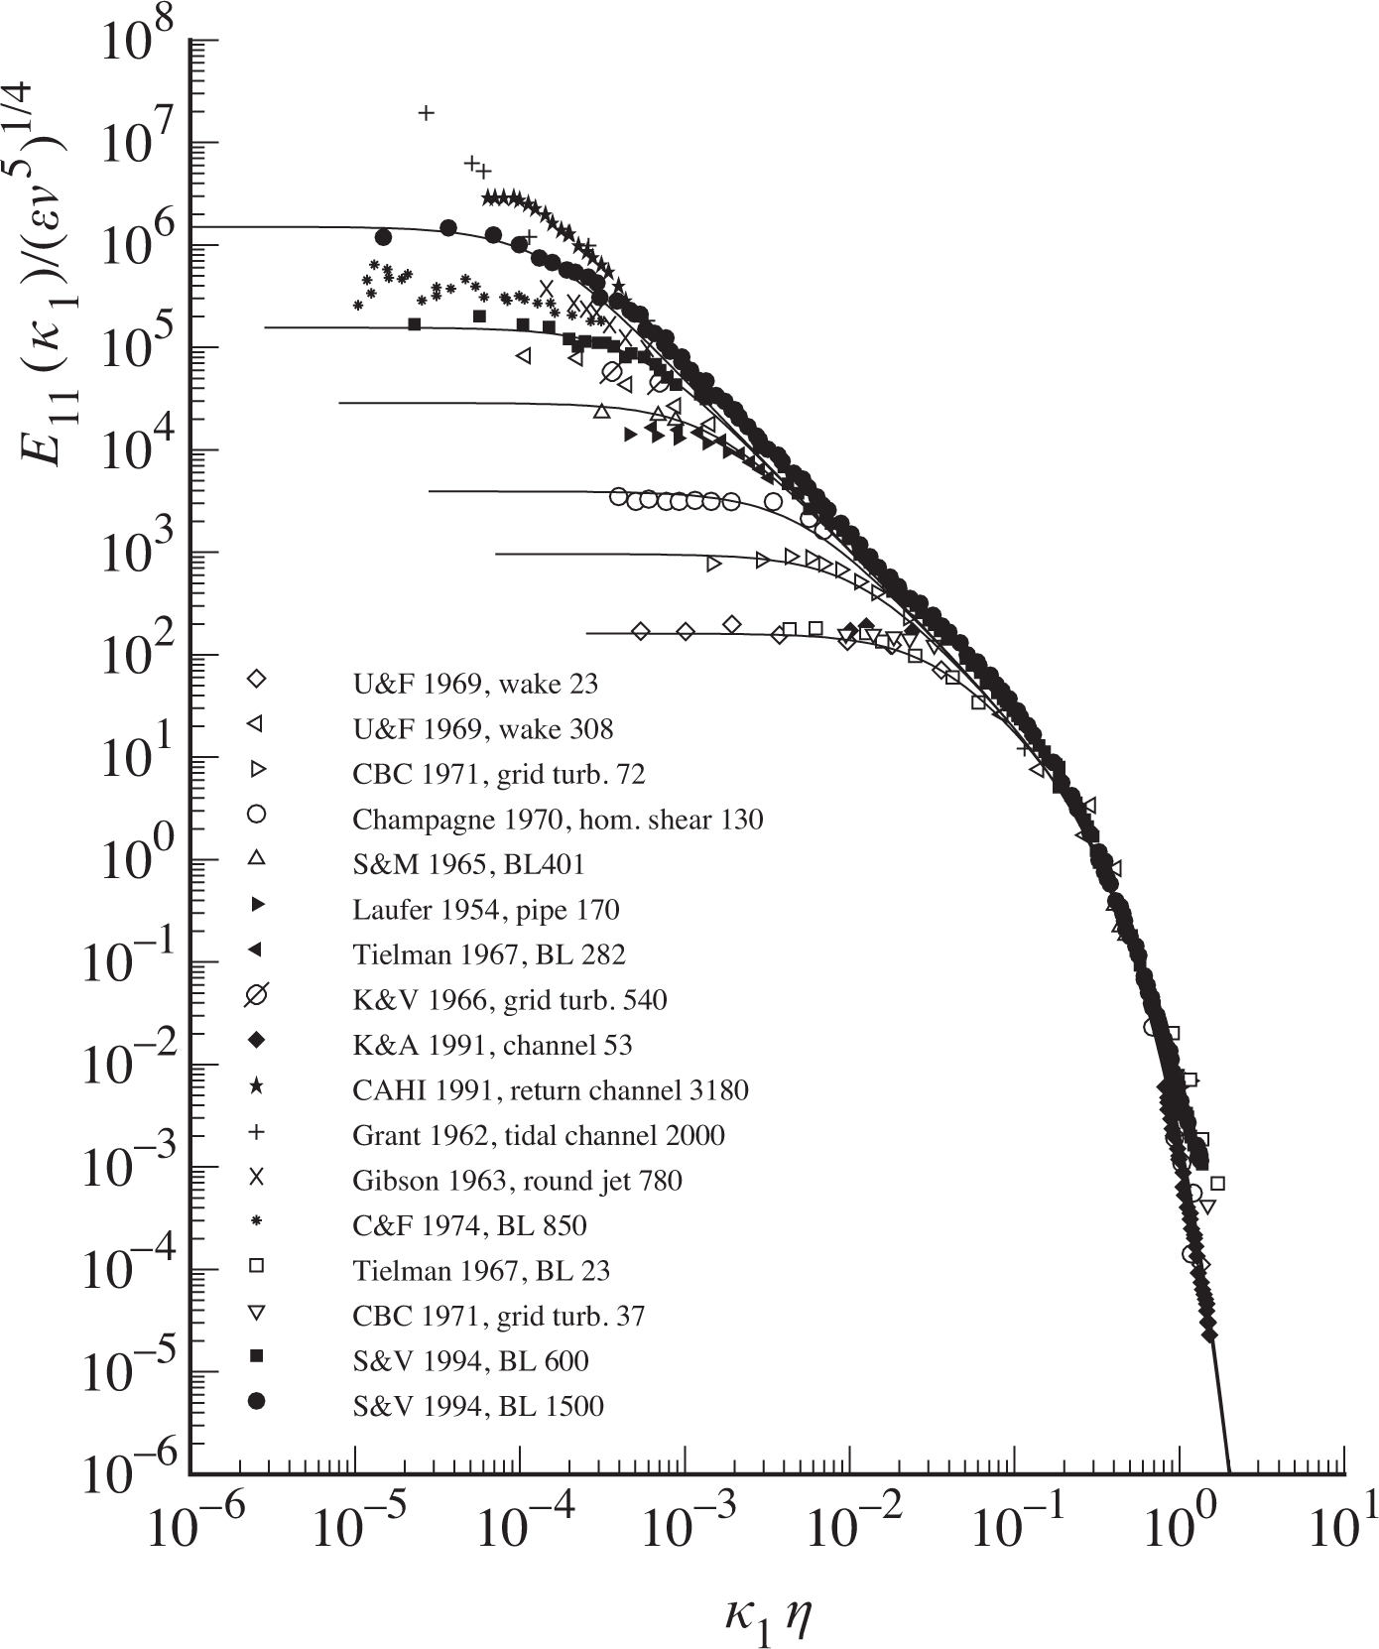

Significant experimental evidence supports inertial cascade at large Reynolds #
Kolmogorov scales
l_{K} = (ν³/ε)^{1/4}
τ_{K} = (ν/ε)^{1/2}
v_{K} = (νε)^{1/4}
Ratio of Kolmogorov / integral scales
l_{K}/l_{int} ~ Re^{-3/4}
τ_{K}u/l_{int} ~ Re^{-1/2}
v_{K}/u ~ Re^{-1/4}
S.G. Saddoughi, J. Fluid Mech (1994)
Notes:
Separation in forcing scale and dissipation scale increases with Reynolds number
In plot, wavenumber normalized by Kolmogorov scale, larger Re goes to lower normalized k.
Alternatively, for fixed forcing scale L, increasing Re leads to smaller dissipation scale
Walk through scaling of ell_k, tau_k, v_k with viscosity & forcing rate/dissipation rate

Slide 33
Significant experimental evidence supports inertial cascade at large Reynolds #
Kolmogorov scales
l_{K} = (ν³/ε)^{1/4}
τ_{K} = (ν/ε)^{1/2}
v_{K} = (νε)^{1/4}
Ratio of Kolmogorov / integral scales
l_{K}/l_{int} ~ Re^{-3/4}
τ_{K}u/l_{int} ~ Re^{-1/2}
v_{K}/u ~ Re^{-1/4}
Too expensive to do direction numerical simulation (DNS) of N-S for realistic applications → look to modeling
S.G. Saddoughi, J. Fluid Mech (1994)
Notes:
Separation in forcing scale and dissipation scale increases with Reynolds number
In plot, wavenumber normalized by Kolmogorov scale, larger Re goes to lower normalized k.
Alternatively, for fixed forcing scale L, increasing Re leads to smaller dissipation scale
Walk through scaling of ell_k, tau_k, v_k with viscosity & forcing rate/dissipation rate

Slide 34
How does plasma dynamics change turbulence?

Slide 35
New dynamics arise in plasma turbulence
New forces & interactions through charged particle motion
  δn_{e,i} & qδv_{e,i} → δE, δj, δB → q[E+δE + (v+δv)×(B+δB)]
  Turbulent dynamos δj×δB in conductive plasma gas
  Additional body forces (neutral beam injection, RF heating, …)
Manipulated by externally applied E & B fields
  Strong guide B-field → quasi-2D dynamics, changes inertial scaling
  Variation in equilibrium E field → can suppress turbulence through sheared V_{ExB} flows (in 2D)
Introduces additional scale lengths & times
  ρ_{i,e}, c/ω_{pe}, λ_{mfp}, (ρ/L)v_{T}, ν_{coll}
High temperature plasma → low collisionality → kinetic effects, additional degrees of freedom
  New sources of instability drive / energy injection (can occur over broad range of spatial scales)
  Different interpretation of spatial scale separation / Reynolds # → phase-space (x,v) scale separation / Dorland #
  Different cascade dynamics & routes to dissipation (that still occurs through collisions / thermalization, but can occur at all spatial scales)

Slide 36
Magnetized plasma turbulence
(e.g. for magnetic confinement fusion)

Slide 37
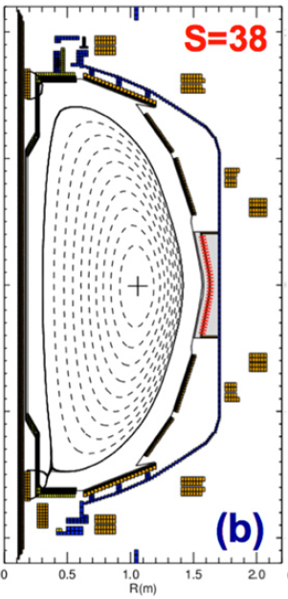
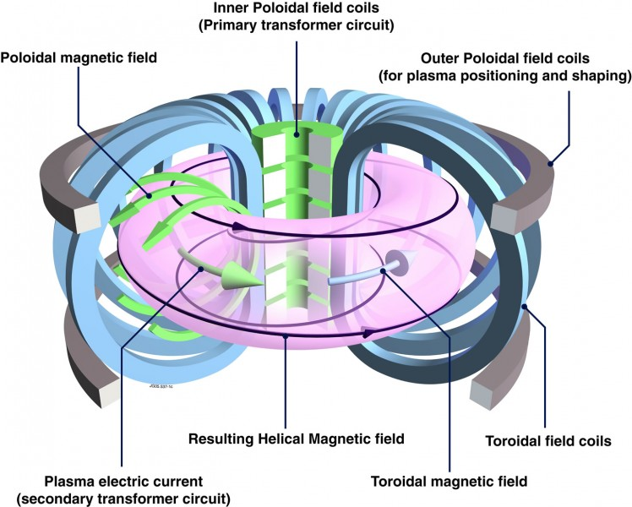
Tokamaks
NSTX
Toroidal, axisymmetric
Helical field lines confine plasma
Closed, nested flux surfaces

Slide 38
Tokamaks
NSTX
Toroidal, axisymmetric
Helical field lines confine plasma
Closed, nested flux surfaces
Heat
loss

Slide 39
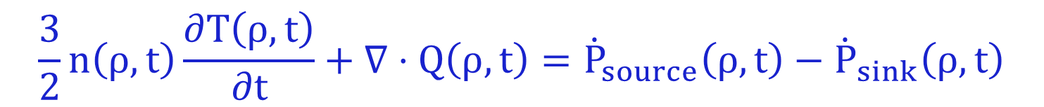
We use 1D transport equations to interpret experiments
Take moments of kinetic equation
Flux surface average, i.e. everything depends only on flux surface label (ρ)

Slide 40
We use 1D transport equations to interpret experiments
Take moments of kinetic equation
Flux surface average, i.e. everything depends only on flux surface label (ρ)
Average over short space and time scales of turbulence (assume sufficient scale separation, e.g τ_{turb} << τ_{transport}, L_{turb} << L_{machine}) → macroscopic transport equation for evolution of equilibrium (non-turbulent) plasma state
To infer experimental transport, Q_{exp}:
  Measure profiles (Thomson Scattering, CHERS)
  Measure / calculate sources (NBI, RF)
  Measure / calculate losses (P_{rad})

Slide 41
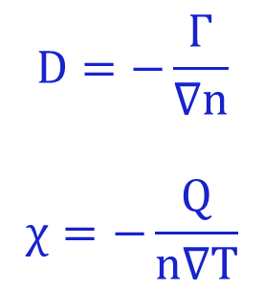
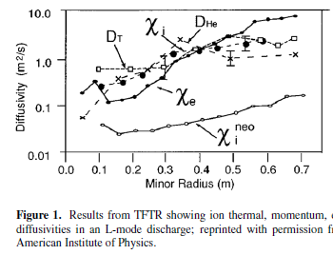
Inferred experimental transport larger than collisional (neoclassical) theory – extra “anomalous” contribution
TFTR
Hawryluk, Phys. Plasmas (1998)
Exp.
Collisional theory
Reporting transport as diffusivities – does not mean the transport processes are collisionally diffusive!

Slide 42
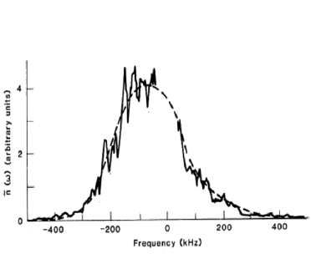
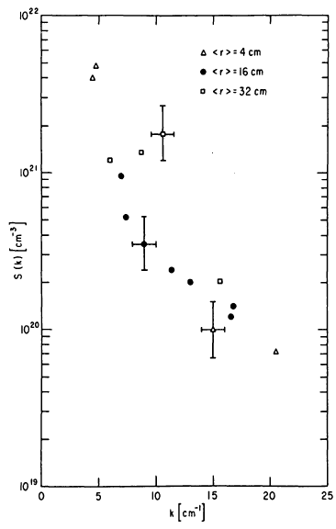
Broad frequency and wavenumber spectra measured, e.g. from microwave scattering
Mazzucato, PRL (1982)
Surko & Slusher, Science (1983)
Princeton Large Torus (PLT)
k~7 cm⁻¹
Different scattering angles measure different k, observe spectral decay in wavenumber

Slide 43
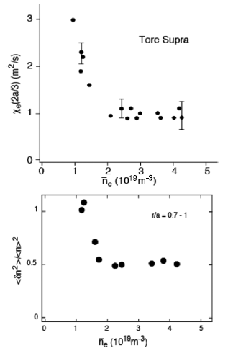

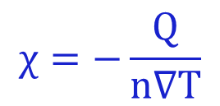
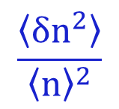
Correlation between local transport and density fluctuations hints at turbulence as source of anomalous transport
Garbet, Nuclear Fusion (1992)
Tynan, PPCF (2009)
Our goal is to understand this

Slide 44


Spectroscopic imaging provides a 2D picture of turbulence in tokamaks: cm spatial scales, μs time scales, <1% amplitude
Utilize interaction of neutral atoms with charged particles to measure density
DIII-D tokamak (General Atomics)
Movies at: https://fusion.gat.com/global/BESMovies
Notes:
Perpendicular cross section size
Turbulence is transporting energy and particles from hot core to cooler edge, mixing them together

Slide 45

Rough estimate of turbulent diffusivity indicates it’s a plausible explanation for confinement
P_{heat} = Heat flux
HOT
COLD
time-averaged
temperature
D_{turbulence} ~ (step size)² × decorrelation rate
step size ~ 5-10 gyroradii ~ few cm’s
decorrelation rate ~ 100 kHz
~ cm’s
instantaneous
temperature
core
boundary
~1 m
Turbulence confinement time estimate ~ 0.1 s
Experimental confinement time ~ 0.1 s

Slide 46
Measurements are challenging and limited – also use theory and simulation to help improve understanding

Slide 47
40+ years of theory predicts turbulence in magnetized plasma should often be drift wave in nature
General predicted drift wave characteristics:
Finite-frequency drifting waves, ω(k_{θ})~ω*~k_{θ}V*~(k_{θ}ρ)v_{T}/L_{n}
Driven by ∇n, ∇T (1/L_{n} = -1/n⋅∇n)
  Can propagate in ion or electron diamagnetic direction, depending on conditions/dominant gradients
Quasi-2D, elongated along the field lines (L||>>L⊥, k|| << k ⊥)
  Particles can rapidly move along field lines to smooth out perturbations
Perpendicular sizes linked to local gyroradius, L⊥~ρ_{i,e} or k⊥ρ_{i,e}~1
Correlation times linked to acoustic velocity, τ_{cor}~c_{s}/R
In a tokamak expected to be “ballooning”, i.e. stronger on outboard side
  Due to “bad curvature”/”effective gravity” pointing outwards from symmetry axis
  Often only measured at one location (e.g. outboard midplane)
Fluctuation strength loosely follows mixing length scaling (δn/n₀~ρ_{s}/L_{n})
Transport has gyrobohm scaling, χ_{GB}=ρ_{i}²v_{Ti}/R
  But other factors important! I.e. χ_{turb} ~ χ_{GB}⋅F(⋅⋅⋅)⋅[R/L_{T}-R/L_{T,crit}]

Slide 48


Slide 49

to obtain δϕ, δB

Slide 50








Transport, density fluctuation amplitude (from reflectometry) and spectral characteristics predicted by nonlinear gyrokinetic simulations
Provides confidence in interpretation of transport in conditions when ITG instability/turbulence predicted to be most important
Casati, PRL (2009)
Tore Supra tokamak
Ion Temperature Gradient (ITG) turbulence
Notes:
Spectra only covers ~order of magnitude (not >4 like high Re neutral fluids)

Slide 51


Energy cascade in 2D turbulence is different than 3D
Loss of vortex stretching, vorticity is conserved → change in non-linear conservation properties
  Inverse energy cascade E(k) ~ k^{-5/3}
  Forward enstrophy [ω²~(∇×v)²] cascade E(k)~k⁻³ (at larger wavenumbers, smaller scales)
  Non-local wavenumber interactions can couple over larger range in k-space (e.g. to zonal flows)
Quasi-2D turbulence exists in many places
Geophysical flows like ocean currents (Charney, 1947), tropical cyclones, polar vortex, chemical mixing in polar stratosphere (→ ozone hole)
Soap films →
Liu et al., PRL (2016)

Slide 52
Gyrokinetic simulations find that nonlinear transport follows many of the underlying linear instability trends
Very valuable to understand linear instabilities → Example: Linear stability analysis of toroidal Ion Temperature Gradient (ITG) micro-instability (expected to dominate in ITER)

Slide 53

Toroidicity Leads To Inhomogeneity in |B|, gives ∇B and curvature (κ) drifts
What happens when there are small perturbations in T||, T⊥? ⇒ Linear stability analysis…
∇B, curvature (κ)
Z
Z
R
R

Slide 54

Temperature perturbation (δT) leads to compression (∇⋅v_{di}), density perturbation – 90° out-of-phase with δT
∇B, curvature
T⁺
T⁻
T+
T-
T+
T-
Fourier decompose perturbations in space (k_{θ}ρ_{i}≤1)
Assume small δT perturbation
n⁻
n⁺
n-
n+
n-
∇B
n
T
∇T

Slide 55
Dynamics Must Satisfy Quasi-neutrality
Quasi-neutrality (Poisson equation, k⊥²λ_{D}²<<1) requires
For this ion drift wave instability, parallel electron motion is very rapid
Electrons (approximately) maintain a Boltzmann distribution

Slide 56

Perturbed Potential Creates E×B Advection
Advection occurs in the radial direction
∇B, curvature
~Boltzmann e’s
T⁺
T⁻
T+
T-
T+
T-
n⁻
n⁺
n-
n+
n-
ϕ⁻
ϕ⁺
ϕ-
ϕ+
ϕ-
E_{θ}
E_{θ}
E_{θ}
E_{θ}
∇B
n
T
∇T

Slide 57
Background Temperature Gradient Reinforces Perturbation ⇒ Instability
∇T
T⁺
T⁻
T+
T-
T+
T-

Slide 58



Analogy for turbulence in tokamaks – Rayleigh-Taylor instability
Higher density on top of lower density, with gravity acting downwards
gravity
density/pressure

Slide 59


Inertial force in toroidal field acts like an effective gravity
centrifugal force
→effective gravity
gravity
pressure
pressure
Unstable in the outer region
GYRO code
https://fusion.gat.com/theory/Gyro

Slide 60
Same Dynamics Occur On Inboard Side But Now Temperature Gradient Is Stabilizing
Advection with ∇T counteracts perturbations on inboard side – “good” curvature region
“good” curvature
“bad” curvature
∇T
∇T
∇B
T⁺
T⁻
T+
T-
T+
T-
T⁺
T⁻
T+
T-
T+
T-
n
T
∇T
∇T

Slide 61
Fast Parallel Motion Along Helical Field Line Connects Good & Bad Curvature Regions
Approximate growth rate on outboard side
Parallel transit time
Expect instability if γ_{instability} > γ_{parallel} , or

Slide 62

Ballooning nature observed in simulations
(Hammett notes)

Slide 63

Threshold-like behavior analogous to Rayleigh-Benard instability
Analogous to convective transport when heating a fluid from below … boiling water (before the boiling)
Heat flux ~ heating power
diffusion
+
turbulence
collisional
diffusion
Temperature gradient
(T_{hot} - T_{cold})
Rayleigh, Benard, early 1900’s
Threshold gradient for temperature gradient driven instabilities have been characterized over parameter space with gyrokinetic simulations
Notes:
Rayleigh-benard, water expands (less dense) as temperature increases (buoyancy), will thermally diffuse to balance, plus viscosity will impede fluid motions until threshold surpassed

Slide 64

Critical gradient for ITG determined from many linear gyrokinetic simulations (guided by theory)
$${{\left(\frac{R}{L_{T}}\right)}_{crit}^{ITG}}_{}=Max\left[\left(1+\frac{T_{i}}{T_{e}}\right)\left(1.3+1.9\frac{s}{q}\right)\left(…\right)\right]$$
Jenko (2001)
Hahm (1989)
Romanelli (1989)
R/L_{T} = -R/T⋅∇T is the normalized temperature gradient
Natural way to normalize gradients for toroidal drift waves, i.e. ratio of diamagnetic-to-toroidal drift frequencies:
  ω_{*T} = k_{y}(B×∇p) / nqB² → (k_{θ}ρ_{i})v_{T}/L_{T}
  ω_{D} = k_{y}(B×mv⊥²∇B/2B) / qB² → (k_{θ}ρ_{i})v_{T}/R
→ ω_{*T}/ω_{D} = R/L_{T}

Slide 65
How does magnetized turbulence saturate?
What sets spatial scales (drive vs. dissipation)?

Slide 66



Nonlinearly-generated “zonal flows” impacts saturation of turbulence and overall transport (esp. ITG)
Potential perturbations uniform on flux surfaces, near zero frequency (f~0)
Predator-prey like behavior: turbulence drives ZF (linearly stable), which regulates/clamps turbulence; if turbulence drops enough, ZF drive drops, allows turbulence to grow again…
Linear instability stage demonstrates structure of fastest growing modes
Large flow shear from instability cause perpendicular “zonal flows”
Zonal flows help moderate the turbulence!!!
Rayleigh-Taylor like instability ultimately driving Kelvin-Helmholtz-like instability → non-linear saturation

Slide 67


Slide 68

The Jet Stream is a zonal flow (or really, vice-versa)
NASA/Goddard Space Flight Center Scientific Visualization Studio

Slide 69


Near linear threshold, strong zonal flows can suppress primary ITG instability → low time-averaged transport
Leads to nonlinear upshift of effective threshold
Predicting threshold and “stiffness” ~d(Q)/d(∇T) was a key breakthrough in understanding tokamak transport (~90s) – has also been measured
Dorland (2000)

Slide 70



Energy drive can occur across large range of scales, but turbulent spectra still exhibit decay
2D energy & enstrophy cascades remain important → nonlinear spectra often downshifted in k_{θ} (w.r.t. linear growth rates)
Both drive and damping can overlap over wide range of k⊥ (very distinct from neutral fluid turbulence)
Linear growth rates
Nonlinear density power spectra
Nonlinear heat flux spectra
Howard, PoP & NF (2016)

Slide 71

Addition effects proposed to model turbulence saturation & dissipation

Slide 72
Summary
Turbulence ubiquitous throughout the universe
  Lots of free energy sources
Turbulence is deterministic yet unpredictable (chaotic), appears random
Turbulence causes increased mixing, transport larger than collisional transport
  Transport is the key application of why we care about turbulence
  Understanding and reducing transport critical for fusion reactors
Turbulence spans a wide range of spatial and temporal scales
  Large Reynolds # (3D neutral fluids) / Dorland # (6D kinetic plasmas)
  6D kinetic plasmas lead to additional degrees of freedom for driving and dissipation mechanisms

Slide 74

(Hammett class notes)
Notes:
Multiple measurements of turbulence in interstellar media ???

Slide 75

Have learned a lot from validating first-principles gyrokinetic simulations with experiment
But the simulations are expensive (1 local multi-scale simulation ~ 20M cpu-hrs)
Desire a model capable of reproducing flux-gradient relationship that is far quicker, so we can do integrated predictive modeling (“flight simulator”)
All physics based models are local & gradient-driven, i.e. given gradients from a single flux surface they predict fluxes:
that can be used in solving the 1D transport equation predictively

Slide 76
Low aspect ratio equilibrium can stabilize electrostatic drift waves, minimize transport
(i.e. one motivation for NSTX-U at PPPL)

Slide 77

Aspect ratio is an important free parameter, can try to make more compact devices (i.e. hopefully cheaper)
Aspect ratio A = R / a
Elongation κ = b / a
R = major radius, a = minor radius, b = vertical ½ height
b
a
R
a
But smaller R = larger curvature, ∇B (~1/R) -- isn’t this terrible for “bad curvature” driven instabilities?!?!?!

Slide 78

Many elements of ST are stabilizing to toroidal, electrostatic ITG/TEM drift waves
Short connection length → smaller average bad curvature
bad curvature
good curvature
Notes:
Something about general toroidal, ballooning drift wave instabilities
Then, how ST configuration is so beneficial, but new instabilities develop (quite different from traditional tokamak discussions)
Add more refs here? Progression slides in backup

Slide 79

Many elements of ST are stabilizing to toroidal, electrostatic ITG/TEM drift waves
Short connection length → smaller average bad curvature
Quasi-isodynamic (~constant B) at high β → grad-B drifts stabilizing [Peng & Strickler, NF 1986]
bad curvature
good curvature
θ (rad)
Notes:
Something about general toroidal, ballooning drift wave instabilities
Then, how ST configuration is so beneficial, but new instabilities develop (quite different from traditional tokamak discussions)
Add more refs here? Progression slides in backup

Slide 80


Many elements of ST are stabilizing to toroidal, electrostatic ITG/TEM drift waves
Short connection length → smaller average bad curvature
Quasi-isodynamic (~constant B) at high β → grad-B drifts stabilizing [Peng & Strickler, NF 1986]
Large fraction of trapped electrons, BUT precession weaker at low A → reduced TEM drive [Rewoldt, Phys. Plasmas 1996]
Orbit-averaged drift of trapped particle
Notes:
Something about general toroidal, ballooning drift wave instabilities
Then, how ST configuration is so beneficial, but new instabilities develop (quite different from traditional tokamak discussions)
Add more refs here? Progression slides in backup

Slide 81

Many elements of ST are stabilizing to toroidal, electrostatic ITG/TEM drift waves
Short connection length → smaller average bad curvature
Quasi-isodynamic (~constant B) at high β → grad-B drifts stabilizing [Peng & Strickler, NF 1986]
Large fraction of trapped electrons, BUT precession weaker at low A → reduced TEM drive [Rewoldt, Phys. Plasmas 1996]
Strong coupling to δB⊥~δA|| at high β → stabilizing to ES-ITG
ITG growth rate
Kim, Horton, Dong, PoFB (1993)
β
Notes:
Something about general toroidal, ballooning drift wave instabilities
Then, how ST configuration is so beneficial, but new instabilities develop (quite different from traditional tokamak discussions)
Add more refs here? Progression slides in backup

Slide 82
Many elements of ST are stabilizing to toroidal, electrostatic ITG/TEM drift waves
Short connection length → smaller average bad curvature
Quasi-isodynamic (~constant B) at high β → grad-B drifts stabilizing [Peng & Strickler, NF 1986]
Large fraction of trapped electrons, BUT precession weaker at low A → reduced TEM drive [Rewoldt, Phys. Plasmas 1996]
Strong coupling to δB⊥~δA|| at high β → stabilizing to ES-ITG
Small inertia (nmR²) with uni-directional NBI heating gives strong toroidal flow & flow shear → E×B shear stabilization (dv⊥/dr)
Biglari, Diamond, Terry, PoFB (1990)
Notes:
Something about general toroidal, ballooning drift wave instabilities
Then, how ST configuration is so beneficial, but new instabilities develop (quite different from traditional tokamak discussions)
Add more refs here? Progression slides in backup

Slide 83
Many elements of ST are stabilizing to toroidal, electrostatic ITG/TEM drift waves
Short connection length → smaller average bad curvature
Quasi-isodynamic (~constant B) at high β → grad-B drifts stabilizing [Peng & Strickler, NF 1986]
Large fraction of trapped electrons, BUT precession weaker at low A → reduced TEM drive [Rewoldt, Phys. Plasmas 1996]
Strong coupling to δB⊥~δA|| at high β → stabilizing to ES-ITG
Small inertia (nmR²) with uni-directional NBI heating gives strong toroidal flow & flow shear → E×B shear stabilization (dv⊥/dr)
Not expecting strong ES ITG/TEM instability (much higher thresholds)
BUT
High beta drives EM instabilities: microtearing modes (MTM) ~ β_{e}⋅∇T_{e}, kinetic ballooning modes (KBM) ~ α_{MHD}~q²∇P/B²
Large shear in parallel velocity can drive Kelvin-Helmholtz-like instability ~dv||/dr
Notes:
Something about general toroidal, ballooning drift wave instabilities
Then, how ST configuration is so beneficial, but new instabilities develop (quite different from traditional tokamak discussions)
Add more refs here? Progression slides in backup

Slide 84
Why is turbulence everywhere?

Slide 85


Energy gradients can drive linear instabilities → turbulence
Free energy drive in fluid gradients (∇V, ∇ρ ∇T) or kinetic gradients ∇F(x,v) in the case of plasma → transport relaxes gradients
Multiple analogous instabilities in magnetic plasmas
Generally expect large scale separation remains between linearly unstable wavelengths and viscous damping scale lengths (often not the case in kinetic plasma turbulence)
Rayleigh-Taylor
instability ~ ∇ρ
Kelvin-Helmholtz instability ~ ∇V
Rayleigh-Benard instability ~ ∇T

Slide 86

Nonlinear instability important for neutral fluid pipe flow
(Hammett notes)
Nonlinear instability (subcritical turbulence) may be important in some plasma scenarios

