Slide 1
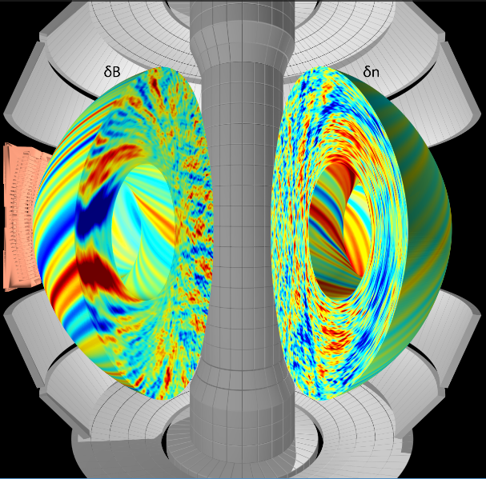
Toroidal magnetized plasma turbulence & transport
Walter Guttenfelder (PPPL)
PPPL Graduate seminar AST 558, April 21, 2023

Slide 2
Outline & references
Outline
Intro & neutral fluid turbulence
Magnetized plasmas & turbulence
Drift waves & characteristics
Ion Temperature Gradient (ITG) instability cartoon
Miscellaneous (nonlinear saturation, zonal flows, E×B shear, validation)
Various introductory & tutorial material on magnetized plasma turbulence and microinstabilities:
Greg Hammett’s webpage, w3.pppl.gov/~hammett
SULI lectures, e.g. https://suli.pppl.gov/2020/index.html
PPPL Graduate Summer School lectures, e.g. https://gss.pppl.gov/2020/
Intro chapters of various Ph.D. theses (Dorland, Beer, Snyder) – all found on Hammett’s webpage

Slide 3
Examples of turbulence

Slide 4

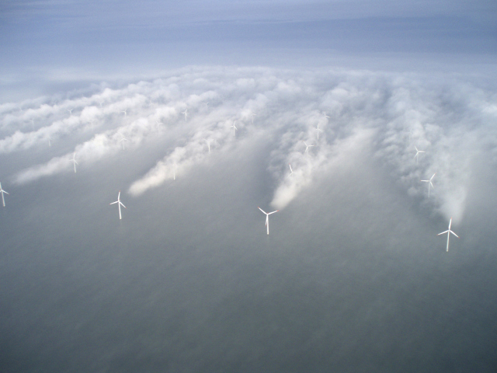
Turbulence is ubiquitous throughout planetary atmospheres

Slide 5
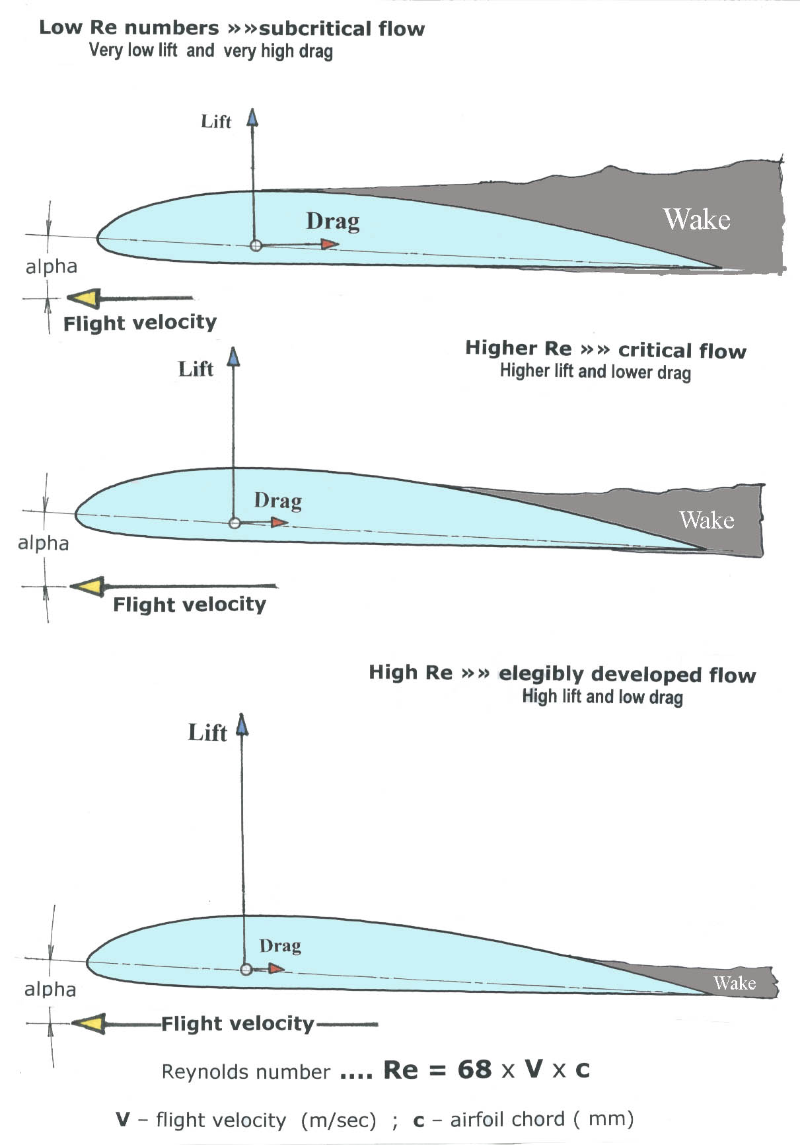
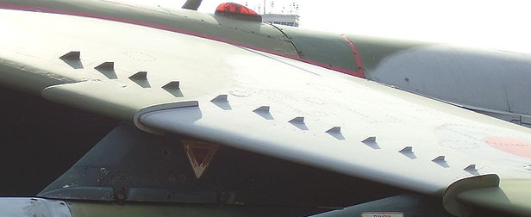

Turbulence is crucial to lift, drag & stall characteristics of airfoils
Increased turbulence on airfoil helps minimize boundary-layer separation and drag from adverse pressure gradient
Turbulence generators
Notes:
Combined with atmospheric turbulence, is crucial for the comfort of passengers and dryness of their clothing

Slide 6
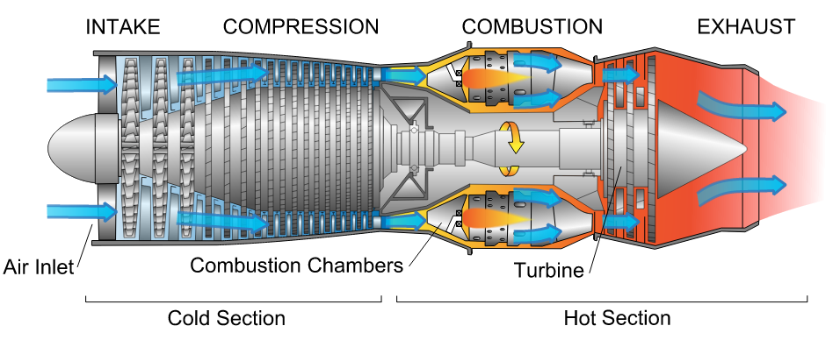

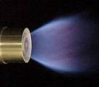
L/D~100 in non-premixed jet flames
L/D much smaller in swirling burner
Turbulent mixing of fuel and air is critical for efficient & economical jet engines
Notes:
L/D ~ 100-200 for non-premixed jet flames
Combustors use swirl-stabilized flames that more effectively mix fuel and air

Slide 7
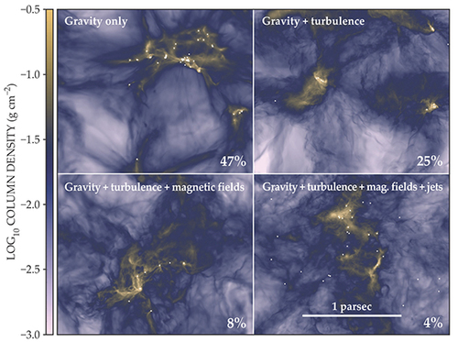
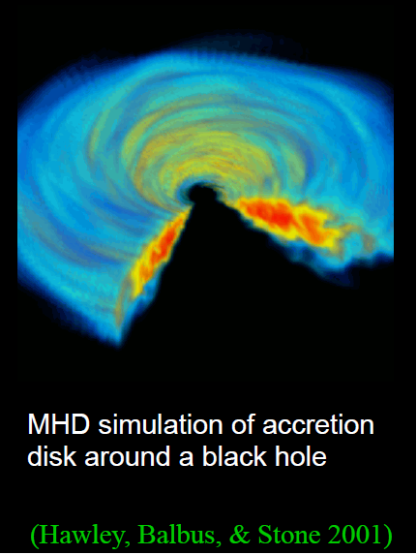
Turbulence is important throughout astrophysics
Plays a role in star formation (C. Federrath, Physics Today, June 2018)

Slide 8
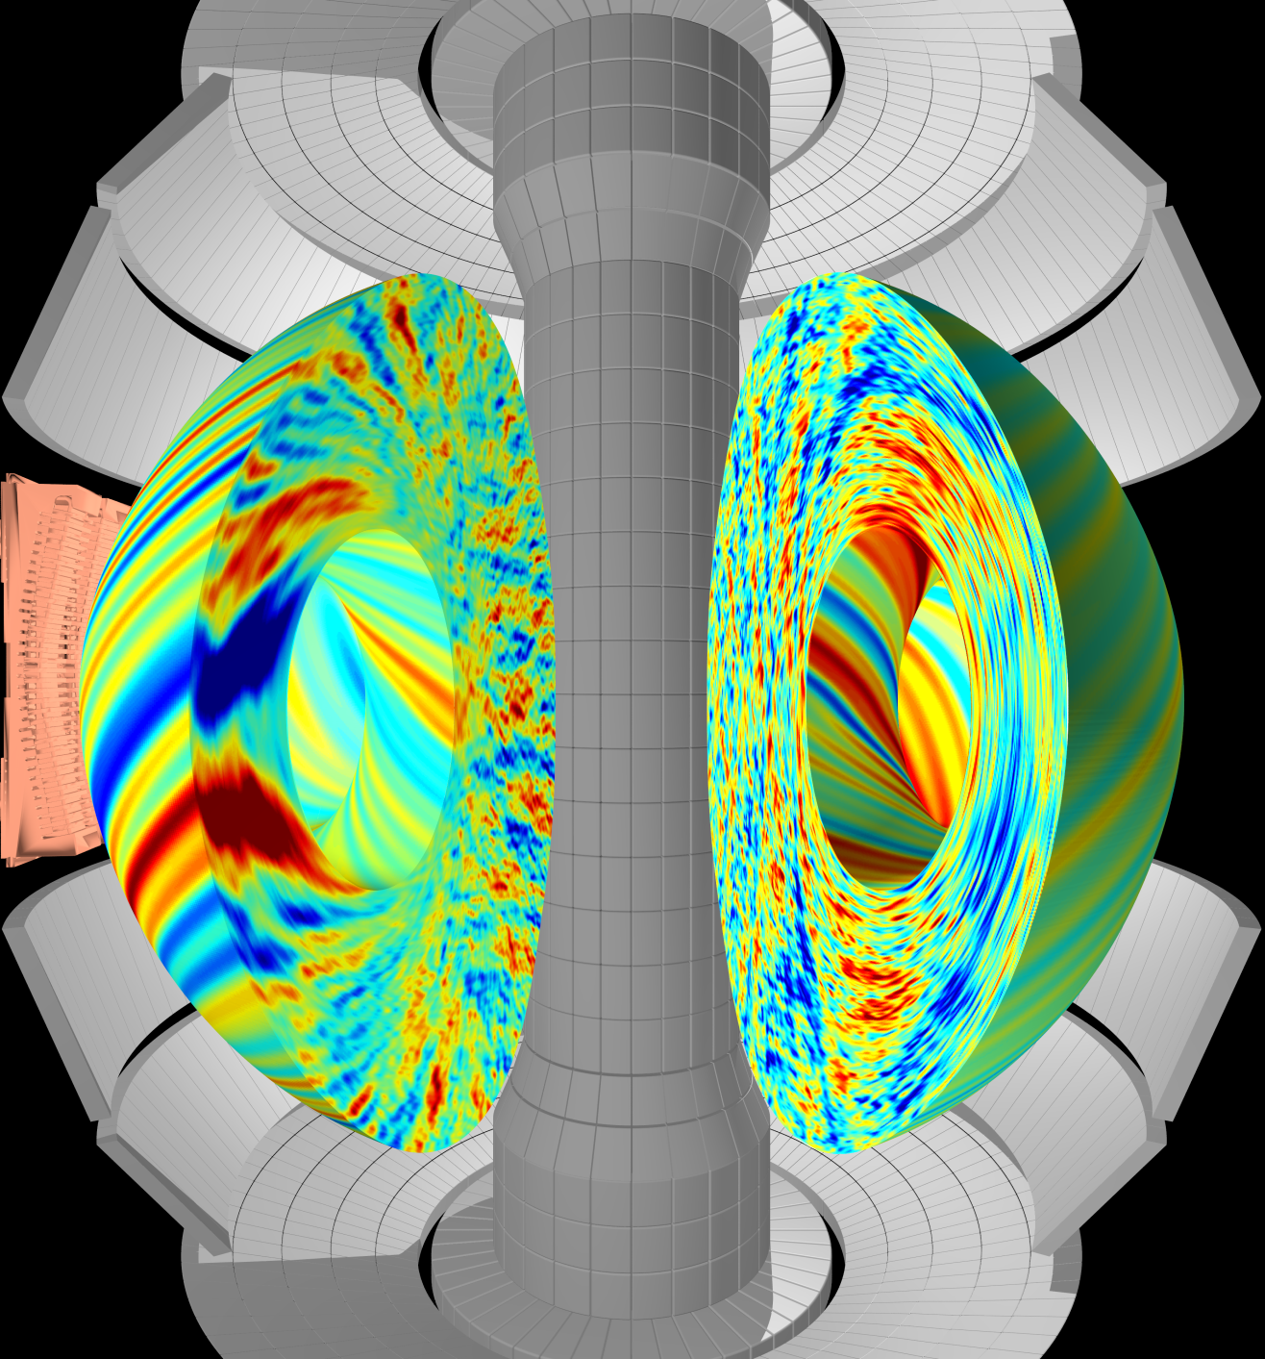

Plasma turbulence degrades energy confinement / insulation in magnetic fusion energy devices
Gyrokinetic simulation of
plasma turbulence
(this is what I do )
Heat
loss
W. Guttenfelder, F. Scotti

Slide 9
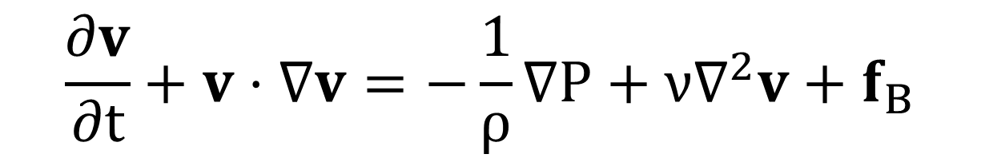

Neutral fluids: Incompressible Navier-Stokes
Momentum conservation law:
Assuming incompressible, from mass conservation:
Unsteady
flow
Convective acceleration
Pressure force
Viscosity
Body forces (g, J×B, qE)
Notes:
Body force, for instance gravity, JxB, qE

Slide 10
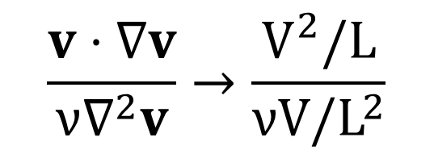
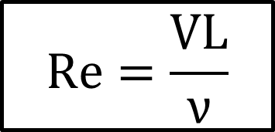
Use dimensionless Reynolds # to estimate laminar vs. turbulent dynamics
Reynolds number: order-of-magnitude ratio of inertial to viscous forces
Fully developed turbulence for Re > ~10³
Flow according to Navier-Stokes becomes highly nonlinear, deterministic yet unpredictable → often treat statistically
Viscosities (m²/s)
Air ~1.5×10⁻⁵
Water ~1.0×10⁻⁶
For L~1 m scale sizes and V~10 m/s, Re~10⁶-10⁷
Notes:
Low mach number limit → incompressible

Slide 11
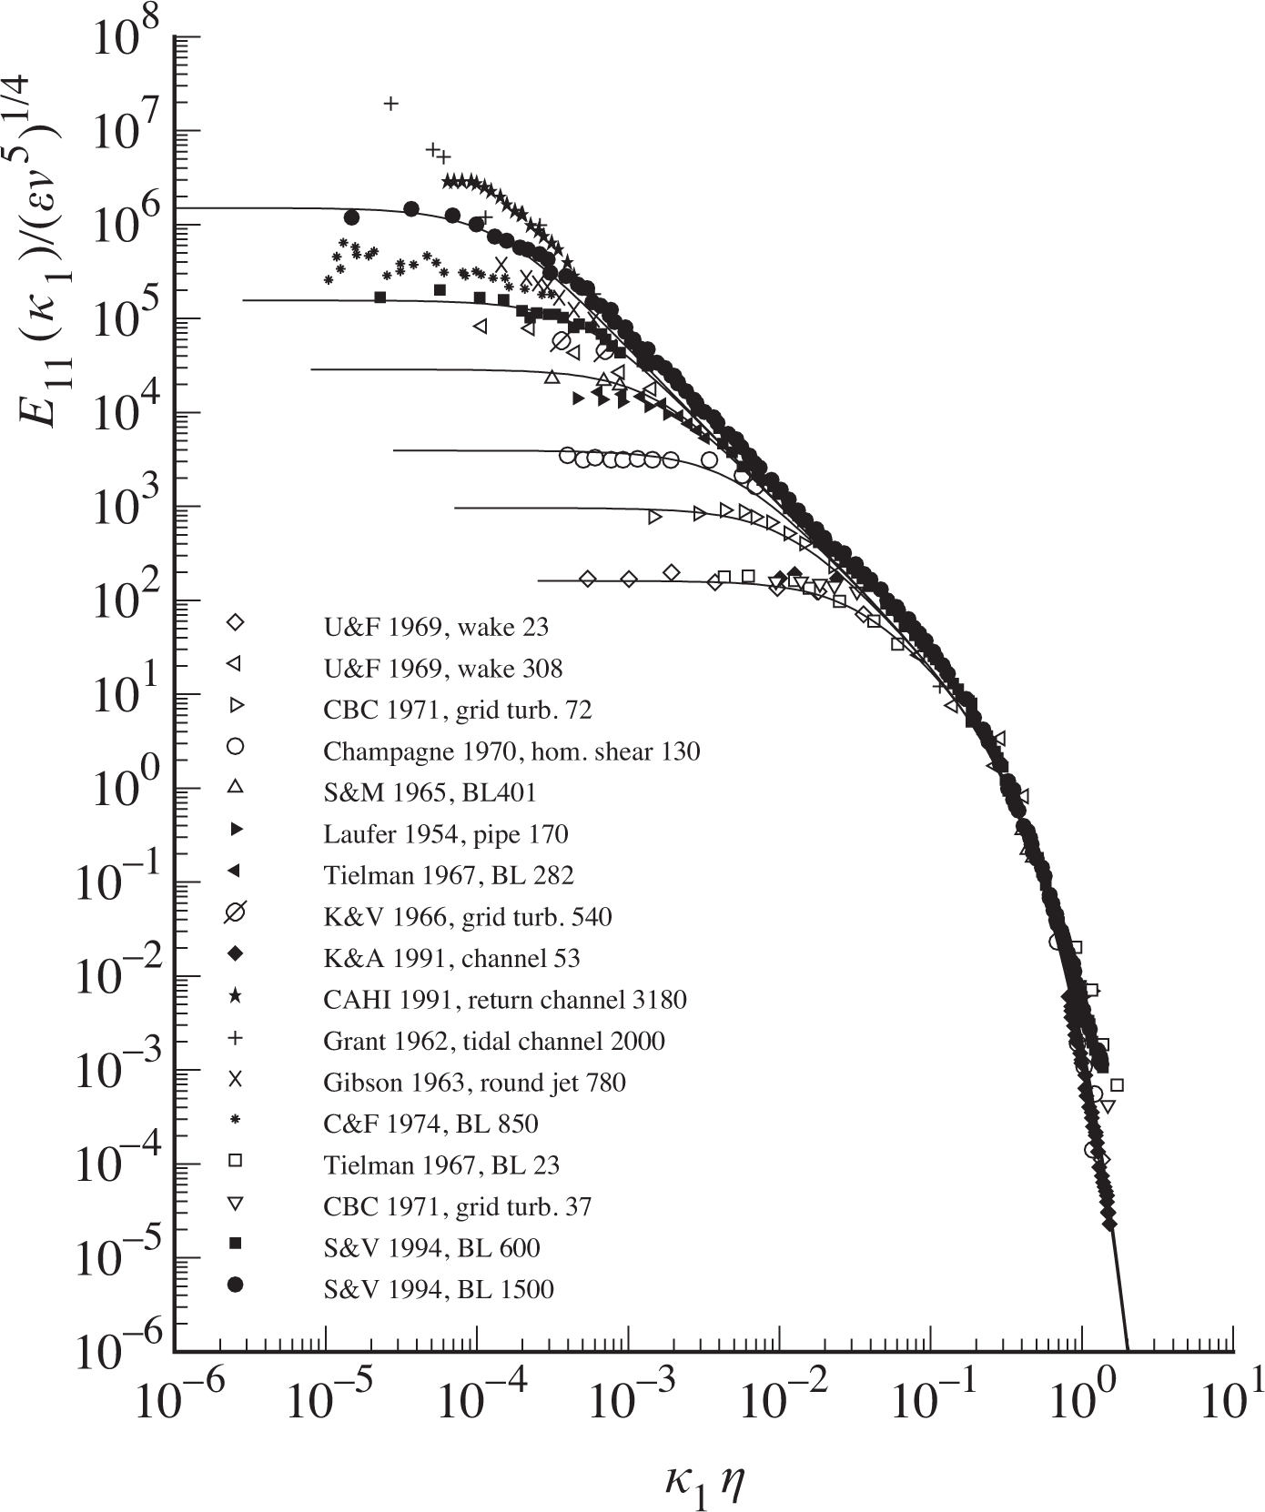

Neutral fluid turbulence energy is distributed over a wide range of scale lengths (and times)
Distribution of fluctuation energy in Fourier wavenumber space exhibits Kolmogorov scaling: E(k) ~ k^{-5/3}
(k=2π/λ)
Assumes turbulence is homogeneous, isotropic, and large separation between energy injection (at low k) and viscous dissipation (at high k)
Ratio of forcing (injection) to Kolmogorov (dissipation) scale lengths increases with Re #
L_{injection}/l_{dissipation} ~ Re^{3/4}
Energy cascades (via nonlinear v⋅∇v) from long wavelengths to small wavelengths in the “inertial range”
Energy “injected” at long wavelengths
Energy dissipated by viscosity at small wavelengths
S.G. Saddoughi,
J. Fluid Mech (1994)
Notes:
Separation in forcing scale and dissipation scale increases with Reynolds number
In plot, wavenumber normalized by Kolmogorov scale, larger Re goes to lower normalized k.
Alternatively, for fixed forcing scale L, increasing Re leads to smaller dissipation scale
Walk through scaling of ell_k, tau_k, v_k with viscosity & forcing rate/dissipation rate

Slide 12
Concepts of turbulence to remember
Turbulence is deterministic yet unpredictable (chaotic), appears random
  Turbulence is not a property of the fluid / plasma, it’s a feature of the flow
  We often treat & diagnose statistically, but also rely on first-principles direct numerical simulation (DNS)
Turbulence spans a wide range of spatial & temporal
  Re >>> 1 for neutral fluids, L_{forcing} / l_{dissipation} ~ (Re)^{3/4}
  Or in the case of hot, low-collisionality plasma, a wide range of scales in 6D phase-space (x,v)
Turbulence causes increased mixing, transport larger than collisional transport
  Transport is the key application of why we care about turbulence (e.g. fusion gain ~ nTτ_{E}, energy confinement time τ_{E} set by turbulence)
It’s cool! “Turbulence is the most important unsolved problem in classical physics” (~Feynman)

Slide 13
Plasma in a strong toroidal magnetic field

Slide 14
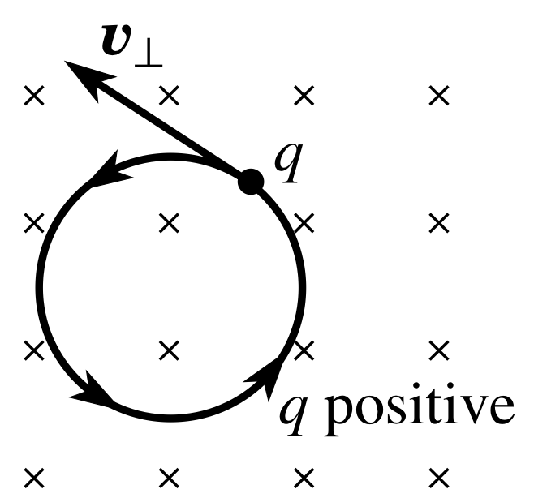
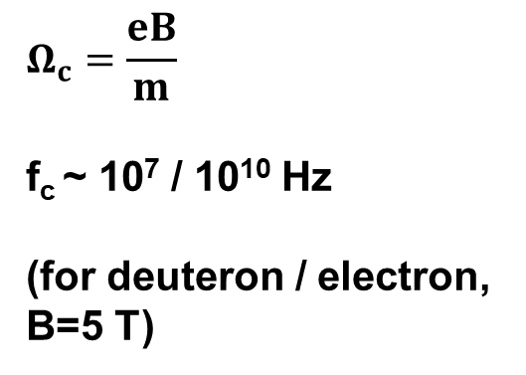
Charged particles experience Lorentz force in a magnetic field → gyro-orbits
Magnetic force acts perpendicular to direction of particle
→Particles follow circular gyro-orbits
B field into plane
$$Ω_{c}=\frac{eB}{m}$$
f_{c} ~ 10⁷ / 10¹⁰ Hz
(for deuteron / electron, B=5 T)

Slide 15
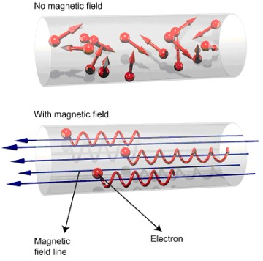

Magnetic field confines particles away from boundaries, leads to strong anisotropy
gyroradius: $ρ=\frac{v_{T}}{Ω_{c}}$
B ≈ 5 T
T ≈ 10 keV
ρ_{i} ~ 3 mm
ρ_{e} ~ 0.05 mm
<<
1-2 meter
device size
Low collision frequency ν~n/T^{3/2}
λ_{MFP}~ km’s >> device size
λ_{MFP} / ρ_{i} ~ 10⁶
χ||/χ⊥ ~ (λ_{mfp}/ρ)² ~ 10¹² → strong anisotropy

Slide 16
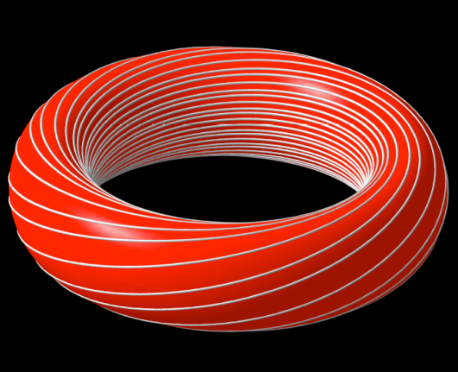
Particles easily lost from ends → bend into a torus

Slide 17

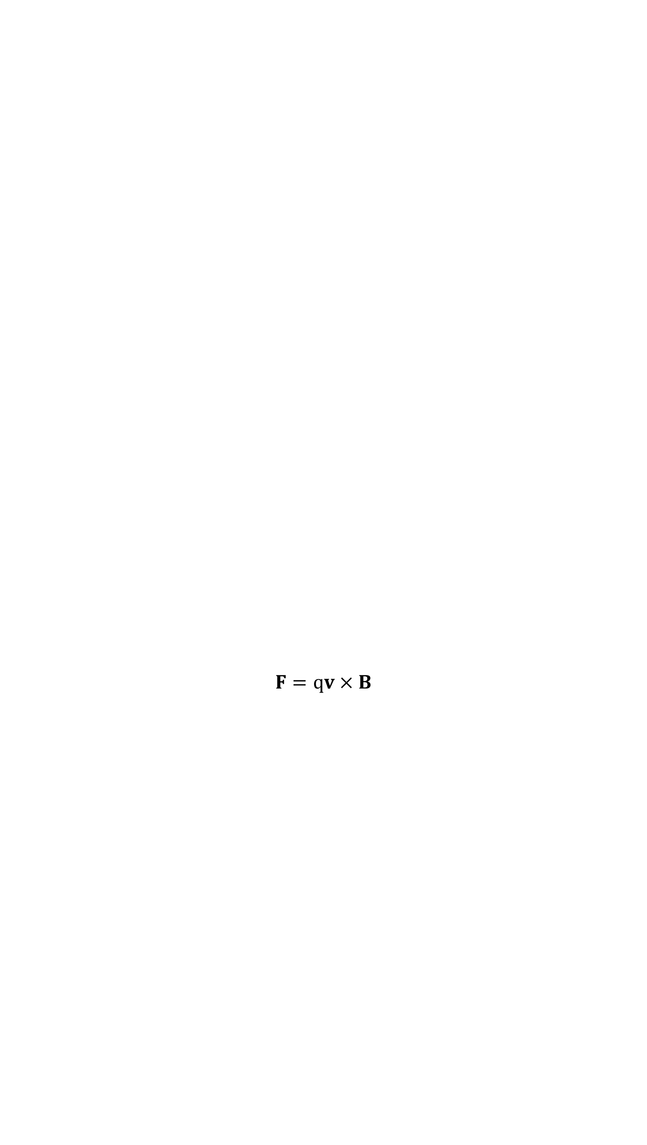
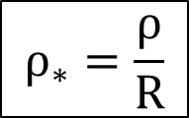
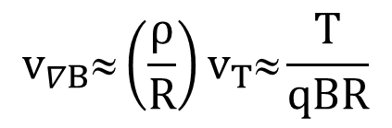
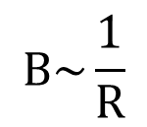
But toroidicity leads to vertical drifts from ∇B & curvature
$$B\sim \frac{1}{R}$$
B
$$F=qv×B$$
$$v_{∇B}≈\left(\frac{ρ}{R}\right)v_{T}≈\frac{T}{qBR}$$
+
-
τ_{loss} ~ 5 ms from vertical drifts (B~5 T, R~5 m, T~15 keV)
$$ρ_{∗}=\frac{ρ}{R}$$
Key parameter in magnetized confinement

Slide 18

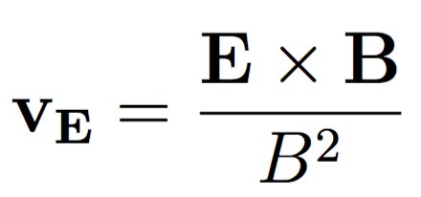
Even worse, charge separation leads to faster E×B drifts out to the walls
z
ɸ
B_{toroidal}
+
+
+
+
Ion
drift
E
Electron
drift
-
-
-
-
τ_{loss} ~ μs from E×B drifts (due to charge separation from vertical drifts)

Slide 19

Solution: need a helical magnetic field for confined (closed) particle orbits
R
a
R=major radius
a=minor radius
Notes:
How do you make a magnetic field like this?
Wrap wire around a nail to make your own electromagnetic
Then think about bending the nail into a circle, remove the nail, expand, replace with a vacuum chamber

Slide 20
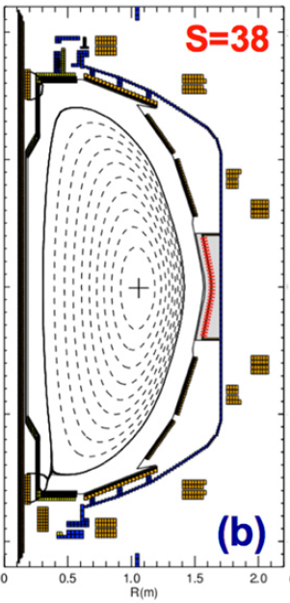
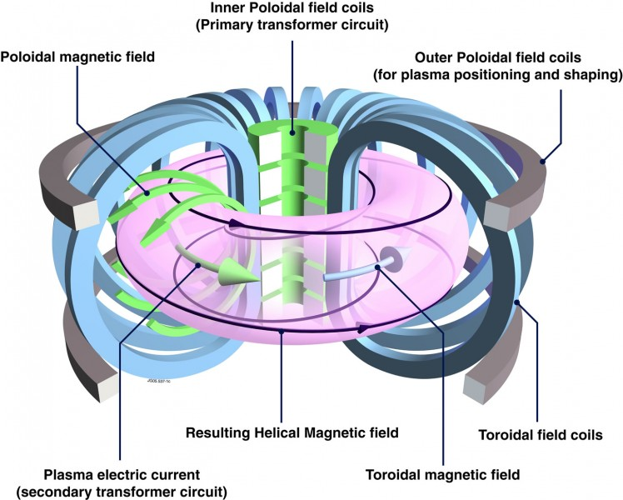
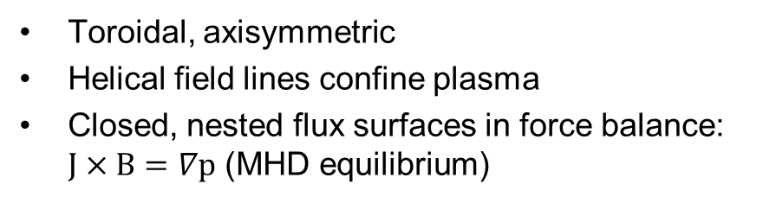
Tokamaks
NSTX
Toroidal, axisymmetric
Helical field lines confine plasma
Closed, nested flux surfaces in force balance: $J×B=∇p$ (MHD equilibrium)
Notes:
Remember anistropy → typically assume background n & T are constant on a flux surface

Slide 21
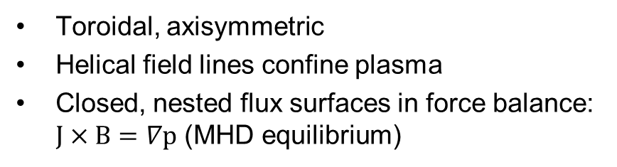
Tokamaks
NSTX
Toroidal, axisymmetric
Helical field lines confine plasma
Closed, nested flux surfaces in force balance: $J×B=∇p$ (MHD equilibrium)
Heat
loss

Slide 22
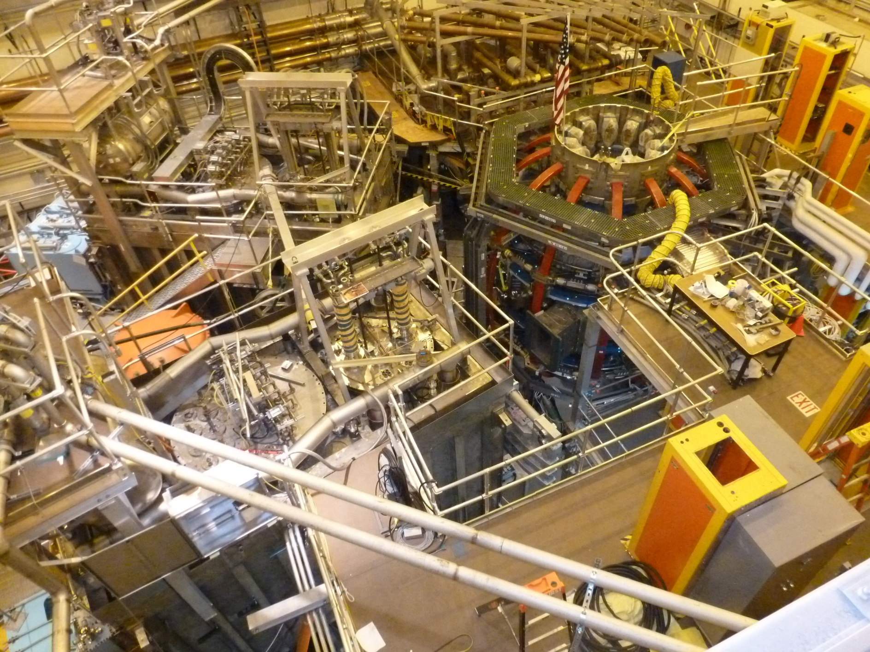
At Princeton Plasma Physics Lab (PPPL):
National Spherical Torus Experiment-Upgrade (NSTX-U)
Notes:
Complicated, going to attempt to deconstruct some of the important components in the coming slides

Slide 23
Turbulence characteristics in tokamaks

Slide 24
40+ years of theory & simulation predicts turbulence in magnetized plasma should often be drift wave in nature
General predicted drift wave characteristics:
Quasi-2D, elongated along the field lines (λ||>>λ⊥, k|| << k ⊥)
  Particles can rapidly move along field lines to smooth out perturbations (v||~v_{T})
  Perpendicular scales linked to local gyroradius, λ⊥~ρ or k⊥ρ~1
  (v_{⊥drift} ~ ρ/R⋅v_{T})
Finite-frequency drifting waves, ω(k_{θ})~ω*~k_{θ}V*~(k_{θ}ρ)v_{T}/L_{n}
  Driven by ∇n, ∇T (1/L_{n} = -1/n⋅∇n)
In a tokamak expected to be “ballooning”, i.e. stronger on outboard side
  Due to “bad curvature” / ”effective gravity” pointing outwards from symmetry axis
Transport has gyrobohm scaling, χ_{GB}=ρ²v_{T}/R=(ρ/R)⋅T/B
  But other factors important like threshold and stiffness: χ_{turb} ~ χ_{GB}⋅F(⋅⋅⋅)⋅[R/L_{T}-R/L_{T,crit}]

Slide 25
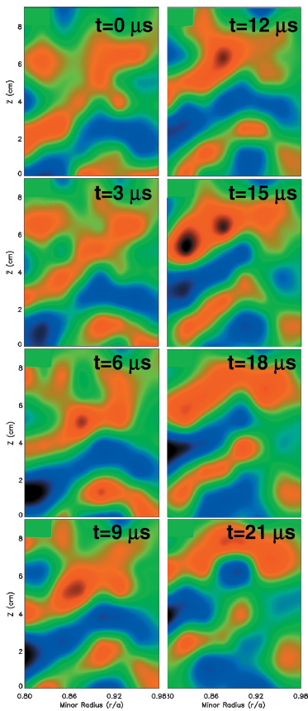
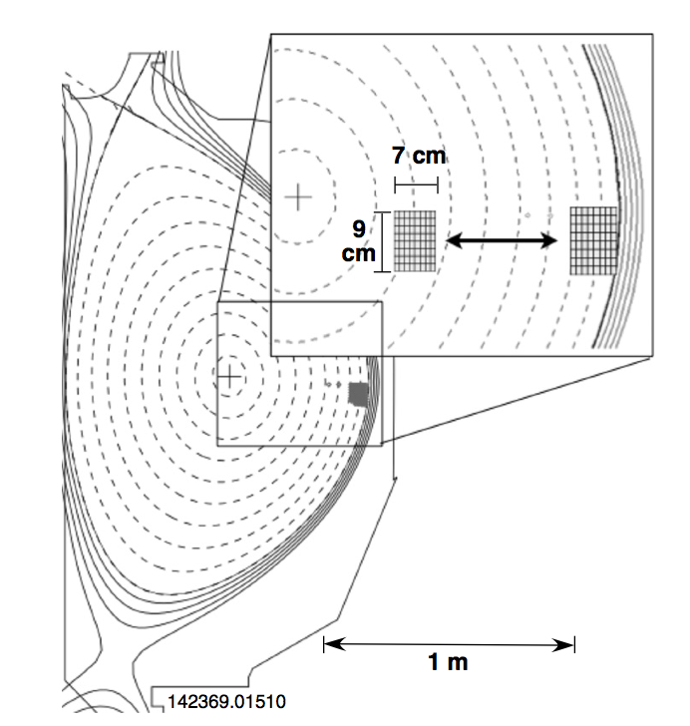
Spectroscopic imaging provides a 2D picture of turbulence in tokamaks: cm spatial scales, μs time scales, <1% amplitude
Beam Emission Spectroscopy (UW-Madison) measures Doppler shifted D_{α} from neutral beam heating to infer plasma density
DIII-D tokamak (General Atomics)
Movies at: https://fusion.gat.com/global/BESMovies
Notes:
Perpendicular cross section size
Turbulence is transporting energy and particles from hot core to cooler edge, mixing them together

Slide 26
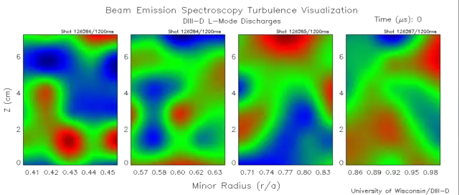

Slide 27
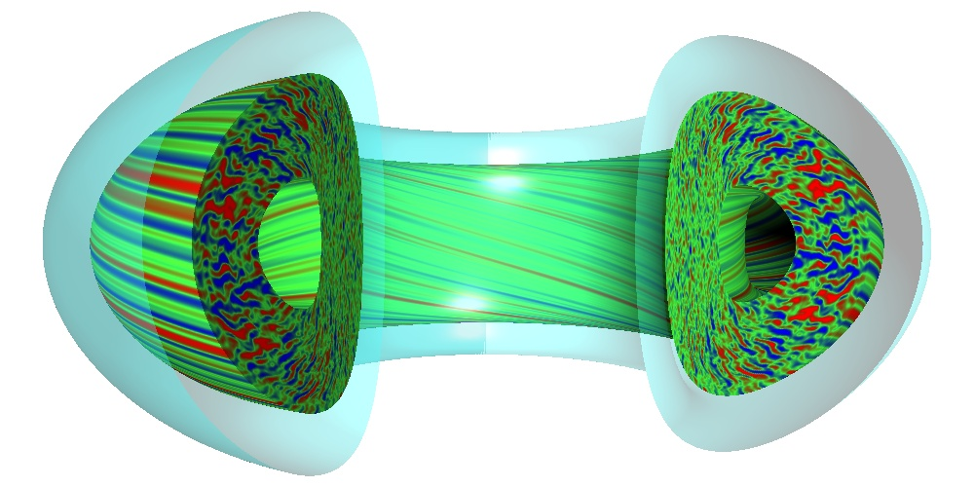
Gyrokinetic simulations provide detailed prediction of expected turbulence characteristics
GYRO simulation (Candy, Waltz – General Atomics)

Slide 28
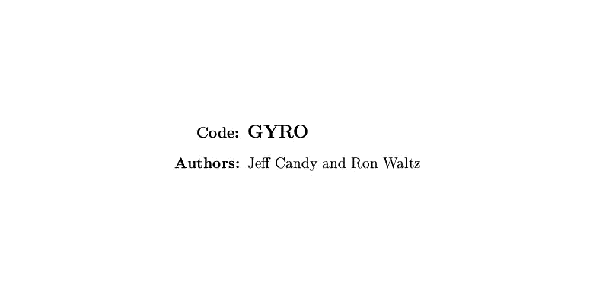
Gyrokinetic simulations provide detailed prediction of expected turbulence characteristics

Slide 29
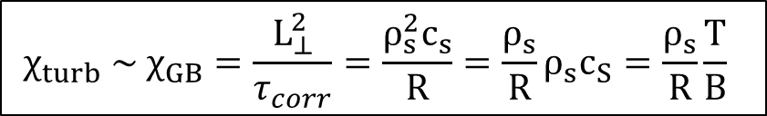
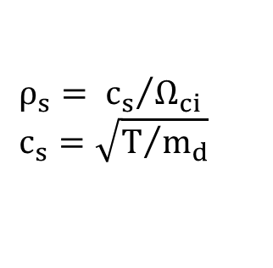

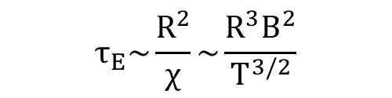
Transport is of order the Gyrobohm diffusivity
Although turbulence is advective, can estimate order of transport due to drift waves as a diffusive process, χ_{turb} ~ ⟨Δx²⟩/⟨Δt⟩ ~ (L_{⊥,corr})² / τ_{corr}
L_{⊥,corr} ~ few ρ_{s} (~ cm’s)
τ_{corr}⁻¹ ~ c_{s}/R (~10⁵ 1/s)
τ_{E} improves with field strength (B) and machine size (R)
$$ρ_{s}= {c_{s}}/{Ω_{ci}}$$
$$c_{s}=\sqrt{T/{m_{d}}}$$
gyroBohm diffusivity
$${χ_{turb} \sim χ}_{GB}=\frac{L_{⊥}^{2}}{τ_{corr}}=\frac{ρ_{s}^{2}c_{s}}{R}=\frac{ρ_{s}}{R}ρ_{s}c_{S}=\frac{ρ_{s}}{R}\frac{T}{B}$$
Bohm diffusivity $≈\frac{1}{16}\frac{T}{B}$
ρ*
$$τ_{E}\sim \frac{R^{2}}{χ}\sim \frac{R^{3}B^{2}}{T^{3/2}}$$
τ_{E} ~ (0.1) sec for current devices
τ_{E} ~ (1+) sec for fusion gain (ITER)

Slide 30
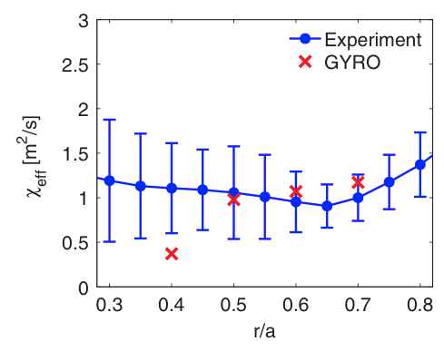
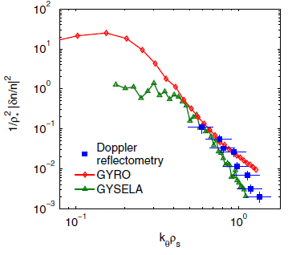
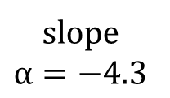

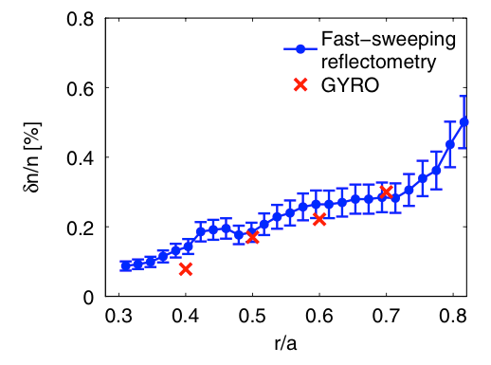
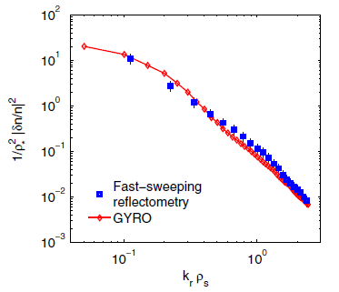
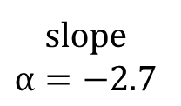

Transport, density fluctuation amplitude (from reflectometry) and spectral characteristics predicted by nonlinear gyrokinetic simulations
Example is for ion temperature gradient (ITG) turbulence
Casati, PRL (2009)
Tore Supra tokamak
Ion Temperature Gradient (ITG) turbulence
Notes:
Spectra only covers ~order of magnitude (not >4 like high Re neutral fluids)

Slide 31

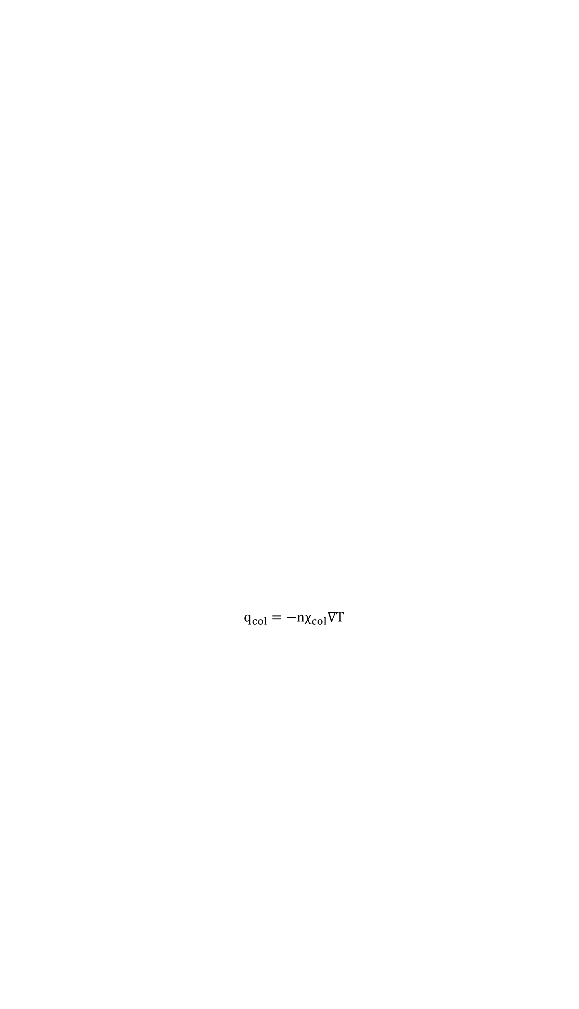
Tokamak turbulence has a threshold gradient for onset, transport tied to linear stability and nonlinear saturation
diffusion
+
turbulence
$$q_{turb}=−nχ_{GB}\left[∇T−∇T_{crit}\right]F\left(⋅⋅⋅\right)$$
Heat flux ~ heating power
collisional
diffusion
$$q_{col}=−nχ_{col}∇T$$
Temperature gradient (-∇T)
GyroBohm scaling important, but linear threshold and scaling also matters
We must discuss linear drift wave and micro-stability in tokamaks as part of the turbulent transport problem (enter gyrokinetic theory)

Slide 32
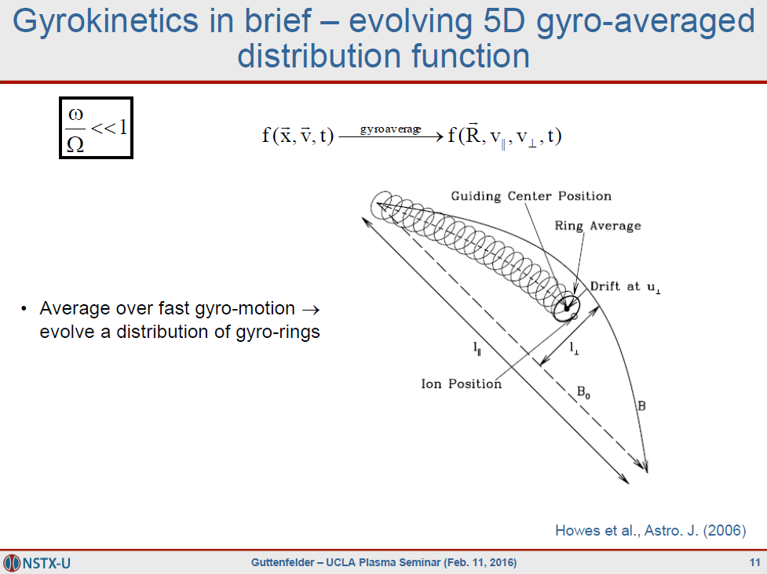

$\sim \frac{10^{5}}{10^{7}}$ for ions
(for each species)

Slide 33
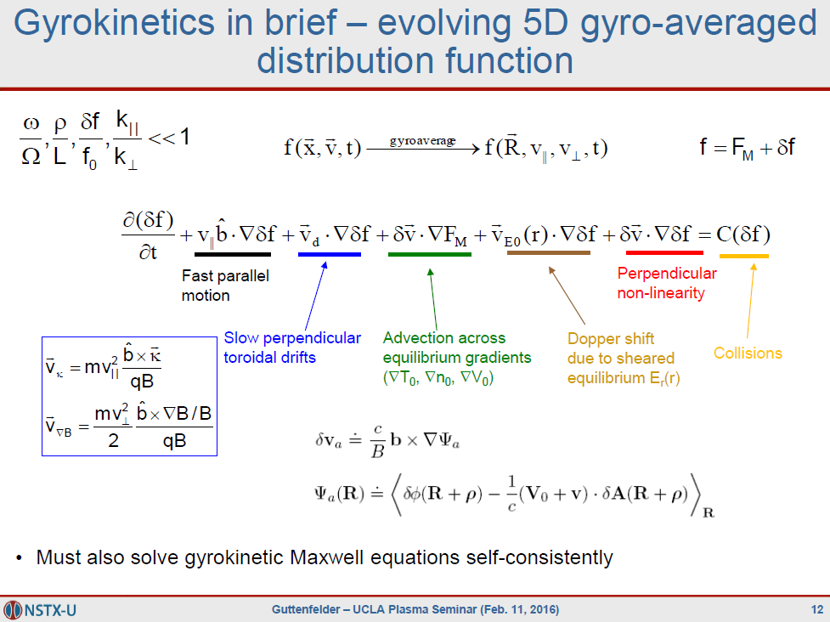
to obtain δϕ, δB

Slide 34
Drift waves

Slide 35
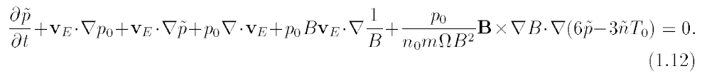

Can identify key terms in gyrofluid equations responsible for drift wave dynamics
Start with toroidal GK equation in the δf limit (δf/F_{M} << 1)
Take fluid moments ($\int{d^{3}v δf [1,v,{\frac{1}{2}v}^{2}]}$)
Apply clever closures that “best” reproduce linear toroidal gyrokinetics (Hammett, Perkins, Beer, Dorland, Waltz, Staebler, …), e.g.:
ion continuity and energy (M. Beer thesis, 1995):

Slide 36
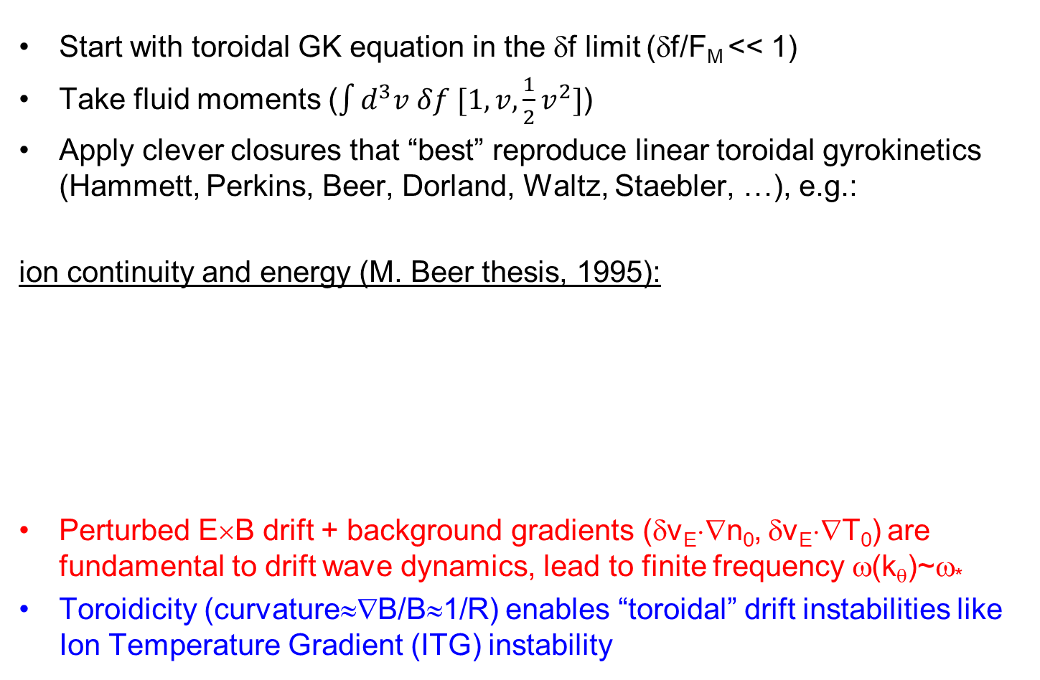
Can identify key terms in gyrofluid equations responsible for drift wave dynamics
Start with toroidal GK equation in the δf limit (δf/F_{M} << 1)
Take fluid moments ($\int{d^{3}v δf [1,v,{\frac{1}{2}v}^{2}]}$)
Apply clever closures that “best” reproduce linear toroidal gyrokinetics (Hammett, Perkins, Beer, Dorland, Waltz, Staebler, …), e.g.:
ion continuity and energy (M. Beer thesis, 1995):
Perturbed E×B drift + background gradients (δv_{E}⋅∇n₀, δv_{E}⋅∇T₀) are fundamental to drift wave dynamics, lead to finite frequency ω(k_{θ})~ω*
Toroidicity (curvature≈∇B/B≈1/R) enables “toroidal” drift instabilities like Ion Temperature Gradient (ITG) instability

Slide 37

Simple classic electron drift wave in a magnetic slab (B=B_{Z})
Assume cool ions (v_{Ti} << ω/k||), isothermal electrons, no temperature gradients, no toroidicity, electrostatic (β→0), no nonlinear term
$\frac{∂}{∂t}{δn}_{i}+δv_{E}⋅∇n_{0}\left(x\right)=0$ ion continuity
Ignore |B| contours for now

Slide 38
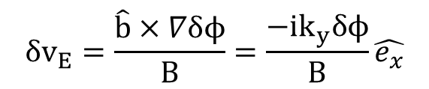

Simple classic electron drift wave in a magnetic slab (B=B_{Z})
Assume cool ions (v_{Ti} << ω/k||), isothermal electrons, no temperature gradients, no toroidicity, electrostatic (β→0), no nonlinear term
$\frac{∂}{∂t}{δn}_{i}+δv_{E}⋅∇n_{0}\left(x\right)=0$ ion continuity
$$δv_{E}=\frac{\hat{b}×∇δϕ}{B}=\frac{{−ik}_{y}δϕ}{B}\hat{e_{x}}$$
$$δϕ\sim exp\left(i\vec{k}⋅\vec{x}−iωt\right)$$

Slide 39

Perturbed Potential Creates E×B Advection
∇n (y)
Advection occurs in the radial direction
∇n (-x)
ϕ⁺
ϕ⁻
ϕ⁺
ϕ⁻
ϕ⁺
ϕ⁻
E_{θ}
E_{θ}
E_{θ}
E_{θ}
∇B
n
T
∇T

Slide 40
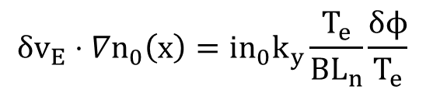
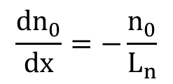

Simple classic electron drift wave in a magnetic slab (B=B_{Z})
Assume cool ions (v_{Ti} << ω/k||), isothermal electrons, no temperature gradients, no toroidicity, electrostatic (β→0), no nonlinear term
$\frac{∂}{∂t}{δn}_{i}+δv_{E}⋅∇n_{0}\left(x\right)=0$ ion continuity
$$δv_{E}=\frac{\hat{b}×∇δϕ}{B}=\frac{{−ik}_{y}δϕ}{B}\hat{e_{x}}$$
$$δϕ\sim exp\left(i\vec{k}⋅\vec{x}−iωt\right)$$
Gradient scale length (L_{n})
$$δv_{E}⋅∇n_{0}\left(x\right)=\frac{{−ik}_{y}δϕ}{B}\frac{{dn}_{0}}{dx}=in_{0}\frac{k_{y}δϕ}{{BL}_{n}}$$
$$\frac{{dn}_{0}}{dx}=−\frac{n_{0}}{L_{n}}$$
$$δv_{E}⋅∇n_{0}\left(x\right)=in_{0}k_{y}\frac{T_{e}}{BL_{n}}\frac{δϕ}{T_{e}}$$

Slide 41




With some algebra we obtain a diamagnetic drift velocity & frequency
$$δv_{E}⋅∇n_{0}\left(x\right)=in_{0}k_{y}\frac{T_{e}}{BL_{n}}\frac{δϕ}{T_{e}}$$
$$\frac{T_{e}}{B}=ρ_{s}c_{s}$$
$$δv_{E}⋅∇n_{0}\left(x\right)=in_{0}k_{y}\frac{ρ_{s}}{L_{n}}c_{s}\frac{δϕ}{T_{e}}={in}_{0}ω_{∗e}\frac{δϕ}{T_{e}}$$
$ω_{∗e}=k_{y}V_{∗e }$ $V_{∗e}=\frac{ρ_{s}}{L_{n}}c_{s}$
Electron diamagnetic drift velocity & frequency (a fluid drift, not a particle drift)
ρ* like parameter

Slide 42


Simplified ion continuity equation
$$\frac{∂}{∂t}{δn}_{i}+δv_{E}⋅∇n_{0}\left(x\right)=0$$
$$−iω\frac{δn_{i}}{n_{0}}+iω_{∗e}\frac{δϕ}{T_{e}}=0$$
Expect characteristic frequency ~ ω_{*e} ~ (k_{y}ρ_{s})⋅c_{s}/L_{n}

Slide 43
Need to add additional cartoon pictures here for classic electron drift wave

Slide 44

Dynamics Must Satisfy Quasi-neutrality;
Rapid parallel electron motion gives Boltzmann distribution
Quasi-neutrality (Poisson equation, k⊥²λ_{D}²<<1) requires
For characteristic drift wave frequency, parallel electron motion is very rapid -- from parallel electron momentum eq, assuming isothermal T_{e}:
Electrons (approximately) maintain a Boltzmann distribution
$$ω<k_{||}v_{Te} → 0=−T_{e}∇_{||}{\tilde{n}}_{e}+n_{e}e∇_{||}\tilde{ϕ}$$

Slide 45



Ion continuity + quasi-neutrality + Boltzmann electron = electron drift wave (linear, slab, cold ions)
$$−iω\frac{δn_{i}}{n_{0}}+iω_{∗e}\frac{δϕ}{T_{e}}=0$$
$$ω=ω_{∗e}=k_{y}V_{∗e}$$
$$\frac{δn_{i}}{n_{0}}=\frac{δn_{e}}{n_{0}}= \frac{δϕ}{T_{e}}$$
Density and potential wave perturbations propagating perpendicular to B_{Z} and ∇n₀
  δv_{E}⋅∇n₀ gives δn 90° out-of-phase with initial δn perturbation
Simple linear dispersion relation (will change with polarization drift / finite Larmor radius effects, toroidicity, other gradients)
No mechanism to drive instability (collisions, temperature gradient, toroidicity / trapped particles, …)

Slide 46
Linear stability analysis of toroidal Ion Temperature Gradient (ITG) micro-instability
(expected to dominate in many tokamak plasmas)

Slide 47

Toroidicity Leads To Inhomogeneity in |B|, gives ∇B and curvature (κ) drifts
What happens when there are small perturbations in T||, T⊥? ⇒ Linear stability analysis…
∇B, curvature (κ)
Z
Z
R
R

Slide 48

Temperature perturbation (δT) leads to compression (∇⋅v_{di}), density perturbation – 90° out-of-phase with δT
∇B, curvature
T⁺
T⁻
T+
T-
T+
T-
Fourier decompose perturbations in space (k_{θ}ρ_{i}≤1)
Assume small δT perturbation
n⁻
n⁺
n-
n+
n-
∇B
n
T
∇T
Notes:
Compressibility important for toroidal drift waves.

Slide 49
Dynamics Must Satisfy Quasi-neutrality;
Rapid parallel electron motion gives Boltzmann distribution
Poisson equation + long-wavelengths (k⊥²λ_{D}²<<1) → quasi-neutrality
For characteristic drift wave frequency, parallel electron motion is very rapid (from parallel electron momentum eq, assuming isothermal T_{e}:)
Electrons (approximately) maintain a Boltzmann distribution
$$ω<k_{||}v_{Te} → 0=−T_{e}∇_{||}{\tilde{n}}_{e}+n_{e}e∇_{||}\tilde{ϕ}$$

Slide 50
Perturbed Potential Creates E×B Advection
Advection occurs in the radial direction
∇B, curvature
~Boltzmann e’s
T⁺
T⁻
T+
T-
T+
T-
n⁻
n⁺
n-
n+
n-
ϕ⁻
ϕ⁺
ϕ-
ϕ+
ϕ-
E_{θ}
E_{θ}
E_{θ}
E_{θ}
∇B
n
T
∇T

Slide 51
Background Temperature Gradient Reinforces Perturbation ⇒ Instability
∇T
T⁺
T⁻
T+
T-
T+
T-
This simple cartoon gives a purely growing “interchange” like mode (coarse derivation in backup slides). The complete derivation (all drifts, gradients) will give a real frequency dispersion, i.e. ω_{r}=ω_{r}(k_{θ})

Slide 52



Analogy for turbulence in tokamaks – Rayleigh-Taylor instability
Higher density on top of lower density, with gravity acting downwards
gravity
density/pressure

Slide 53


Inertial force in toroidal field acts like an effective gravity
centrifugal force
→effective gravity
gravity
pressure
pressure
Unstable in the outer region

Slide 54
Same Dynamics Occur On Inboard Side But Now Temperature Gradient Is Stabilizing
Advection with ∇T counteracts perturbations on inboard side – “good” curvature region
“good” curvature
“bad” curvature
∇T
∇T
∇B
T⁺
T⁻
T+
T-
T+
T-
T⁺
T⁻
T+
T-
T+
T-
n
T
∇T
∇T
Notes:
Analogy to inverted pendulum (outboard side) and pendulum (inboard side).

Slide 55


Fast Parallel Motion Along Helical Field Line Connects Good & Bad Curvature Regions
$$γ_{instability}\sim {\left(\frac{g_{eff}}{L}\right)}^{1/2}\sim \frac{v_{th}}{\sqrt{RL_{T}}}$$
Approximate growth rate on outboard side
effective gravity: g_{eff} = v_{th}²/R
gradient scale length: 1/L_{T} = -1/T⋅∇T
Parallel transit time along helical field line with “safety factor” q
Expect instability if γ_{instability} > γ_{parallel} , or
$$q=\frac{\# toroidal transits}{\# poloidal transits}$$

Slide 56

Critical gradient for ITG determined from theory + linear gyrokinetic simulations
$${\left(\frac{R}{L_{T}}\right)}_{crit}^{ITG}=Max\left[\left(1+\frac{T_{i}}{T_{e}}\right)\left(1.3+1.9\frac{s}{q}\right)\left(…\right), \frac{R}{L_{n}}\right]$$
Jenko (2001)
Hahm (1989)
Romanelli (1989)
R/L_{T} = -R/T⋅∇T is the normalized temperature gradient
Natural way to normalize gradients for toroidal drift waves, i.e. ratio of diamagnetic-to-toroidal drift frequencies:
  ω_{*T} = k_{y}(B×∇p) / nqB² → (k_{θ}ρ_{i})v_{T}/L_{T}
  ω_{D} = k_{y}(B×mv⊥²∇B/2B) / qB² → (k_{θ}ρ_{i})v_{T}/R
Another key stability parameter that often arises is η = L_{n}/L_{T} = (R/L_{T}) / (R/L_{n}), i.e. a sufficiently large density gradient can set the temperature gradient threshold
  E.g. can be important in the pedestal
→ ω_{*T}/ω_{D} = R/L_{T}

Slide 57

Threshold-like behavior analogous to Rayleigh-Benard instability
Analogous to convective transport when heating a fluid from below … boiling water (before the boiling)
Heat flux ~ heating power
diffusion
+
turbulence
collisional
diffusion
Temperature gradient
(T_{hot} - T_{cold})
Rayleigh, Benard, early 1900’s
“Hydrodynamic and hydromagnetic stability”, S. Chandrasekhar (1961)
Discussed in E×B shear suppression review papers by K. Burrell (2020, 1999, 1997)
Notes:
Rayleigh-benard, water expands (less dense) as temperature increases (buoyancy), will thermally diffuse to balance, plus viscosity will impede fluid motions until threshold surpassed

Slide 58



With physical understanding, can try to manipulate/optimize microstability
E.g., magnetic shear influences stability by twisting radially-elongated instability to better align (or misalign) with bad curvature drive
Antoneson

Slide 59
What happens nonlinearly?

Slide 60



Saturated spectrum shape governed by nonlinear (2D perpendicular) three-wave interactions
Linearly unstable modes grow:
At large amplitude, interact via nonlinear advection, δv_{E}⋅∇δf
i.e. “three-wave” coupling in (2D perpendicular) wavenumber space
Energy gets distributed across k space (& velocity space) until damped by stable modes (& collisions) → saturation
  Local (in k) 2D cascades
  Non-local (in k) interactions drive “zonal flows” that also mediate turbulence
$$δϕ\left(k\right)\sim exp \left[ik⋅x+iω\left(k\right)t+γ\left(k\right)t\right]$$
$\frac{∂}{∂t}δf \sim δv_{E}⋅∇δ$f
$$\frac{∂}{∂t}δf_{k_{⊥3}} \sim \sum_{\begin{aligned}k_{⊥1},k_{⊥2} \\ k_{⊥3}=k_{⊥1}+k_{⊥2}\end{aligned}}{\left(b×k_{⊥1}δϕ_{k_{⊥1}}\right)⋅k_{⊥2}δf_{k_{⊥2}}}$$

Slide 61


Energy cascade in 2D turbulence is different than 3D
Change in non-linear conservation properties → energy and vorticity is conserved
  Inverse energy cascade E(k) ~ k^{-5/3}
  Forward enstrophy [ω²~(∇×v)²] cascade E(k)~k⁻³
  Non-local wavenumber interactions can couple over larger range in k-space (e.g. to zonal flows)
Quasi-2D turbulence exists in many places
Geophysical flows like ocean currents, tropical cyclones, polar vortex, chemical mixing in polar stratosphere (→ ozone hole)
Soap films →
Liu et al., PRL (2016)

Slide 62



Energy drive can occur across large range of scales, but turbulent spectra still exhibit decay
2D energy & enstrophy cascades remain important → nonlinear spectra often downshifted in k_{θ} (w.r.t. linear growth rates)
Damping can occur at all scales through kinetic effects (Terry, Hatch, …), very distinct from neutral fluid turbulence
Linear growth rates
Nonlinear density power spectra
Nonlinear heat flux spectra
Howard, PoP & NF (2016)

Slide 63



Nonlinearly-generated “zonal flows” also impact saturation
Potential perturbations uniform on flux surfaces (k_{y}=0) → marginally stable, do not cause transport
Turbulence can condense to system size → ZF driven largely by non-local (in k) NL interactions (k >> k_{ZF})
Linear instability stage demonstrates structure of fastest growing modes
Large flow shear from instability cause perpendicular “zonal flows”
Zonal flows help moderate the turbulence
(potential contours → stream functions)
Rayleigh-Taylor like instability driving Kelvin-Helmholtz-like instability

Slide 64


Near linear threshold, strong zonal flows can suppress primary ITG instability → low time-averaged transport
Leads to nonlinear upshift of effective threshold
Dorland (2000)

Slide 65



Large scale equilibrium sheared flows also influence saturation
Large scale background flow shear distorts eddies → reduces radial correlation length, fluctuation strength, cross-phases and transport
Turbulent transport expected to be reduced as the mean flow shear rate (ω_{s}~dU₀/dy) approaches the turbulence decorrelation rate (Δω_{D})
Biglari, Diamond, Terry 1990

Slide 66


In neutral fluids, sheared flows are often a source of free energy to drive turbulence
Thin (quasi-2D) atmosphere in axisymmetric geometry of rotating planets similar to tokamak plasma turbulence → can also suppress transport
Stratospheric ash from Mt. Pinatubo eruption (1991) spread rapidly around equator, but confined in latitude by flow shear
Aerosol concentration
Large shear in stratospheric equatorial jet
(Trepte, 1993)
Notes:
Sheared flows in neutral fluids are usually a drive for turbulence, not a suppression mechanism
However, another example of sheared flows suppressing turbulent mixing is found in atmospheric turbulence (Terry, 2000; Trepte, 1993)
Eruption of Mt. Pinatubo (Philippines) in 1991???? (15 N, 120 E), spewed ash into the stratosphere, spreads in latitude to +/- 20 degree but large gradient persists for months, large shear in stratospheric equatorial jet at same position [in contrast to lower altitude troposphere]

Slide 67
Beyond general characteristics, there are many theoretical “flavors” of drift waves possible in tokamak core & edge
Usually think of drift waves as gradient driven (∇T_{i}, ∇T_{e}, ∇n)
  Often exhibit threshold in one or more of these parameters
Different theoretical “flavors” exhibit different parametric dependencies, predicted in various limits, depending on gradients, T_{e}/T_{i}, ν, β, geometry, location in plasma…
  Electrostatic, ion scale (k_{θ}ρ_{i}≤1)
    Ion temperature gradient (ITG) – driven by ∇T_{i}, weakened by ∇n
    Trapped electron mode (TEM) – driven by ∇T_{e} & ∇n_{e}, weakened by ν_{e}
    Parallel velocity gradient (PVG) – driven by R∇Ω (like Kelvin-Helmholtz)
  Electrostatic, electron scale (k_{θ}ρ_{e}≤1)
    Electron temperature gradient (ETG) - driven by ∇T_{e}, weakened by ∇n
  Electromagnetic, ion scale (k_{θ}ρ_{i}≤1)
    Kinetic ballooning mode (KBM) - driven by ∇β_{pol} ~ α_{MHD}
    Microtearing mode (MTM) – driven by ∇T_{e}, at sufficient β_{e}

Slide 68

MTM density fluctuations distinct from ballooning modes like ITG (simulations)
NSTX MTM turbulence
DIII-D ITG turbulence
Guttenfelder, PRL (2011), PoP (2012)
Candy, Waltz (GA)

Slide 69
Summary
Turbulence ubiquitous throughout the universe
  Lots of free energy sources
Turbulence is deterministic yet unpredictable (chaotic), appears random
Turbulence causes increased mixing, transport larger than collisional transport
  Transport is the key application of why we care about turbulence
  Understanding and optimizing transport critical for fusion reactors
Turbulence spans a wide range of spatial and temporal scales
  Large Reynolds # (3D neutral fluids) / Dorland # (6D kinetic plasmas)
  6D kinetic plasmas lead to additional degrees of freedom for driving and dissipation mechanisms

Slide 70
Some review references
Transport & Turbulence reviews:
  Liewer, Nuclear Fusion (1985)
  Wootton, Phys. Fluids B (1990)
  Carreras, IEEE Trans. Plasma Science (1997)
  Wolf, PPCF (2003)
  Tynan, PPCF (2009)
  ITER Physics Basis (IPB), Nuclear Fusion (1999)
  Progress in ITER Physics Basis (PIPB), Nuclear Fusion (2007)
Drift wave reviews:
  Horton, Rev. Modern Physics (1999)
  Tang, Nuclear Fusion (1978)
Gyrokinetic simulation review:
  Garbet, Nuclear Fusion (2010)
Zonal flow/GAM reviews:
  Diamond et al., PPCF (2005)
  Fujisawa, Nuclear Fusion (2009)
Measurement techniques:
  Bretz, RSI (1997)

Slide 71
THE END

Slide 72

Threshold-like behavior observed experimentally
Experimentally inferred threshold varies with equilibrium, plasma rotation, ...
Stiffness (~dQ/d∇T above threshold) also varies
χ = -Q/n∇T highly nonlinear (also use perturbative experiments to probe stiffness)
JET
Mantica, PRL (2011)

Slide 73

Reverse magnetic shear can lead to internal transport barriers (ITBs)
ITBs established on numerous devices
Used to achieve “equivalent” Q_{DT,eq}~1.25 in JT-60U (in D-D plasma)
χ_{i}~χ_{i,NC} in ITB region (complete suppression of ion scale turbulence)
JT-60U
Ishida, NF (1999)

Slide 74
Very simple growth rate derivation of toroidal ITG cartoon picture

Slide 75
Can identify key terms in “gyrofluid” equations responsible for toroidal ITG instability
Start with toroidal GK equation in the δf limit (δf/F_{M} << 1)
Take fluid moments
Apply clever closures that “best” reproduce linear toroidal gyrokinetics (Hammett, Perkins, Beer, Dorland, Waltz, …)
Ion continuity and energy (M. Beer thesis, 1995):

Slide 76

Temperature perturbation (δT) leads to compression (∇⋅v_{di}), density perturbation – 90° out-of-phase with δT
dn/dt + ∇⋅(nv)=0
-iωδn from -n₀∇⋅δv_{d} ~ -n₀∇⋅(δT⊥ b×∇B/B)/B ~ -n₀ ik_{y}δT / BR
-iω(δn/n₀) ~ -ik_{y}(δT/T₀) T/BR ~ -i(k_{y}V_{D}) (δT/T₀) ~ -iω_{D} (δT/T₀)
-iω(δn/n₀) = -iω_{D}(δT/T₀)

Slide 77

Background Temperature Gradient Reinforces Perturbation ⇒ Instability
-iωδT from -δv_{E}⋅∇T₀ ~ -(b×∇δϕ/B)∇T₀ ~ ik_{y}δϕ/B⋅∇T₀ ~ ik_{y}δϕ(T/B)/L_{T}
-iω(δT/T) ~ ik_{y}(δϕ/T)T/BL_{T} ~ i(k_{y}V_{*T})(δϕ/T) ~ iω_{*T}(δϕ/T)
-iω(δT/T) = iω_{*T}(δϕ/T)

Slide 78

Simplest dispersion from these 3 terms
(1) Compression from toroidal drifts
ω(δn_{i}/n₀) = ω_{Di} (δT_{i}/T_{i0})
(2) Quasi-neutrality + Boltzmann electron response
(δn_{i}/n₀) = (δn_{e}/n₀) = (δϕ/T_{e0}) = (δϕ/T_{i0})(T_{i}/T_{e})
(3) E×B advection of background gradient
-ω(δT_{i}/T_{i0}) = ω_{*T}(δϕ/T_{i})
(1)+(2): ω(T_{i}/T_{e})(δϕ/T_{i0}) = ω_{Di} (δT_{i}/T_{i0})
(+3): ω(T_{i}/T_{e}) = -ω_{Di} ω_{*T} / ω
ω² = -(k_{y}ρ_{i})²v_{Ti}² / RL_{T} (assume T_{e}=T_{i})
$$γ=\left(k_{y}ρ_{i}\right)\frac{v_{Ti}}{{\left(RL_{T}\right)}^{1/2}}$$
“bad curvature”
ω_{Di}⋅ω_{*T} ~ ∇B⋅∇T > 0

Slide 79


Finite gyroradius effects limit characteristic size to ion-gyroradius (k⊥ρ_{i}~1)
Drift velocity increases with smaller wavelength (larger k⊥ρ_{i})
If wavelength approaches ion gyroradius (k⊥ρ_{i})≥1, average electric field experienced over fast ion-gyromotion is reduced:
⟨∇ϕ⟩_{gyro-average} ~ ∇ϕ ⟨∇ϕ⟩_{gyro-average} ~ ∇ϕ[1-(k⊥ρ_{i})²]
Maximum growth rates (and typical turbulence scale sizes) occur for (k⊥ρ_{i}) ≤ 1
$${\vec{v}}_{E}=\frac{\hat{b}×∇φ}{B}=−ik_{⊥}\frac{φ}{B}=−ik_{⊥}\left(\frac{φ}{T_{i}}\right)\left(\frac{T_{i}}{B}\right)=−i\left(k_{⊥}ρ_{i}\right)\left(\frac{φ}{T_{i}}\right)v_{Ti}$$

Slide 80
Mixing length estimate of fluctuation amplitude

Slide 81
Mixing length estimate for fluctuation amplitude
In the presence of an equilibrium gradient, ∇n₀, turbulence with radial correlation L_{r} will mix regions of high and low density
instantaneous
temperature
or density
time-averaged
temperature or density
∇n₀
L_{r}~1/k_{r}
turbulent eddy (~mm-cm)
core
boundary
1-2 m

Slide 82
Mixing length estimate for fluctuation amplitude
In the presence of an equilibrium gradient, ∇n₀, turbulence with radial correlation L_{r} will mix regions of high and low density
Leads to fluctuation δn
instantaneous
temperature
or density
time-averaged
temperature or density
∇n₀
L_{r}~1/k_{r}
δn
turbulent eddy (~mm-cm)
core
boundary
1-2 m

Slide 83

Mixing length estimate for fluctuation amplitude
In the presence of an equilibrium gradient, ∇n₀, turbulence with radial correlation L_{r} will mix regions of high and low density
Leads to fluctuation δn
Another interpretation: local, instantaneous gradient limited to equilibrium gradient
instantaneous
temperature
or density
time-averaged
temperature or density
∇n₀
core
boundary
1-2 m

Slide 84
Mixing length estimate for fluctuation amplitude
Expect δn/n₀ ~ ρ_{s}/L ~ ρ*

Slide 85
Low aspect ratio equilibrium can stabilize electrostatic drift waves, minimize transport
(i.e. one motivation for NSTX-U at PPPL)

Slide 86

Aspect ratio is an important free parameter, can try to make more compact devices (i.e. hopefully cheaper)
Aspect ratio A = R / a
Elongation κ = b / a
R = major radius, a = minor radius, b = vertical ½ height
b
a
R
a
But smaller R = larger curvature, ∇B (~1/R) -- isn’t this terrible for “bad curvature” driven instabilities?!?!?!

Slide 87

Many elements of ST are stabilizing to toroidal, electrostatic ITG/TEM drift waves
Short connection length → smaller average bad curvature
bad curvature
good curvature
Notes:
Something about general toroidal, ballooning drift wave instabilities
Then, how ST configuration is so beneficial, but new instabilities develop (quite different from traditional tokamak discussions)
Add more refs here? Progression slides in backup

Slide 88

Many elements of ST are stabilizing to toroidal, electrostatic ITG/TEM drift waves
Short connection length → smaller average bad curvature
Quasi-isodynamic (~constant B) at high β → grad-B drifts stabilizing [Peng & Strickler, NF 1986]
bad curvature
good curvature
θ (rad)
Notes:
Something about general toroidal, ballooning drift wave instabilities
Then, how ST configuration is so beneficial, but new instabilities develop (quite different from traditional tokamak discussions)
Add more refs here? Progression slides in backup

Slide 89


Many elements of ST are stabilizing to toroidal, electrostatic ITG/TEM drift waves
Short connection length → smaller average bad curvature
Quasi-isodynamic (~constant B) at high β → grad-B drifts stabilizing [Peng & Strickler, NF 1986]
Large fraction of trapped electrons, BUT precession weaker at low A → reduced TEM drive [Rewoldt, Phys. Plasmas 1996]
Orbit-averaged drift of trapped particle
Notes:
Something about general toroidal, ballooning drift wave instabilities
Then, how ST configuration is so beneficial, but new instabilities develop (quite different from traditional tokamak discussions)
Add more refs here? Progression slides in backup

Slide 90

Many elements of ST are stabilizing to toroidal, electrostatic ITG/TEM drift waves
Short connection length → smaller average bad curvature
Quasi-isodynamic (~constant B) at high β → grad-B drifts stabilizing [Peng & Strickler, NF 1986]
Large fraction of trapped electrons, BUT precession weaker at low A → reduced TEM drive [Rewoldt, Phys. Plasmas 1996]
Strong coupling to δB⊥~δA|| at high β → stabilizing to ES-ITG
ITG growth rate
Kim, Horton, Dong, PoFB (1993)
β
Notes:
Something about general toroidal, ballooning drift wave instabilities
Then, how ST configuration is so beneficial, but new instabilities develop (quite different from traditional tokamak discussions)
Add more refs here? Progression slides in backup

Slide 91
Many elements of ST are stabilizing to toroidal, electrostatic ITG/TEM drift waves
Short connection length → smaller average bad curvature
Quasi-isodynamic (~constant B) at high β → grad-B drifts stabilizing [Peng & Strickler, NF 1986]
Large fraction of trapped electrons, BUT precession weaker at low A → reduced TEM drive [Rewoldt, Phys. Plasmas 1996]
Strong coupling to δB⊥~δA|| at high β → stabilizing to ES-ITG
Small inertia (nmR²) with uni-directional NBI heating gives strong toroidal flow & flow shear → E×B shear stabilization (dv⊥/dr)
Biglari, Diamond, Terry, PoFB (1990)
Notes:
Something about general toroidal, ballooning drift wave instabilities
Then, how ST configuration is so beneficial, but new instabilities develop (quite different from traditional tokamak discussions)
Add more refs here? Progression slides in backup

Slide 92
Many elements of ST are stabilizing to toroidal, electrostatic ITG/TEM drift waves
Short connection length → smaller average bad curvature
Quasi-isodynamic (~constant B) at high β → grad-B drifts stabilizing [Peng & Strickler, NF 1986]
Large fraction of trapped electrons, BUT precession weaker at low A → reduced TEM drive [Rewoldt, Phys. Plasmas 1996]
Strong coupling to δB⊥~δA|| at high β → stabilizing to ES-ITG
Small inertia (nmR²) with uni-directional NBI heating gives strong toroidal flow & flow shear → E×B shear stabilization (dv⊥/dr)
Not expecting strong ES ITG/TEM instability (much higher thresholds)
BUT
High beta drives EM instabilities: microtearing modes (MTM) ~ β_{e}⋅∇T_{e}, kinetic ballooning modes (KBM) ~ α_{MHD}~q²∇P/B²
Large shear in parallel velocity can drive Kelvin-Helmholtz-like instability ~dv||/dr
Notes:
Something about general toroidal, ballooning drift wave instabilities
Then, how ST configuration is so beneficial, but new instabilities develop (quite different from traditional tokamak discussions)
Add more refs here? Progression slides in backup

