Slide 1
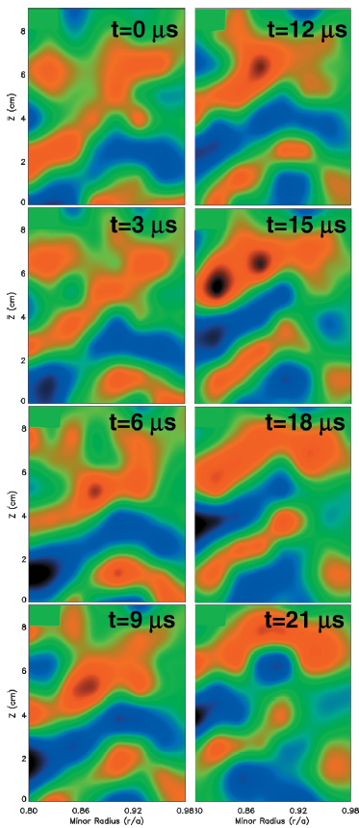
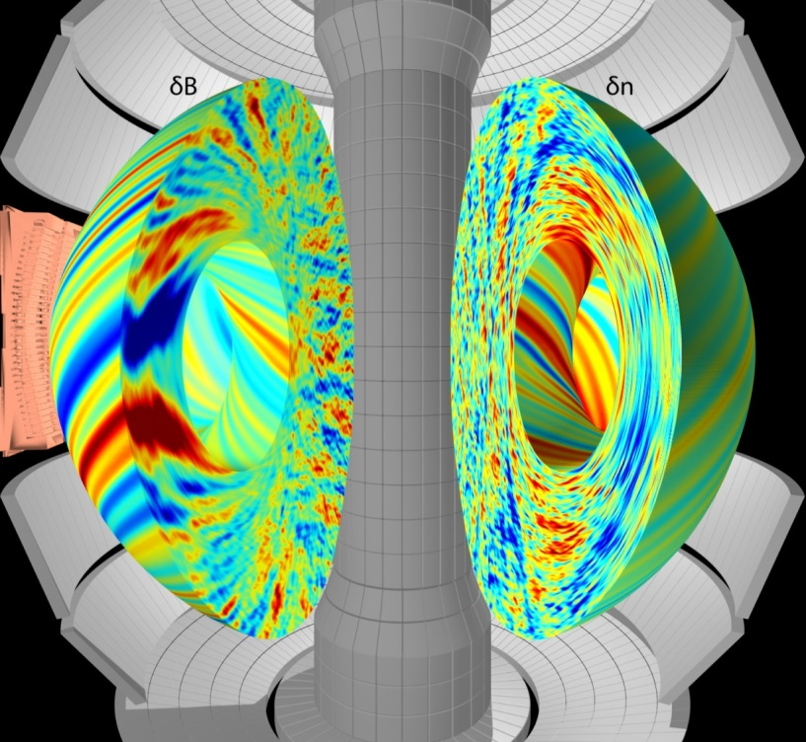
Intro to magnetized plasma turbulence
Beam emission spectroscopy (BES) measurements in DIII-D
Gyrokinetic turbulence simulation in NSTX
Walter Guttenfelder
Princeton Plasma Physics Laboratory
UT-Knoxville lectures
Oct. 16 & 18, 2018

Slide 2
2 slide summary of some turbulent transport concepts in magnetized fusion plasmas (1)
For fusion gain Q~nTτ_{E} (& 100% non-inductive tokamak operation) we need excellent energy confinement, τ_{E}
Energy confinement depends on turbulence (τ_{E}~a²/χ_{turb})
  As does particle, impurity & momentum transport
Core turbulence generally accepted to be drift wave in nature
  Quasi-2D (L⊥~ρ_{i}, ρ_{e} << L||~qR)
  Driven by ∇T & ∇n
  Frequencies ~ diamagnetic drift frequency (ω ~ ω* ~ k_{θ}ρ_{i} ⋅ c_{s}/L_{n,T})
  Drift wave transport generally follows gyroBohm scaling χ_{turb} ~ χ_{GB} ~ ρ_{i}²v_{Ti}/a, however…
  Thresholds and stiffness are critical, i.e. χ_{turb}~χ_{GB}⋅F(…)⋅(∇T-∇T_{crit})
Toroidal ion temperature gradient (ITG) drift wave is a key instability for controlling confinement in current tokamaks
  Unstable due to interchange-like toroidal drifts, analogous to Rayleigh-Taylor instability
  Threshold influenced by magnetic equilibrium (q, s) and other parameters
  Nonlinear saturated transport depends on zonal flows & perpendicular E×B sheared flow

Slide 3
2 slide summary of some turbulent transport concepts in magnetized fusion plasmas (2)
Reduced models are constructed by quasi-linear calculations + “mixing-length” estimates for nonlinear saturation
  We rely heavily on direct numerical simulation using gyrokinetic codes to guide model development
  Reasonably predict confinement scaling and core profiles
Many other flavors of turbulence exist (TEM, ETG, PVG, MTM, KBM)
  ρ_{i} or ρ_{e} scale
  Electrostatic or electromagnetic (at increasing beta)
  Different physical drives, parametric dependencies, & influence on transport channels (Γ vs. Q vs. Π)
Things get more complicated for edge / boundary turbulence
  Changing topology (closed flux surfaces → X-point (poloidal field null) → open field lines & sheaths at physical boundary)
  Larger gyroradius / banana widths, ρ_{banana}/Δ_{ped}~1 → orbit losses & non-local effects
  Large amplitude fluctuations, δn/n₀~1 (delta-f → full-F simulations)
  Neutral particles, radiation, other atomic physics…

Slide 4
Some additional sources & references
Greg Hammett has a lot of great introductory material to fusion, tokamaks, drift waves, ITG turbulence, gyrokinetics, etc… (w3.pppl.gov/~hammett)
Greg & I recently gave five 90 minute lectures on turbulence at the 2018 Graduate Summer School (gss.pppl.gov)
See the following for broader reviews and thousands of useful references
Transport & Turbulence reviews:
  Liewer, Nuclear Fusion (1985)
  Wootton, Phys. Fluids B (1990)
  Carreras, IEEE Trans. Plasma Science (1997)
  Wolf, PPCF (2003)
  Tynan, PPCF (2009)
  ITER Physics Basis (IPB), Nuclear Fusion (1999)
  Progress in ITER Physics Basis (PIPB), Nuclear Fusion (2007)
Drift wave reviews:
  Horton, Rev. Modern Physics (1999)
  Tang, Nuclear Fusion (1978)
Gyrokinetic simulation review:
  Garbet, Nuclear Fusion (2010)
Zonal flow/GAM reviews:
  Diamond et al., PPCF (2005)
  Fujisawa, Nuclear Fusion (2009)
Measurement techniques:
  Bretz, RSI (1997)

Slide 5
OUTLINE
Lecture #1 (Tuesday, 10/16)
Fusion, confinement, tokamaks, transport
General turbulence examples
Turbulence in magnetized plasma
Drift waves
ITG instability
Lecture #2 (Thursday, 10/18)
Other flavors of microinstability (TEM, ETG, MTM, KBM, PVG/KH)
Turbulent transport, nonlinear saturation
Zonal flows & geodesic acoustic modes (GAMs)
ExB shear suppression
Modeling turbulent transport
Extra
Edge turbulence considerations (L-H transition, H-mode pedestal turbulence, scrape off layer/divertor turbulence)
Stellarator turbulence considerations

Slide 6
FUSION, CONFINEMENT, TOKAMAKS, TRANSPORT

Slide 7
We desire fusion gain > 1, more fusion power out than power to heat the plasma
Fusion gain
Fusion power ~ (pressure)² × volume

Slide 8
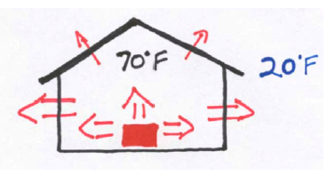
Confinement time is a measure of how well insulated the plasma is from the surrounding boundary
For ignition (a self-sustaining, “burning plasma”)
Q ~ pressure × confinement time > 8 atm⋅s (at ~150 million C)
pressure ~ 2-4 × atmospheric pressure (limited by MHD stability, β limits)
energy confinement time, τ_{E} ~ 2-4 seconds

Slide 9
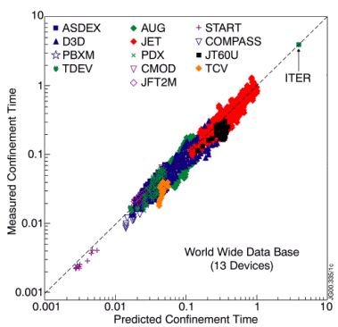

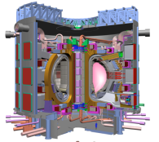
Machine design / extrapolation often relies on empirical scaling of energy confinement
E.g “ITER H-mode scaling”, τ_{IPB,H98(y,2)}
Tokamak reactor design studies that enforce 100% non-inductive (stationary) require excellent confinement, i.e. H₉₈>1 for τ_{E} = H₉₈⋅τ_{IPB98(y,2)}
Empirical confinement scalings are very useful, but have known pitfalls (power laws may not be appropriate, strong collinearity in some variables, …)
Can we understand (turbulent) transport losses to optimize, or at least improve confidence in, next step MFE device performance?

Slide 10
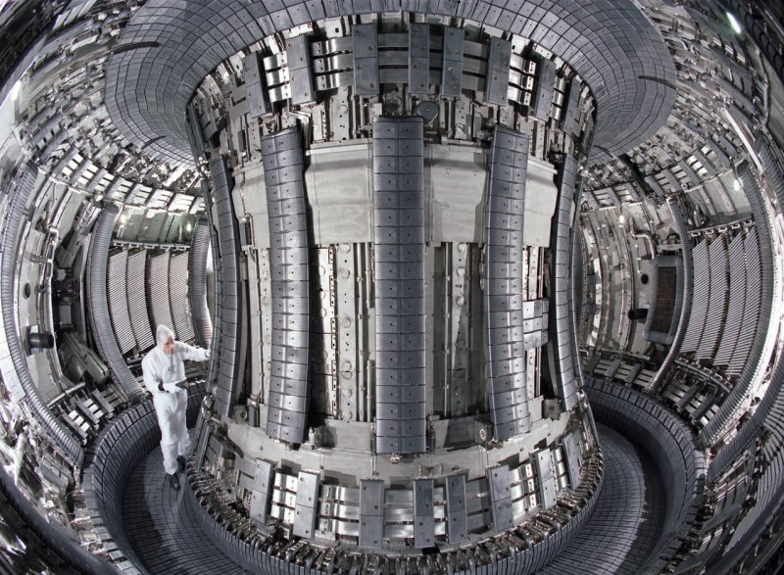
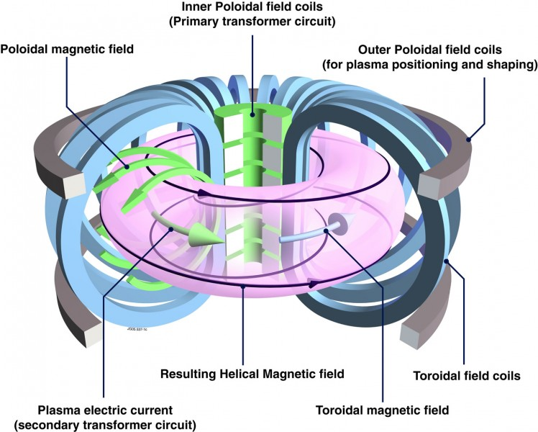
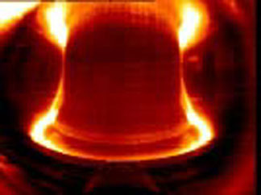
Tokamaks
Axisymmetric
Helical field lines confine plasma
JET (UK)
Alcator C-Mod (MIT)

Slide 11
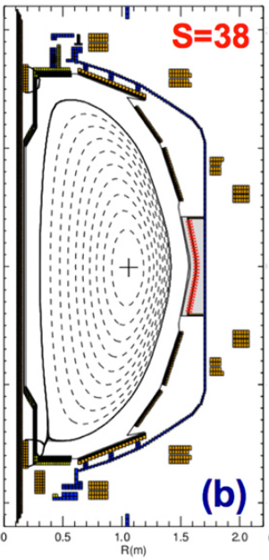
Tokamaks
NSTX
Axisymmetric
Helical field lines confine plasma
Closed, nested flux surfaces

Slide 12
Tokamaks
NSTX
Axisymmetric
Helical field lines confine plasma
Closed, nested flux surfaces
Heat
loss

Slide 13
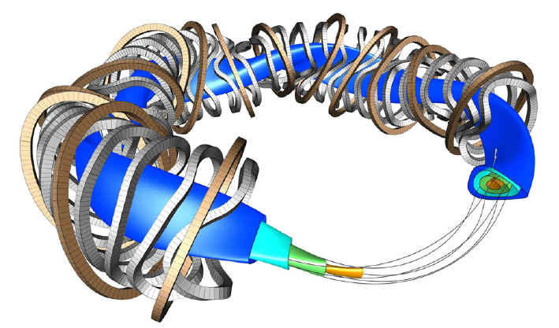
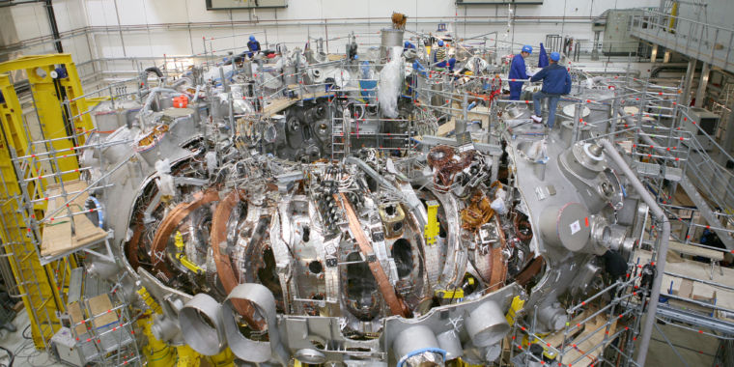
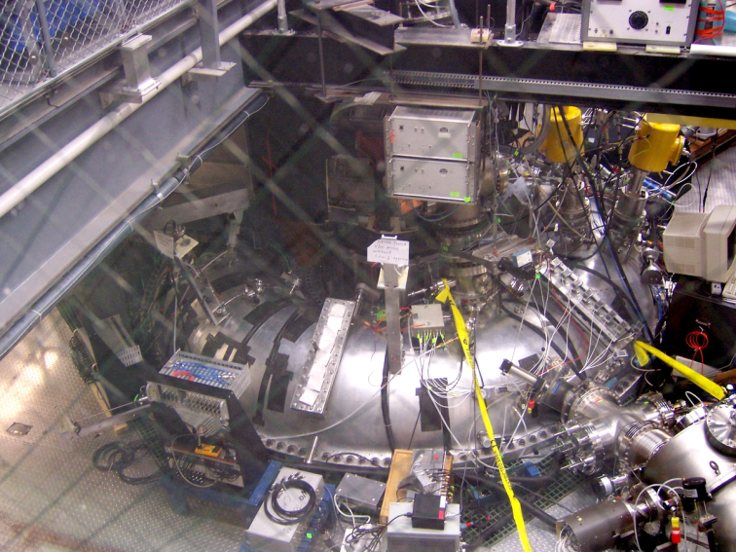
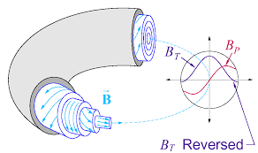
For what we’re going to discuss, general phenomenology also important for stellarators or any toroidal B field
W7-X stellarator
MST Reversed Field Pinch (RFP)

Slide 14
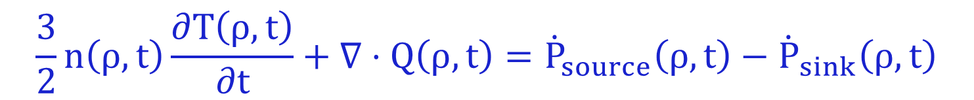
We use 1D transport equations to interpret experiments
Take moments of kinetic equation
Flux surface average, i.e. everything depends only on flux surface label (ρ)

Slide 15
We use 1D transport equations to interpret experiments
Take moments of kinetic equation
Flux surface average, i.e. everything depends only on flux surface label (ρ)
Average over short space and time scales of turbulence (assume sufficient scale separation, e.g τ_{turb} << τ_{transport}, L_{turb} << L_{machine}) → macroscopic transport equation for evolution of equilibrium (non-turbulent) plasma state
To infer experimental transport, Q_{exp}:
  Measure profiles (Thomson Scattering, CHERS)
  Measure / calculate sources (NBI, RF)
  Measure / calculate losses (P_{rad})

Slide 16
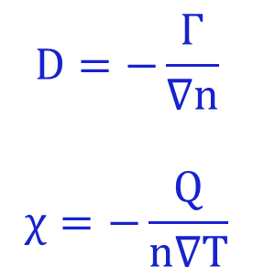
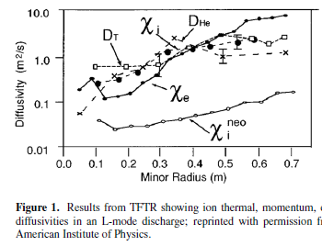
Inferred experimental transport larger than collisional (neoclassical) theory – extra “anomalous” contribution
TFTR
Hawryluk, Phys. Plasmas (1998)
Exp.
Collisional theory
Reporting transport as diffusivities – does not mean the transport processes are collisionally diffusive!

Slide 17
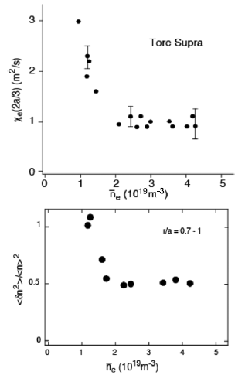

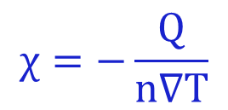
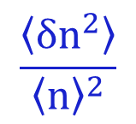
Correlation between local transport and density fluctuations hints at turbulence as source of anomalous transport
Garbet, Nuclear Fusion (1992)
Tynan, PPCF (2009)
Our goal is to understand this

Slide 18
What is turbulence?

Slide 19
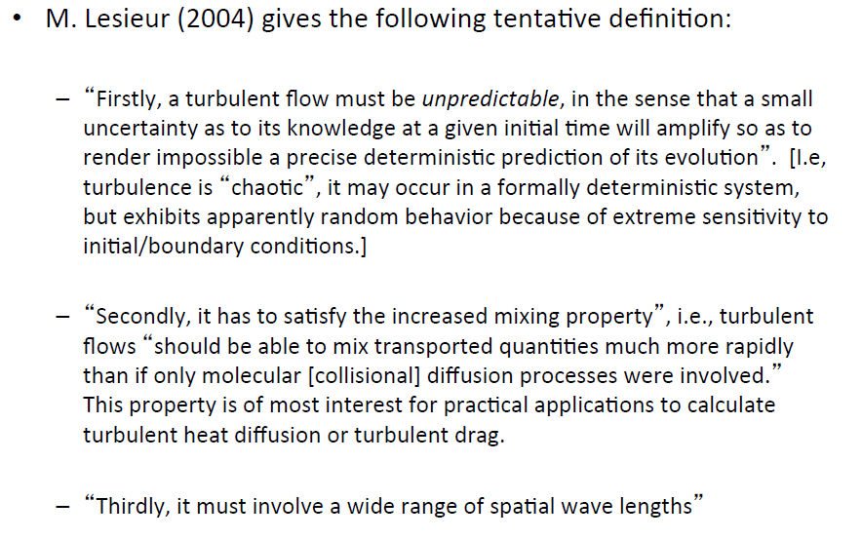
What is turbulence? I know it when I see it (maybe)…
(Hammett class notes)
Also, turbulence is not a property of the fluid, it’s a feature of the flow

Slide 20
Turbulence is an advective process
Transport a result of finite average correlation between perturbed drift velocity (δv) and perturbed fluid moments (δn, δT, δv)
  Particle flux, Γ = ⟨δvδn⟩
  Heat flux, Q = 3/2n₀⟨δvδT⟩ + 3/2T₀⟨δvδn⟩
  Momentum flux, Π ~ ⟨δvδv⟩ (Reynolds stress, just like Navier Stokes)
Electrostatic turbulence often most relevant in tokamaks → E×B drift from potential perturbations: δv_{E}=B×∇(δϕ)/B² ~ k_{θ}(δϕ)/B
Can also have magnetic contributions at high beta, δv_{B}~v||(δB_{r}/B) (magnetic “flutter” transport)

Slide 21
Concepts of turbulence to remember
Turbulence is deterministic yet unpredictable (chaotic), appears random
  We often treat & diagnose statistically, but also rely on first-principles direct numerical simulation (DNS)
Turbulence causes transport larger than collisional transport
  Transport is the key application of why we care about turbulence
Turbulence spans a wide range of spatial and temporal scales
  Or in the case of hot, low-collisionality plasma, a wide range of scales in 6D phase-space (x,v)

Slide 22
Concepts of turbulence to remember
Turbulence is deterministic yet unpredictable (chaotic), appears random
  We often treat & diagnose statistically, but also rely on first-principles direct numerical simulation (DNS)
Turbulence causes transport larger than collisional transport
  Transport is the key application of why we care about turbulence
Turbulence spans a wide range of spatial and temporal scales
  Or in the case of hot, low-collisionality plasma, a wide range of scales in 6D phase-space (x,v)
It’s cool! “Turbulence is the most important unsolved problem in classical physics” (~Feynman)

Slide 23
Turbulence examples (that you can see with your eyes)

Slide 24
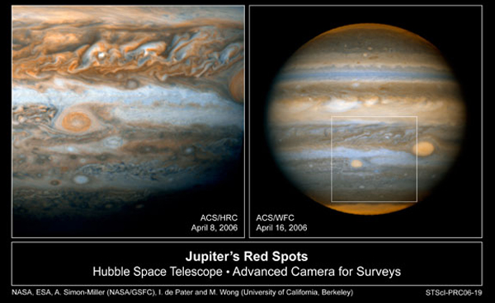
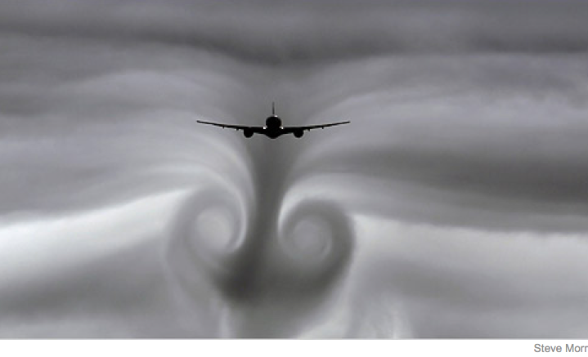
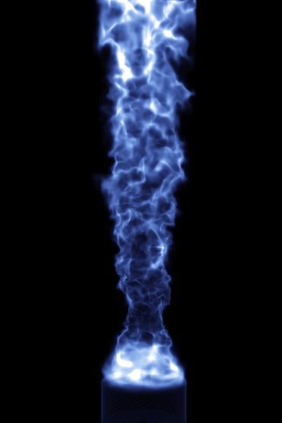
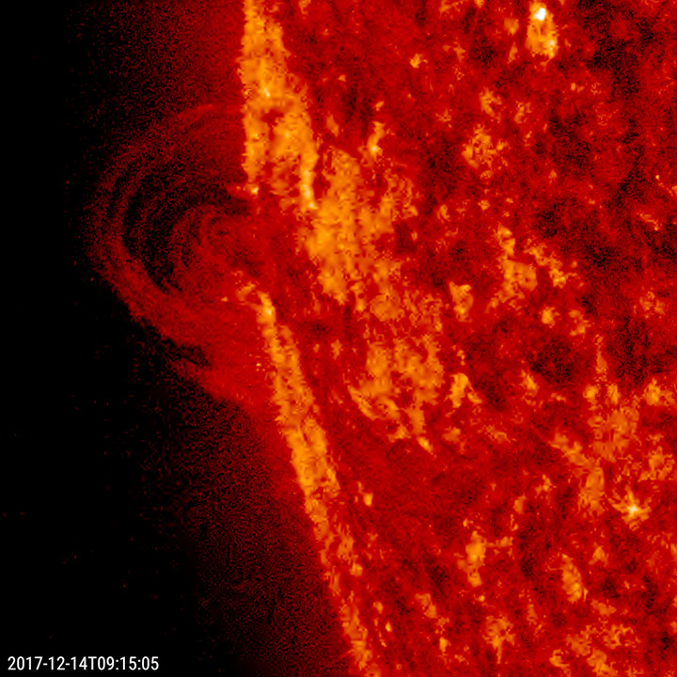
Turbulence found throughout the universe
Universität Duisburg-Essen
https://sdo.gsfc.nasa.gov/gallery

Slide 25

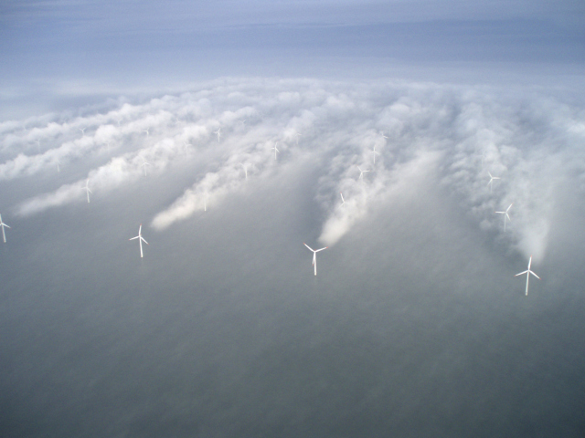
Turbulence is ubiquitous throughout planetary atmospheres

Slide 26
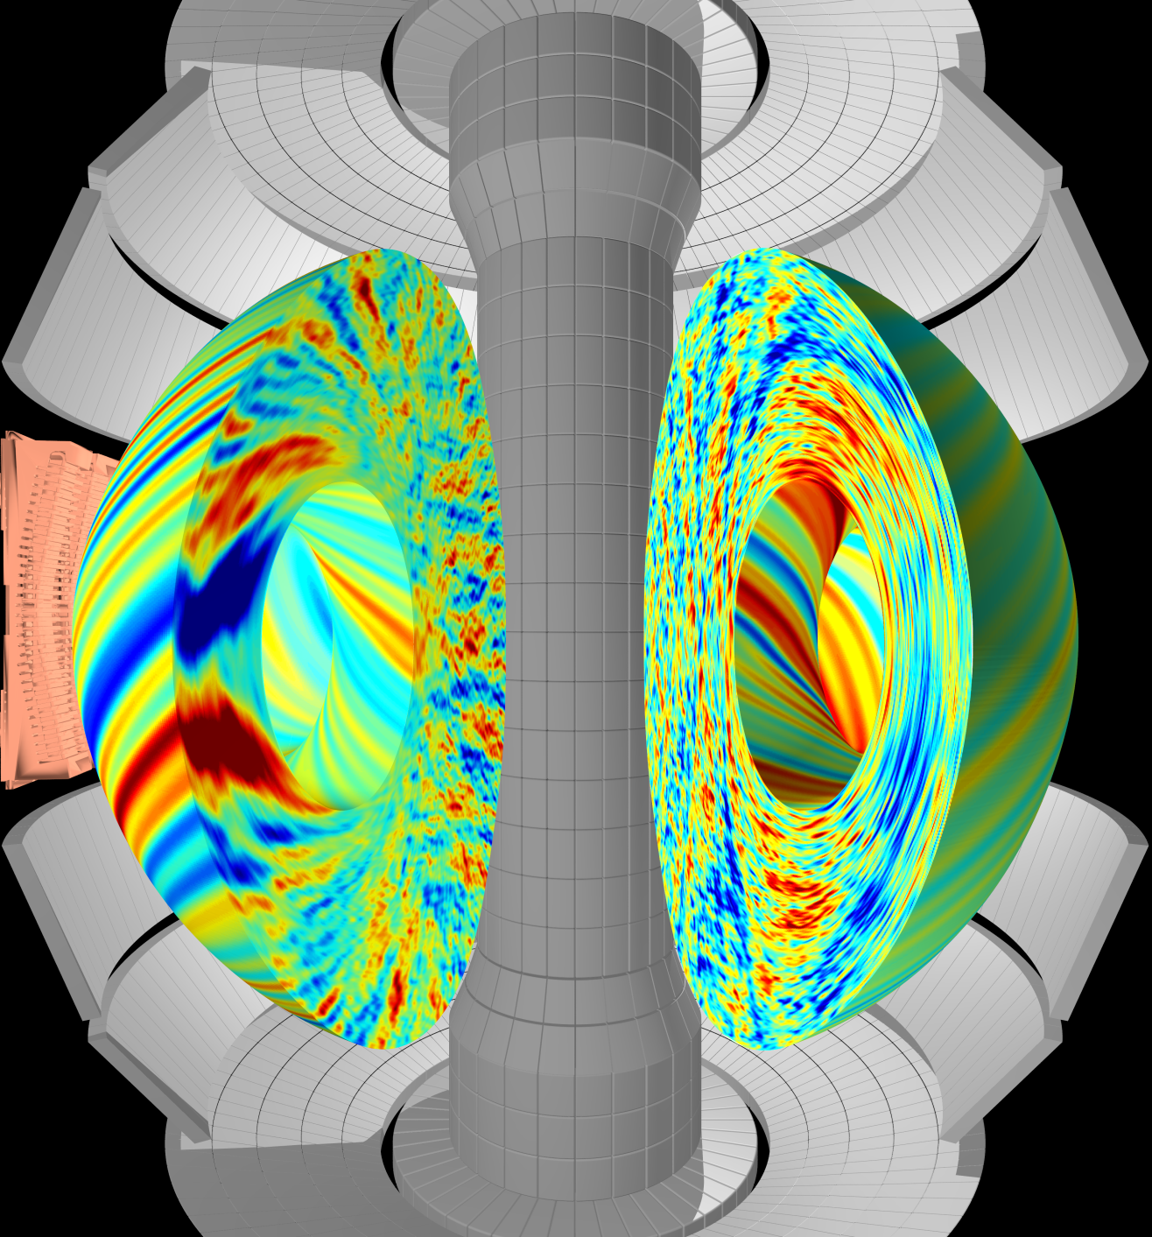

Plasma turbulence determines energy confinement / insulation in magnetic fusion energy devices
Supercomputer simulation of
plasma turbulence
(this is what I do )
Heat
loss
W. Guttenfelder, F. Scotti

Slide 27
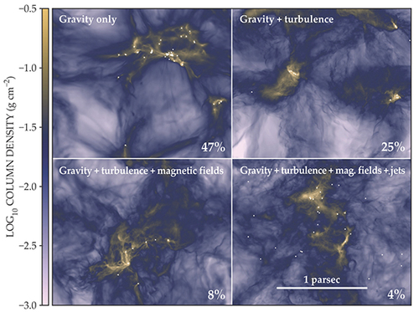
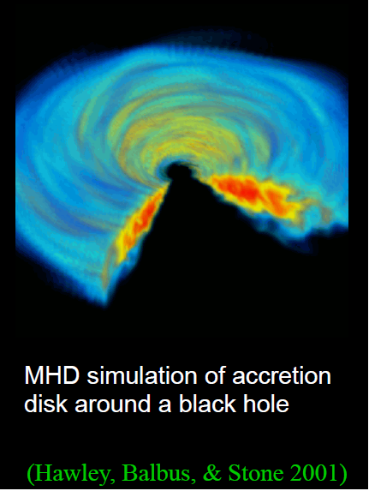
Turbulence is important throughout astrophysics
Plays a role in star formation (C. Federrath, Physics Today, June 2018)

Slide 28
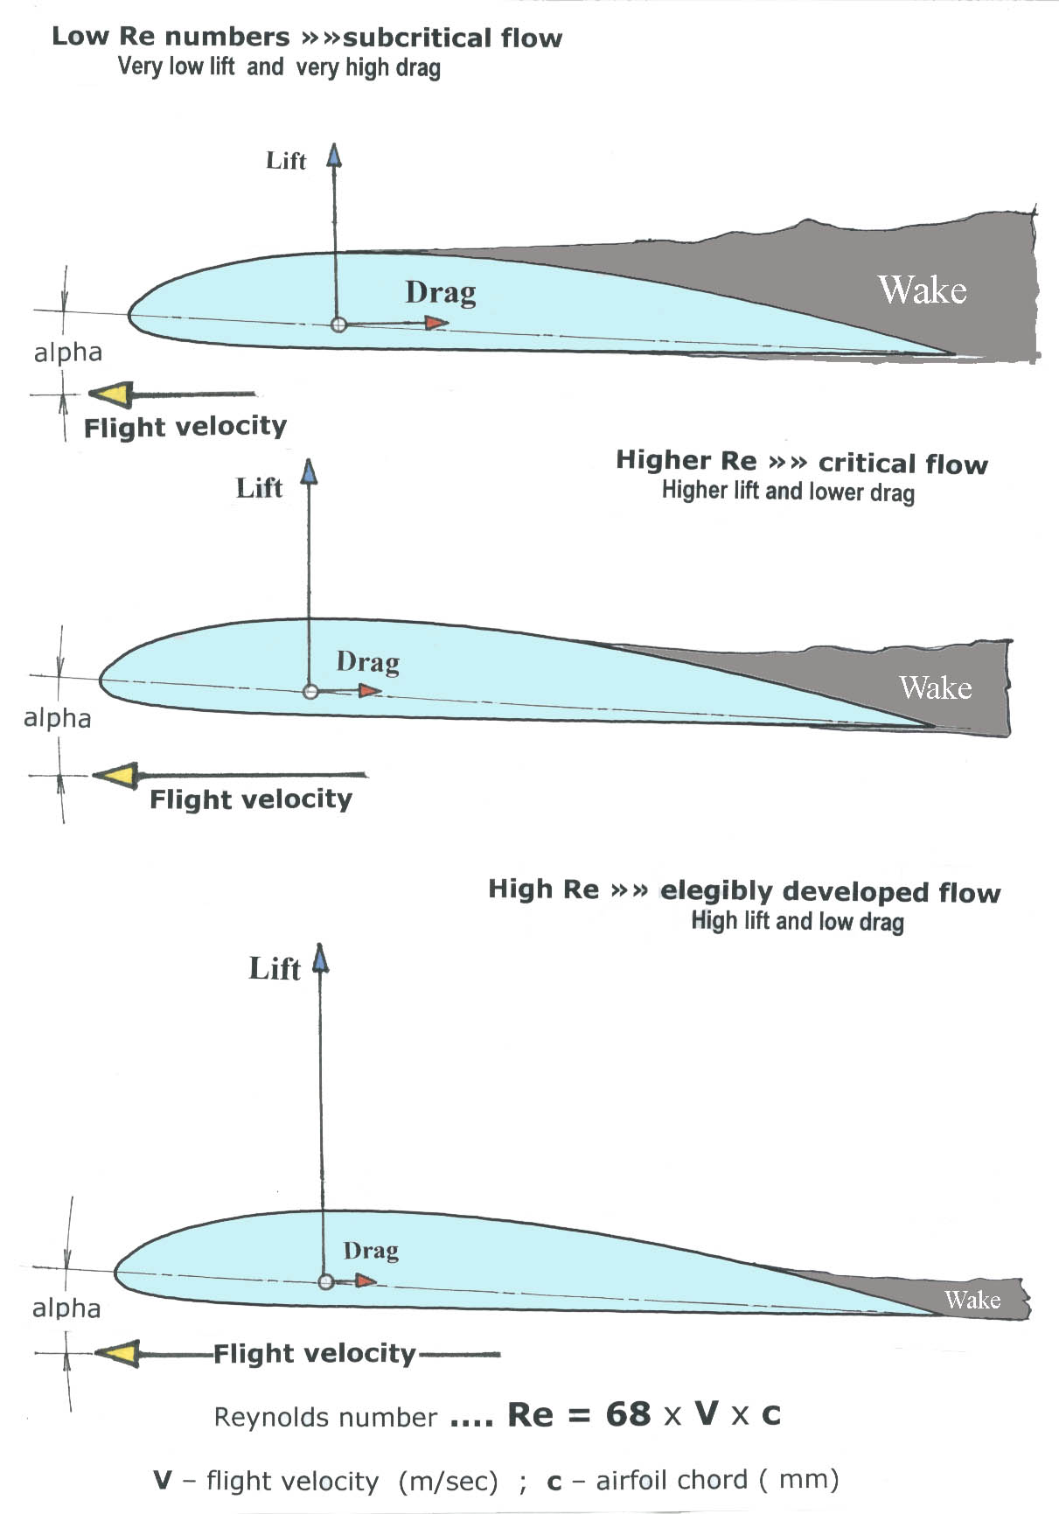
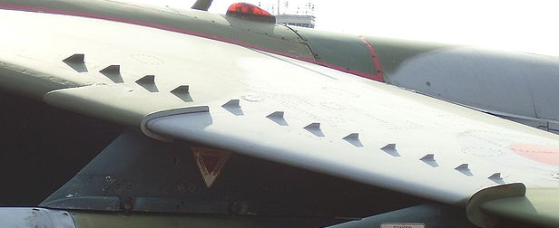
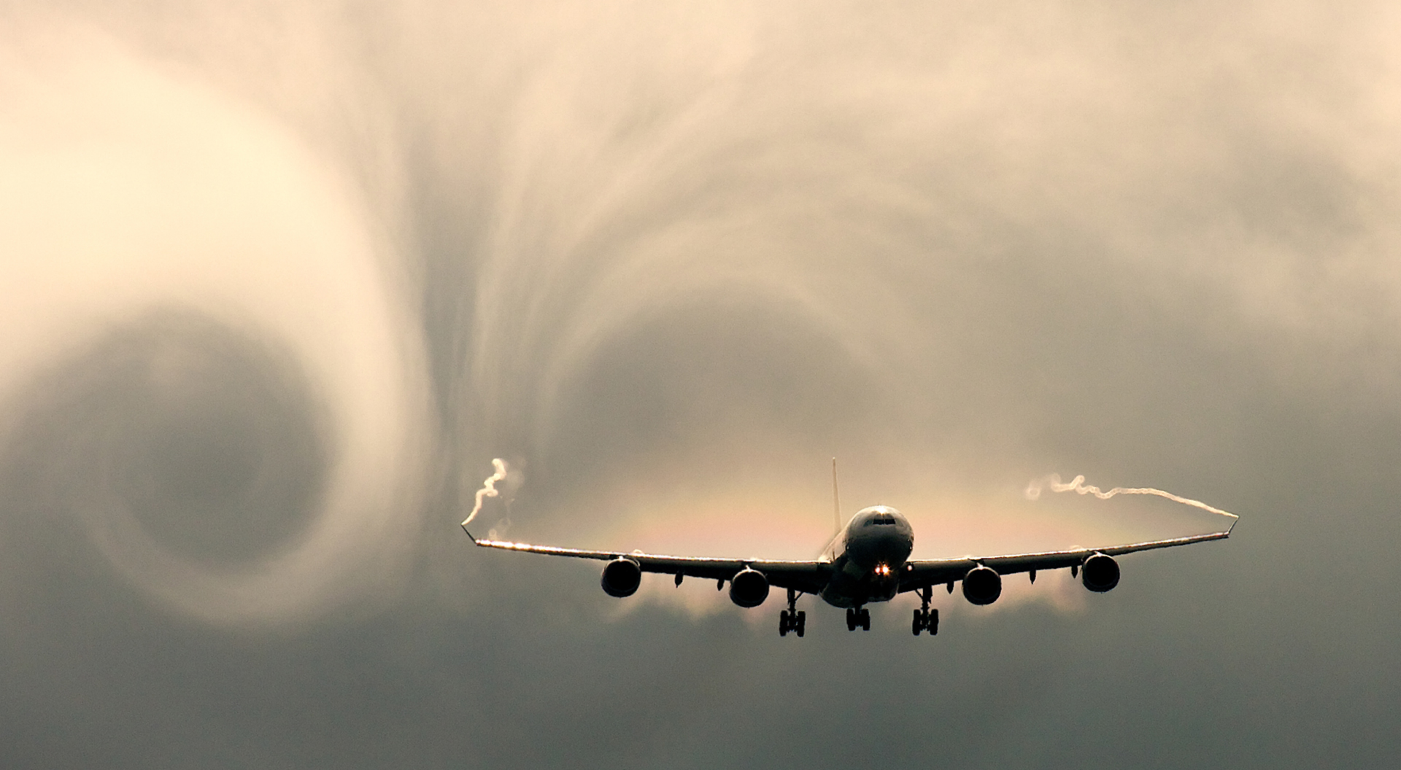
Turbulence is crucial to lift, drag & stall characteristics of airfoils
Increased turbulence on airfoil helps minimize boundary-layer separation and drag from adverse pressure gradient
Turbulence generators
Notes:
Combined with atmospheric turbulence, is crucial for the comfort of passengers and dryness of their clothing

Slide 29
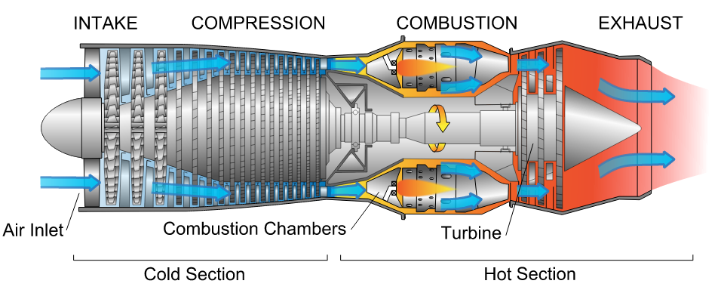

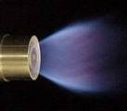
L/D~100-200 in non-premixed jet flames
L/D much smaller in swirling burner
Turbulent mixing of fuel and air is critical for efficient & economical jet engines
Notes:
L/D ~ 100-200 for non-premixed jet flames
Combustors use swirl-stabilized flames that more effectively mix fuel and air

Slide 30
Turbulence in oceans crucial to the climate, important for transporting heat, salinity and carbon
Perpetual Ocean (NASA, MIT)
nasa.gov
mitgcm.org

Slide 31
Fun with turbulence in art

Slide 32
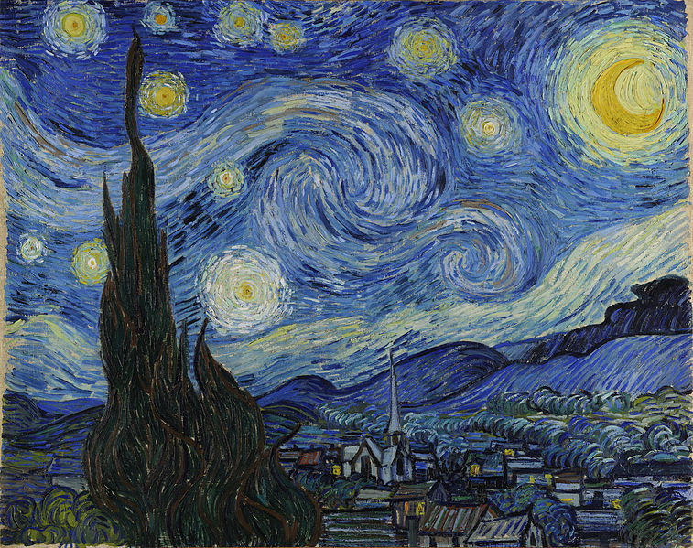
Starry Night, Van Gogh (1889)
Notes:
A view from his asylum room
http://www.nature.com/news/2006/060703/full/news060703-17.html
Scientists in Mexico image Starry Night, find Kolmogorov scaling holds with intensity
Perhaps a reflection of the turbulence in his mind ;)

Slide 33
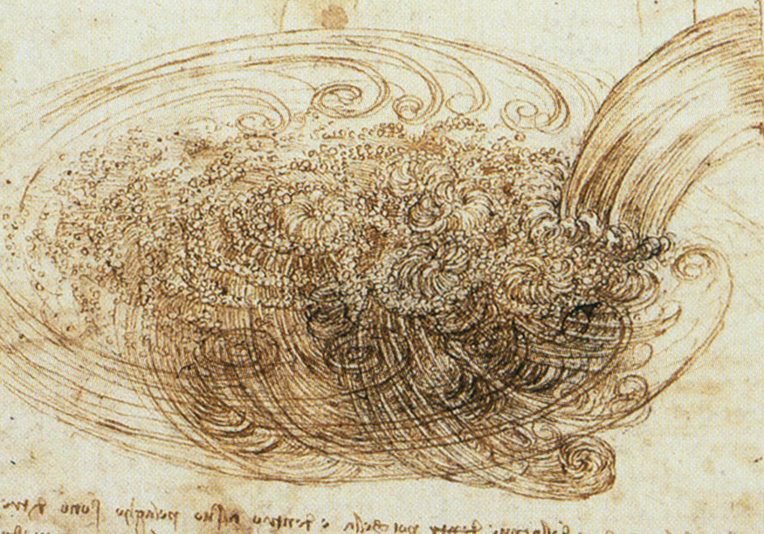
Leonardo da Vinci (1508), turbolenza
Notes:
Been appreciated for a long time, people have had intuitive feel for it and recognized it is ubiquitous
“. . .the smallest eddies are almost numberless, and large things are rotated only by large eddies and not by small ones, and small things are turned by small eddies and large.”
"Observe the motion of the surface of the water, which resembles that of hair, which has two motions, of which one is caused by the weight of the hair, the other by the direction of the curls; thus the water has eddying motions, one part of which is due to the principal current, the other to random and reverse motion"

Slide 34
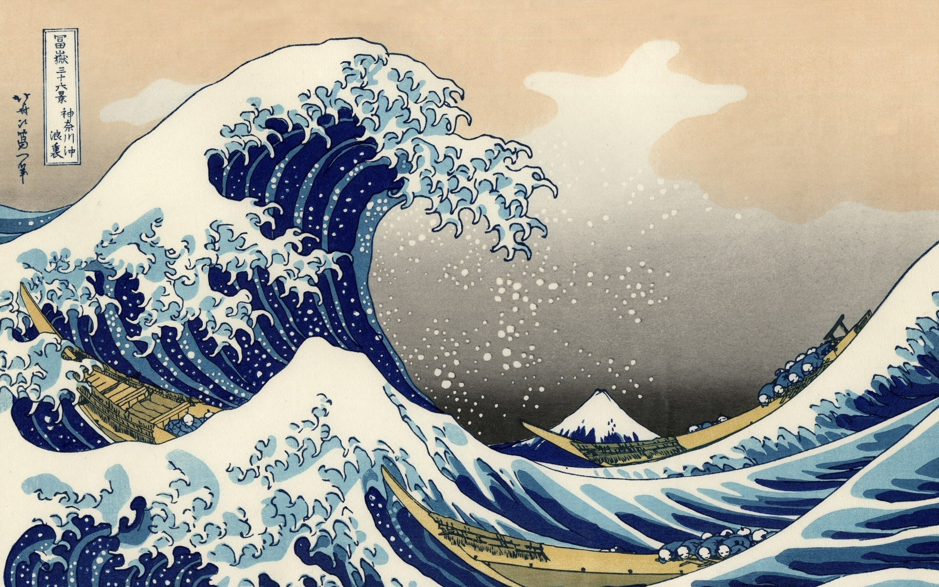
The Great Wave off Kanagawa, Hokusai (1831)
Notes:
Turbulence depicted in art, From “Thirty six views of Mt. Fuji” wood block prints, more literal translation “Off Kanagawa, the underside of a wave”
Fluctuations at different scales (3D), large and small (both water and clouds), also in time (slower, faster) – because energy in flows >> energy dissipated by friction due to viscosity;
Energy is largest for some characteristic length scale, or “correlation length”, certainly what the people in boats are most worried about, even if small perturbations are an inherent part of the turbulence dynamics
Reference to mixing (trying to mix humans from above to below!)

Slide 35
Observing turbulence in tokamaks

Slide 36
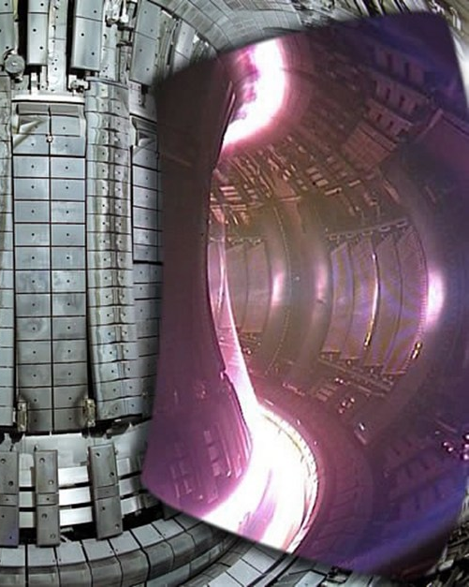
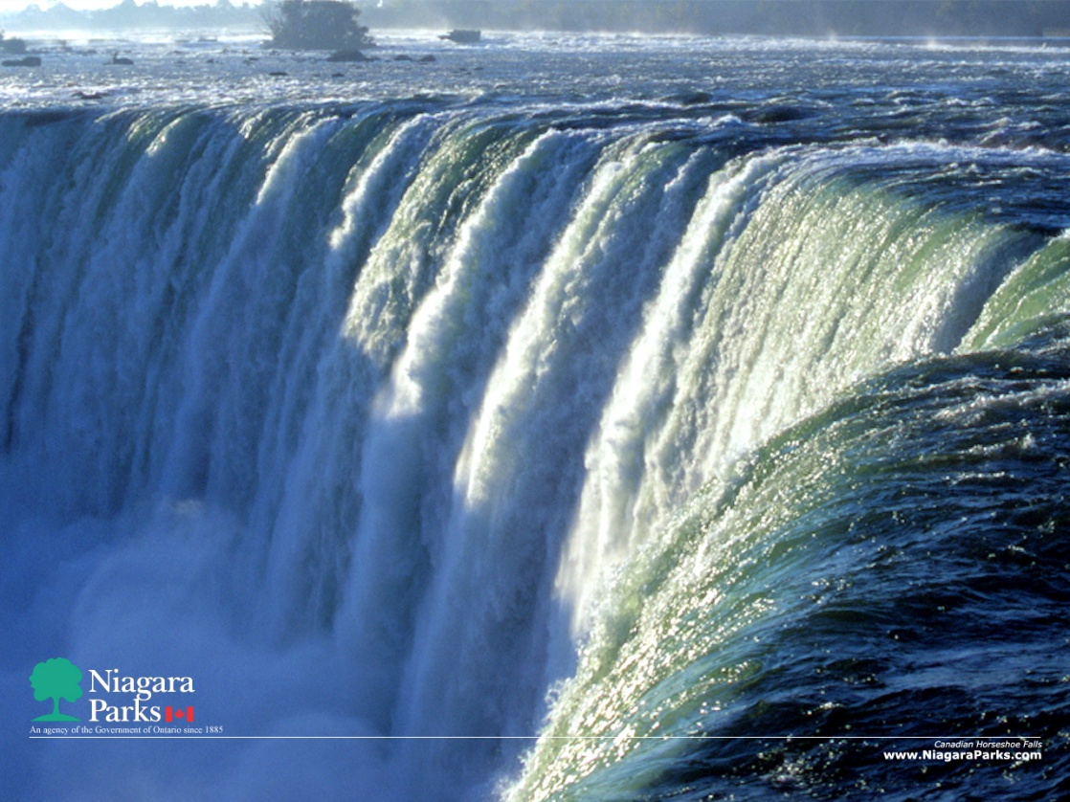
Very challenging to diagnose turbulence at 100 million degrees…
100,000,000 C
300 C
Notes:
Little visible radiation
Can’t really insert material objects, will be obliterated

Slide 37
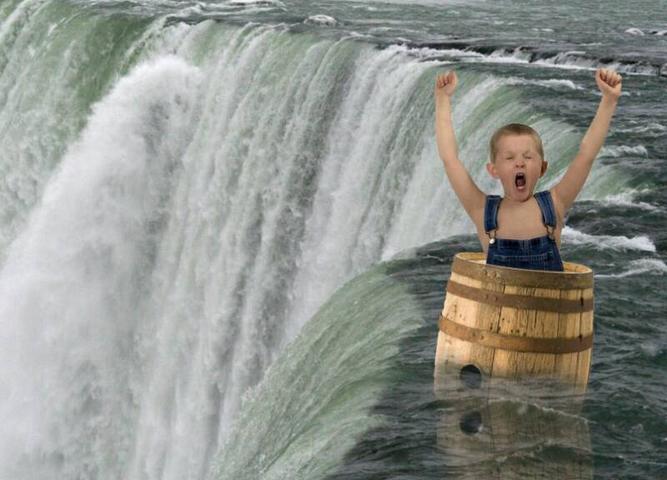
Very challenging to diagnose turbulence at 100 million degrees…
100,000,000 C
300 C
Physical probes don’t work for hot core plasmas, instead → spectroscopy, reflectometry, μwave scattering, …

Slide 39
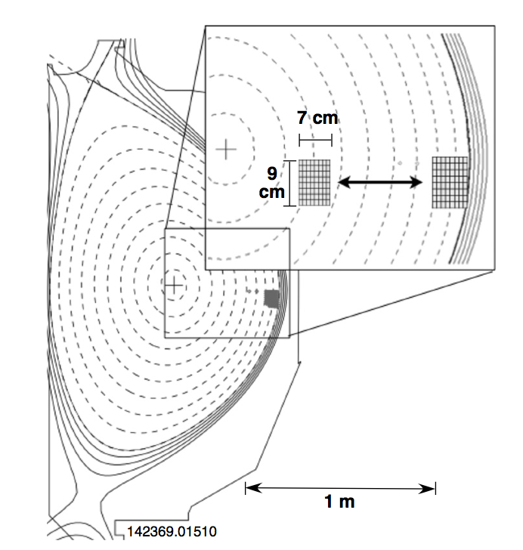
Spectroscopic imaging provides a 2D picture of turbulence in tokamaks: cm spatial scales, μs time scales, <1% amplitude
Utilize interaction of neutral atoms with charged particles to measure density
DIII-D tokamak (General Atomics)
Movies at: https://fusion.gat.com/global/BESMovies
Notes:
Perpendicular cross section size
Turbulence is transporting energy and particles from hot core to cooler edge, mixing them together

Slide 40
BES videos
https://fusion.gat.com/global/BESMovies
(University of Wisconsin; General Atomics)

Slide 41
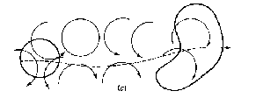
Rough estimate of turbulent diffusivity indicates it’s a plausible explanation for confinement
P_{heat} = Heat flux
HOT
COLD
time-averaged
temperature
D_{turbulence} ~ (step size)² × decorrelation rate
step size ~ 5-10 gyroradii ~ few cm’s
decorrelation rate ~ 100 kHz
~ cm’s
instantaneous
temperature
core
boundary
~1 m
Turbulence confinement time estimate ~ 0.1 s
Experimental confinement time ~ 0.1 s

Slide 42
Turbulence advects/mixes/transports energy, particles and momentum
Turbulence provides a highly nonlinear flux-gradient relationship due to sources of free energy
I realize I’m largely referring to energy transport, but just as important for a self-consistent reactor solution is:
  Particle transport → need to fuel D & T in reactors
  Impurity transport → expelling He ash; avoiding impurity accumulation from e.g. sputtering high-Z (e.g. tungsten) walls
  Momentum transport → rotation is critical to macrostability (RWM/NTM) and part of self-consistent turbulence solution via E×B sheared flows (more later)

Slide 43
Measurements are challenging and limited – also use theory and simulation to help improve understanding

Slide 44
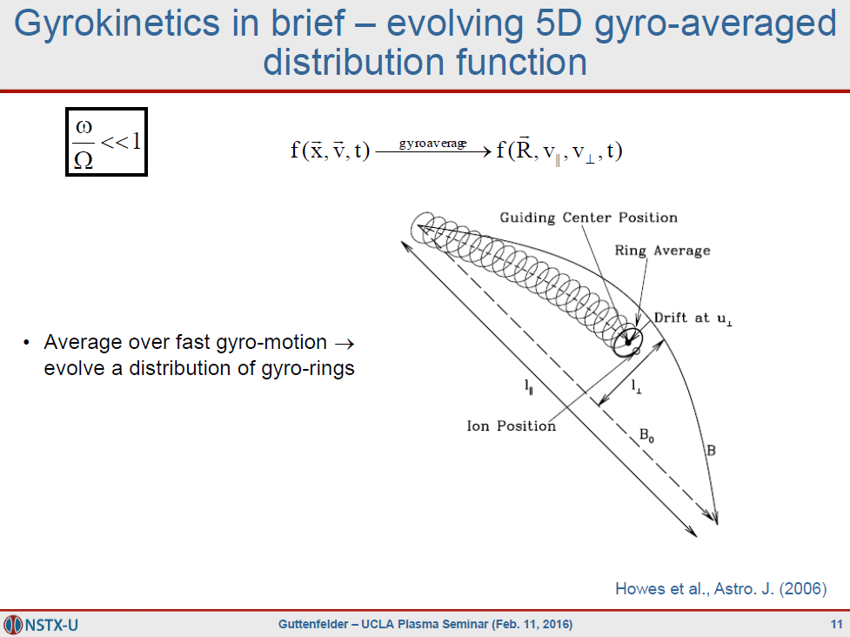

Slide 45
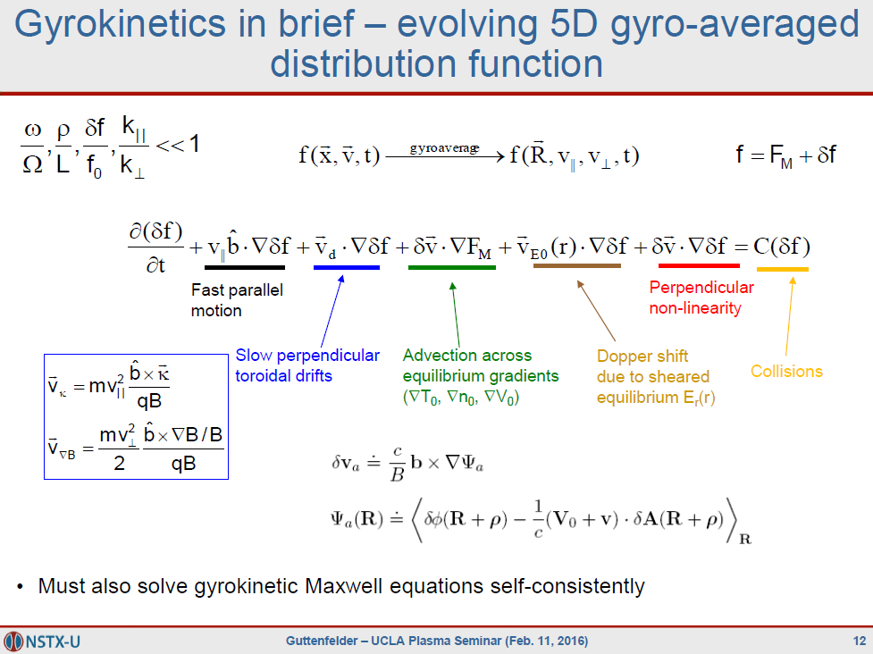
to obtain δϕ, δB

Slide 46
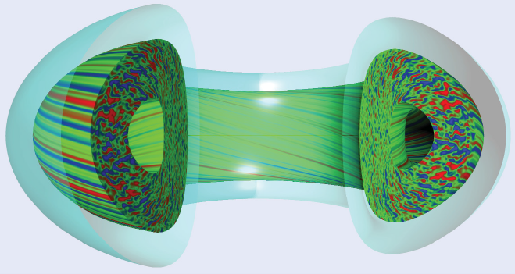
Direct numerical simulations of 5D gyrokinetic turbulence enabled by supercomputing
3D space + 2D particle motion, self-consistent electric and magnetic fields
  100’s millions of grid points, or 10’s billions of particle markers
  Millions of cpu-hours, exploiting up to 200,000 cpu’s (nersc.gov, nccs.gov)
GYRO code
General Atomics
(fusion.gat.com/theory/Gyro)
Notes:
Shown density perturbations calculated by averaging over velocity space of 5D distribution function
Hard to measure, but theory and predictions illustrate turbulence is quasi-2D due to fast parallel motion

Slide 47
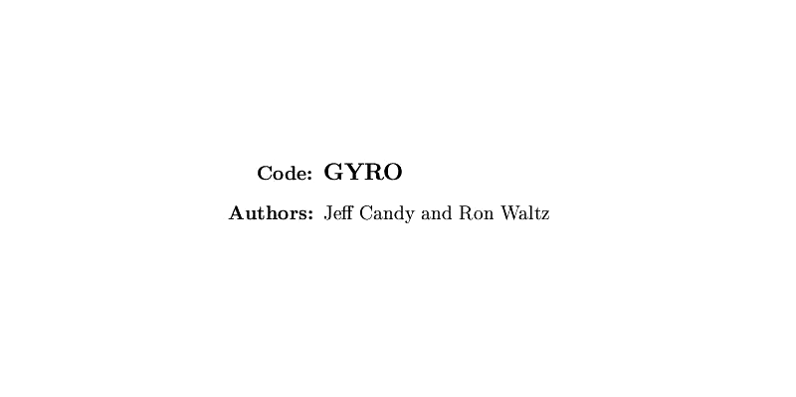

Slide 48
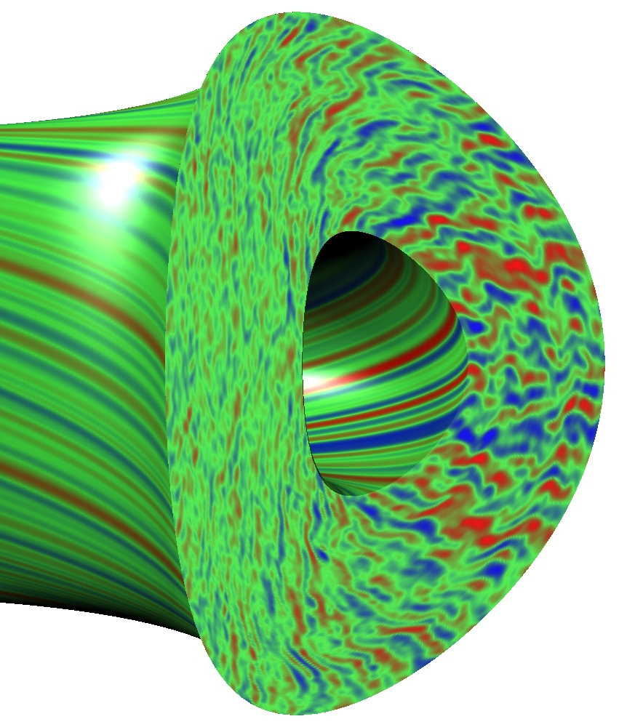
Physically realistic turbulence simulations now capable of reproducing measured behavior
Simulation
Experiment
Movies at: https://fusion.gat.com/theory/Gyromovies

Slide 49
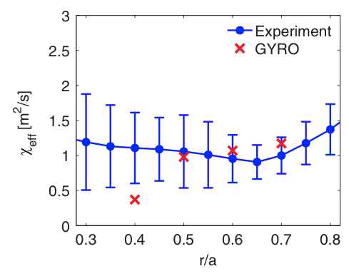
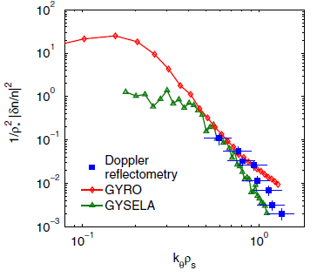
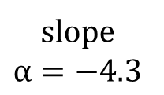

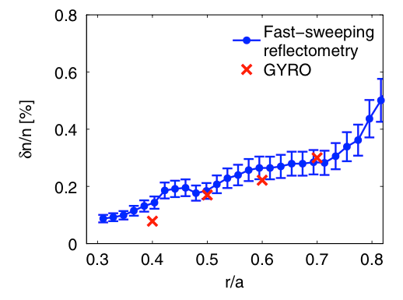



Example of a validation study in Tore Supra
Transport, density fluctuation amplitude (from reflectometry) and spectral characteristics all consistent with nonlinear gyrokinetic simulations (GYRO, GYSELA)
Provides confidence in theoretical understanding of key turbulence mechanism (ITG in this case, more on ITG later)
Casati, PRL (2009)
Notes:
Spectra only covers ~order of magnitude (not >4 like high Re neutral fluids)

Slide 50
What is the nature of turbulence dynamics in tokamaks?
Drift waves

Slide 51
40+ years of theory predicts turbulence in magnetized plasma should often be drift wave in nature
General predicted drift wave characteristics:
Finite-frequency drifting waves, ω(k_{θ})~ω*~k_{θ}V*~(k_{θ}ρ)v_{T}/L_{n}
Driven by ∇n, ∇T (1/L_{n} = -1/n⋅∇n)
  Can propagate in ion or electron diamagnetic direction, depending on conditions/dominant gradients
Quasi-2D, elongated along the field lines (L||>>L⊥, k|| << k ⊥)
  Particles can rapidly move along field lines to smooth out perturbations
Perpendicular sizes linked to local gyroradius, L⊥~ρ_{i,e} or k⊥ρ_{i,e}~1
Correlation times linked to acoustic velocity, τ_{cor}~c_{s}/R
In a tokamak expected to be “ballooning”, i.e. stronger on outboard side
  Due to “bad curvature”/”effective gravity” pointing outwards from symmetry axis
  Often only measured at one location (e.g. outboard midplane)
Fluctuation strength loosely follows mixing length scaling (δn/n₀~ρ_{s}/L_{n})
Transport has gyrobohm scaling, χ_{GB}=ρ_{i}²v_{Ti}/R
  But other factors important! I.e. χ_{turb} ~ χ_{GB}⋅F(⋅⋅⋅)⋅[R/L_{T}-R/L_{T,crit}]

Slide 52

In fact, we’re assuming T_{i}=∇T_{i}=0
(Hammett notes)

Slide 53

Insert perturbed E×B drift into ion continuity
Perturbed advection of background gradient is key element of electrostatic drift waves
(Hammett notes)

Slide 54


(Hammett notes)

Slide 55

(Hammett notes)

Slide 56

ω=(k_{y}ρ_{s})⋅c_{s}/L_{n}
(Hammett notes)

Slide 57
No instability in this simple model because of Boltzmann (adiabatic) electrons & no ion temperature gradient
We will illustrate the “toroidal ion temperature gradient (ITG)” instability in the next section

Slide 58


Finite gyroradius effects limit characteristic size to ion-gyroradius (k⊥ρ_{i}~1)
Drift velocity increases with smaller wavelength (larger k⊥ρ_{i})
If wavelength approaches ion gyroradius (k⊥ρ_{i})≥1, average electric field experienced over fast ion-gyromotion is reduced:
⟨∇ϕ⟩_{gyro-average} ~ ∇ϕ ⟨∇ϕ⟩_{gyro-average} ~ ∇ϕ[1-(k⊥ρ_{i})²]
Maximum growth rates (and typical turbulence scale sizes) occur for (k⊥ρ_{i}) ≤ 1
$${\vec{v}}_{E}=\frac{\hat{b}×∇φ}{B}=−ik_{⊥}\frac{φ}{B}=−ik_{⊥}\left(\frac{φ}{T_{i}}\right)\left(\frac{T_{i}}{B}\right)=−i\left(k_{⊥}ρ_{i}\right)\left(\frac{φ}{T_{i}}\right)v_{Ti}$$

Slide 59

Example linear gyrokinetic simulation results (MAST tokamak)
Real frequencies
Different colors represent different radii in the plasma
Linear growth rates
(Hammett notes)

Slide 60
Why do micro-instabilities & turbulence develop in tokamaks?
Example: Linear stability analysis of Ion Temperature Gradient (ITG) “ballooning” micro-instability (expected to dominate in ITER)

Slide 61

Toroidicity Leads To Inhomogeneity in |B|, gives ∇B and curvature (κ) drifts
What happens when there are small perturbations in T||, T⊥? ⇒ Linear stability analysis…
∇B, curvature (κ)
Z
Z
R
R

Slide 62

Temperature perturbation (δT) leads to compression (∇⋅v_{di}), density perturbation – 90° out-of-phase with δT
∇B, curvature
T⁺
T⁻
T+
T-
T+
T-
Fourier decompose perturbations in space (k_{θ}ρ_{i}≤1)
Assume small δT perturbation
n⁻
n⁺
n-
n+
n-
∇B
n
T
∇T

Slide 63
Dynamics Must Satisfy Quasi-neutrality
Quasi-neutrality (Poisson equation, k⊥²λ_{D}²<<1) requires
For this ion drift wave instability, parallel electron motion is very rapid
Electrons (approximately) maintain a Boltzmann distribution

Slide 64

Perturbed Potential Creates E×B Advection
Advection occurs in the radial direction
∇B, curvature
~Boltzmann e’s
T⁺
T⁻
T+
T-
T+
T-
n⁻
n⁺
n-
n+
n-
ϕ⁻
ϕ⁺
ϕ-
ϕ+
ϕ-
E_{θ}
E_{θ}
E_{θ}
E_{θ}
∇B
n
T
∇T

Slide 65
Background Temperature Gradient Reinforces Perturbation ⇒ Instability
∇T
T⁺
T⁻
T+
T-
T+
T-

Slide 66



Analogy for turbulence in tokamaks – Rayleigh-Taylor instability
Higher density on top of lower density, with gravity acting downwards
gravity
density/pressure

Slide 67


Inertial force in toroidal field acts like an effective gravity
centrifugal force
→effective gravity
gravity
pressure
pressure
Unstable in the outer region
GYRO code
https://fusion.gat.com/theory/Gyro

Slide 68
Same Dynamics Occur On Inboard Side But Now Temperature Gradient Is Stabilizing
Advection with ∇T counteracts perturbations on inboard side – “good” curvature region
“good” curvature
“bad” curvature
∇T
∇T
∇B
T⁺
T⁻
T+
T-
T+
T-
T⁺
T⁻
T+
T-
T+
T-
n
T
∇T
∇T

Slide 69

Similar to comparing stable / unstable (inverted) pendulum
(Hammett notes)

Slide 70

(Hammett notes)

Slide 71

(Hammett notes)

Slide 72
Fast Parallel Motion Along Helical Field Line Connects Good & Bad Curvature Regions
Approximate growth rate on outboard side
Parallel transit time
Expect instability if γ_{instability} > γ_{parallel} , or

Slide 73

Ballooning nature observed in simulations
(Hammett notes)

Slide 74

Threshold-like behavior analogous to Rayleigh-Benard instability
Analogous to convective transport when heating a fluid from below … boiling water (before the boiling)
Heat flux ~ heating power
diffusion
+
turbulence
collisional
diffusion
Temperature gradient
(T_{hot} - T_{cold})
Rayleigh, Benard, early 1900’s
Threshold gradient for temperature gradient driven instabilities have been characterized over parameter space with gyrokinetic simulations
Notes:
Rayleigh-benard, water expands (less dense) as temperature increases (buoyancy), will thermally diffuse to balance, plus viscosity will impede fluid motions until threshold surpassed

Slide 75


Critical gradient for ITG determined from many linear gyrokinetic simulations (guided by theory)
$${\left(\frac{R}{L_{T}}\right)}_{crit}=Max[(1+\frac{T_{i}}{T_{e}})]$$
R/L_{T} = -R/T⋅∇T is the normalized temperature gradient
Natural way to normalize gradients for toroidal drift waves, i.e. ratio of diamagnetic-to-toroidal drift frequencies:
  ω_{*T} = k_{y}(B×∇p) / nqB² → (k_{θ}ρ_{i})v_{T}/L_{T}
  ω_{D} = k_{y}(B×mv⊥²∇B/2B) / qB² → (k_{θ}ρ_{i})v_{T}/R
→ ω_{*T}/ω_{D} = R/L_{T}

Slide 76

Threshold-like behavior observed experimentally
Experimentally inferred threshold varies with equilibrium, plasma rotation, ...
Stiffness (~dQ/d∇T above threshold) also varies
χ = -Q/n∇T highly nonlinear (also use perturbative experiments to probe stiffness)
JET
Mantica, PRL (2011)

Slide 77



With physical understanding, can try to manipulate/optimize microstability
E.g., magnetic shear influences stability by twisting radially-elongated instability to better align (or misalign) with bad curvature drive
Antoneson

Slide 78

Reverse magnetic shear can lead to internal transport barriers (ITBs)
ITBs established on numerous devices
Used to achieve “equivalent” Q_{DT,eq}~1.25 in JT-60U (in D-D plasma)
χ_{i}~χ_{i,NC} in ITB region (complete suppression of ion scale turbulence)
JT-60U
Ishida, NF (1999)

Slide 79
Very simple growth rate derivation of previous toroidal ITG cartoon picture

Slide 80

Temperature perturbation (δT) leads to compression (∇⋅v_{di}), density perturbation – 90° out-of-phase with δT
dn/dt + ∇⋅(nv)=0
-iωδn from -n₀∇⋅δv_{d} ~ -n₀∇⋅(δT⊥ b×∇B/B)/B ~ -n₀ ik_{y}δT / BR
-iω(δn/n₀) ~ -ik_{y}(δT/T₀) T/BR ~ -i(k_{y}V_{D}) (δT/T₀) ~ -iω_{D} (δT/T₀)
-iω(δn/n₀) = -iω_{D} (δT/T₀)

Slide 81

Background Temperature Gradient Reinforces Perturbation ⇒ Instability
-iωδT from -δv_{E}⋅∇T₀ ~ -(b×∇δϕ/B)∇T₀ ~ ik_{y}δϕ/B⋅∇T₀ ~ ik_{y}δϕ(T/B)/L_{T}
-iω(δT/T) ~ ik_{y}(δϕ/T)T/BL_{T} ~ i(k_{y}V_{*T})(δϕ/T) ~ iω_{*T}(δϕ/T)
-iω(δT/T) = iω_{*T}(δϕ/T)

Slide 82
Simplest dispersion from these 3 terms
(1) Compression from toroidal drifts
ω(δn_{i}/n₀) = ω_{Di} (δT_{i}/T_{i0})
(2) Quasi-neutrality + Boltzmann electron response
(δn_{i}/n₀) = (δn_{e}/n₀) = (δϕ/T_{e0}) = (δϕ/T_{i0})(T_{i}/T_{e})
(3) E×B advection of background gradient
-ω(δT_{i}/T_{i0}) = ω_{*T}(δϕ/T_{i})
(1)+(2): ω(T_{i}/T_{e})(δϕ/T_{i0}) = ω_{Di} (δT_{i}/T_{i0})
(+3): ω(T_{i}/T_{e}) = -ω_{Di} ω_{*T} / ω
ω² = -(k_{y}ρ_{i})²v_{Ti}² / RL_{T} (assume T_{e}=T_{i})
ω = +/- i (k_{y}ρ_{i})v_{Ti} / (RL_{T})^{1/2}

Slide 83
How do we go from linear stability to turbulent transport?

Slide 84


Transport depends on a spectrum of amplitude fluctuations and cross-phases
E.g. particle flux from electrostatic perturbations
As a function of wavenumber:
Except for Languir probes in cool edge plasma, we never (?) have been able to measure all the quantities needed to directly infer turbulent transport (especially cross phase)
Cross phase
Amplitude spectra

Slide 85
Mixing length estimate for fluctuation amplitude
In the presence of an equilibrium gradient, ∇n₀, turbulence with radial correlation L_{r} will mix regions of high and low density
instantaneous
temperature
or density
time-averaged
temperature or density
∇n₀
L_{r}~1/k_{r}
turbulent eddy (~mm-cm)
core
boundary
1-2 m

Slide 86
Mixing length estimate for fluctuation amplitude
In the presence of an equilibrium gradient, ∇n₀, turbulence with radial correlation L_{r} will mix regions of high and low density
Leads to fluctuation δn
instantaneous
temperature
or density
time-averaged
temperature or density
∇n₀
L_{r}~1/k_{r}
δn
turbulent eddy (~mm-cm)
core
boundary
1-2 m

Slide 87

Mixing length estimate for fluctuation amplitude
In the presence of an equilibrium gradient, ∇n₀, turbulence with radial correlation L_{r} will mix regions of high and low density
Leads to fluctuation δn
Another interpretation: local, instantaneous gradient limited to equilibrium gradient
instantaneous
temperature
or density
time-averaged
temperature or density
∇n₀
core
boundary
1-2 m

Slide 88
Mixing length estimate for fluctuation amplitude
IF turbulence scale length linked to ρ_{s}, would loosely expect δn/n₀~ρ_{s}/L_{n}

Slide 89






Fluctuation intensity across machines loosely scales with mixing length estimate, reinforces local ρ_{s} drift nature
Liewer, Nuclear Fusion (1985)
Lechte, New J. of Physics (2002)
ρ_{s}/L_{n}

Slide 90


Broad frequency and wavenumber spectra measured, e.g. from microwave scattering
Mazzucato, PRL (1982)
Surko & Slusher, Science (1983)
Princeton Large Torus (PLT)
k~7 cm⁻¹
Different scattering angles measure different k, observe spectral decay in wavenumber

Slide 91

Broad drift wave turbulent spectrum verified simultaneously with Langmuir probes and FIR scattering
TEXT, Ritz, Nuclear Fusion (1987)
Wooton, Phys. Fluids B (1990)
Illustrates drift wave dispersion
However, real frequency almost always dominated by Doppler shift
Often challenging to determine mode frequency (in plasma frame) within uncertainties
FIR
Langmuir probe

Slide 92



Simultaneous measurement of n_{e} and T_{e} using same beam path allows for cross-phase measurement
Not directly the cross-phase relate to transport (e.g. ϕ-T).
DIII-D
White, PoP (2010)

Slide 93

n_{e}-T_{e} cross phases agree amazingly well with simulations!
Concept of “validation hierarchy” – validate theory with high level quantities (transport) + components [δn(ω,k), δT(ω,k), cross-phases]
Provides (stronger) constraint to validate theory & physical understanding

Slide 94
Spectrum shape / distribution governed by nonlinear three-wave interactions
Linearly unstable modes grow, δn(k)~exp[ik⋅x+γ(k)t]
At large amplitude, interact via nonlinear advection, δv_{E}⋅∇δn
I.e. “three-wave” coupling in wavenumber space
d/dt(δn) ~ δv_{E}⋅∇δn
d/dt[δn(k₃)] ~ Σ_{k1,k2} [(b×k₁δϕ)⋅k₂δn]
summed over all (k₁,k₂) for k₁+k₂=k₃
Energy gets distributed across k space (& velocity space) until damped by stable modes (& collisions) → saturation

Slide 95



Self-generated “zonal flows” also impacts saturation of turbulence and overall transport (esp. ITG)
Potential perturbations uniform on flux surfaces, near zero frequency (f~0)
Predator-prey like behavior: turbulence drives ZF (linearly stable), which regulates/clamps turbulence; if turbulence drops enough, ZF drive drops, allows turbulence to grow again…
Linear instability stage demonstrates structure of fastest growing modes
Large flow shear from instability cause perpendicular “zonal flows”
Zonal flows help moderate the turbulence!!!
Rayleigh-Taylor like instability ultimately driving Kelvin-Helmholtz-like instability → non-linear saturation

Slide 96


Slide 97

Generation of zonal flows in tokamaks similar to “Kelvin-Helmotz” instability found throughout nature
Variation of flows in one direction…
lead to flows in another direction
(potential contours → stream functions)

Slide 98

The Jet Stream is a zonal flow (or really, vice-versa)
NASA/Goddard Space Flight Center Scientific Visualization Studio

Slide 99
Zonal flows reduce the heating power required to maintain a given temperature (than had they not been there)
Heat flux ~ heating power
diffusion
+
turbulence
Influence of
zonal flows
diffusion
Temperature gradient
(T_{hot} - T_{cold})
So-called “Dimits shift” [A. Dimits et al, Phys. Plasmas 7, 969 (2000)]

Slide 100

ZF also leads to Geodesic Acoustic Mode (GAM) oscillation, also contributes to nonlinear saturation
Zonal flow potential ϕ is uniform on a flux surface
v_{E,ZF}=∇_{r}ϕ/B varies like cos(θ) from 1/B
Compressibility (∇⋅v_{E,ZF}) gives rise to ~coherent geodesic acoustic mode (ω_{GAM}≈c_{s}/R) from associated (n=0, m=1) pressure perturbation
coherence
CHS, Fujisawa, PRL (2004)
GAM
GAMs are easier to measure, have been identified in numerous tokamaks and stellarators, consistent with theory predictions

Slide 101
Suppression of turbulence via sheared perpendicular (E×B) flow

Slide 102



Large scale sheared flows can tear apart turbulent eddies, reduce turbulence, mixing and transport
Turbulent transport expected to be reduced as the mean flow shear rate (ω_{s}~dU₀/dy) approaches the turbulence decorrelation rate (Δω_{D})
Biglari, Diamond, Terry 1990

Slide 103

Large scale sheared flows can tear apart turbulent eddies, reduce turbulence → improve confinement
NSTX simulations
Snapshot of density without flow shear
Snapshot of density with flow shear
Heat flux
Heat flux
Lower amplitude
Smaller (titled) eddies
Reduced transport
100 ion radii
6,000 electron radii
~50 cm
mean flow velocity profile

Slide 104

Spontaneous “H-mode” edge transport barrier can form with sufficient heating power → improved confinement
Correlated with strong shear in equilibrium radial electric field (E_{r})
Suppression of turbulence predicted when equilibrium shearing rate (ω_{E×B}) > turbulence decorrelation rate (Δω_{D}) [Biglari, 1990; Hahm, 1994]
(from Carter, 2013)

Slide 105


In neutral fluids, sheared flows are usually the source of free energy to drive turbulence
Thin (quasi-2D) atmosphere in axisymmetric geometry of rotating planets similar to tokamak plasma turbulence
Stratospheric ash from Mt. Pinatubo eruption (1991) spread rapidly around equator, but confined in latitude by flow shear
Aerosol concentration
Large shear in stratospheric equatorial jet
(Trepte, 1993)
Notes:
Sheared flows in neutral fluids are usually a drive for turbulence, not a suppression mechanism
However, another example of sheared flows suppressing turbulent mixing is found in atmospheric turbulence (Terry, 2000; Trepte, 1993)
Eruption of Mt. Pinatubo (Philippines) in 1991???? (15 N, 120 E), spewed ash into the stratosphere, spreads in latitude to +/- 20 degree but large gradient persists for months, large shear in stratospheric equatorial jet at same position [in contrast to lower altitude troposphere]

Slide 106
REDUCED MODELS

Slide 107

Have learned a lot from validating first-principles gyrokinetic simulations with experiment
But the simulations are expensive (1 local multi-scale simulation ~ 20M cpu-hrs)
Desire a model capable of reproducing flux-gradient relationship that is far quicker, so we can do integrated predictive modeling (“flight simulator”)
All physics based models are local & gradient-driven, i.e. given gradients from a single flux surface they predict fluxes:
that can be used in solving the 1D transport equation predictively

Slide 108
Is local assumption appropriate?
If ρ*=ρ_{i}/L is small enough (<~1/300), local is good → OK for ITER and most reactor designs (at least in the core, not the edge)
Challenges: In the edge, additional effects may change how we model transport / gradient relationship
  Large, intermittent edge fluctuations with strong non-local effects may demand full-F gyrokinetic simulations (XGC-1, Gkeyll)
  Local transport time scale, i.e. evolution of T(ρ,t), is increasingly fast relative to turbulence
  Related -- edge turbulence should perhaps more realistically be thought of as source driven vs. gradient driven (think external forcing vs. linear instability)
    We’re heating the plasma and watching the temperature respond, not experimentally prescribing a temperature gradient
  Unclear how to incorporate these effects in reduced models

Slide 109

Illustration of how to develop a simple plasma turbulence drift wave transport model
Decompose flux expressions into wavenumber, amplitude spectra, and cross-phases
Amplitude could be estimated using mixing-length hypothesis:

Slide 110




Using dispersion relation, we recover gyroBohm scaling factor
γ ≈
k_{θ}ρ_{s} for expected peak γ
Assuming isotropic
In the local (small ρ*) limit, all transport quantities have leading order gyroBohm scaling
But linear stability (δ) still matters (e.g. thresholds & stiffness)

Slide 111
Early models (60’s-80’s) used analytic fluid or gyrokinetic theory to evaluate linear stability
Fancy non-linear theories also used to refine model for saturated fluctuation amplitudes
A turning point in model sophistication was the advent of gyrofluid equations & increased computational power
  Hammett, Perkins, Dorland, Beer, Waltz, ….
Take fluid moments of gyrokinetic equation
Pick suitable kinetic closures
Tweak closure free parameters to best match linear gyrokinetic simulations
  Linear GK simulations became routine in mid-90’s, but expensive and slow relative to gyrofluid

Slide 112

Breakthrough in understanding (90’s…) was recognition of threshold and stiffness
All local models have gyroBohm prefactor (Q_{GB})
First modern model approaches fit coefficients in above equation to large numbers of GF and/or GK simulations
  R/L_{T,crit} from linear simulations
  Additional scaling coefficient F(s,q,…) from nonlinear simulations
A bunch of fit coefficients, but entirely from first principles
Modern transport models: IFS-PPPL, GLF23, TGLF, QualiKiz, …

Slide 113

Some success in profile predictions (TGLF model on DIII-D)
Temperature
prediction
Measurement
core
Kinsey (2010)
boundary

Slide 114

Good agreement in predicted energy confinement over database of discharges
Kinsey (2011)

Slide 115
There are many flavors of micro-instabilities/turbulence

Slide 116
Beyond general characteristics, there are many theoretical “flavors” of drift waves possible in tokamak core & edge
Usually think of drift waves as gradient driven (∇T_{i}, ∇T_{e}, ∇n)
  Often exhibit threshold in one or more of these parameters
Different theoretical “flavors” exhibit different parametric dependencies, predicted in various limits, depending on gradients, T_{e}/T_{i}, ν, β, geometry, location in plasma…
  Electrostatic, ion scale (k_{θ}ρ_{i}≤1)
    Ion temperature gradient (ITG) – driven by ∇T_{i}, weakened by ∇n
    Trapped electron mode (TEM) – driven by ∇T_{e} & ∇n_{e}, weakened by ν_{e}
    Parallel velocity gradient (PVG) – driven by R∇Ω (like Kelvin-Helmholtz)
  Electrostatic, electron scale (k_{θ}ρ_{e}≤1)
    Electron temperature gradient (ETG) - driven by ∇T_{e}, weakened by ∇n
  Electromagnetic, ion scale (k_{θ}ρ_{i}≤1)
    Kinetic ballooning mode (KBM) - driven by ∇β_{pol} ~ α_{MHD}
    Microtearing mode (MTM) – driven by ∇T_{e}, at sufficient β_{e}

Slide 117
Trapped electrons enhance ITG and lead to new instabilty: trapped electron mode (TEM)

Slide 118

Inhomogeneous magnetic field causes trapped particles to precess toroidally
E = 1/2mv² = constant
μ = mv⊥²/2B = constant
Trapped electron precession frequencies can be comparable to drift wave frequency (ω~v_{Ti}/R) ⇒ resonance can enhance ITG instability and lead to distinct trapped electron mode (TEM) instabilities driven by ∇T_{e}, ∇n_{e}

Slide 119
Turbulence at electron gyroradius can also be important

Slide 120

Electron scale (~mm) turbulence can dominate when ITG/TEM suppressed
Electron temperature gradient (ETG) instability “isomorphic” to ITG, same ballooning instability mechanism but reversed role of ions and electrons
L⊥ ~ ρ_{e}, ω ~ v_{Te}/R (~60 times smaller, ~60 times faster than ITG)
Characteristic gyroBohm transport expected to be 1/60 of ITG transport
χ_{ETG} ~ (Δx)²/Δt ~ ρ_{e}²v_{Te}/R ~ (1/60) ⋅ ρ_{i}²v_{Ti}/R
“Streamers” can exist nonlinearly (Jenko, Dorland, 2000, 2001)
Δx ~ L_{r} > L_{θ} (k_{θ}>>k_{r})
Much larger transport than expected
density fluctuations from ETG simulation
6 ion radii
360 electron radii
~2 cm
Guttenfelder, PoP (2011)

Slide 121

Not easy to image electron scale (mm) fluctuations → “microwave scattering” used to detect high-k fluctuations
density fluctuations from ETG simulation
k_{p}
θ_{s}
k_{s}
k_{i}
2a
6 ion radii
360 electron radii
~2 cm
280 GHz probe beam
Smith, RSI (2008)
Notes:
Can no longer image, not enough resolution
Use scattering, like scattering x-rays off crystals, sound waves

Slide 122

Correlation observed between high-k scattering fluctuations and ∇T_{e}
Applying RF heating to increase Te
Fluctuations increase as expected for ETG turbulence
Other trends measured that are consistent with ETG expectations, e.g. reduction of high-k scattering with:
Strongly reversed magnetic shear (Yuh, PRL 2011)
  Simulations predict comparable suppression (Peterson, PoP 2012)
Increasing density gradient (Ren, PRL 2011)
  Simulations predict comparable trend (Ren, PoP 2012, Guttenfelder NF, 2013, Ruiz PoP 2015)
Sufficiently large E×B shear (Smith, PRL 2009)
  Observed in ETG simulations (Roach, PPCF 2009; Guttenfelder, PoP 2011)
E. Mazzucato et al., NF (2009)

Slide 123
MULTI-SCALE TURBULENCE
(FROM ρ_{i} TO ρ_{e} SCALES)

Slide 124

ETG-like “streamers predicted to exist on top of ion scale turbulence
Howard, PoP (2014)

Slide 125



Non-intuitive change in predicted transport due to cross-scale coupling between ~ρ_{i} and ~ρ_{e}
As a/L_{Ti} (=-R∇T_{i}/T_{i}) is reduced towards ITG threshold, Q_{i} decreases while electron transport increases due to very small scale (k_{θ}ρ_{i}>1, k_{θ}ρ_{e}<1) turbulence
→ can match experiment
Howard, NF (2016)

Slide 126
2 slide summary of some turbulent transport concepts in magnetized fusion plasmas (1)
For fusion gain Q~nTτ_{E} (& 100% non-inductive tokamak operation) we need excellent energy confinement, τ_{E}
Energy confinement depends on turbulence (τ_{E}~a²/χ_{turb})
  As does particle, impurity & momentum transport
Core turbulence generally accepted to be drift wave in nature
  Quasi-2D (L⊥~ρ_{i}, ρ_{e} << L||~qR)
  Driven by ∇T & ∇n
  Frequencies ~ diamagnetic drift frequency (ω ~ ω* ~ k_{θ}ρ_{i} ⋅ c_{s}/L_{n,T})
  Drift wave transport generally follows gyroBohm scaling χ_{turb} ~ χ_{GB} ~ ρ_{i}²v_{Ti}/a, however…
  Thresholds and stiffness are critical, i.e. χ_{turb}~χ_{GB}⋅F(…)⋅(∇T-∇T_{crit})
Toroidal ion temperature gradient (ITG) drift wave is a key instability for controlling confinement in current tokamaks
  Unstable due to interchange-like toroidal drifts, analogous to Rayleigh-Taylor instability
  Threshold influenced by magnetic equilibrium (q, s) and other parameters
  Nonlinear saturated transport depends on zonal flows & perpendicular E×B sheared flow

Slide 127
2 slide summary of some turbulent transport concepts in magnetized fusion plasmas (2)
Many other flavors of turbulence exist (TEM, ETG, PVG, MTM, KBM)
  ρ_{i} or ρ_{e} scale
  Electrostatic or electromagnetic (at increasing beta)
  Different physical drives, parametric dependencies, & influence on transport channels (Γ vs. Q vs. Π)
Reduced models are constructed by quasi-linear calculations + “mixing-length” estimates for nonlinear saturation
  We rely heavily on direct numerical simulation using gyrokinetic codes to guide model development
  Reasonably predict confinement scaling and core profiles
Things get more complicated for edge / boundary turbulence
  Changing topology (closed flux surfaces → X-point (poloidal field null) → open field lines & sheaths at physical boundary)
  Larger gyroradius / banana widths, ρ_{banana}/Δ_{ped}~1 → orbit losses & non-local effects
  Large amplitude fluctuations, δn/n₀~1 (delta-f → full-F simulations)
  Neutral particles, radiation, other atomic physics…

Slide 128
THE END

Slide 131
Tokamaks
Axisymmetric
Helical field lines confine plasma
JET (UK)
Alcator C-Mod (MIT)

Slide 132


Going to refer to different spatial regions in the tokamaks
Especially core (~100% ionized), edge (just inside separatrix), and scrape-off layer (SOL, just outside separatrix)

Slide 133
Going to refer to different spatial regions in the tokamaks
Especially core (~100% ionized), edge (just inside separatrix), and scrape-off layer (SOL, just outside separatrix)

Slide 134


Slide 135
Turbulence measurements in ~100 Million C plasma will always be challenging and incomplete
I’m going to show a lot of results from gyrokinetic turbulence simulations, as they help develop the physics basis to explain and predict
Such simulations are being used more frequently to predict first and guide experiments

Slide 136
GENERAL CORE TURBULENCE CHARACTERISTICS

Slide 137
40+ years of theory predicts turbulence in magnetized plasma should often be drift wave in nature
General predicted drift wave characteristics
Fluctuations in EM fields (ϕ, B) and fluid quantities (n,v,T) (although really kinetic at high temperature/low collisionality)
Finite-frequency drifting waves, ω(k_{θ})~ω*~(k_{θ}ρ)v_{T}/L
  Can propagate in ion or electron diamagnetic direction, depending on conditions/dominant gradients
Perpendicular sizes linked to local gyroradius, L⊥~ρ_{i,e} or k ⊥ρ_{i,e}~1
Correlation times linked to acoustic velocity, τ_{cor}~c_{s}/R
Quasi-2D, elongated along the field lines (L||>>L⊥, k|| << k ⊥)
  Particles can rapidly move along field lines to smooth out perturbations
in a tokamak expected to be “ballooning”, i.e. stronger on outboard side
  Due to “bad curvature”/”effective gravity” pointing outwards from symmetry axis
  Often only measured at one location (e.g. outboard midplane)

Slide 138

Microwave & far-infrared (FIR) scattering used extensively for density fluctuation measurements
Park, RSI (1985)
Geometry and frequency determine measureable ω, k
ω_{meas} = ω_{scat} - ω_{incident}
k_{meas} = k_{scat} - k_{incident}
Can be configured for forward scattering, backscattering, reflectometery, …

Slide 139
Broad frequency spectra measured for given scattering wavenumber
Mazzucato, PRL (1982)
Surko & Slusher, Science (1983)
Princeton Large Torus (PLT)
k~7 cm⁻¹
Different scattering angles measure different k, observe spectral decay in wavenumber

Slide 140
Broad drift wave turbulent spectrum verified simultaneously with Langmuir probes and FIR scattering
TEXT, Ritz, Nuclear Fusion (1987)
Wooton, Phys. Fluids B (1990)
Illustrates drift wave dispersion
However, real frequency almost always dominated by Doppler shift
Often challenging to determine mode frequency (in plasma frame) within uncertainties
FIR
Langmuir probe

Slide 141


Small normalized fluctuations in core (≤1%) increasing to the edge
Combination of diagnostics used to measure fluctuation amplitudes
Measurements also often show δn/n₀~δϕ/T₀ (within factor ~2), expected for
ATF stellarator, Hanson, Nuclear Fusion (1992)
TEXT tokamak, Wooton, PoFB (1990)

Slide 142
Mixing length estimate for fluctuation amplitude
In the presence of an equilibrium gradient, ∇n₀, turbulence with radial correlation L_{r} will mix regions of high and low density
Another interpretation: local, instantaneous gradient limited to equilibrium gradient
IF turbulence scale length linked to ρ_{s}, would loosely expect δn/n₀~ρ_{s}/L_{n}

Slide 143
Fluctuation intensity across machines loosely scales with mixing length estimate, reinforces local ρ_{s} drift nature
Liewer, Nuclear Fusion (1985)
Lechte, New J. of Physics (2002)
ρ_{s}/L_{n}

Slide 144


2D Langmuir probe array in TJ-K stellarator used to directly measure spatial and temporal structures
Simultaneously acquiring 64 time signals – can directly calculate 2D correlation, with time
Caveat – relatively cool (T~10 eV) compared to fusion performance plasmas (T~10 keV)
TJ-K [Ramisch, PoP (2005)]

Slide 145

Radial and poloidal correlation lengths scale with ρ_{s} reinforcing drift wave nature
TJ-K [Ramisch, PoP (2005)]
Turbulence close to isotropic
L_{r}~L_{θ}

Slide 146

Temporal scales loosely correlated with acoustic times c_{s}/a
TJ-K [Ramisch, PoP (2005)]

Slide 148
Spectroscopic imaging provides a 2D picture of turbulence in hot tokamak core: cm spatial scales, μs time scales
Utilize interaction of neutral atoms with charged particles to measure density
DIII-D tokamak (General Atomics)
Movies at: https://fusion.gat.com/global/BESMovies

Slide 149
BES videos
https://fusion.gat.com/global/BESMovies
(University of Wisconsin; General Atomics)

Slide 150

Radial and poloidal correlation lengths scale with ρ_{s} in core imaging, reinforcing local drift wave nature
DIII-D
Mckee, Nucl. Fusion (2001)
Correlation length increases with local gyroradius ρ (ρ*=ρ/a)
Ratio of L_{r}/ρ relatively constant in radius, for the two different ρ∗ discharges

Slide 151



Example of stronger turbulence measured on outboard side, “ballooning” in nature
Consistent with bad curvature drive
ISSTOK [Silva, PPCF (2011)]
R
Curvature, “effective gravity”

Slide 152


Evidence for quasi-2D (L|| >> L⊥)
Assume an exponential or Gaussian correlation function
Measure correlation between two probes “on the same field line” (Δ⊥≈0) separated a large distance Δ||>>0
JET edge plasma
L|| ~ many meters
L⊥ ~ mm-cm
JET edge [Thomsen, Contrib. Plasma Phys. (2001)]

Slide 153



More direct measurement in TJ-K plasmas
TJ-K [Birkenmeier, PPCF (2012)]

Slide 154
General turbulence characteristics are useful for testing theory predictions, but we mostly care about transport
Transport a result of finite average correlation between perturbed drift velocity (δv) and perturbed fluid moments (δn, δT, δv)
  Particle flux, Γ = ⟨δvδn⟩
  Heat flux, Q = 3/2n₀⟨δvδT⟩ + 3/2T₀⟨δvδn⟩
  Momentum flux, Π ~ ⟨δvδv⟩ (Reynolds stress, just like Navier Stokes)
Electrostatic turbulence often most relevant → E×B drift from potential perturbations: δv_{E}=B×∇(δϕ)/B² ~ k_{θ}(δϕ)/B
Can also have magnetic contributions at high beta, δv_{B}~v||(δB_{r}/B) (magnetic “flutter” transport – more later)

Slide 155


Measuring turbulent particle and heat fluxes using Langmuir probes
Illustrates that turbulent transport can account for inferred anomalous transport (only possible in edge region)
TEXT, Wooton, PoFB (1990)

Slide 156
Useful to Fourier decompose transport contributions, especially for theory comparisons
E.g. particle flux from electrostatic perturbations:
Everything is a function of wavenumber
coherence
Cross phase
Amplitude spectra

Slide 157


Edge Langmuir probe arrays used to decompose turbulent fluxes in k_{θ}
TJ-K [Birkenmeier, PPCF (2012)]
Very rare to measure this comprehensively!
Useful for challenging theory calculations
Yet to be done this thoroughly for hot tokamak core, where comprehensive gyrokinetic simulations available for comparison

Slide 158
Beyond general characteristics, there are many theoretical “flavors” of drift waves possible in tokamak core & edge
Usually think of drift waves as gradient driven (∇T_{i}, ∇T_{e}, ∇n)
  Often exhibit threshold in one or more of these parameters
Different theoretical “flavors” exhibit different parametric dependencies, predicted in various limits, depending on gradients, T_{e}/T_{i}, ν, β, geometry, location in plasma…
  Electrostatic, ion scale (k_{θ}ρ_{i}≤1)
    Ion temperature gradient (ITG) – driven by ∇T_{i}, weakened by ∇n
    Trapped electron mode (TEM) – driven by ∇T_{e} & ∇n_{e}, weakened by ν_{e}
  Electrostatic, electron scale (k_{θ}ρ_{e}≤1)
    Electron temperature gradient (ETG) - driven by ∇T_{e}, weakened by ∇n
  Electromagnetic, ion scale (k_{θ}ρ_{i}≤1)
    Kinetic ballooning mode (KBM) - driven by ∇β_{pol}
    Microtearing mode (MTM) – driven by ∇T_{e}, at sufficient β_{e}

Slide 159
Challenging to definitively identify a particular theoretical turbulent transport mechanism
Best we can do:
  Measure as many turbulence quantities as possible (amplitude spectra, cross-phases, transport
  Compare with theory (simulation) predictions
  Scaling equilibrium parameters to investigate trends/sensitivities

Slide 160
CORE ION SCALE TURBULENCE

Slide 161
Transport, density fluctuation amplitude (from reflectometry) and spectral characteristics all consistent with nonlinear ITG simulations in Tore Supra
Provides confidence in interpretation of transport in conditions when ITG instability/turbulence predicted to be most important
Casati, PRL (2009)

Slide 162

Measurement of both electron density and temperature fluctuations at overlapping locations (DIII-D)
Using electron cyclotron emission (ECE) to measure δT_{e}
DIII-D
White, PoP (2008)

Slide 163


Normalized density and temperature fluctuations are very similar in amplitude
DIII-D
White, PoP (2008)

Slide 164


Comparing δn_{e}, δT_{e} fluctuation spectra with simulations using synthetic diagnostic
Level of agreement sensitive to accounting for realistic instrument function
ρ=0.5 (mid-radius)
C. Holland, PoP (2009)

Slide 165

Agreement worse further out (ρ=0.75)
Measured intensity larger than simulations (as is transport), so called “edge shortfall” problem challenging gyrokinetic simulations
ρ=0.75 (outer half)
ρ=0.5 (mid-radius)
Holland, PoP (2009)

Slide 166

Can also compare 2D correlation functions for additional validation, try to understand “shortfall” discrepancy
Comparing 2D correlation/spectra reveals that simulated <k_{r}> is larger than experiment at ρ=0.75
ρ=0.75 (outer half)
ρ=0.5 (mid-radius)
Larger <k_{r}> in simulations possibly from tilting due to sheared equilibrium E×B flows being too strongly represented → also consistent with small predicted transport (more later)
Has sparked a huge international code benchmarking & validation effort

Slide 167
Simultaneous measurement of n_{e} and T_{e} using same beam path allows for cross-phase measurement
DIII-D
White, PoP (2010)

Slide 168

ne-Te cross phases agree well with simulations
Amplitude spectra and transport fluxes still off by 2-3

Slide 169


Measured changes of δT_{e}, n_{e}-T_{e} crossphase and transport with increasing ∇T_{e} provides constraint for simulations
Increasing fluctuations and transport with a/L_{Te} consistent with enhanced TEM turbulence (∇T_{e} driven TEM)
DIII-D
Hillesheim, PRL,PoP (2013)

Slide 170


Simulations can reproduce transport for some observations
Predicted turbulence levels always too small, even when accounting for sensitivity to ∇Te
Discrepancies point to missing physics in theory/simulation
Holland, PoP (2013)

Slide 171
JET core ITG stiffness results (Mantica, PRL 2011)

Slide 172
ADDITIONAL EVIDENCE FOR TRAPPED ELECTRON MODE (TEM) TURBULENCE

Slide 173


Quasi-coherent modes observed in the deep core of Tore Supra, TEXTOR and JET tokamaks
Measured with reflectometers
Amplitudes large at low collisionality (enhanced TEM growth rates) via low density (below), ECRH heating, …
Arnichand, NF (2015)

Slide 174

Similar coherent modes observed in the core of ECH heated DIII-D QH-modes, reproduced with nonlinear gyrokinetics
Ernst, IAEA (2014), PoP (2016)
Guttenfelder, APS (2015)

Slide 175



Nonlinear gyrokinetics of density-gradient driven TEM reproduces change in transport and turbulence with addition of ECH
Measured profiles
Transport fluxes (exp & sim)
Nonlinear GYRO simulations illustrate presence of ∇n-driven TEM at ρ=0.3
Simulations reproduce magnitude of transport (Q_{i}, Q_{e}, Γ_{e}, Γ_{c}, Π_{ϕ}) and DBS spectra using synthetic diagnostic
  Also reproduces changes of transport and DBS with addition of ECH
DBS turbulence spectra (exp & sim)
DND QH-mode 155161 [Ernst, PoP (2016)]
B_{T}=2.05 T, I_{p}=1.2 MA
P_{NBI}=5.5 MW (ctr-Ip), P_{ECH}=3.4 MW
β_{N}=1.5, q₉₅=5.2

Slide 176
MULTI-SCALE TURBULENCE
(FROM ρ_{i} TO ρ_{e} SCALES)

Slide 177

In some instances simulations can account for ion transport, but predicts too small electron transport
Alcator C-Mod (MIT)
Howard, PoP (2014)
Requires self-consistent multi-scale simulations to account for Q_{e} & Q_{i} together
Numerous examples (DIII-D, ITER, C-Mod, NSTX) where this might be important → very expensive computationally ~ 20 M cpu-hrs/sim

Slide 178
Non-intuitive change in predicted transport due to cross-scale coupling between ~ρ_{i} and ~ρ_{e}
As a/L_{Ti} (=-R∇T_{i}/T_{i}) is reduced towards ITG threshold, Q_{i} decreases while electron transport increases due to very small scale (k_{θ}ρ_{i}>1, k_{θ}ρ_{e}<1) turbulence
→ can match experiment
Howard, NF (2016)

Slide 179
ETG-like “streamers predicted to exist on top of ion scale turbulence
Howard, PoP (2014)

Slide 180


Hot topic: measure change in turbulence spectrum consistent with multi-scale effects
Howard, PoP (2016)
Proposal to use Phase Contrast Imaging (PCI) on C-Mod (don’t think it was done before 2016 end-of-life?)
Some “multi-scale” turbulence measurements in L. Schmitz, NF (2012)

Slide 181

Stronger electron stiffness also predicted and consequences observed in experiments
Howard, PoP (2016)
Transport modeling including above multi-scale effects (Staebler, PoP 2016; Pablo-Fernandez, PRL 2018) reproduces observed fast perturbative transport (e.g. introduce a local cold spot and watch Te, ∇Te propagate, )

Slide 182
SUPPRESSION OF ION SCALE TURBULENCE BY SHEARED E×B FLOWS

Slide 183
Large scale sheared flows can tear apart turbulent eddies, reduce turbulence → improve confinement
Simulations for NSTX (PPPL) – a low aspect ratio tokamak
Snapshot of density without flow shear
Snapshot of density with flow shear
Heat flux
Heat flux
Lower amplitude
Smaller (titled) eddies
Reduced transport
100 ion radii
6,000 electron radii
~50 cm
mean flow velocity profile

Slide 184
Equilibrium background (E×B) flows can suppress turbulence
Loosely need:
dU/dy > τ_{c}⁻¹
Shear flow in neutral (3D) fluids is a source of free-energy, how does it stabilize turbulence in magnetized plasmas?
Three conditions for sheared flow suppression of turbulence (Terry, RMP 2000):
  Shear flow should be stable (→Kelvin-Helmholtz threshold different in 2D)
  Turbulence must reside in region of shear flow for longer than an eddy-turnover time/decorrelation time (→tokamak is a periodic system)
  Dynamics should be 2D (→strong guide magnetic field)
K.H. Burrell, PoP (1997,1999); Biglari, Diamond, Terry, PoFB (1990)

Slide 185
Experimental turbulence and transport measurements of ExB shear suppression
(I’ll show this in section on L-H transition)

Slide 186
There are also examples of turbulence suppression via sheared flows in neutral fluids
Thin (quasi-2D) atmosphere in axisymmetric geometry of rotating planets similar to tokamak plasma turbulence
Stratospheric ash from Mt. Pinatubo eruption (1991) spread rapidly around equator, but confined in latitude by flow shear
Aerosol concentration
Large shear in stratospheric equatorial jet
(Trepte, 1993)
Notes:
Sheared flows in neutral fluids are usually a drive for turbulence, not a suppression mechanism
However, another example of sheared flows suppressing turbulent mixing is found in atmospheric turbulence (Terry, 2000; Trepte, 1993)
Eruption of Mt. Pinatubo (Philippines) in 1991???? (15 N, 120 E), spewed ash into the stratosphere, spreads in latitude to +/- 20 degree but large gradient persists for months, large shear in stratospheric equatorial jet at same position [in contrast to lower altitude troposphere]

Slide 187
“PURE” ELECTRON SCALE TURBULENCE (not multiscale)

Slide 188
Microwave scattering used to detect high-k⊥ (~mm) fluctuations
density fluctuations from ETG simulation
k_{p}
θ_{s}
k_{s}
k_{i}
2a
6 ion radii
360 electron radii
~2 cm
Guttenfelder, PoP (2011)
280 GHz probe beam
NSTX
Mazzucato, PRL (2008)
Smith, RSI (2008)
Notes:
Can no longer image, not enough resolution
Use scattering, like scattering x-rays off crystals, sound waves

Slide 189
Correlation observed between high-k scattering fluctuations and ∇T_{e}
Applying RF heating to increase Te
Fluctuations increase as expected for ETG turbulence (R/L_{Te}>R/L_{Te,crit})
Other trends measured that are consistent with ETG expectations, e.g. reduction of high-k scattering fluctuations with:
Strongly reversed magnetic shear (Yuh, PRL 2011)
  Simulations predict comparable suppression (Peterson, PoP 2012)
Increasing density gradient (Ren, PRL 2011)
  Simulations predict comparable trend (Ren, PoP 2012, Guttenfelder NF, 2013, Ruiz PoP 2015)
Sufficiently large E×B shear (Smith, PRL 2009)
  Observed in ETG simulations (Roach, PPCF 2009; Guttenfelder, PoP 2011)
ω_{*e}
direction
E. Mazzucato et al., NF (2009)
NSTX

Slide 190

Many ETG trends observed in NSTX, challenging to correctly predict transport
(another potential case for multi-scale simulations)

Slide 191
ELECTROMAGNETIC EFFECTS ON ITG/TEM TURBULENCE

Slide 192

Electromagnetic stabilization at finite β predicted to be critical for quantitative agreement in NBI-only scenario
nonlinear GYRO simulations
DIII-D 155161, ρ=0.3, NBI-only
Good agreement in all transport channels with EM effects (δB)
  Near marginal
Transport over-predicted in the electrostatic (ES) limit (δB→0)
  Downshift of ∇n threshold
Max. growth rates increase ~35% if electromagnetic effects ignored (δB→0)
Guttenfelder, APS-DPP (2015)

Slide 193



Nonlinear gyrokinetic simulations predict δB/B₀~1-2×10⁻⁴
δB ~ 3-5 Gauss
(δB/B₀) / (δn/n₀) similar to quasilinear ratio → useful for scoping (next section)
rms at θ=0
nonlinear GYRO simulations
DIII-D 155161, ρ=0.3, NBI+ECH

Slide 194

Strength of EM stabilization consistent with local proximity to KBM threshold
Theory [7] predicts EM stabilization strengthens as local pressure gradient (α = -q²⋅R∇P_{tot}⋅2μ₀/B²) approaches the KBM limit (α_{crit})
In GYRO-normalized units:
β_{e} scan used to identify KBM linear threshold
  Does not account for profile changes
As a function of α (including profile changes):
NBI-only case, α within ~15% of α_{crit} → strong EM stabilization (previous slides)
ECH case has lower α/α_{crit} due to larger α_{crit} → weak EM stabilization (not shown)
Ernst, PoP (2016)
Notes:
Note: Kinetic fast ions (as opposed to dilution only) make little difference to transport in these cases (n_{beam}/n_{e}≤10%)
Has been found to be important in other DIII-D [Holland, 2012] and JET [Citrin, 2013] scenarios

Slide 195


Using Doppler backscattering (DBS ~ δn) and cross polarization scattering (CPS ~ δB) to measure core EM turbulence
Increase of CPS/DBS amplitude ratio (~δB/δn) with β consistent with expectations
Requires ray tracing, gyrokinetic simulations + synthetic diagnostics to thoroughly validate
~δn
Power spectra
β_{N}=1.5 (172221, 2000 ms)
β_{N}=2.3 (172225, 3300 ms)
~δB
k_{scatt}:
DBS k_{θ}ρ_{s}=0.3-3
CPS k_{r}ρ_{s}= 1.2-6
Power spectra
• Simultaneous CPS & DBS
Core W-band DBS

Slide 196
Stabilization of ITG from coupling to dB at high beta + FI
Proximity of local profiles to KBM/BAE stability limit
Provides increase in predicted Ti
Potentially beneficial for deep core of burning plasmas
CPS stuff here (and Barada, Rhodes)

Slide 197


Polarimetry on C-Mod has observed broadband high frequency polarization fluctuations
Requires careful interpretation to separate δn_{e} and δB influence
Bergerson, RSI (2012)

Slide 198


Cross polarization scattering used on Tore Supra to measure internal magnetic fluctuations
Broad δB frequency spectra
Correlation between δB/B increasing with local ∇Te
However, require additional measurements/simulations to determine weather δB due to
  j|| from predominantly electrostatic turbulence (Callen PRL 1977)
  fundamentally different turbulence (e.g. microtearing)
Colas, Nuclear Fusion (1998)

Slide 199
“PURE”
ELECTROMAGNETIC TURBULENCE

Slide 200

But first, an aside on low aspect ratio “spherical” tokamaks, like NSTX-U at PPPL

Slide 201

Aspect ratio is an important free parameter, enables higher beta, more compact devices
Aspect ratio A = R / a
Elongation κ = b / a
R = major radius, a = minor radius, b = vertical ½ height
b
a
R
a
But smaller R = larger curvature, ∇B (~1/R) -- isn’t this terrible for “bad curvature” driven instabilities?!?!?!

Slide 202

Many elements of ST are stabilizing to toroidal, electrostatic ITG/TEM drift waves
Short connection length → smaller average bad curvature
bad curvature
good curvature
Notes:
Something about general toroidal, ballooning drift wave instabilities
Then, how ST configuration is so beneficial, but new instabilities develop (quite different from traditional tokamak discussions)
Add more refs here? Progression slides in backup

Slide 203
Many elements of ST are stabilizing to toroidal, electrostatic ITG/TEM drift waves
Short connection length → smaller average bad curvature
Quasi-isodynamic (~constant B) at high β → grad-B drifts stabilizing [Peng & Strickler, NF 1986]
bad curvature
good curvature
θ (rad)
Notes:
Something about general toroidal, ballooning drift wave instabilities
Then, how ST configuration is so beneficial, but new instabilities develop (quite different from traditional tokamak discussions)
Add more refs here? Progression slides in backup

Slide 204

Many elements of ST are stabilizing to toroidal, electrostatic ITG/TEM drift waves
Short connection length → smaller average bad curvature
Quasi-isodynamic (~constant B) at high β → grad-B drifts stabilizing [Peng & Strickler, NF 1986]
These same features stabilize macroinstabilities (MHD), allowing for very high β equilibrium: ~40% on NSTX, ~100% on Pegasus (U-Wisc)
= I_{P}/aB
Notes:
Something about general toroidal, ballooning drift wave instabilities
Then, how ST configuration is so beneficial, but new instabilities develop (quite different from traditional tokamak discussions)
Add more refs here? Progression slides in backup

Slide 205

Many elements of ST are stabilizing to toroidal, electrostatic ITG/TEM drift waves
Short connection length → smaller average bad curvature
Quasi-isodynamic (~constant B) at high β → grad-B drifts stabilizing [Peng & Strickler, NF 1986]
Large fraction of trapped electrons, BUT precession weaker at low A → reduced TEM drive [Rewoldt, Phys. Plasmas 1996]
Orbit-averaged drift of trapped particle
Notes:
Something about general toroidal, ballooning drift wave instabilities
Then, how ST configuration is so beneficial, but new instabilities develop (quite different from traditional tokamak discussions)
Add more refs here? Progression slides in backup

Slide 206

Many elements of ST are stabilizing to toroidal, electrostatic ITG/TEM drift waves
Short connection length → smaller average bad curvature
Quasi-isodynamic (~constant B) at high β → grad-B drifts stabilizing [Peng & Strickler, NF 1986]
Large fraction of trapped electrons, BUT precession weaker at low A → reduced TEM drive [Rewoldt, Phys. Plasmas 1996]
Strong coupling to δB⊥~δA|| at high β → stabilizing to ES-ITG
ITG growth rate
Kim, Horton, Dong, PoFB (1993)
β
Notes:
Something about general toroidal, ballooning drift wave instabilities
Then, how ST configuration is so beneficial, but new instabilities develop (quite different from traditional tokamak discussions)
Add more refs here? Progression slides in backup

Slide 207
Many elements of ST are stabilizing to toroidal, electrostatic ITG/TEM drift waves
Short connection length → smaller average bad curvature
Quasi-isodynamic (~constant B) at high β → grad-B drifts stabilizing [Peng & Strickler, NF 1986]
Large fraction of trapped electrons, BUT precession weaker at low A → reduced TEM drive [Rewoldt, Phys. Plasmas 1996]
Strong coupling to δB⊥~δA|| at high β → stabilizing to ES-ITG
Small inertia (nmR²) with uni-directional NBI heating gives strong toroidal flow & flow shear → E×B shear stabilization (dv⊥/dr)
Biglari, Diamond, Terry, PoFB (1990)
Notes:
Something about general toroidal, ballooning drift wave instabilities
Then, how ST configuration is so beneficial, but new instabilities develop (quite different from traditional tokamak discussions)
Add more refs here? Progression slides in backup

Slide 208
Many elements of ST are stabilizing to toroidal, electrostatic ITG/TEM drift waves
Short connection length → smaller average bad curvature
Quasi-isodynamic (~constant B) at high β → grad-B drifts stabilizing [Peng & Strickler, NF 1986]
Large fraction of trapped electrons, BUT precession weaker at low A → reduced TEM drive [Rewoldt, Phys. Plasmas 1996]
Strong coupling to δB⊥~δA|| at high β → stabilizing to ES-ITG
Small inertia (nmR²) with uni-directional NBI heating gives strong toroidal flow & flow shear → E×B shear stabilization (dv⊥/dr)
Not expecting strong ES ITG/TEM instability (much higher thresholds)
BUT High beta drives EM instabilities:
  microtearing modes (MTM) ~ β_{e}⋅∇T_{e}
  kinetic ballooning modes/energetic particle modes (KBM/EPM) ~ α_{MHD}~q²∇P/B² & ∇P_{fast}
Large shear in parallel velocity can drive Kelvin-Helmholtz-like instability ~dv||/dr
Notes:
Something about general toroidal, ballooning drift wave instabilities
Then, how ST configuration is so beneficial, but new instabilities develop (quite different from traditional tokamak discussions)
Add more refs here? Progression slides in backup

Slide 209

Ion thermal transport in ST H-modes (higher beta) usually very close to collisional (neoclassical) transport theory
Courtesy Y. Ren
Consistent with ITG/TEM stabilization by equilibrium configuration & strong E×B flow shear
  Impurity transport (intrinsic carbon, injected Ne, …) also usually well described by neoclassical theory [Delgado-Aparicio, NF 2009 & 2011 ; Scotti, NF 2013]
Electron energy transport always anomalous
  Toroidal angular momentum transport also anomalous (Kaye, NF 2009)
Notes:
Understanding electron thermal transport is priority of NSTX transport research.

Slide 210
Predicted dominant core-gradient instability correlated with local beta and collisionality
For sufficiently small β, ES instabilities can still exist (ITG, TEM, ETG)
At increasing β, MTM and KBM are predicted → depending on ν
  Various instabilities often predicted in the same discharge – global, nonlinear EM theory & predictions will hopefully simplify interpretation (under development)
KBM
NSTX
MTM
Local gyrokinetic analyses at ~2/3 radius
ITG, TEM, ETG
Guttenfelder, NF (2013)
Notes:
Looking at 2/3 radius; confinement strongly correlated with transport coefficients at 2/3 radius
Local electron beta values

Slide 211

Simulations of core microtearing mode (MTM) turbulence predict significant transport at high β & ν
Collisionality scaling (χ_{e,MTM}~ν_{e}) consistent with global confinement (τ_{E}~1/ν), follows linear stability trends:
  In the core, driven by ∇T_{e} with time-dependent thermal force (e.g. Hassam, 1980)
  Requires collisionality → not explicitly driven by bad-curvature
δB leads to flutter transport (~v||⋅δB²) consistent with stochastic transport
Predicted transport
Poincare plots of flux-tube surfaces
exp.
sim.
(γ_{E}=0)
NSTX
Guttenfelder, PRL (2011), PoP (2012)
E. Wang, PoP (2011)
Notes:
Promising explanation, but what takes over if MTM becomes much weaker?
Numerical challenges, high resolution required
Really want internal measurements – UCLA collaboration, initial evidence from MAST

Slide 212


MTM density fluctuations distinct from ballooning modes like ITG (simulations)
NSTX MTM turbulence
DIII-D ITG turbulence

Slide 213
MTM structure distinct from ballooning modes
Predictions from MTM simulation
Narrow density perturbations due to high-m tearing mode around rational surfaces q=m/n
  Potential to validate with beam emission spectroscopy (BES) imaging [Smith, RSI (2012)]
Large δB/B~10⁻³
  Potential for internal δB measurements via Cross Polarization Scattering, CPS (UCLA collaboration) ⇒ focus of a 2017 DIII-D National Campaign experiment
Visualization courtesy F. Scotti (LLNL)
Notes:
Important to measure the small, internal magnetic fluctuations, which is challenging

Slide 214



Very challenging to measure internal magnetic fluctuations
NSTX (PPPL)
Synthetic diagnostic calculations predict polarimetery could be sensitive
Will try to validate using CPS (UCLA) on NSTX-U
Fluctuations in magnetic field
Injected and reflected microwaves experience a shift in polarization
Zhang, PPCF (2013)
Guttenfelder, PRL (2011)
UCLA

Slide 215


Inference of microtearing turbulence via magnetic probes in RFX reversed field pinch (Zuin, PRL 2013)
Used internal array of closely spaced (~wavenumber resolved) high frequency Mirnov coils (~dB/dt) mounted near vacuum vessel wall
Confinement and Te increase during “quasi-single helicity” (QSH) state → broadband δB measured (3 below left)
δB amplitude increases with a/L_{Te} & β (expected for MTM)
Measured frequency and mode numbers (n,m) align with linear gyrokinetic predictions of MTM
Additional MTM inferences using novel heavy ion beam probe technique (internal, non-perturbative) in JIPPT-IIU tokamak (Hamada, NF 2015)

Slide 216
Core KBM (NSTX, high beta_pol)

Slide 217
At high β & lower ν, KBM modes predicted;
Sensitive to compressional magnetic (B||) perturbations
Kinetic analogue of MHD high-n ballooning mode, driven by total ∇P (α_{MHD})
Smooth transition from ITG/TEM at reduced ∇P
Transport has significant compressional component (~δB||)
Linear growth rates
exp.
values
(ρ=0.7)
TEM KBM
NSTX
Guttenfelder, NF (2013)
Notes:
Unclear if experimentally NSTX really unstable to KBM, or have just learned how to operate machine with profiles just below KBM threshold

Slide 218
ZONAL FLOWS, GAMs
(important elements 2D turbulence nonlinear saturation)

Slide 219
Self-generated “zonal flows” impact saturation of turbulence and overall transport (roughly analogous to jet stream)
Potential perturbations uniform on flux surfaces, near zero frequency (f~0)
Predator-prey like behavior: turbulence drives ZF, which regulates/clamps turbulence; if turbulence drops enough, ZF drive drops, allows turbulence to grow again…
Linear instability stage demonstrates structure of fastest growing modes
Large flow shear from instability cause perpendicular “zonal flows”
Zonal flows help moderate the turbulence!!!

Slide 220
Evidence of zonal flows from measuring potential on same flux surface at two different toroidal locations
High coherency at very low frequency with zero phase shift suggests uniform zonal perturbation
Also evidence of a coherent mode around 17 kHZ - geodesic acoustic mode (ω_{GAM}≈c_{s}/R) from associated n=0, m=1 pressure perturbation
coherence
CHS, Fujisawa, PRL (2004)

Slide 221

Also found using poloidal flow measurements from BES on DIII-D
Poloidal flow determined from time delay estimation of poloidally separated BES channels
High coherency at low frequency, zero phase shift
Evidence of GAM oscillation
Relative strength of each varies with radius
DIII-D, Gupta PRL (2003)

Slide 222

GAM seen on numerous devices using different measurement techniques
Seems to be in nearly all machines, if looked for
See Fig. 11 of Fujisawa, Nuclear Fusion (2009) for legend

Slide 223


Shafer (L-mode)

Slide 224

Broad cross-machine agreement of GAM frequency with theory
Discrepancies have spurred additional theory developments to refine gam frequency and damping rates (due to geometry, nonlinear effects, …)
Fujisawa, NF (2009)

Slide 225
Three-wave coupling, cascades, bispectrum measurements

Slide 226
EDGE TURBULENCE
L-H TRANSITION

Slide 227
Going to refer to different spatial regions in the tokamaks
Especially core, edge (just inside separatrix), and scrape-off layer (SOL, just outside separatrix)

Slide 228
Spontaneous “H-mode” edge transport barrier can form with sufficient heating power → improved confinement
Correlated with strong shear in equilibrium radial electric field (E_{r})
Suppression of turbulence predicted when equilibrium shearing rate (ω_{E×B}) > turbulence decorrelation rate (Δω_{D}) [Biglari, 1990; Hahm, 1994]
(from Carter, 2013)

Slide 229

Transition from L→H correlated with drop in turbulence amplitude, reduction in radial correlation length
Consistent with E×B shear suppression
However, there is still no clear understanding regarding what initiates the transition and the dynamics involved
Practically important for understanding how much power required to reach H-mode (→ almost all reactor designs assume H-mode)
Burrell, PoP (1997)
Coda, Phys. Lett. A (2000)

Slide 230

Multiple doppler backscattering diagnostics provide δn, δv_{E×B} at multiple radii simultaneously
During dithering L-H phase (identified by D_{α} signal), δv_{E×B} and δn start to oscillate
Equilibrium n_{e}, T_{e} begin to increase
Eventually strong equilibrium flow shear locks in, fluctuations drop permanently, and pedestal finishes forming
DIII-D, Schmitz, PRL (2012)

Slide 231

Dynamics consistent with two-predator – prey model (Kim, PRL 2003)
In L-mode, increasing turbulence drives stronger ZF
Eventually starts to suppress turbulence, leads to predator-prey limit cycle oscillation between ZF and turbulence
As confinement (and gradients) increases, equilibrium Er driven by ∇Pi increases, until it is strong enough to maintain suppression
DIII-D, Schmitz, PRL (2012)

Slide 232
EDGE TURBULENCE
H-mode pedestal

Slide 233


In established H-modes, periodic MHD instabilities (Edge Localized Modes, ELMs) often occur
Rapidly expels energy
Profiles drop after ELM, recover between ELMs
General question of what transport mechanism limits H-mode pedestal & post-ELM recovery
NSTX, Diallo, NF (2011)

Slide 234


Local density and magnetic fluctuations measured inter-ELM - possible importance of EM turbulence
Density from reflectometry (& Gas Puff Imaging)
Magnetic probes inserted 2 cm from separatrix (measures same k_{θ} as density)
Evidence for importance of EM turbulence?
Leading theory posits KBM (EM drift wave) as a key contributor setting H-mode pedestal (Snyder, NF, 2011)
Alcator C-Mod, Diallo, PRL (2014)

Slide 235
SLIDE ON KBM CONSTRAINT FROM EPED???
NONLOCAL EFFECTS?
LOW HANGING FRUIT – KBM/EPM LINEAR THRESHOLDS IN NSTX/NSTX-U

Slide 236
DIII-D BES measurements of KBM???

Slide 237

Various fluctuations observed in ELM free pedestal regions – Weakly Coherent Mode in C-mod I-mode
I-mode in C-mod similar to H-mode except temperature pedestal only
Evidence for weakly coherent density, temperature & magnetic fluctuations associated with increased particle transport preventing density pedestal
Other examples exist in ELM-free H-modes (EHO in DIII-D; QCM in C-Mod)
C-mod, White, NF (2011)

Slide 238
Theory pedestal calcs for pedestal
D.R. Hatch, Mike K.
MTM + ETG + NC
ETG at bottom, high-k measurements (Canik)
AUG inter-ELM examples
DIII-D inter-ELM examples
MAST/DIII-D edge CPS

Slide 239
SCRAPE OFF LAYER TURBULENCE

Slide 240

Going to refer to different spatial regions in the tokamaks
Especially core, edge (just inside separatrix), and scrape-off layer (SOL, just outside separatrix)

Slide 241

Understanding scrape-off-layer (SOL) heat-flux width extremely important under reactor conditions
Narrow SOL heat flux width λ_{q} leads to huge (>10 MW/m²) heat flux density on the divertor plasma facing components (PFCs) → significant concern for sputtering and erosion
Empirical scaling (λ_{q} ~ 1/B_{pol,MP}) very unfavorable for reactors
Recent turbulence simulations suggest a possible break from this scaling
D. Brunner, APS-DPP (2017)
T. Eich, PRL (2011)
XGC-1 turbulence predictions (C.S. Chang)

Slide 242



Many options being considered for divertor/SOL magnetic geometry
Requires additional complexity in poloidal field coils and controllability
Generally will also required impurity seeding in core/edge plasma to radiate much of the power
Spreading (from turbulence) could reduce heat flux density
X divertor
Snowflake divertor
Super-X divertor

Slide 243


Slide 244

Lots of videos via Stewart Zweben: http://w3.pppl.gov/~szweben/
L-H mode transition t~0.245 s

Slide 245

Outside separatrix, blobs can be ejected and self-propagate to vessel wall
Plasma is much less dense farther out in scrape-off layer
Relative intensity of blob becomes large (δI/I)

Slide 246

Theories and simulations exist that predict blob characteristics: size, density, velocity
Simulations further out in edge become progressively more challenging, more effects to deal with (neutrals, open field lines to conducting walls, dust, …)

Slide 247



Blob filaments seen to propagate down to divertor, but also can exist in isolation, be driven near X-point (not traditional outboard midplane “bad curvature” region”)
Scotti (2017/2018)
Imaging techniques

Slide 248
Intermittency, skewed PDFs
Much larger dn/n0~10-100% (compared to core, <1%)

Slide 249
STELLARATOR TURBULENCE

Slide 250
No direction of symmetry
Parallel connection between good/bad curvature and varying local magnetic shear complicates dynamics (and theory), BUT opens the door for optimization

Slide 251
SUMMARY
Many experiments and diagnostics developed to measure fluctuation amplitudes, spectra, cross-phases, transport, etc… in various regions of magnetically confined plasmas
Have seen progress in comparing theory/simulation & measurements, with agreement approving from order-of-magnitude to factor of 2-3 or better in limited cases
Improves confidence (in some regimes) in our physics understanding, which improves our predictive ability (not really addressed here)
Plenty more to do

Slide 252
Hot topics, low hanging fruit

